Slide 1
Predictive Analysis of fake job postings in the us
BY
Jonathan yoon
MAHA JAYAPAL
Yi wang

Slide 2
Attributes of the Dataset
JOB-ID
TITLE
LOCATION
DEPARTMENT
SALARY-RANGE
COMPANY-PROFILE
DESCRIPTION
REQUIREMENTS
BENEFITS
TELECOMMuTING
HAS-COMPANY-LOGO
HAS-QUESTIONS
EMPLOYMENT-TYPE
REQUIRED-EXPERIENCE
REQUIRED-EDUCATION
INDUSTRY
FUNCTION
FRAUDULENT

Slide 3
Preliminary analysis
17880 records with 18 attributes
Location of records spread across the world including us and nz
Target attribute – fraudulent
More missing values in salary-range and department
No missing values in the target variable
Data types of the records are integers and objects

Slide 4
Interested attributes
Employment-type
Required-education
Required-experience
Has-company-logo
Fraudulent
location – to select data only from united states

Slide 5

Data pre-processing
Replace nan to “ “ to specify they are missing values
From the location attribute separate country, state and city
Separate the united states data from the dataset
10593 records in the us dataset
Replaced missing values with the mode of the attributes
Converting the categorical variables to numeric with cat.code
Notes:
The goal is to see what patterns we can detect on the surface of the data, and to get the data ready for machine learning tools that can unpack the deeper patterns.
First, we will read the data set to the program. We get that there are a lot of null values and textual data which needs to be cleaned. We can see that missing values are present as NaN. We will check all the Nan values and replace them with blank.
Second, we delete the unnecessary columns such as, job_id, telecommuting, has_questions, salary_range. We want employment type, required experience, required education, and has company logo.
Third, we only need the data set in US, which there are 10,593 records in the US data set. Replaced missing values with the mode of the attributes and converting the categorical variables to numeric with CAT.CODE.

Slide 6
Missing values
Replaced missing values with the modes of those attributes
Missing data in employment type with other
Missing data in required-experience with not-applicable
Missing data in required-education with unspecified
Dropped missing values in locations
Notes:
We replace different missing data from different variables to different attributes such as, we replace missing data in employment type with other, missing data in required experience with not-applicable, missing data in required-education with unspecified, and dropped missing values in locations.

Slide 7
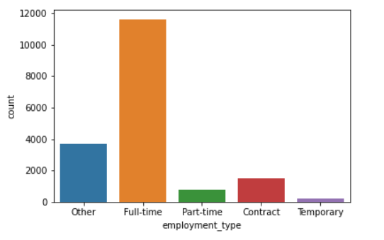
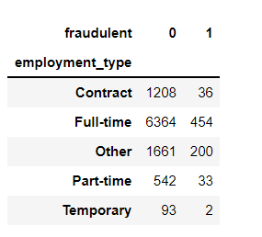
Employment-type
Employment-type spreads from full-time to temporary
Notes:
The data set is now free from the missing values. Now, we will visualize the number of employment-type. There are two graphs showing employment type. The left graph shows how many real and fake jobs in different type of employments. The right graph shows how many jobs in different type of employments. As you can see from the left graph, there are 725 posting jobs are fake, and 9,871 posting jobs are real. It also shows most fake posting jobs appear in full-time. However, from the ratio rate between real and fake, the “Other” type of employment has 0.12 which is the highest ratio rate in these type of employments.

Slide 8
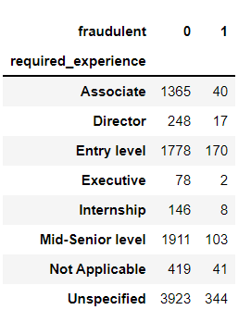
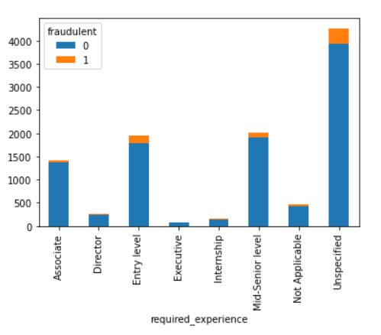
Required experience
Notes:
Visualize the required experience in the jobs. The left graph shows how many real and fake jobs in different working experience, and the right graph shows how many jobs in different working experience. Most fake jobs appear in unspecified experience. But “Not Applicable” has the highest real and fake ratio rate 0.1. Executive has the less real and fake ratio rate which is 0.03.

Slide 9
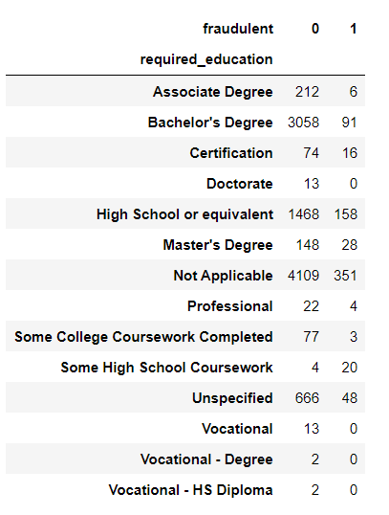
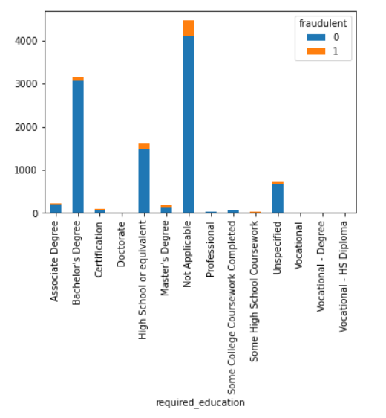
Required-education
Notes:
Visualize the required education in the jobs. The right graph shows how many real and fake jobs in different required education, and the left graph shows how many jobs in different required education. The interesting thing is almost half jobs do not require any education. Most fake jobs appear in not applicable, but “some high school coursework” has the highest real and fake ratio rate which is 5. The second highest real and fake ratio rate is “Certification” which is 0.216.

Slide 10
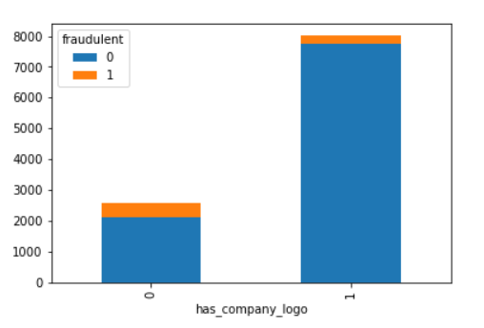
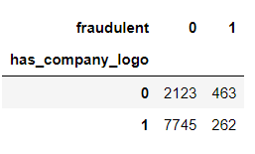
Has-company-logo
Correlation coefficient to the target variable: -0.25
Moderate negative correlation
Notes:
Visualize the has company logo in the jobs. The left graph shows how many real and fake jobs in “has company logo”, and the left graph shows how many jobs in “has company logo”. Most fake jobs appear in no company logo, which it has 0.22 real and fake ratio rate.
Okay, Jonathan is going to talk about what models and metrics we used in the project.

Slide 11
Models and metrics
Naïve bayes model
Decision tree classifier
K-nearest neighbors
Random forest
ACCURACY
F1 SCORE
PRECISION
RECALL
Sensitivity
specificity

Slide 12
Model metrics
Naïve bayes model
Decision tree classifier
Accuracy – 0.94
F1 score – 0.97
Precision – 0.94
Recall – 1.00
Sensitivity - 1.00
Specificity - 0.00
Accuracy – 0.93
F1 score –
Precision –
Recall –
Sensitivity - 0.99
Specificity - 0.03

Slide 13
Model metrics
K-nearest neighbor
Random forest
Accuracy – 0.92
F1 score –
Precision –
Recall –
Sensitivity -0.96
Specificity -0.17
Accuracy – 0.94
F1 score –
Precision –
Recall –
Sensitivity - 0.99
Specificity - 0.02

Slide 14
Models and metrics
Logistic regression
Accuracy – 0.94
F1 score –
Precision –
Recall –
Sensitivity - 1.00
Specificity -0.00

