Slide 1
Predictive Analysis of fake job postings in the us
BY
Jonathan yoon
MAHA JAYAPAL
Yi wang

Slide 2
Attributes of the Dataset
JOB-ID
TITLE
LOCATION
DEPARTMENT
SALARY-RANGE
COMPANY-PROFILE
DESCRIPTION
REQUIREMENTS
BENEFITS
TELECOMMuTING
HAS-COMPANY-LOGO
HAS-QUESTIONS
EMPLOYMENT-TYPE
REQUIRED-EXPERIENCE
REQUIRED-EDUCATION
INDUSTRY
FUNCTION
FRAUDULENT

Slide 3
Preliminary analysis
17880 records with 18 attributes
Location of records spread across the world including us and nz
Target attribute – fraudulent
More missing values in salary-range and department
No missing values in the target variable
Data types of the records are integers and objects

Slide 4
Data pre-processing
Replace nan to “ “ to specify they are missing values
From the location attribute separate country, state and city
Separate the united states datas from the dataset
10593 records in the us dataset

Slide 5
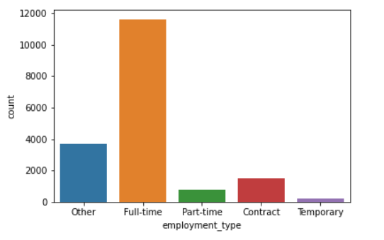
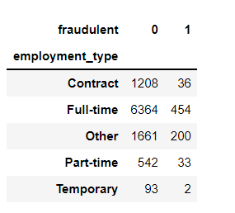
Employment-type
Employment-type spreads from full-time to temporary

Slide 6
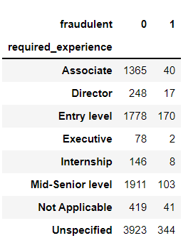
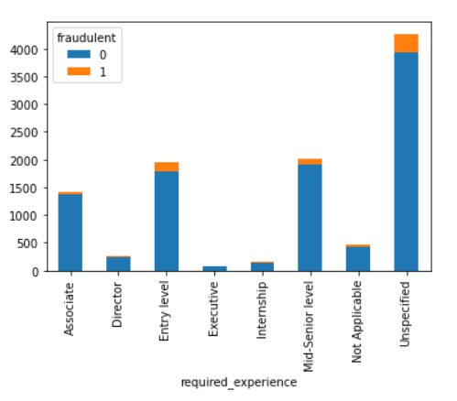
Required experience

Slide 7
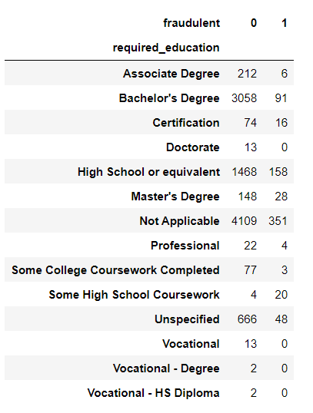
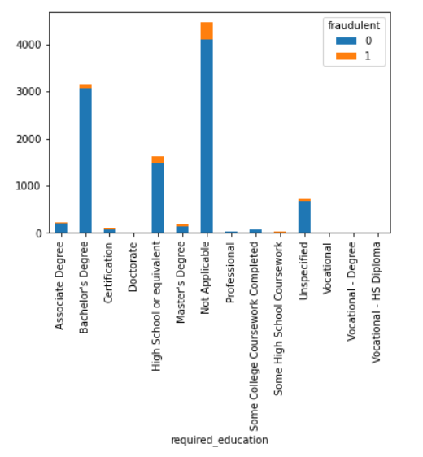
Required-education

Slide 8
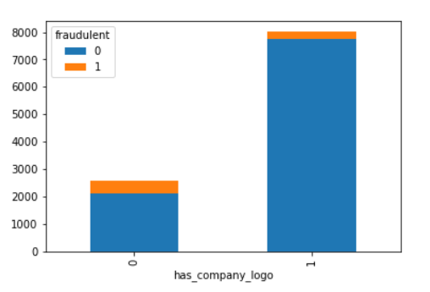
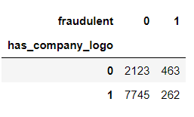
Has-company-logo
Correlation coefficient to the target variable: -0.25
Moderate negative correlation

Slide 9
Models and metrics
Naïve bayes model
Decision tree classifier
K-nearest neighbors
Random forest
ACCURACY
F1 SCORE
PRECISION
RECALL

