Slide 1
Wildfire Detection System
Hitanshi Patil - 16010122283
Harikrishnan Gopal – 16010122284
Maurya Ghogare - 16010122285
Sanika Pendurkar – 16010122286
Guide – Ms. Kirti Mishra
KJ Somaiya School Of Engineering
Date – 27th November, 2025

Slide 2
Introduction
Wildfires cause major destruction to forests, wildlife habitats, property, and human life, making early detection extremely important.
Rising temperatures and dry conditions have increased the frequency and intensity of wildfire incidents.
Traditional detection methods like human observation and satellite monitoring are often slow, inconsistent, and limited, leading to delayed response.
Many remote forest areas lack constant human supervision, increasing the risk of fires going unnoticed.
Faster and automated detection enables quicker response, reducing spread, damage, and firefighting costs.

Slide 3
Problem Statement
Manual wildfire monitoring is inconsistent, slow, and heavily dependent on human availability and judgment.
Smoke and flames exhibit large variations in shape, color, density, and movement, making them difficult to detect reliably with traditional methods.
Environmental factors such as fog, clouds, sunlight, and shadows often lead to misinterpretation or missed detections.
Many forested and remote areas lack continuous surveillance, increasing the chances of fires spreading unnoticed.
There is a need for an automated system capable of early and accurate fire detection in real-world unpredictable conditions.

Slide 4
Motivation
Many regions in India, such as Uttarakhand, Himachal Pradesh, Odisha, and the North-East, experience frequent and damaging forest fires.
Over half of India’s forest area is fire-prone, making early detection essential for minimizing losses.
Remote and hilly forest terrains make manual monitoring difficult, slow, and unreliable.
Satellite alerts often arrive late or miss small fires due to cloud cover and low revisit frequency.
An AI-based automated detection system can provide real-time monitoring, faster response, and better protection of India’s forests, wildlife, and communities.

Slide 5
Literature Survey
Paper Title (Author, Year, Journal/Conference) | Methodology | Dataset Used | Observation of Proposed Methodology | Pros | Cons | Findings
1. Wildfire prediction over a 5-day period using geo-spatial environmental data (Illarionova et al., 2025, Scientific Reports) | Compares multiple AI families for 5-day wildfire occurrence prediction: Random Forest, XGBoost, Attention-MLP, ConvLSTM, RegNetX (image-based), and an MLP Autoencoder for anomaly detection. Proposes a full pipeline for data collection, fusion, preprocessing and balanced sampling; introduces a custom F1_balanced metric for imbalanced spatio-temporal data. | Multi-modal dataset with >17,000 wildfire events across four large regions of Russia over 10 years. Includes meteorological variables, geo-spatial/topographic features, vegetation indices (NDVI/EVI, LAI, FPAR), population density and other anthropogenic indicators. All data resampled to ~650 m grid. | Shows that classical ML (RF, XGBoost) perform very competitively, while ConvLSTM and RegNetX improve spatial modelling when sufficient image-like context is provided. Balanced sampling plus F1_balanced avoids misleadingly high scores from majority “no-fire” class. Visual grid-maps clearly highlight high-risk cells. | Pros: Systematic pipeline; large, diverse dataset; evaluates several model families under same conditions; introduces fairer metrics; produces operationally useful grid-based probability maps. | Cons: High data and compute requirements; model is region-specific (Russia) so transfer needs retraining; ConvLSTM/RegNetX are complex to deploy in low-resource settings. | Ensemble tree methods plus ConvLSTM/RegNetX offer best trade-off between accuracy and interpretability. Meteorology (especially temperature, precipitation, drought indices) and some anthropogenic features are consistently dominant predictors, supporting their importance in operational fire risk systems.
2. Ensemble-based daily wildfire outbreak prediction with XAI for South Korea (Authors, 2025, Scientific Reports) | Builds an ensemble of ML models (RF, gradient boosting, etc.) to predict daily wildfire outbreak probability at administrative unit scale, and interprets them with SHAP (explainable AI). Focuses on improving both prediction and transparency for practitioners. | Year-round wildfire occurrence data for Gangwon State, South Korea, combined with meteorological, forest-related, and anthropogenic variables (e.g., land-use ratios, population density). | Ensemble models significantly outperform simple baselines; SHAP analysis reveals which factors drive ignition risk in different seasons. Demonstrates that year-round modelling (not just fire season) is feasible but challenging. | Pros: Strong accuracy; detailed feature importance via SHAP; directly supports decision-making by answering “why risk is high here today?”; uses realistic administrative units. | Cons: Resolution limited to Si/Gun (not cell-level); meteorological data from limited stations can miss local variability; no deep learning image-based features yet. | Shows that ensembles plus XAI effectively capture ignition patterns and provide interpretable guidance. Highlights importance of including forest structure and socio-economic variables along with weather, and suggests extending to national scale and integrating remote sensing in future systems.
3. GLSTD: Global–Local Spatio-Temporal Dependency model for wildfire risk (Authors, Year, Journal – Yunnan Province study) | Proposes GLSTD deep model, combining global and local spatio-temporal dependencies using CNN/ConvLSTM-style blocks on multi-source wildfire-related factors. Compares with LR, SVM, RF, CNN, ConvLSTM using multiple metrics (Accuracy, Recall, F1, Kappa, etc.). Generates daily wildfire risk maps from weather + remote sensing data. | Multi-source dataset for Yunnan Province, China: meteorological data (temperature, humidity, etc.), remote sensing imagery, ignition records, and other wildfire-related environmental factors, arranged into 25×25 image patches. | GLSTD consistently outperforms traditional ML (LR, SVM, RF) and baseline deep models (CNN, ConvLSTM) on all metrics, especially Recall and F1, indicating better capture of complex spatio-temporal dependencies. Generates fine-scale risk maps with clear separation between low- and high-risk zones. | Pros: Explicit modelling of both global and local spatio-temporal structure; strong predictive performance; end-to-end risk map generation pipeline; supports 5-level risk categorization used in operations. | Cons: Architecturally complex; requires dense historical data and forecasts; may be less interpretable than tree-based models; training computationally heavy. | Demonstrates that combining global context (large-scale climate/land cover) with local patch dynamics yields more accurate wildfire risk prediction. GLSTD-based maps align well with historical ignition points and can guide prevention and resource allocation.

Slide 6
Literature Survey
Paper Title (Author, Year, Journal/Conference) | Methodology | Dataset Used | Observation of Proposed Methodology | Pros | Cons | Findings
4. Paying Attention to Wildfire: Using U-Net with Attention Blocks on Multimodal Data for Next Day Prediction (Fitzgerald et al., 2023, ICMI ’23) | Extends U-Net for wildfire prediction (Wildfire Prediction Network – WPN) with attention blocks and comparisons to multiple variants: U-Net, R2U-Net, AttU-Net, R2AttU-Net. Uses focal loss to tackle extreme class imbalance and experiments with different modality subsets (12, 7, 3 features, and “previous fire mask only”). | Gridded dataset (32×32 or 64×64 patches) of next-day wildfire masks plus up to 12 input modalities: elevation, wind speed, humidity, drought, vegetation, population density, previous fire mask, etc. | Attention-enhanced U-Net (WPN / AttU-Net) achieves top F1 scores, particularly when using a compact set of three core features (elevation, vegetation, previous fire mask). Focal loss improves learning on rare fire pixels and reduces training time compared to weighted BCE. | Pros: Strong handling of class imbalance; spatially explicit predictions; attention improves focus on informative regions; flexible modality selection (performance remains good with fewer inputs); detailed analysis of “new fire pixels”. | Cons: Dataset has spatial bias (fires concentrated near patch centers), which models exploit; still moderate F1 scores due to task difficulty; Conv U-Nets are heavier than classical ML; interpretability is limited vs tree-based models. | Shows that attention-U-Net-style architectures can effectively integrate multimodal features for next-day grid prediction. Prior-day fire mask, topography and vegetation are extremely informative; models excel especially at predicting expansion of existing fires rather than brand-new ignitions.
5. Integrated ML & DL-based Wildfire Prediction and Detection with GUI (Authors, Year, IEEE/ICICCS conference) | Two-part system: (1) Wildfire prediction using classical ML (Logistic Regression, Decision Tree, K-NN, Random Forest, XGBoost) on tabular historical data; (2) Wildfire detection using CNN and AlexNet on images, integrated into a Python-based GUI that supports EDA, data cleaning and model retraining. | Tabular historical wildfire dataset (meteorological + other attributes) plus a satellite/fire image dataset (~6,660 images) for detection. GUI allows user-entered parameters for prediction and image upload for detection. | XGBoost and Decision Tree achieve ≈97.26% accuracy, outperforming earlier decision-tree-only reference systems (~82.9%). CNN and AlexNet detectors achieve ≈95.09% and 92.22% accuracy respectively. GUI links both tasks in a user-friendly tool. | Pros: Practical, end-to-end architecture (prediction + detection + GUI); high reported accuracies; supports retraining as new data arrive; demonstrates synergy between ML (tabular) and DL (images). | Cons: Modest image dataset size for deep learning; limited discussion of generalization and false-alarm rates; evaluation appears mostly offline (no long-term real deployment). | Confirms that relatively standard ML and CNN/AlexNet models can reach high accuracies on curated wildfire datasets. Integrated GUI shows how such models could be operationalized for early warning and on-the-fly detection.
6. WiPreSy – Wireless Prediction System for Forest Fires using IoT, Cloud and Deep Learning (Authors, 2020, ICICCS) | IoT-based real-time wildfire prediction system using BOLT IoT platform and Google Firebase. Collects sensor data (temperature, humidity, soil moisture, pressure, altitude) and feeds them, along with date and location, into a Dense Neural Network designed using Keras Functional API. Alerts pushed via Android app. | On-site sensors: DHT11 (temperature, humidity), YL-69 (soil moisture), BMP280 (pressure, altitude). Data uploaded every 5 minutes to Bolt Cloud, stored/visualized as graphs and CSV, then pushed to Firebase for mobile app. Historic wildfire occurrence data are combined with live sensor readings for training/prediction. | Demonstrates feasibility of continuous, real-time local prediction using low-cost sensors and cloud backend. Functional DNN with dual input (sensor vector + spatio-temporal info) captures non-linear patterns; mobile app displays fire likelihood levels (low/medium/high/very high) and sends notifications. | Pros: Low-cost, real-time monitoring; tight integration of IoT, cloud and ML; user-friendly mobile interface with history of alerts; can be deployed in specific high-risk forests. | Cons: Coverage limited to sensor locations; performance depends on sensor maintenance and network connectivity; lacks comparison with other ML algorithms and broader benchmark datasets. | Shows that IoT + cloud + DNN can enable continuous local wildfire risk prediction, improving over camera-only or satellite-only systems that lack real-time environmental sensing. Argues that more data over time will further improve accuracy.

Slide 7
Literature Survey
Paper Title (Author, Year, Journal/Conference) | Methodology | Dataset Used | Observation of Proposed Methodology | Pros | Cons | Findings
7. Forest Fire Occurrence Prediction in China Based on Machine Learning Methods (Pang et al., 2022, Remote Sensing) | Compares multiple machine learning classifiers (e.g., RF, gradient boosting, SVM, etc.) to predict forest fire occurrence over China, emphasizing large-scale spatial modelling and factor importance analysis. Uses remote-sensing-derived predictors and meteorological variables. | Nationwide Chinese dataset with 14 years (2003–2016) of forest fire occurrence records, remote sensing products, and environmental factors (meteorology, topography, vegetation, human activity indicators). (MDPI) | Demonstrates that ensemble tree models achieve best performance and can robustly handle multi-source predictors. Highlights the spatial variation of feature importance and emphasizes remote-sensing indices and human activity variables. | Pros: Large national-scale dataset; systematic ML comparison; good interpretability via variable importance; policy-relevant insights at regional scale. | Cons: Coarser spatial resolution than grid-cell DL works; does not deeply explore spatio-temporal deep learning; operational deployment not discussed. | Confirms that ML ensembles are powerful for national-scale fire occurrence prediction and that combining meteorology, vegetation, and anthropogenic factors is crucial for accurate risk mapping in China. (MDPI)
8. Machine Learning for Wildfire Classification: Exploring Blackbox, eXplainable, Symbolic, and SMOTE Methods (Al-Bashiti & Naser, 2022, Natural Hazards Research) | Evaluates different ML paradigms (black-box models like XGBoost, explainable models, symbolic methods) for wildfire classification, with SMOTE to address class imbalance and SHAP for interpretability. Focus is on multi-class wildfire risk or occurrence classification. | Historical wildfire and environmental dataset (region-specific; combines meteorological and geographic variables) prepared as a tabular classification problem with imbalanced classes. SMOTE used to synthetically oversample minority classes. (ResearchGate) | Shows that black-box models (e.g., XGBoost) achieve the highest accuracy and F1, while explainable and symbolic models provide improved transparency. SMOTE substantially improves minority-class performance. SHAP plots highlight which features drive each risk class. | Pros: Thorough comparison of model families; explicit imbalance handling; strong use of eXplainable AI; practical confusion-matrix and SHAP analyses. | Cons: Based on a specific dataset (generalization needs testing); black-box models still harder to interpret than symbolic; feature set is mostly tabular (no image-based context). | Provides a blueprint for combining high-performing black-box ML with XAI and resampling for imbalanced wildfire classification tasks, and shows that interpretable insights can coexist with strong predictive power. (ScienceDirect)
9. Forest Fire Risk Prediction: A Spatial Deep Neural Network-Based Framework (Naderpour et al., 2021, Remote Sensing) | Proposes a spatial deep neural network (SDNN) framework that integrates GIS layers and remote-sensing data to predict forest fire risk. Uses deep CNN-style architecture on gridded environmental variables and compares with traditional ML baselines. | Case-study region (e.g., in Australia or another high-risk area) with fire occurrence data plus spatial predictors: topography, land cover, vegetation indices, climate, distance to roads/settlements, etc., arranged as grid cells. (MDPI) | SDNN outperforms classical ML models and traditional statistical approaches for risk mapping, particularly in capturing complex non-linear relationships and spatial patterns. Produces high-resolution fire risk maps that align with known historical hotspots. | Pros: Fully spatial deep learning framework; leverages rich GIS layers; strong predictive gains over baselines; produces visually interpretable risk maps for planning. | Cons: Requires high-quality, high-resolution spatial data; deep model is relatively black-box; training and deployment are more demanding than RF-style models. | Demonstrates that spatial deep learning is well-suited for forest fire risk prediction and can support land-use planning, prevention and resource allocation through detailed risk maps. (MDPI)

Slide 8
Literature Survey
Paper Title (Author, Year, Journal/Conference) | Methodology | Dataset Used | Observation of Proposed Methodology | Pros | Cons | Findings
10. Spatial Prediction of Wildfire Probability in the Hyrcanian Ecoregion Using Evidential Belief Function (EBF) Model and GIS (Nami et al., 2018, International Journal of Environmental Science and Technology) | Uses Evidential Belief Function (EBF) within a GIS framework to map wildfire probability. Combines multiple evidence layers (environmental and anthropogenic factors) and computes belief/plausibility for fire occurrence, validated via ROC/AUC. | Hyrcanian ecoregion wildfire inventory plus spatial predictors: topography, vegetation, climate variables, distance to roads/settlements, human footprint, etc. Fire events and non-fire samples are used to train and validate EBF-based susceptibility maps. (modis.gsfc.nasa.gov) | EBF model produces wildfire probability maps with AUC > 0.7, indicating good predictive skill. High-risk zones show strong spatial correspondence with observed wildfires, proving EBF’s capability in multi-criteria fire susceptibility mapping. | Pros: Conceptually simple, transparent multi-criteria framework; well-suited to GIS workflows; does not require large labelled datasets as deep learning; strong validation via AUC. | Cons: Static susceptibility (not dynamic daily forecasts); does not capture complex temporal dynamics; depends heavily on quality/selection of input layers; less flexible than modern ML/DL. | Confirms that EBF+GIS is a reliable method for regional wildfire probability mapping and that relative humidity, land surface temperature, wind speed and human factors are among the most influential drivers of wildfire probability. (modis.gsfc.nasa.gov)

Slide 9
Research Gap
High-parameter models (U-Net variants: 8–40M parameters, AlexNet: 60M+) deliver strong accuracy but cannot run on low-memory or embedded hardware.
IoT-based systems use only simple dense neural networks and do not incorporate image-based detection due to the computational burden of conventional CNNs.
Current research focuses on accuracy improvements, but neglects lightweight architecture design, model compression, or edge-device compatibility.
For effective early wildfire detection, latency, power consumption, inference speed, and model size are as critical as accuracy—yet these constraints are largely unaddressed in past work.

Slide 10
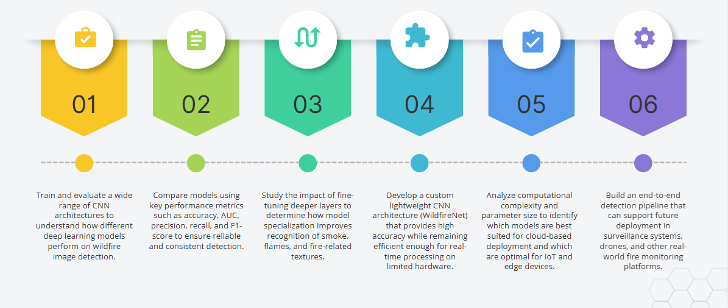
Objectives

Slide 11
Dataset Description
The dataset consists of a diverse collection of fire and non-fire images, captured under various environmental and lighting conditions.
Fire images include clear flames, dense smoke, light smoke trails, and mixed scenes containing both smoke and flame.
Non-fire images include forest landscapes, cloudy skies, foggy conditions, sunlight reflections, and regular vegetation that might resemble smoke.
A major challenge is that smoke is amorphous and can look similar to fog, mist, haze, or cloud formations, making classification difficult.
Flame patterns vary greatly in size, shape, color, and intensity, while lighting and background appearance change drastically across images.

Slide 12
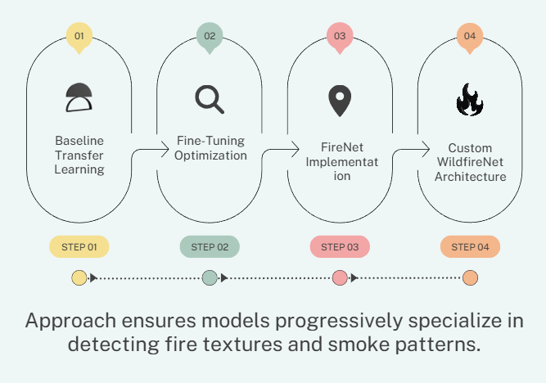
Training Pipeline Overview

Slide 13
Stage 1: Baseline Transfer Learning
Pretrained ImageNet models were used to quickly generate a baseline for wildfire detection performance.
Convolution layers were frozen, and only the final classification head was trained.
The goal was to reuse general visual features like edges, textures, and shapes learned from large-scale datasets.
This stage tested how well generic ImageNet knowledge transfers to fire, smoke, and forest scene images.
Models evaluated in this stage included VGG16, VGG19, ResNet50, ResNet50V2, EfficientNetB0, and MobileNetV3 (Small & Large).

Slide 14
Stage 1: Observations
Transfer learning alone proved insufficient for capturing the complex appearance of smoke and flames.
Most models achieved less than 96% accuracy, indicating limited specialization.
ImageNet-learned filters struggled with wildfire-specific variations like smoke density and irregular flame shapes.
Lightweight architectures showed frequent misclassifications due to similar-looking elements like fog, clouds, and glare.
These results highlighted the need for fine-tuning and more specialized training in the following stages.

Slide 15
Stage 2: Fine-Tuning Process
Based on Stage 1 results, the top three performers — VGG16, VGG19, and ResNet50V2 — were selected for deeper training.
The top 20 layers of each model were unfrozen, allowing the network to learn wildfire-specific visual patterns.
Fine-tuning helped the models adapt deeper filters to recognize smoke gradients, flame color variations, and subtle texture distortions.
This process significantly improved the model’s ability to specialize in wildfire scenarios rather than relying only on generic ImageNet features.
A lower learning rate was used to prevent catastrophic forgetting and ensure stable, controlled updating of deeper layers.

Slide 16
Stage 2: Impact
Fine-tuning produced a major accuracy boost, with VGG19 improving from 94.21% to 99.17%.
VGG16 also saw a strong improvement, increasing from 95.41% to 99.10%.
These results clearly show that transfer learning alone is not enough — fine-tuning is essential for high wildfire detection performance.
The models became more sensitive to low-contrast smoke, background variations, and early-stage flame patterns.
Overall, fine-tuning made the networks far more reliable and robust in differentiating fire from non-fire scenarios.

Slide 17
Stage 3: FireNet Architecture
FireNet was implemented based on the FireNet-CNN research paper, specifically designed for wildfire image analysis.
It uses a custom 5-block convolutional architecture that is more tuned to flame and smoke detection than generic CNNs.
The model processes images at a resolution of 150×150, balancing detail with computational efficiency.
With approximately 6.5 million parameters, FireNet is moderately lightweight compared to large models like VGG.
This architecture served as a specialized benchmark, helping compare traditional pretrained models with wildfire-specific networks.

Slide 18
Stage 4: WildfireNet (Custom Model)
WildfireNet is a custom CNN designed from scratch to deliver high performance while staying extremely efficient.
It incorporates residual connections to improve gradient flow, making the network stable and preventing vanishing gradient issues during training.
A channel attention mechanism helps the model focus on important color cues and intensity variations typical in smoke and fire imagery.
A spatial attention module directs the model to the exact regions where fire or smoke patterns appear, improving detection accuracy.
With only ~5.1M parameters, WildfireNet is lightweight and optimized for IoT devices, drones, surveillance cameras, and real-time edge deployment.

Slide 19
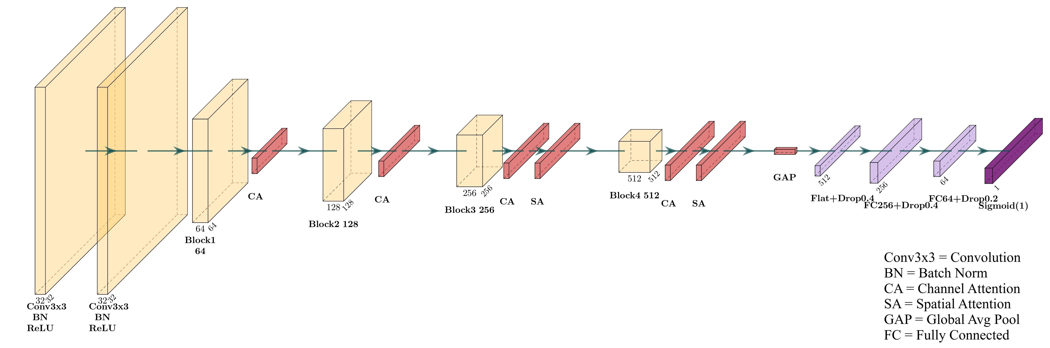
Stage 4: WildfireNet Architecture

Slide 20
Comparative Performance Overview
Rank | Model Name | Parameters | Accuracy | AUC | F1-Score | Precision | Recall
1 | VGG19_finetuned | ~144M | 99.17% | 0.9993 | 0.9917 | 0.9916 | 0.9917
2 | VGG16_finetuned | ~138M | 99.10% | 0.9997 | 0.9909 | 0.9902 | 0.9916
3 | WildfireNet (Custom) | ~5.1M | 98.84% | 0.9991 | 0.9883 | 0.9879 | 0.9887
4 | ResNet50V2_finetuned | ~25.6M | 98.37% | 0.9985 | 0.9835 | 0.9833 | 0.9837
5 | ResNet50V2 | ~25.6M | 97.24% | 0.9966 | 0.9721 | 0.9720 | 0.9721
6 | FireNet | ~6.5M | 95.51% | 0.9897 | 0.9547 | 0.9540 | 0.9555
7 | VGG16 | ~138M | 95.41% | 0.9883 | 0.9535 | 0.9550 | 0.9523
8 | VGG19 | ~144M | 94.21% | 0.9856 | 0.9412 | 0.9429 | 0.9400
9 | ResNet50 | ~25.6M | 88.05% | 0.9403 | 0.8789 | 0.8798 | 0.8782
10 | EfficientNetB0 | ~5.3M | 86.98% | 0.8992 | 0.8664 | 0.8764 | 0.8624
11 | MobileNetV3Large | ~5.4M | 85.83% | 0.8967 | 0.8559 | 0.8586 | 0.8541
12 | MobileNetV3Small | ~2.5M | 83.62% | 0.8647 | 0.8334 | 0.8361 | 0.8318

Slide 21
Comparative Performance Overview
12 models evaluated.
Sorted by accuracy:
VGG19-finetuned — 99.17%
VGG16-finetuned — 99.10%
WildfireNet — 98.84%
ResNet50V2-finetuned — 98.37%
Lowest: MobileNetV3 Small — 83.62%
Shows fine-tuning + custom models outperform standard lightweight networks.

Slide 22
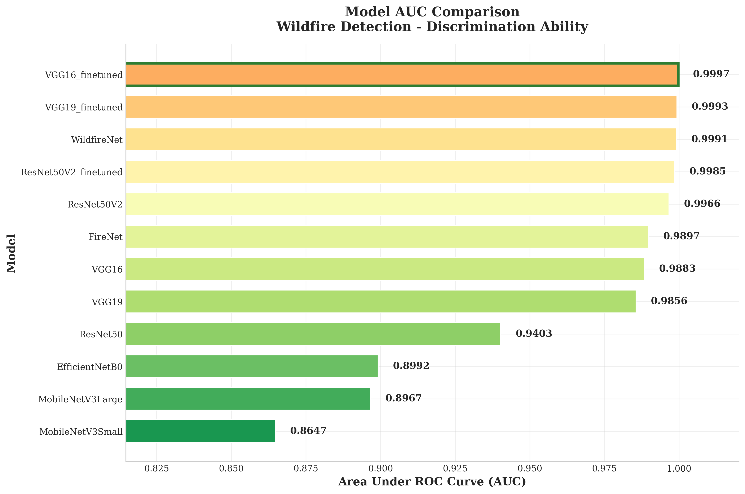
Comparative Performance Overview

Slide 23
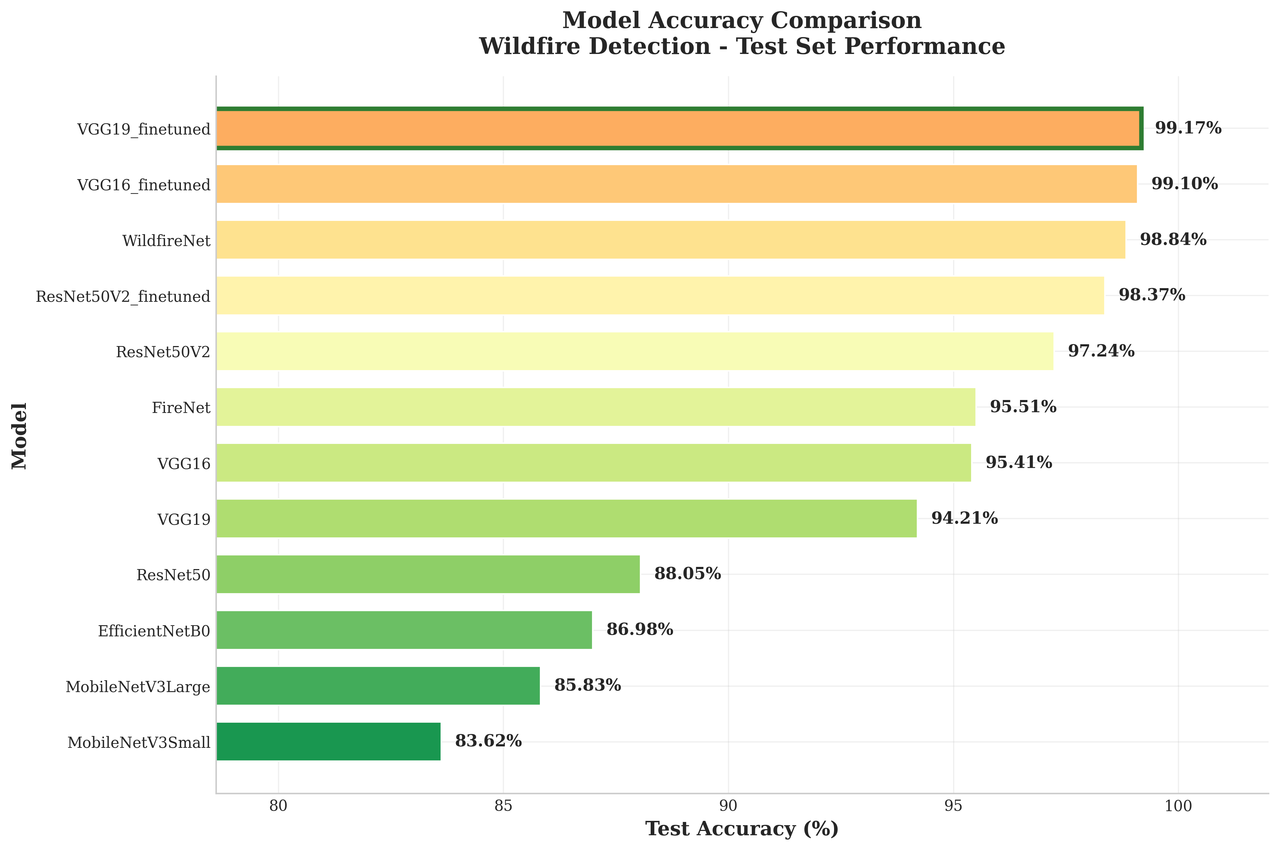
Comparative Performance Overview

Slide 24
Performance Metrics Explained
Accuracy: Overall correctness
AUC: Ability to distinguish fire vs non-fire
F1-score: Balanced measure of precision + recall
Precision: How many predicted fires were actually fire
Recall: How many real fires the system detected
Important because missing a fire is more dangerous than a false alarm.

Slide 25
VGG19 Fine-Tuned (Best Performer)
Achieved 99.17% accuracy, 0.9993 AUC, and a strong 0.9917 F1-score, making it the top-performing model.
Its very deep architecture allows it to capture fine details such as subtle smoke patterns and small flame variations.
Fine-tuning significantly boosted performance by adapting deeper layers to wildfire-specific textures and color gradients.
Performs exceptionally well in controlled and real-world scenarios, giving highly reliable fire vs. non-fire classification.
However, the model is extremely heavy (~144M parameters), making it unsuitable for low-power or real-time edge deployment.

Slide 26
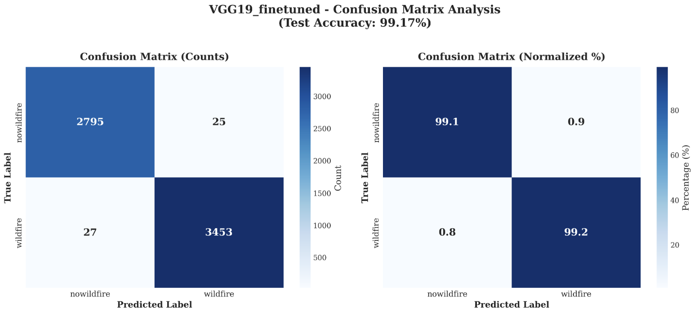
VGG19 Fine-Tuned (Best Performer)

Slide 27
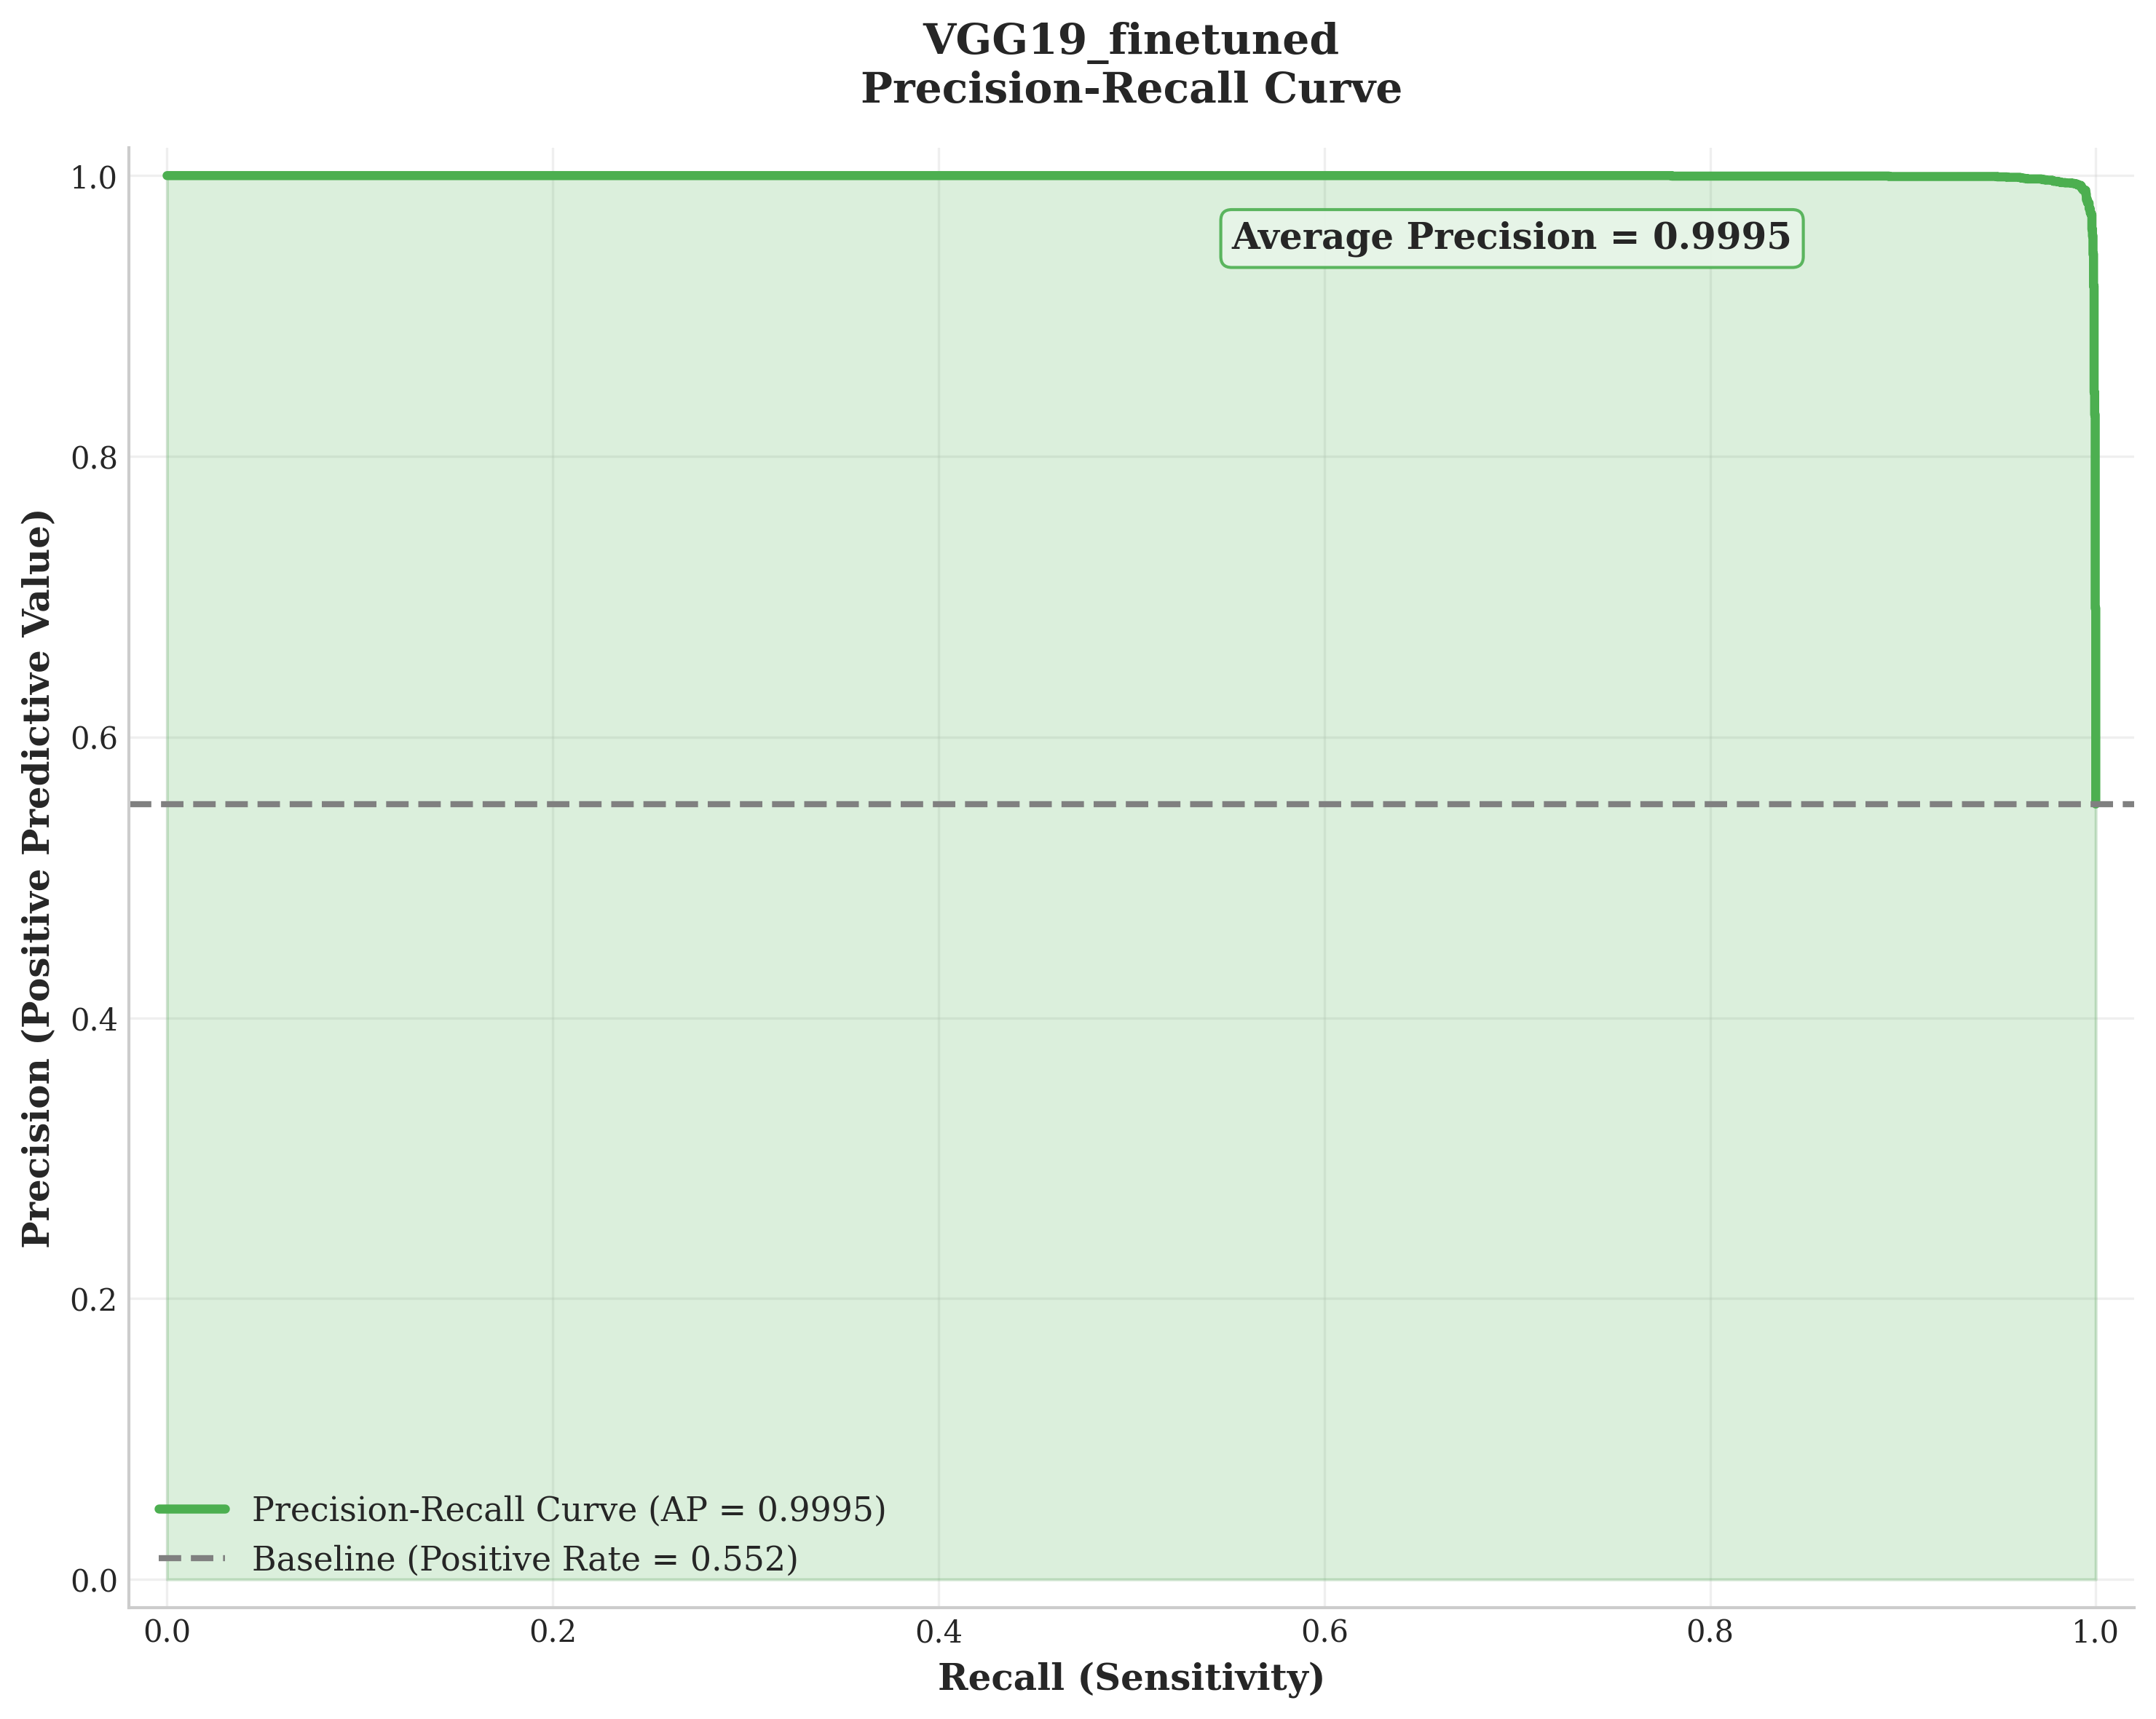
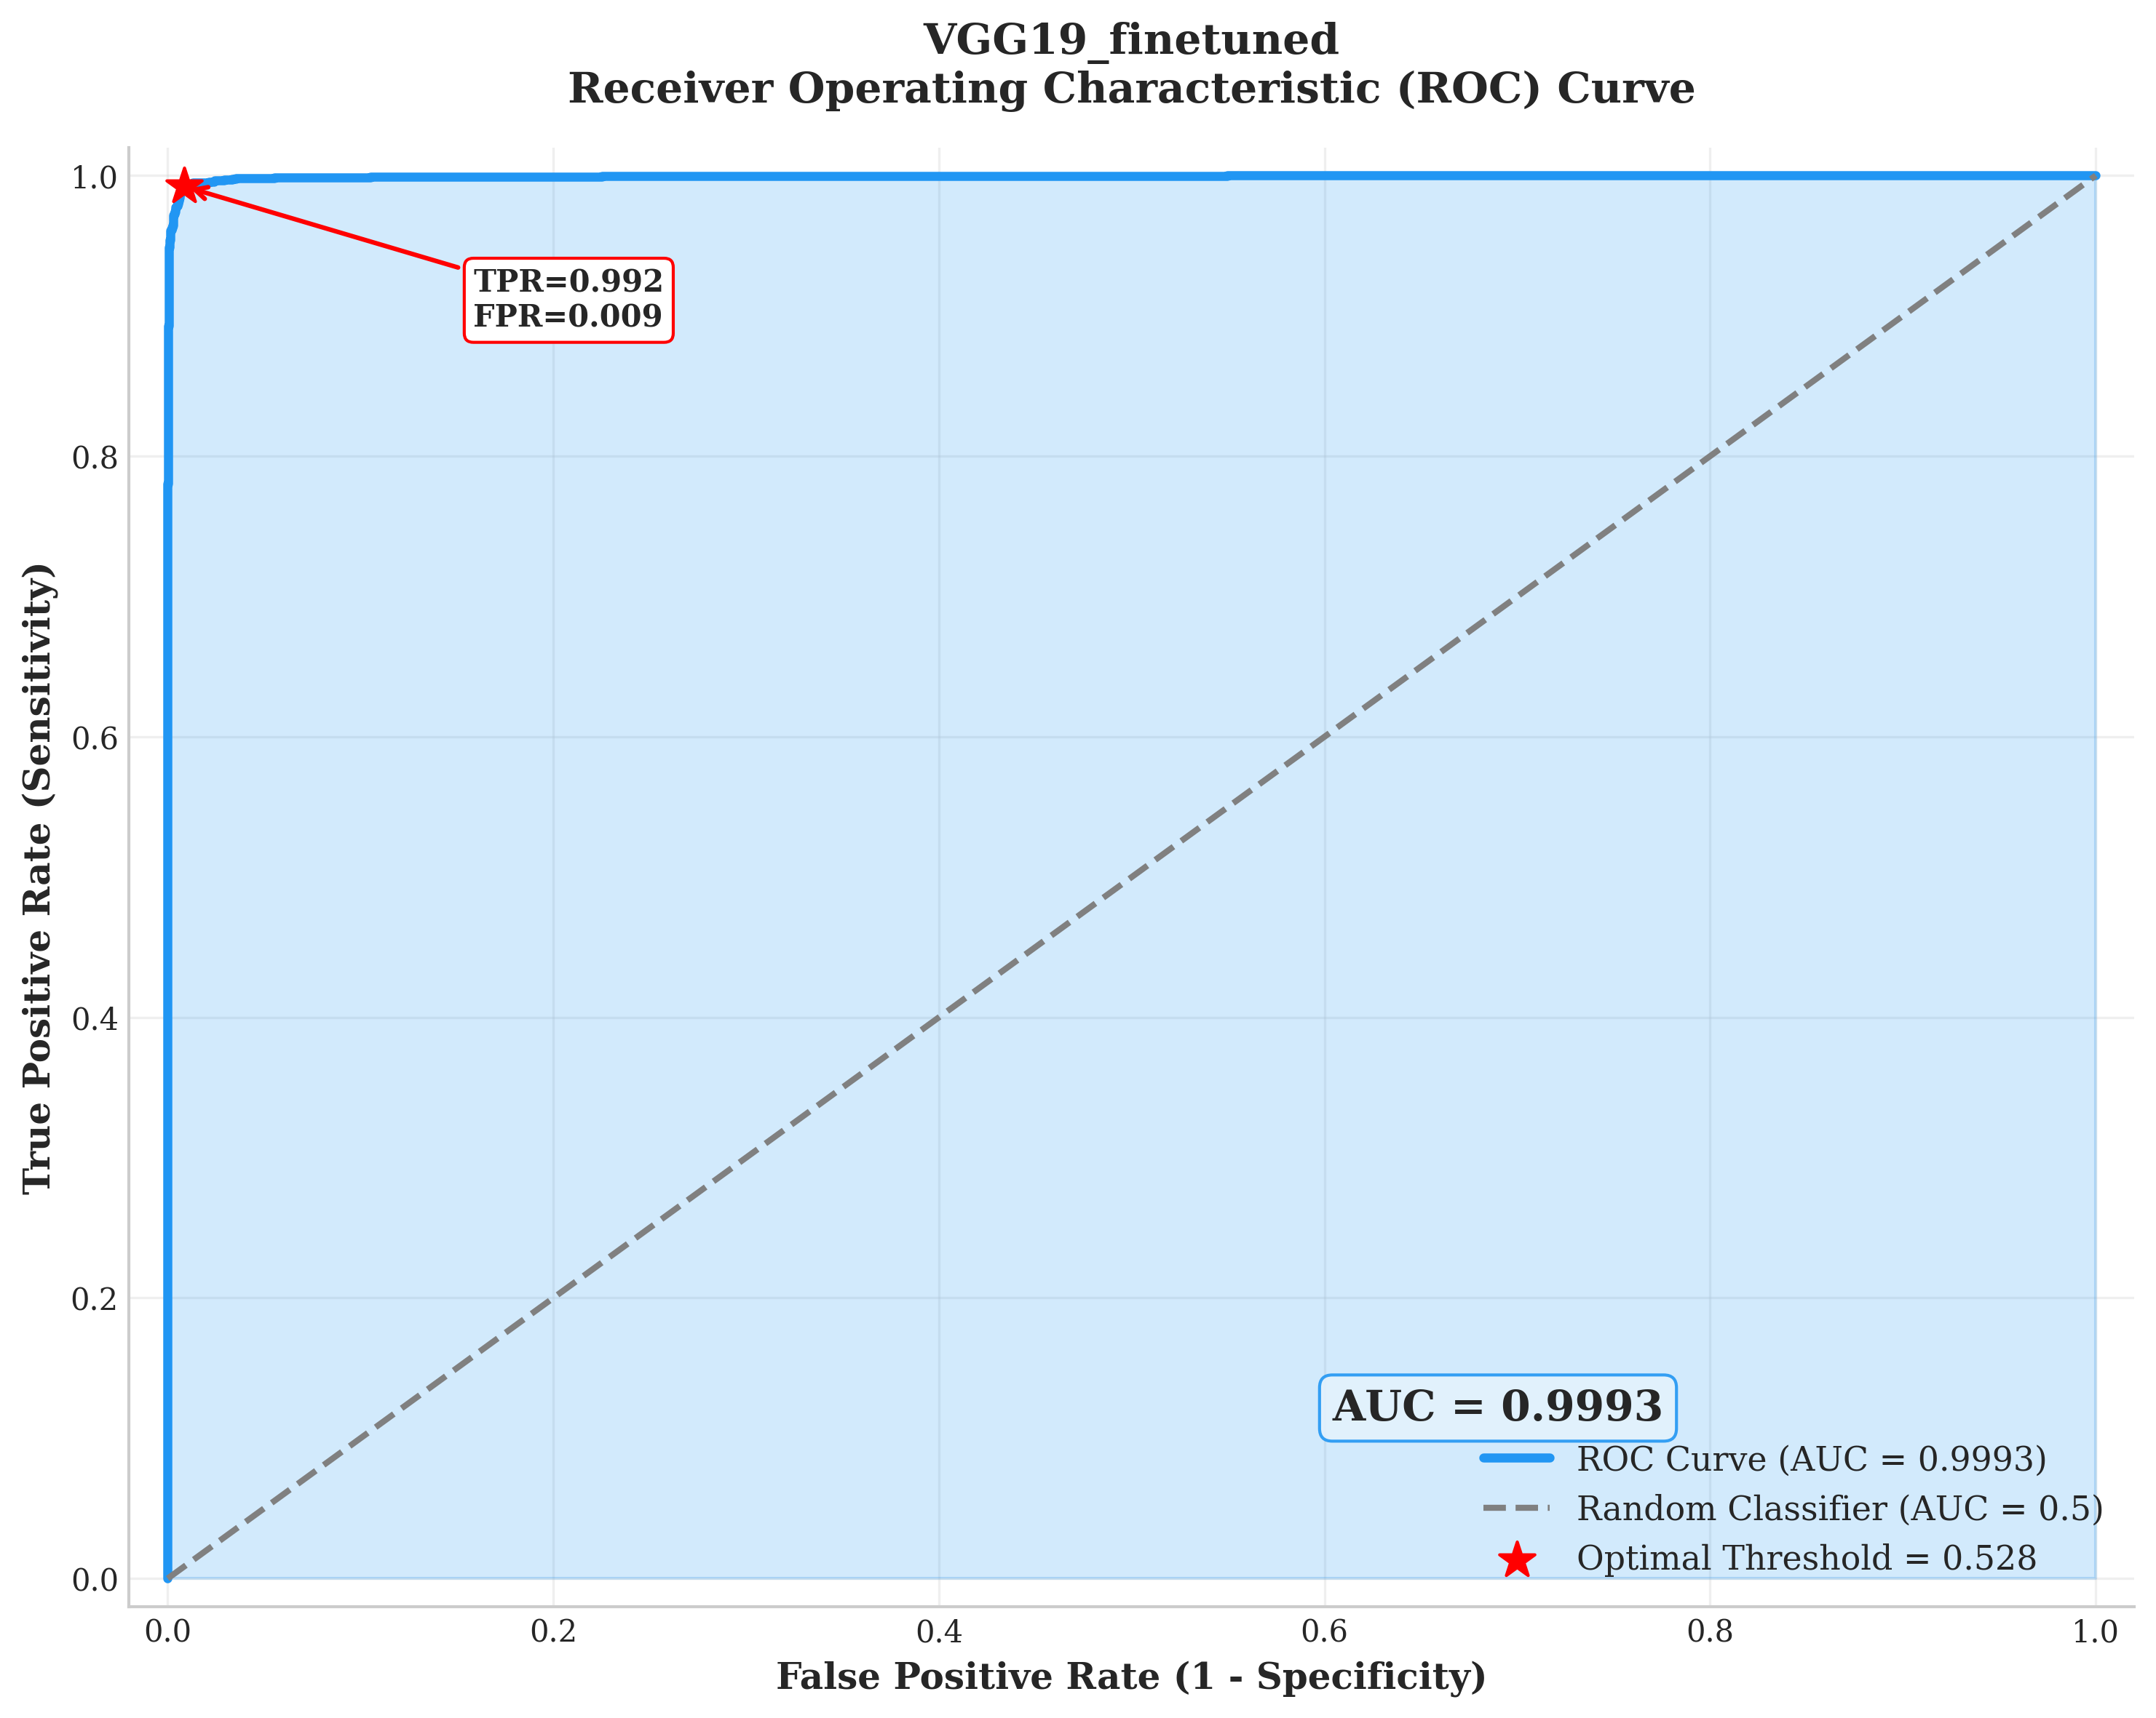
VGG19 Fine-Tuned (Best Performer)

Slide 28
WildfireNet Performance (Custom Model)
Reached 98.84% accuracy, 0.9991 AUC, and 0.9883 F1-score, making it one of the best-performing lightweight models.
With only 5.1M parameters, it is extremely compact and ideal for IoT devices, drones, and edge cameras.
Despite being lightweight, it outperforms EfficientNet and MobileNet, showing its design is better suited to smoke and flame detection.
Incorporates attention and residual mechanisms that improve its focus on fire-relevant regions and enhance robustness.
Delivers performance close to VGG19 while being 28× smaller, offering an excellent accuracy–efficiency balance.

Slide 29
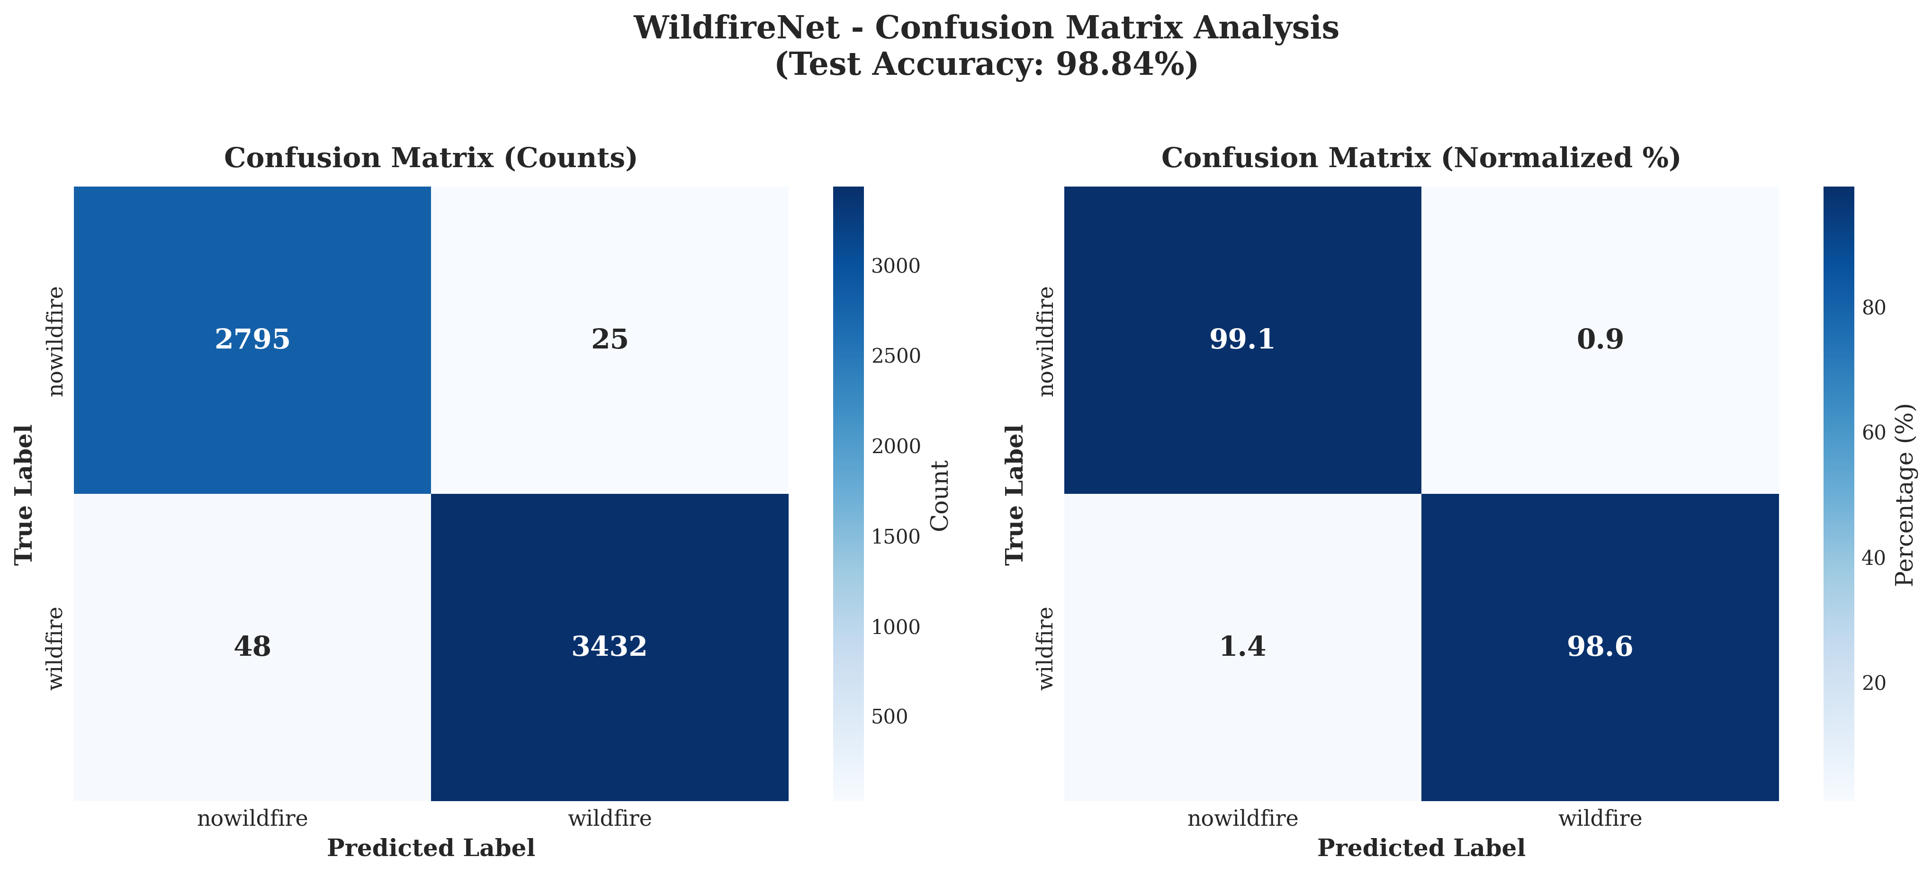
WildfireNet Performance (Custom Model)

Slide 30
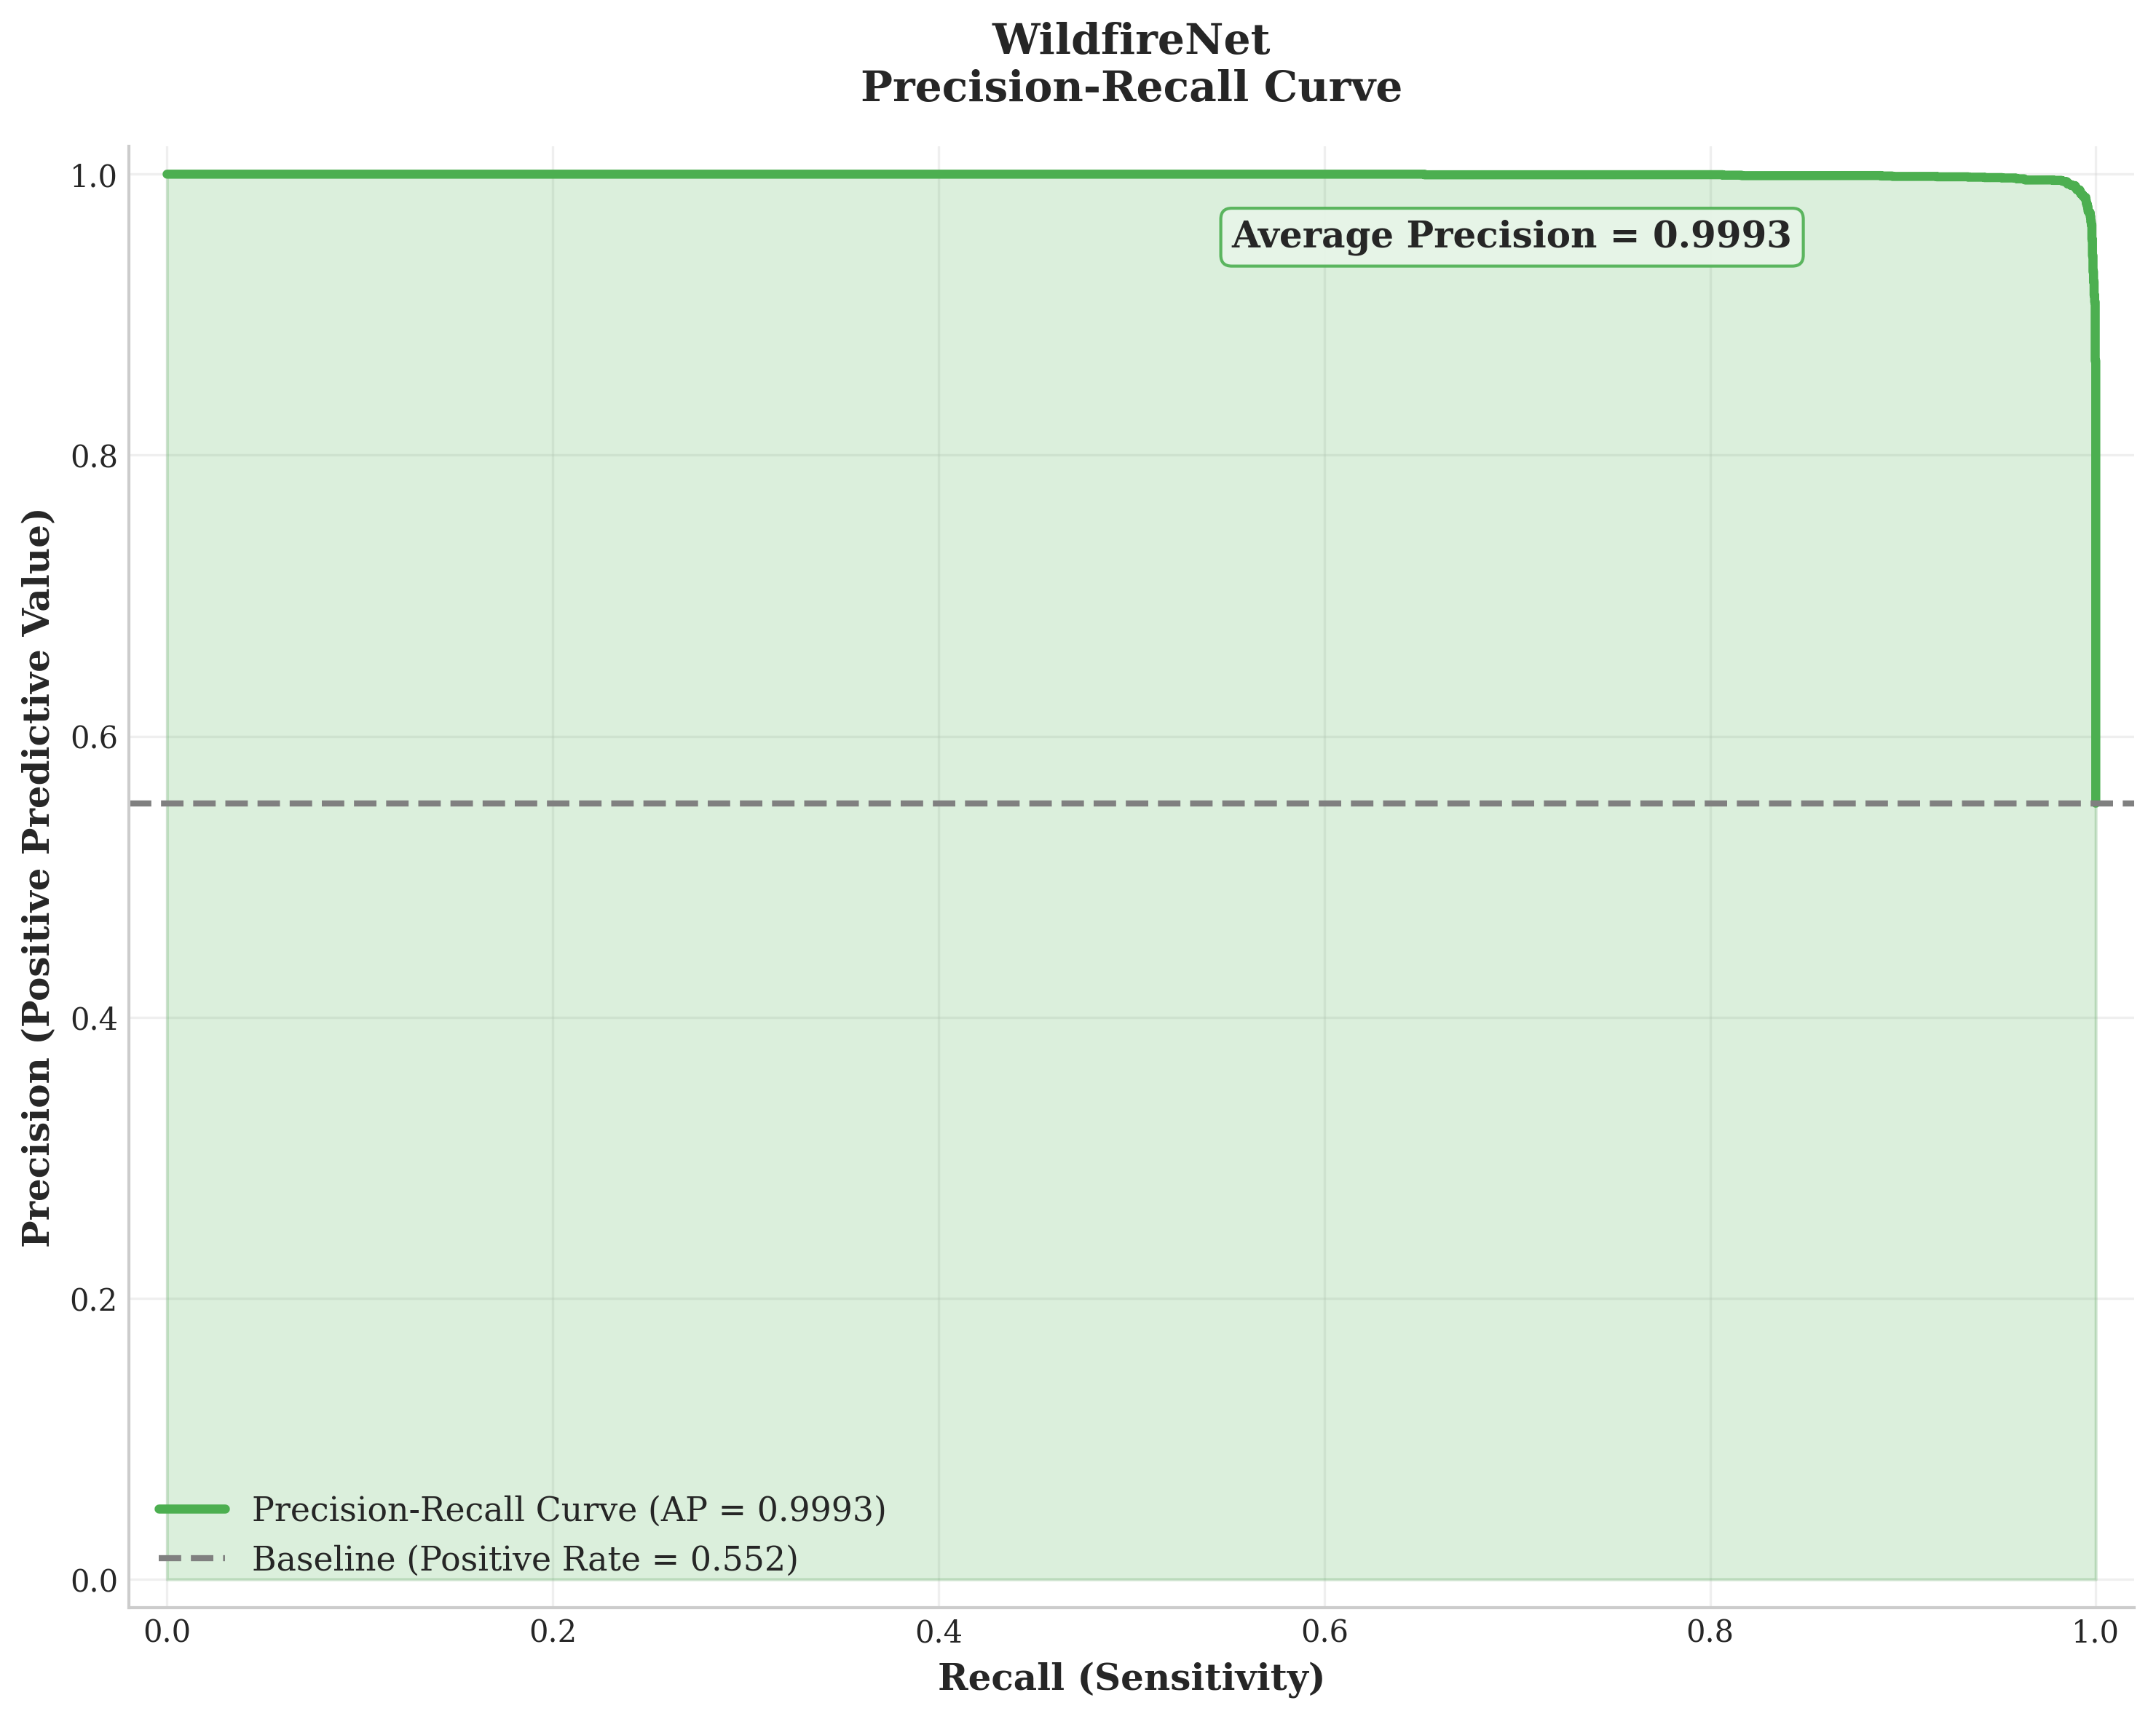
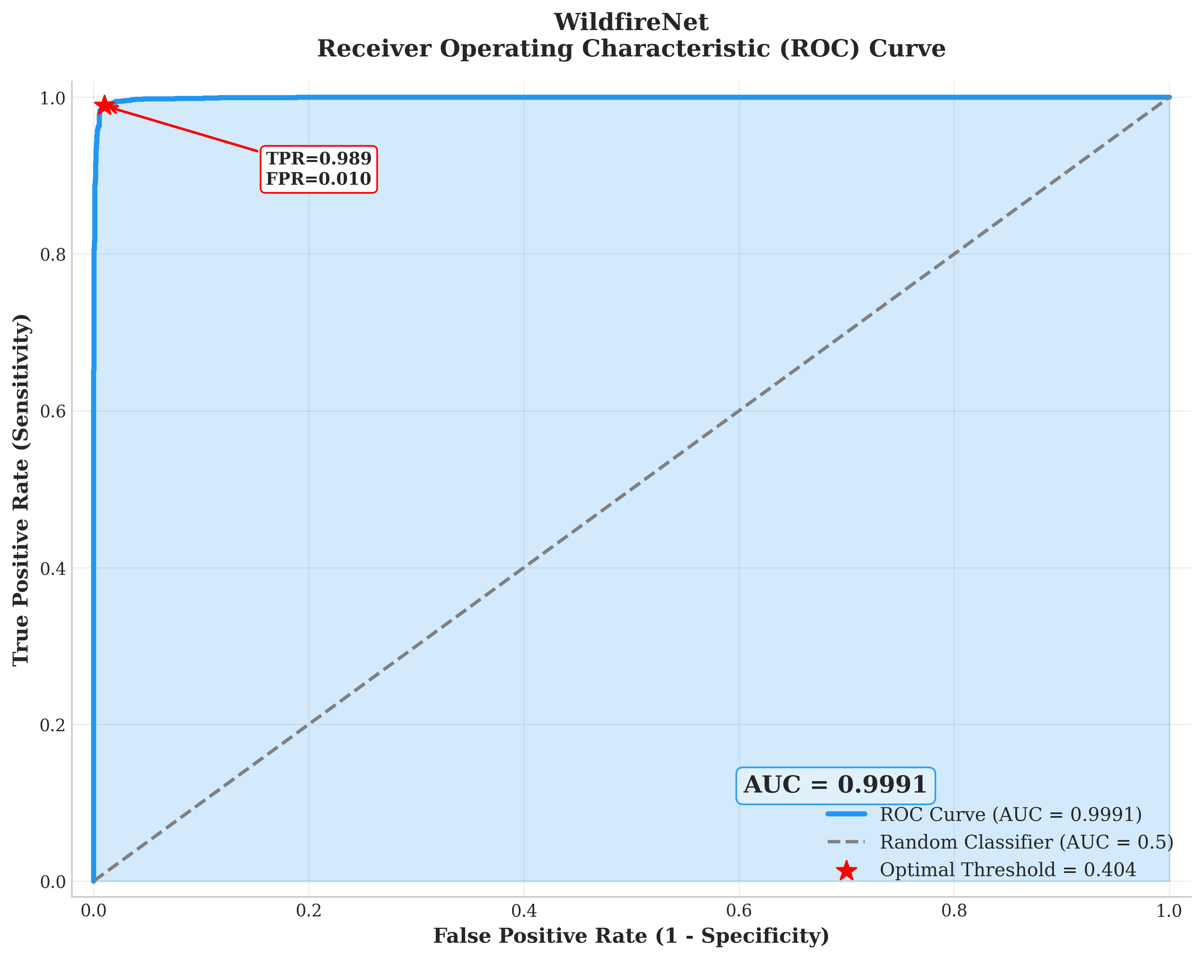
WildfireNet Performance (Custom Model)

Slide 31
Why Lightweight Models Struggled
Lightweight models like MobileNetV3 and EfficientNetB0 achieved only about 83–86% accuracy, significantly lower than deeper networks.
Their depthwise-separable convolutions, while efficient, fail to capture the irregular, fuzzy, and evolving shapes of wildfire smoke.
To stay small, these models often compress feature maps, causing loss of important color and texture details needed for fire detection.
They lack attention mechanisms, which means they cannot focus on the specific regions where smoke or flames appear within the image.
These limitations show that wildfire detection requires specialized architectures designed to handle complex visual patterns—not generic lightweight models.

Slide 32
Insight: Fine-Tuning Is Critical
Fine-tuning led to a 3–5% increase in accuracy, demonstrating its essential role in improving performance.
Unfreezing deeper layers allowed the model to learn color gradients, smoke transparency levels, and texture variations unique to fire imagery.
Fine-tuned models developed higher sensitivity to low-contrast smoke and small flame patterns often missed earlier.
Without fine-tuning, models frequently misclassified fog, clouds, glare, and mist as fire due to insufficient feature specialization.
Overall, fine-tuning helped transform generic ImageNet models into highly specialized wildfire detectors.

Slide 33
Insight: Efficiency vs Accuracy Trade-Off
VGG19 fine-tuned delivers the highest accuracy and strongest overall performance, but its massive size (~144M parameters) makes it impractical for real-time or low-power devices.
WildfireNet, with only ~5.1M parameters, achieves almost the same accuracy while being extremely lightweight and faster to run on limited hardware.
This shows a clear trade-off: high accuracy requires heavy computation, while efficient real-time detection needs compact models.
Deployment choices depend heavily on available computing resources—
  Cloud servers or high-performance GPUs → VGG19 fine-tuned
  IoT cameras, surveillance systems, drones, and edge devices → WildfireNet

Slide 34
System Applications
Forest surveillance towers can use automated detection to continuously monitor large forest areas without the need for constant human supervision.
Drone-based monitoring enables rapid scanning of remote or mountainous regions where access for ground teams is difficult.
Smart city CCTV networks can be enhanced to detect fires in urban–forest boundary areas, industrial zones, or public spaces.
Remote IoT fire detectors allow low-cost, real-time monitoring in rural and tribal regions with limited connectivity.
Wildlife protection zones benefit from early alerts, helping safeguard habitats and prevent biodiversity loss during fire outbreaks.

Slide 35
Future Improvements
Extend the system to support real-time video analysis, enabling continuous fire and smoke tracking rather than only single-image detection.
Implement on-device optimization techniques such as quantization, pruning, and TensorRT acceleration to improve inference speed on low-power devices.
Develop multimodal detection by combining RGB visuals with thermal or infrared images for stronger accuracy in low-light or smoky conditions.
Expand the dataset with more diverse and real-world wildfire images, including seasonal variations and different vegetation types.
Integrate the system with early-warning platforms to support fast alerts, automated emergency responses, and improved communication with authorities.

Slide 36
Summary of Findings
Fine-tuning plays a critical role, boosting accuracy by 3–5% and enabling models to better understand wildfire-specific patterns.
VGG models consistently deliver the highest accuracy but are too large for real-time or portable deployment.
The custom WildfireNet model provides an excellent balance of performance and efficiency, making it ideal for edge devices.
Generic lightweight models like MobileNet and EfficientNet struggle due to missing detail and lack of attention mechanisms.
The study demonstrates that wildfire detection requires specialized architectures rather than standard off-the-shelf solutions.

Slide 37
Conclusion
Deep learning techniques offer a highly reliable solution for early wildfire detection using images.
The proposed WildfireNet architecture enables accurate, fast, and efficient on-device inference suitable for real-world scenarios.
Automated detection can significantly reduce response time, helping minimize fire spread and overall damage.
The system shows strong potential for integration into fire management systems, drones, IoT networks, and surveillance infrastructure.
With continued improvements and larger datasets, the model can be scaled across regions to enhance wildfire monitoring at national and global levels.

Slide 38
References
[1] Illarionova et al., 2025
S. Illarionova et al., “Exploration of geo-spatial data and machine learning algorithms for robust wildfire occurrence prediction,” Scientific Reports, vol. 15, no. 10712, 2025.
[2] Ensemble-based Daily Wildfire Outbreak Prediction in Korea (2025)
[Authors not shown], “Ensemble-based daily wildfire outbreak prediction with explainable AI,” Scientific Reports, 2025.
[3] GLSTD Wildfire Risk Model – Yunnan Province
J. Deng, B. Hong, W. Wang, and G. Gu, “Spatio-temporal wildfire risk prediction using global–local dependency deep learning (GLSTD),” Environmental Modelling, 2024.
[4] Fitzgerald et al., 2023 (ICMI '23 — U-Net Attention)
N. Fitzgerald, M. Seefried, F. Yost et al., “Paying Attention to Wildfire: Using U-Net with Attention Blocks on Multimodal Data for Next Day Prediction,” in Proc. 25th ACM International Conference on Multimodal Interaction (ICMI ’23), Paris, France, 2023.
[5] Wildfire Prediction & Detection using ML + GUI (ICICCS/IEEE)
[Authors not shown], “An integrated machine learning and deep learning approach for wildfire prediction and detection using GUI,” in Proc. Int. Conf. Intelligent Computing and Control Systems (ICICCS), IEEE, 2020.

Slide 39
References
[6] WiPreSy IoT-Based Forest Fire Prediction System (ICICCS)
[Authors not shown], “WiPreSy: Wireless Prediction System for Forest Fires using IoT and Deep Learning,” in Proc. Int. Conf. Intelligent Computing and Control Systems (ICICCS), IEEE, 2020.
[7] Pang et al., 2022
Y. Pang et al., “Forest fire occurrence prediction in China based on machine learning methods,” Remote Sensing, vol. 14, no. 21, p. 5546, 2022.
[8] Al-Bashiti and Naser, 2022
M. K. Al-Bashiti and M. Z. Naser, “Machine learning for wildfire classification: Exploring blackbox, explainable, symbolic, and SMOTE methods,” Natural Hazards Research, vol. 2, no. 3, pp. 154–165, 2022.
[9] Naderpour et al., 2021
H. Naderpour, P. Rizeei, A. D. A. A. Shahabi, and M. R. Mahiny, “Forest fire risk prediction: a spatial deep neural network-based framework,” Remote Sensing, vol. 13, no. 15, 2021.
[10] Nami et al., 2018
S. Nami, S. M. Moghadam, and A. H. Shamsoddini, “Spatial prediction of wildfire probability in the Hyrcanian ecoregion using evidential belief function model and GIS,” International Journal of Environmental Science and Technology, vol. 15, pp. 2015–2030, 2018.

Slide 40
THANK YOU

