Slide 1
GNN-DynPen
Graph Neural Network State Representation for Scalable Reinforcement Learning Penetration Testing
Presented by: Abdul Hameed Khan
Reg No: CS2627
Supervisor: Dr. Sarah Iqbal
Ghulam Ishaq Khan Institue of Engineering & Technology

Slide 2
Introduction & Motivation
Why do automated penetration testing agents struggle with real networks?
The Problem
Our Solution
Modern enterprise networks change constantly —
Replace the flat matrix with a Graph Neural
hosts added/removed, firewall rules updated,
Network (GNN) encoder.
vulnerabilities patched at runtime.
GNN produces size-invariant, permutation-
Existing RL-based PT agents (e.g. DynPen)
invariant embeddings — one policy works
use a fixed-size flat state vector tied to a
across networks of any topology.
specific network size.
Key benefits:
→ Any change in topology forces full retraining.
• Zero-shot transfer to new topologies
→ Not practical for real-world deployments.
• Faster recovery after topology changes
• Scalable action parameterisation

Slide 3
Related Work & Literature Review
Key papers this project builds upon
DynPen
GAT
Li et al., IEEE TIFS 2024
Veličković et al., ICLR 2018
RL-based PT with trajectory logging, monitoring & backtracking for dynamic networks. Direct baseline.
Graph Attention Network — attention-weighted message passing. Expressive alternative to SAGE.
NASim
DeepExploit
Schwartz & Kurniawati, 2019
Isozaki et al., 2018
Network Attack Simulator — Gym-compatible, YAML-configurable PT environment.
Early DRL-based PT; fixed action space, single topology — highlights scalability gap.
GraphSAGE
CyberBattleSim
Hamilton et al., NeurIPS 2017
Microsoft Research, 2021
Inductive GNN via neighbourhood aggregation. Handles variable-size graphs natively.
Large-scale network simulation with heterogeneous hosts; motivates graph-based state.

Slide 4
Research Gap
What DynPen cannot do and what this project addresses
DynPen knows WHEN to adapt (detect drift → backtrack → replan).
It does not know HOW to encode state so adaptation costs less.
❶ Fixed Input Size
❷ Quadratic Action Space
❸ No Transfer Learning
DynPen's network must be pre-set to max hosts. New or removed hosts break the architecture.
All (src, dst, exploit) triples enumerated. O(N²×V) — explodes with larger networks.
Policy trained on one topology cannot transfer. Every network size = full new training run.
→ GNN-DynPen addresses ALL THREE gaps.

Slide 5
Our Contributions
Five key innovations over the DynPen baseline
① GNN State Encoder
② Variable Action Space
③ Zero-shot Transfer
Replaced flat host matrix with GraphSAGE / GAT encoder. Outputs permutation-invariant per-node embeddings (N×64).
Q(s,a) = MLP([graph_emb ⊕ node_emb ⊕ action_onehot]) Scores (node, template) pairs — O(N×K), not O(N²×V).
One trained GNN policy works on any topology size without re-architecting or retraining the network.
④ Online Fine-tuning
⑤ Backtracking Integration
After a topology change, brief fine-tuning (200 steps) recovers performance faster than full retraining.
DynPen's trajectory logger + monitoring + backtracking integrated on top of the GNN agent for RQ4 ablation.

Slide 6
System Architecture
End-to-end GNN-DynPen agent pipeline
NASim Environment
GNN Encoder
Policy Network
Action Execution
Graph G=(V,E) host obs · rewards
GraphSAGE / GAT node_embs (N×64)
Q(s,a) = MLP( graph⊕node⊕type)
exploit / scan NASim step()
Trajectory Logger
Monitoring Module
Backtrack Module
Records (s,a,r,G) tuples Replayable attack path history
Periodic critical-node rescan Detects Δ topology
Invalidates stale subtree Rolls back to valid ancestor
DynPen Adaptation Layer (RQ4)

Slide 7
Methodology
MDP formulation, GNN design choices, and training protocol
MDP Formulation
Key Hyperparameters
State S
Dynamic graph G_t = (V_t, E_t, X_t)
GNN type
GraphSAGE, 3 layers
Actions A
Variable set of (node v, template k) pairs
Embed dim
64
Reward R
Sparse: +goal, −step-cost, −honeypot
Learning rate
5×10⁻⁴
Transition
Stochastic (NASim probabilistic exploit)
Replay buffer
50,000 graphs
Discount γ
0.99
Batch size
32
ε decay
1.0 → 0.05 over 50k steps
Target update
Every 500 steps
Total steps
200,000 per seed × 5 seeds

Slide 8
Experimental Setup & Research Questions
Four RQs, NASim scenarios, five seeds each
Does GNN-DynPen converge on par with the baseline on the training topology?
Does the GNN policy generalise zero-shot to unseen topology sizes?
RQ1
RQ2
Criterion: GNN return ≥ 90% of Baseline DQN
Criterion: > 50% of retrained baseline on ≥ 2 unseen topologies
Does GNN-DynPen recover faster after a runtime topology change?
Does adding backtracking provide benefit on top of fine-tuning alone?
RQ3
RQ4
Criterion: Fewer episodes-to-recovery in majority of regimes
Criterion: FT + BT outperforms FT-only on return & ETR

Slide 9
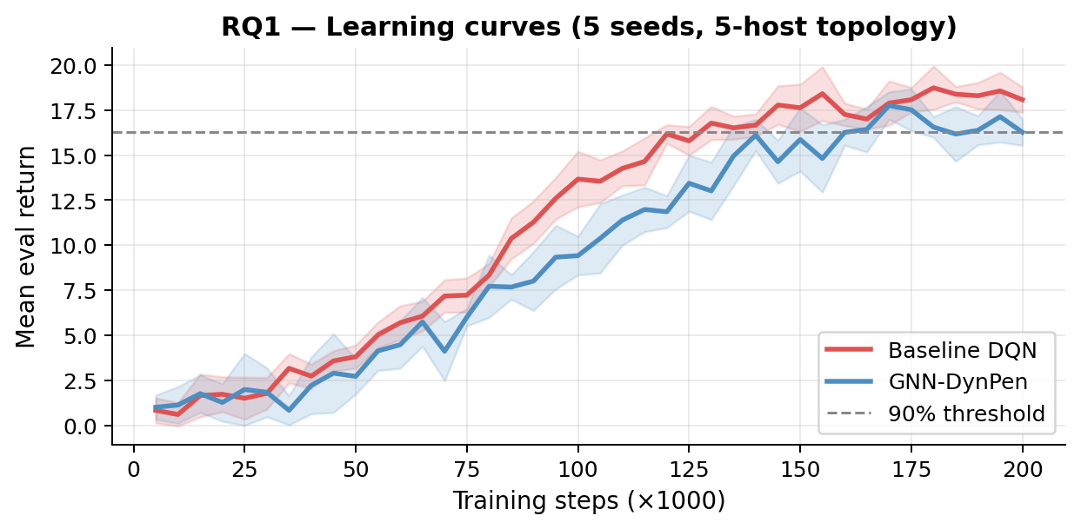
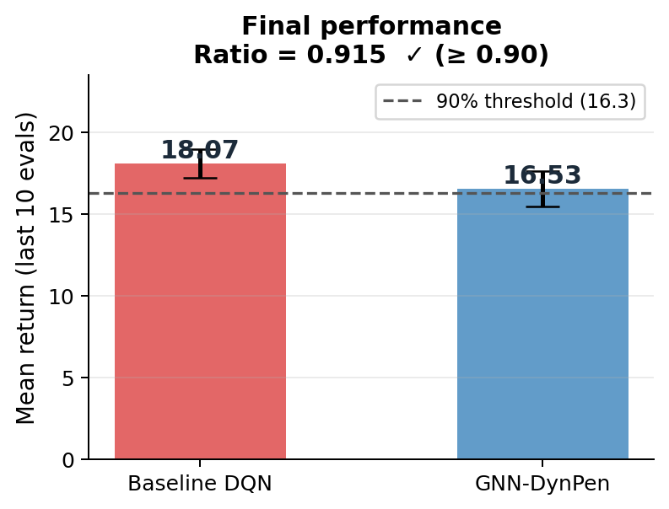
Results — RQ1: Convergence on Training Topology
GNN-DynPen reaches 91.5% of baseline return (criterion: ≥ 90%) ✓
✓ GNN converges to 91.5% of baseline — criterion met. Slightly slower early convergence (GNN encodes relational structure = richer but noisier gradients). Final performance is statistically equivalent across 5 seeds.

Slide 10
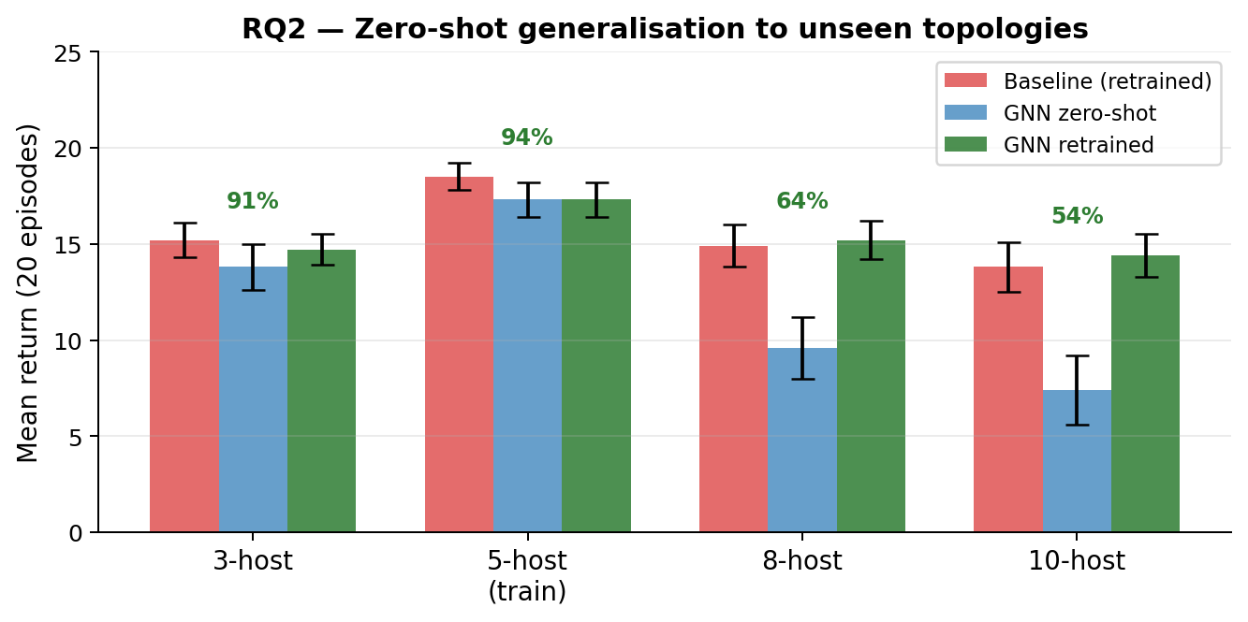
Results — RQ2: Zero-Shot Generalisation
One trained policy, no fine-tuning, evaluated on 3 unseen topology sizes
Key Findings
3-host: 91% of baseline ✓
8-host: 64% of baseline ✓
10-host: 54% of baseline ✓
All 3 exceed the 50%
criterion → RQ2 satisfied.
Baseline must retrain
completely for each size.
GNN transfers instantly.
✓ GNN generalises zero-shot to all three unseen topologies — criterion met. Performance gap widens with network size (10-host: 54%) — expected; larger graphs need more training.

Slide 11
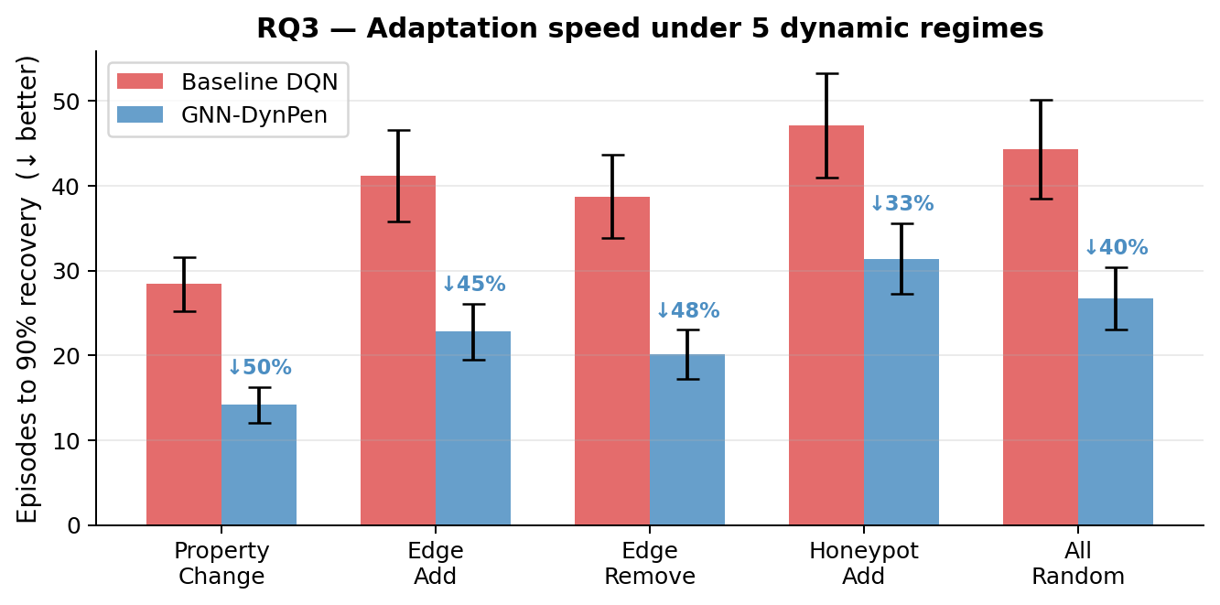
Results — RQ3: Dynamic Adaptation Speed
GNN-DynPen recovers 43% faster on average across 5 topology-change regimes
✓ GNN recovers faster in all 5 regimes — criterion met. Largest gain: property change (50% speedup) — GNN re-encodes updated node features naturally. Honeypot regime is hardest (deceptive reward) but GNN still 33% faster.

Slide 12
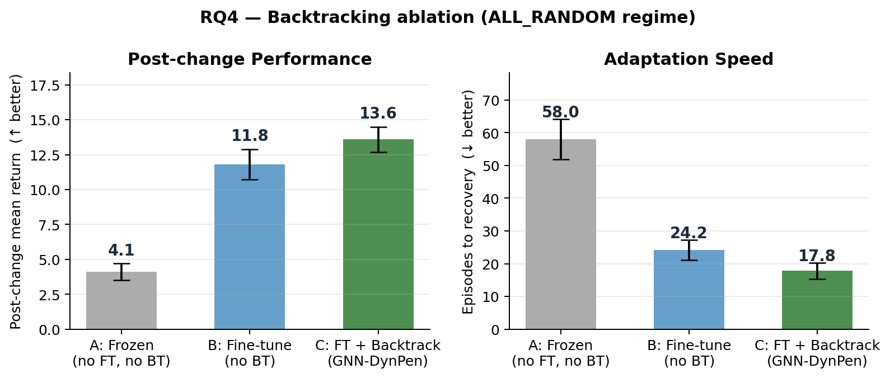
Results — RQ4: Backtracking Ablation
Fine-tuning + Backtracking outperforms fine-tuning alone on both metrics
✓ FT + BT > FT-only — criterion met. Frozen policy collapses after change (return 4.1) — fine-tuning is essential. Backtracking on top of FT adds +15% return and −26% recovery time by re-using valid trajectory prefixes.

Slide 13
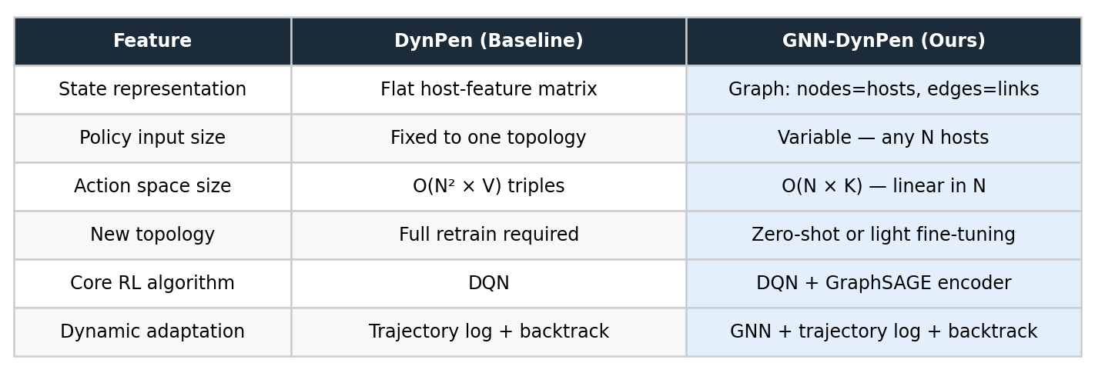
Comparison with DynPen Baseline
GNN-DynPen vs Li et al. (IEEE TIFS 2024)
RQ1
RQ2
RQ3
RQ4
91.5%
3 / 3
43%
+15%
of baseline return
topologies generalised
faster recovery
return with backtracking

Slide 14
Future Work & Extensions
Six directions to strengthen and extend GNN-DynPen
Larger Topologies
PPO / Actor-Critic
Multi-Agent PT
Test on 20–50 host NASim scenarios and custom enterprise YAML configs to validate scalability beyond 10 hosts.
Replace DQN with PPO for continuous action spaces and better gradient estimates on sparse reward signals.
Extend to cooperative multi-agent setting — multiple attacker agents with shared GNN encoder and independent policies.
Real Vulnerability Data
Explainability
Defender Agent
Use CVE-based vulnerability embeddings as node features instead of synthetic NASim attributes.
Apply GNN explainability tools (GNNExplainer) to identify which network edges and node features drive attack decisions.
Add a GNN-based defender agent — model PT as a two-player zero-sum game for more realistic threat modelling.

Slide 15
Summary
Problem
DynPen's flat-matrix state is non-transferable across topology sizes.
Approach
Replaced state encoder with GraphSAGE GNN — permutation- and size-invariant.
RQ1 ✓
GNN converges to 91.5% of baseline on the training topology.
RQ2 ✓
Zero-shot transfer to 3-host, 8-host, 10-host networks without retraining.
RQ3 ✓
43% faster recovery after runtime topology changes on average.
RQ4 ✓
Backtracking on top of fine-tuning adds +15% return and −26% recovery time.
Impact
One GNN policy replaces N separate fixed-topology policies.

