Slide 1
Principal Component Analysis
Seeing dimensionality reduction on a real healthcare dataset
Breast Cancer Wisconsin · Python / scikit-learn
Notes:
The goal of this talk: take a real 30-feature medical dataset and show, visually, that PCA can shrink it to a handful of dimensions while keeping almost all the information. Dataset is the Breast Cancer Wisconsin (Diagnostic) set, built into scikit-learn.

Slide 2
A Look at the Data
# | radius | texture | perimeter | area | smooth. | compact. | … | diagnosis
1 | 17.99 | 10.38 | 122.8 | 1001 | 0.12 | 0.28 | … | malignant
2 | 20.57 | 17.77 | 132.9 | 1326 | 0.08 | 0.08 | … | malignant
3 | 19.69 | 21.25 | 130 | 1203 | 0.11 | 0.16 | … | malignant
4 | 11.42 | 20.38 | 77.58 | 386.1 | 0.14 | 0.28 | … | malignant
5 | 20.29 | 14.34 | 135.1 | 1297 | 0.1 | 0.13 | … | malignant
6 | 12.45 | 15.7 | 82.57 | 477.1 | 0.13 | 0.17 | … | malignant
6 of 569 patients · 6 of 30 feature columns shown
Every row is a patient; every column a measurement. All 30 columns are numbers like these.
Notes:
Before any PCA, here is the raw data. Each of the 569 rows is one patient; each of the 30 columns is a numeric measurement from the cell-nucleus image. I am only showing 6 patients and 6 columns here, but the full table is 569 by 30 - far too wide to read or plot. That width is exactly what PCA will shrink.

Slide 3
The Problem
30
Too many dimensions to plot or reason about.
Heavily redundant — radius, perimeter and area all measure size.
569 patients, each labelled malignant or benign.
features per patient
Notes:
Each patient is described by 30 numeric measurements taken from images of cell nuclei. That is far too many to visualise, and many of them carry the same information — size-related features move together. The question PCA answers: can we describe each patient with far fewer numbers?

Slide 4
What PCA Does
Finds new axes along the directions of greatest variance.
Orders them: PC1 holds the most information, PC2 the next.
Keep the top few, drop the rest — that is the reduction.
New axes = the eigenvectors of the covariance matrix.
Notes:
PCA rotates the coordinate system to point along the directions where the data spreads most. The first principal component captures the single most informative direction, the second the next, and so on. Because the later components carry little variance, we can safely drop them. Mathematically these axes are the eigenvectors of the data's covariance matrix, and each one's eigenvalue is the amount of variance it captures.

Slide 5
The Pipeline
Load
→
Standardize
→
Fit PCA
→
Project
→
Reconstruct
30 numbers in → a few numbers out, with the error measured at the end.
Notes:
Five steps. Load the 569x30 matrix. Standardize so every feature is on the same scale. Fit PCA to get the components and the variance each explains. Project the data onto the top k components. Finally reconstruct from those k components to measure how much information was lost.

Slide 6
30 → 10
components keep 95% of the information
Two-thirds of the dimensions, gone — at almost no cost.
Notes:
This is the headline result. Ten of the thirty components retain about 95% of the total variance. You can throw away two-thirds of the dimensions and lose almost nothing — that is dimensionality reduction in one number.

Slide 7
A Few Components Hold Most of the Variance
2 PCs
63% of variance
10 PCs
95% of variance
Notes:
The curve climbs steeply then flattens. The first two components already reach 63%, and ten reach 95%. The flattening tells you where adding components stops being worthwhile — the elbow around ten.

Slide 8
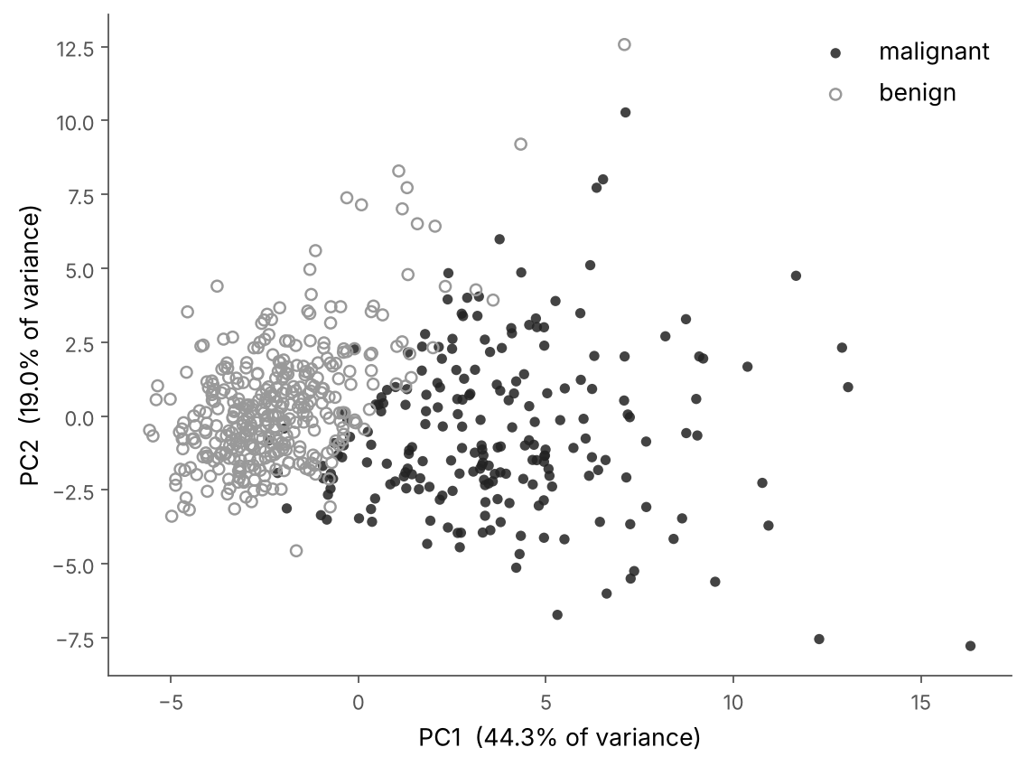
Two Components Already Separate the Groups
Every patient, drawn with just PC1 and PC2.
PCA never saw the diagnosis — yet malignant (dark) and benign (open) land in different regions.
Two numbers carry the signal that took thirty before.
Notes:
This is the most convincing slide. We reduced 30 features to 2 and plotted all 569 patients. The diagnosis label was never given to PCA, yet the two classes separate clearly — proof that the first two components captured the real structure.

Slide 9
Takeaways
30 features → 10 components, ~95% of the information kept.
Just 2 components separate malignant from benign.
Always standardize first; pick k at the elbow of the curve.
Smaller data: faster models, easier plots, less noise.
Notes:
To summarise: PCA cut the data to a third of its size while keeping almost all the information, two components already separate the diagnoses, and the practical rules are to standardize before PCA and to choose the number of components at the elbow of the variance curve.

