Slide 1
DATA MINING
High-level topics for the course
An overview of the concepts, techniques, and tools we will cover
01 Process
02 Tasks
03 Association
04 Clustering
05 Time & Spatial
06 Anomaly detection

Slide 2




Four Ways of Knowing
Each paradigm was born when the one before it hit a wall, not replacing it, but adding a new way to ask questions of the world.
1
2
3
4
BEFORE 1600
1600 – 1950s
1950s – 1990s
1990s – NOW · THE 4TH PARADIGM
Empirical Science
Theoretical Science
Computational Science
Data Science
“What happens?”
“Why does it happen?”
“What if it’s too complex?”
“What patterns are hidden?”
Watch nature closely and record exactly what you see — the senses are the only instrument.
Compress observations into mathematical laws that explain the cause, and predict the unseen.
Let computers crunch the equations no human could, simulating systems number by number.
Let algorithms mine oceans of data to surface patterns first, and the laws behind them second.
e.g. Tycho Brahe logs planet positions by eye, night after night.
e.g. Newton’s gravity predicts Neptune’s orbit before anyone sees it.
e.g. Simulating a galaxy of a billion stars, or tomorrow’s weather.
e.g. AI finds new planets and galaxies buried in petabytes of sky data.
THE WALL Records told you that something happened — never why.
THE WALL The equations grew too complex to solve by hand.
THE WALL Instruments + sims made more data than models could digest.
TODAY All four now work together — the full toolkit of modern science.
One field quietly walked all four of these roads. → The night sky.
Notes:
The four paradigms of science as a flow. Each new paradigm appeared when the previous one hit a limit: observation could not explain why; theory became unsolvable by hand; simulation produced more data than models could handle. Data science (the fourth paradigm) unifies all four.

Slide 3

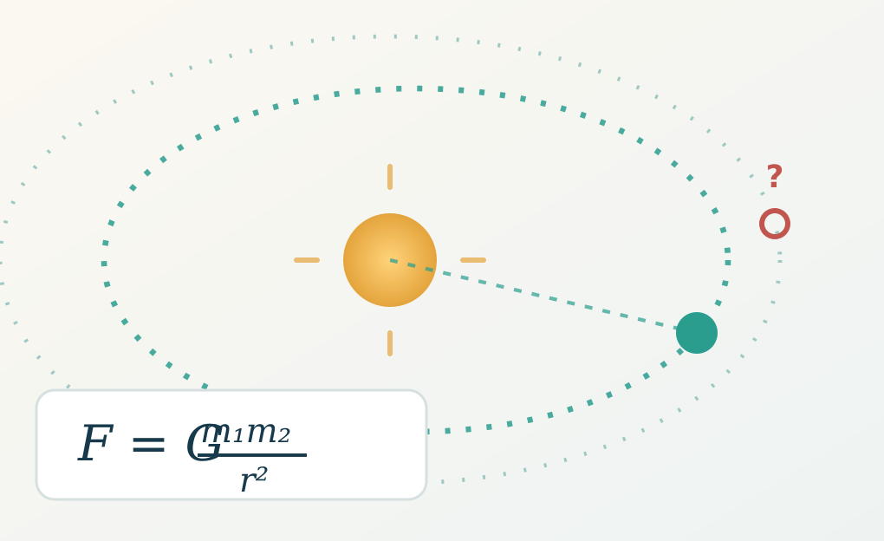
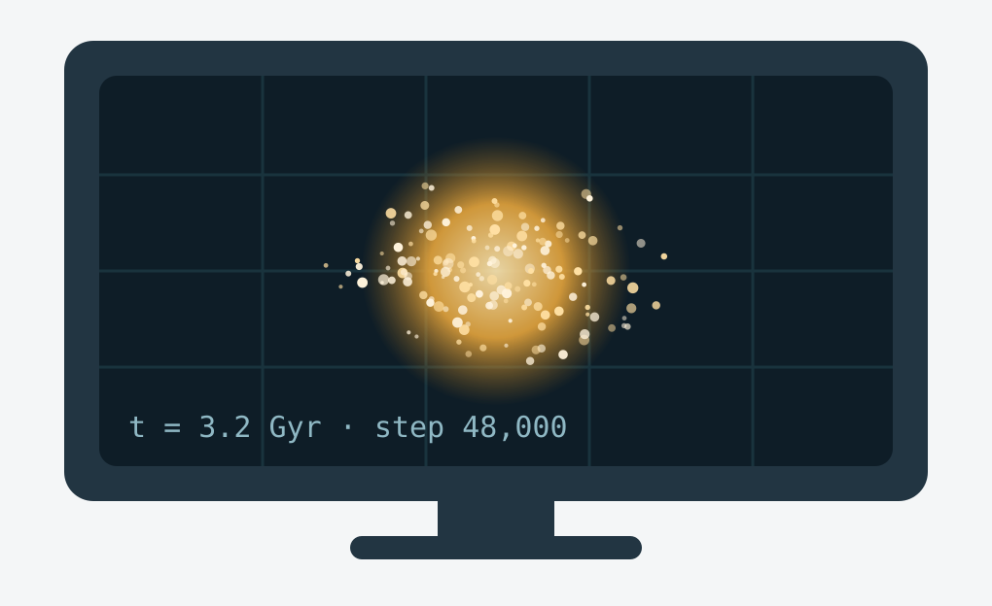
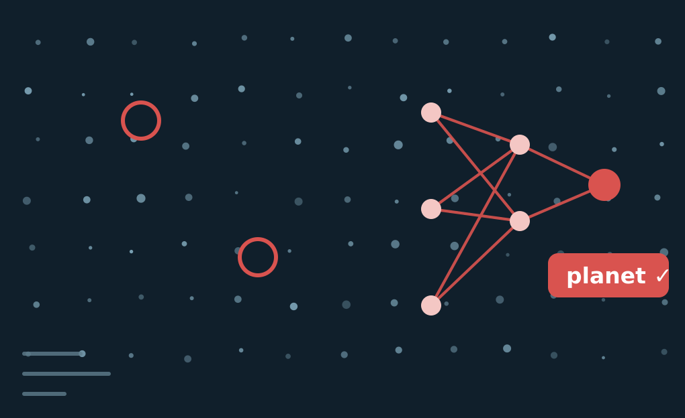

One Pursuit, Four Lenses: Mapping the Cosmos
The same human question — understand the night sky — was answered more deeply by each new paradigm. Watch it travel across all four.
the same question, asked deeper each time
1
EMPIRICAL · before 1600
2
THEORETICAL · 1600–1950s
3
COMPUTATIONAL · 1950s–1990s
4
DATA · 1990s–now
Charting the sky by eye
Turning logs into laws
Simulating the universe
Mining the data flood
Long before telescopes, people simply watched the sky and wrote down where the stars and planets appeared each night. They collected careful notes — but had no idea what was actually making everything move
Kepler and Newton distilled those logs into laws of gravity and motion. One equation now predicted any orbit — and even pointed to Neptune before a telescope found it.
Gravity acting on a billion stars has no solution you can write down. Supercomputers run N-body simulations, growing whole galaxies to test theories we can’t recreate.
Modern surveys stream petabytes every night. Machine learning sifts billions of objects to flag exoplanets, galaxies and flashes no human could ever scan by eye.
Today, all four at once: ● Observe with telescopes → ● Explain with physics → ● Simulate the cosmos → ● Mine the data with AI
Notes:
A single real-world thread — the study of the night sky — traced through all four paradigms: naked-eye observation (Tycho Brahe), mathematical law (Newton/Kepler, predicting Neptune), N-body simulation of galaxies, and machine learning on petabyte sky surveys. Today astronomy uses all four together.

Slide 4
The Fourth Paradigm: The Data Science Era
1990 – now. The data grew faster than any human could analyze it — so the method itself had to change.
WHAT CHANGED — WHY THIS ERA IS DIFFERENT
THE REASONING
1
Flood of data
New instruments and large-scale simulations pour out data — telescopes, gene sequencers, sensors, the Web.
In the first three eras a scientist could look at the data and reason it through. In the data era the data is too big, too fast, and too complex for that. The patterns are still in there — but only automated methods can surface them.
2
Cheap storage
We can now economically keep petabytes online, so nothing has to be thrown away.
Universal access
The Internet and computing grids make these huge archives reachable by anyone, anywhere.
LANDMARK EXAMPLE
3
The Sloan Digital Sky Survey / "World Wide Telescope." Astronomers stopped peering through one telescope and began querying a shared, petabyte-scale sky database — discovery became a data-mining task. (Gray & Szalay, Comm. ACM, 2002.)
4
Analysis breaks down
Storing and querying scales with data volume — but making sense of it by hand does not.
The takeaway: the data era makes manual analysis impossible — data mining is the major new challenge, and the reason this course exists.

Slide 5
MOTIVATION
Why Data Mining?
We are drowning in data, but starving for knowledge.
THE EXPLOSIVE GROWTH OF DATA
MAJOR SOURCES OF ABUNDANT DATA
Terabytes → Petabytes
B
Business
Automated collection tools, database systems, and the Web mean a computerized society generates data non-stop.
Web & e-commerce, transactions, stock trading
"We are drowning in data,
but starving for knowledge!"
Science
S
Remote sensing, bioinformatics, scientific simulation
The answer: data mining — automated analysis of massive data sets to turn raw data into knowledge.
E
Society & everyone
News, digital cameras, social media, YouTube

Slide 6
MOTIVATION · A DAY IN YOUR LIFE
Example: You Are the Data Explosion
One ordinary day with your phone makes more data than a whole village once did in a year.
ONE DAY, ONE PERSON
FROM YOUR MESS → REAL KNOWLEDGE
7 AM
Fitness band logs sleep,
heart rate, steps
Drowning in data
Thousands of photos, years of steps, endless purchases — piling up, unused.
→ Science
1 PM
Order food, tap-pay,
check a stock price
DATA MINING
→ Business
9 PM
20 reels, 100 messages,
a story posted
KNOWLEDGE OUT
YOUR PHONE
→ Society
Here's the birthday photo you wanted.
Your heart rate spikes every Monday.
You always buy coffee after the gym.

Slide 7
DEFINITION
What Is Data Mining?
Discovering hidden, useful knowledge from huge amounts of data.
Data Mining = Knowledge Discovery from Data
Extracting patterns that are non-trivial, implicit, previously unknown, and potentially useful from a huge amount of data.
WHAT MAKES IT "MINING"
WATCH OUT — IS EVERYTHING DATA MINING?
Non-trivial — not a simple lookup — needs real analysis
REAL-LIFE EXAMPLE
A store mines years of receipts and discovers that customers who buy diapers often buy beer too — an implicit, previously unknown pattern it can act on with product placement.
Implicit — the pattern is hidden, not stated in the data
Previously unknown — reveals something you did not already know
NOT data mining: simple search & query ("find all sales in May") or basic expert systems — they retrieve known facts, they don’t discover new patterns.
Potentially useful — the insight can drive a real decision
Also called: KDD, knowledge extraction, pattern analysis, business intelligence.

Slide 8
DATA MINING AT A GLANCE
From Raw Data to Insights
STAGE 1 · THE PROCESS
Prepare the data
Capture
Preprocess
Store
(Warehouse)
Mine
STAGE 2 · THE TASKS
Apply the right algorithm for your goal
Descriptive
describe what's in the data
Predictive
forecast unknown values
Association
items bought together
Clustering
group similar points
Classification
predict a category
Regression
predict a number
Forecasting
predict over time

Slide 9
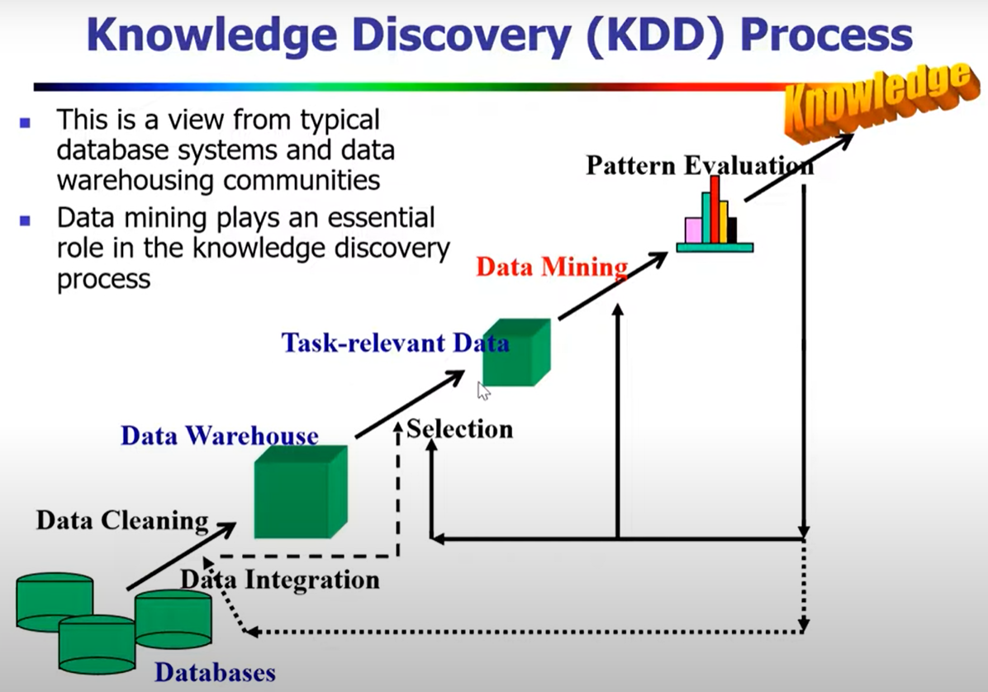

Slide 10
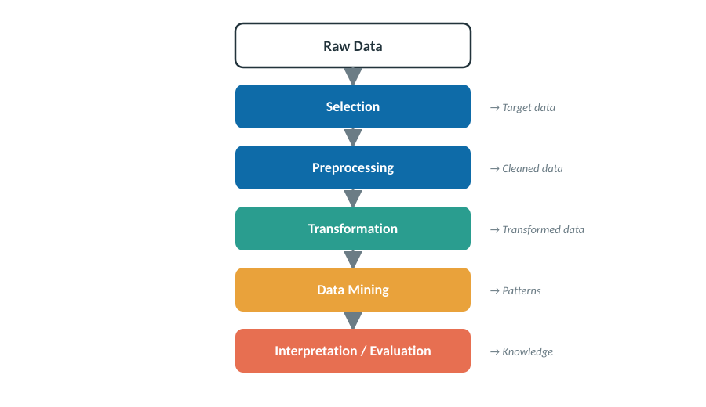
TOPIC 01
Data Mining Process
The KDD Pipeline
Its need and motivation
Raw data alone holds little value — the process extracts hidden, useful knowledge from it.
It follows the KDD pipeline: from selecting and cleaning data through to interpreting the mined patterns.
Driven by real decision-making needs in business, science, and healthcare.
REAL-LIFE EXAMPLE
A supermarket collects millions of receipts. The KDD process cleans and mines them to discover buying patterns — turning raw sales logs into stocking and promotion decisions.

Slide 11
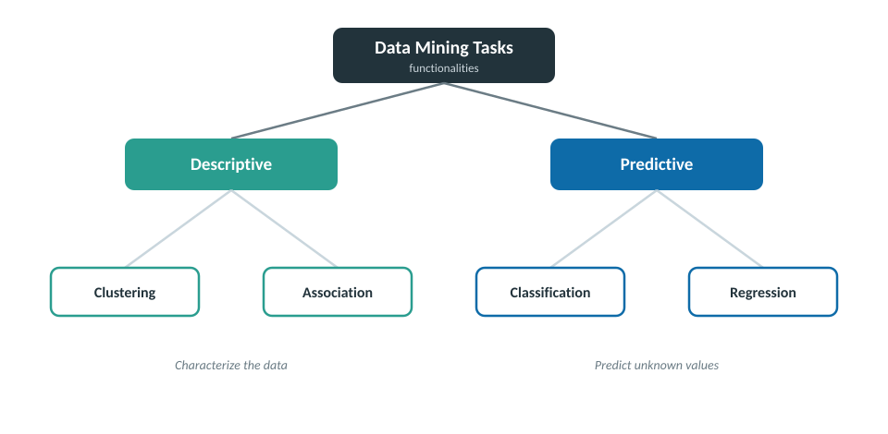
TOPIC 02
Tasks & Functionalities
Taxonomy of mining tasks
What data mining can do
Descriptive tasks characterize the data — clustering and association reveal its structure.
Predictive tasks forecast unknown values — classification and regression learn from past data.
Together they cover the core functionalities used across every mining application.
REAL-LIFE EXAMPLE
An email service uses classification (predictive) to label messages spam or not, and clustering (descriptive) to group similar emails into folders automatically.

Slide 12
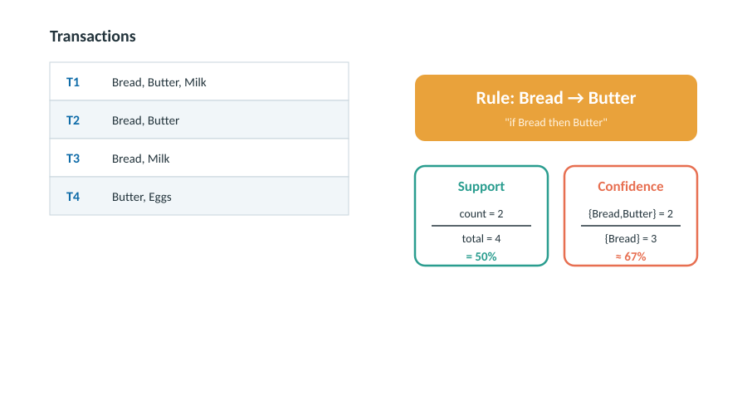
Frequent Pattern & Association
Discovering what occurs together
Support & confidence worked example
Finds itemsets that appear together often — the classic case is market-basket analysis.
Rules are judged by support (how often) and confidence (how reliably) they hold.
Key algorithms: Apriori and FP-Growth; used in retail and recommendations.
REAL-LIFE EXAMPLE
Amazon’s "customers who bought this also bought…" is association mining: it learns that buyers of a phone often buy a case, then recommends it.

Slide 13
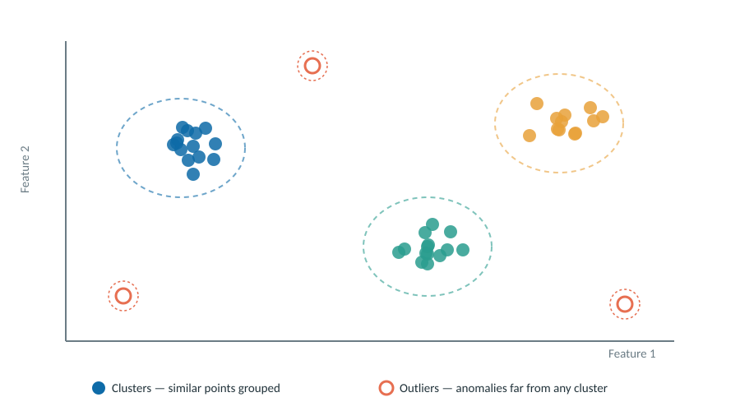
TOPIC 04
Clustering & Outlier Detection
Clusters vs. outliers
Grouping the similar, flagging the odd
Clustering groups unlabeled data so members of a group are similar (k-means, DBSCAN).
Outlier detection isolates rare points that deviate sharply from every cluster.
Applications: customer segmentation, fraud and intrusion detection.
REAL-LIFE EXAMPLE
A bank clusters normal spending behavior, then flags a transaction in another country at 3 a.m. as an outlier — a likely fraud alert.

Slide 14
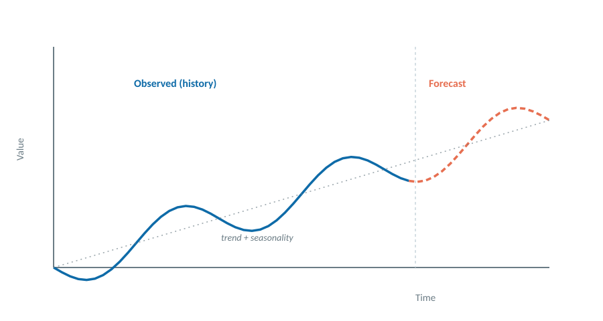
Time Series & Spatial Mining
Mining data with time and place
Trend, seasonality & forecast
Time-series mining finds trends, seasonality, and forecasts in time-ordered data.
Spatial mining works with location data to find regional and neighborhood patterns.
Powers forecasting, sensor analytics, GIS, and traffic analysis.
REAL-LIFE EXAMPLE
Weather services mine years of temperature readings (time) across regions (space) to forecast tomorrow’s weather and map rainfall by area.

Slide 15
From raw data to knowledge
These six areas form the roadmap for the course — each step turns data into decisions.

