Slide 1
C2DSR

Slide 2
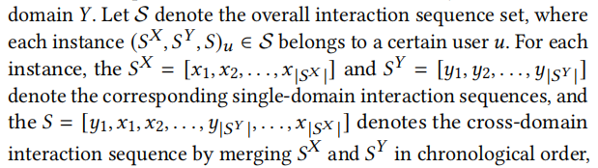
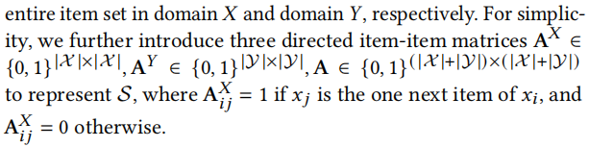
Data Preprocessing:
adj, adj_single

Slide 3
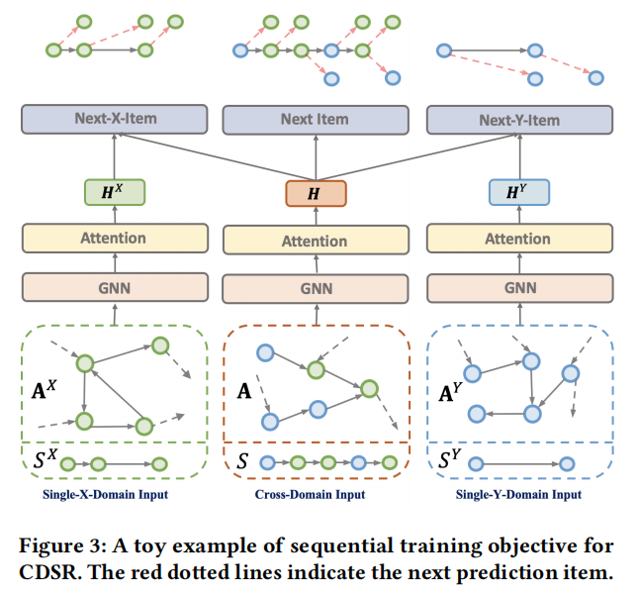
Toy Example

Slide 4
There are three major components of C2DSR:
(1) Graphical and attentional encoder, which includes an embedding layer, a graph neural network module, and a self-attention module to generate a series of sequential representations (i.e., user representations) for each interaction sequence.
(2) Sequential training objective, which includes two training objectives for single-domain and cross-domain interaction sequences to obtain single-domain and cross-domain user representations.
(3) Contrastive infomax objective, which leverages the mutual information maximization principle to enhance the correlation between single-domain and cross-domain representations.

Slide 5
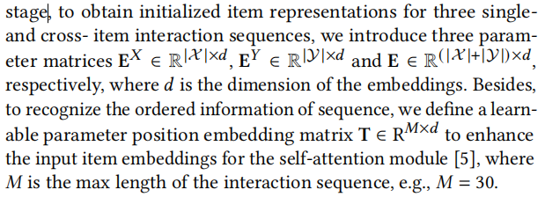
3.1 Graphical and Attentional Encoder
3.1.1 Embedding Initialization Layer.
In the C2DSR.py:
self.item_emb_X = torch.nn.Embedding(self.opt["itemnum"], self.opt["hidden_units"],padding_idx=self.opt["itemnum"] - 1)
self.item_emb_Y = torch.nn.Embedding(self.opt["itemnum"], self.opt["hidden_units"],padding_idx=self.opt["itemnum"] - 1)
self.item_emb = torch.nn.Embedding(self.opt["itemnum"], self.opt["hidden_units"],padding_idx=self.opt["itemnum"] - 1)
In self-attention module:
self.pos_emb = torch.nn.Embedding(self.opt["maxlen"], self.opt["hidden_units"], padding_idx=0)
#which maxlen = 15,hidden_units = 256,itemnum=

Slide 6
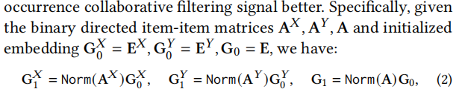
3.1 Graphical and Attentional Encoder
3.1.2 Graph Neural Network Module (For handling inter-sequence item relationship)
In C2DSR.py:
self.GNN_encoder_X = GCNLayer(opt)
self.GNN_encoder_Y = GCNLayer(opt)
self.GNN_encoder = GCNLayer(opt)
In trainer.py > train_batch > self.model.graph_convolution() > C2DSR.py > graph_convolution:
#選取相應的item emb 》 fea，然后放進GNN encoder裡面 G1 = Norm（A）G0，G0 = E
self.cross_emb = self.GNN_encoder(fea, self.adj) #G
self.single_emb_X = self.GNN_encoder_X(fea_X, self.adj_single) #GX
self.single_emb_Y = self.GNN_encoder_Y(fea_Y, self.adj_single) #GY

Slide 7
3.1 Graphical and Attentional Encoder
3.1.2 Graph Neural Network Module
In GNN.py > GCNLayer:
def forward(self, fea, adj):
learn_fea = fea
tmp_fea = fea
for layer in self.encoder:
learn_fea = F.dropout(learn_fea, self.dropout, training=self.training)
learn_fea = layer(learn_fea, adj)
tmp_fea = tmp_fea + learn_fea
return tmp_fea / (self.layer_number + 1)
#remove the convolution matrix multiplication and non-linear activation function to capture the co-occurrence collaborative filtering signal better.
最後得到self.cross_emb (G) self.single_emb_X (GX) self.single_emb_Y (GY)

Slide 8
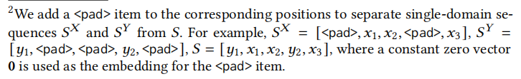
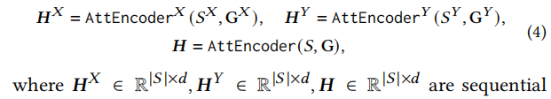
3.1 Graphical and Attentional Encoder
3.1.3 Self-Attention Module
C2DSR.py > foward :
seqs = self.my_index_select(self.cross_emb, o_seqs) + self.item_emb(o_seqs)
seqs *= self.item_emb.embedding_dim ** 0.5
seqs_fea = self.encoder(o_seqs, seqs, position)
seqs = self.my_index_select(self.single_emb_X, x_seqs) + self.item_emb_X(x_seqs)
seqs *= self.item_emb.embedding_dim ** 0.5
x_seqs_fea = self.encoder_X(x_seqs, seqs, x_position)
seqs = self.my_index_select(self.single_emb_Y, y_seqs) + self.item_emb_Y(y_seqs)
seqs *= self.item_emb.embedding_dim ** 0.5
y_seqs_fea = self.encoder_Y(y_seqs, seqs, y_position)

Slide 9
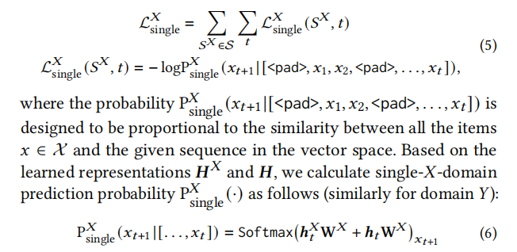

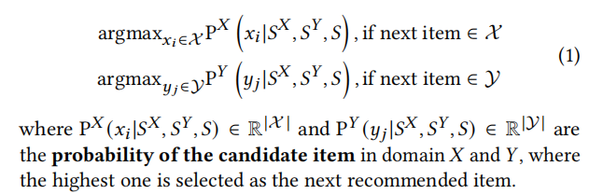
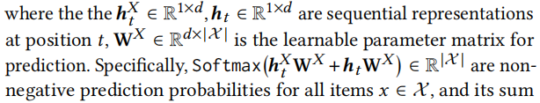
3.2 Sequential Training Objective
3.2.1 Single-Domain Item Prediction（For optimizing encoder model）
x_loss = self.CS_criterion(specific_x_result.reshape(-1, self.opt["source_item_num"] + 1),x_ground.reshape(-1))
specific_x_result = self.model.lin_X(seqs_fea[:,-used:] + x_seqs_fea[:, -used:])

Slide 10
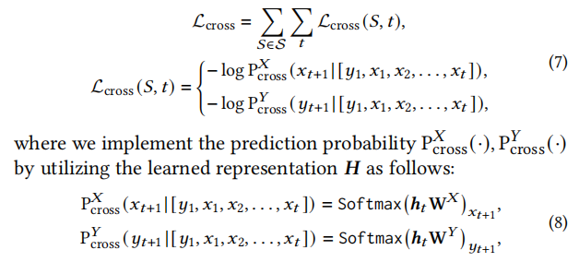
3.2 Sequential Training Objective
3.2.2 Cross-Domain Item Prediction.
we decompose the loss function as two equally separate parts for the domain 𝑋 and 𝑌 to optimize, which could preserve the prediction ability for one domain even if the interaction sequence contains many consecutive items in another domain.
x_share_loss = self.CS_criterion(share_trans_x_result.reshape(-1, self.opt["source_item_num"] + 1), share_x_ground.reshape(-1)) # b * seq
y_share_loss = self.CS_criterion(share_trans_y_result.reshape(-1, self.opt["target_item_num"] + 1),share_y_ground.reshape(-1)) # b * seq
share_x_result = self.model.lin_X(seqs_fea[:,-used:]) # b * seq * X_num
share_y_result = self.model.lin_Y(seqs_fea[:, -used:]) # b * seq * Y_num

Slide 11




3.3 Contrastive Infomax Objective
3.3.1 Single- and Cross- Domain Prototype Representations
r_x_fea = (x_seqs_fea * x_mask).sum(1) r_y_fea = (y_seqs_fea * y_mask).sum(1)
real_x_fea = (seqs_fea * x_mask).sum(1) real_y_fea = (seqs_fea * y_mask).sum(1)
3.3.2 Infomax Objective
corru_x_fea = self.model.false_forward(corru_x, position)
corru_y_fea = self.model.false_forward(corru_y, position)

Slide 12
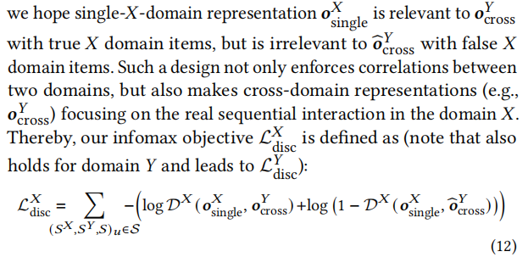
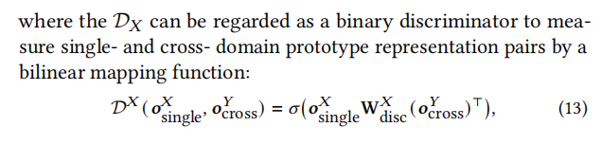
3.3 Contrastive Infomax Objective
pos_label = torch.ones_like(real_x_score).cuda()
neg_label = torch.zeros_like(false_x_score).cuda()
x_mi_real = self.BCE_criterion(real_x_score, pos_label)
x_mi_false = self.BCE_criterion(false_x_score, neg_label)
x_mi_loss = x_mi_real + x_mi_false
y_mi_real = self.BCE_criterion(real_y_score, pos_label)
y_mi_false = self.BCE_criterion(false_y_score, neg_label)
y_mi_loss = y_mi_real + y_mi_false
real_x_score = self.model.D_X(r_x_fea, real_y_fea) false_x_score = self.model.D_X(r_x_fea, y_false_fea)

Slide 13
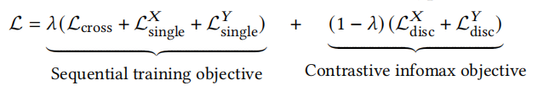
The total loss function of C2DSR
loss = self.opt["lambda"]*(x_share_loss + y_share_loss + x_loss + y_loss) + (1 - self.opt["lambda"]) * (x_mi_loss + y_mi_loss)

