Slide 1

Welcome to the Toronto HashiCorp User Group
Terraform Stacks with CI/CD
By: Kaan Turgut

Slide 2


Kaan Turgut
Senior DevOps Engineer | Muay Thai Enthusiast
Socials:
LinkedIn: linkedin.com/in/kaanturgut
GitHub: github.com/kaanturgut
YouTube: youtube.com/@KaanintheCloud

Slide 3
Agenda
Understanding Stacks: What are Terraform Stacks and their benefits?
Challenges Solved: Complexity, coordination, and scalability
Use Cases: Applications, multi-region, and Kubernetes
Workflow: Components, deployments, and orchestration rules
Demo: Live Terraform Stacks demonstration
Quiz: Interactive quiz with Terraform book gift to TOP 3
Q&A: Open floor for questions

Slide 4
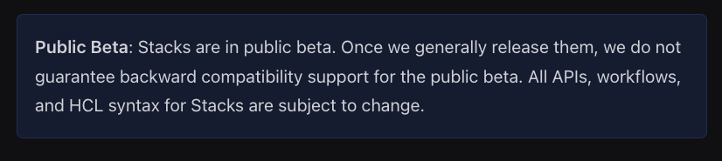
Understanding Terraform Stacks
What Are Terraform Stacks?
As your infrastructure grows, managing Terraform configurations becomes increasingly complex. Stacks are a powerful configuration layer in HCP Terraform that simplifies managing your infrastructure modules and then repeating that infrastructure.
Notes:
As your infrastructure grows, managing Terraform configurations becomes increasingly complex. Stacks are a powerful configuration layer in HCP Terraform that simplifies managing your infrastructure modules and then repeating that infrastructure.
Stacks replace Terraform's traditional root module structure with a new configuration layer of modular components built on top of your Terraform child and shared modules. Stacks enable you to provision and coordinate your infrastructure lifecycle at scale, offering an organized and reusable approach that expands upon infrastructure as code (IaC).

Slide 5

What Does Stacks Solve?
Reusability and Consistency
Scalability for Multi-Region Deployments
Coordination Across Environments
Configuration complexity
Lifecycle Orchestration
Notes:
What Challenges Do Terraform Stacks Solve?
Simplifies managing infrastructure by splitting Terraform code into smaller, manageable modules.
Challenges before Stacks:
Isolated states meant managing dependencies manually across multiple configurations.
No built-in way to manage repeated infrastructure deployments across:
Accounts, environments, regions, or landing zones.
Teams relied on custom scripts and external tools, which were error-prone and difficult to maintain.
Terraform Stacks solve these issues by providing a unified way to provision and manage infrastructure lifecycle at scale.

Slide 6
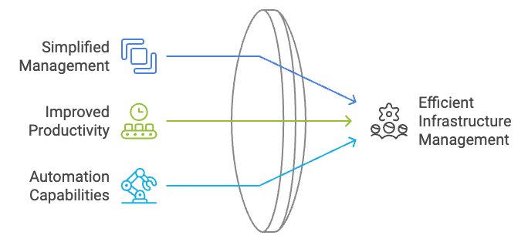
Benefits of Using Terraform Stacks
Notes:
Key Benefits
Simplified Management:
Automatically handle dependencies between configurations.
Organize and deploy multiple modules sharing the same lifecycle as a single unit.
Improved Productivity:
Quickly create and modify consistent setups with different inputs.
Automate rollouts across environments using orchestration rules.
Benefits include:
Limiting the blast radius of resource changes.
Reducing run time for deployments.
Separating management across team boundaries.
Handling multi-step setups, like provisioning Kubernetes clusters.
Purpose: Stacks extend infrastructure as code (IaC) to a higher level while continuing to use familiar Terraform shared modules.

Slide 7
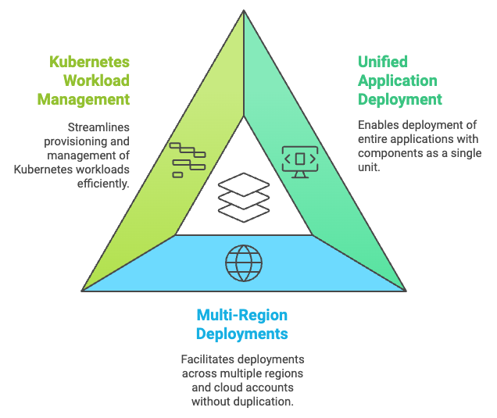
Common Use Cases for Terraform Stacks
Notes:
Common Use Cases for Terraform Stacks
1. Deploy Complete Applications
Deploy components like networking, storage, and compute as a single unit.
Simplify complex infrastructure deployments for users with minimal Terraform expertise.
A single Stack configuration can manage the entire application lifecycle.
2. Multi-Region and Multi-Account Deployments
Deploy infrastructure across regions, availability zones, and accounts without duplicating effort.
Define multiple instances of the same configuration in a single Stack.
Roll out changes across all deployments with a single update to the Stack configuration.
3. Manage Kubernetes Workloads
Streamline Kubernetes workload deployments with a single configuration.
Avoid challenges caused by unknown variables in Kubernetes setups.
Accelerate time-to-market for Kubernetes deployments at scale without complex layered approaches.

Slide 8
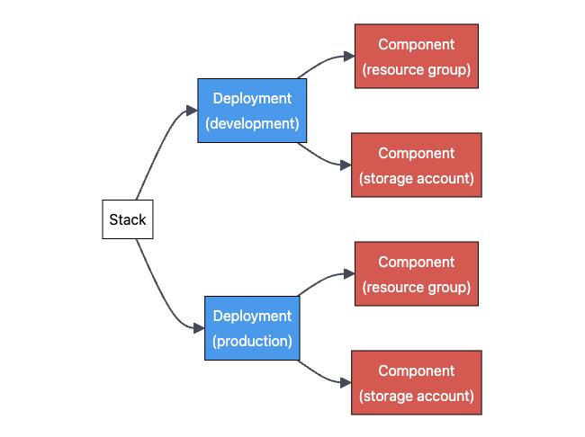
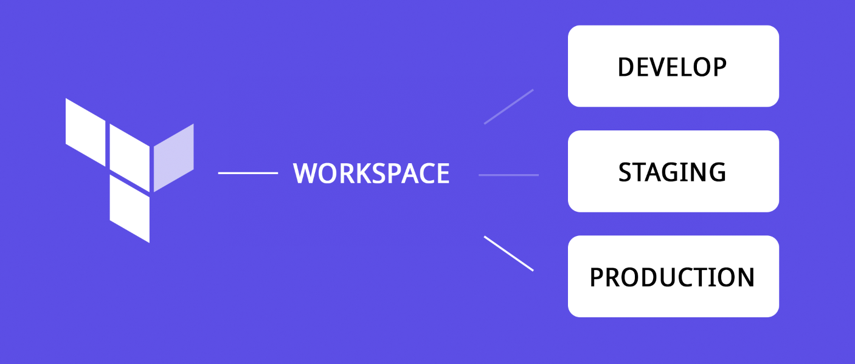

Terraform
Workspace vs Stacks
Notes:
Terraform Workspace vs Terraform Stacks
Workspaces: Workspaces are great for isolating state files in small or single-environment configurations but become cumbersome for large-scale, multi-environment setups.
Stacks: Stacks address the challenges of scalability, reusability, and coordination by introducing a modular approach that works seamlessly across environments and regions.
Key Points to Highlight While Presenting:
Purpose and Structure:
Workspaces focus on separating state files but are tied to a single root module.
Stacks use modular components, enabling more flexibility in large-scale setups.
Reusability and Coordination:
Workspaces require manual duplication for multi-region setups, while Stacks offer high reusability.
Stacks provide orchestration rules to automate deployments, unlike workspaces that depend on external triggers.
Scalability and Lifecycle Management:
Workspaces are best for small-scale environments, but Stacks shine in complex multi-region or multi-environment infrastructures with built-in lifecycle orchestration.
Integration:
Stacks operate independently of HCP Terraform workspaces, offering more flexibility in managing deployments.
Encourage the audience to think about their infrastructure needs—if they face challenges scaling or reusing configurations, Stacks are likely the better choice.

Slide 9
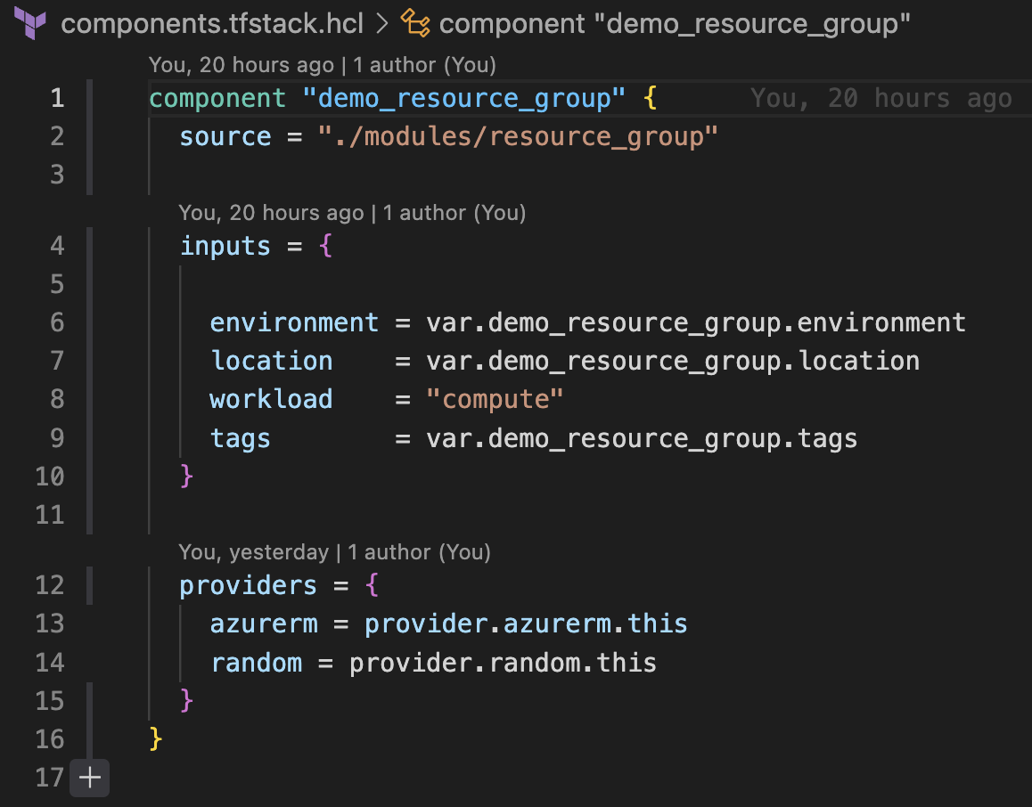
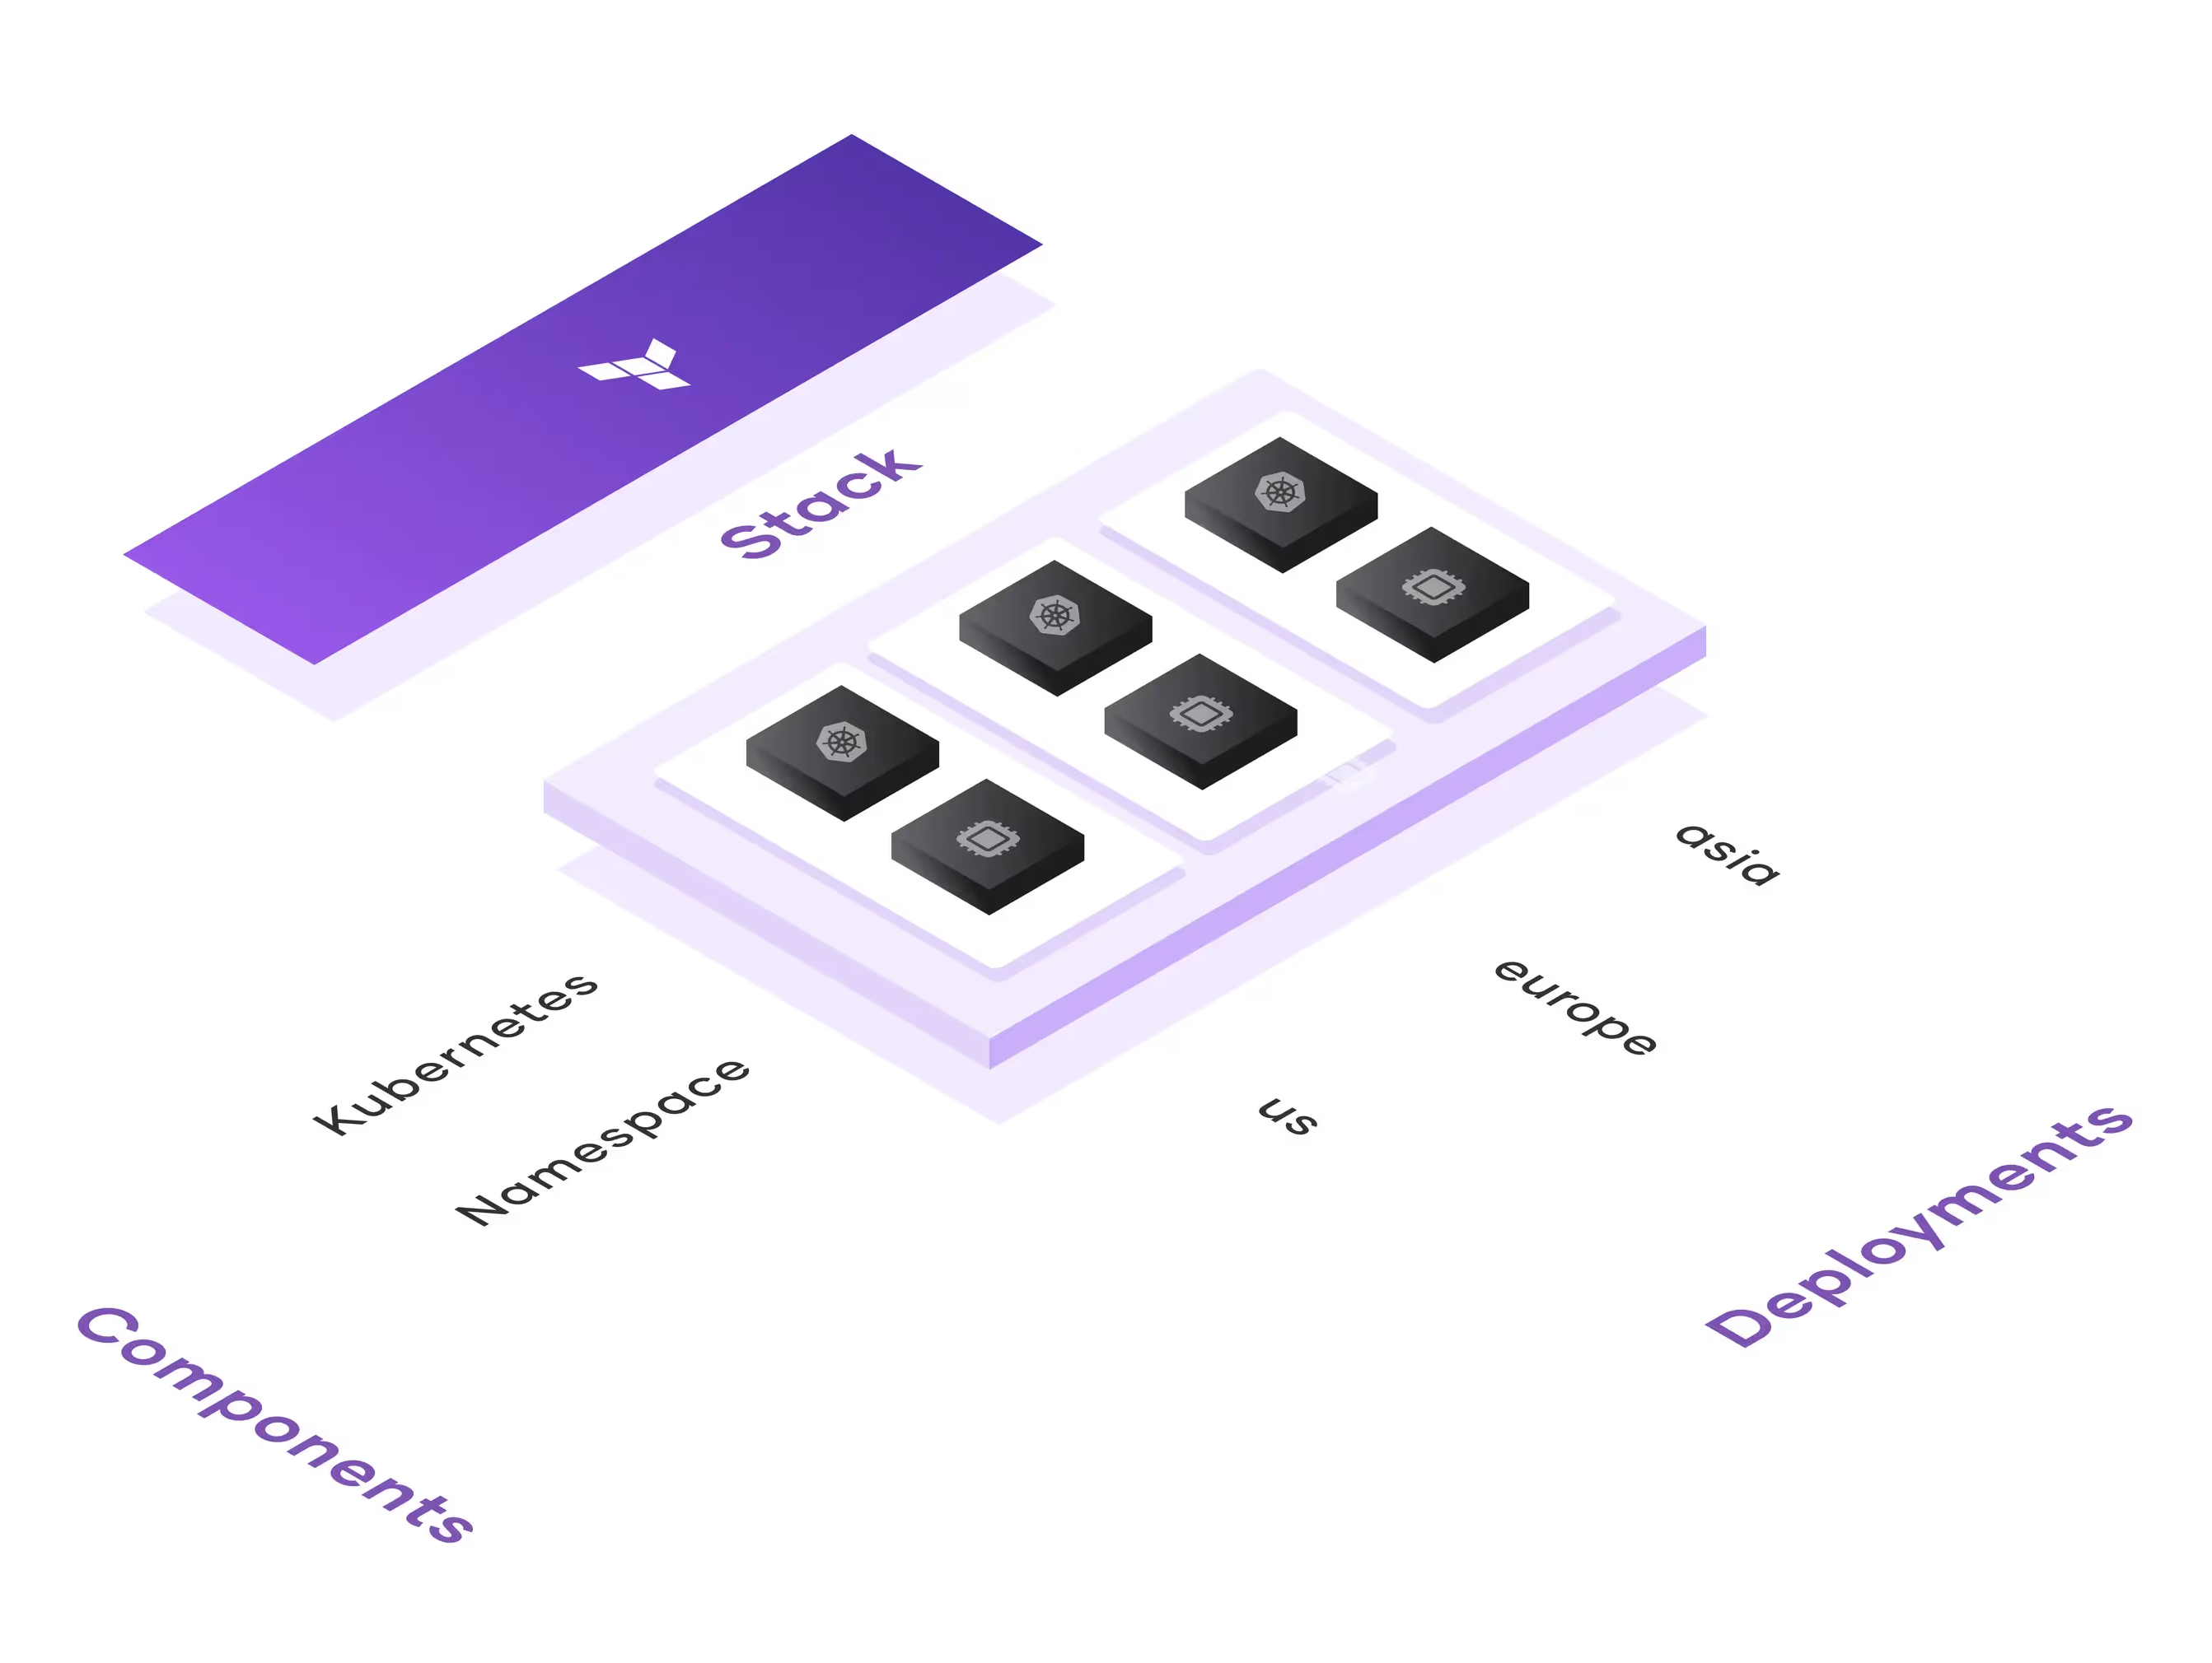
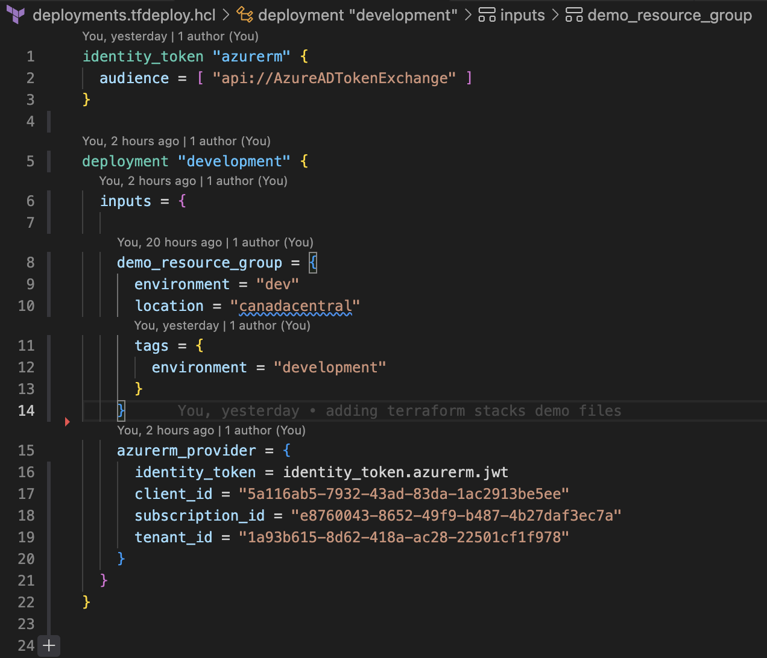
Stacks Workflow
Notes:
Components Configuration
Defined in .tfstack.hcl files.
Specifies what infrastructure (components) is in the Stack.
Includes:
Source Module: Points to existing modules.
Inputs & Providers: Pass variables and define providers.
Benefit: Reuses existing modules without rewriting.
2. Deployments Configuration
Defined in .tfdeploy.hcl files.
Specifies where and how many times to deploy.
Each deployment includes inputs like region and instance count.
Benefit: Automates repeated infrastructure setup across environments.
3. Lifecycle Management
Plans changes for all deployments when a Stack is updated.
Approve changes for all, some, or none of the deployments.
Ensures consistent updates across the infrastructure.
Key Takeaways
Components: Define the “what.”
Deployments: Define the “where and how.”
Lifecycle: Automates and simplifies updates.

Slide 10
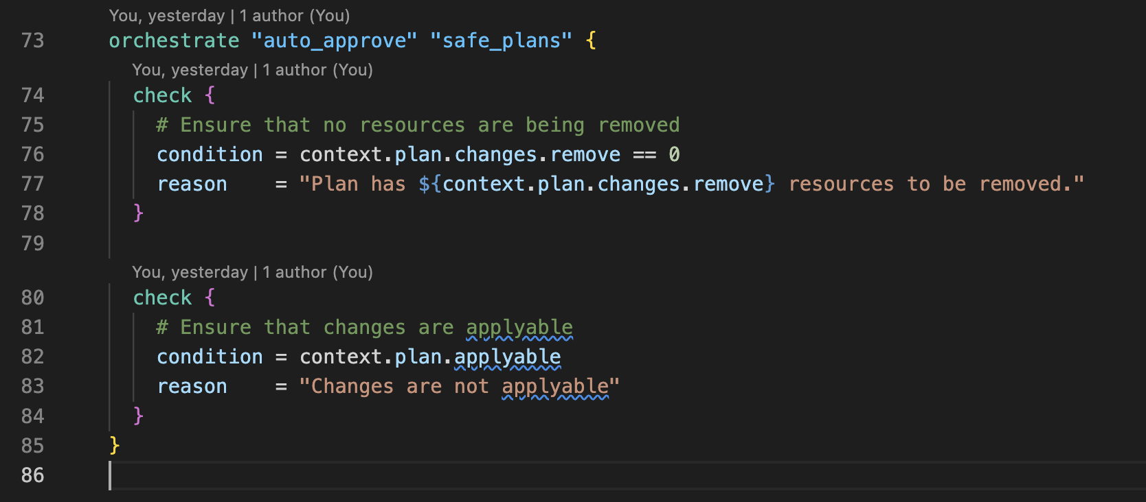
Orchestration Rules
Notes:
This orchestration block automates the approval process for Terraform plans in your Stack, ensuring plans meet specific safety and applicability criteria before proceeding without manual intervention.
Key Components
Orchestration Block:
Name: "auto_approve"
Identifier: "safe_plans"
Automates approval based on defined checks.
Check 1: No Resource Removal
Condition: context.plan.changes.remove == 0
Ensures no resources are being removed in the plan.
Reason: "Plan has ${context.plan.changes.remove} resources to be removed."
Provides context on why the condition fails if removal is detected.
Check 2: Applyable Changes
Condition: context.plan.applyable
Confirms that the proposed changes can actually be applied.
Reason: "Changes are not applyable"
Explains why the plan cannot be approved if this condition is false.
How It Works
Evaluation:
HCP Terraform checks each condition sequentially.
If all conditions pass, the plan is auto-approved.
If any condition fails, Terraform displays the associated reason, requiring manual intervention.
Automation:
Ensures safety (no resource removal).
Validates the readiness of changes for application.
Benefits
Safety: Prevents unintentional deletion of resources.
Efficiency: Automates routine checks, reducing manual effort.
Reliability: Ensures only valid and safe plans are executed.

Slide 11


Slide 12
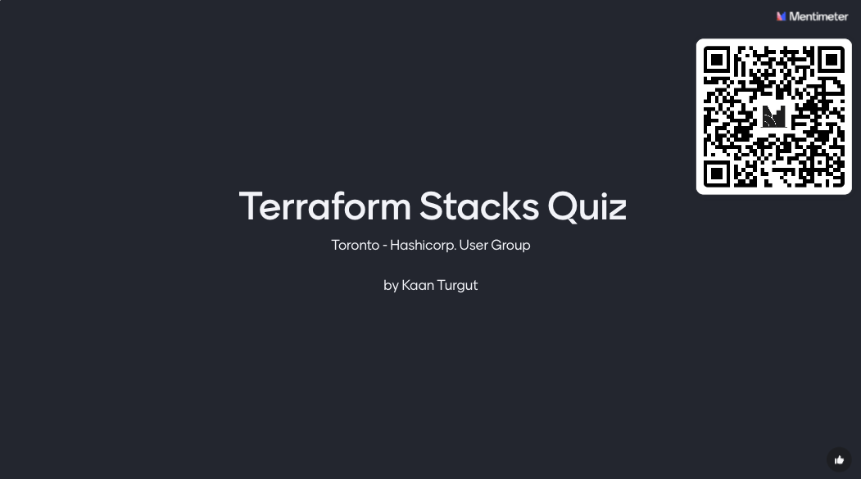

Slide 13


