Slide 1

Predicting the cost of hospitalization in Singapore, 2011-2015
26 July 2018
(Deidentified data from Holmusk)

Slide 2

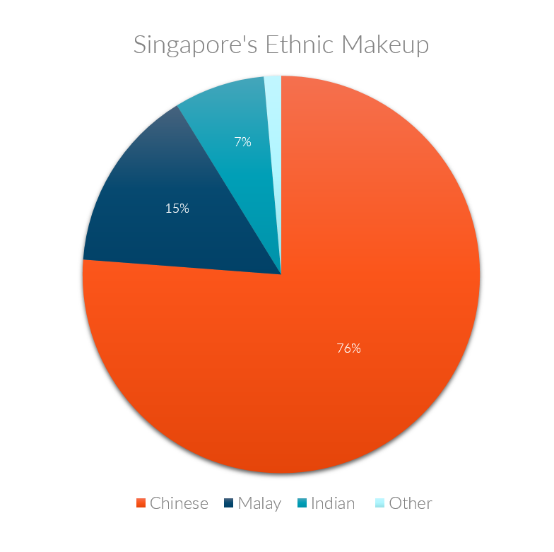
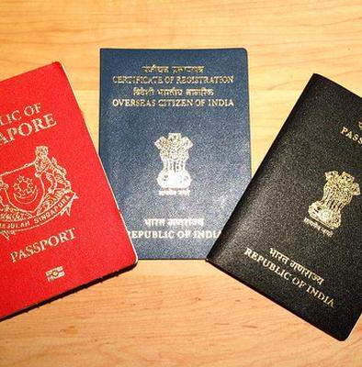
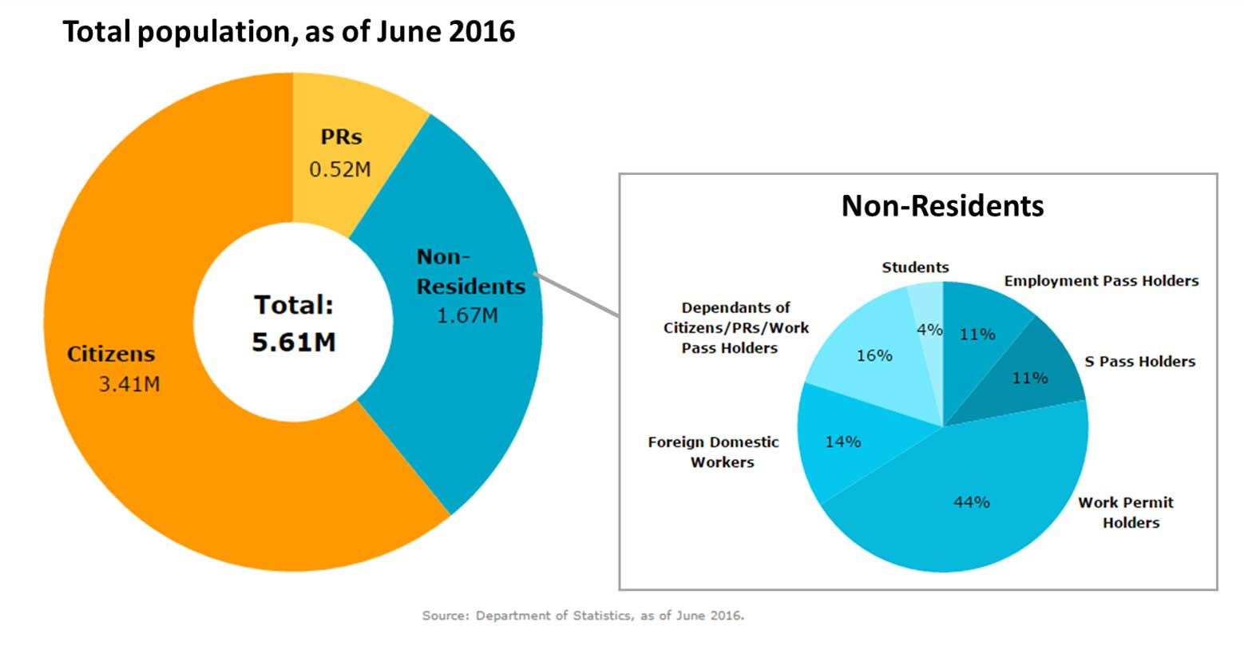
2014

Slide 3


Admitted patients (2011-2015)
‘symptom_1’ (Yes/No)
‘symptom_2’ (Yes/No)
‘symptom_3’ (Yes/No)
‘symptom_4’ (Yes/No)
'symptom_5’ (Yes/No)
Outcomes:
‘Cost of per admission’ (SGD)

Slide 4

Results
 | Descriptive
Age (years) | 52 (sd 15)
Height (cm) | 165 (sd 7)
Weight (kg) | 79 (sd 11)
% Male | 50.2%
lab_result_1 | 14.5 (sd 1.7)
lab_result_2 | 99.5 (sd 15.3)
lab_result_3 | 78.9 (sd 11)
Length of stay, los (days) | 11 (sd 3)
Patient
characteristics
2898

Slide 5
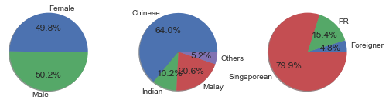
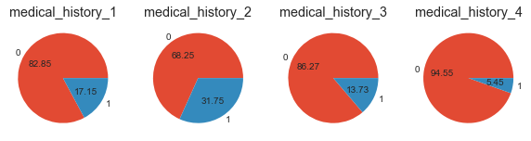
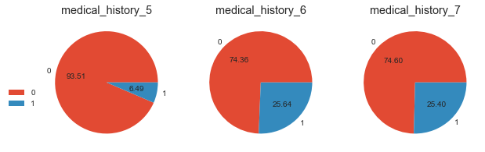
Results
Patient
characteristics
2898

Slide 6
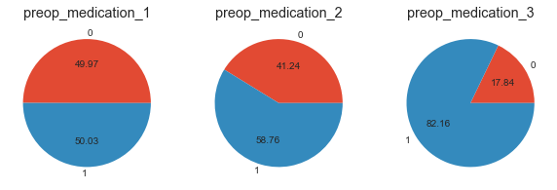
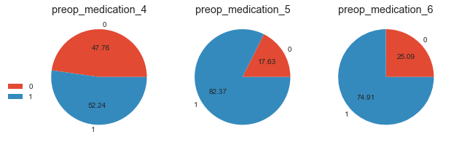
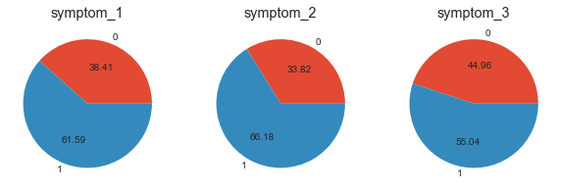
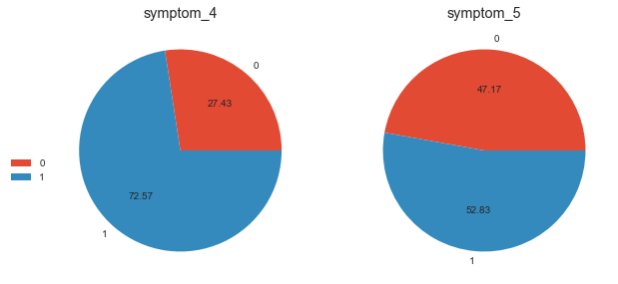
Results
Patient
characteristics
2898

Slide 7
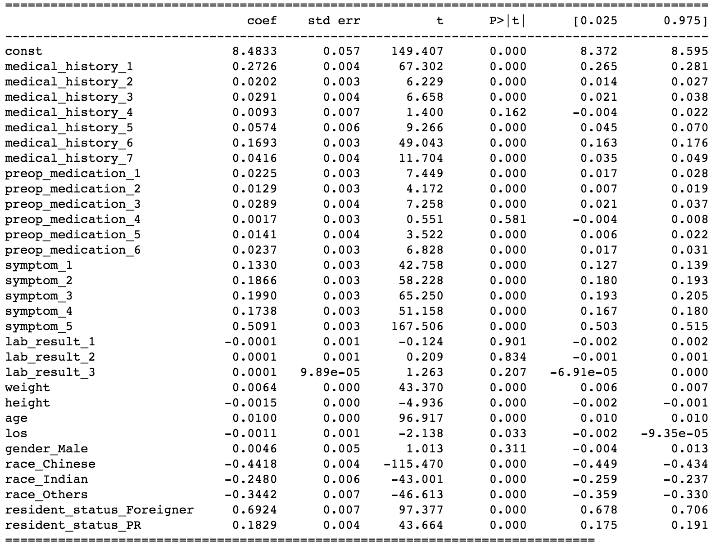
Results
Predictors of “Cost of per admission in log10 ”
Multiple linear regression (based on training set of 2318 subjects)
R² = 0.974
Accuracy of prediction model based on test set of 580 subjects), R² = 0.972

Slide 8
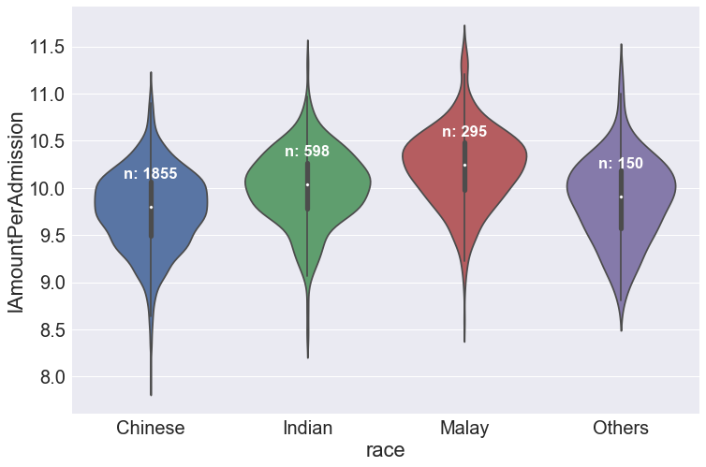
Cost of per admission in log10 vs RACE
n=2898

Slide 9
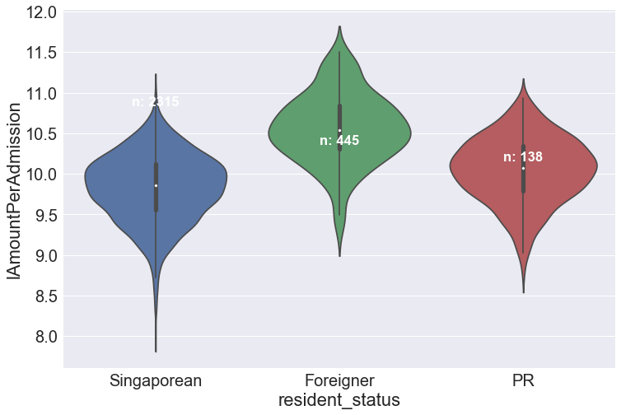
Cost of per admission in log10 vs RESIDENT STATUS
n=2898

Slide 10
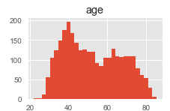
Caveats
Only applicable for prediction between 2011 and 2015
Not adjusted for possible annual inflation rate
Age has a bimodal distribution. The model may be further improved by splitting the datasets into 2 obvious age groups, i.e. adults and the elders

