Slide 1
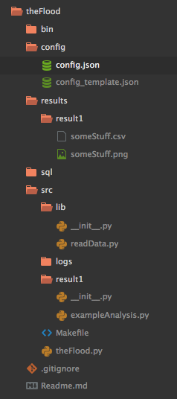
Shell scripts (running programs, setting up VE, …)
Location of database host id’s and passwords. Not to be pushed to Github. It is already placed in the .gitignore file
Template for config.json. Is pushed to Github. Actual password is pushed to everyone over slack
All analysis may be seen as a collection of results.
The ./src folder will contain a list of folders called ./src/result1, ./src/result2, … , ./src/result{m}
The programs present in ./src/result1 should create all results within ./result/result1, etc.
This way, the results can be easily identified to the program that created them.
It is recommended that this information be present within each of the ./result/result{i} folders that explains what that result is. At a later time, results can quickly be combined to generate reports, presentations, and papers. This is also useful when many people want to work upon a different result independently.
.sql files to be run directly using CLI

