Slide 1
Data Scientist Case Study: Direct Marketing Optimization
Lee Hong Kai

Slide 2
Work Framework and steps
Basic_cleaning,data_check
Data_split
Train_*
Training dataset, n=951 (clean_sample.csv)
5-fold cv (stratified by label) with pipelines,
Feature selection for each model
Best model determined with AUC for each of the MF, CC, CL propensity models
MAE (log revenue) for MF, CC, CL revenue prediction
Training dataset (80%, n=761)
CaseStudyDataset in excel
Stratified by Sex
Test_model
Testing dataset (20%, n=190)
Test dataset performance, with AUC and MAE/R2
Test dataset, n=636 (clean_sample_test.csv)
Probability of getting product, Predicted revenue for each product, expected revenue for each product by each client, product with highest revenue for each client.
Test_production
All MLOPs artifacts available at https://wandb.ai/leehongkai/financial-product-marketing-optimization/table

Slide 3
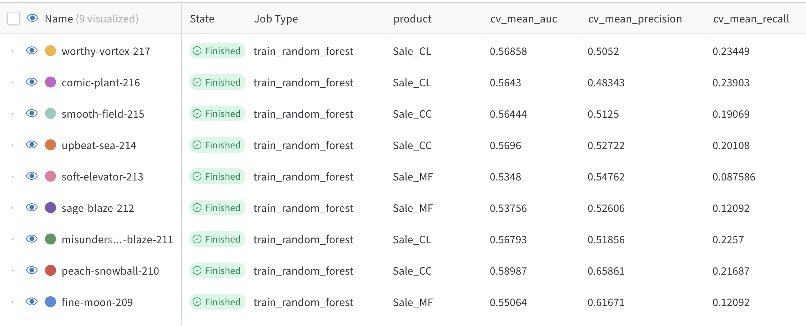
Model CV performance - Propensity
Use AUC of ROC as key model metrics so that higher AUC indicate higher recall and lower false positive
CV performance
Labelling inconsistency – roc is the AUC in the rest of the slides
Test performance

Slide 4
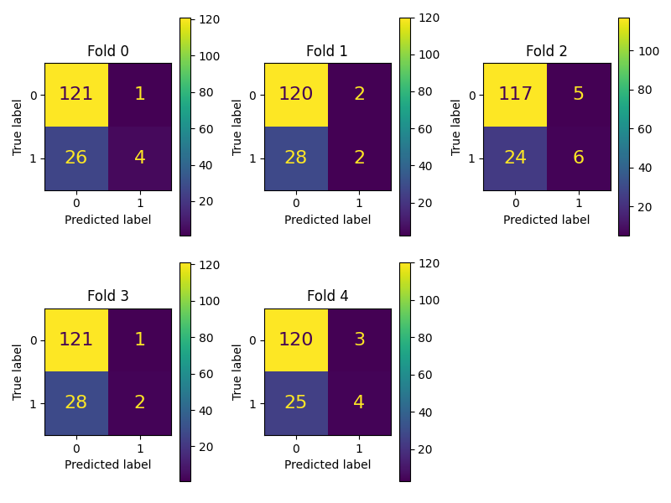
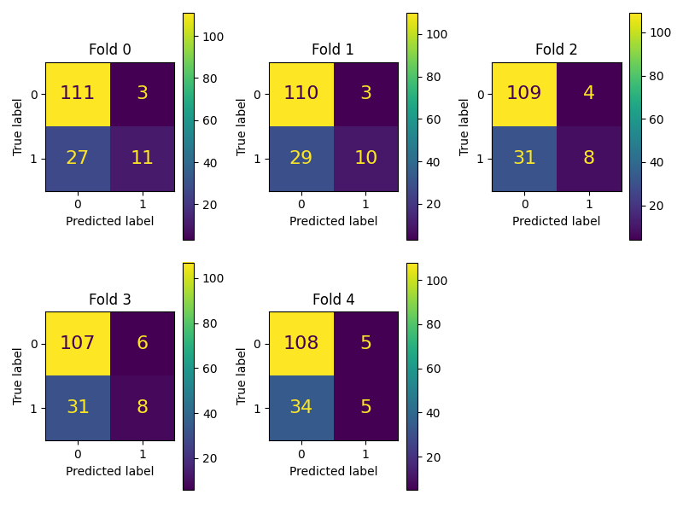
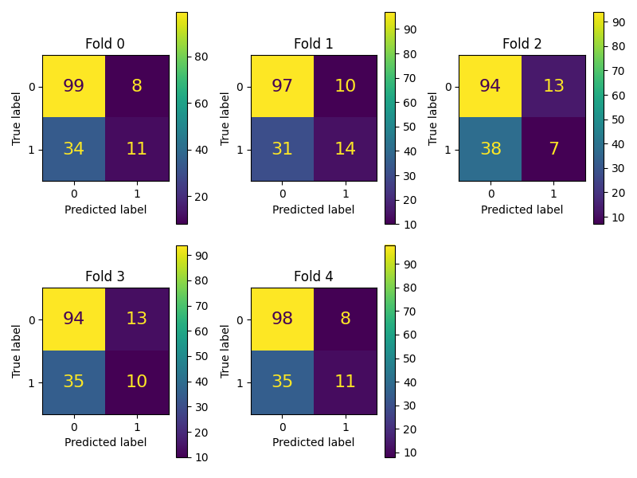
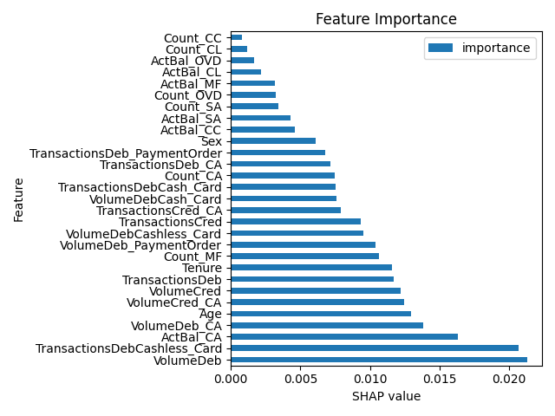
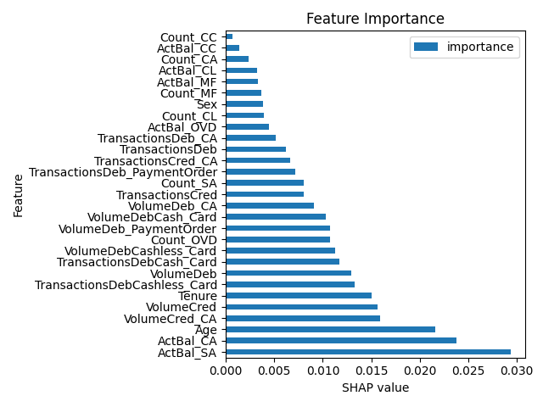
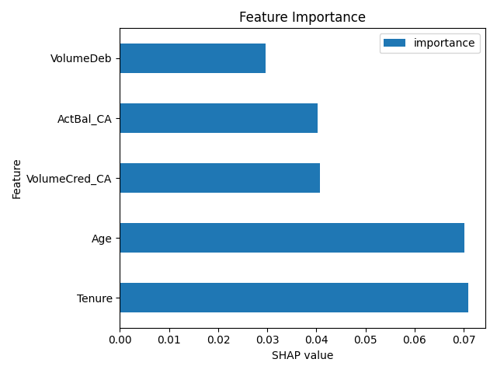
Model CV performance - Propensity
Sale_MF (fine-moon-209)
Sale_CC (Peach-snowball-210)
Sale_CL (worthy-vortex-217)
Best model from selected features below:-
(higher in bought)
(lower in bought)
(higher in bought)
(lower in bought)
Top predictive features:
VolumeDeb (higher in bought),
TransactionsDebCashless_Card (higher in bought)
ActBal_SA (higher in bought),
ActBal_CA (higher in bought),
Age (higher in bought)
(higher in bought)

Slide 5
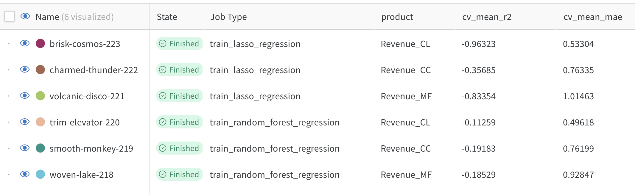
Model CV performance - Revenue
Use MAE as key model metrics as r2 is not reliable metrics in this study.
CV performance
Test performance
Observations: All R2 are <0 -- no reliable predictive power

Slide 6
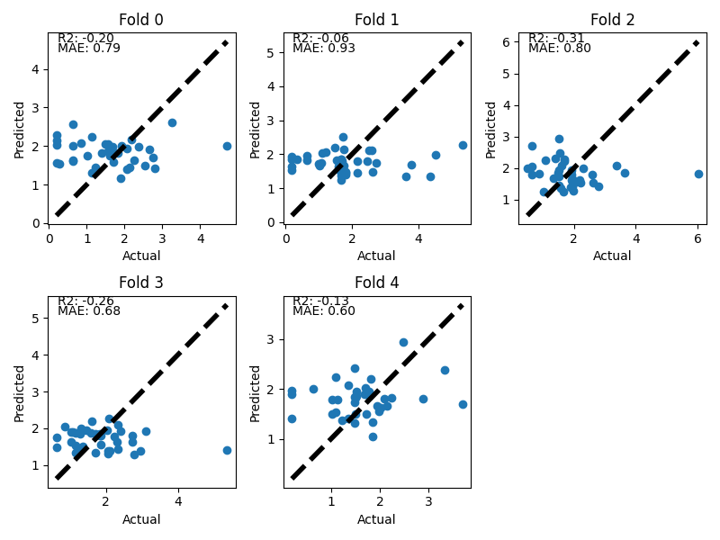
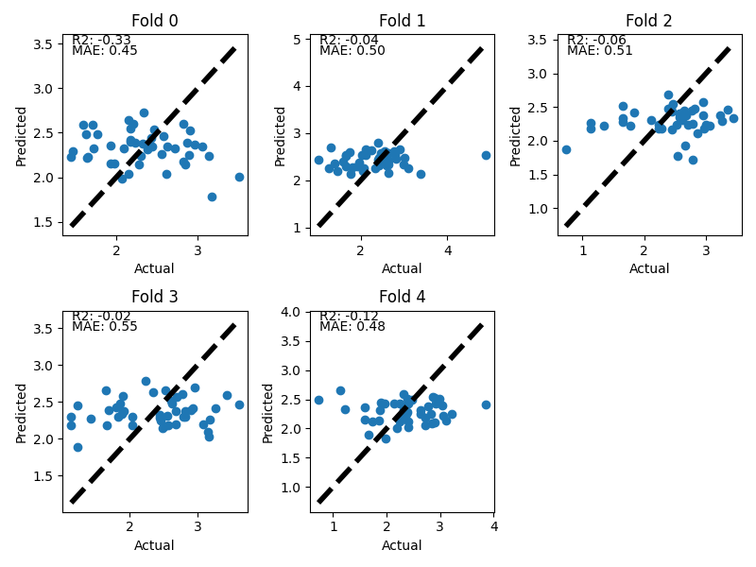
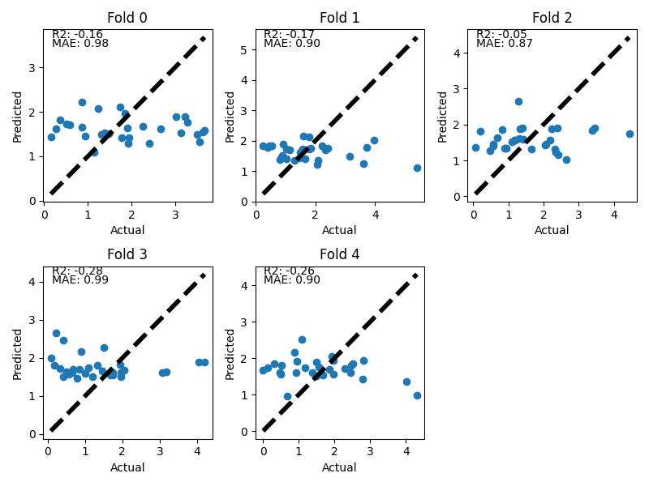
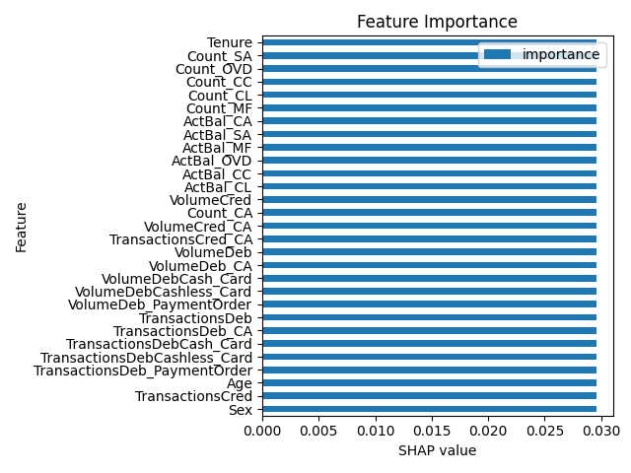


Model CV performance - Revenue
Revenue_MF (woven-lake-218)
Revenue_CC (smooth-monkey-219)
Revenue_CL (trim-elevator-220)
Observations: All features have the equal importance, likely indicate they are not predictive to the outcome

Slide 7
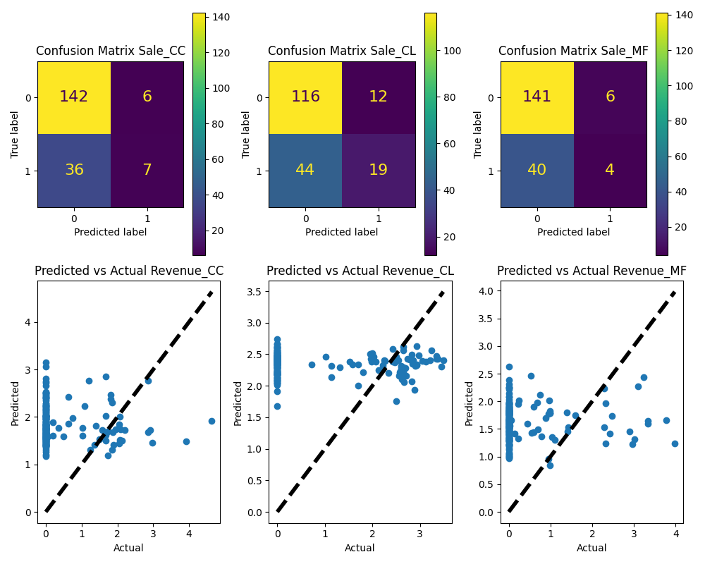
Test dataset performance
 | CV-AUC | Test-AUC
Sale_MF (fine-moon-209) | 0.55064 | 0.52505
Sale_CC (Peach-snowball-210) | 0.58987 | 0.56113
Sale_CL (worthy-vortex-217) | 0.56858 | 0.60392
 | CV-R2 | Test-R2 | CV-MAE | Test-MAE
Revenue_MF (woven-lake-218) | -0.18529 | -2.52043 | 0.92847 | 1.48146
Revenue_CC (smooth-monkey-219) | -0.19183 | -3.31907 | 0.76199 | 1.60443
Revenue_CL (trim-elevator-220) | -0.11259 | -1.66395 | 0.49618 | 1.75445
Observations: Test performance is within expected range as the CV performance, indicating minimal leaking

Slide 8
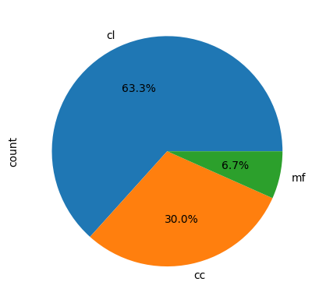
Production test dataset
Holdout/test dataset performance
Count of groundtruth best product to offer vs predicted:
- Expected total revenue for the selected 150 clients with Single Offer Per Client that has highest expected product revenue: 923452.67
 | Product-to-offer-predicted
Product_to_offer_groundtruth | cc | cl | mf | no-purchase
cc | 6 | 4 | 1 | 18
cl | 3 | 15 | 3 | 32
mf | 1 | 5 | 3 | 22
no-purchase | 3 | 6 | 0 | 69
Normalized, with total test accuracy of 0.49:
 | Product-to-offer-predicted
product_to_offer_groundtruth | cc | cl | mf | no-purchase
cc | 0.031413613 | 0.020942408 | 0.005235602 | 0.094240838
cl | 0.015706806 | 0.078534031 | 0.015706806 | 0.167539267
mf | 0.005235602 | 0.02617801 | 0.015706806 | 0.115183246
no-purchase | 0.015706806 | 0.031413613 | 0 | 0.361256545
95
10
Normalized randomized base model, with total base accuracy of 0.27:
 | random_product_to_offer_stratified
product_to_offer_groundtruth | cc | cl | mf | no-purchase
cc | 0.02617801 | 0.052356021 | 0.015706806 | 0.057591623
cl | 0.047120419 | 0.062827225 | 0.041884817 | 0.12565445
mf | 0.036649215 | 0.041884817 | 0.015706806 | 0.068062827
no-purchase | 0.057591623 | 0.104712042 | 0.078534031 | 0.167539267
45
Total groundtruth revenue: 1324.70 VS Total predicted revenue: 28,053.24

Slide 9
Conclusion, observations & To-do’s:
Based on the hold-out test dataset, the current optimization framework can accurately offer 49% correct product to Single Offer Per Client that has highest expected product revenue VS 27% of the baseline random stratified offering.
The revenue prediction models for each product+client are not accurate, hence the expected total revenue are over-estimated.
Feature engineering for model optimization with feature selection, if no new feature available from clients.
Model optimization using other boosting, ensemble, and/or bagging approach to get higher models’ performances.
To sample the training dataset with SMOTE approach before classification modelling for the Sale_CC, Sale_CL, and Sale_MF before model training.
Current Expected Revenue is calculated with the formula of “probability of a client will purchase a product” X “predicted the product revenue from the client” X “predicted outcome if the client buy the product (1 if probability to purchase > 50% else 0)”. The other method to consider to get the top 150 clients with best revenue product recommendation is to calculate the Expected Value by excluding the product of “predicted outcome if the client buy the product (1 if probability to purchase > 50% else 0)”, then obtained the top150 list purely based on the Expected Revenue regardless the predicted outcome 1 or 0.

Slide 10
Appendix
MLOps workflow. https://github.com/hkailee/financial-product-marketing-optimization/tree/main/app/mlops
Notebook for slides preparation. https://github.com/hkailee/financial-product-marketing-optimization/blob/main/notebooks/01-slides-preparation.ipynb

