Slide 1
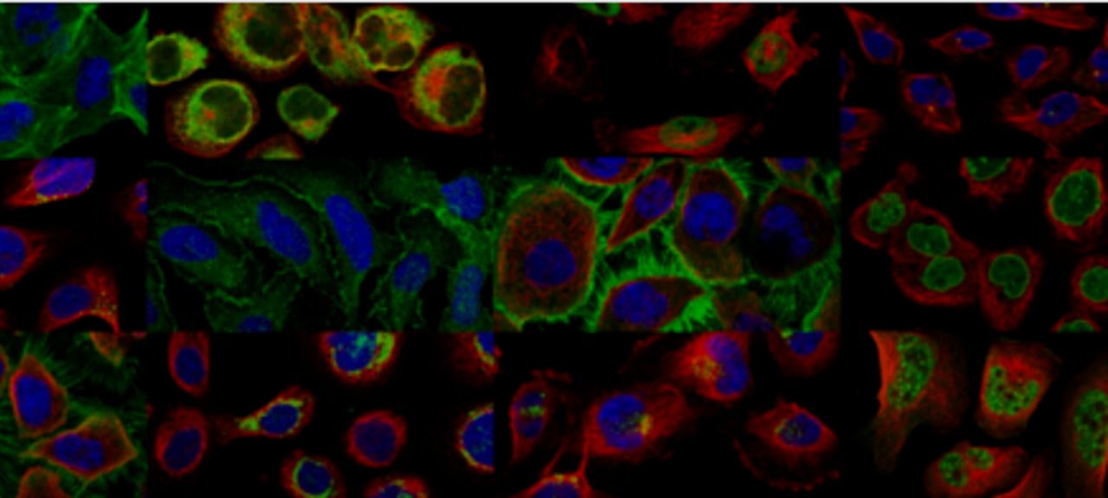
Hack on Google Cloud Vision API and HERE Traffic API
Gong Chen, Kaiwen Huang, Qingyang Li

Slide 2
Hack around Google Cloud API & HERE Map API
Google Cloud API: test the accuracy of Google Cloud Vision OCR
HERE Map API: pull real-time data traffic to build our own map service

Slide 3
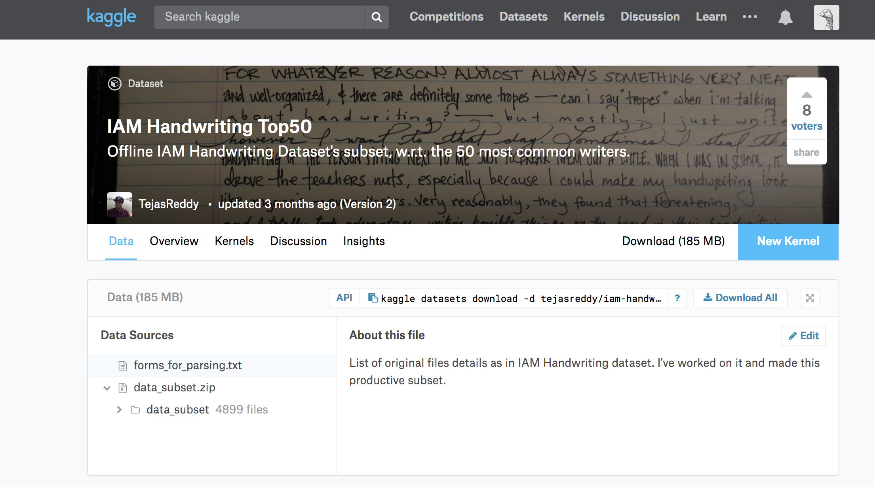
Google Cloud related to Dataset
From kaggle
Images of Handwriting message from 50 writers.
We used google vision api to configure these messages from images
Nearly 6000 messages

Slide 4
Process: Vision API
Manually configure the messages from images for 150 messages as ground truth
Writing code in python to call google cloud vision api
To read all the dataset we use and print all the text configured by google cloud
Compare the result read by google AI to ground truth
Calculate the accuracy

Slide 5
Result: Vision API
The accuracy is about 70%
More details on the result

Slide 6
HERE Map
Use hack methods to pull real-time traffic data from HERE
We can build up our own map using HERE data (real HACK!!!)
Generated data: iowacity.osm

Slide 7
