Slide 1

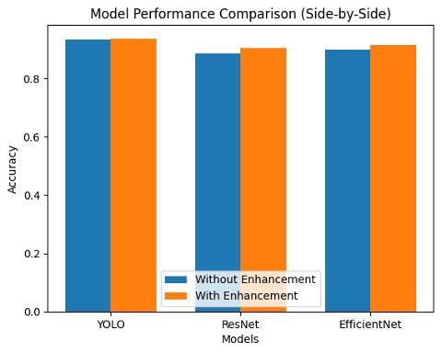
FRACTURE DETECTION FROM X-RAY IMAGESUSING DEEP LEARNING ALGORITHMS
24BCE1445, 24BCE1450
School of Computer Science and Engineering
INTRODUCTION
Bone fractures are a common medical condition that require accurate and timely diagnosis. Manual detection from X-ray images is time-consuming and prone to human error.
With advancements in Deep Learning and Computer Vision, automated fracture detection systems can assist radiologists by improving accuracy and efficiency.
The following factors motivate this project:
• Fractures are often small and difficult to detect • Misdiagnosis can lead to severe complications • Large-scale datasets enable training of robust models
This project presents a comparison of modern object detection algorithms for fracture detection in X-ray images.
Objectives
• Develop an automated system for fracture detection • Train multiple deep learning models for comparison • Evaluate performance using accuracy and mAP metrics • Identify the best-performing model for medical diagnosis
SCOPE of the project
This system can assist healthcare professionals by providing:
• Faster diagnosis • Improved accuracy • Reduced workload
It can be extended for detecting other medical abnormalities such as tumors and infections.
Methodology
Preprocessing
• Image resizing and normalization • Data augmentation (flipping, rotation) • Dataset splitting (train / validation)
(continue…)
Feature Extraction
Deep learning models automatically extract features such as:
• Bone edges • Fracture lines • Texture variations
Backbone networks like Convolutional Neural Networks are used.
Models Used
1. YOLOv8 (You Only Look Once)
• Single-stage detector • Fast and efficient • Performs detection in one pass
2. EfficientNet
• Deep learning model for feature extraction • Uses compound scaling (depth, width, resolution) • Efficient and high accuracy • Extracts important patterns like fracture lines and bone edges
3. RetinaNet
• Uses focal loss to handle class imbalance • Effective for detecting small fractures
Architecture
Dataset
• X-ray fracture dataset • Images labeled with bounding boxes • Training and validation split
Training Details
• Optimizer: Adam / SGD • Loss functions: Classification + Bounding box regression • Evaluation metric: mAP@50
Results and discussion
Loss vs Epoch
Model Performance
Comparision
Conclusion
This study compares multiple deep learning algorithms for fracture detection.
• YOLOv8 is best for real-time applications • Faster R-CNN provides high precision • RetinaNet handles class imbalance effectively
Overall, deep learning models significantly improve fracture detection performance and can support medical professionals in diagnosis.
References
Joseph Redmon et al., “You Only Look Once: Unified, Real-Time Object Detection”, Proceedings of the IEEE Conference on Computer Vision and Pattern Recognition (CVPR), 2016.
Tsung-Yi Lin et al., “Focal Loss for Dense Object Detection”, Proceedings of the IEEE International Conference on Computer Vision (ICCV), 2017.
Dataset
Preprocessing
Model Training
caption here.
Detection Output
Feature Extraction
GIT HUB: https://github.com/hkakati/Fracture-Detection-from-x-ray-Images-Using-Machine-Learning

