Slide 1
Climate Change: trend and factors (USA)
Team: Jeanette, Harneet, Mohamed & Halak

Slide 2
Topics
Project inspiration
Data & Scope
Solution definition
Demo of the web-site
Post-Mortem

Slide 3
Climate Change our inspiration
Global socio-economic issue
Current observations in climate change
Increase in Hurricane and Cyclone activities
Ice melting due to increase in temperatures in northern part of earth
Increase in Industrialization
Unhealthy Air Notifications

Slide 4
Data needs & challenges
Data Needs:
Foundational temperature data for us states for 10 to 20 years
Research key factors impacting global warming. Find respective data sources
Challenges:
Authoritative sources with multiple decades of key factors data
Means to procure data- downloadable (api or files)
Time periods alignment across data sources
Common denominators across data sources

Slide 5
Final data sources
Global Temperature: https://www.kaggle.com/berkeleyearth/climate-change-earth-surface-temperature-data
US Population Data: https://www.kaggle.com/lodgeh/us-population-growth/data
US Co2 Data: https://www.eia.gov/opendata/qb.php?category=2251669
Finalization of the data sources defined project scope to 3 key factors impacting global warming.

Slide 6
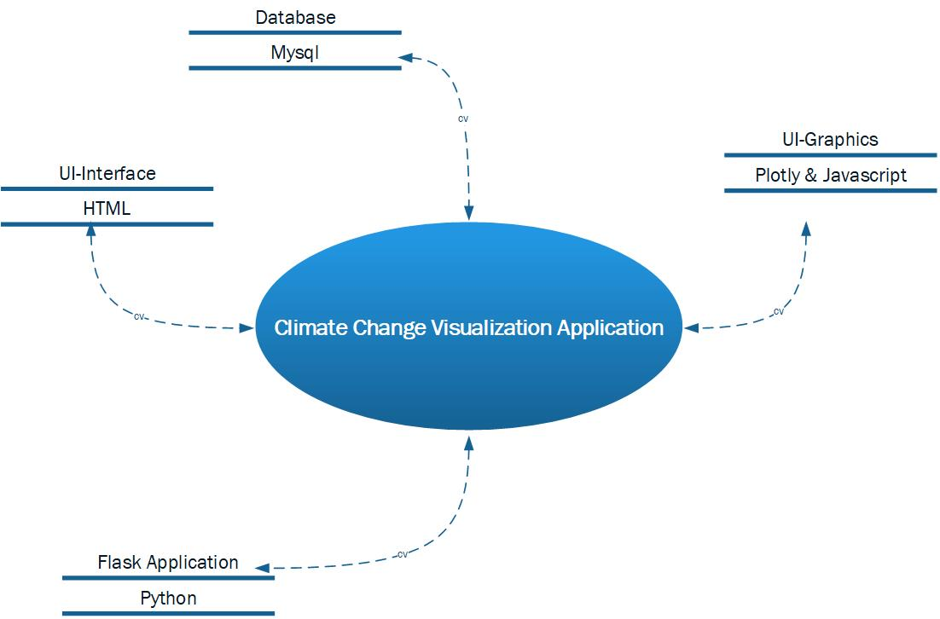
High-level Architecture

Slide 7
The Solution
Interactive dashboard with 4 views that update on user based on selection
Video.js as a new Library
Used multiple Data sources to generate data sets
API’s to get CO2 data
Census data
Temperature data (Analyze and summarized data)
US State Data to get Longitudes and Latitudes

Slide 8
Web-Site Walkthrough

Slide 9
Post-Mortem
Limited availability of data on factors impacting global warming. Such as industrialization, water pollution etc.
Limited time to:
explore technical possibilities. Such as create custom geojson to visualize changing temperatures in state for selected years
Explore different types of visualizations for final hypothesis

Slide 10
Thank YoU

