Slide 1
High-Performance PL/SQL interpreter for Graal using Truffle
Hugo Kapp
Master Thesis
Spring 2017

Slide 2
Summary
Background
  PL/SQL
  Graal
  Truffle
PL/SQL interpreter using Truffle
  DIANA parsing
  Statically-typed nodes
  Multiple representations for strings
Performance evaluation
Conclusion

Slide 3
Background

Slide 4
PL/SQL
Procedural Language / Structured Query Language
A procedural extension to SQL
Runs in the database
Based on the Ada programming language
Used in Oracle databases
Native support for SQL queries and types
PL/SQL functions can be called inside an SQL query (this is called a UDF call)

Slide 5
PL/SQL example
PROCEDURE fill_squares(NUMBER n) IS
BEGIN
FOR i IN 1..n LOOP
INSERT INTO squares VALUES(i*i);
END LOOP;
END;
Stored procedures tend to issue multiples SQL queries in a procedural manner
FUNCTION gcd(a NUMBER, b NUMBER) IS
BEGIN
...
END;
SELECT * FROM pairs WHERE gcd(a,b) = 1;
PL/SQL functions can also be called from an SQL query (bottom)
This is called a UDF call

Slide 6
Graal
A new Java bytecode compiler
Aims at bringing more languages to the JVM
Uses speculative optimizations and deoptimization
Can be used as a dynamic compiler for the JVM
(JIT compiler)
Developped at Oracle Labs

Slide 7
Truffle
A language implementation framework
Used in combination with Graal to bring more languages to the JVM
Provides a Java API to write AST interpreters
Provides support for writing self-specializing node
Specifically optimized for and understood by Graal
High speed execution of the implemented languages

Slide 8
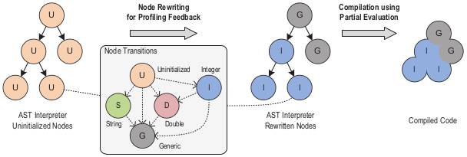
Truffle specialization
Specialization helps define more than one implementation
Correct implementation is chosen at runtime
In this case, choice made using input types
Then, assert only the same type is seen, and optimize the code using this
Once specialized, tree is completely inlined in a special “partial evaluation” phase
Removes boxing, virtual calls, and makes optimizations easier
Input program is compiled down to machine code by Graal
* Image from [1]

Slide 9
A PL/SQL interpreter using Truffle

Slide 10
Parsing the DIANA
DIANA is one the of the IR used in the PL/SQL compiler
It represents an annotated AST of the input program
We intercept this tree and compile it to a Truffle AST
Basically, every DIANA node is turned into a Truffle node
This is done on top of the current execution options for PL/SQL : interpreted or natively compiled

Slide 11
Using static information
Truffle usually used for dynamically-typed languages
Specialization is very useful in this case because the type of the operands is not known at compile time
PL/SQL is statically-typed, so we already know which operand to use
Instead, use specialization to handle various runtime representation for the same type
We call this data representation specialization

Slide 12
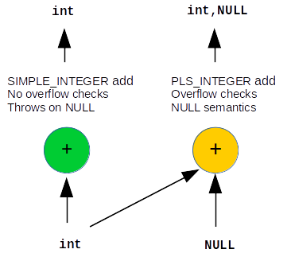
Statically typed nodes for different integer types
With data representation specialization and statically-typed nodes, can use java ints for both, and special value for NULL
Removes stress on escape analysis and boxing elimination

Slide 13
Using multiple representation for strings
Strings can also benefit from the same optimization
At runtime, specialize on the data representation used
Allows us to provide efficient string operators
Specifically target concatenation

Slide 14
Heap value
The simplest value possible
Classic buffer-based string value
Uses sub-index on the buffer to provide cheap substring operation
int length
int index
byte[] buffer
Java heap

Slide 15
Native value
Very similar to heap value :
- one buffer
- sub-indexes on this buffer
However, buffer is not byte[] in the heap, but external C char* buffer
Removes the need for copy of input values into the heap
int length
int index
C pointer
C managed memory

Slide 16
List values
Upon concatenation, no copy is made (for speed)
Instead, use pointers to sub-values concatenated
This creates a linked list of values
The sub-values must be based on a buffer, i.e. heap or native value (useful to keep reading operations simple on the list)

Slide 17
Concatenation examples
Node
Node
+
F
O
O
B
A
R
F
O
O
B
A
R
+
Node
Node
Node
Node
Node
B
A
Z
F
O
O
B
A
R
B
A
Z
F
O
O
B
A
R
Node
Node
Node
+
Node
Node
F
O
O
B
A
R
B
A
Z
Node
Node
Node
Node
Node
F
O
O
B
A
R
B
A
Z

Slide 18
Immutability constraint
In PL/SQL, string values are immutable
Problem : with linked lists, modifying pointers changes the original values !
x
Node
Node
x := ‘FOO’ || ‘BAR’;
y := ‘BAZ’ || ‘baz’;
z := x || y;
F
O
O
B
A
R
y
Node
Node
B
A
Z
b
a
z
x
Node
Node
Node
Node
z
F
O
O
B
A
R
B
A
Z
b
a
z
The value of x has been changed !

Slide 19
Immutability extension
Solution : give the (fixed) number of nodes the list contains
Appending does not modify the original value anymore
(though it still modifies the pointer)
Intuition : the original value does not “see” past its number of nodes
x
y
z
Node
Node
Node
Node
F
O
O
B
A
R
B
A
Z
b
a
z

Slide 20
Performance of the system

Slide 21
Comparison on PLS_INTEGER
Significant speedup
- up to 6x (on computation intensive)
- average 2.75x
Due to :
- specialization :
without NULL, use only primitive int
- self-specializing conversion
(code from dbjs [2])
Upon NULL, multi-specialization degrades performance
(average 11% slowdown, max 50%)

Slide 22
Comparison on string
Less uniform than integer speedup
At worst on par with existing implementation
Up to 8.5x speedup on specific benchmarks
Average 2x speedup

Slide 23
Conclusion
We found a way to use type specialization in a statically-typed context
We showed this can lead to significant improvements in execution speed
We also used this to change the runtime representation for strings, and provide highly efficient string operations
It was rather easy to write the AST interpreter using Truffle
(~4100 lines of high-level Java code)
This demonstrates
the effect code specialization can have on performance for more than just dynamically typed languages
how to use type specialization to change data representation at runtime
and how easy it can be to write such optimizations using modern tools

Slide 24
Thank you !
Questions ?

Slide 25
References
[1] T. Würtinger, C. Wimmer, A. Wöß, L. Stadler, G. Duboscq, C. Humer,
G. Richards, D. Simon, M. Wolczko. One VM to rule them all.
[2] The Walnut project, Oracle Labs.
https://labs.oracle.com/pls/apex/fp=labs:49:::::P49_PROJECT_ID:15
[3] Graal, GraalVM.
http://www.oracle.com/technetwork/oracle-labs/program-languages/overview/index.html

