Slide 1

IE6200 - Sec 7 - Project - Group10
Analysis of
Rainfall in India
Presentation By:
Hansika Karkera
Kush Adhvaryu
Abhishek Shetty

Slide 2
Objectives
Rainfall is one of the primary inputs for various engineering designs. Statistical analysis of the rainfall data is important to facilitate decision making in cropping pattern, urban and rural engineering, climatic changes.
Using the data recorded for Rainfall in India from 1901 to 2017 we plot various visualizations to draw suitable conclusions about the rainfall pattern.
With the help of these visualizations, we go on to test a few hypothesis and also, predict the annual rainfall using linear regression.

Slide 3
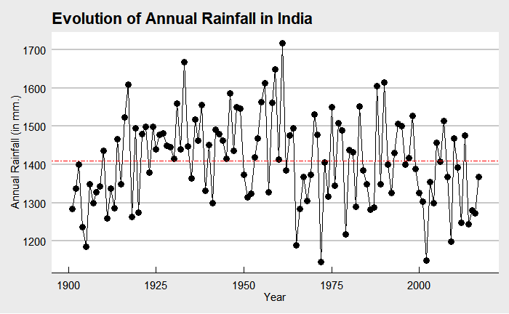
Data Visualization
This plot summarizes the annual rainfall in India from the year 1901 – 2017.
The highest average rainfall in India was recorded in the year 1961 and the lowest average rainfall was recorded in the year 1972.
The red line is the average of the annual rainfall in India throughout 1901 - 2017.
We can observe that after 1960s there has been a slight dip in the amount of rainfall in India.

Slide 4
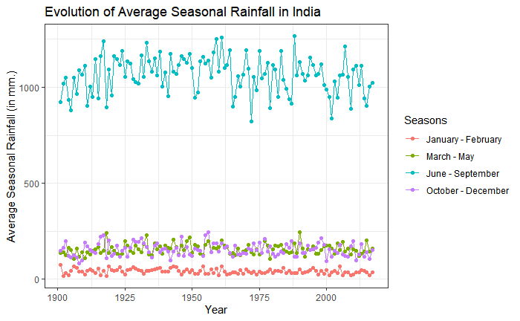
The graph shows the average seasonal rainfall received through 1901-2017.
We can observe that highest rainfall is received between June - September which is the monsoon season in India, where the mean annual rainfall ranges from 800mm - 1500mm.
March - May is the season before the monsoon and October - December marks the return of monsoon, thus we can see scanty rainfall during these periods.
January - February is the late winters, when mostly there is no rainfall but due to the climatic changes we can see showers below 50mm from time to time.

Slide 5
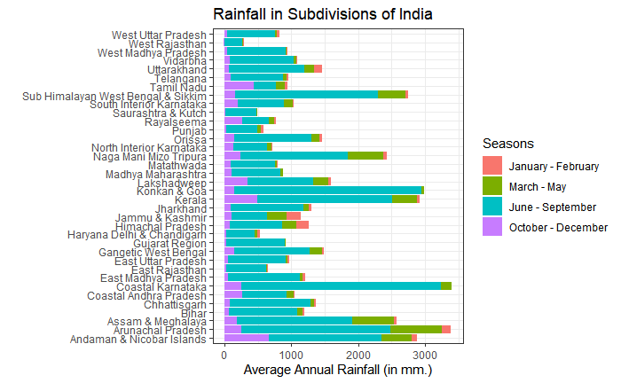
Histogram shown represents the average annual rainfall received by the various subdivisions of India throughout the seasons.
The subdivisions namely, Coastal Karnataka, Arunachal Pradesh, Konkan & Goa and Kerala receive highest rainfall throughout all the years.
The sub-divisions like Rajasthan, Gujarat, Haryana Delhi & Chandigarh and Punjab receive low rainfall throughout all the seasons.

Slide 6
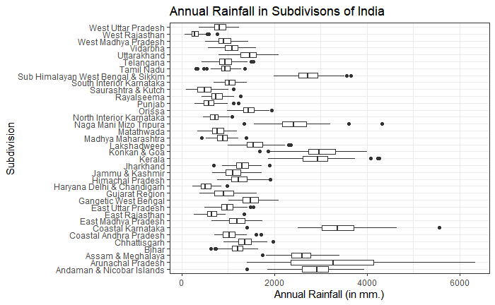
The box plot shown portrays the difference between the maximum & minimum rainfall for all the Indian subdivisions. We can observe that Arunachal Pradesh has a wider range of annual rainfall, while West Rajasthan has the lowest range. Also, the mean annual rainfall for West Rajasthan is the lowest and the highest for Coastal Karnataka.

Slide 7
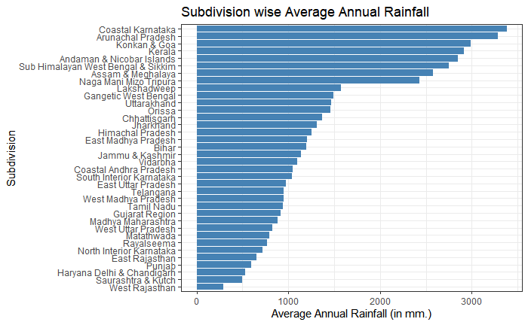
The bar plot here arranges all the subdivisions in descending order, depending upon the mean annual rainfall received throughout all these years.
We can see that Coastal Karnataka is the wettest region while West Rajasthan is the driest region.

Slide 8
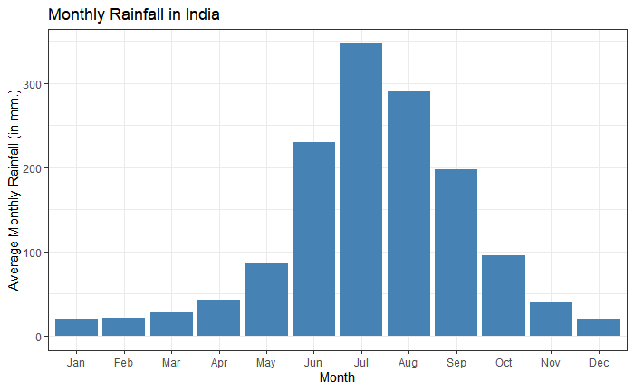
The above histogram shows the amount of average rainfall received every month in the past few years.
We observe that a maximum of 347 mm of average rainfall was received in the month of July, hence making it the peak of the monsoon season in India.

Slide 9
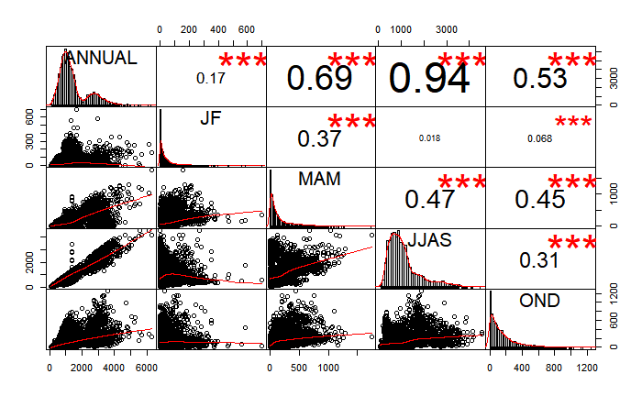
The plot here shows the correlation between the four seasonal divisions and annual rainfall received.
The distribution of each variable is shown on the diagonal and below it are the bivariate scatter plots with a fitted line.
The numbers above the diagonal are the values of the correlation plus the significance level as stars.
We can see that the period of June - September has the highest correlation coefficient of 0.94, followed by March - May, October - December and finally January - February.

Slide 10
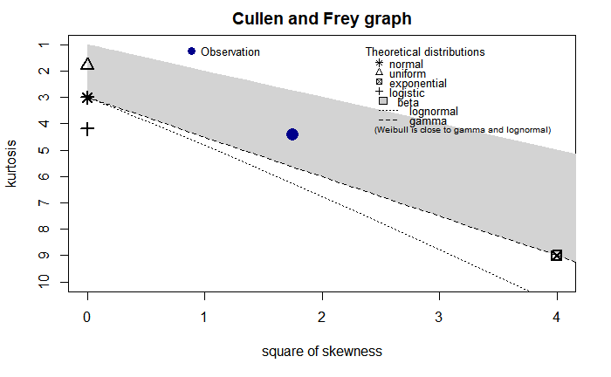
Statistical Analysis
Before beginning with any statistical analysis, we check if the annual rainfall data is normal using the descdist function in R Studio.
The Cullen and Frey graph here clearly shows that the observation point for annual rainfall is not near the normal distribution.
Since there is only one possible value of skewness and kurtosis for normal distribution, the annual rainfall data is not normal.

Slide 11
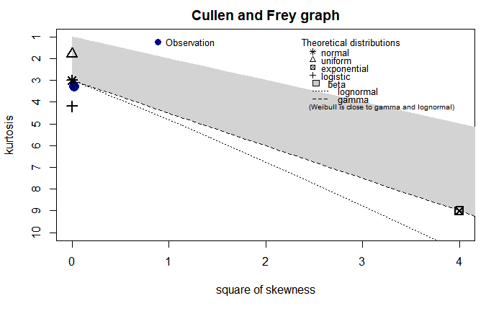
To make the annual rainfall data normal we perform log transformation on the entire annual rainfall data.
Post which we observe using the Cullen and Frey graph that the transformed data is very close to the normal distribution.

Slide 12
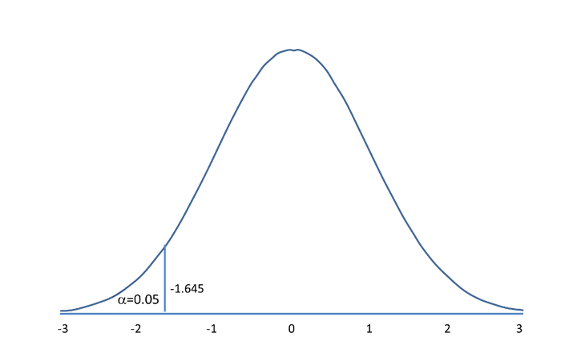

Hypothesis Testing - Hypothesis 1
From the visualizations, we can see that Arunachal Pradesh is one of the states which receives the highest rainfall.
We want to test if the mean annual rainfall of Arunachal Pradesh (x) is greater than the mean annual rainfall for all the subdivisions. (µo)
Hypothesis :
Ho : x ≥ µo
H1 : x < µo
Using the given formula, we calculate the Zcalc value in R, i.e. 15.4.
This being a left-tailed test Z-score does not lie in the rejection region. Hence, we fail to reject the null hypothesis.
Concluding that the mean annual rainfall for Arunachal Pradesh is greater than the mean annual rainfall for all the sub-divisions.

Slide 13

Hypothesis Testing- Hypothesis 2
From the visualizations, we can see Haryana Delhi & Chandigarh is the one of the subdivisions which receives low rainfall.
We want to test if the mean annual rainfall of Haryana Delhi & Chandigarh (x) is greater than the mean annual rainfall for all the subdivisions. (µo)
Hypothesis :
Ho : x ≥ µo & H1 : x < µo
Using the given formula, we calculate the Zcalc value in R, i.e. -14.37.
This being a left-tailed test Z-score lies in the rejection region. Hence, we reject the null hypothesis.
Concluding that the mean annual rainfall for Haryana Delhi & Chandigarh is less than the mean annual rainfall for all the sub-divisions.

Slide 14

Hypothesis Testing- Hypothesis 3
To test if the mean annual rainfall of Telangana is greater or the mean annual rainfall of West Madhya Pradesh is greater.
Hypothesis :
Ho : µ1-µ2 > 0
H1 : µ1-µ2 < 0
Using the given formula, we calculate the Zcalc value in R, i.e. -0.03.
This being a left-tailed test with a critical value of -1.645 , the Z-score does not lie in the rejection region. Hence, we fail to reject the null hypothesis.
Concluding that the mean annual rainfall of Telangana is greater than the mean annual rainfall of West Madhya Pradesh.

Slide 15
Linear Regression
Linear regression is one of the simplest and most common supervised algorithms that data scientists use for predictive modeling.
The equation has the form Y= a + bX, where Y is the dependent variable, X is the independent variable, b is the slope of the line and a is the y-intercept.
If a scatter plot of the data appears to form a straight line, you can use simple linear regression to find a predictive function.
In R studio we will be using lm, abline and predict functions to perform linear regression.
lm() is used to fit linear models and abline() is used to plot the regression line over the current plot. The predict function predicts the result using the linear model formed in lm.

Slide 16
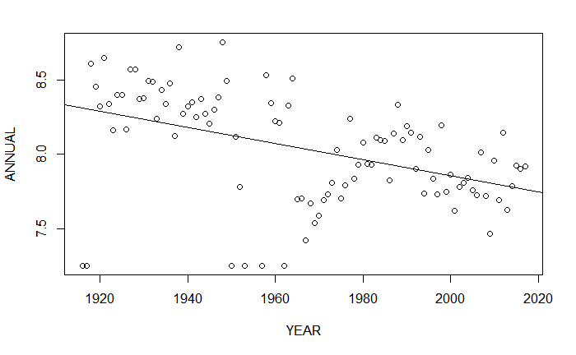
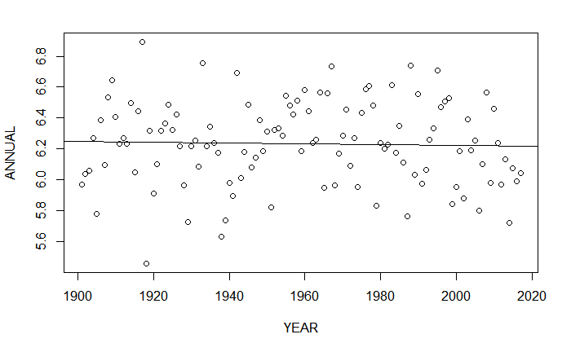
Here we predict the amount of annual rainfall that Arunachal Pradesh will receive in the year 2020.
Using the predict function we can state that Arunachal Pradesh will receive 2307.635mm of rainfall in the year 2020.
Here we predict the amount of annual rainfall that Haryana Delhi& Chandigarh will receive in the year 2020.
Using the predict function we can state that Haryana, Delhi & Chandigarh will receive 501.893 mm. of rainfall in the year 2020.

Slide 17

THANK YOU !
Please rate our presentation using the below QR code.

