Slide 1
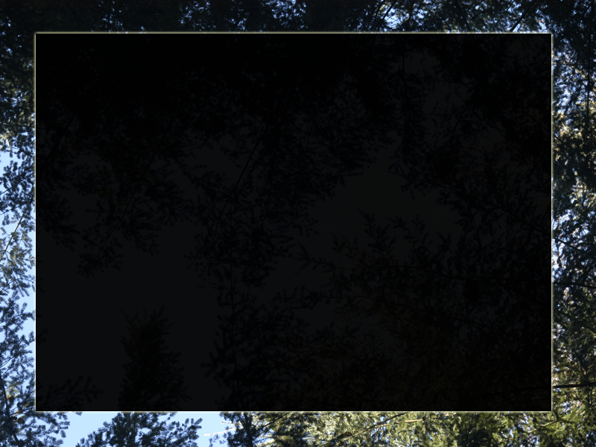
Intro. to Random Forests
M. Zimmer
zim @ neomath.net

Slide 2
Kaggle: “Benchmark Bond Trade Price Competition”
Predict 'trade_price' from previous prices
and other data
+700K observations, 61 columns
Closed 4-30-2012

Slide 3
Decision Trees
For classification or regression
Node splits on any of the attributes
Prune tree to avoid over-fitting
Given one data set, get one predictor

Slide 4
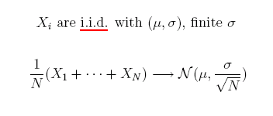
Central Limit Theorem

Slide 5
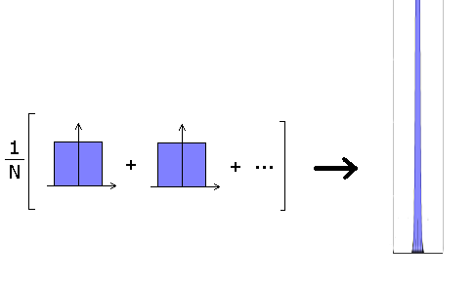
“Central Limit Theorem”

Slide 6
Bootstrapping
Create replicate data sets from one data set
Sample N times, with replacement, from a data set of N observations → one replicate
Sort of like drawing samples from the
same underlying distribution

Slide 7
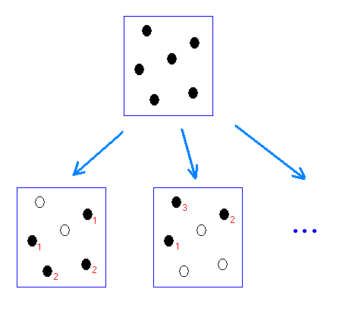
“Bootstrapping”

Slide 8
BAGGING = Bootstrap Aggregating
Use bootstrapping to generate a lot of replicate data sets
Grow a decision tree for each replicate
Aggregate tree predictions to get a
forest prediction
Breiman, 1996

Slide 9
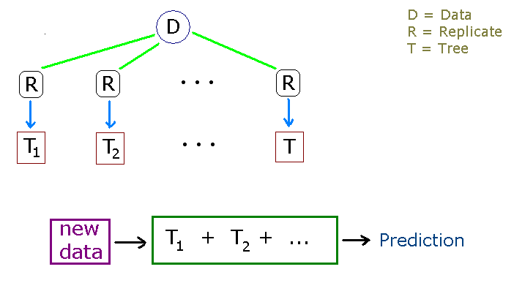

Slide 10
Ensemble/aggregate
Average
Weighted average
Vote
Weighted vote (*)
Others...

Slide 11
Why does Bagging work?
UNSTABLE:
--classification & regression trees
--ANNs
--subset selection (linear reg.)
STABLE:
--kNN

Slide 12
Random Forest = (bagging of trees)
+ (random variable selection)
Input: one data set
Bootstrap: many replicates
Train: a decision tree for each replicate
At each node, use one of 'mtry' randomly sampled variables
Predict: new data through aggregate
Breiman, 2001

Slide 13
Parameters for 'randomForest'
mtry - # vars. randomly sampled for each split
(sqrt(p) for classification, p/3 for regression)
ntree - # trees (500)
nodesize – min size leaf nodes (5reg./1clas.)
sampsize - # obs. for each replicate (N)
importance - variable importance (TRUE)
(see CRAN page for more...)

Slide 14
Other...
For each replicate, data not sampled
is "out of bag" (OOB)
Can estimate error rate from OOB data
Proximity measure
Build each tree to maximum depth

Slide 15
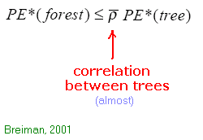
Prediction Error (regression)

Slide 16
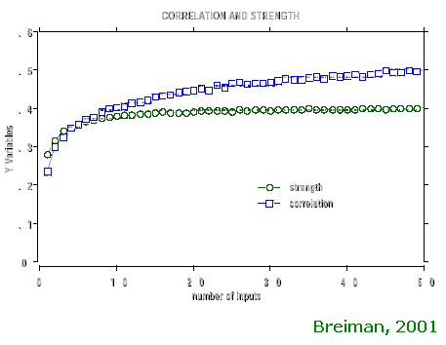
Strength & correlation vs. 'mtry'

Slide 17
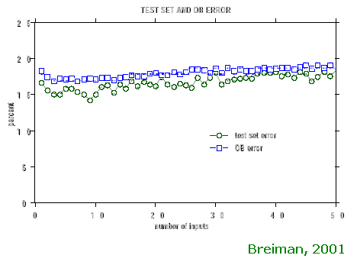
Error vs. 'mtry'

Slide 18
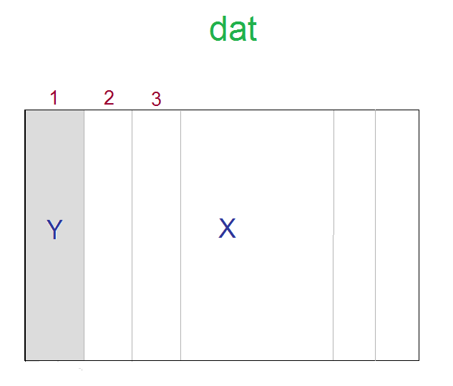

Slide 19
library(randomForest)
rf ← randomForest( x=dat[,-1], y=dat[,1],
ntree=100,
do.trace=10 )
--'proximity' option eats up memory

Slide 20
New example:
Classify human activity based on smartphone data (acceleration,gyroscope,...)
Activities = laying, sitting, standing, walk, walkdown, walkup
http://archive.ics.uci.edu/ml/datasets/Human+Activity+Recognition+Using+Smartphones

Slide 21
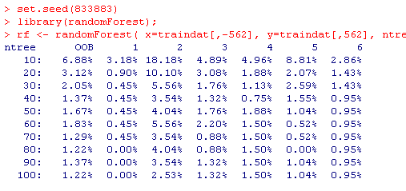
'randomForest' for classification

Slide 22
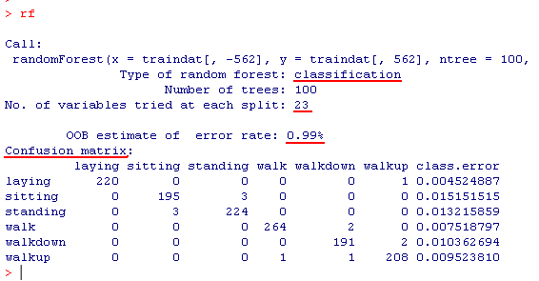
'randomForest' object

Slide 23
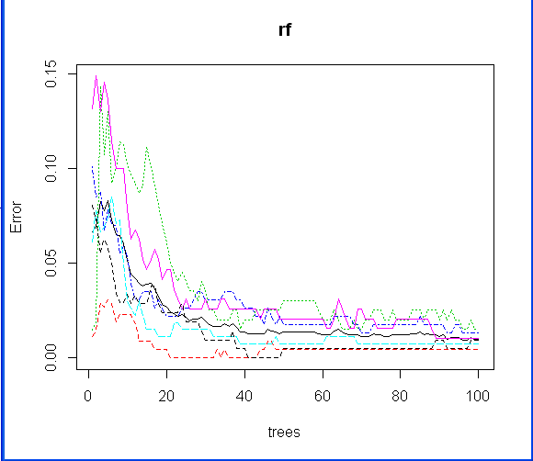
plot(rf)

Slide 24
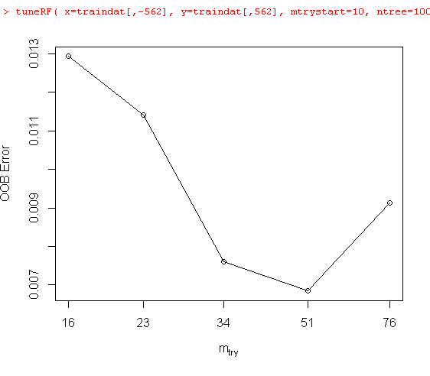
Optimize 'mtry'

Slide 25
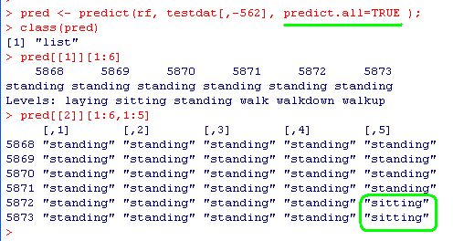
Confidence estimates
Look at predictions of all trees (& figure stats)

Slide 26
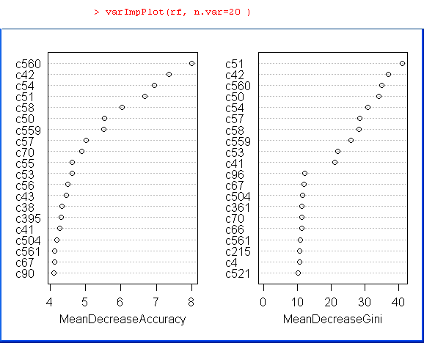
Variable importance

Slide 27
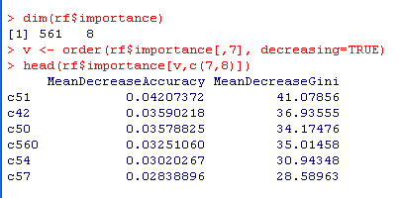
Variable importance

Slide 28
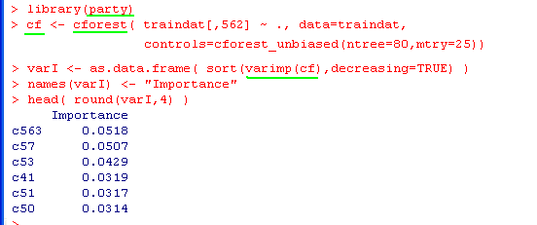
Conditional Inference

Slide 29
Package 'randomForestSRC'
RFs for survival, regression, classification
Calculates variable importance (VIMP) in four different ways
see H. Ishwaran et al. (2008)

Slide 30
Final Remarks
Works best on low-bias, high-variance predictors
Results comparable to Boosting, SVMs
RF/Bagging are “embarrassingly parallel”
Also combine different classifiers (BellKor)
(www.netflixprize.com/leaderboard)

Slide 31
Related approaches:
Ho ('95, '98) – subspace method
Dietterich ('98) – random split selection
Amit & Geman ('97) – visual features
Williams ('87, '88) – MIL algorithm

Slide 32
References
Breiman, L. (1996). "Bagging Predictors", Machine Learning 26: 123-140.
Breiman, L. (2001). "Random Forests", Machine Learning, 45: 5-32.
Hastie, T., Tibshirani, R., and Friedman, J. (2009). "The Elements of Statistical Learning, 2nd ed.", Springer.

Slide 33
References (cont'd)
Liaw, A. and Wiener, M. (2002). "Classification and Regression by randomForest", R News, v.2/3, p.18
Williams, G. (2011). "Data Mining with Rattle and R", Springer.

Slide 34
https://sites.google.com / site
/ ZimNotes
zim @ neomath.net

