Slide 1
Supply Chain Optimization using Pyspark
Harshit Kavathia, Shaunak Dhande, Siddharth Shankar

Slide 2
CONTENTS
INTRODUCTION
DATASET
ANALYZING THE DATA
DEMAND FORECASTING
HOW TO AVOID LATE DELIVERIES

Slide 3
INTRODUCTION
Global Supply Chain getting complex
Analyzing and Identifying problems in Supply chain
What are top selling categories in products
Which market regions are expected to have increased orders based on
historical data
Average shipping times taken by different modes
Percentage of Late deliveries
Identifying different delivery statuses for source-destination
How to identify and avoid late delivery for shipments?

Slide 4
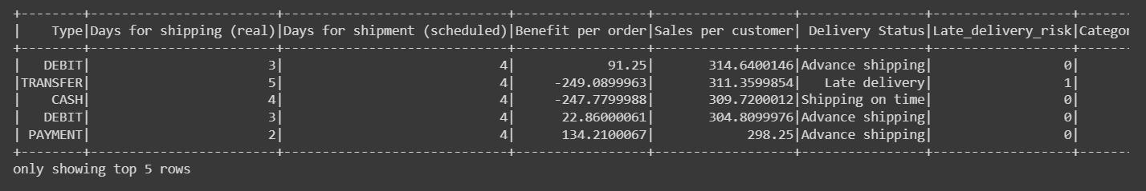
DATASET
The dataset used in our supply chain optimization project contains essential information on transactions and orders within the supply chain network. It comprises 180,520 rows and 53 columns, providing a comprehensive view of various aspects involved in the supply chain process.

Slide 5
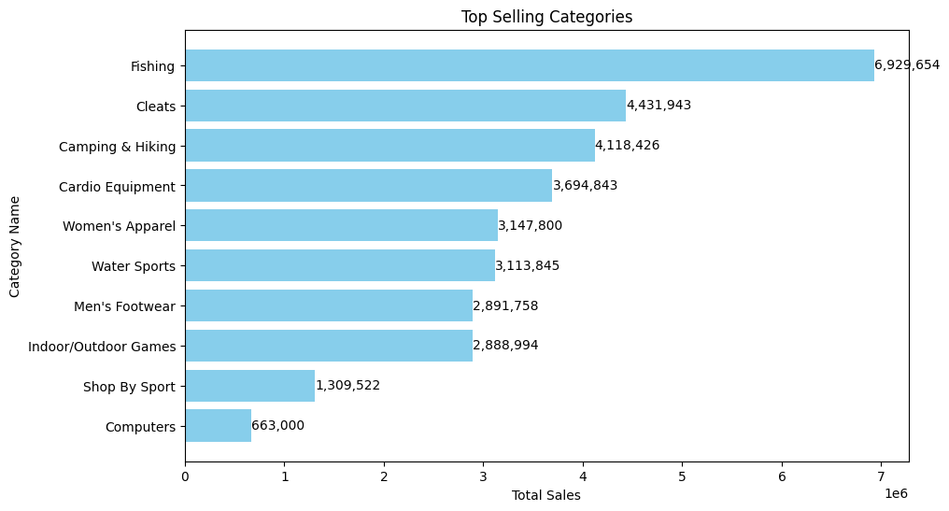
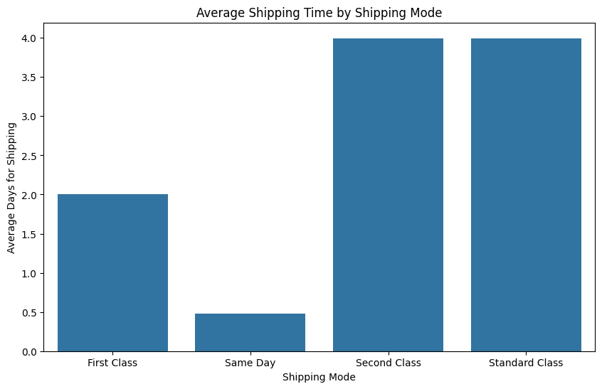
ANALYZING THE DATA
What are top selling categories in products?
Average shipping times taken by different modes?

Slide 6
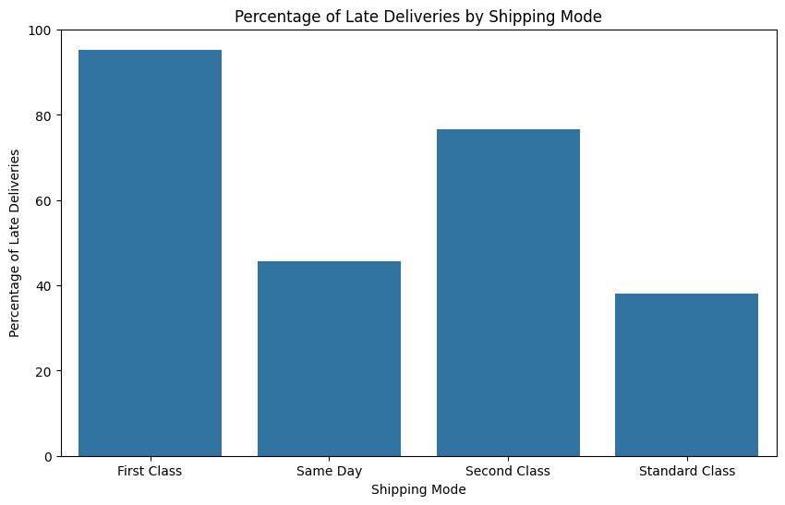
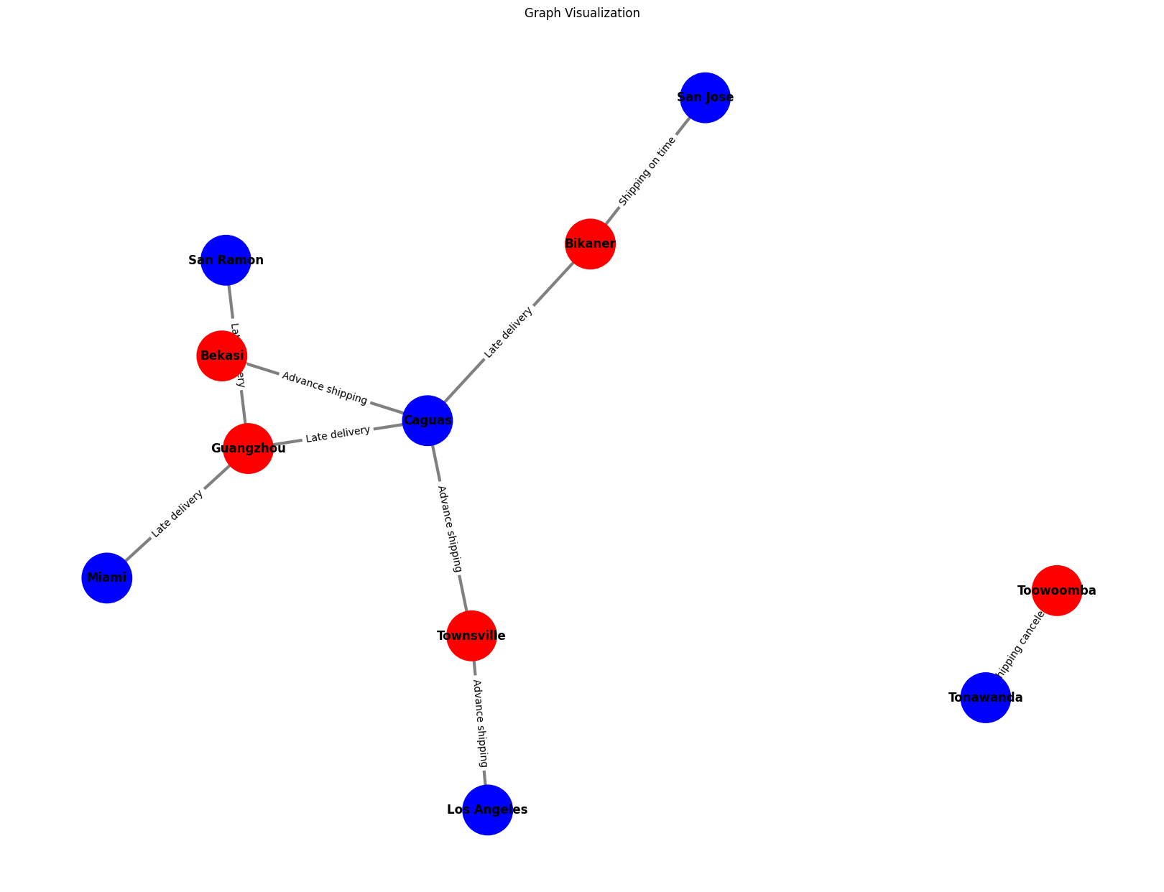
Percentage of Late deliveries for all modes?
Analyzing different delivery statuses for source-destination.

Slide 7
Demand Forecasting
Predict the demand for various Sports products based on historical order data
Identify the potential features contributing to a products demand/increased order rate:
Order Profit per order, Benefits per Order
Late delivery risk
Order Region
Allows production teams to plan their schedules more efficiently, ahead of time.
Businesses can use this information to expand into new markets, introduce new products, or discontinue low-demand items.

Slide 8
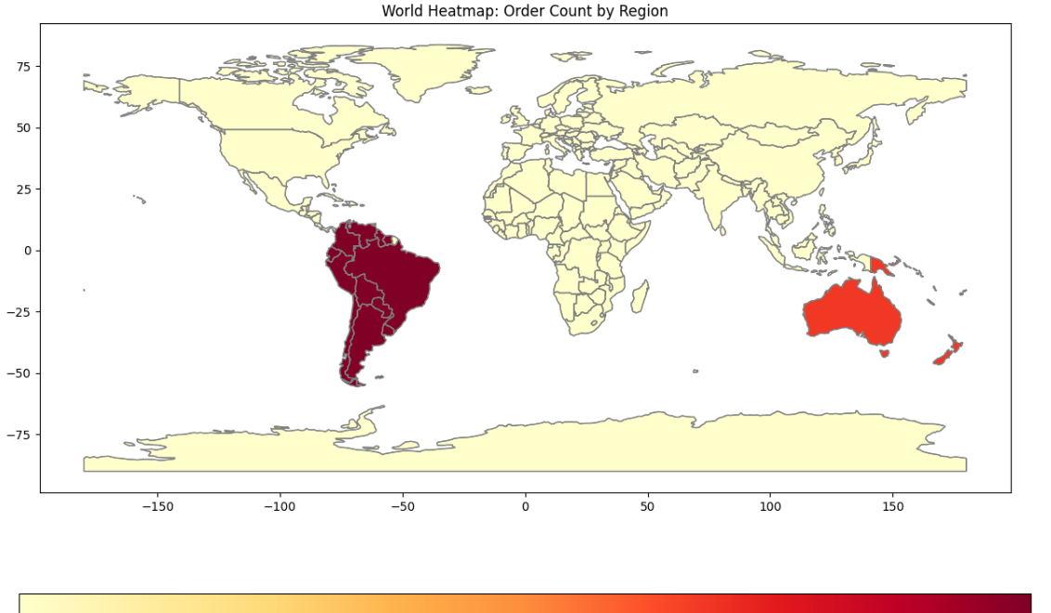
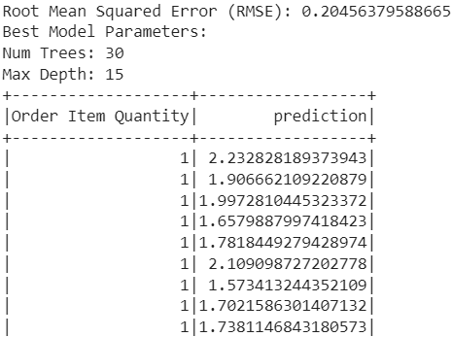
Ensemble Model results

Slide 9
How to avoid late deliveries?
Predicting the delivery status based on certain factors like source, destination, shipping mode and other order details.
Using classification models: Logistic Regression, Decision Tree and Random Forest Classifier.
We can suspect late deliveries in advance and change the strategy accordingly.

Slide 10
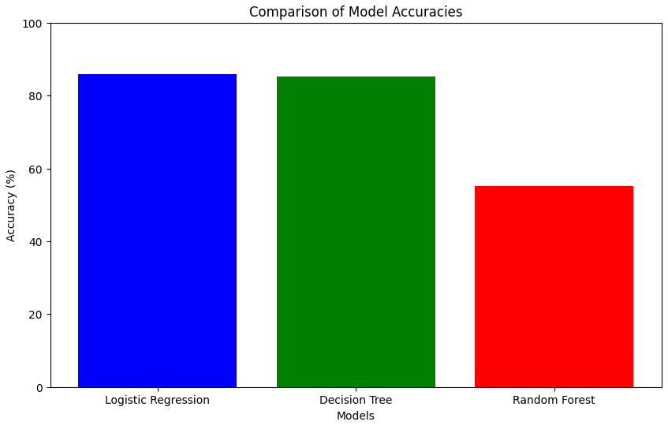
Classification Results

Slide 11
Future Scope
Reinforcement model can be used for decision-making.
Advanced Time-Series models (ARIMA) for forecasting accuracy
Incorporating external data sources such as economic indicators, weather data, social media trends, or competitor information could provide valuable insights.

