Slide 1
Amazon Reviews
Group 4 | Minhae Park, Minhao Zhang, Harleen Buttar, Ali Mardan, Zach Laurence
Big Data and Cloud Computing |
Final Project

Slide 2
01
02
03
04
05
Agenda
Business Problem
Dataset overview
Machine Learning Models
Conclusion
Appendix

Slide 3

Context:
Review quality increasingly influences customer purchase decisions on Amazon
Star ratings alone fail to capture nuanced customer experiences
Core Challenge:
Rating prediction and helpfulness modeling show that not all reviews are equal and that low‑star, high‑helpful reviews are especially valuable signals​
When text sounds positive but the rating is low, something important is being overlooked: unmet expectations, quality issues, or misaligned expectations
Business Objective:
Identify sentiment-rating mismatches to show hidden product/service problems
Create a model that finds signals for helpfulness
Protecting consumer LTV by building reliable recommendations
Business Problem
Notes:
Amazon is flooded with reviews; star ratings miss subtle but critical issues

Slide 4
2. Amazon Reviews Dataset (115 GB)
4 Chosen Categories: Electronics, Books, Clothes and Arts and Crafts
Data Fields
Reviews
timestamp, rating, helpful_vote
title, text, image
asin, parent_asin
user_id, verified_purchase
Metadata
main_category, categories
title, description, price
…
images, videos (URL)
parent_asin
Data Preparation
Scripted download and upload pipeline from Huggingface to GCS
Custom PySpark schema to load inconsistent json data
Add raw_category label
Drop unnecessary values (images, videos URLs)
Deduplication
Select recent 10-year data for analysis and 5-year data ML
Save in parquet (2 tables)
Benefit
Storage efficiency: 115GB -> 40GB
Speed efficiency: Load time 60+ min -> 5 min
Work efficiency: reduce redundant work

Slide 5
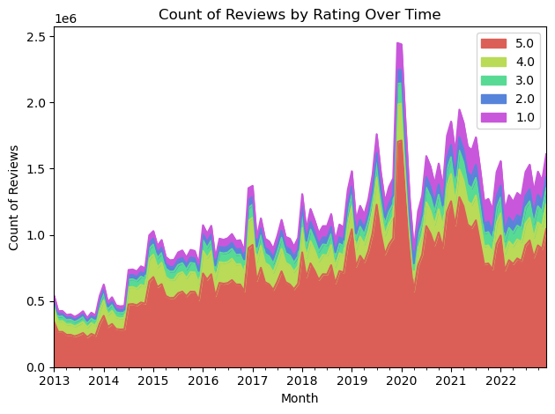
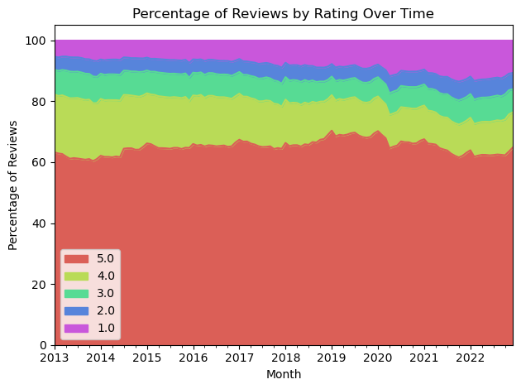
Historical Review Change
Total reviews grew over time as Amazon grew, steady stall in recent years due to emerging competition. The percentage of 1 star rating has increased in recent years.

Slide 6
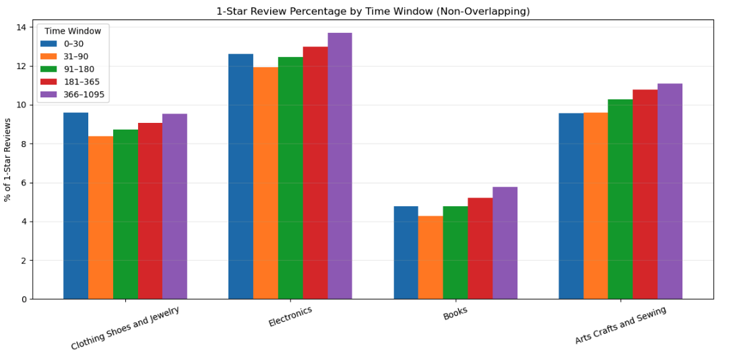
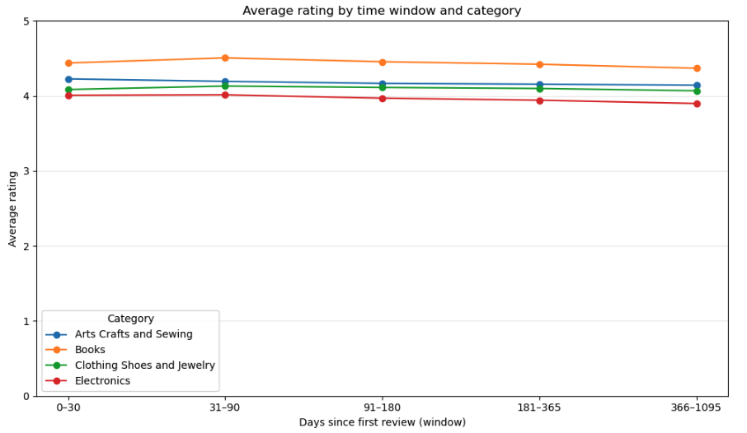
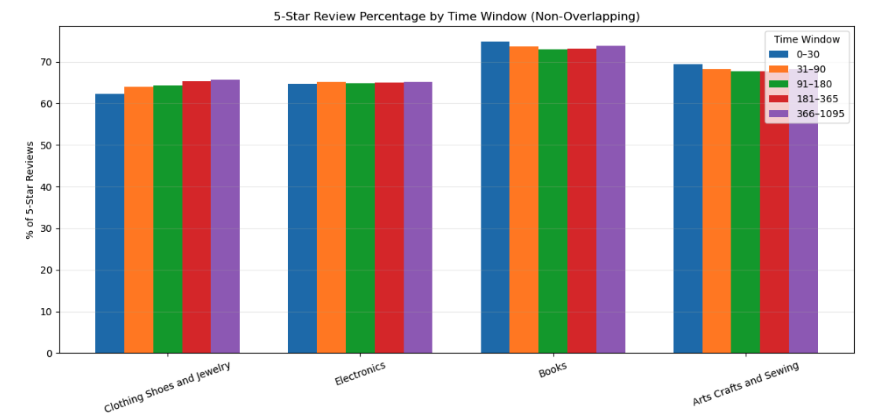
Ratings over time
Ratings do not change across time
On average, ratings across the four different categories do not change over time
Notes:
Time windows reviewed: 0~30, 31~90, 91~180, 181~365, 366 ~ 1095 days

Slide 7
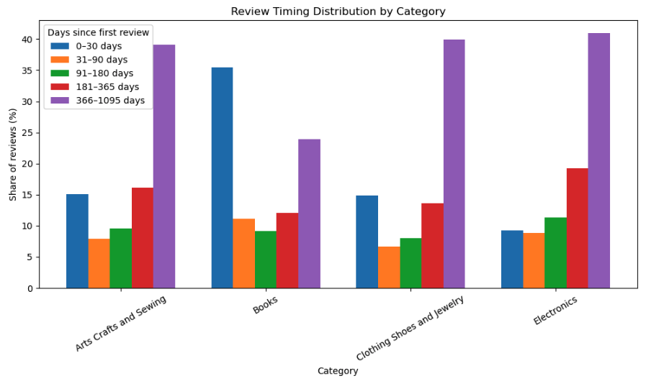
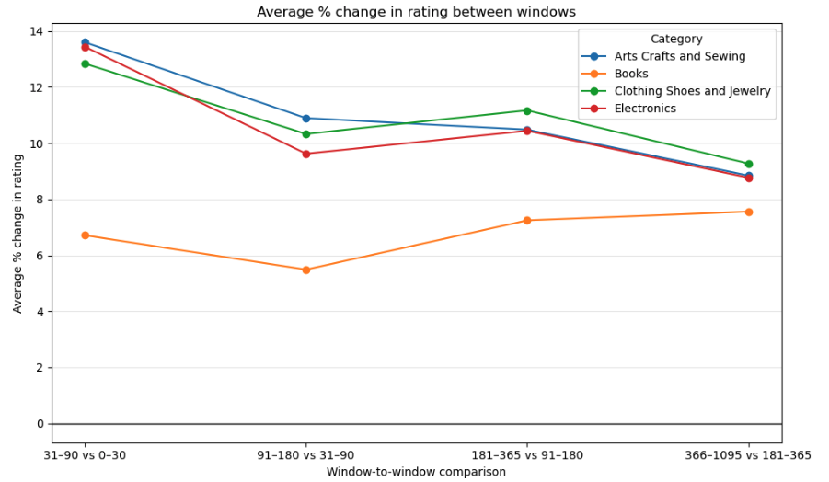
Ratings over time
Time when reviews were written
Majority of reviews were written 1~3 years after the first one. This makes sense as many customers leave reviews after a one-year warranty period hoping to get a refund and/or exchanges
Business category makes an impact
Unsurprisingly, the category at hand does show different trends. Books show a different percent change in rating while the other three categories show a similar trend in average ratings falling overtime

Slide 8
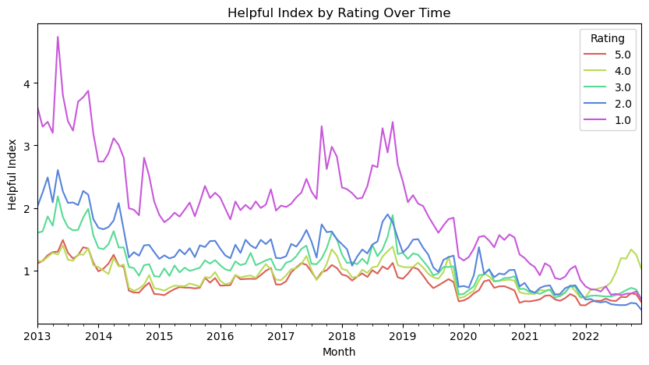
Helpfulness by rating category
1 star reviews are the most helpful and most common rating. As a whole, there is a general trend of decreasing helpfulness, especially after 2020.
For a given category in a given period of time:
Helpful Index = sum of helpful votes / count of reviews

Slide 9

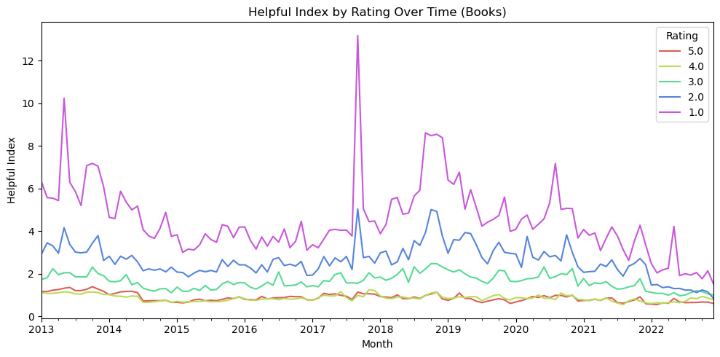
Interesting find
On Sept 12, 2017, there was a surge in helpful index for 1 star rating in Books.
Hillary Clinton released What Happened, a book revealing what she was thinking and feeling during one of the most controversial and unpredictable presidential elections in history.

Slide 10
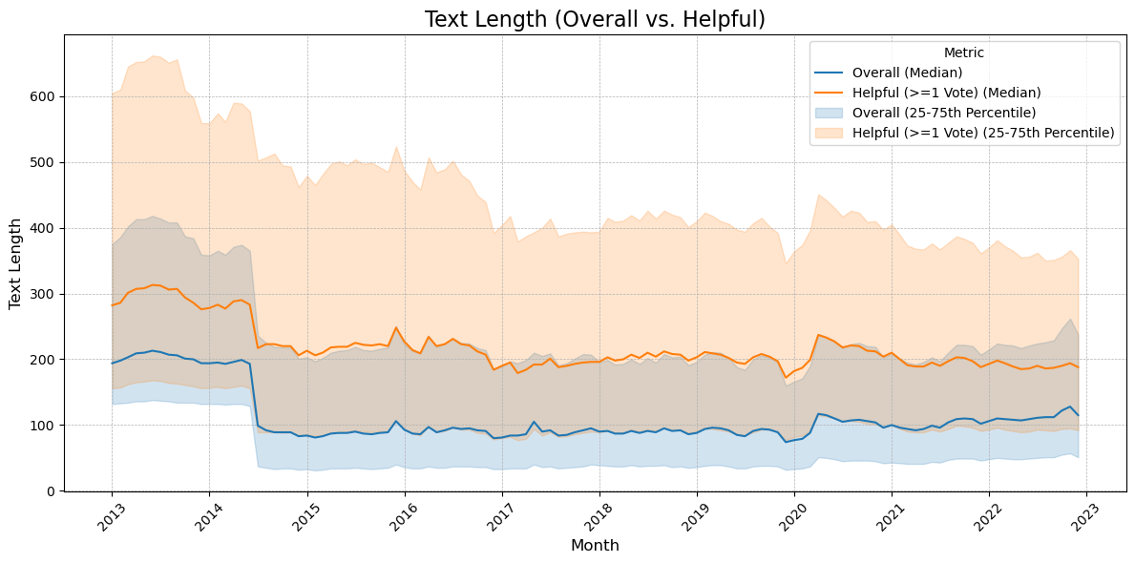
Median Review Text Length overtime
Comparing the overall reviews and those with helpful votes, we find that the helpful reviews are generally longer. The median length is around 200 characters (33-40 words) and it didn’t much overtime.

Slide 11
3. Machine Learning Model
Problem: Star ratings alone fail to capture nuanced customer experiences
Computing limitations prevented full-scale rating prediction
Solution: Pivot to binary sentiment classification
Classify review text as positive or negative
Detect sentiment rating mismatches
Use mismatches to surface product/service issues
Problem: Protecting CLV by building Trust
Regression metrics on ratings fail to predict preference in highly skewed data
Solution: Pivot to Binary Classification
Classify interactions as "Like" vs. "Not Like”
Abandon error minimization RMSE in favor of AUC
Prioritize Precision (94%) to ensure recommendations are "Safe Bets" for users

Slide 12
Predicting Rating
Overall Test Accuracy: 0.4252
Overall F1 Score (weighted): 0.4753
Overall Weighted Precision: 0.6023
Overall Weighted Recall: 0.4252
Even with limitations, our results were sub-par, which we attribute to mismatched reviews

Slide 13
Why Mismatches are Important
Mismatched reviews, specifically positive text paired with low ratings, let us focus on cases where customer expectations were not met
Examples:
4.0–Comes a little long which is perfect so you can size it as you please. Not very good quality but for a one time costume its great
1.0–The actual content of the book is good, but the cover that came on the book was all tattered on both the front and back. See photos. Hard to give this as a gift
Notes:
Why Mismatches are Important
Mismatched reviews, specifically positive text paired with low ratings, let us focus on cases where customer expectations were not met.
These reviews often reveal issues like products breaking during shipping, misleading descriptions, or features that don’t match what customers expected.
By analyzing the words most associated with mismatched reviews, we can understand why customers speak favorably in text yet still give 1–2 star ratings.
Text–rating disagreements highlight quality problems, UX friction, or misclicks and are some of the most actionable signals for improving product pages, customer experience, and conversion.

Slide 14
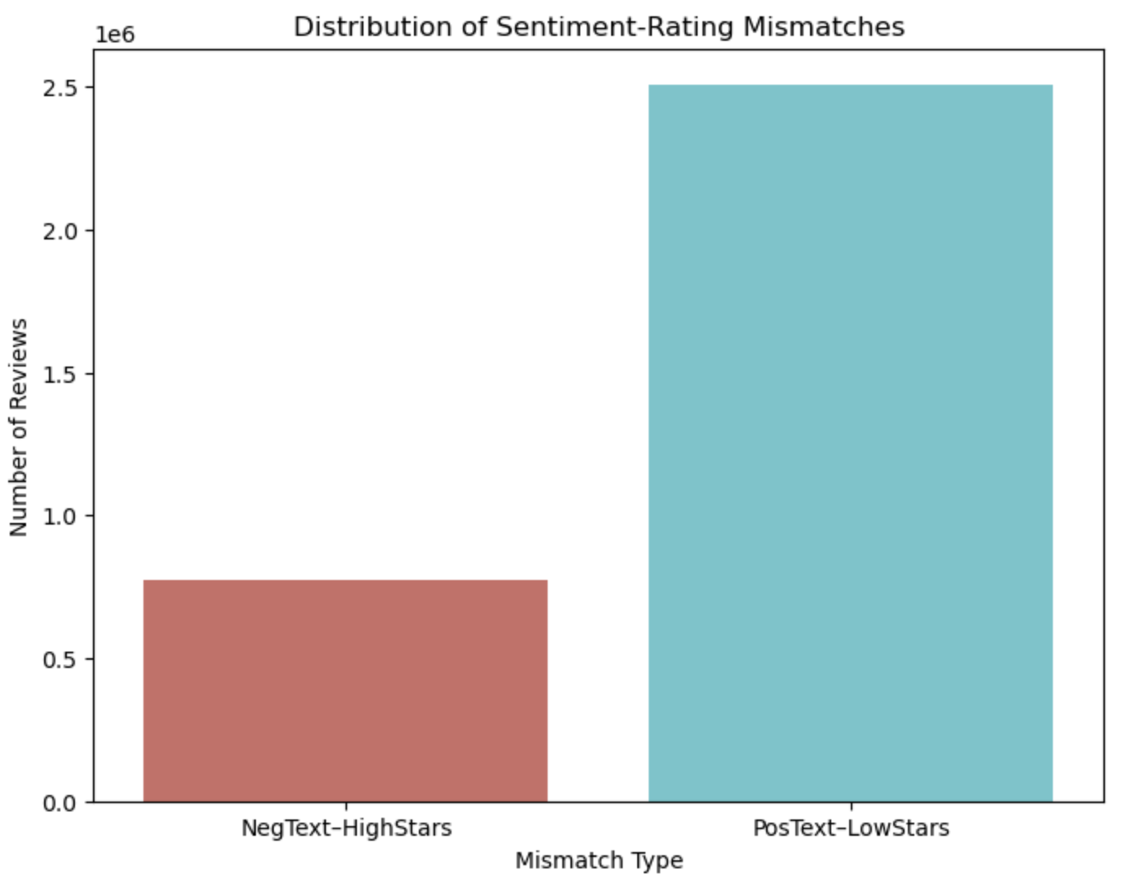
Mismatch Rates
We see the amount of types of mismatches. As you can see from the graph, there are more low star-positive text mismatches than high star-negative text mismatches, which implies people liking products but being unhappy with it for some reason

Slide 15
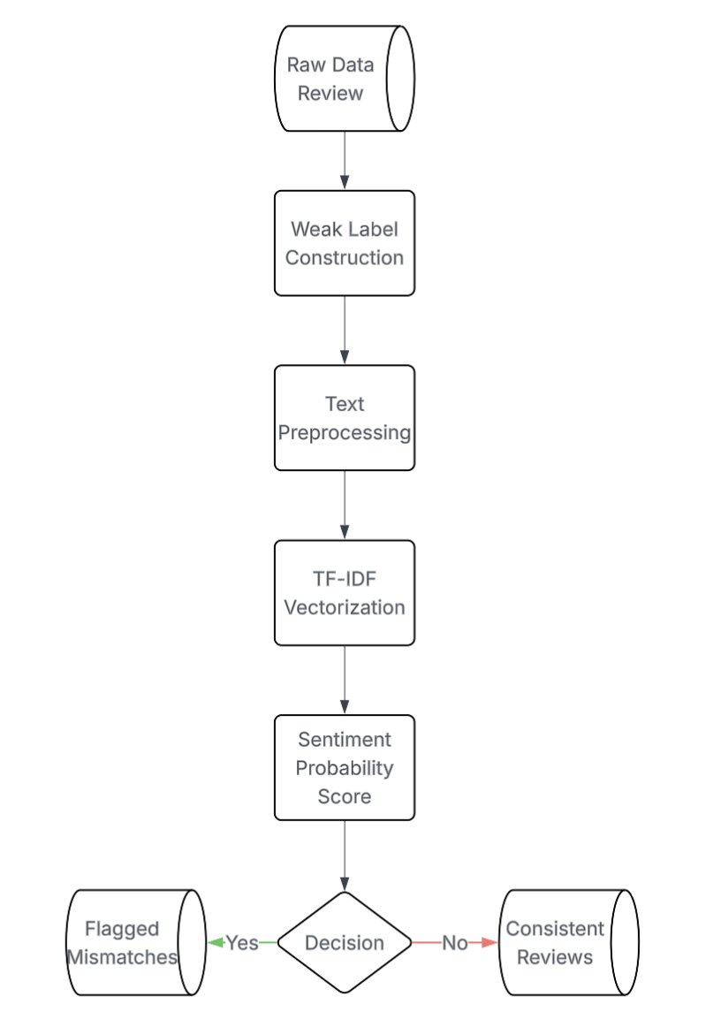
1. Score Sentiment & Detect Mismatches
Weak Labels allows us to approximate “positive vs negative text” using star ratings without manually labeling millions of reviews
TF-IDF + logistic Regression is a fast, scalable text-scoring method that produces interpretable probability outputs
Notes:
1. Score Sentiment & Detect Mismatches
Recreates weak labels (high vs low stars) to match original training setup
Applies TF-IDF + logistic regression to score each review’s positive-sentiment probability
Flags mismatches:
Positive text + low rating
Negative text + high rating
Why weak labels?
Allows us to approximate “positive vs negative text” using star ratings without manually labeling millions of reviews.
Ensures the inference pipeline matches the structure used during training, improving scoring accuracy.
Why TF-IDF + logistic regression?
Fast, scalable text-scoring method suitable for millions of records
Produces interpretable probability outputs (how positive the text sounds).

Slide 16
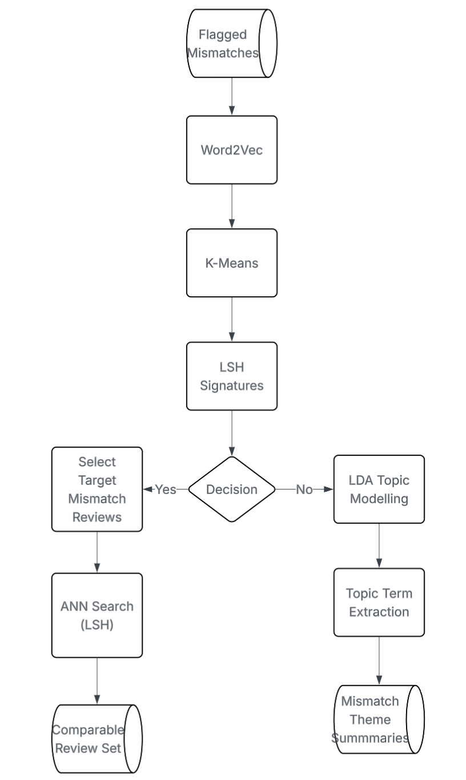
2. Semantic Structure, Similarity Search & Topic Extraction
Word2Vec captures the semantic meanings of reviews
K-Means Clusters helps build segment aware insights and prioritize improvement areas
LSH signatures enables fast similarity search at scale
ANN helps explain why a mismatch occurred by comparing it to similar reviews
LDA topics provides a clear, human-readable summary
Notes:
Why LSH signatures?
Enables fast similarity search at scale (millions of reviews).
Useful for surfacing comparable reviews, finding patterns, and detecting systemic issues quickly.
3. Similarity Search & Topic Extraction
Selects a mismatch review and finds its nearest neighbors using LSH ANN search
Applies LDA to mismatch reviews to uncover topics
Extracts and stores top terms per topic
Why nearest-neighbor search for mismatches?
Helps explain why a mismatch occurred by comparing it to similar reviews.
Supports customer service, marketing, and product teams in diagnosing root causes.
Why LDA topics specifically on mismatches?
Distills recurring themes behind the disagreement (e.g., “broken on arrival,” “wrong item,” “fit issues”).
Provides clear, human-readable summaries directly useful for decision-makers.

Slide 17
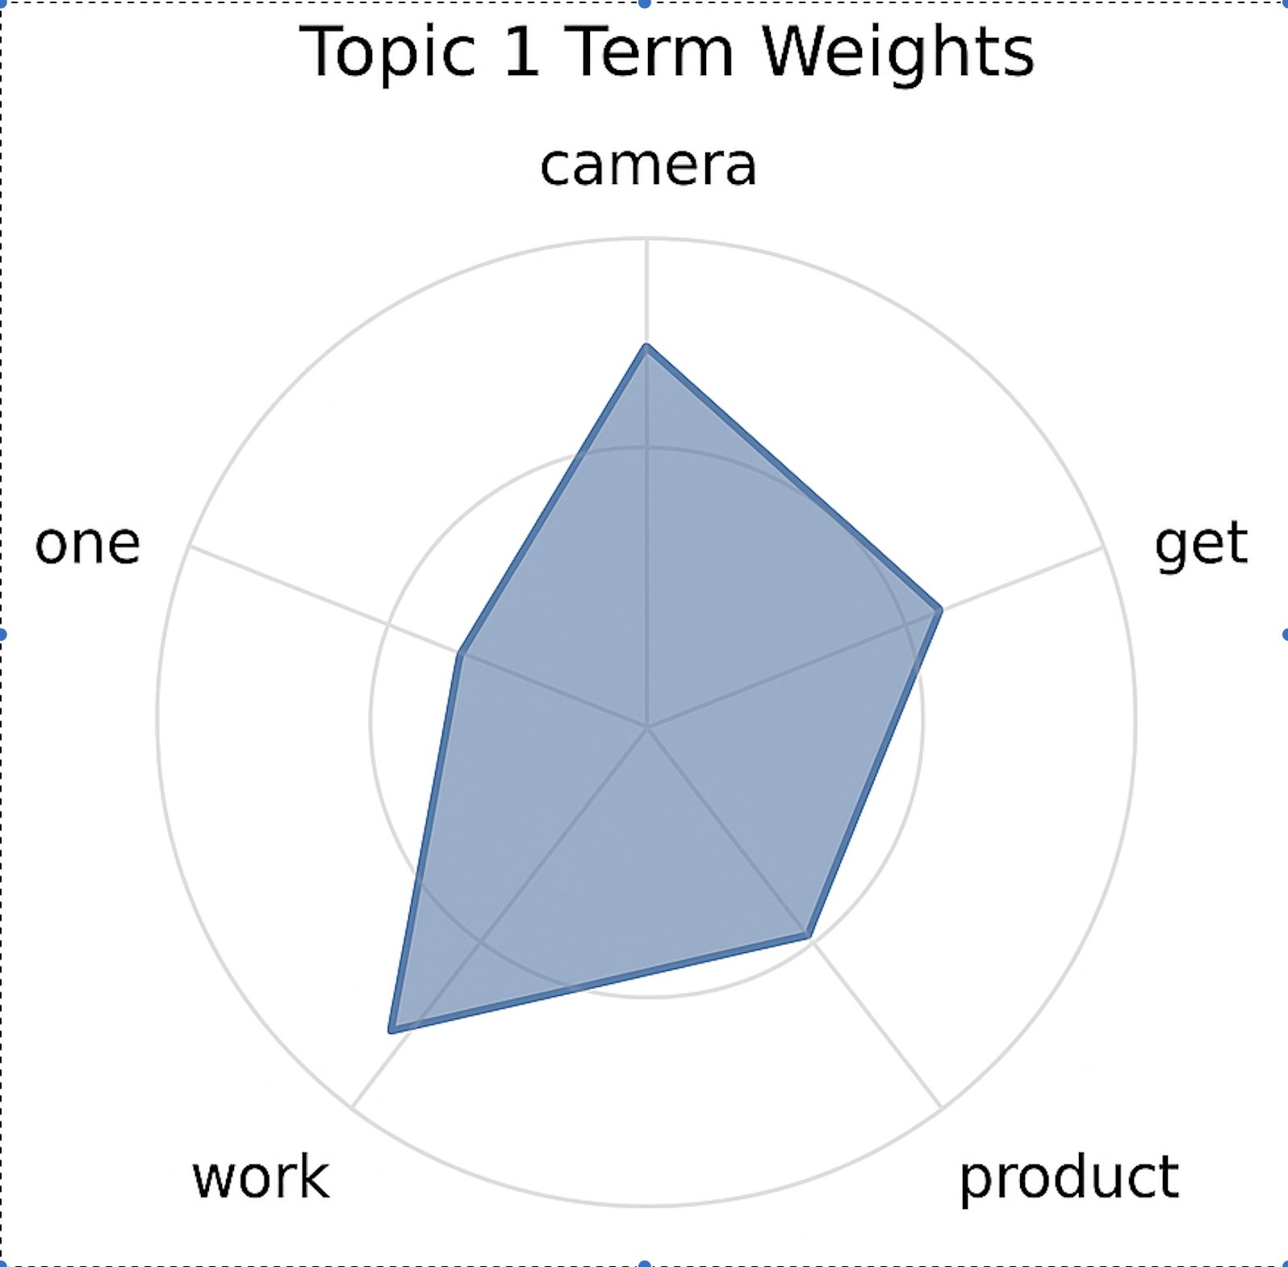
Interpretation
LDA Topic Modeling
Each topic captures a common theme among mismatched reviews.
The top terms show the key words defining that theme
Together, they reveal why customers sounded positive but still give low ratings, helping identify and prioritize product or service issues
Notes:
Each topic represents a recurring theme found across mismatched reviews (positive text but low rating).
The top terms are the words most strongly associated with that topic based on their statistical weight in the LDA model.
These terms help us understand the underlying reason why customers expressed positive sentiment in the text but still rated the product poorly.
By examining the top terms, we can infer patterns such as shipping damage, sizing issues, product quality problems, or unmet expectations.
The topics give the business a summarized map of common failure points, allowing teams to quickly identify and prioritize areas for improvement across products or categories.
Example of Top Terms Per Topic for Mismatches
This topic likely reflects customers who speak positively about the camera but encounter functional or reliability issues.
The presence of terms like “get” and “work” suggests frustration with getting the camera to operate correctly, even if aspects of the product seem good.
The mix of general product terms (“one,” “product”) implies broad dissatisfaction rather than a niche technical issue.
In the mismatch context, this points to users initially liking the camera but ultimately giving low ratings because it did not work as expected or failed to function consistently.

Slide 18
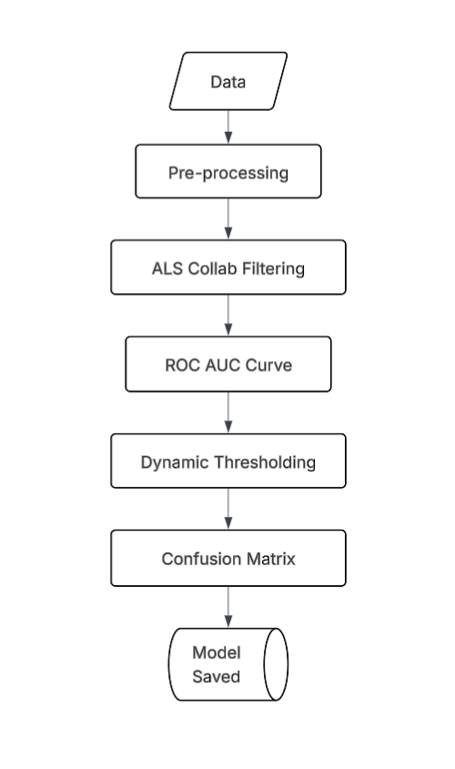
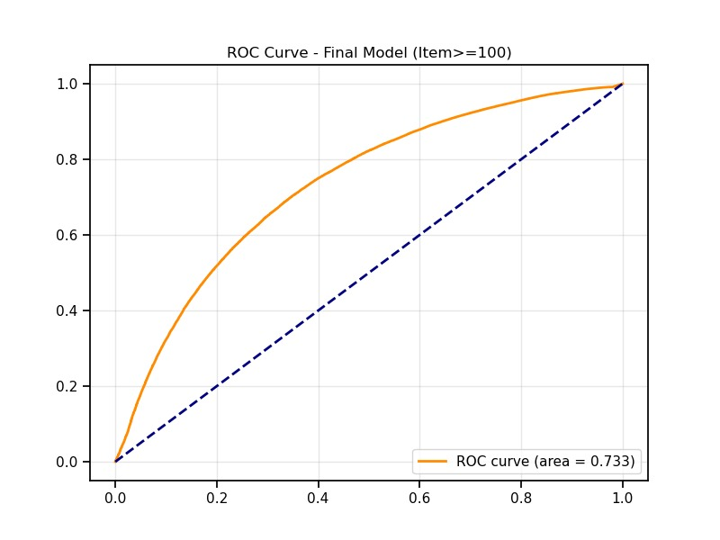
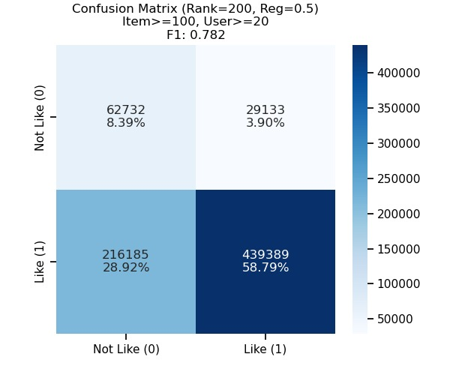
ALS Collab filtering Binary Classification
Model Configuration:
Rank=200, Reg=0.5, Dynamic Thresholding, Filter (Users < 20 reviews, Products < 100 reviews)
F1 Score: 0.782 – Indicates strong balance between precision and recall in an imbalanced dataset
ROC AUC: 0.733 – The model discriminates between "Like" and "Dislike" items 73% of the time
Precision: 93.8% – When the model predicts a "Like," it is correct 94% of the time
Notes:
too sparse..signals for binary (reconfirm with minhao)

Slide 19


Interpretation & Business Impact
1. Imbalanced Dataset
The dataset is heavily imbalanced (approx. 7:1 ratio of Likes to Dislikes ratio)
Amazon Users rarely rate items 1 or 2 stars (Dislike) since users mostly buy products which already have good reviews or are ranked higher. The model has learned this bias
2. High Precision (94%) with Moderate Recall (67%)
The model rarely makes "False Positive" errors with only 3.9% of predictions
Users will not be annoyed by irrelevant recommendations. If the model suggests it, users will most probably like it. This builds long-term user trust and retention
The model missed around 29% of actual likes (False Negatives)
Due to the high regularization (Reg=0.5), the model is "conservative." It ignores weak signals to avoid making mistakes
This is acceptable for a recommender system. It is better to miss a sale than to break user trust with a bad recommendation

Slide 20
Challenges
We had to refine Word2Vec dimensionality and moved from full-dataset training to sample-based training for efficiency
Model training required iterative tuning due to heavy computational demands
The text data needed extensive cleaning before modeling
Random Forest features were optimized using grid search with cross-validation
Shifted from random splitting to a Time-Based Split to simulate real-world forecasting.
Pivoted from Regression to Binary Classification to generate more actionable recommendations.
Expanded the hyperparameter grid to maximize complexity after initial tests showed stronger regularization yielded better results.
Notes:
We initially struggled to choose an appropriate dimensionality for Word2Vec and first attempted to train it on the entire dataset.
We ultimately shifted to training Word2Vec on a representative sample and then applying the trained model across the full dataset.
Model training was challenging due to the computational load; we had to iteratively adjust features and parameters so the cluster could train models without interruption.
The raw text data required substantial cleaning, such as removing HTML line breaks, before it could be used effectively in any model.
Selecting the right features for the Random Forest model was difficult; we addressed this by performing a grid search with cross-validation to identify the optimal configuration.

Slide 21
4. Conclusion
Key Findings
25-30% of reviews contain sentiment–rating mismatches, revealing unmet customer expectations
Low-star, high-helpful reviews are the most actionable signals for product improvement
Sentiment analysis + topic extraction successfully identifies hidden pain points
What We Delivered
Built a two-pipeline system to detect and explain sentiment rating mismatches
Achieved 94% precision in identifying reliable signals for product teams
Extracted recurring themes (shipping, quality, fit, durability) from mismatched reviews

Slide 22
Thank you
Q & A

Slide 23
5. Appendix

Slide 24
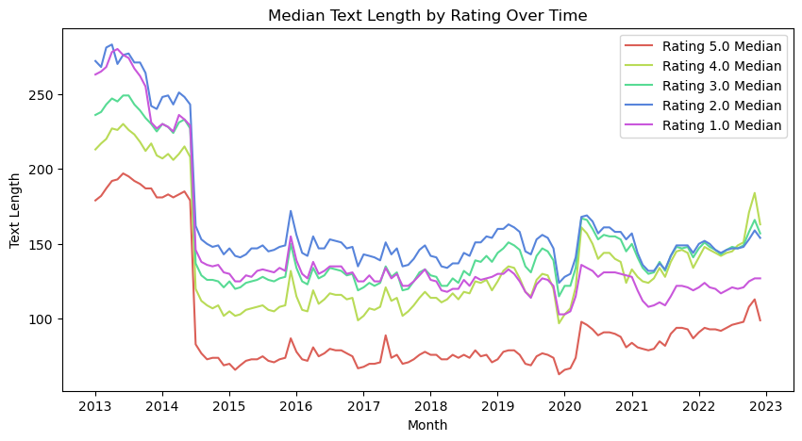

Slide 25
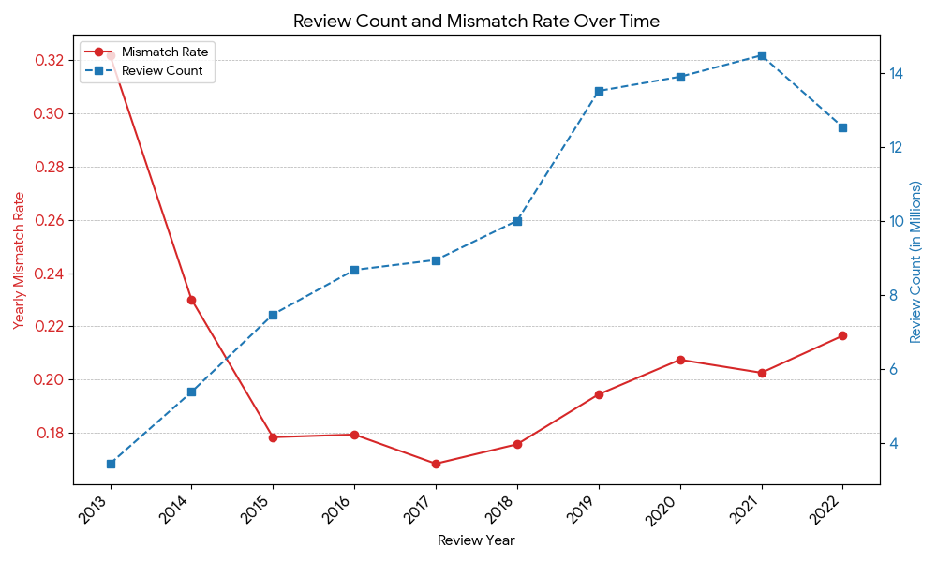

Slide 26
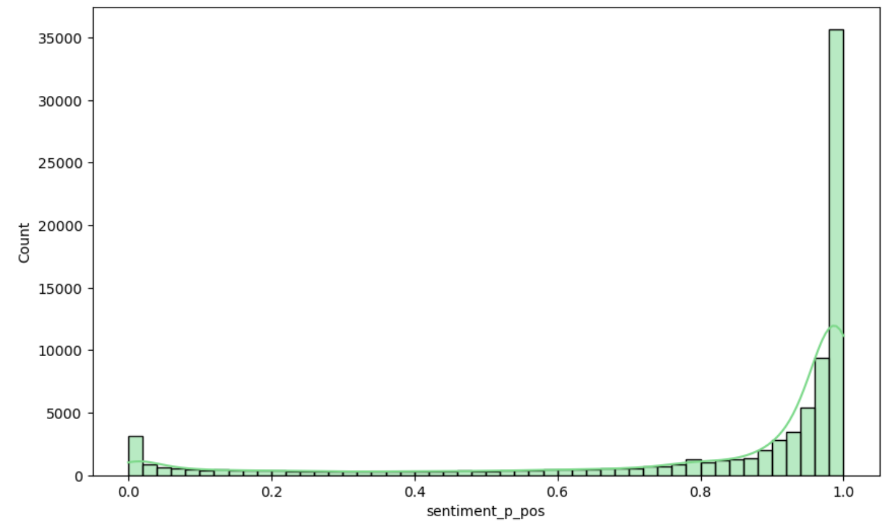
Distribution of Predicted Positive Sentiment Probability
This shows the distribution of the predicted positive sentiment from our logistic regression model

Slide 27
5-Class Random Forest Prediction Model
Overall Test Accuracy: 0.4252
Overall F1 Score (weighted): 0.4753
Overall Weighted Precision: 0.6023
Overall Weighted Recall: 0.4252
 | 1.0 | 2.0 | 3.0 | 4.0 | 5.0
1.0 | 1042063 | 455869 | 215061 | 179859 | 147100
2.0 | 332796 | 270107 | 114701 | 163678 | 95389
3.0 | 364871 | 316749 | 171659 | 295309 | 186951
4.0 | 339548 | 282674 | 198609 | 553106 | 494419
5.0 | 1326104 | 1069272 | 794411 | 2237097 | 5072702

Slide 28
By Rating Metrics
Rating 1.0: Precision=0.3060, Recall=0.5108, F1=0.3827, Support=203995
Rating 2.0: Precision=0.1128, Recall=0.2766, F1=0.1602, Support=976671
Rating 3.0: Precision=0.1149, Recall=0.1285, F1=0.1213, Support=1335539
Rating 4.0: Precision=0.1613, Recall=0.2960, F1=0.2088, Support=1868356
Rating 5.0: Precision=0.8459, Recall=0.4831, F1=0.6150, Support=10499586

Slide 29
