Slide 1
OPTIMIZATION METHODS — FINAL PROJECT
Strategy–Asset Selection
Under an Operating Cap
Exact CP-SAT vs. Bayesian Search vs. Greedy Selection, with Shared Convex Risk Sizing
3 STRATEGIES × 5 ASSETS = 15 CANDIDATES
Authors: Harleen Buttar & Sabyasachi Chowdhury Course: Optimization Methods, MS Applied Data Science — University of Chicago
An original recreation of an approved proposal — new assets, new signal logic, new solvers (OR-Tools CP-SAT, CVXPY), and an added greedy benchmark — validated by an 18-round semiannual walk-forward backtest.

Slide 2



1 · DECISION CONTEXT
Which strategy–asset slots are worth the operating cost of running live?
Who decides
Why it's costly
The real question
A portfolio or research lead choosing which strategy–asset pairs to activate at each semiannual rebalance.
Every live pair adds data monitoring, model review, execution oversight, and risk sign-off — capacity is not free.
Does an exact discrete optimizer beat black-box Bayesian search or a simple greedy rule — and does a better pick even help out of sample?
Downstream flow: selected slots → shared convex QP sizing → fixed weights held over the next 6 months → tested on data neither method used during optimization.
Strategy–Asset Selection Under an Operating Cap
2

Slide 3
2 · PROBLEM FORMULATION
15 candidates. Two coupled optimization stages.
Stage A — Selection (MIP)
Stage B — Risk Sizing (Convex QP)
Decision variable y_{s,a} ∈ {0, 1} — 1 if strategy s is active on asset a
Shared identically across all three selection methods — so any performance gap comes only from the selection stage, never from sizing.
Objective (maximize):
Objective (maximize):
Σ s,a q_{s,a} · y_{s,a} (q = trailing annualized mean return score)
μᵀw − (γ/2)·wᵀΣw
Subject to:
Subject to:
Σs y s,a ≤ 1 ∀a at most one strategy live per asset
0 ≤ w i ≤ w max position cap, w max = 0.60
Σ y s,a ≤ K at most K slots funded in total (K = 3)
Σ w i ≤ 1 unused capital sits in cash
y s,a ∈ {0,1} binary selection
μ and Σ are the annualized mean return vector and covariance matrix estimated from the trailing 756-day training window, ridge-stabilized for numerical stability.
Solved exactly with OR-Tools CP-SAT, and independently approximated with Bayesian Optimization and a greedy heuristic, for a genuine head-to-head.
Strategy–Asset Selection Under an Operating Cap
3

Slide 4





3 · DATA DESCRIPTION
Five assets, one calendar, thirteen years of daily prices.
SPY
QQQ
BTC-USD
XOM
GLD
Broad U.S. equity market
Technology-heavy equities
Cryptocurrency
Energy-sector single stock
Gold exposure
Source & Window
Preprocessing & Leakage Control
• Source: Daily adjusted closes via yfinance • Window: 2013-01-01 through 2026-07-29, local disk cache after first pull • Lookback: 756 trading days (~3 years) per training window • Rebalance: every 126 trading days (~6 months)
• Prices aligned to a common calendar; missing rows dropped only after alignment • Converted to simple daily returns • Signals use data available at or before each date • Strategy returns lag the signal by one trading day to block look-ahead
15 candidates total = 3 strategies × 5 assets
Strategy–Asset Selection Under an Operating Cap
4

Slide 5
3 · DATA DESCRIPTION (CONT.)
Three strategies, deliberately rebuilt from scratch.
1
2
3
EMA Trend
Bollinger Mean-Reversion
Cross-Sectional Momentum
Long when the 20-day EMA is above the 100-day EMA — a classic dual-moving-average crossover, evaluated per asset.
Long after a low-price excursion, defined as Bollinger %B falling below 0.10 — a genuine oversold trigger, not a flat threshold.
Each day, rank all five assets by trailing 12–1 momentum; activate only the top 2 when their momentum is positive — a real cross-sectional ranker.
All strategy returns multiply today's asset return by yesterday's signal — the same one-day lag enforced across every strategy, asset, and rebalance.
Strategy–Asset Selection Under an Operating Cap
5

Slide 6




4 · SOLUTION METHOD
Three ways to pick 3-of-15, one way to size them.
CP-SAT (Exact)
Bayesian Optimization
Greedy Heuristic
Convex QP Sizing
Google OR-Tools
bayesian-optimization
Custom, deterministic
CVXPY + OSQP / CLARABEL
Integer-scaled scores solved as a MIP — guarantees the true optimum, with a formal feasibility/optimality status.
One continuous, rounded variable per asset (4 choices); cardinality violations penalized. Multiple seeds expose run-to-run variability.
Sorts candidates by score, accepts the next one only if its asset is free and the cap allows — fast, but not guaranteed optimal in general.
One shared mean-variance sizing model applied identically to every method's selected set, with a ridge-stabilized covariance.
The selection stage is the only thing that differs between methods — Stage B (QP sizing) is identical for all three, so any downstream performance gap traces back to selection quality alone.
Strategy–Asset Selection Under an Operating Cap
6

Slide 7


5 · IMPLEMENTATION DETAILS
One computational workflow, run identically 18 times.
→
→
→
→
Cache prices
Build signals
(1-day lag)
Estimate scores
& covariance
Solve 3 selection
methods + QP
Hold 126 days,
repeat ×18
Key Libraries
Modeling Choices & Reproducibility
ortools — CP-SAT exact selection cvxpy + osqp/clarabel — convex QP sizing bayesian-optimization — black-box selection pandas / numpy / yfinance — data & scoring
• CP-SAT needs integer coefficients — scores are scaled and rounded without changing the formulation. • Covariance is ridge-stabilized before entering the QP. • Bayesian search runs multiple fixed seeds to expose (not hide) run-to-run variability. • Prices are cached locally, so a rerun is fully deterministic after the first download.
Strategy–Asset Selection Under an Operating Cap
7

Slide 8
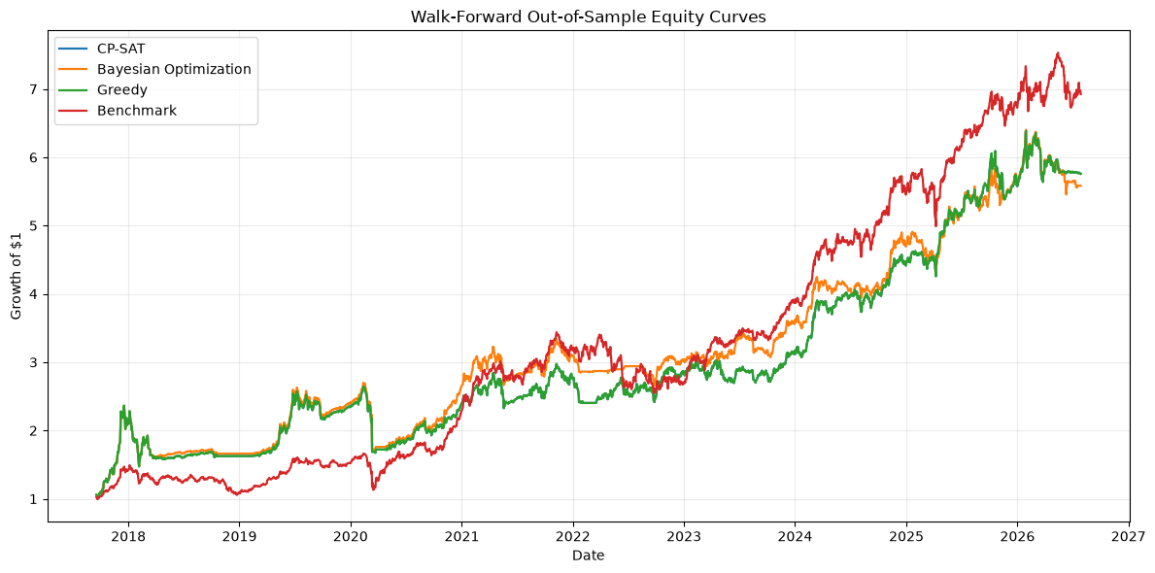
6 · RESULTS
18 semiannual rebalances, 2017–2026, fully out of sample.
Method | CAGR% | Sharpe | MaxDD%
CP-SAT | 21.9 | 0.967 | -37.6
Greedy | 21.9 | 0.967 | -37.6
Bayesian Opt. | 21.4 | 0.971 | -37.6
Benchmark* | 24.4 | 1.165 | -31.8
*Naive equal-weight buy-and-hold across all five assets.
Honest finding: all three optimized methods underperformed the naive benchmark out-of-sample on every metric — despite CP-SAT and Greedy strictly dominating in-sample. Concentrating into 3 of 15 slots carried more drawdown risk than staying diversified across all five assets.
Out-of-sample equity curves — CP-SAT and Greedy overlap exactly.
Strategy–Asset Selection Under an Operating Cap
8

Slide 9
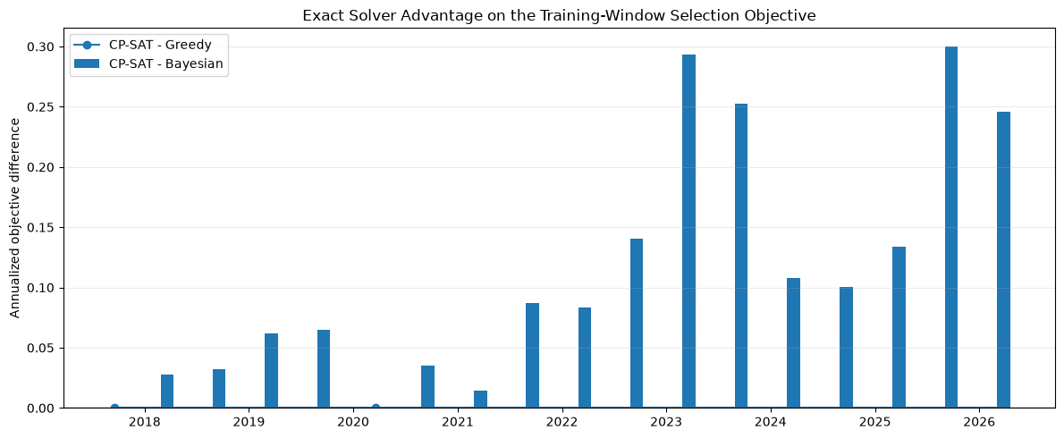
6 · RESULTS (CONT.)
CP-SAT never lost. Bayesian search paid for it in time and stability.
18/18
713×
0.110
rebalances where CP-SAT matched or beat both alternatives
faster than Bayesian Optimization (0.0018s vs. 1.283s mean)
mean annualized objective gap Bayesian left on the table vs. CP-SAT
Strategy–Asset Selection Under an Operating Cap
9

Slide 10
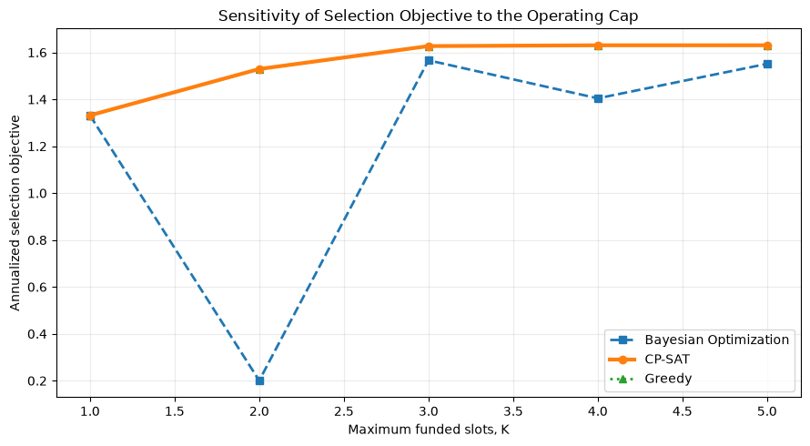
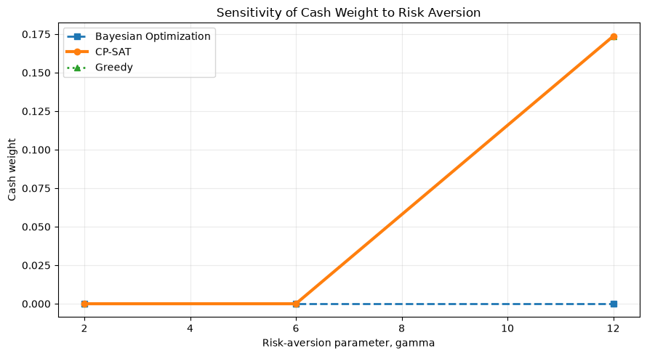
7 · SENSITIVITY / SCENARIO ANALYSIS
How the picture changes as K and risk aversion move.
Selection objective vs. cap K
Cash weight vs. risk aversion γ
Raising K from 1 to 5 increases the selection objective for all three methods, with CP-SAT and Greedy tracking each other and Bayesian generally trailing (most visibly at K=2). Raising risk aversion γ shifts QP weight out of risky slots and into cash. Additional scenarios (position caps, transaction costs, Bayesian search budget) are covered in the full notebook.
Strategy–Asset Selection Under an Operating Cap
10

Slide 11
8 · DEPLOYMENT OR DECISION SUPPORT
From notebook to a repeatable semiannual decision ticket.
1
Refresh adjusted prices
Latest Decision Ticket — 2026-07-28
2
Rebuild signals & net strategy returns
Solver: OR-Tools CP-SAT · K = 3 · status: OPTIMAL
ema_trend
3
Estimate trailing scores & covariance
QQQ
7.2%
4
Solve the CP-SAT selection model
ema_trend
GLD
60.0% (cap)
5
Solve the CVXPY sizing model
cross_sectional_momentum
BTC-USD
32.8%
6
Export a decision ticket
Suitable as a scheduled research workflow or the backend of a lightweight dashboard.
Cash weight: 0.0%
QP status: OPTIMAL
Strategy–Asset Selection Under an Operating Cap
11

Slide 12

9 · REQUIREMENTS
CPU-only. Fifteen binaries don't need a GPU.
Environment
Package Versions
• Python 3.10–3.13 • Internet access needed only for the first Yahoo Finance pull • Prices cached locally after that — reruns need no network • macOS install cell removes highspy to avoid a libhighs dylib collision with cvxpy
• yfinance
CPU
• pandas / numpy
• ortools (CP-SAT)
2 cores · 4 GB RAM
is plenty
• cvxpy + osqp / clarabel
• bayesian-optimization
15 binary candidates, a QP with ≤3 free weights, and a 4-choice Bayesian search — none of it benefits meaningfully from a GPU at this scale.
• matplotlib / seaborn
• scikit-learn
Strategy–Asset Selection Under an Operating Cap
12

Slide 13


10 · CONCLUSIONS
Exact optimization won the fight it was built for — not the one that mattered most.
Confirmed
Not Confirmed / Limits
• CP-SAT is exactly optimal and reproducible — confirmed at all 18/18 rebalances. • Bayesian Optimization is slower (~713×) and sometimes misses the optimum (16/18 rebalances, mean gap 0.110, seed-to-seed std ≈ 0.069). • Greedy matched CP-SAT exactly in every tested window on this small, largely non-conflicting candidate set — a useful finding, not a general guarantee.
• Better in-sample selection did not translate to better out-of-sample performance — the equal-weight benchmark won on every metric. • Trailing return is a noisy proxy for future opportunity; concentrating into 3-of-15 slots added drawdown risk that staying diversified avoided. • No shorting, taxes, or capacity limits modeled; covariance is sample-based, not regime-aware. Educational study, not investment advice.
Strategy–Asset Selection Under an Operating Cap
13

