Slide 1


Standardizing Accurate Revenue Forecasting for Affiliate Marketing
Building Standardized, Scalable, and Accurate Forecasting Pipelines with Time Series Foundation Models and Parameter-Efficient Fine-Tuning
Capstone Project · 2026
Harleen Buttar, Kevin Fan, Aren Mizuno, Kai Schindler
Notes:
Aren Mizuno

Slide 2
1 / 18
AGENDA
BACKGROUND
APPROACH
RESULTS
Table of Contents
01
02
03
Background
Approach
Results
Team Introduction
Company Background
Business Problem
Goal of Analysis
Deliverables
Literature Review
Results
Final Takeaway
Data
Modeling Analysis
Notes:
Aren Mizuno

Slide 3




2 / 18
AGENDA
BACKGROUND
APPROACH
RESULTS
Meet the Team
Harleen Buttar
Kevin Fan
Aren Mizuno
Kai Schindler
MS Applied Data Science, UChicago
BS Data Science UChicago
Data Science Project Manager, CharacTour
Data Science Team Member, Internet Equity Initiative
MS Applied Data Science, UChicago
BS Data Science & Economics, UC Berkeley
Academic Intern, UC Berkeley
MS Applied Data Science, UChicago
BA Data Science & Business Economics, UChicago
Data Science Intern, Actelligent
Data Science Intern, Morningstar
MS Applied Data Science, UChicago
BA Mathematics, UChicago
Data Science Intern, CharacTour
Notes:
Aren Mizuno

Slide 4
3 / 18
AGENDA
BACKGROUND
APPROACH
RESULTS
Why Forecasting Matters at Rakuten Advertising
The Affiliate Network
Why Accurate Forecasting Matters
Rakuten operates a global affiliate advertising network, connecting brands with affiliate marketers and publishers across key verticals:
Revenue forecasts protect revenue and drive critical business decisions:
Revenue Target Setting
Luxury Brand Retail
Luxury Department Retail
Advertising Budget Allocation
Travel
Finance
Campaign Timing & Planning
Affiliate Partner Selection
Notes:
Aren Mizuno

Slide 5
4 / 18
AGENDA
BACKGROUND
APPROACH
RESULTS
The Need for a Standardized Forecasting Pipeline
Current Process Challenges
Manual Monthly Adjustments
Client Pressure
Vertical-level Modeling Gaps
Forecasts are manually revised each month with no scalable or repeatable framework, resulting in high revision costs
Clients frequently adjust company-specific assumptions, and inaccurate forecasts can reduce client satisfaction and trust
Companies within the same vertical often share trends and behaviors, but these relationships are not currently leveraged in forecasting models
Operational Cost
400
6hrs
$75
$2.16M
Forecasts / Month
Per Forecast
Labor Cost / Hr
Annual Cost
400 forecasts × 12 months × 6 hrs × $75/hr = $2.16M annually in forecasting labor
Notes:
Aren Mizuno

Slide 6
5 / 18
AGENDA
BACKGROUND
APPROACH
RESULTS
3 Questions That Guided Our Design
We aim to design a forecasting system that is accurate, standardized, personalized by vertical, and computationally efficient. To achieve this, we address three core research questions:
Question 1
Question 2
Question 3
Do Time Series Foundation Models (TSFMs) outperform traditional forecasting approaches?
Can Parameter-Efficient Fine-Tuning (PEFT) improve forecasting accuracy within vertical while remaining cost-effective?
Can these approaches operate within Rakuten's computational and infrastructure constraints at scale?
Notes:
Kai

Slide 7
6 / 18
AGENDA
BACKGROUND
APPROACH
RESULTS
3 Core Deliverables
Standardized Forecasting Pipeline
2.
1.
Interactive Dashboard
Model Evaluation Framework
3.
Built for technical and non-technical stakeholders — adjustable models, covariates, and horizon, with forecasts, comparisons, and confidence intervals
Vertical-aware pipeline, one-click forecasts – replaces 6 hours of manual tuning per run
Scores every candidate model on shared metrics, re-checked for drift as new data arrives
Notes:
Kai

Slide 8
7 / 18
AGENDA
BACKGROUND
APPROACH
RESULTS
The Literature’s Case: Pretrain Broadly, Fine-Tune Cheaply
TSFMs Capture Complex Temporal Patterns at Scale
PEFT Enables Affordable Vertical Adaptation
Broad temporal patterns learned via large-scale pretraining (web/search data or synthetic augmentation)
Variants extend this further: exogenous-variable support (Tiny Time Mixer), sparse-history handling (Chronos), trend alignment (TimesFM)
Full fine-tuning: costly, prone to overfitting
Low Rank Adaptation (LoRA / QLoRA): update only a small fraction of parameters
Prompt-based methods: trainable embeddings adapt to industry specific patterns
Notes:
Kai

Slide 9
8 / 18
AGENDA
BACKGROUND
APPROACH
RESULTS
Dataset Overview
Source
Size and Range
Variables
Nielsen Consumer Marketing Data (Receipts)
1,661,290 rows x 8 columns
100MB
01-01-2022 to 04-05-2026
order date, vertical, merchant name, order count, scaled order volume, scaled item volume, scaled revenue, scaled average order value
Notes:
Kevin

Slide 10
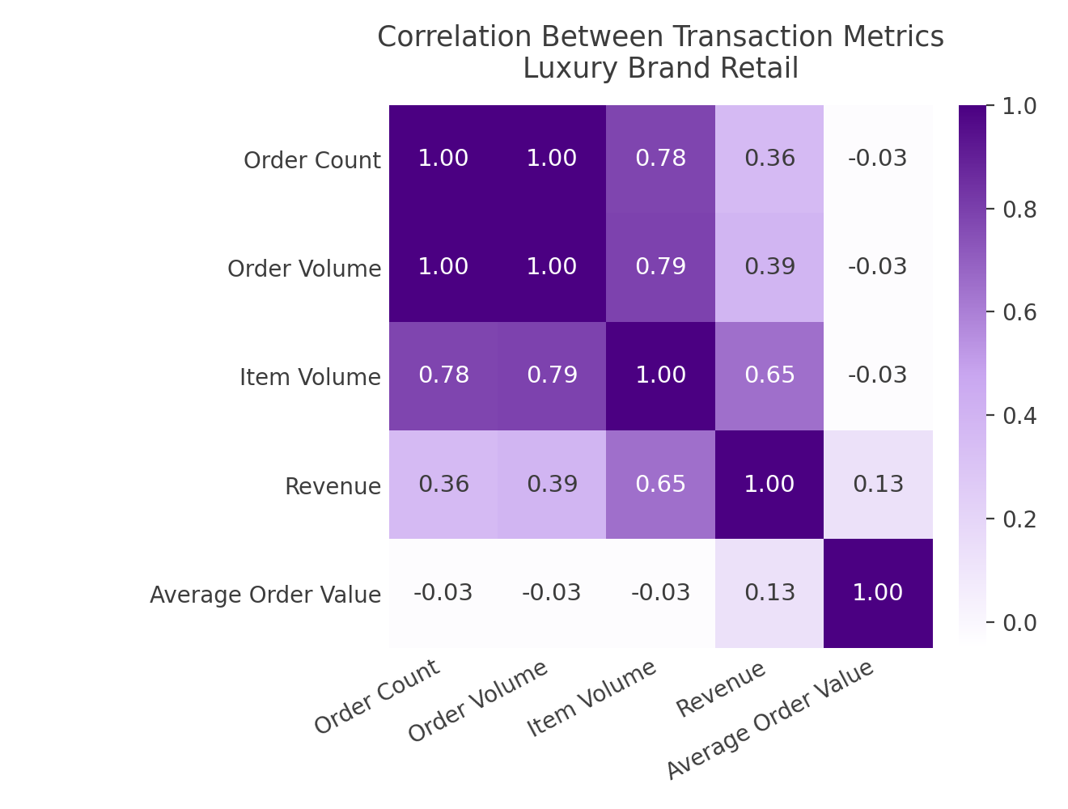
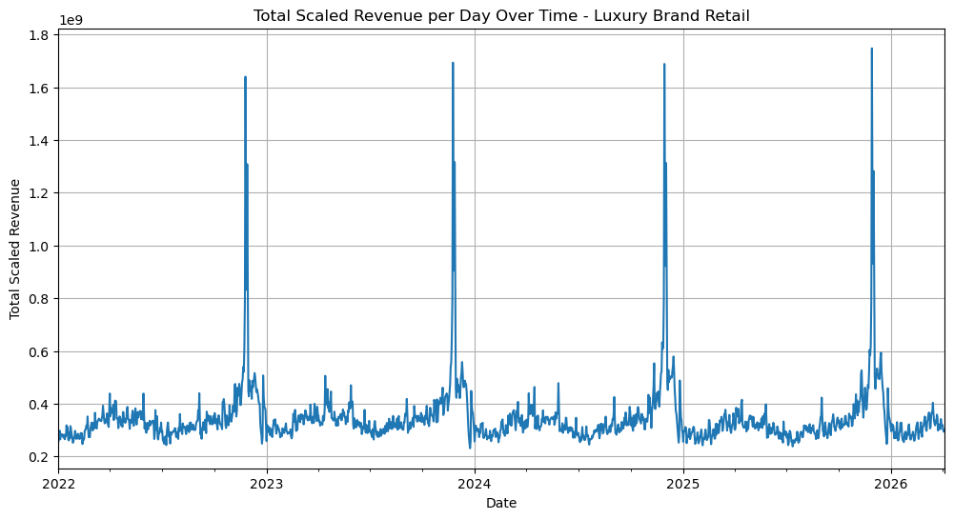
9 / 18
AGENDA
BACKGROUND
APPROACH
RESULTS
Exploratory Data Analysis (EDA)
Data Quality
No duplicate records
10% missingness in scaled revenue & average order value
Weak relationship to observed variables
Limited concentration in primary verticals
Business Verticals
14 business verticals in total
Narrowed to Luxury Brand Retail, Luxury Dept. Retail, Travel & Finance
Trend & Seasonality
Seasonal patterns in revenue transaction metrics
Holiday demand peaks every December
Correlation Structure
Order count, order volume & item volume correlate strongly with revenue
Average order value behaves more independently across verticals
Distribution Analysis
Revenue, order count & order volume are right-skewed
Many outliers observed across verticals
Notes:
Kevin

Slide 11
10 / 18
AGENDA
BACKGROUND
APPROACH
RESULTS
Preprocessing & Validation Strategy
1
2
3
4
Feature Engineering
Missing Values
Vertical and Test/Train Split
Normalization
Rolling statistics (7-day and 28-day moving averages and standard deviations)
Lag features for revenue, order count, and AOV (1, 7, and 28 days)
Day-over-day and week-over-week percentage change features
Ratio features including items per order and revenue per item
Cyclical sine/cosine encodings for day of week and month
Weekend indicator variables and expanding revenue averages
Missing values were consistent with moving at random behavior and removed due to limited impact on the primary verticals of interest
The dataset was segmented by business vertical and split chronologically into training and testing periods. The length of the testing window can be adjusted by the client
Standard scaling was applied to normalize the heavily right-skewed feature distributions
Notes:
Kevin

Slide 12
11 / 18
AGENDA
BACKGROUND
APPROACH
RESULTS
The Benchmarks We Had to Beat
Statistical Forecasting Models
SARIMA/SARIMAX
(Seasonal AutoRegressive Integrated Moving Average/eXogenous regressors)
Autoregressive trend + seasonality modeling; SARIMAX adds external regressors
VAR (Vector AutoRegression)
Multivariate modeling of interdependent time series
GARCH (Generalized AutoRegressive Conditional Heteroskedasticity)
Time-varying volatility (heteroskedasticity) modeling
ETS (Exponential Smoothing)
Level, trend, and seasonal decomposition via smoothing
Machine Learning Models
LightGBM
Histogram-based tree boosting, optimized for speed and scale
XGBoost
Gradient boosting with engineered lag/rolling features
Notes:
Harleen

Slide 13
12 / 18
AGENDA
BACKGROUND
APPROACH
RESULTS
Foundation Models Off the Shelf, Then Tuned 7 Ways
Foundation Models
TimesFM
Decoder-only pretrained transformer (Google) for zero-shot forecasting
Chronos
Tokenizes time series values, trained as a language model (Amazon, T5-based)
MOMENT
Masked pretraining transformer for forecasting, classification, anomaly detection, imputation
Tiny Time Mixers
Lightweight MLP-Mixer model (IBM), no attention, fast zero/few-shot forecasting
Moirai
Masked encoder transformer (Salesforce) handling arbitrary frequencies/dimensions via any-variate attention
Parameter Efficient Fine-Tuning
P-tuning / Prompt Tuning / Prefix Tuning
Learn continuous prompt vectors prepended to inputs (or to keys/values per layer for prefix tuning); backbone frozen
BitFit
Fine-tunes only bias terms, freezes all other weights
LoRA/QLoRA/DoRA
Trainable low-rank matrices injected into frozen weights; QLoRA adds 4-bit quantization; applies LoRA only to direction
Notes:
Harleen

Slide 14
13 / 18
AGENDA
BACKGROUND
APPROACH
RESULTS
2 Metrics Decide the Winner, 7 Keep It Honest
Metrics
Nine accuracy metrics were computed for every model run; WAPE and MdAPE were tracked as the primary metrics.
WAPE
Weighted Absolute Percentage Error
Primary metric — aggregate, scale-independent accuracy across verticals
MdAPE
Median Absolute Percentage Error
Primary metric — robust to outliers and near-zero revenue days
Also Tracked
MAE
Mean Absolute Error
RMSE
Root Mean Squared Error
MAPE
Mean Absolute Percentage Error
SMAPE
Symmetric MAPE
R²
Coefficient of Determination
Bias
Mean Forecast Error
Pooled Error
Weighted error across candidate models
Notes:
Harleen

Slide 15
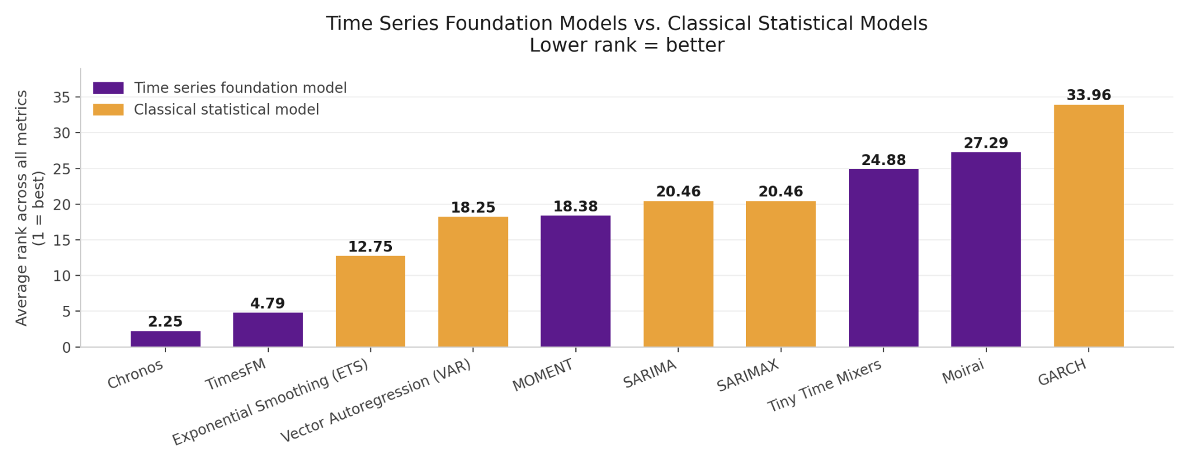
14 / 18
AGENDA
BACKGROUND
APPROACH
RESULTS
Foundational Models Win
45%
More accurate than the best traditional baseline (WAPE)
13–25%
Original improvement target — exceeded
3 / 3
Verticals where zero-shot, covariate Chronos ranked #1
Notes:
Aren

Slide 16
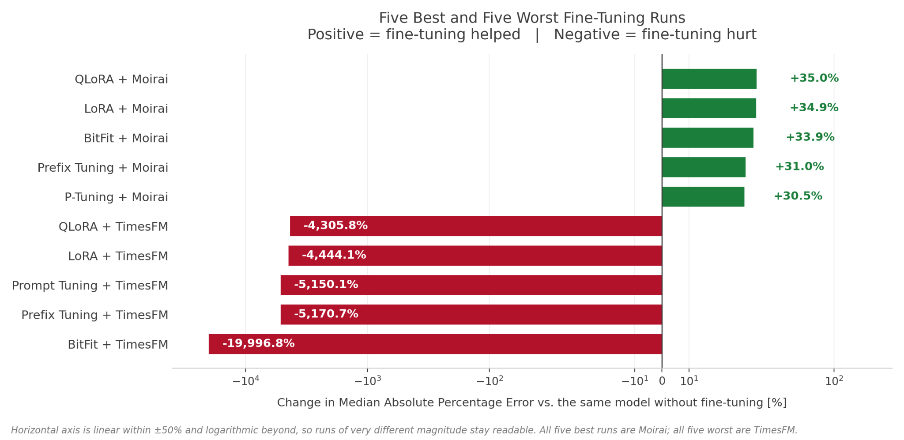
15 / 18
AGENDA
BACKGROUND
APPROACH
RESULTS
Fine-tuning Foundational Models Didn’t Pay
83%
Of 168 fine-tuned runs got worse than their base model
0
Fine-tunes that beat zero-shot, covariate Chronos
$0
Training compute needed for the winning model
Notes:
Aren

Slide 17

16 / 18
AGENDA
BACKGROUND
APPROACH
RESULTS
Every Forecast in the Deck, in a Tool Anyone Can Use
Notes:
Harleen

Slide 18
17 / 18
AGENDA
BACKGROUND
APPROACH
RESULTS
Foundation Models Yes, Fine-Tuning No, Deployment Almost
Q1 Do TSFMs outperform traditional forecasting approaches?
Q2 Does PEFT improve accuracy cost-effectively?
Q3 Can this run within Rakuten’s infrastructure?
YES
NO
YES, with work
Zero-shot covariate Chronos won every vertical, cutting WAPE 45% vs ETS, well past 13-25% target
PEFT beat its base model in only 17% of runs, and hurt the strongest backbones the most
One fast, low-cost, shareable dashboard — still needs security work before production
Notes:
Harleen

Slide 19
18 / 18
AGENDA
BACKGROUND
APPROACH
RESULTS
$1.84M Saved, Three Steps to More
Replace client-by-client forecasting with standardized zero-shot Chronos per vertical, continuously benchmarking new models as data grows
Impact: 85% less analyst time per forecast — ~$1.84M in annual savings
Extend to Data Coverage
Parallelize Model Execution
Production harden the Dashboard
Finance is scaffolded but unpopulated. A new Travel tranche is blocked by a format mismatch — fixing it also tests whether more data improves fine-tuning.
Comparisons run sequentially, so uncached runs take minutes. Concurrent execution is the highest-impact near-term fix.
Add authentication, restrict access to Rakuten's network, and automate re-evaluation as new data arrives.
Notes:
Kevin

Slide 20


Appendix
Supporting detail for the dataset, variable definitions, and the full model evaluation results
Appendix A
Appendix B
Appendix C
Appendix D
Appendix E
Appendix F
Data Types & Variable Definitions
Overall Model Performance Charts
Fine-Tuning Comparison Charts
Time Horizon Comparison Charts
Cost Savings Calculation
Model & Hyperparameter Definitions

Slide 21
Appendix A: Data Types
Feature | Type
ORDER_DATE | object
VERTICAL | object
MERCHANT_NAME | int64
ORDER_COUNT | int64
SCALED_ORDER_VOLUME | int64
SCALED_ITEM_VOLUME | int64
SCALED_REVENUE | float64
SCALED_AOV | float64

Slide 22
Appendix A: Variable Description
Output Field Definitions
Field | Description
order_date | Time period start date, truncated to the grain (month, week, or day)
vertical | Merchant category grouping assigned based on merchant_group and tags (e.g. Beauty, Department Stores)
merchant_name | Name of the individual retailer (or number for the encoded version)
order_count | Raw count of distinct orders observed in the NIQ panel — not projected
scaled_order_volume | Estimated total US market order volume, projected using each user's population weight
scaled_item_volume | Estimated total US market item volume, projected using population weights
scaled_revenue | Estimated total US market revenue at the item level (excludes tax/shipping), projected using population weights
scaled_aov | Average order value — calculated as scaled_revenue divided by scaled_order_volume

Slide 23
Appendix A: Variable Calculations
1. User Unique Weight
user_unique_weight = projected_weight + (DENSE_RANK() × 0.0000001)
2. Order Unique Weight
order_unique_weight = projected_weight + (DENSE_RANK() × 0.000000001)
3. Scaled Metrics
scaled_order_volume = SUM(order_unique_weight)
scaled_item_volume = SUM(projected_items)
scaled_revenue = SUM(projected_revenue)
scaled_aov = scaled_revenue / scaled_order_volume

Slide 24
Appendix B: Overall Model Performance Charts
This appendix contains the complete set of evaluation charts comparing every model configuration, including the statistical baselines, the gradient-boosted trees, the zero-shot foundation models, and all fine-tuned variants, across the three business verticals.
For each of the eight evaluation metrics, a heatmap reports performance for every model within each vertical, and a bar chart reports the average across verticals with models sorted from best to worst.
All charts use a common red-yellow-green traffic-light color scale in which green always indicates better relative performance and red always indicates worse, regardless of the direction of the underlying metric: lower is better for the error metrics (MAE, RMSE, MAPE, SMAPE, MdAPE, and WAPE), higher is better for R², and closest to zero is better for bias.

Slide 25
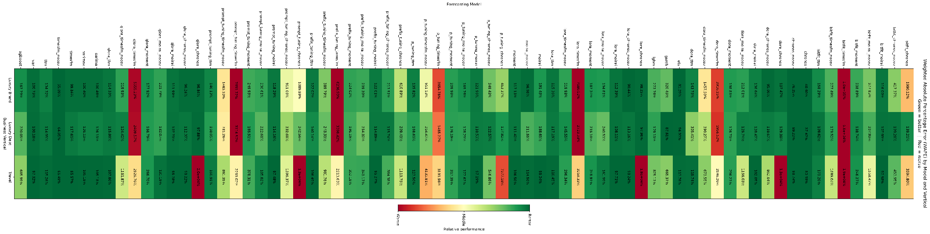
Appendix B: WAPE by Model and Vertical
Figure A1. Weighted Absolute Percentage Error (WAPE) by model and business vertical.

Slide 26
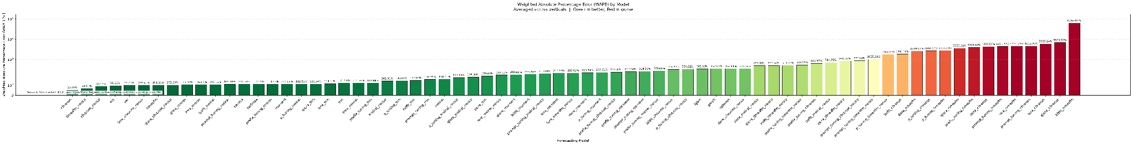
Appendix B: WAPE by Model (Average)
Figure A2. Weighted Absolute Percentage Error (WAPE) by model, averaged across verticals.

Slide 27
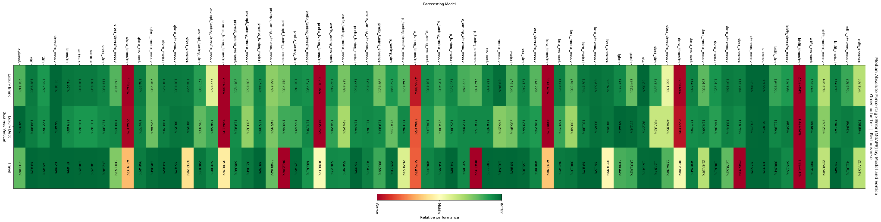
Appendix B: MdAPE by Model and Vertical
Figure A3. Median Absolute Percentage Error (MdAPE) by model and business vertical.

Slide 28
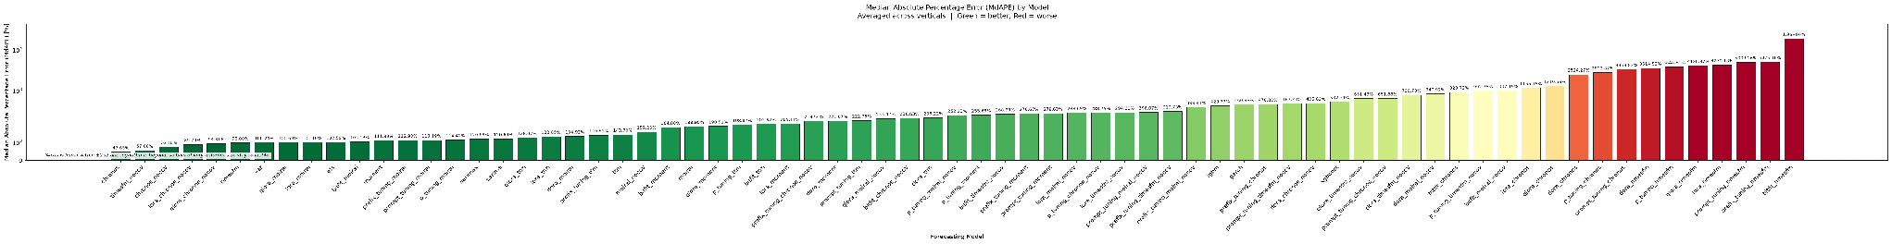
Appendix B: MdAPE by Model (Average)
Figure A4. Median Absolute Percentage Error (MdAPE) by model, averaged across verticals.

Slide 29
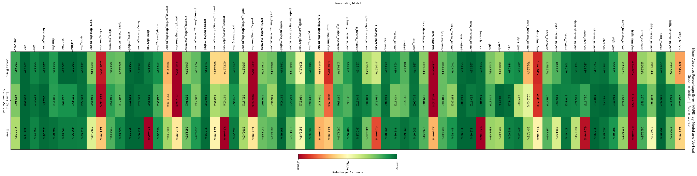
Appendix B: MAPE by Model and Vertical
Figure A5. Mean Absolute Percentage Error (MAPE) by model and business vertical.

Slide 30
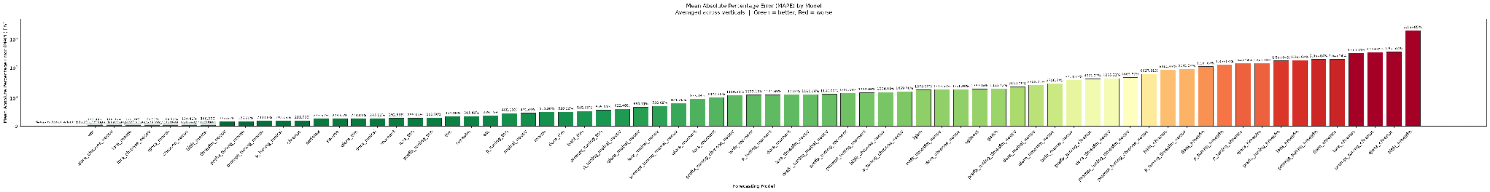
Appendix B: MAPE by Model (Average)
Figure A6. Mean Absolute Percentage Error (MAPE) by model, averaged across verticals.

Slide 31
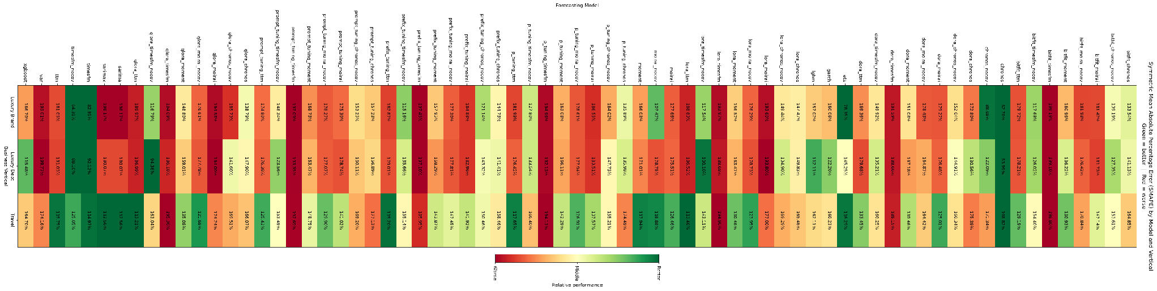
Appendix B: SMAPE by Model and Vertical
Figure A7. Symmetric Mean Absolute Percentage Error (SMAPE) by model and business vertical.

Slide 32
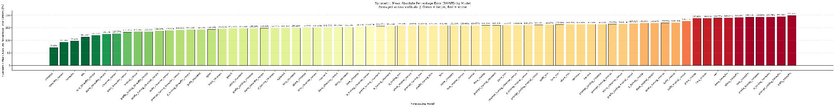
Appendix B: SMAPE by Model (Average)
Figure A8. Symmetric Mean Absolute Percentage Error (SMAPE) by model, averaged across verticals.

Slide 33

Appendix B: MAE by Model and Vertical
Figure A9. Mean Absolute Error (MAE) by model and business vertical.

Slide 34
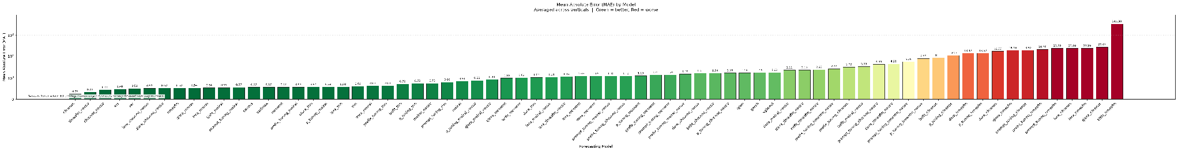
Appendix B: MAE by Model (Average)
Figure A10. Mean Absolute Error (MAE) by model, averaged across verticals.

Slide 35
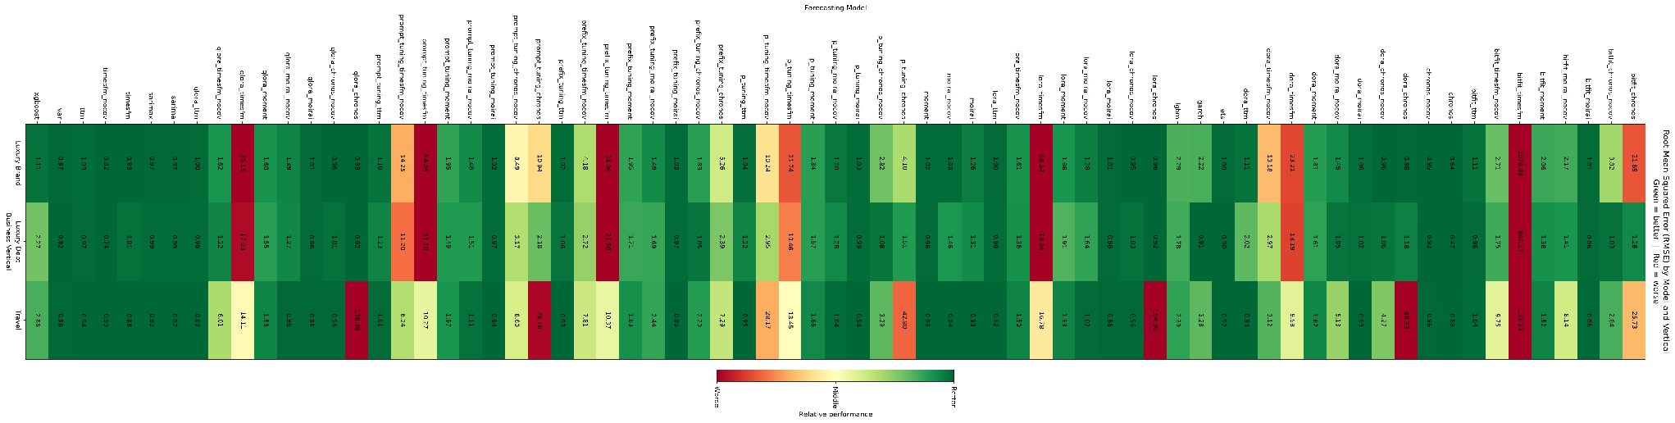
Appendix B: RMSE by Model and Vertical
Figure A11. Root Mean Squared Error (RMSE) by model and business vertical.

Slide 36
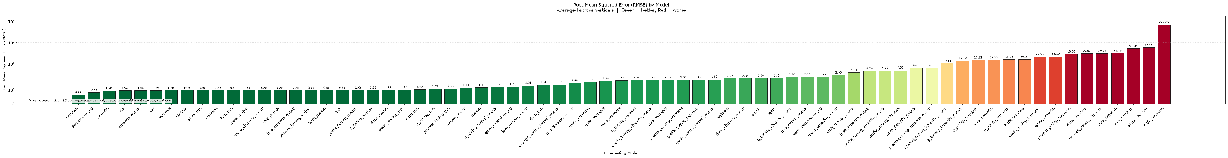
Appendix B: RMSE by Model (Average)
Figure A12. Root Mean Squared Error (RMSE) by model, averaged across verticals.

Slide 37
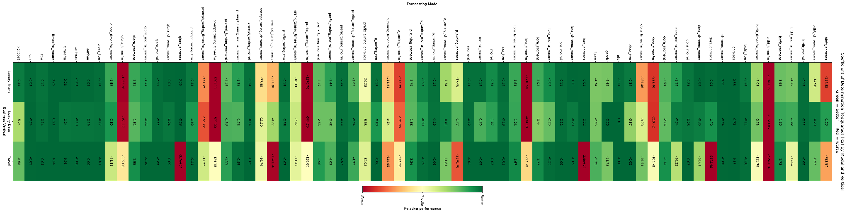
Appendix B: R² by Model and Vertical
Figure A13. Coefficient of Determination (R²) by model and business vertical.

Slide 38
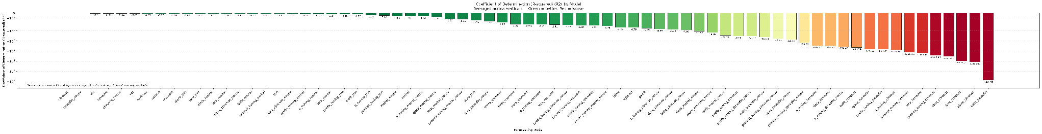
Appendix B: R² by Model (Average)
Figure A14. Coefficient of Determination (R²) by model, averaged across verticals.

Slide 39
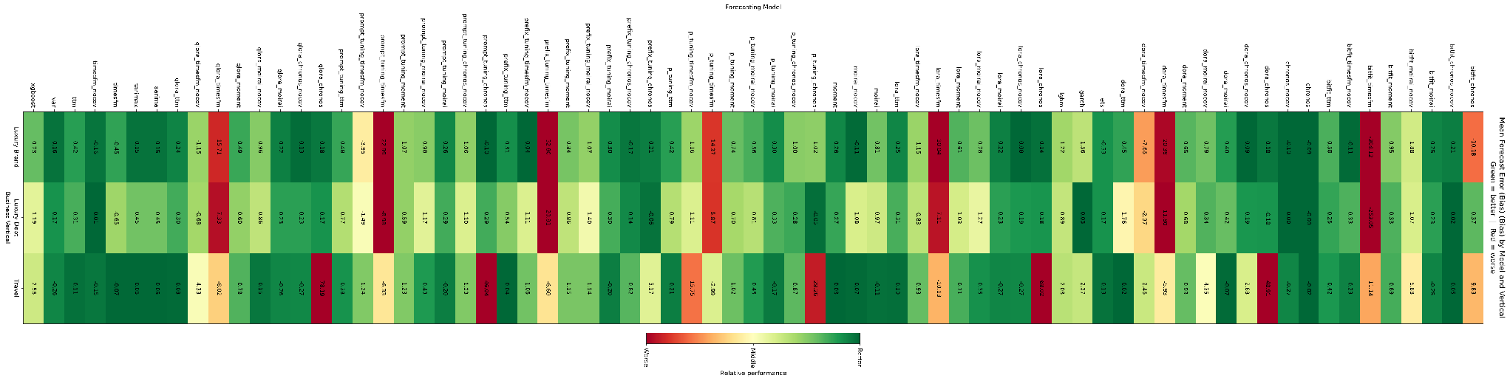
Appendix B: Bias by Model and Vertical
Figure A15. Mean Forecast Error (Bias) by model and business vertical.

Slide 40
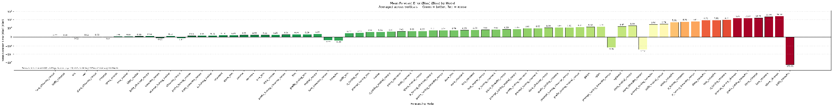
Appendix B: Bias by Model (Average)
Figure A16. Mean Forecast Error (Bias) by model, averaged across verticals.

Slide 41
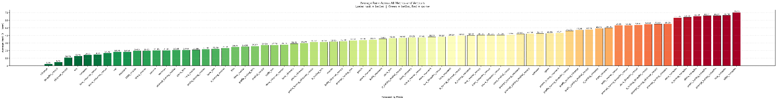
Appendix B: Overall Model Ranking
Figure A17. Average rank across all eight evaluation metrics and all verticals for every model configuration, where a rank of 1 is best. Reproduced from Figure 6.

Slide 42
Appendix C: Fine-Tuning Comparison Charts
This appendix contains the complete set of charts for the fine-tuning comparison, covering the foundation-model backbones and their variants under each of the seven parameter-efficient fine-tuning methods (LoRA, QLoRA, DoRA, BitFit, prompt tuning, prefix tuning, and P-tuning).
For each of the eight evaluation metrics there are three charts: a heatmap of per-vertical performance, a bar chart of the cross-vertical average, and an improvement chart expressing each fine-tuned variant's change relative to its own base model, in which positive values always indicate that fine-tuning improved that metric.
The same red-yellow-green color convention from Appendix B applies throughout.

Slide 43
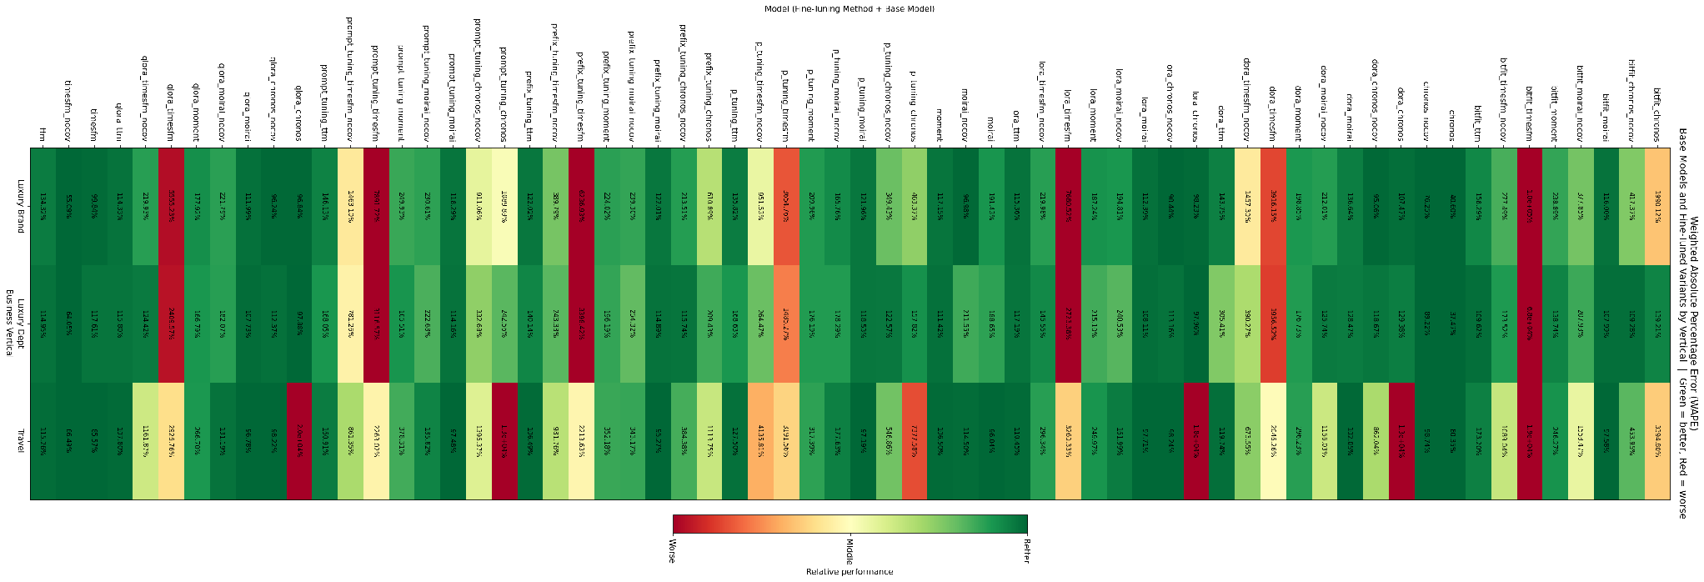
Appendix C: WAPE — Fine-Tuned Models by Vertical
Figure B1. Weighted Absolute Percentage Error (WAPE) by model and business vertical.

Slide 44
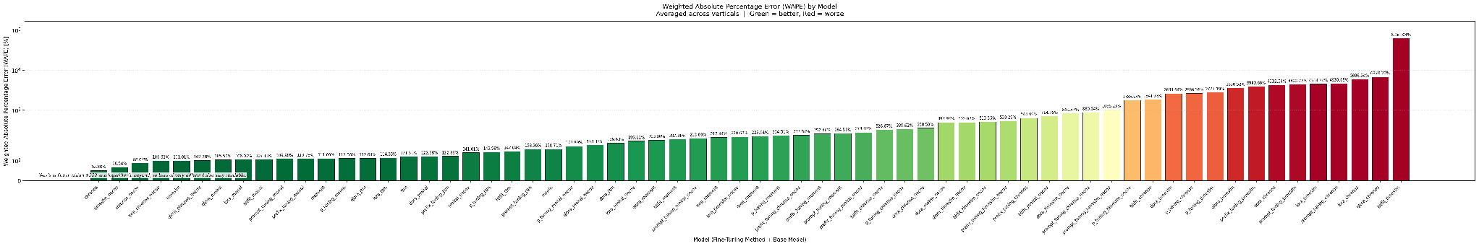
Appendix C: WAPE — Fine-Tuned Models (Average)
Figure B2. Weighted Absolute Percentage Error (WAPE) by model, averaged across verticals.

Slide 45
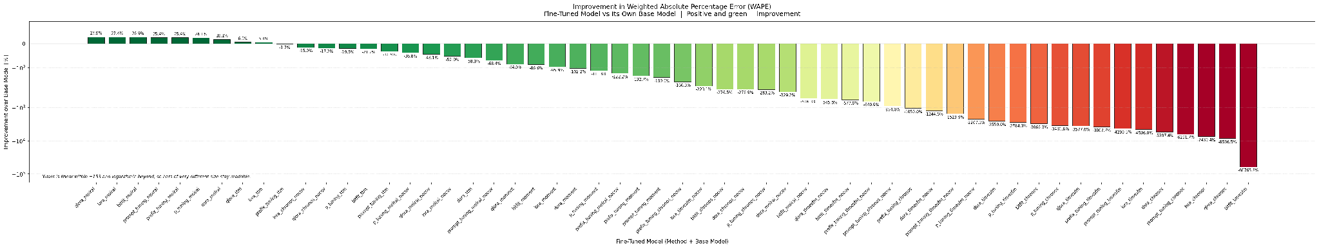
Appendix C: WAPE Improvement from Fine-Tuning
Figure B3. Improvement in WAPE from fine-tuning, for each fine-tuned model relative to its own base model.

Slide 46
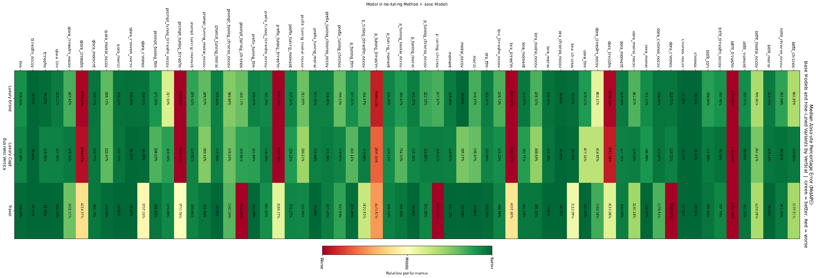
Appendix C: MdAPE — Fine-Tuned Models by Vertical
Figure B4. Median Absolute Percentage Error (MdAPE) by model and business vertical.

Slide 47
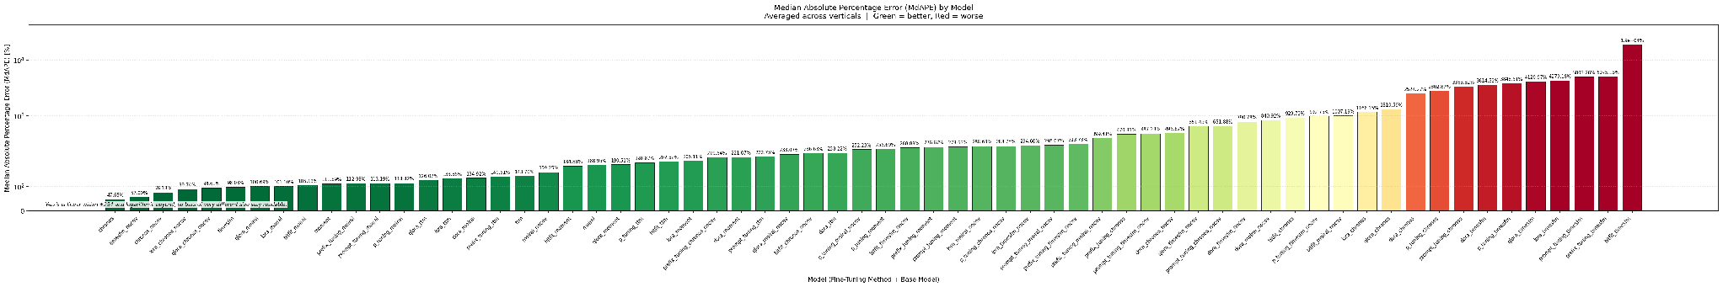
Appendix C: MdAPE — Fine-Tuned Models (Average)
Figure B5. Median Absolute Percentage Error (MdAPE) by model, averaged across verticals.

Slide 48
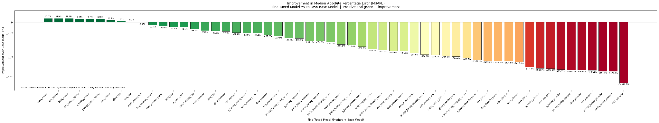
Appendix C: MdAPE Improvement from Fine-Tuning
Figure B6. Improvement in MdAPE from fine-tuning, for each fine-tuned model relative to its own base model.

Slide 49
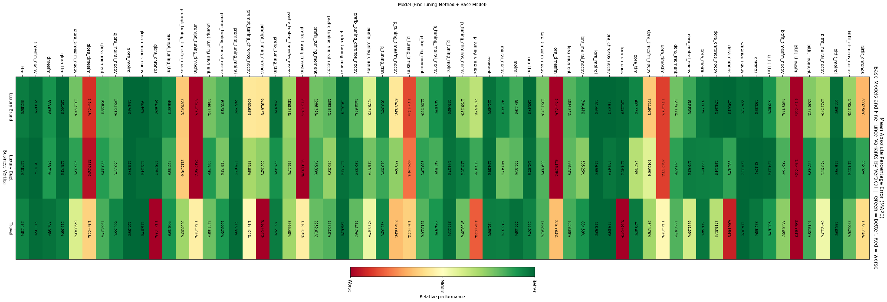
Appendix C: MAPE — Fine-Tuned Models by Vertical
Figure B7. Mean Absolute Percentage Error (MAPE) by model and business vertical.

Slide 50
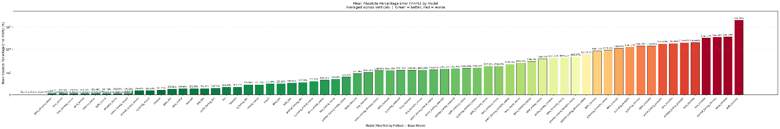
Appendix C: MAPE — Fine-Tuned Models (Average)
Figure B8. Mean Absolute Percentage Error (MAPE) by model, averaged across verticals.

Slide 51
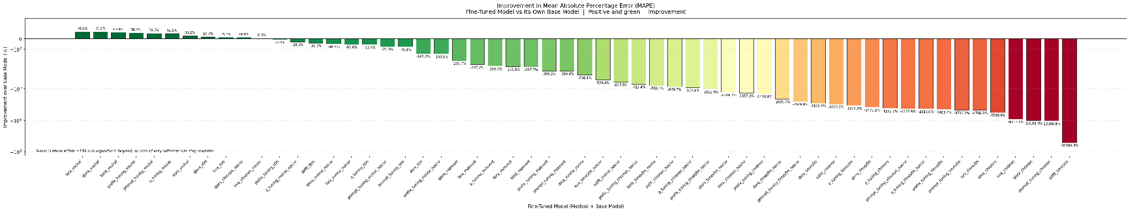
Appendix C: MAPE Improvement from Fine-Tuning
Figure B9. Improvement in MAPE from fine-tuning, for each fine-tuned model relative to its own base model.

Slide 52
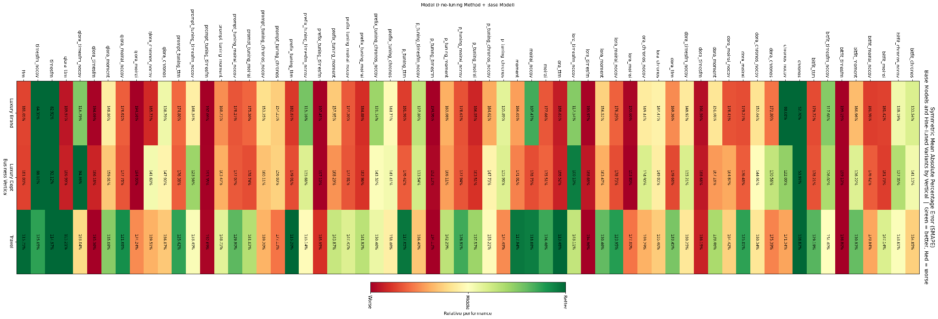
Appendix C: SMAPE — Fine-Tuned Models by Vertical
Figure B10. Symmetric Mean Absolute Percentage Error (SMAPE) by model and business vertical.

Slide 53
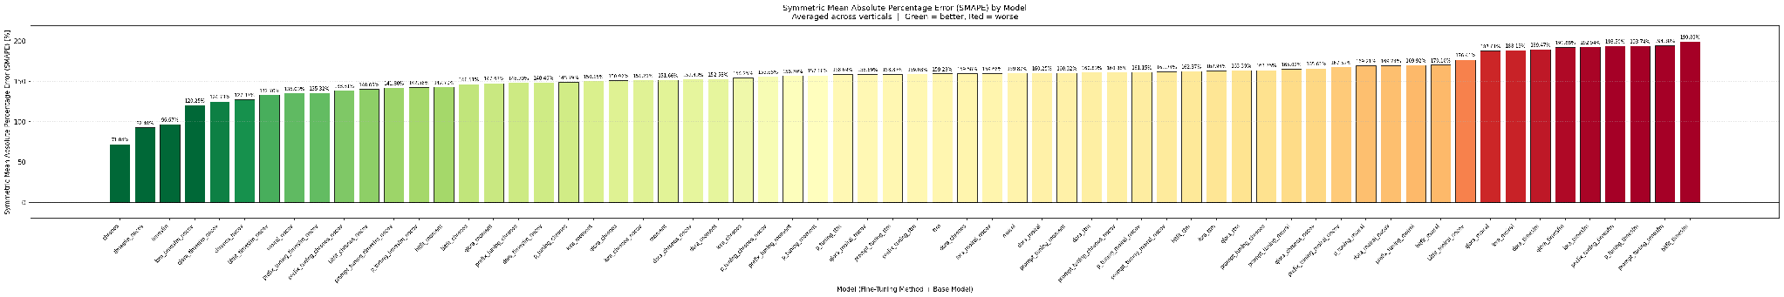
Appendix C: SMAPE — Fine-Tuned Models (Average)
Figure B11. Symmetric Mean Absolute Percentage Error (SMAPE) by model, averaged across verticals.

Slide 54
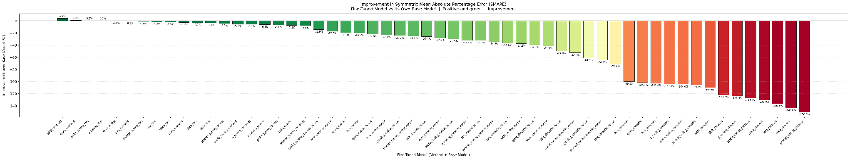
Appendix C: SMAPE Improvement from Fine-Tuning
Figure B12. Improvement in SMAPE from fine-tuning, for each fine-tuned model relative to its own base model.

Slide 55
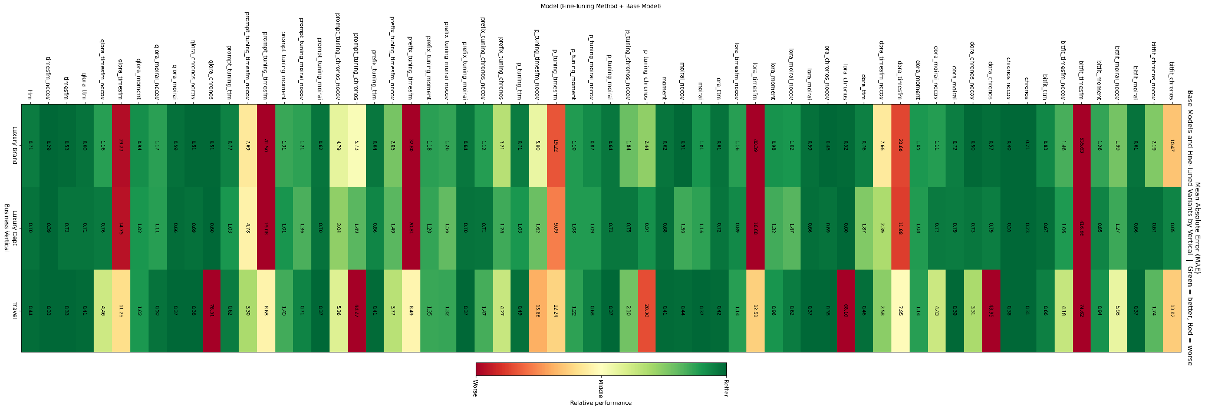
Appendix C: MAE — Fine-Tuned Models by Vertical
Figure B13. Mean Absolute Error (MAE) by model and business vertical.

Slide 56
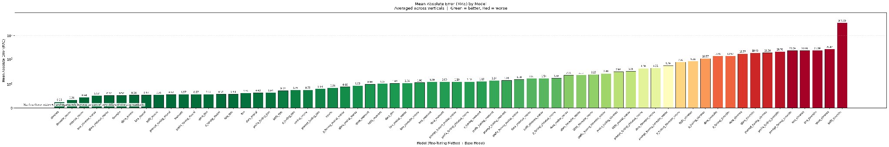
Appendix C: MAE — Fine-Tuned Models (Average)
Figure B14. Mean Absolute Error (MAE) by model, averaged across verticals.

Slide 57
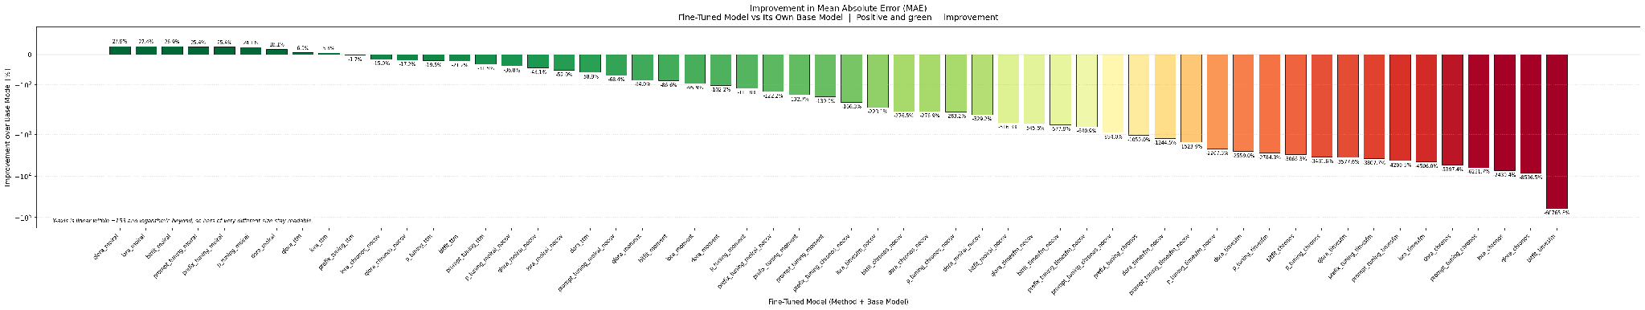
Appendix C: MAE Improvement from Fine-Tuning
Figure B15. Improvement in MAE from fine-tuning, for each fine-tuned model relative to its own base model.

Slide 58
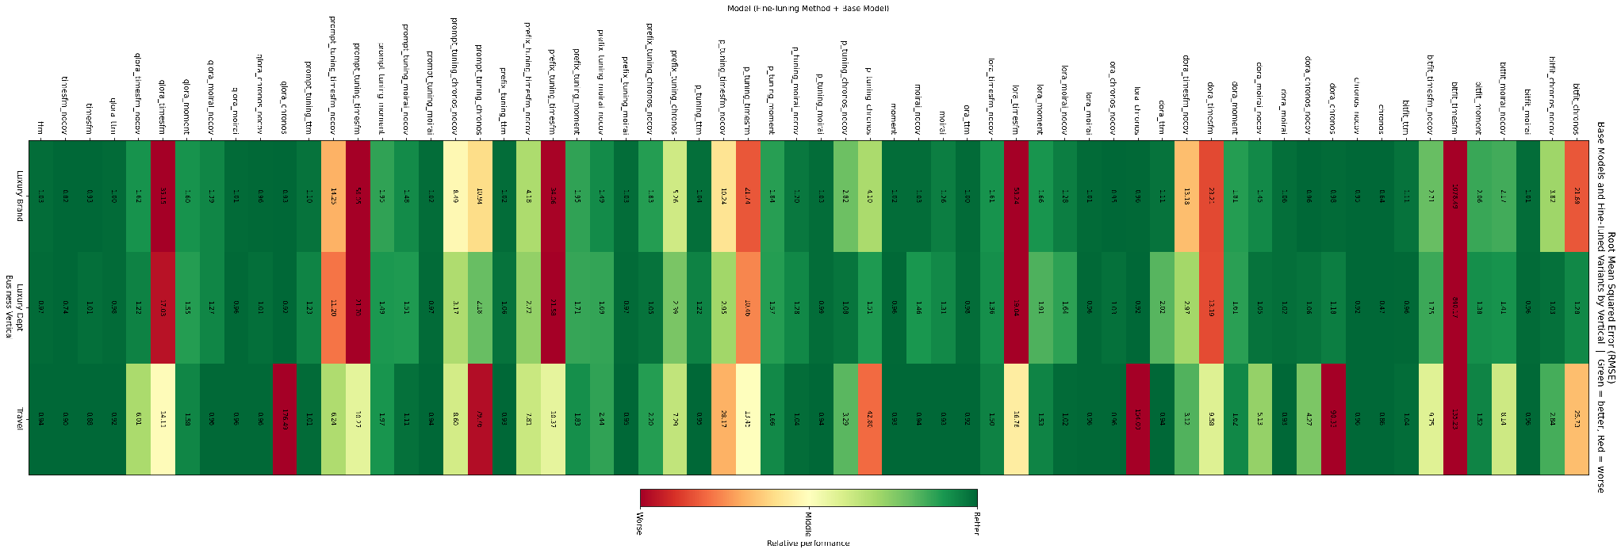
Appendix C: RMSE — Fine-Tuned Models by Vertical
Figure B16. Root Mean Squared Error (RMSE) by model and business vertical.

Slide 59
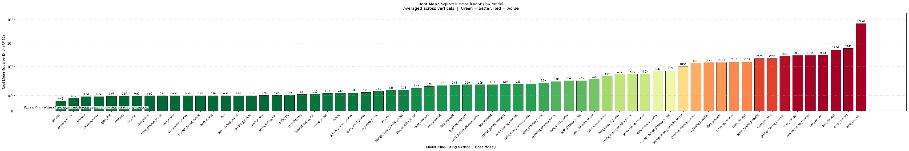
Appendix C: RMSE — Fine-Tuned Models (Average)
Figure B17. Root Mean Squared Error (RMSE) by model, averaged across verticals.

Slide 60
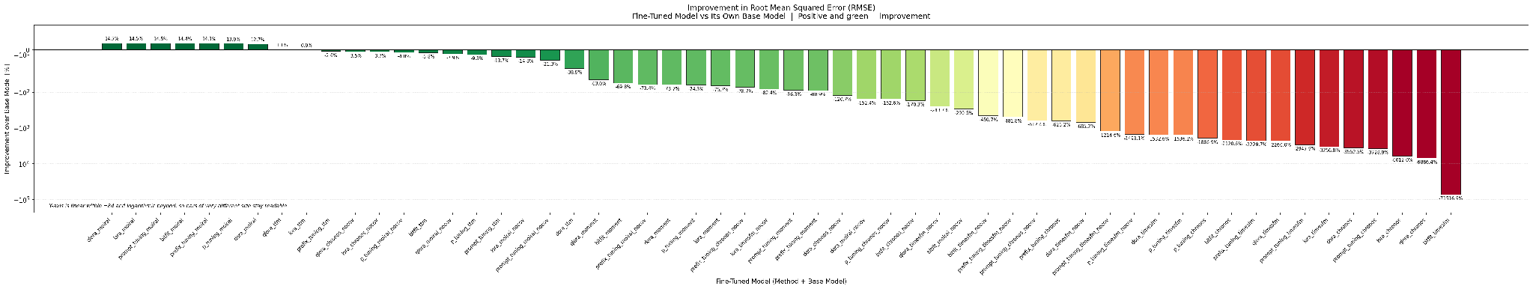
Appendix C: RMSE Improvement from Fine-Tuning
Figure B18. Improvement in RMSE from fine-tuning, for each fine-tuned model relative to its own base model.

Slide 61
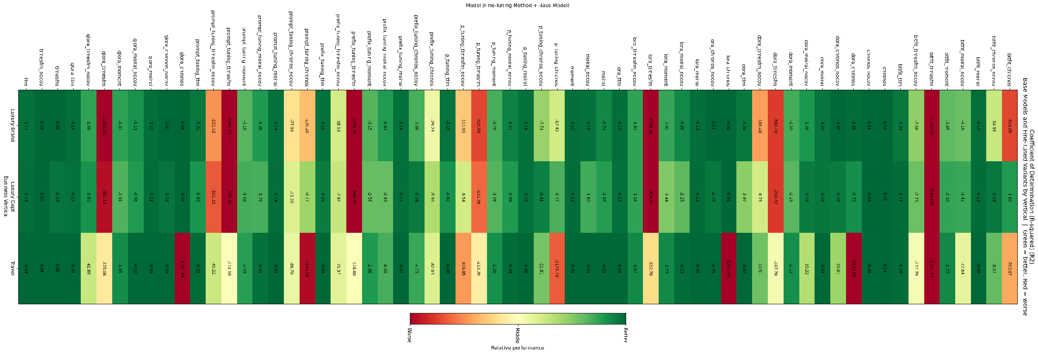
Appendix C: R² — Fine-Tuned Models by Vertical
Figure B19. Coefficient of Determination (R²) by model and business vertical.

Slide 62
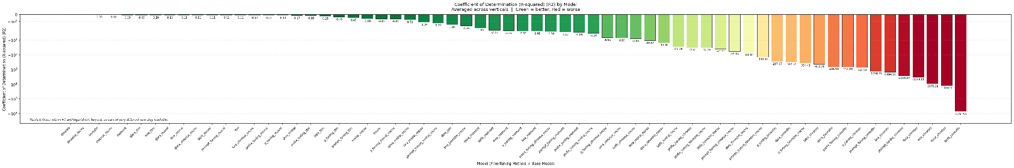
Appendix C: R² — Fine-Tuned Models (Average)
Figure B20. Coefficient of Determination (R²) by model, averaged across verticals.

Slide 63
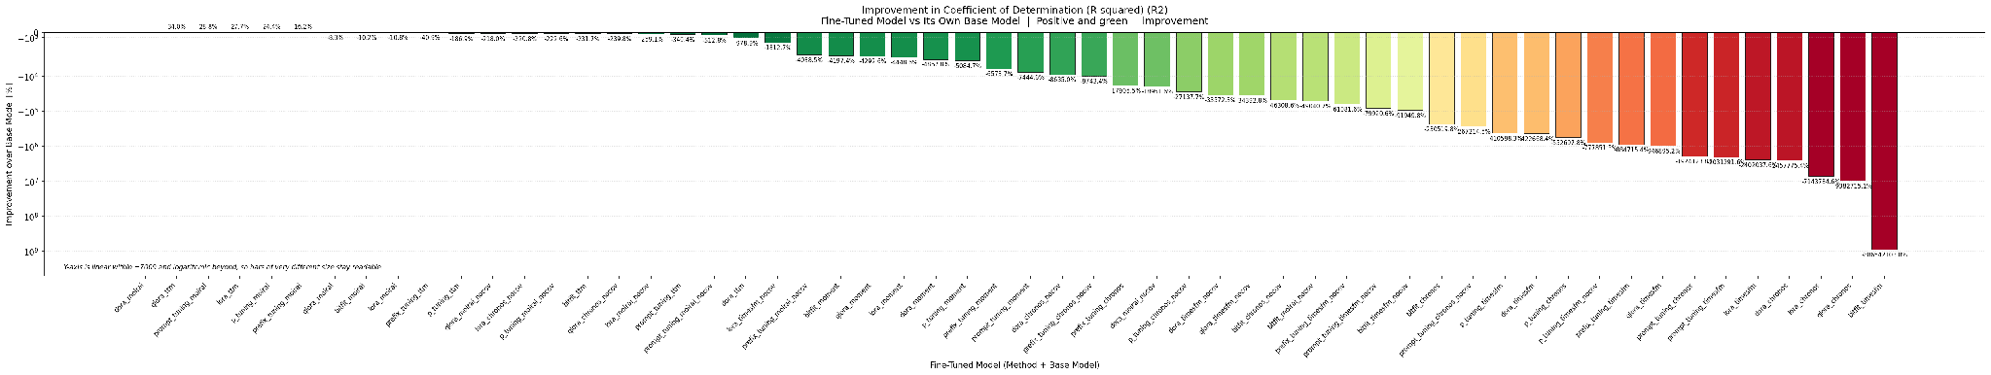
Appendix C: R² Improvement from Fine-Tuning
Figure B21. Improvement in R² from fine-tuning, for each fine-tuned model relative to its own base model.

Slide 64
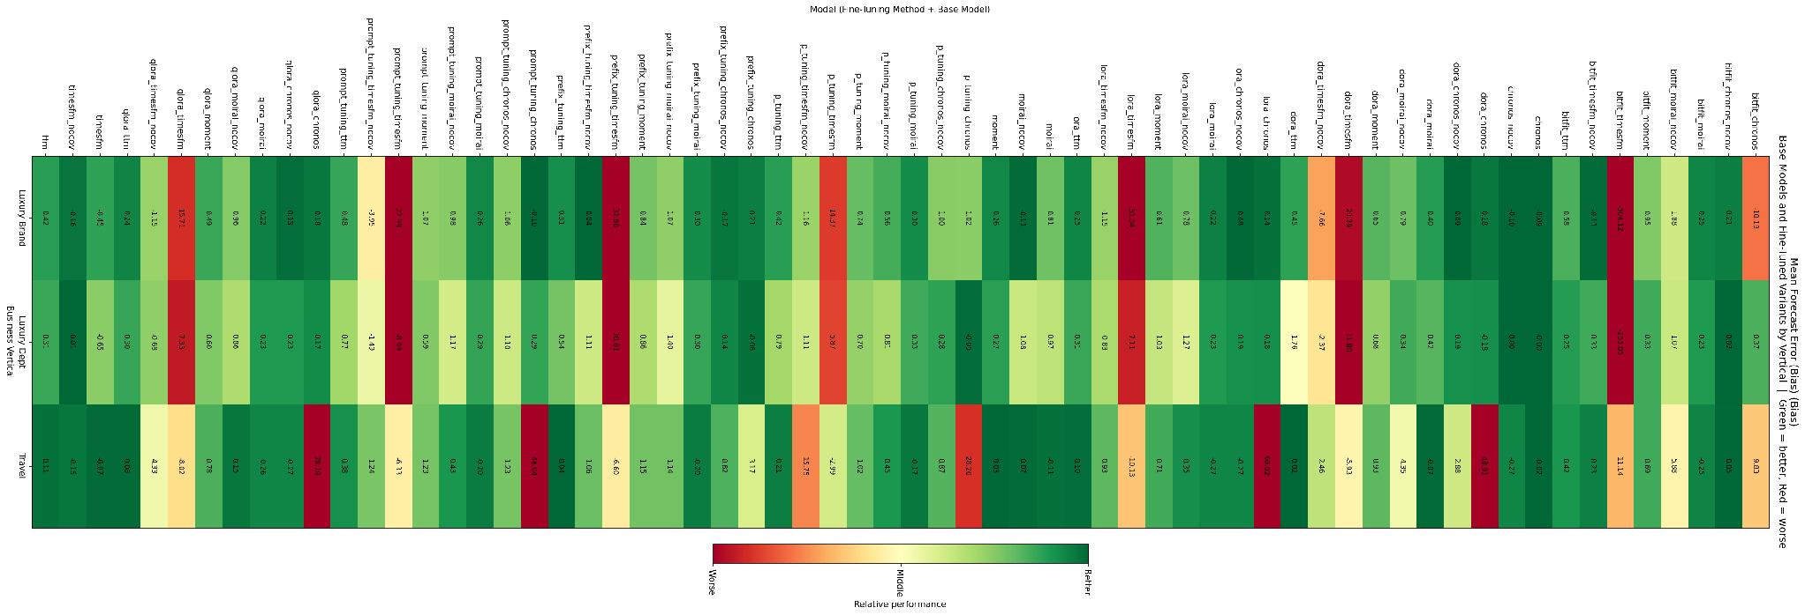
Appendix C: Bias — Fine-Tuned Models by Vertical
Figure B22. Mean Forecast Error (Bias) by model and business vertical.

Slide 65
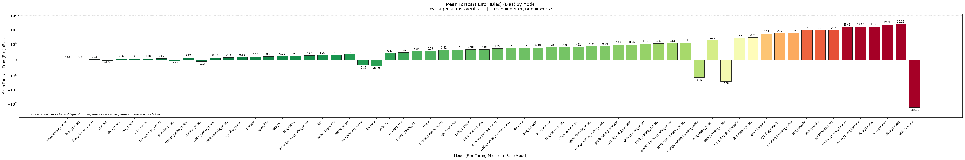
Appendix C: Bias — Fine-Tuned Models (Average)
Figure B23. Mean Forecast Error (Bias) by model, averaged across verticals.

Slide 66
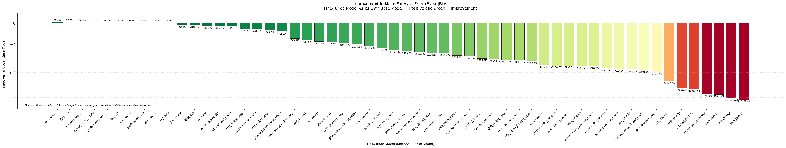
Appendix C: Bias Improvement from Fine-Tuning
Figure B24. Improvement in Mean Forecast Error (Bias) from fine-tuning, for each fine-tuned model relative to its own base model.

Slide 67
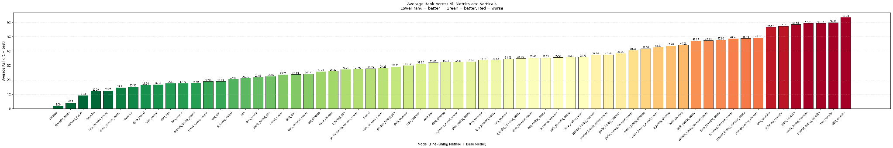
Appendix C: Fine-Tuned Model Ranking (Average)
Figure B25. Average rank across all eight evaluation metrics and all verticals for the foundation models and their fine-tuned variants, where a rank of 1 is best.

Slide 68
Appendix D: Time Horizon Comparison Charts
This appendix contains the forecast-horizon comparison charts, which re-evaluate the models at four horizons (1 month, 3 months, 6 months, and 12 months) using the same chronological train/test protocol described in the Methodology.
The first three figures aggregate across the three business verticals; the final three break the same comparisons out by vertical.
In the line charts, each series is one model and lower values indicate better accuracy; the vertical axis is capped at 260% so that the competitive models remain distinguishable. In the fine-tuning success charts, the dashed reference line marks 50%, the level at which fine-tuning would help and harm equally often.

Slide 69
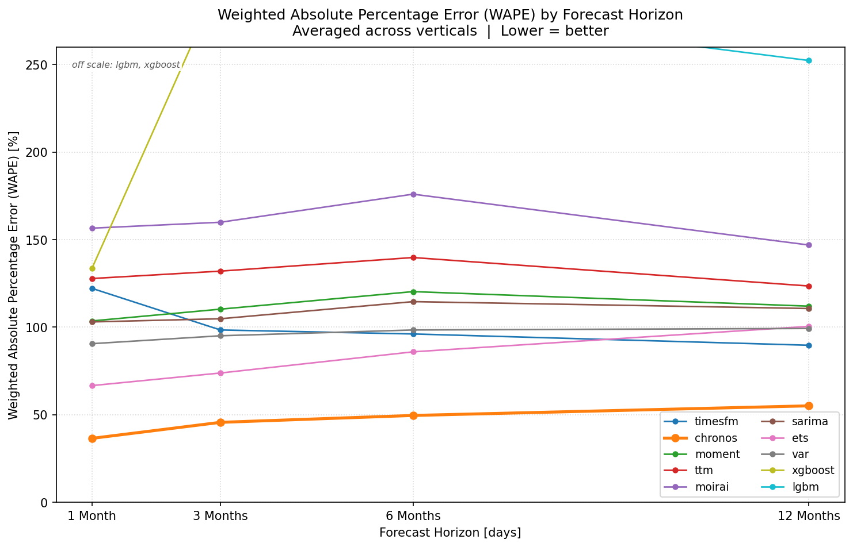
Appendix D: WAPE by Forecast Horizon
Figure C1. Weighted Absolute Percentage Error (WAPE) by forecast horizon, averaged across the three business verticals. Reproduced from Figure 8.

Slide 70
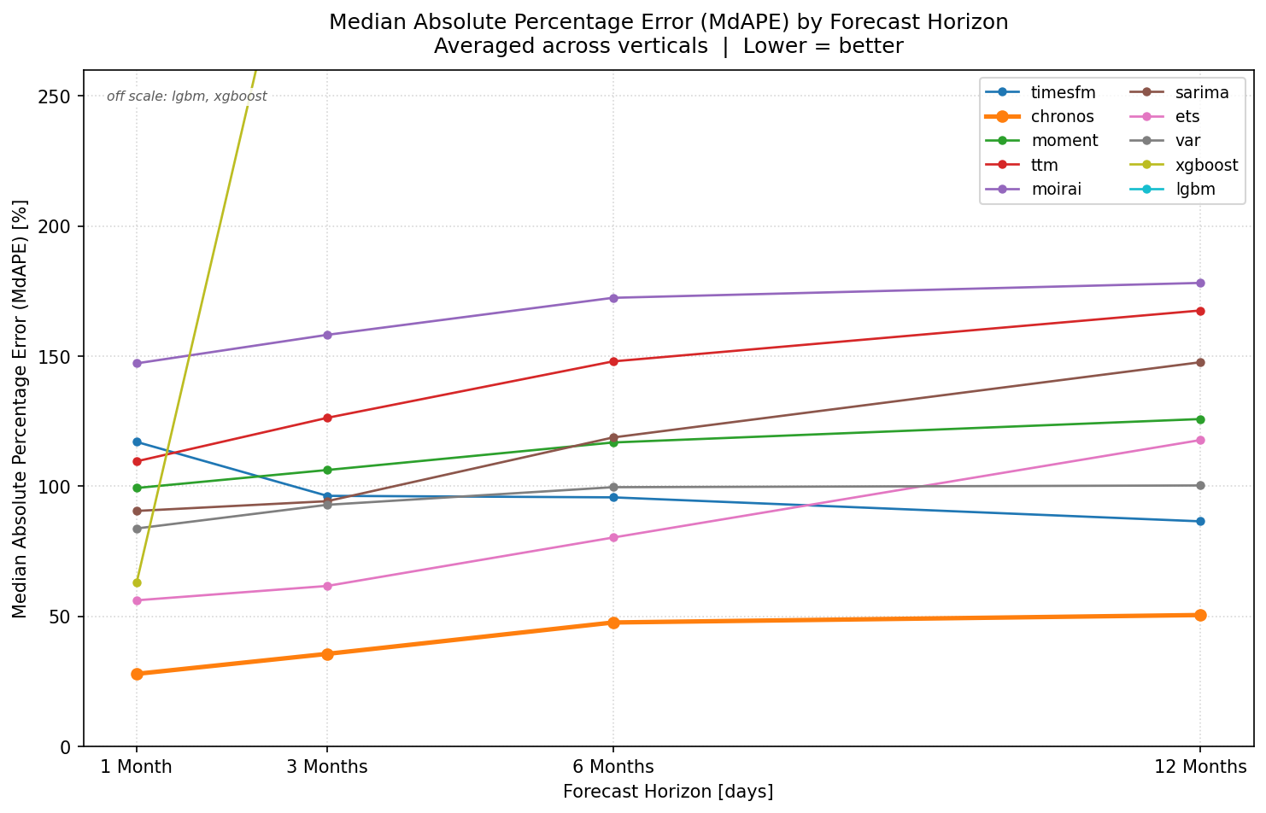
Appendix D: MdAPE by Forecast Horizon
Figure C2. Median Absolute Percentage Error (MdAPE) by forecast horizon, averaged across the three business verticals.

Slide 71
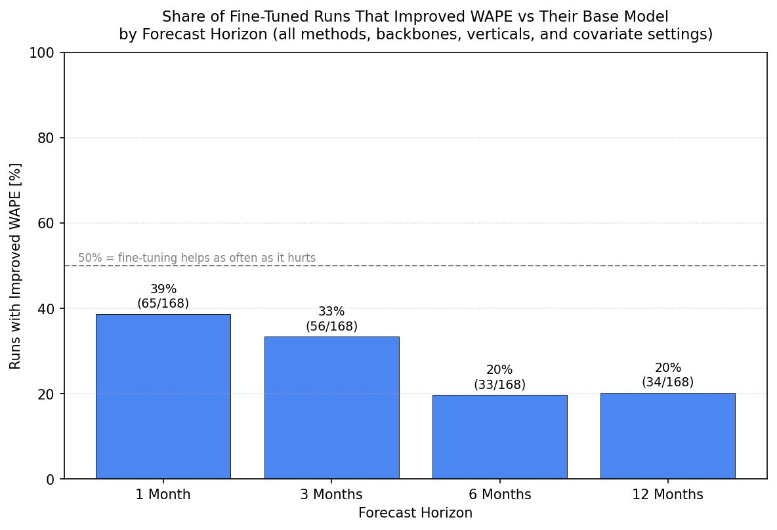
Appendix D: Fine-Tuning Success by Horizon
Figure C3. Share of fine-tuned runs that improved WAPE over their own base model, by forecast horizon. Reproduced from Figure 9.

Slide 72
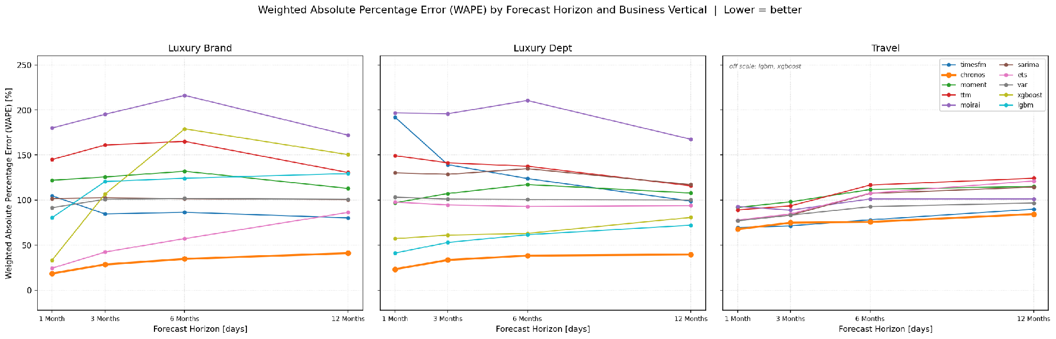
Appendix D: WAPE by Horizon and Vertical
Figure C4. Weighted Absolute Percentage Error (WAPE) by forecast horizon, shown separately for each business vertical.

Slide 73
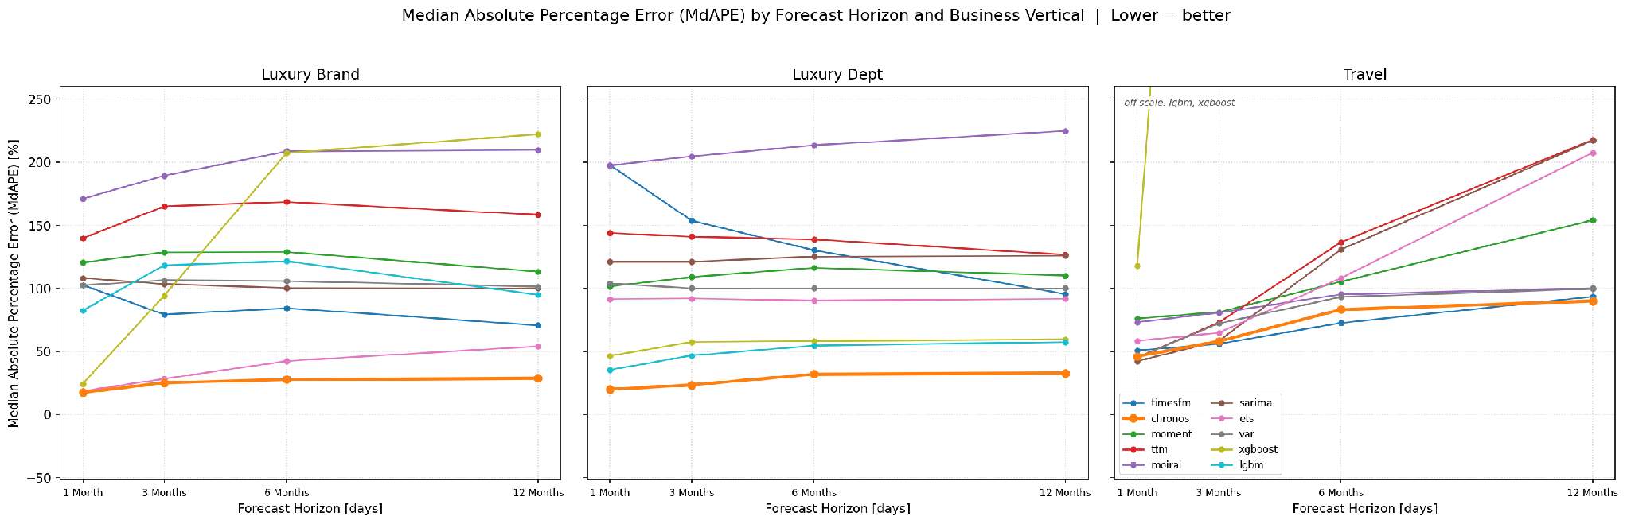
Appendix D: MdAPE by Horizon and Vertical
Figure C5. Median Absolute Percentage Error (MdAPE) by forecast horizon, shown separately for each business vertical.

Slide 74

Appendix D: Fine-Tuning Success by Horizon and Vertical
Figure C6. Share of fine-tuned runs that improved WAPE over their own base model, by forecast horizon and business vertical.

Slide 75
Appendix E: Cost Savings Calculation
Current cost
Projected cost
Projected Savings
400 forecasts/month × 12
= 4,800 forecasts/year
4,800 × 6 hours
= 28,800 hours × $75
= $2.16M/year
85% time reduction leaves
~1 hour per forecast
for review
4,800 × 0.9
= 4,320 hours × $75
= $324K/year
$1.84M
per year

Slide 76
Appendix F: Model Definitions
SARIMA
SARIMAX
ETS
VAR
Autoregressive trend and seasonality modeling on a single series.
SARIMA extended with exogenous calendar regressors.
Level, trend, and seasonal decomposition via exponential smoothing.
Multivariate modeling of interdependent time series.
GARCH
LightGBM
XGBoost
Chronos
Models time-varying volatility (heteroskedasticity) in the series.
Histogram-based gradient-boosted trees, optimized for speed and scale.
Gradient-boosted trees over engineered lag and rolling features.
Tokenizes time series values and forecasts with a pretrained language model (Amazon, T5-based).
TimesFM
Moirai
MOMENT
TTM
Decoder-only pretrained transformer (Google) for zero-shot forecasting.
Masked encoder transformer (Salesforce) handling arbitrary frequencies via any-variate attention.
Masked-pretraining transformer for forecasting, classification, anomaly detection, and imputation.
Lightweight MLP-Mixer model (IBM), no attention, fast zero/few-shot forecasting.

Slide 77
Appendix F: PEFT Method Definitions
LoRA
QLoRA
DoRA
BitFit
Injects trainable low-rank matrices into frozen backbone weights. Rank 8, alpha 16.
LoRA with simulated 4-bit (NF4) quantization of the frozen down-projection. Rank 4, alpha 16.
Decomposes weight updates into magnitude and direction; LoRA applied only to direction. Rank 8, alpha 16.
Fine-tunes only the bias terms; all other weights stay frozen. Hidden dim 64, 2 layers.
Prompt Tuning
Prefix Tuning
P-Tuning
Learns a continuous prompt vector prepended to input embeddings; backbone frozen. Prompt length 8, dim 32.
Learns continuous vectors prepended to keys/values at each layer; backbone frozen. 4 layers, prefix length 8.
Learns a continuous prompt via a small trainable encoder rather than direct embeddings; backbone frozen. Prompt length 8, dim 32.
Shared across all seven adapters: context length 128, horizon 24, dropout 0.05, 3 epochs, batch size 8, learning rate 1e-3 (AdamW), trained on the most recent 25 sliding windows.

Slide 78
Appendix F: Hyperparameter Tuning Protocol
1. Validation Split
2. Grid Search
3. Selection
4. Refit & Test
A 178-day validation slice is carved from the tail of each vertical's training partition; the preceding 1,012 observations form tuning-train.
Every hyperparameter combination is fit on tuning-train and scored on the validation slice across nine metrics. 130 configurations per vertical, 390 total.
The configuration with the lowest validation RMSE wins; the full scoreboard and winning config are logged per model and vertical.
The winning configuration is refit on the full training partition and forecasts the untouched test window exactly once.
Context length 512 was selected in 13 of 15 foundation-model slots, and every vertical chose weekly (period-7) seasonality where available. PEFT adapters use fixed hyperparameters with no grid search (Appendix F: PEFT Method Definitions).
Note: tune flags for Moirai, MOMENT, TimesFM, TTM, and VAR are currently saved as False in src/models, and the dashboard defaults to tune=False unless the caller opts in — reconcile before this goes into an external report.

Slide 79
Appendix F: Hyperparameter Search Spaces
Model | Grid | Combos
SARIMA | order in {(1,0,0), (1,1,0), (1,1,1), (2,1,1)}; seasonal_order in {(0,0,0,0), (1,0,1,7), (1,1,1,7), (1,1,1,30)}; trend = None | 16
SARIMAX | Same grid as SARIMA (exogenous calendar features held fixed) | 16
ETS | error = add; trend in {None, add}; seasonal in {None, add}; seasonal_periods in {7, 30}; damped_trend in {False, True} | 12
VAR | maxlags in {1, 2, 3, 7}; trend in {c, n} | 8
GARCH | p in {1, 2}; q in {1, 2}; mean in {Constant, Zero}; vol = GARCH; dist in {normal, t} | 16
LightGBM | n_estimators in {300, 500}; learning_rate in {0.03, 0.05}; num_leaves in {15, 31}; max_depth in {-1, 6} | 16
XGBoost | n_estimators in {300, 500}; learning_rate in {0.03, 0.05}; max_depth in {3, 5}; subsample in {0.8, 0.9} | 16
Chronos | context_length in {256, 512}; num_samples in {50, 100} | 4
TimesFM | max_context in {256, 512}; max_horizon in {64, 128} | 4
Moirai | context_length in {256, 512}; num_samples in {50, 100}; patch_size = auto | 4
MOMENT | context_length in {256, 512}; forecast_horizon = 96 | 2
TTM | context_length = 512; prediction_length in {96, 192, 336, 720} | 4
Held fixed outside the grids: gradient-boosting lags = (1, 7, 14, 30), rolling_windows = (7, 14, 30), colsample_bytree = 0.9, reg_lambda = 1.0, reg_alpha = 0.0, random_state = 42; statistical models alpha = 0.20 with enforce_stationarity and enforce_invertibility both False; GARCH rescale_factor = 100; Moirai model_size = small, batch_size = 32; TimesFM normalize_inputs = True; TTM scaling = True. 130 configurations evaluated per vertical, 390 total.

Slide 80
Appendix F: Selected Hyperparameters — Statistical/ML
Model | Luxury Brand | Luxury Dept | Travel
SARIMA | (1,0,0) x (1,0,1,7) | (1,1,1) x (1,1,1,7) | (2,1,1) x (1,0,1,7)
SARIMAX | (1,0,0) x (1,0,1,7) | (1,1,1) x (1,1,1,7) | (2,1,1) x (1,0,1,7)
ETS | add / no trend / add / 7 / undamped | add / add / add / 7 / damped | add / add / add / 7 / undamped
VAR | maxlags 2, trend n | maxlags 1, trend n | maxlags 7, trend n
GARCH | p1 q2, Constant, normal | p1 q1, Zero, normal | p2 q1, Constant, t
LightGBM | 500 / 0.05 / leaves 31 / depth -1 | 500 / 0.03 / leaves 15 / depth 6 | 500 / 0.05 / leaves 15 / depth -1
XGBoost | 500 / 0.03 / depth 3 / sub 0.8 | 300 / 0.03 / depth 3 / sub 0.8 | 300 / 0.03 / depth 3 / sub 0.8
Selection criterion: lowest validation RMSE, refit on the full training partition. ETS fields read error / trend / seasonal / seasonal_periods / damped_trend.

Slide 81
Appendix F: Selected Hyperparameters — Foundation Models
Model | Luxury Brand | Luxury Dept | Travel
Chronos | ctx 512, 50 samples | ctx 512, 50 samples | ctx 512, 50 samples
Chronos (nocov) | ctx 512, 50 samples | ctx 256, 100 samples | ctx 256, 100 samples
TimesFM | ctx 512, horizon 128 | ctx 512, horizon 64 | ctx 512, horizon 128
TimesFM (nocov) | ctx 512, horizon 128 | ctx 512, horizon 128 | ctx 512, horizon 128
Moirai | ctx 512, 50 samples | ctx 512, 100 samples | ctx 512, 100 samples
Moirai (nocov) | ctx 256, 50 samples | ctx 512, 100 samples | ctx 512, 100 samples
MOMENT | ctx 512, horizon 96 | ctx 512, horizon 96 | ctx 512, horizon 96
TTM | ctx 512, pred 96 | ctx 512, pred 96 | ctx 512, pred 96
Checkpoints: amazon/chronos-2, google/timesfm-2.5-200m-pytorch, AutonLab/MOMENT-1-small, ibm-granite/granite-timeseries-ttm-r2, Moirai small. Context length 512 was selected in 13 of 15 slots.

