Slide 1

GREENHOUSE GASSES & CLIMATE CHANGE
A Machine Learning Approach
Notes:
-Talk about what exactly our project is about and our inspiration
- Why global warming; and how our project focused on a different angle (ie; we focused on concentration in atmosphere VS emissions)

Slide 2
APPROACH
HYPOTHESIS
DATA
Regulations of greenhouse gasses have significantly lowered the impact of climate change, and their subsequent consequences.
By looking at the concentrations and not the emissions we can get straight to the source of truth and avoid any misreporting of emissions
The molecular concentration of 43 greenhouse gasses in the atmosphere (1880 – 2014)
ETHzurich, Department of Environmental Systems Science
The GCAG (Global Climate at a Glance) variation in temperature
NOAA (National Oceanic and Atmospheric Administration)
Severe Weather Events
NOAA – National Climatic Data Center
Notes:
-Go more in depth with hypothesis
-mention that global warming is a story that has many sides to the story, we want to present this story so people can come to conclusions by themselves
-Discuss how we pivoted from emissions VS concentration
-why?
-led to us seeing how effective regulations actually are

Slide 3
PREDICTING 2019 TEMPERATURE WITH GREENHOUSE GAS CONCENTRATIONS
Random Forest Regression
Forecasting with Algebra
Prediction with Random Forest
Each year was considered one datapoint
GCAG was our target (Temperature)
Molecular concentrations of each GHG were our features
This built our model and assigned impact on temperature to each GHG
We looked at 4 different periods of time to calculate slope of increase for each GHG
Pre-Regulation (1950-1970)
Regulation Infancy (1970-1988)
Post-Regulation (1988-2014)
Last 5 Years (2009-2014)
We used a linear forecast to estimate the 2019 concentrations of each GHG
We passed in our forecasts for each of the 4 periods to determine the predicted temperature
This was used to confirm a conclusion on our hypothesis
Hypothesis: Regulations of greenhouse gasses have significantly lowered the impact of climate change, and their subsequent consequences.

Slide 4
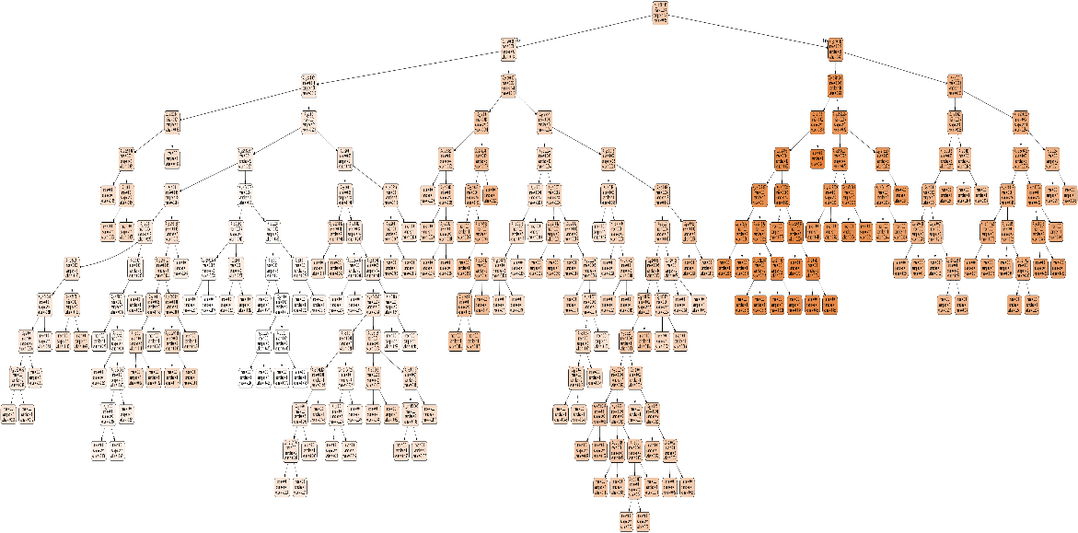
Random Forest Regression
Inspiration
Process
Flaws
Assumption
To pinpoint which chemicals were having the biggest impact on temperature change
GCAG was our target
Concentration of chemicals were used as our features
Greenhouse gases are only one side to the complex relationship between climate change and humans
CO2 is bad and will have the most prominent negative relationship

Slide 5

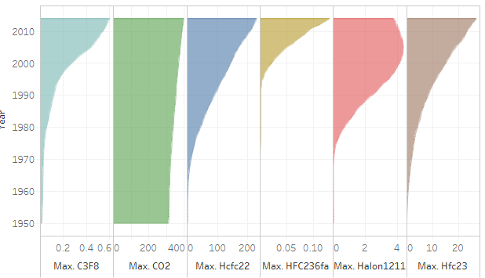
Top 5 Greenhouse Gas History
Halon1211
HFC23
Class: Haloalkane
Primary Use: Fire Extinguisher for aircrafts and tanks WW2
Banned since 1994 (Montreal Protocol)
Class: Hydrofluorocarbons
Primary Use: Fire Extinguisher, refrigerant, automobile AC
HFC22
HFC236FA
Class: Hydrofluorocarbons
Primary Use: Propane, refrigerant
Originally used as an alternative for high ozone depleting chemicals
High phase out % in developed countries
Class: Hydrofluorocarbons
Primary Use: Fire extinguisher, refrigerant
Most used alternative for Halon1211
No regulations
Class (ozone depleting substance, etc.)
History
Lifetime
Regulation

Slide 6
Forecasting with Algebra
Inspiration
Process
To test whether regulations influenced chemical emissions
To pinpoint regulations, leadership, and historic moments that drastically changed the trajectory of chemical concentration
We gathered slope intercepts of 3 prominent time spans
Pre-Regulation (1950-1970)
Regulation Infancy (1970-1988)
Post-Regulation (1988-2014)
We applied these slopes to the same time span 1970 to 1980
Flaws
Assumption
Some chemicals are not properly represented
We are limiting ourselves to a 10-year assumption
While regulations were put into place, when do we see the actual effects
How long does the chemical concentration remain in the atmosphere
We will see the largest predicted to actual % difference from pre-regulation eras, and a low predicted to actual % from post-regulation eras.

Slide 7
WHY THESE PERIODS OF TIME?
1950-1970
(Pre-Regulation)
1970-1988
(Regulation Infancy)
1988-2014
(Post-Regulation)
The Great Acceleration
Post WW2
London Smog
Creation of the Keeling Curve
Earth Day
UN Conference
National Environment Policy Act (NEPA)
Environmental Protection Agency (EPA)
Chernobyl
Intergovernmental Panel on Climate Change (IPCC)
Montreal Protocol
Kyoto Protocol
Public Concern
Notes:
-Dense heavy fogs, theorized to be caused by combination of nitrogen dioxide and sulfur dioxide
-caused over 6000 deaths
-Keeling curve first significant evidence of rapidly increasing carbon dioxide, measurements took on Hawaii
-UN first conference to address international environmental issues
-IPCC first nationally coordinated organization to address human environmental impact
-Montreal Protocol begins phasing out harmful chemicals
-Nixon creates the first environmental agency

Slide 8
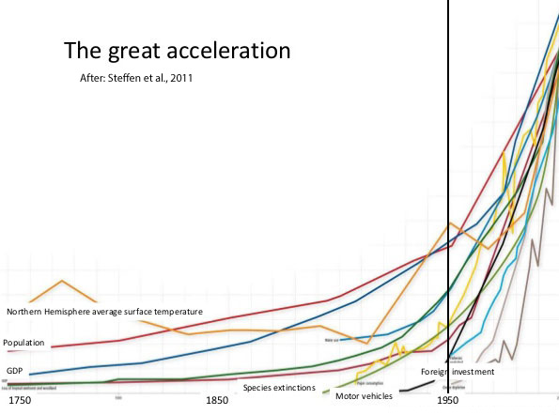

Slide 9
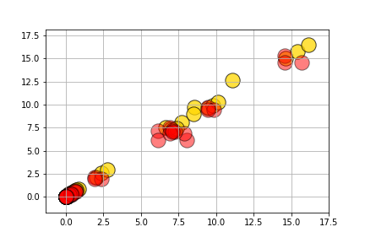
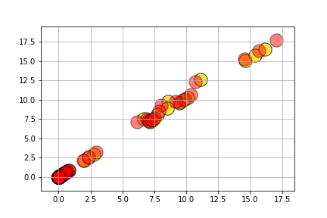
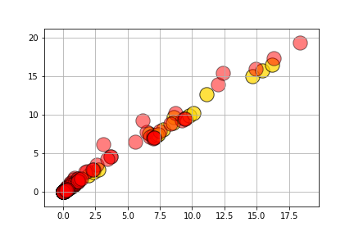
Chemical concentration from 1970 to 1980 (10-year span), based on our 3-time era slopes
RED = PREDICTED
GOLD = ACTUAL
1950-1970
1970-1988
1988-2014
Notes:
-Note that we expected a huge decrease after regulations
-results did surprise us
-what does this tell us?
-are regulations being followed? Regulations and agencies are put into place, but are they having any effect?
-trajectories are almost identical

Slide 10
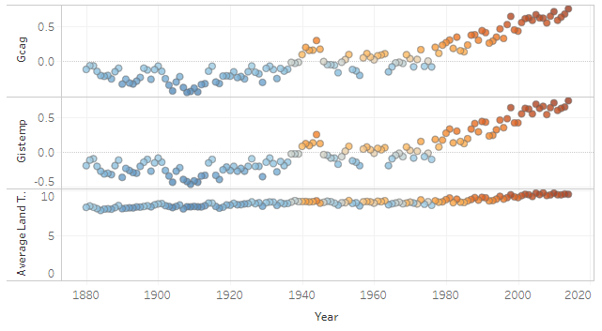
Random Forest Prediction
Inspiration
Process
Flaws
Assumption
?????????
????????????
??????????
????????????

Slide 11
But actually
GCAG = 0.8
Yada yada

Slide 12
Consequences of Climate Change (insert pictures of sad polar bears, methane bubbles, dead cattle, mosquitos)

Slide 13
But why tell you when we can Tabsheau you

Slide 14
Did that Tableau you away?

Slide 15
Regulation and Greenhouse Gasses
CFC11-Equivalent
CFC11-Equivalent is a standardized way to measure ODS (Ozone Depleting Substances) We used a linear regression model (with sklearn) to understand the correlation between the concentration of the CFC11-equivalent and the temperature.
72% R^2 value
0.02 MSE (Mean-Squared Error)
Model output images

Slide 16
Where Regulation Fails (add picture of graph output) speaking point will be on the Montreal Agreement

Slide 17
Conclusion
What did we learn?
How would we go further?
Our hypothesis was disproven
Regulations show that the world is taking climate change seriously, but are countries following through?
A clear definite rise in temperature and CO2 emissions, this can not be disputed, but their relationship is up to interpretation
Most harmful chemicals are addressed, but the replacements do not solve the problem at hand
HFC chemicals seem to have the highest impact on climate change
Dive more into emissions, what countries are not regulating?
Go into weather data, are severe weather events happening more often due to climate change?
Sea level and acidity level
Look more into the lingering effects of chemicals; when exactly do we see the results of regulations?
Look more in depth of regulations and their impacts; are regulations targeting specific chemicals?

Slide 18
THANK YOU

Slide 19
GENERAL

Slide 20
EDUCATION

