Slide 1
Working with OpenStreetMap data
Dr. Peter Mooney
FOSS4VGI Summer School 2015
Como, Italy

Slide 2
Some assumptions starting off..
You have heard about OpenStreetMap
You have seen an OpenStreetMap Map

Slide 3

This workshop lecture aims to provide a broad overview of working with OSM data
Introduce OpenStreetMap
Understand the OSM project, data model, contribution models, etc
Access data – understand how data is stored, extracted, queried, etc
TAKE HOME – An understanding of how OSM could be used in your work, your leisure, your life

Slide 4
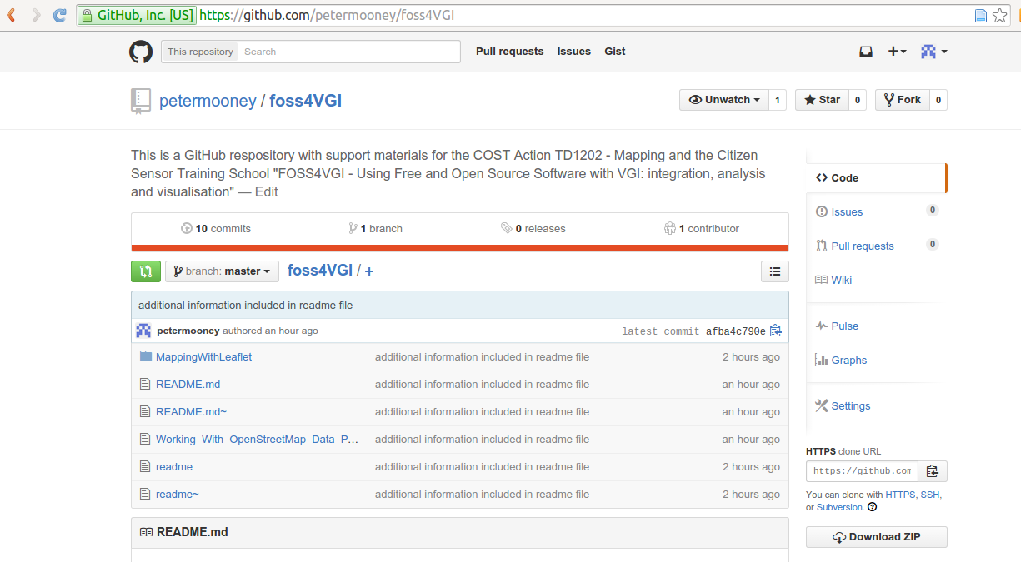
All materials shall be available on my GitHub pages
https://github.com/petermooney/foss4VGI

Slide 5
Wikipedia: OpenStreetMap
OpenStreetMap (OSM) is a collaborative project to create a free editable map of the world. Two major driving forces behind the establishment and growth of OSM have been restrictions on use or availability of map information across much of the world and the advent of inexpensive portable satellite navigation devices.
Created by Steve Coast in the UK in 2004, it was inspired by the success of Wikipedia and the preponderance of proprietary map data in the UK and elsewhere. Since then, it has grown to over 2 million registered users, who can collect data using manual survey, GPS devices, aerial photography, and other free sources. This crowdsourced data is then made available under the Open Database License.
Rather than the map itself, the data generated by the OpenStreetMap project is considered its primary output. This data is then available for use in both traditional applications, like its usage by Craigslist, OsmAnd, Geocaching, MapQuest Open, JMP statistical software, and Foursquare to replace Google Maps, and more unusual roles, like replacing default data included with GPS receivers. This data has been favourably compared with proprietary datasources, though data quality varies worldwide.
https://en.wikipedia.org/wiki/OpenStreetMap

Slide 6
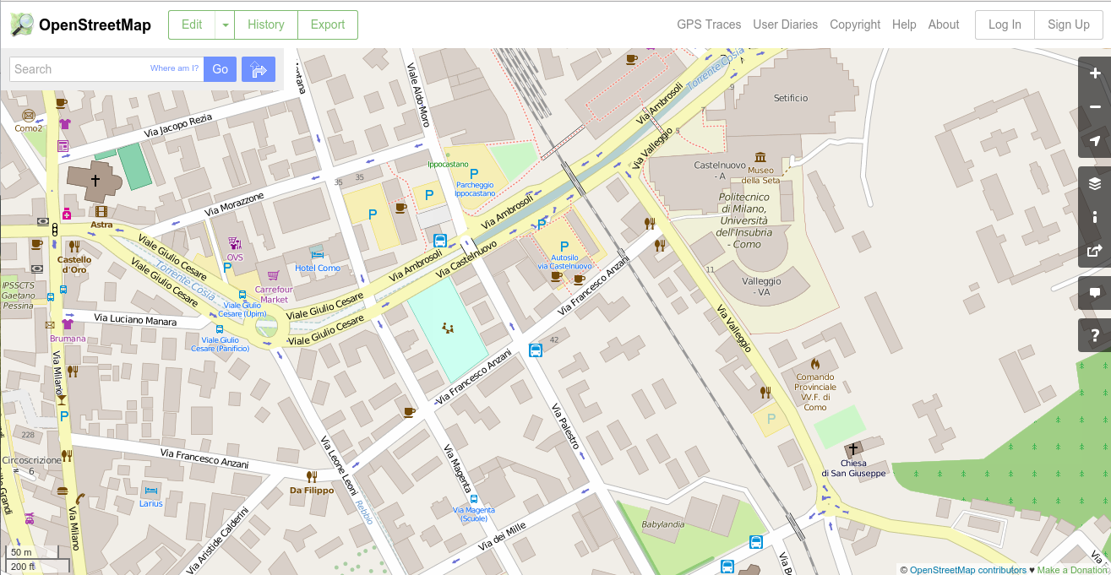
OpenStreetMap is more than just a map...

Slide 7
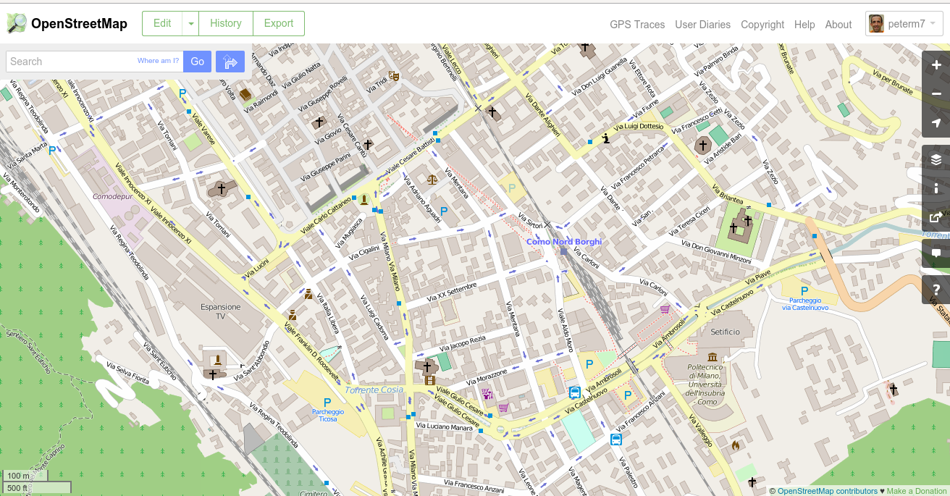
OSM looks to map ALL visible physical objects such as:
points of interest, roads, buildings, transportation systems,
landuse, social facilities such as health, education, government,
law, shops, industry, water systems, sanitation systems,
energy systems, environmental features.
Also looks to map administrative and legal boundaries,
land parcels, administrative zones, transportation lines....

Slide 8


OpenStreetMap is actually a massive spatial database

Slide 9
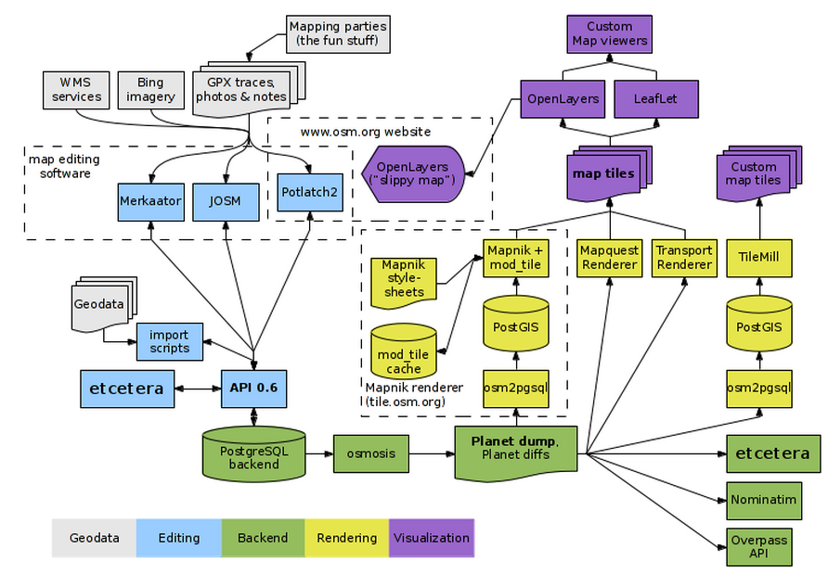
In reality OpenStreetMap is a connected ecosystem of software and services
http://wiki.openstreetmap.org/wiki/Component_overview

Slide 10
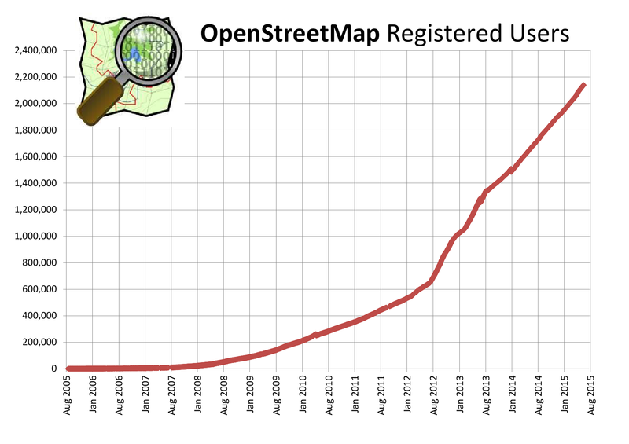
OSM is probably the most famous example of VGI around today
http://wiki.openstreetmap.org/wiki/Stats

Slide 11
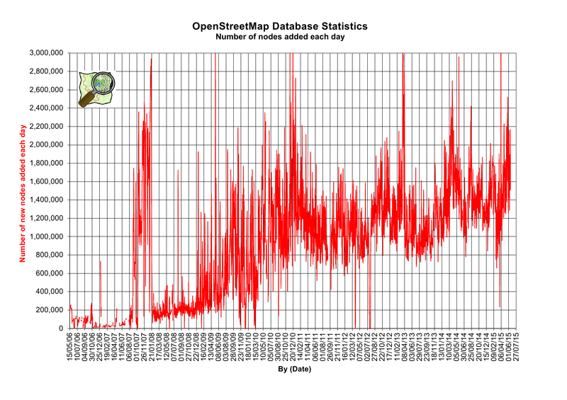
The amount of data added to OSM on a daily basis is staggering

Slide 12
There are many many reasons why OpenStreetMap is very special
Volunteered Geographic Information (VGI) and Citizen Sensors
ANYONE can contribute – from people without any geo-training/skills to very highly skilled IT people and geo people
It is an evolving ecosystem – there is new software, new techniques etc appearing all the time
It is democratic – you can have your say, you can make a difference

Slide 13
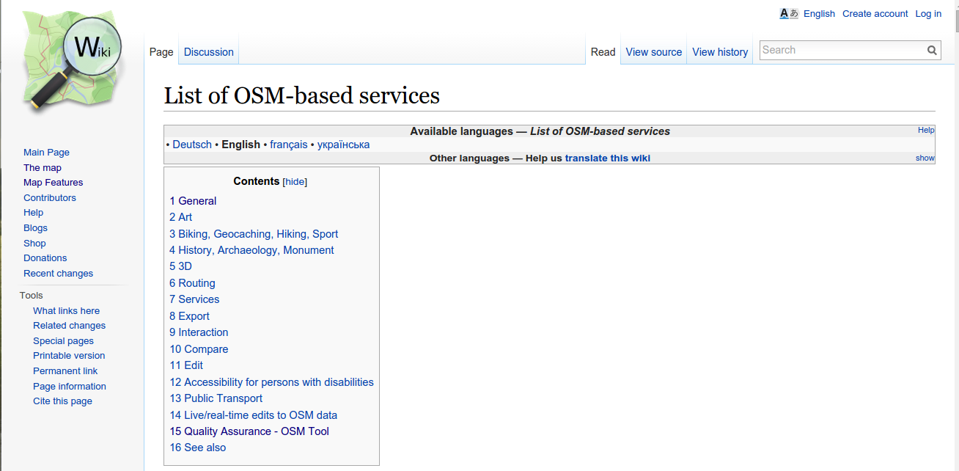
OSM data is used for thousands of different geodata services
http://wiki.openstreetmap.org/wiki/List_of_OSM-based_services

Slide 14
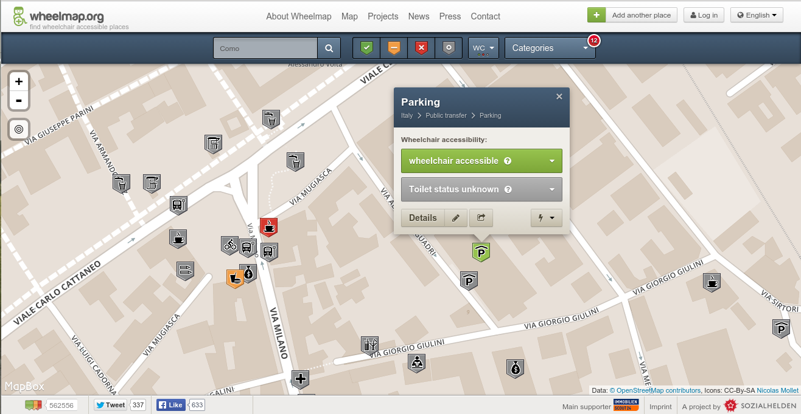
Wheelmap.org

Slide 15
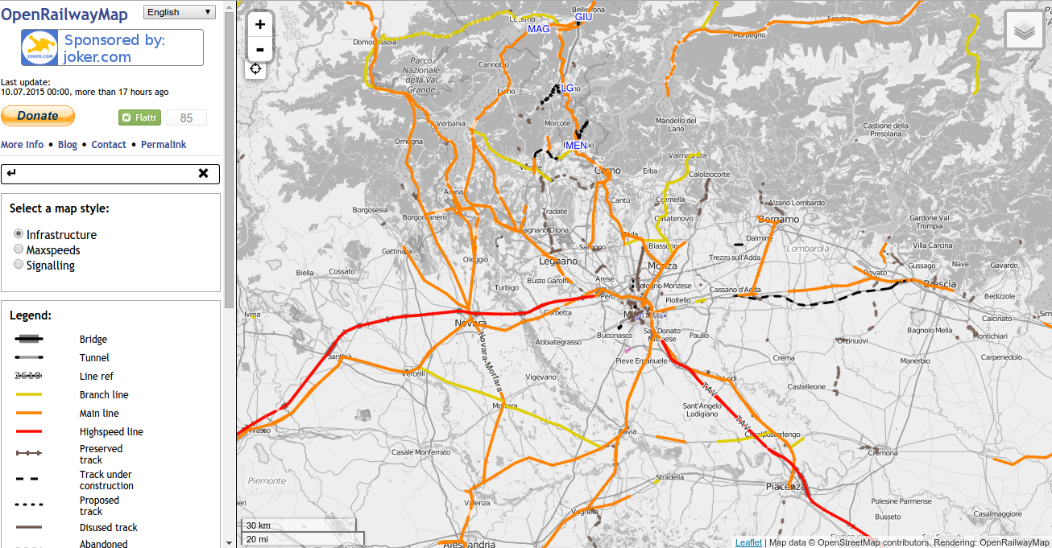
OpenRailwayMap

Slide 16
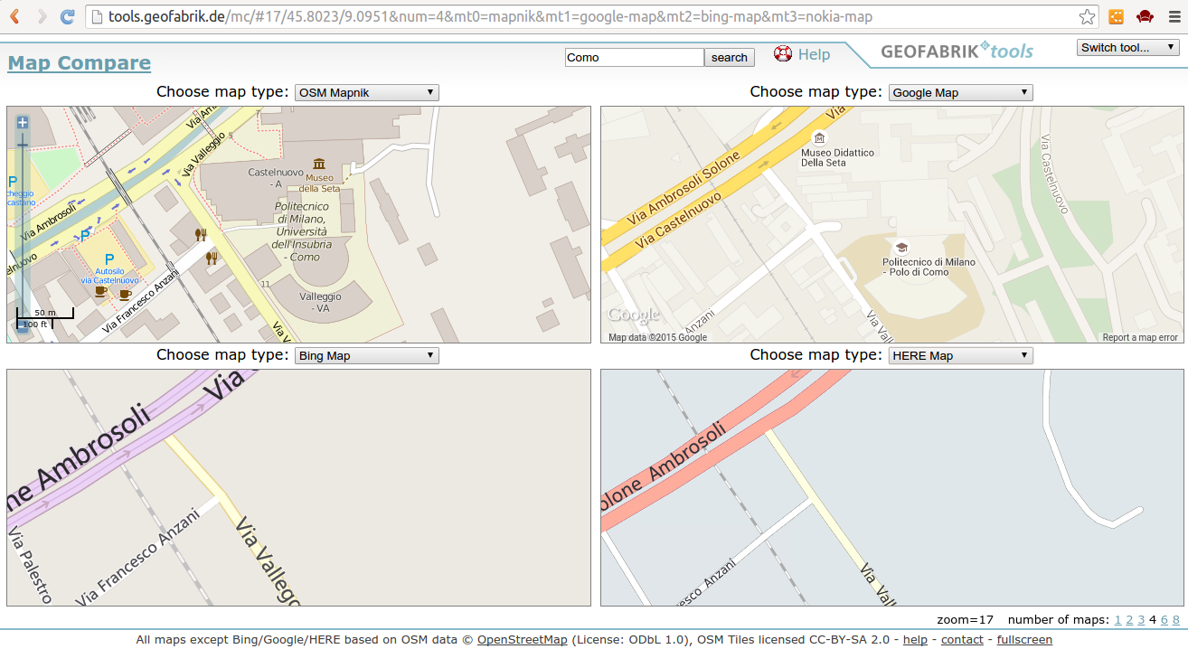
Map Compare
http://tools.geofabrik.de/mc/

Slide 17
Exercise with Map Compare
Let's look at Map Compare for an area which you are very familiar with – your home, your university, your favourite town, etc
Exercise and Discussion: Use Map Compare to make a visual comparison of OSM in this area with Google Maps, Bing etc.
Can you make some statements about: coverage, missing data, overall quality of the map data?

Slide 18

Contributing to OpenStreetMap

Slide 19
There are several different ways that people can contribute data to OpenStreetMap
FIELD COLLECTION: By collecting data using GPS and GPS-enabled devices and uploading this data to OSM using special open source software
ARMCHAIR MAPPING: By tracing out nodes, lines, polygons on specially designed web-based software
BULK IMPORT: By taking open-license compatiable data and upload this data to OSM using special open source software

Slide 20
In OpenStreetMap 'the mapper on the street' has precedence
OSM guidance says that you should “always map what is on the ground”
With ARMCHAIR MAPPING and BULK IMPORT there could be serious data quality issues introduced
DISCUSSION: Why should there be precedence for the “mapper on the street”? What can those mappers bring to OSM which ARMCHAIR MAPPING and BULK IMPORT cannot bring? What are the data quality issues?

Slide 21
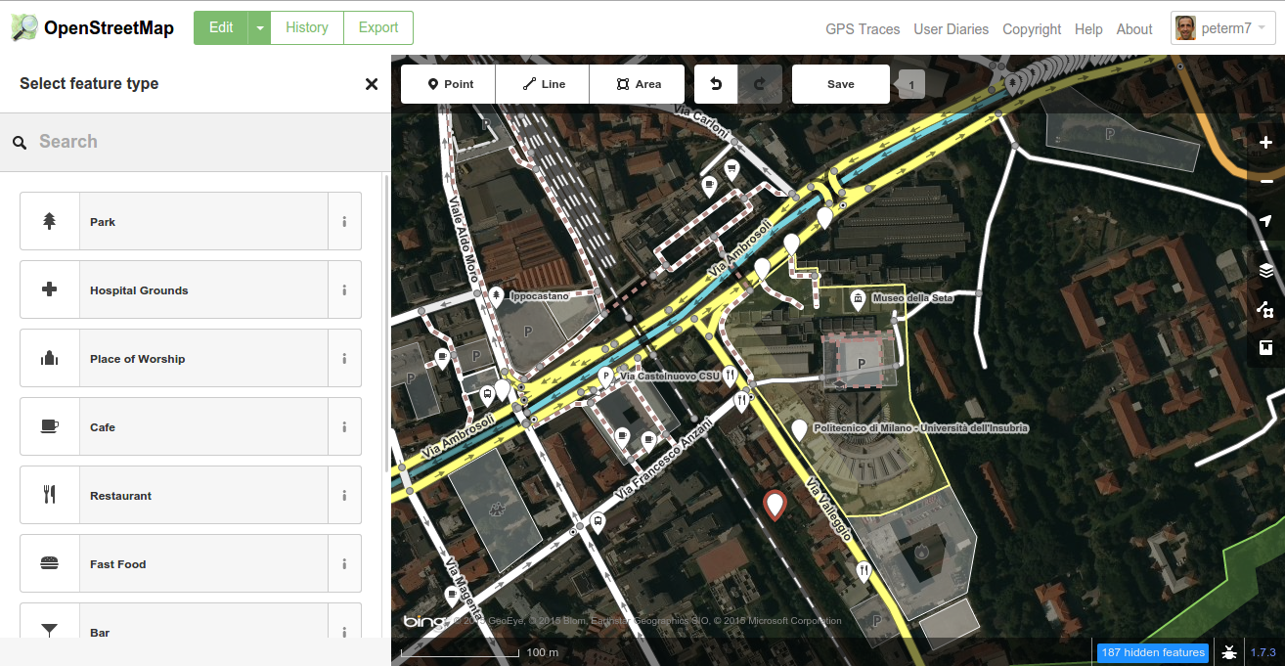
The iD OSM editor

Slide 22
There is huge emphasis on LOCAL KNOWLEDGE in OpenStreetMap
Mappers or contributors to OpenStreetMap who have local knowledge of a particular area or region are considered very valuable sources of data and knowledge.
DISCUSSION: What makes a mapper or contributor with local knowledge more valuable? What advantages do they have? Can you see any negative issues which might arise?

Slide 23
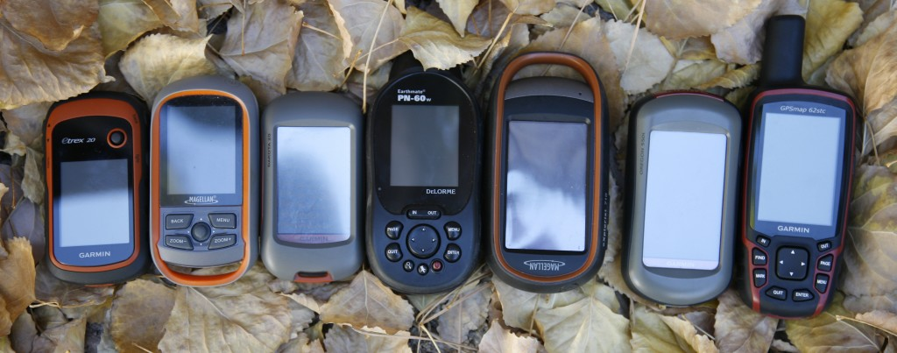
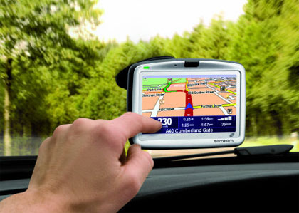
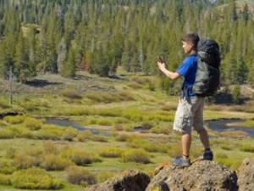
FIELD COLLECTION

Slide 24
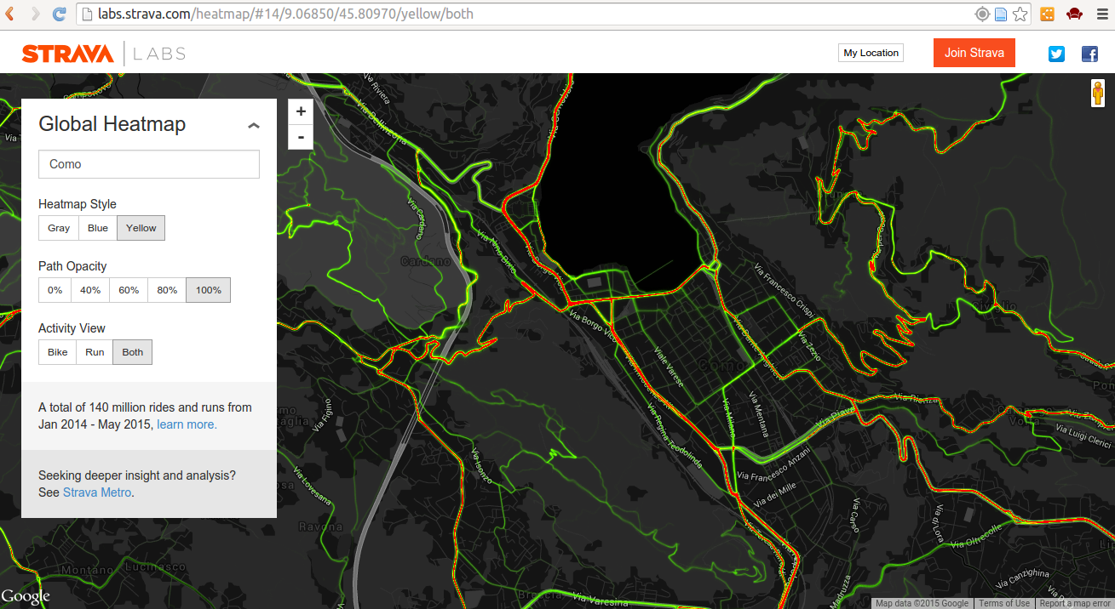

Slide 25
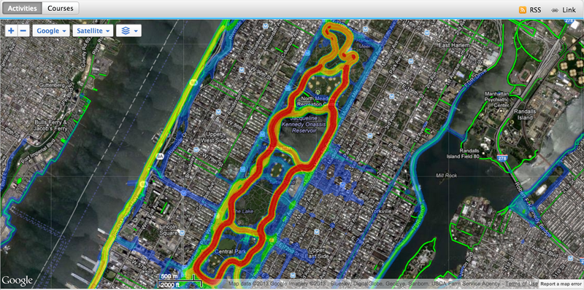
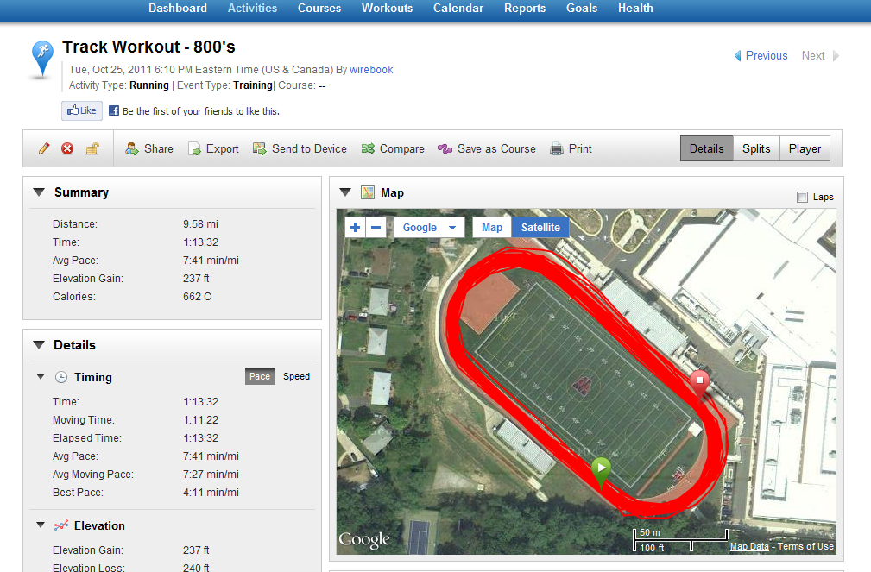

Slide 26
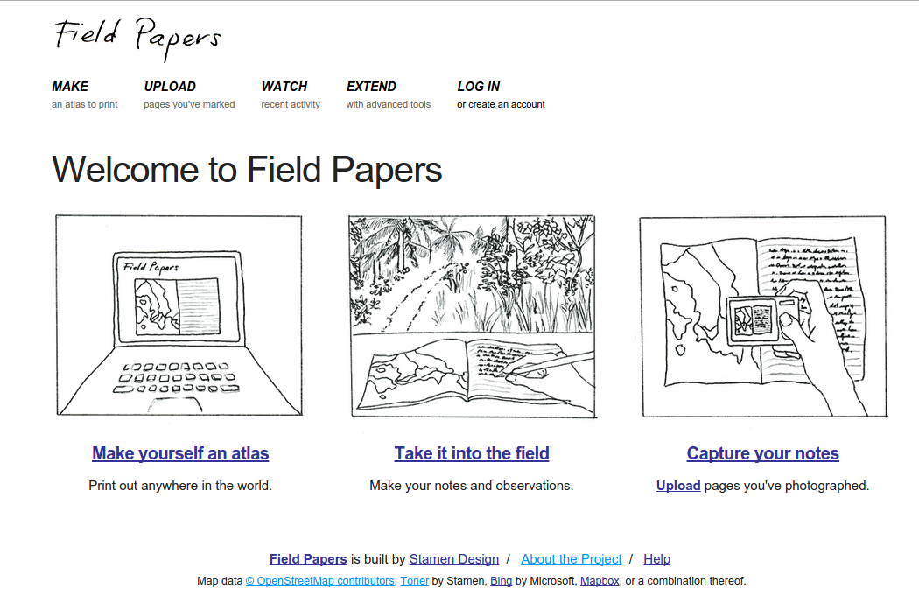

Slide 27
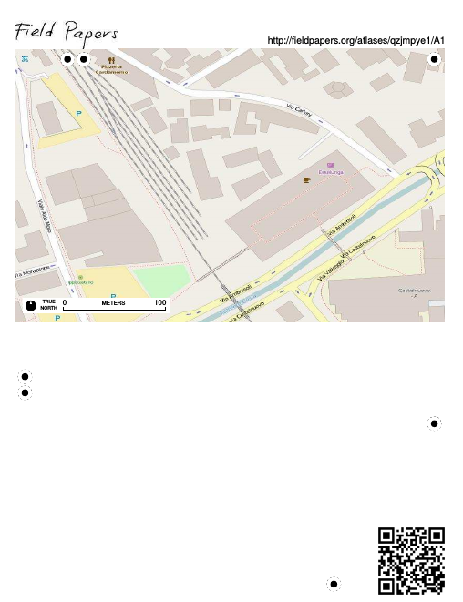

Slide 28
Example:
OpenStreetMap BULK IMPORT
Many many examples of Bulk Import
http://wiki.openstreetmap.org/wiki/Import/Catalogue
Bulk Import IS NOT A SIMPLE TASK
It can include: POI, placenames, legal boundaries, geographic features, road and transportation networks

Slide 29
Example:
OpenStreetMap BULK IMPORT
Bulk Import is also a very controversial method of contributing data to OpenStreetMap
There are a number of reasons:
  The data might not always “fit” into OSM directly and can require lots of manipulation
  The data might be out of date or incorrect
  The import can overwrite the hard work of many OSM contributors
  Bulk import does not obey the “mapper on the ground” rule.

Slide 30
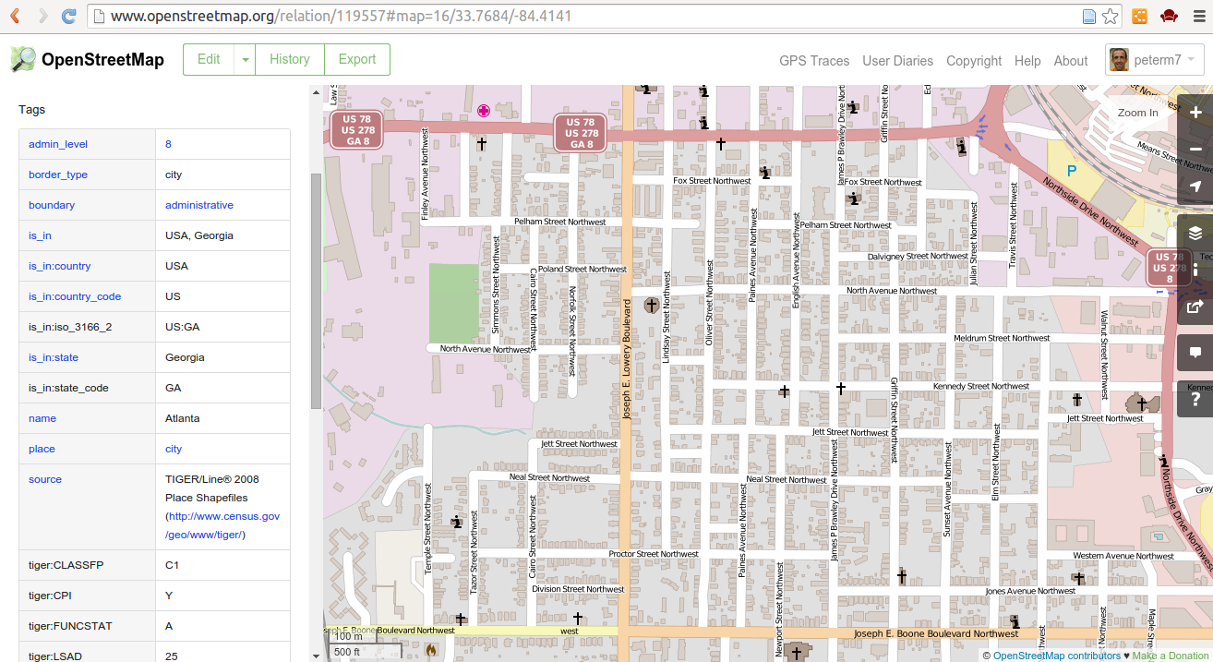
TIGER import in the USA

Slide 31
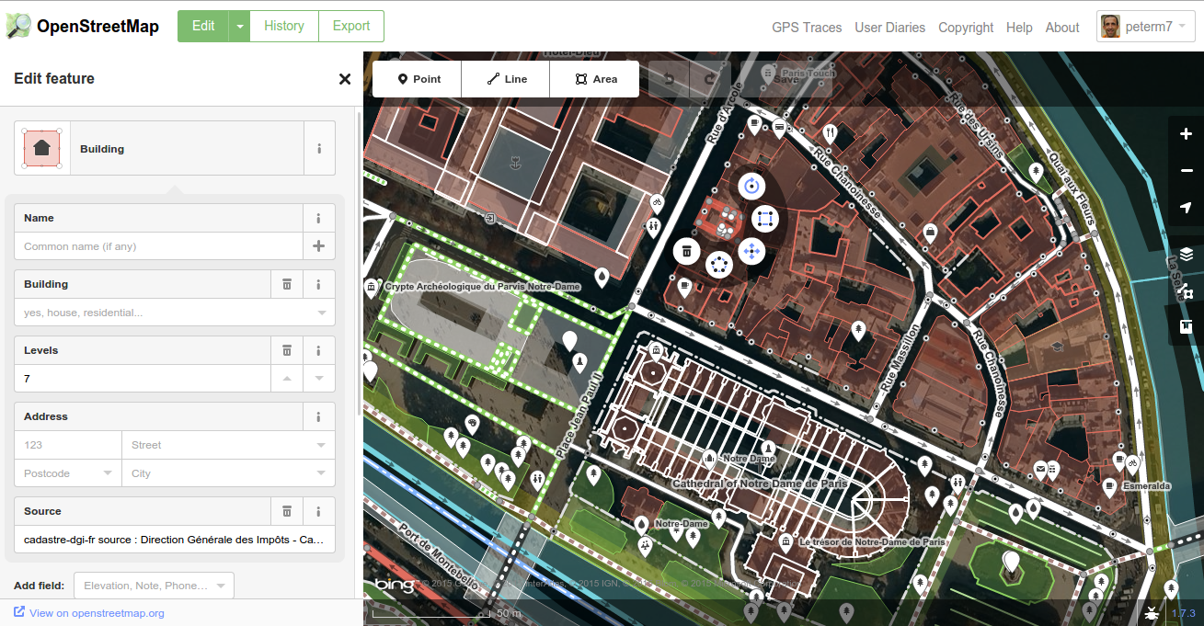
French National Cadastre

Slide 32
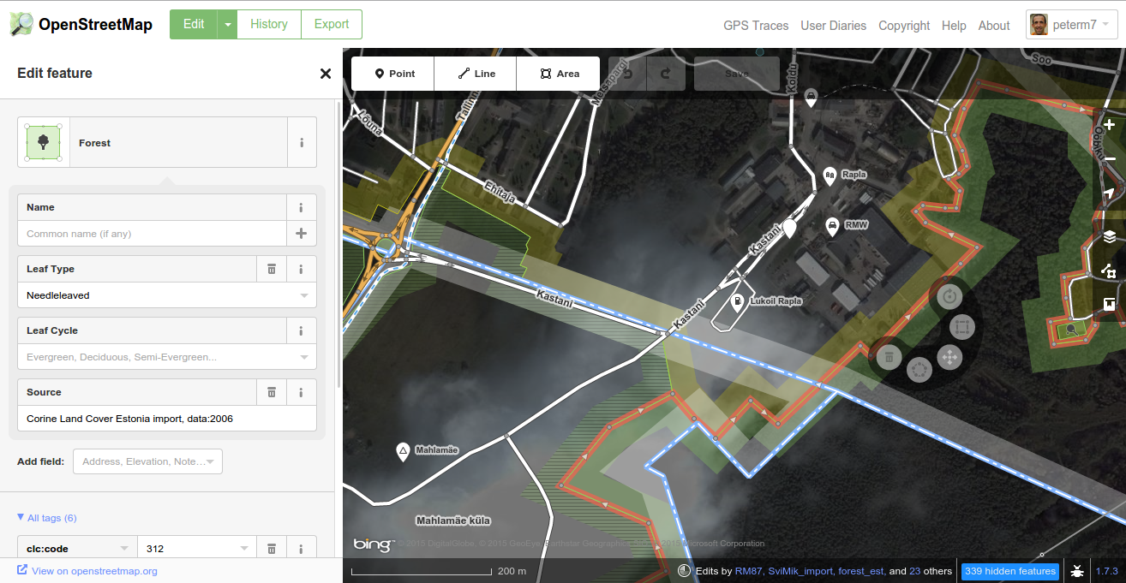
Estonia – Corine Landcover Import

Slide 33
The OSM Data Model

Slide 34
The conceptual model of OSM is easy to understand
All features in OSM are either nodes, polylines, polygons or relations
Nodes – single point -geo coordinate + tags
Polylines – an ordered list of nodes + tags (start and end node are different)
Polygons – an ordered lis of nodes + tags (start and end node are the same)
Relations – a logical grouping of nodes, polylines and polygons + tags (example – country boundary)

Slide 35
The OpenStreetMap WAY
In OSM terminology the term WAY is used to describe either polylines or polygons
Usually tags are then used to distinguish between WAYS which represent polylines or polygons.
We shall use the term WAY and polygon/polyline interchangeably during the lectures today

Slide 36
The OSM Data Structure relates the objects and tags
Highway=residential
Name = Sleepy Street
Ref = R167
Building = yes
Address = 17 Sleepy Street
City = Como
Building = hotel
Address = 27 Sleepy Street
City = Como
Name = Peter's Hotel
Amenity = Hotel
Landuse = water
Name = Lake Como
Building = yes
Address = 19 Sleepy Street
City = Como

Slide 37
How are OSM objects created?
In almost ALL cases OSM Objects (points, lines, polygons, relations) are created using the OSM Editing Software
There is a wide range of OSM Editing Software and software means of contributing data
However for today's class we'll restrict ourselves to the most popular methods (web-based editors)
When we look at tagging we'll create some objects.

Slide 38
Tagging in OpenStreetMap
Tagging is one of the most important aspects of OpenStreetMap
It also provokes the most debate, conversation, chat, discussion, disagreement, etc
Tagging in OpenStreetMap is very flexible
It is very different to the type of tagging (or ontology) that one would find in databases such as those used by National Mapping Agencies

Slide 39
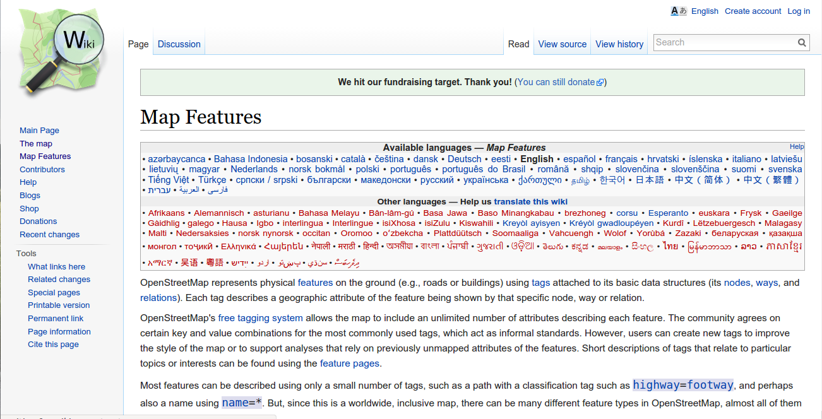
The “Map Features” Page – one of the cornerstones of OSM
http://wiki.openstreetmap.org/wiki/Map_Features

Slide 40
Tags can be considered as the attributes of an object
An object can have at minimum 1 attribute (tag) – and there is no upper limit.
There are no strict rules on how many attributes any object should have
This flexibility means that you must use your own judgement in regards to how many attributes you provide

Slide 41
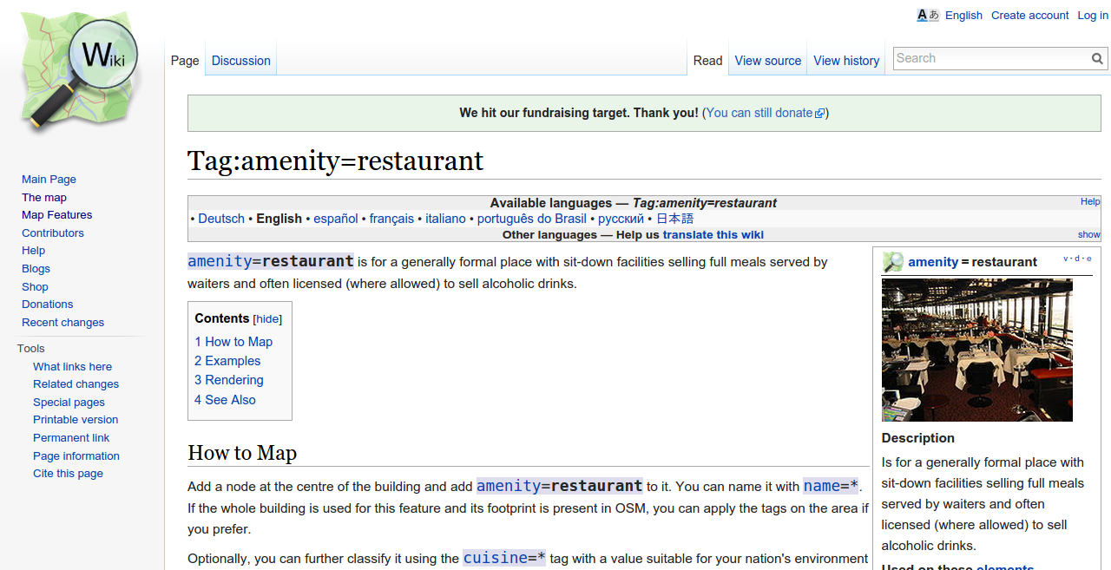
Let's look at the OSM tag for restaurants

Slide 42
We use the amenity = restaurant tag and others where applicable
Amenity = restaurant
Name = Peter's Italian Place
Cuisine = Italian
Smoking = no
internet_access = wlan

Slide 43
In OSM we try to supply an appropriate number of tags to an object/feature
We try to use the tags to supply as much accurate and timely attribute information about the object/feature as we can
ALWAYS USE MAP FEATURES FOR GUIDANCE WHEN USING TAGS
In the case of many tags there are suggested accompanying tags you should use

Slide 44
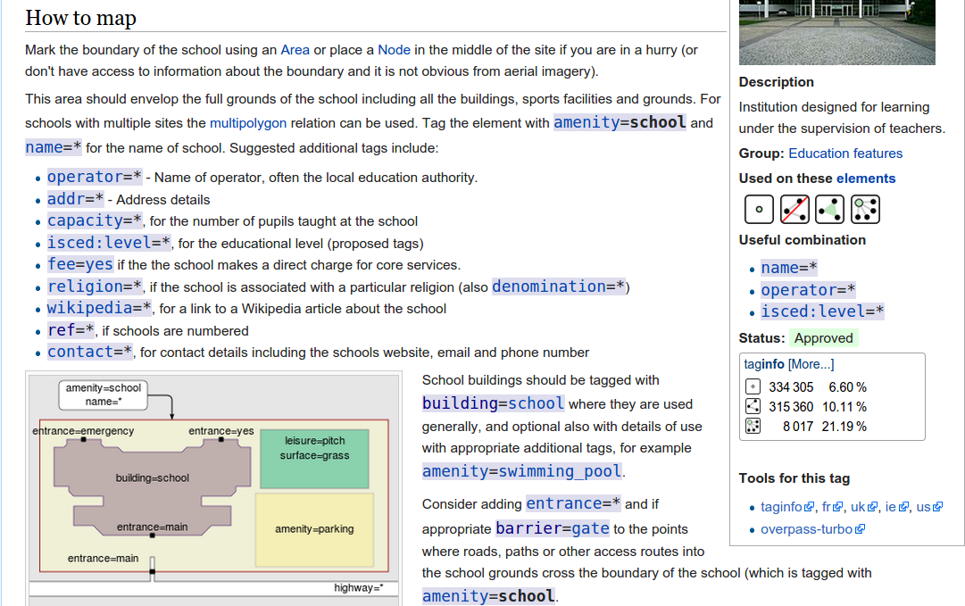
Example: Amenity = School

Slide 45
Choosing the correct tags is not an easy task
Choosing the correct tags requires you to think about the object/feature you are mapping
As you get more experienced with mapping you will become more familiar with tagging
Remember – you should always use tags which you can VERIFY
Remember – you should use the Map Features guidance on the popular combinations of tags

Slide 46
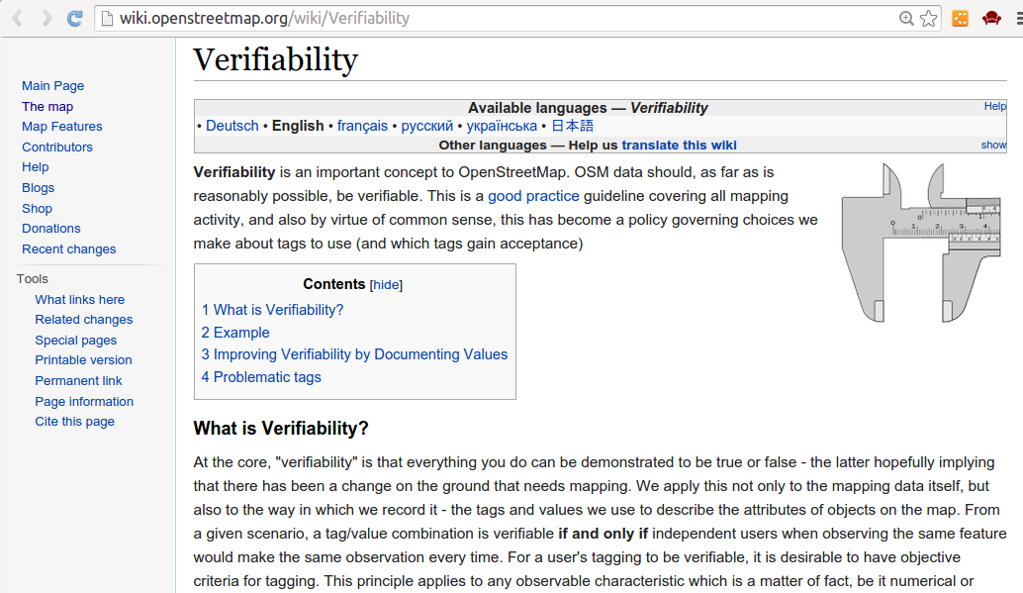
Verifiability in OpenStreetMap

Slide 47
Verifiable Tagging
“ From a given scenario, a tag/value combination is verifiable if and only if independent users when observing the same feature would make the same observation every time. For a user's tagging to be verifiable, it is desirable to have objective criteria for tagging. This principle applies to any observable characteristic which is a matter of fact, be it numerical or descriptive - a concrete road surface, a red brick building, etc.”
http://wiki.openstreetmap.org/wiki/Verifiability

Slide 48
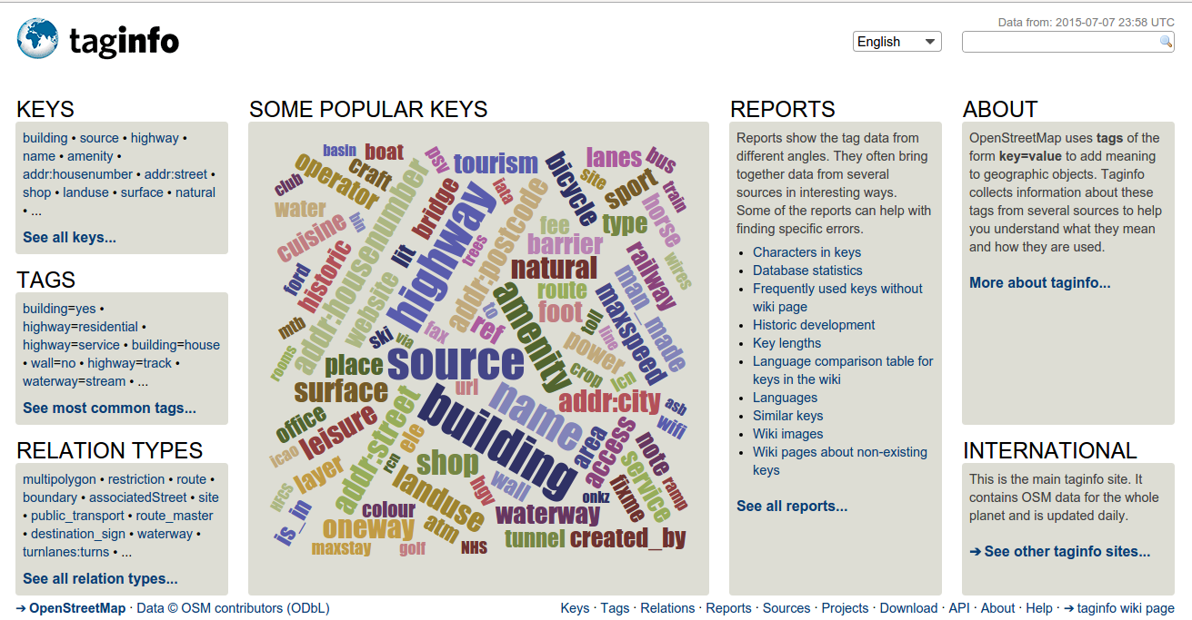
The OpenStreetMap
TagInfo Service
https://taginfo.openstreetmap.org/

Slide 49
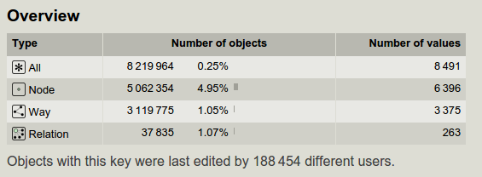
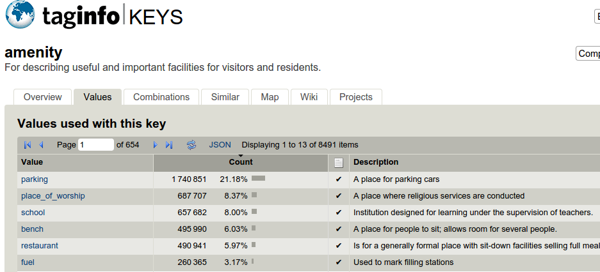
TagInfo provides very useful statistical information on tag usage in OpenStreetMap globally
What we see here is that amenity=parking is the most popular tag for amenity in the global OpenStreetMap database – this tag has been used on over five million nodes

Slide 50
TagInfo Exercise
Let's look at TagInfo in closer detail so we can understand how tagging is performed in OSM
We'll need to look at OSM Map Features at the same time
The aim of the exercise is to look at TagInfo and Map Features and see where there are issues related to the tags (tags formed incorrectly, incorrect spelling, etc, etc)

Slide 51
Looking at “raw” OpenStreetMap data for the first time

Slide 52
In the next few slides we are going to look at OpenStreetMap data
We have mentioned that OSM is a very large spatial database.
There are different ways in which we can extract or download the data within OSM for use in our own databases, applications or analysis.
The most common format is the OpenStreetMap XML format
Understanding OSM XML will give you a much deeper appreciation of the OSM data model including its flexibility and its drawbacks.

Slide 53
OSM XML is easy to understand
During this summer school lecture we shall avoid going into the nuts and bolts of XML
For the purposes of the following exercises you will not need any experience with XML
Your web-browser will open and display OSM XML (any XML actually) – but we will use a text editor (Notepad ++) to open the data and inspect it ourselves

Slide 54
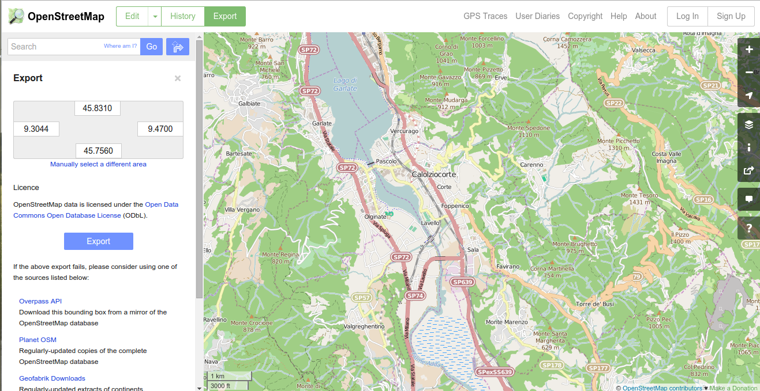
The OSM Website provides an 'Export' button for OSM XML

Slide 55
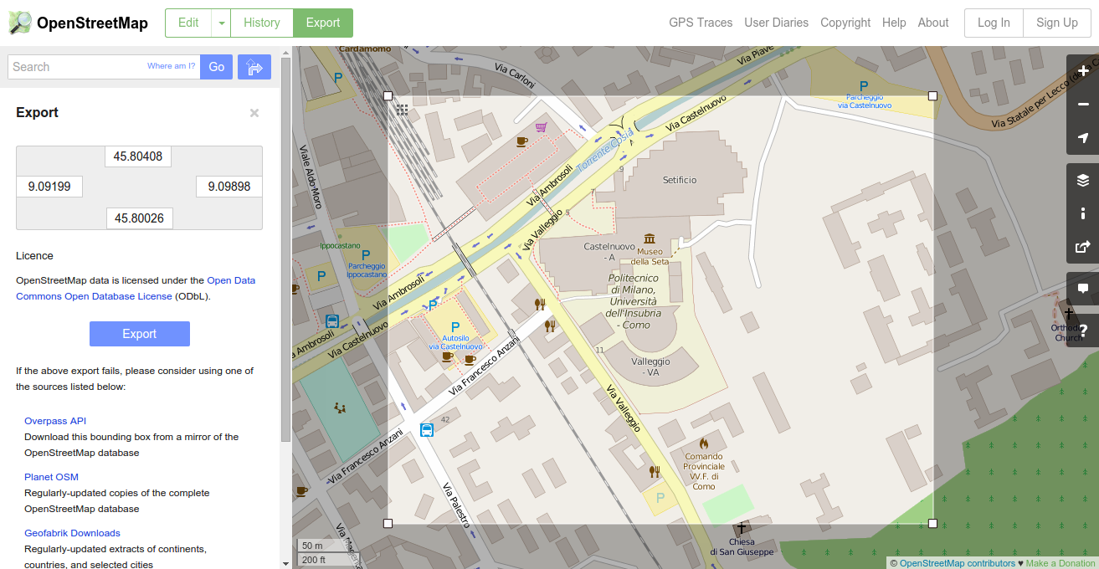
Excercise – download some OSM XML and inspect it
Go to anywhere in the world and create a bounding box like above – remember to keep the area of the bounding box small (or you'll end up with a very large XML file)

Slide 56
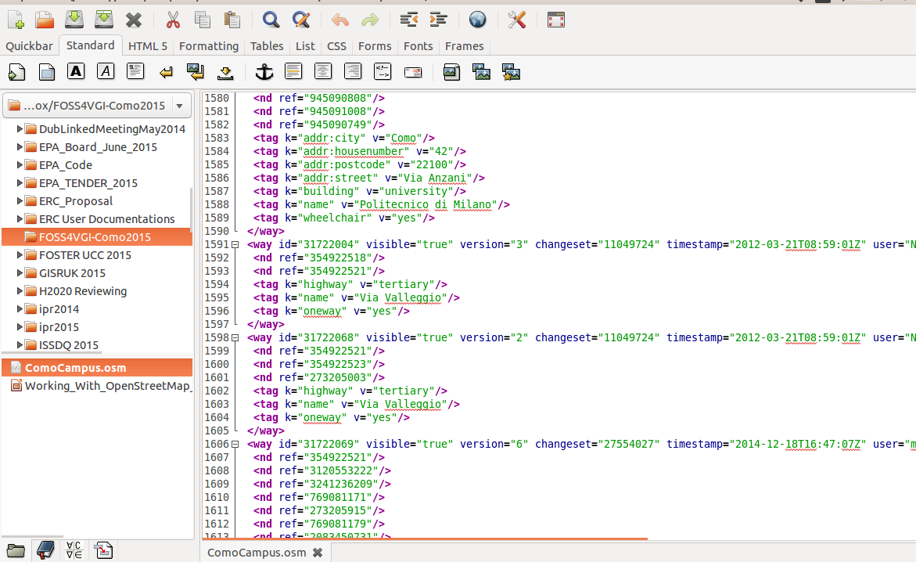
The OSM XML should look something like this in your text editor!

Slide 57
Exercise – Inspecting the XML
Take a closer look at the XML. This is OSM data.
Before we look at the XML in detail together – write down at least 5 pieces of information about the spatial data contained in the OSM XML.

Slide 58
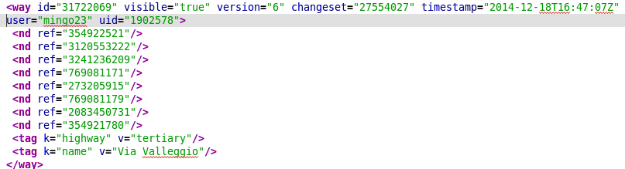
While it might not appear very useful there is very rich spatial detail in the OSM XML
ID of the object
VERSION of the object
CHANGESET it is part of
TIMESTAMP of when it was created/edited
USER who created it
USER ID
The ordered list of NODES
The list of tags (no order)

Slide 59
One of the unique aspects of OSM is the ability to view the history of all edits to a particular object
We can type a special URL into our browser – once we know the ID of the object which we would like to view the history
NODES: https://www.openstreetmap.org/node/NODEID/history
WAYS: https://www.openstreetmap.org/way/WAYID/history
RELATIONS: https://www.openstreetmap.org/relation/RELATIONID/history
YOU MUST KNOW THE CORRECT ID OF THE OBJECT YOU ARE ANALYSING

Slide 60
Let's take a look at Way: Via Castelnuovo (32223922) in Como
To simply view the specific WAY we type
https://www.openstreetmap.org/way/32223922
To view the history of this specific WAY we type
https://www.openstreetmap.org/way/32223922/history
Notice that we can download the history of this object in OSM XML format (the link is at the bottom of the page)
As an exercise – download the OSM XML format of the history and view it in Notepad++ ... can you understand it?

Slide 61
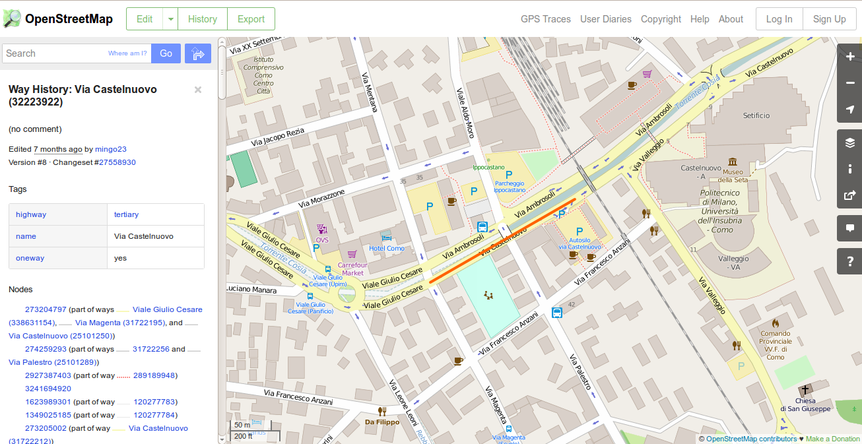
Via Castelnuovo (32223922) in Como

Slide 62
OSM History Exercise
Go to any region of your choice and download some OSM XML for that region (keep the region size small)
Inspect the OSM and pick out an 'interesting' object/feature (look for high version number)
Download the OSM XML for the history of this specific object/feature
Make some general comments on the history of contributions to this object in OSM

Slide 63
Downloading OSM XML in Bulk

Slide 64
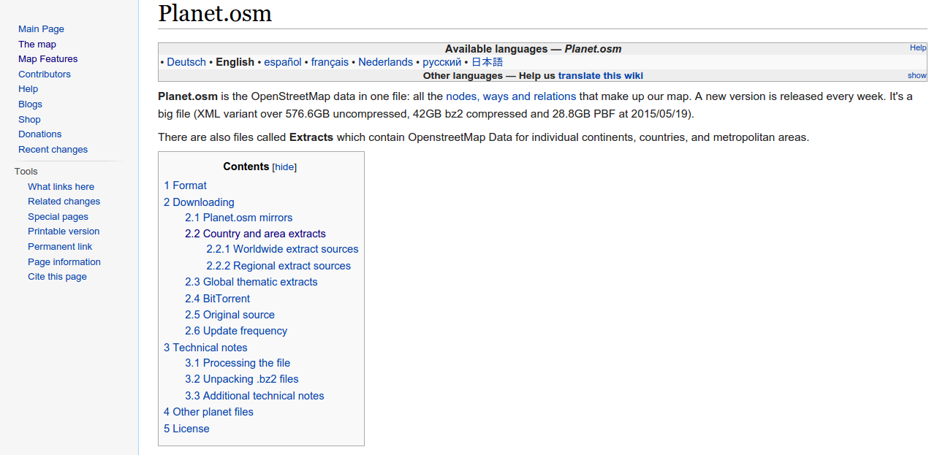
There are many ways to access OSM XML in larger quantities

Slide 65
OSM XML does have some drawbacks
While OSM XML has many advantages (it is easy for humans to read, it is easy to write software to understand it....) it does have some drawbacks.
As OSM grows in size so to does the size of the XML. As XML files get larger they become more difficult to process

Slide 66
There are services where you can download OSM data in different formats
Geofabrik http://download.geofabrik.de/
  Download in ESRI SHAPEFILE Format
The OpenStreetMap Data (http://openstreetmapdata.com/) website provides access to OSM data in SHAPEFILE format.
Other services are available to provide access to OSM data in other formats such as JSON and GPX

Slide 67
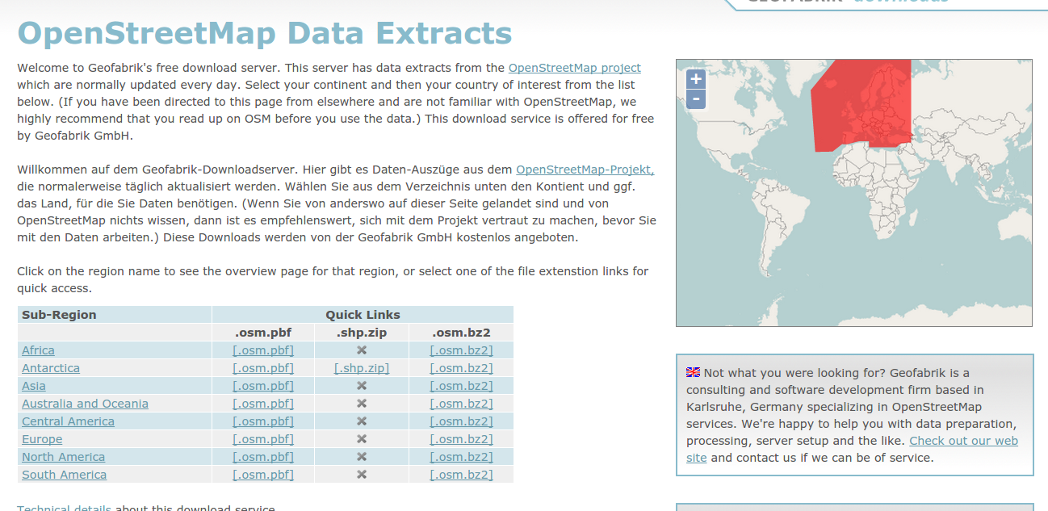
GeoFabrik Downloads

Slide 68
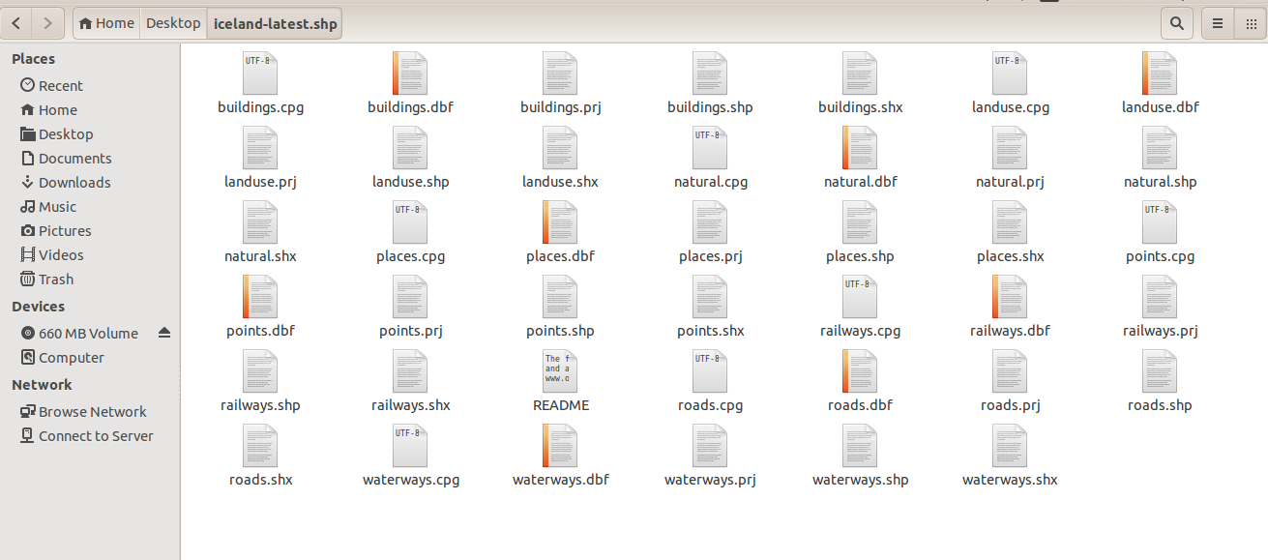
What a Shapefile looks like

Slide 69
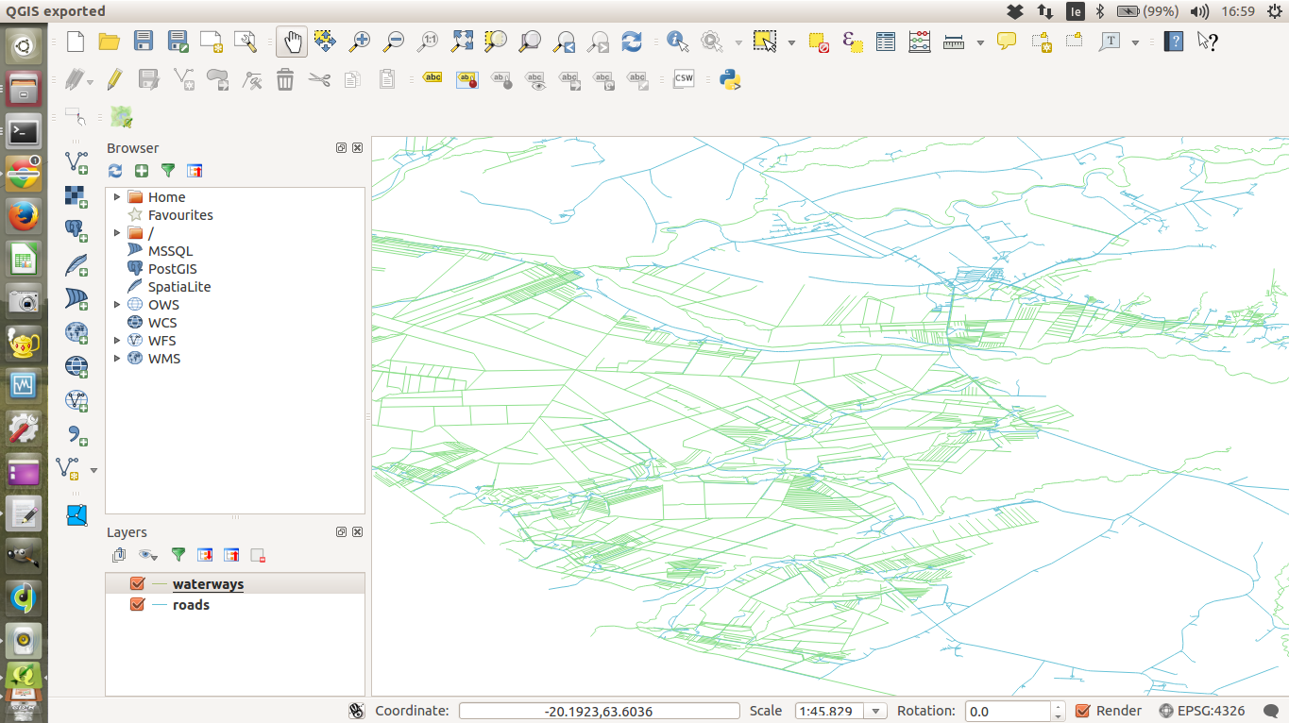
Two layers from a Shapefile visualised within QGIS

Slide 70
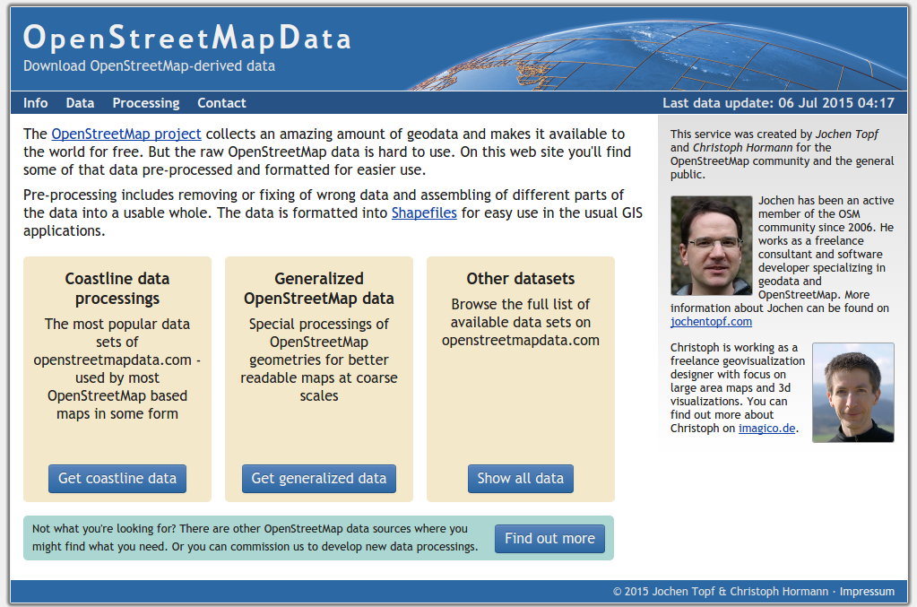
http://openstreetmapdata.com/

Slide 71
The OSM Point of Interest

Slide 72
WGS84 (EPSG 4326)
OpenStreetMap uses the WGS-84 coordinate system, as do most GPS units.
Every country tends to use its own standard or preferred coordinate system; so that the maps for that region are as undistorted as possible and the coordinates are reasonably simple to use. These coordinates need to be converted to WGS-84 before being used in OSM.

Slide 73
The Point of Interest (POI) is a fundamental building block of OSM
A POI is a NODE in OSM
It always (as a minimum) has a “name” tag attribute.
http://wiki.openstreetmap.org/wiki/Points_of_interest
Churches, schools, town halls, distinctive buildings, Post offices, shops, postboxes, telephone boxes, Pubs, Car parks and lay-bys (and whether free or not), statues, Speed cameras, tourist attractions, administrative buildings, etc

Slide 74
Sometimes POIs do not have name tags in OSM
It's not always clear what a POI actually is.
The examples on the previous slide are POI but there are other types of POI.
For example – a node within a line feature representing a railway line can be (railway=crossing) to represent a railway crossing
As you become more experienced with OSM you become better able to make these types of decisions in regards to your mapping data

Slide 75
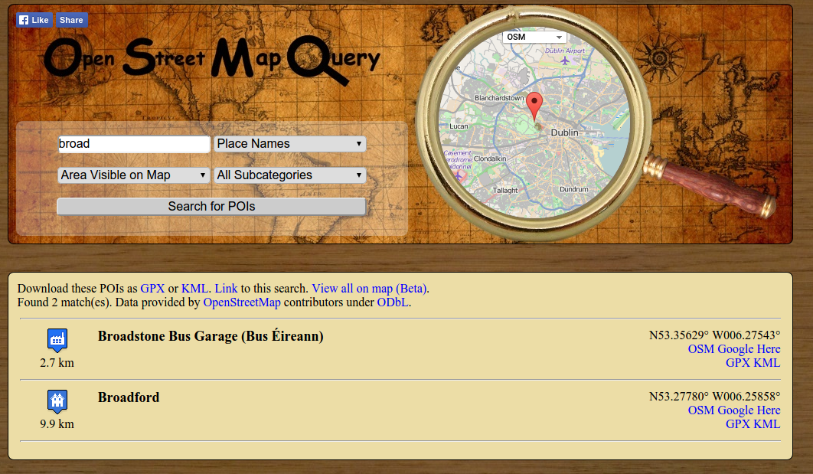
http://www.osmquery.com/

Slide 76
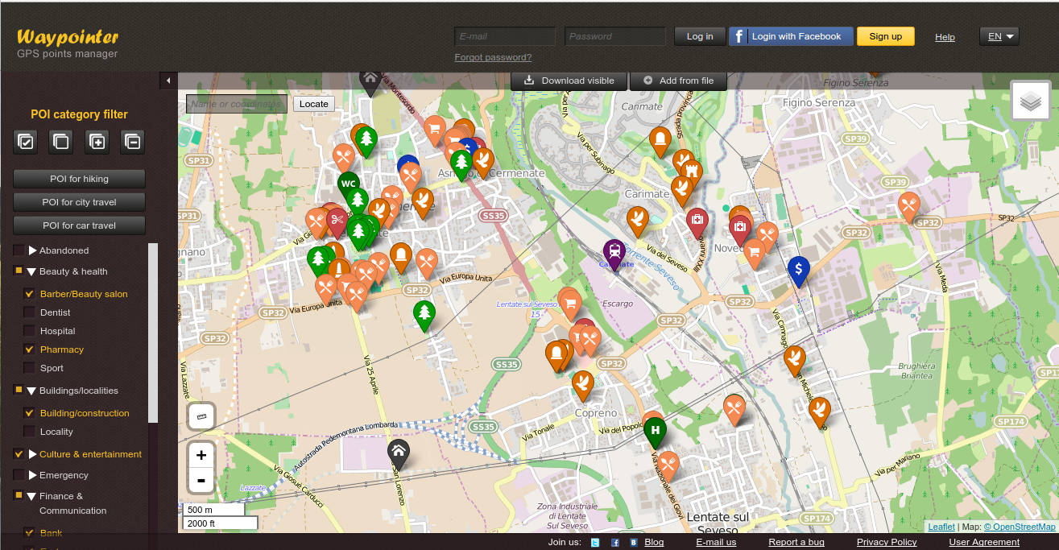
https://waypointer.info/

Slide 77

The Overpass API Tool

Slide 78
The Overpass API Tool
The Overpass API (or OSM3S) is a read-only API that serves up custom selected parts of the OSM map data. It acts as a database over the web: the client sends a query to the API and gets back the data set that corresponds to the query.
Overpass API is optimized for data consumers that need a few elements within a glimpse or up to roughly 100 million elements in some minutes
We will use the Overpass API to get small specific samples of OSM data (in other formats to OSM XML)
This will be very useful for our lecture on LEAFLET on Tuesday afternoon

Slide 79
The Overpass API has its own specific query language
Again due to time limitations we do not have time to go very deeply into the Overpass Query Language
However we are going to look at a few examples which will give you a flavour of what is possible.
http://wiki.openstreetmap.org/wiki/Overpass_API/Language_Guide

Slide 80
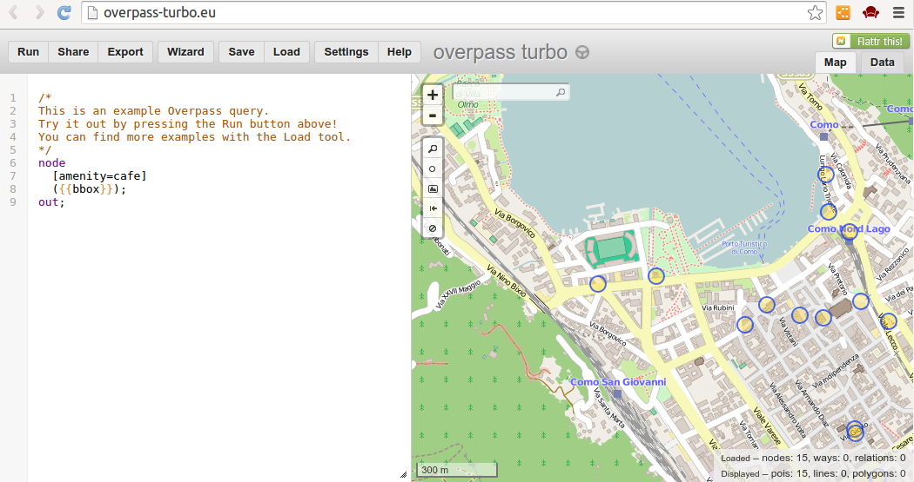
Example 1: Overpass API – Accessing Nodes

Slide 81
Overpass: Accessing Nodes
Zoom to an area of the map that you are interested in – do not make the area too large
Overpass Query
node
[amenity=cafe]
({{bbox}});
out;
Change this to anything you wish – look up something you like on OSM Map Features

Slide 82
Overpass: Accessing WAYS
/* south, west, north, east longitude latitude
Use either the map here - or the OSM export map to help you get the coordinates of the bounding rectangle correct
*/
way
[amenity=university]
(45.4462,9.1101,45.5160,9.2757);
(._;>;);
out body;
UNIVERSITIES inside a bounding rectangle of MILANO

Slide 83
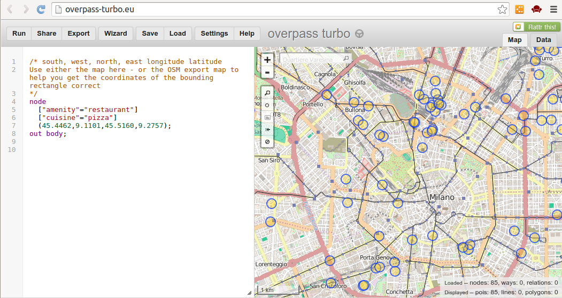
Overpass: Getting a pizza in Milano
node
["amenity"="restaurant"]
["cuisine"="pizza"]
(45.4462,9.1101,45.5160,9.2757);
out body;
NOTICE – the use of a combination of tags – and the bounding rectangle

Slide 84
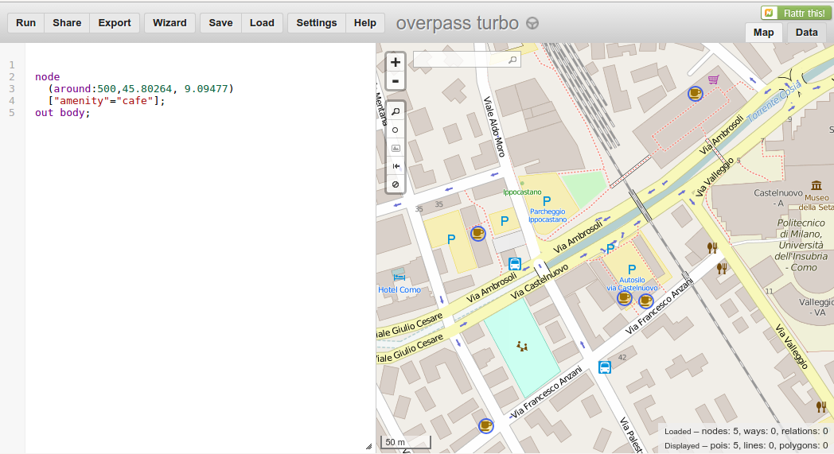
Overpass: Cafe locations within 500m radius of the Politecnico in Como
node
(around:500,45.80264, 9.09477)
["amenity"="cafe"];
out body;

Slide 85
Overpass API
Find a cafe OR a restaurant within a specific radius of a point
node
(around:1000,45.80264, 9.09477)
["amenity"~"cafe|restaurant"];
out body;

Slide 86
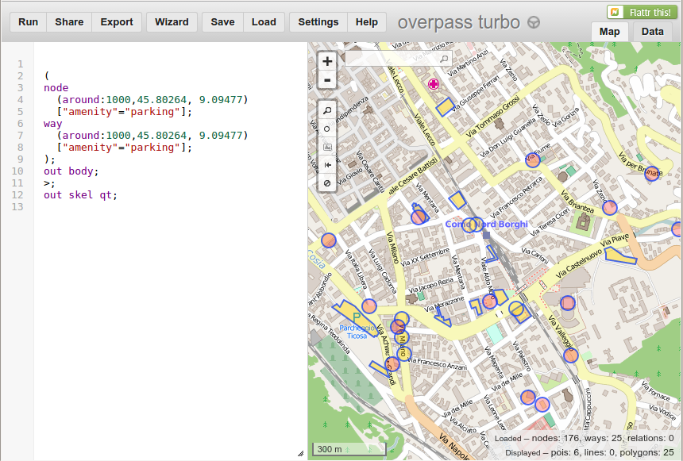
Find all Parking Nodes and Ways around the university in Como
(
node
(around:1000,45.80264, 9.09477)
["amenity"="parking"];
way
(around:1000,45.80264, 9.09477)
["amenity"="parking"];
);
out body;
>;
out skel qt;

Slide 87
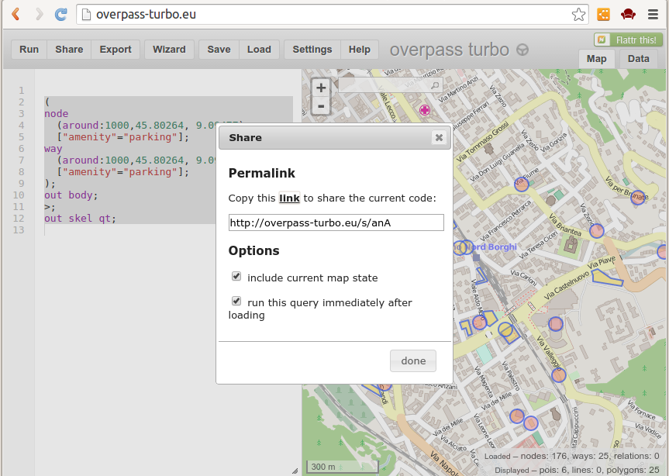
You can “SHARE” overpass query links with your friends

Slide 88
Looking at GeoJSON

Slide 89
GeoJSON is a lightweight text-based format for storing geospatial data on the web
GeoJSON is an industry standard and is produced (and consumed) by thousands of applications and services on the Internet.
It is a VERY USEFUL data format for displaying geospatial data on web-based maps.
We will make significant use of the GeoJSON format in tomorrow's (Tuesday) session on Leaflet.

Slide 90
The Overpass Turbo service will produce GeoJSON for our queries
Let's look at a simple example – let's look at all of the bus shelters around Como which are mapped in OpenStreetMap
node
["highway"="bus_stop"]
(around:1000,45.80264, 9.09477);
out body;

Slide 91
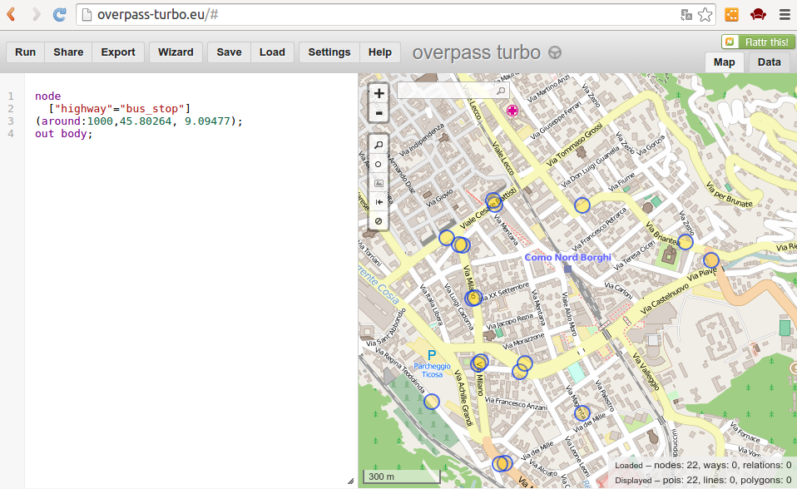
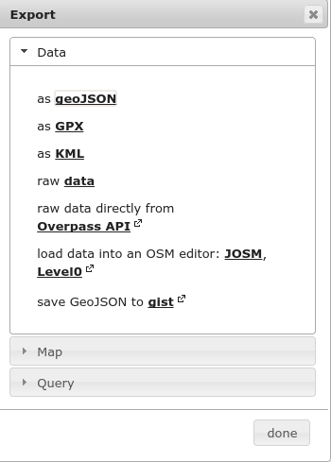
Bus Shelters in Como
Query Result

Slide 92
Download the resulting GeoJSON and then open it in Notepad ++
We are going to look a little closer at the GeoJSON format which contain the query results.
This should help you understand the potential usage of GeoJSON and how the output relates to the query results.

Slide 93
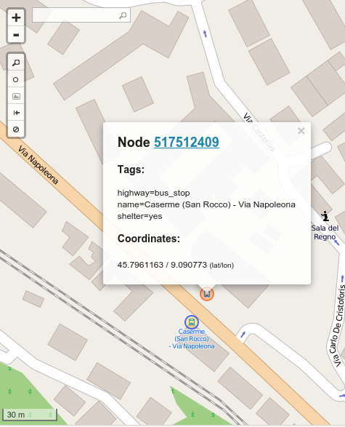
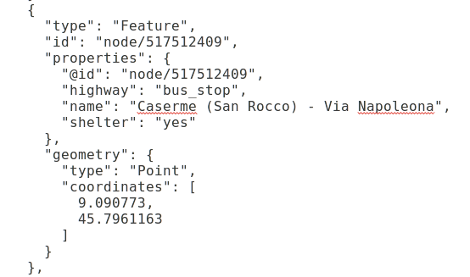
Here is one of the objects from the Query result in GeoJSON and displayed on the map!

Slide 94


Notice how GeoJSON can accomodate different PROPERTIES
GeoJSON properties = OSM tags

Slide 95

GeoJSON is flexible and allows nodes, lines and polygons
way
["highway"="pedestrian"]
(around:1000,45.80264, 9.09477);
(._;>;);
out body;

Slide 96

GeoJSON can also have WAYS included – notice the structure below

Slide 97
Starting to Map....

Slide 98
We are going to attempt some basic mapping in OSM today
We shall approach this in two ways
1: Setup an account on the OSM Sandbox Server to allow us to test out editing with the iD editor
2: Setup an account on the OSM REAL LIVE SERVER to allow us to actually edit data within the OSM database

Slide 99

The OSM Mapping Sandbox http://api06.dev.openstreetmap.org/

Slide 100


Slide 101
Sandbox Demo (signup and demo)

Slide 102
Sandbox Demo
TASK:
Create at least one POINT (preferably a POI)
Create at least TWO WAYS (a closed polygon such as a building and then a line such as a road or river)
REMEMBER – edit locally – try an area where you are familiar with.

Slide 103
Real Live Server DEMO

Slide 104
A few things to note about working on the REAL LIVE OSM SERVER
You are on the real server now – edits which you submit will appear on the OSM world map
Edits will appear within minutes on the OSM world map
For this demo – do not make major edits to existing data – try to find something new to map.
If you make a mistake – we can delete your object and start again.

Slide 105

Watch live edits – live.openstreetmap.fr

Slide 106

The JOSM tool for OpenStreetMap allows for much more complex editing

Slide 107

JOSM allows for much finer level of control over the OSM data model

Slide 108
Who is mapping close by?

Slide 109

Who are the other OSM mappers in the surrounding area?
http://resultmaps.neis-one.org/oooc

Slide 110

How did you contribute?
http://www.hdyc.neis-one.org/

Slide 111
What about OSM Data quality?

Slide 112
Data Quality and Accuracy are very important issues in OSM
There has been substantial work done within the OpenStreetMap community and also by the academic community in analysing the quality and accuarcy of data in OSM.
DISCUSSION: What are the key issues regarding accuracy and quality of data in OSM?
There are some tools available which will allow us to look at data quality issues in OSM.

Slide 113

Data Quality/Consistency Checks for OSM
http://keepright.ipax.at/

Slide 114
Exercise: Using Keepright
Keepright is a very useful tool for indicating where there are potential problems in OSM
ARMCHAIR MAPPERS could potentially fix many ofthe errors/problems outlined
EXERCISE: Use Keepright for your own area/region. Investigate the errors/issues highlighted. How many could you fix? What is the overall quality situation for OSM in this area?

Slide 115

http://tools.geofabrik.de/osmi/

Slide 116

Addressing in OpenStreetMap tags

Slide 117
Nominatim
Nominatim is a tool to search OSM data by name and address and to generate synthetic addresses of OSM points (reverse geocoding).
Nominatim is also used as one of the sources for the search box on the OpenStreetMap home page

Slide 118

Example Search:
Via Ambrosoli (no city specified)
http://nominatim.openstreetmap.org/

Slide 119


An example of reverse geocoding using Nominatim
http://nominatim.openstreetmap.org/reverse?format=xml&lat=45.80223&lon=9.09525&zoom=18&addressdetails=1

Slide 120
The Social Side of OpenStreetMap
Mapping Parties

Slide 121

Mailing Lists are a very effective means of communication in OSM

Slide 122


Slide 123
Mapping Parties in OpenStreetMap
Mapping Parties are a very unique aspect of how OpenStreetMap collects spatial data
It is an organised gathering of ANYONE interested or involved in OpenStreetMap – from those experienced people to new people
Usually organised by a local group of OSM contirbutors – focussing on a specific local area
Usually the mapping party has a HQ in a pub, restaurant, cafe or public space where WiFi is available to allow participants to upload data to OpenStreetMap after the mapping party.

Slide 124



Slide 125

An example of how an OSM Mapping Party organises mapping
http://en.flossmanuals.net/openstreetmap/beyond-the-map/

Slide 126
There will be an OSM Mapping Party in Como with FOSS4G 2015
Details: Wednesday 15th July 2015 @ 16:30
Everyone is welcome
No OSM experience is needed
GOAL – To add details such as POI, house numbers, building numbers, names and types etc to the OSM database for COMO
And of course..... to have some OSM Fun
http://wiki.openstreetmap.org/wiki/Como_foss4ge_2015

Slide 127

LOTS of work to do in Como!

Slide 128

(
node["addr:housenumber"]({{bbox}});
way["addr:housenumber"]({{bbox}});
);
out body;
>;
out skel qt;

Slide 129

Thank You!
Email – petermooney78@gmail.com

