Slide 1
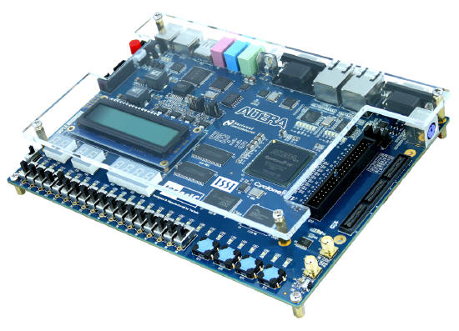
CPE 322
Digital Hardware Design Fundamentals
Electrical and Computer Engineering
UAH
Algorithmic State Machine Notation

Slide 2
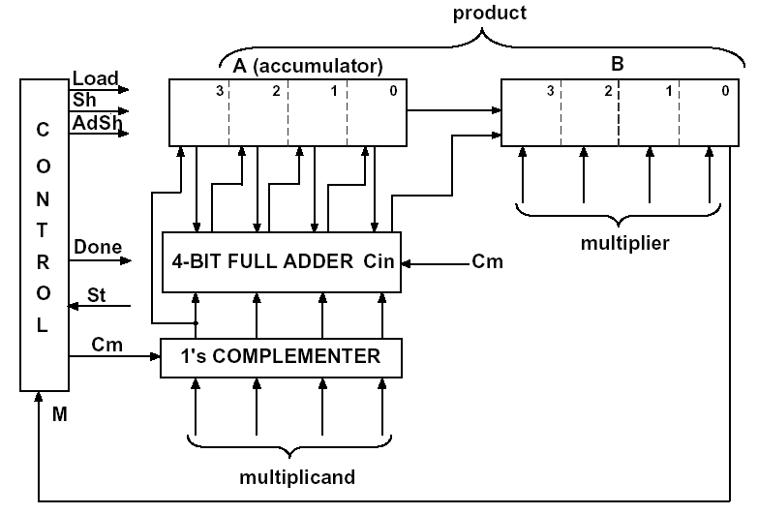
Example: Faster Multiplier
Move wires from the adder outputs one position to the right =>
add and shift can occur at the same clock cycle

Slide 3
Extended State Transition Graph
Similarities to basic State Transition Graph
  Nodes represent states
  Arcs (or edges) represent transition between states
  Labelling are arcs are Inputs/Outputs
Differences with basic State Transition Graph
  To reduce Clutter
    Only Inputs that impact a transition from one state to another are present.
    Only Outputs that are TRUE for a given transition are listed.

Slide 4
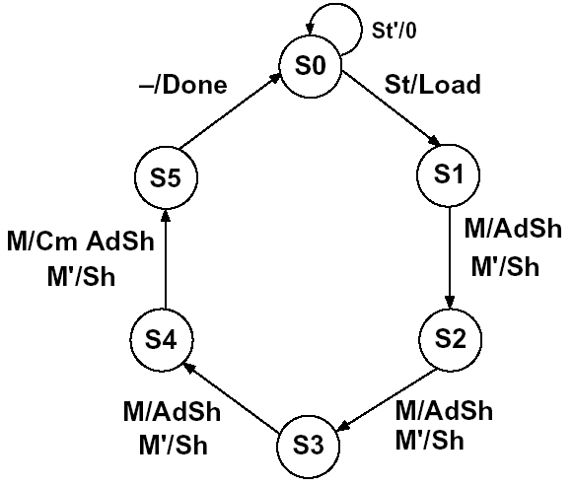
Extended State Transition Graph for Multiplier

Slide 5
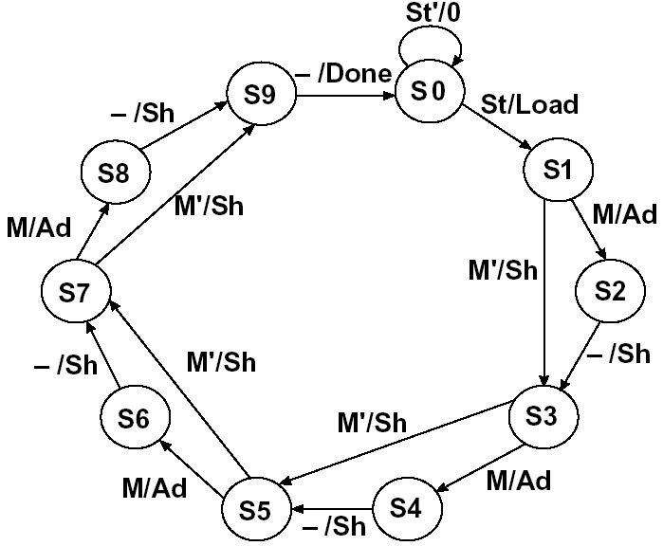
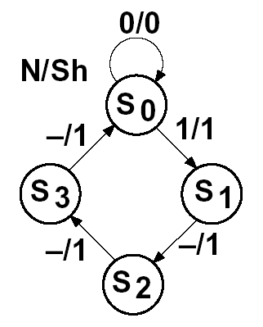
Digital Design with ASM Charts
State Transition Graphs are used to describe
state machines controlling a digital system
Alternative: use algorithmic state machine flowchart

Slide 6
State Machine Charts
ASM (Algorithmic State Machine) or simply a SM chart
  Easier to understand the operation of digital system by examining of the ASM chart instead of equivalent state transition graph
  ASM chart leads directly to hardware realization

Slide 7
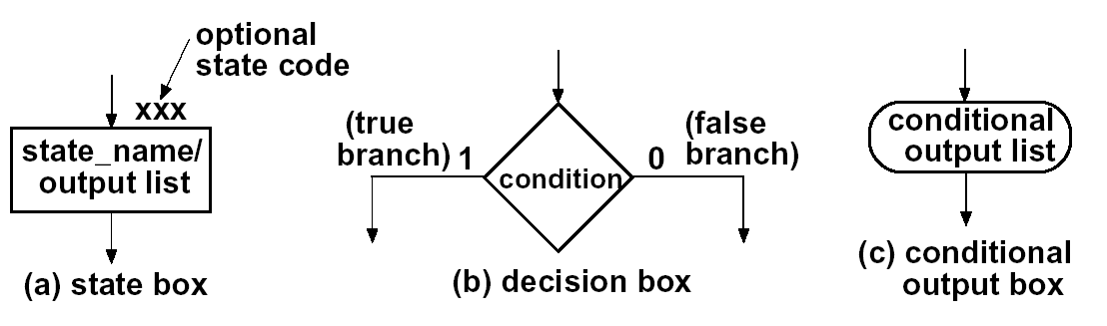
Components of ASM charts

Slide 8
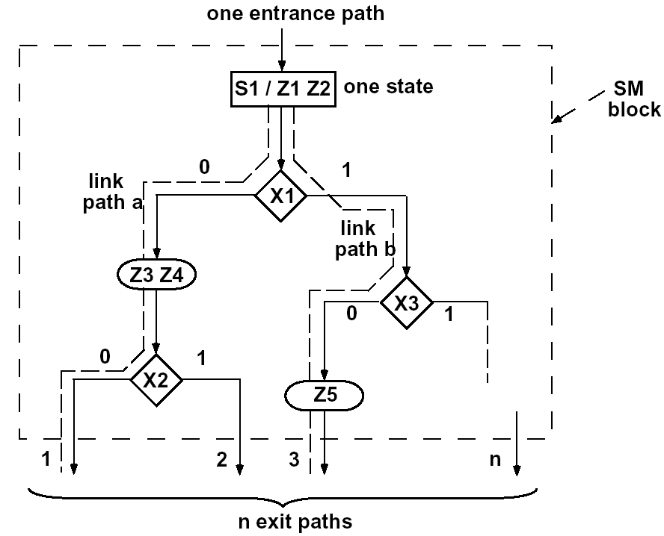
ASM Blocks
ASM chart is constructed from SM blocks
State S1 is entered =>
Z1 and Z2 become 1
if X1=0
Z3 and Z4 become 1
if X1=1 and X3=0
Z5 become 1

Slide 9
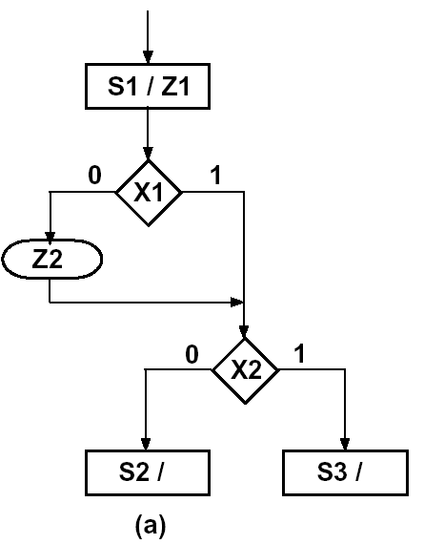
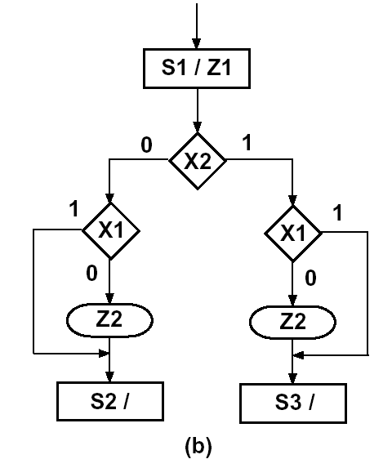
Equivalent SM Blocks

Slide 10
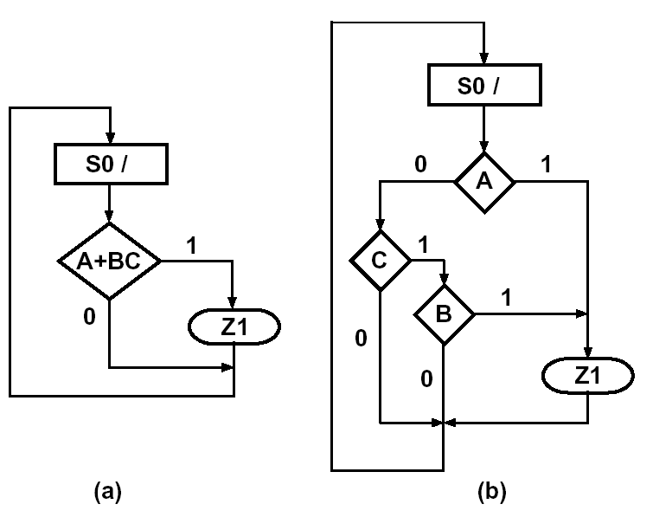
Equivalent ASM Charts for Comb Networks

Slide 11
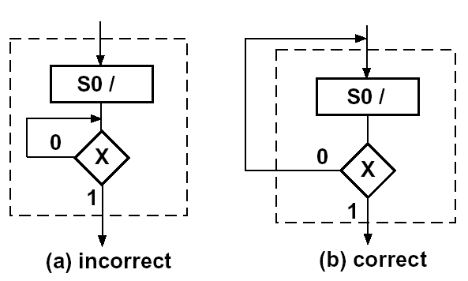
Block with Feedback

Slide 12
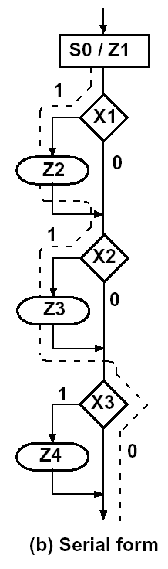
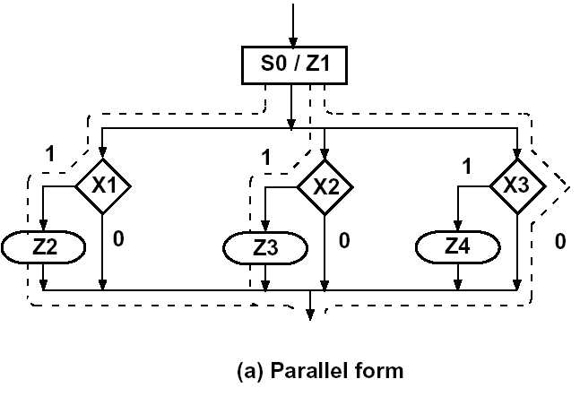
Equivalent ASM Blocks

Slide 13
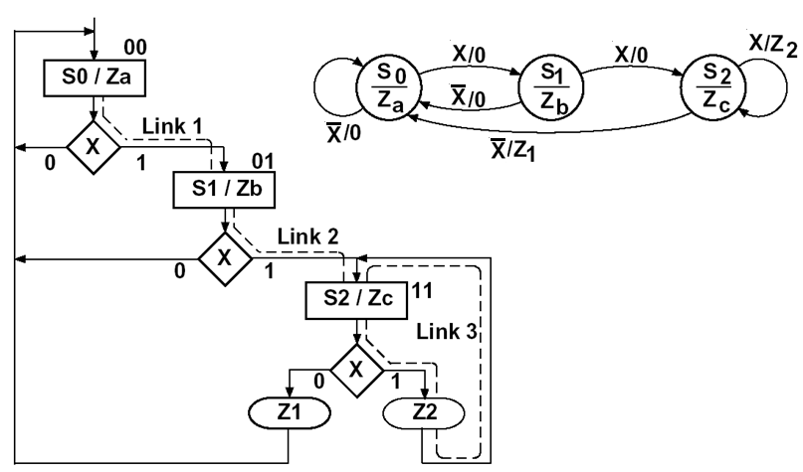
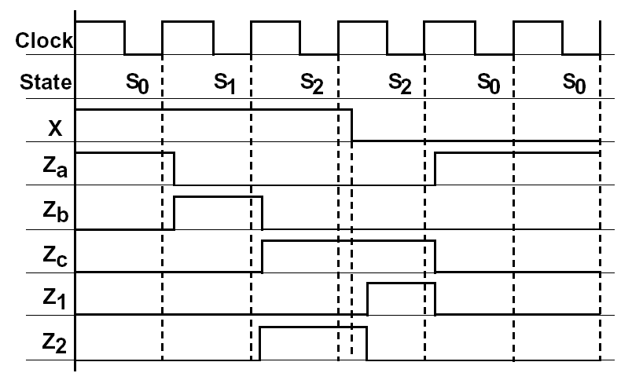
Converting an Extended STG to an ASM Chart

Slide 14
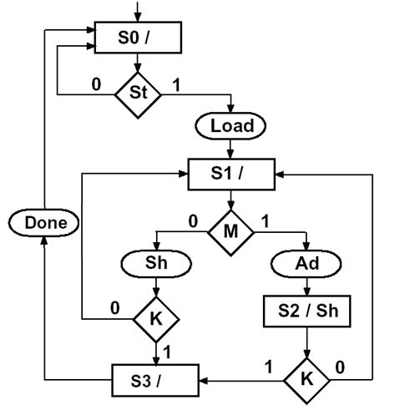
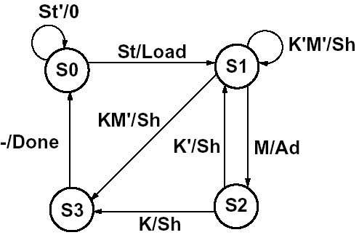
ASM Chart for Binary Multiplier

Slide 15
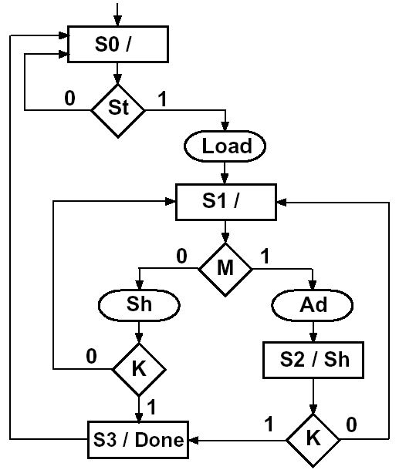
ASM Chart for Binary Multiplier

