Slide 1
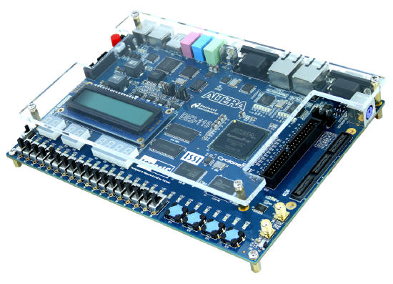
CPE 322
Digital Hardware Design Fundamentals
Electrical and Computer Engineering
UAH
Extended State Graph Finite State Machine Representations

Slide 2
Extended State Graph
Similarities to basic State (Transition) Graph
  Nodes represent states
  Arcs (or edges) represent transition between states
  Labelling on arcs represent Inputs/Outputs on Mealy Machines
  Labelling on arcs represent Inputs and labelling on nodes represent Outputs on Moore Machines
Differences with basic State (Transition) Graph
  To reduce Clutter
    Only Inputs that impact a transition from one state to another are present on the graph – others are ignored.
    Only Outputs that are TRUE (logic high) for a given transition are listed.

Slide 3
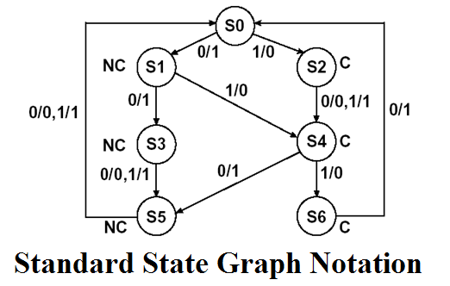
BCD to Excess 3 Mealy FSM Example
X/Z

Slide 4
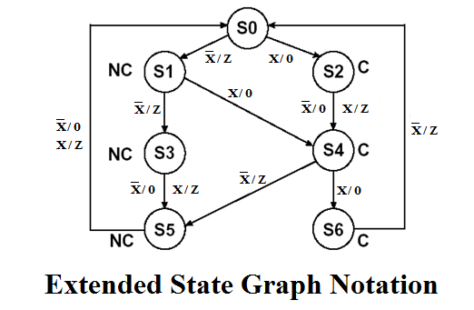
BCD to Excess 3 Mealy FSM Example
    Only Inputs that impact a transition from one state to another are present on the graph – others are ignored.
    Only Outputs that are TRUE (logic high) for a given transition are listed.

Slide 5
BCD to Excess 3 Mealy FSM Example
X/Z

Slide 6
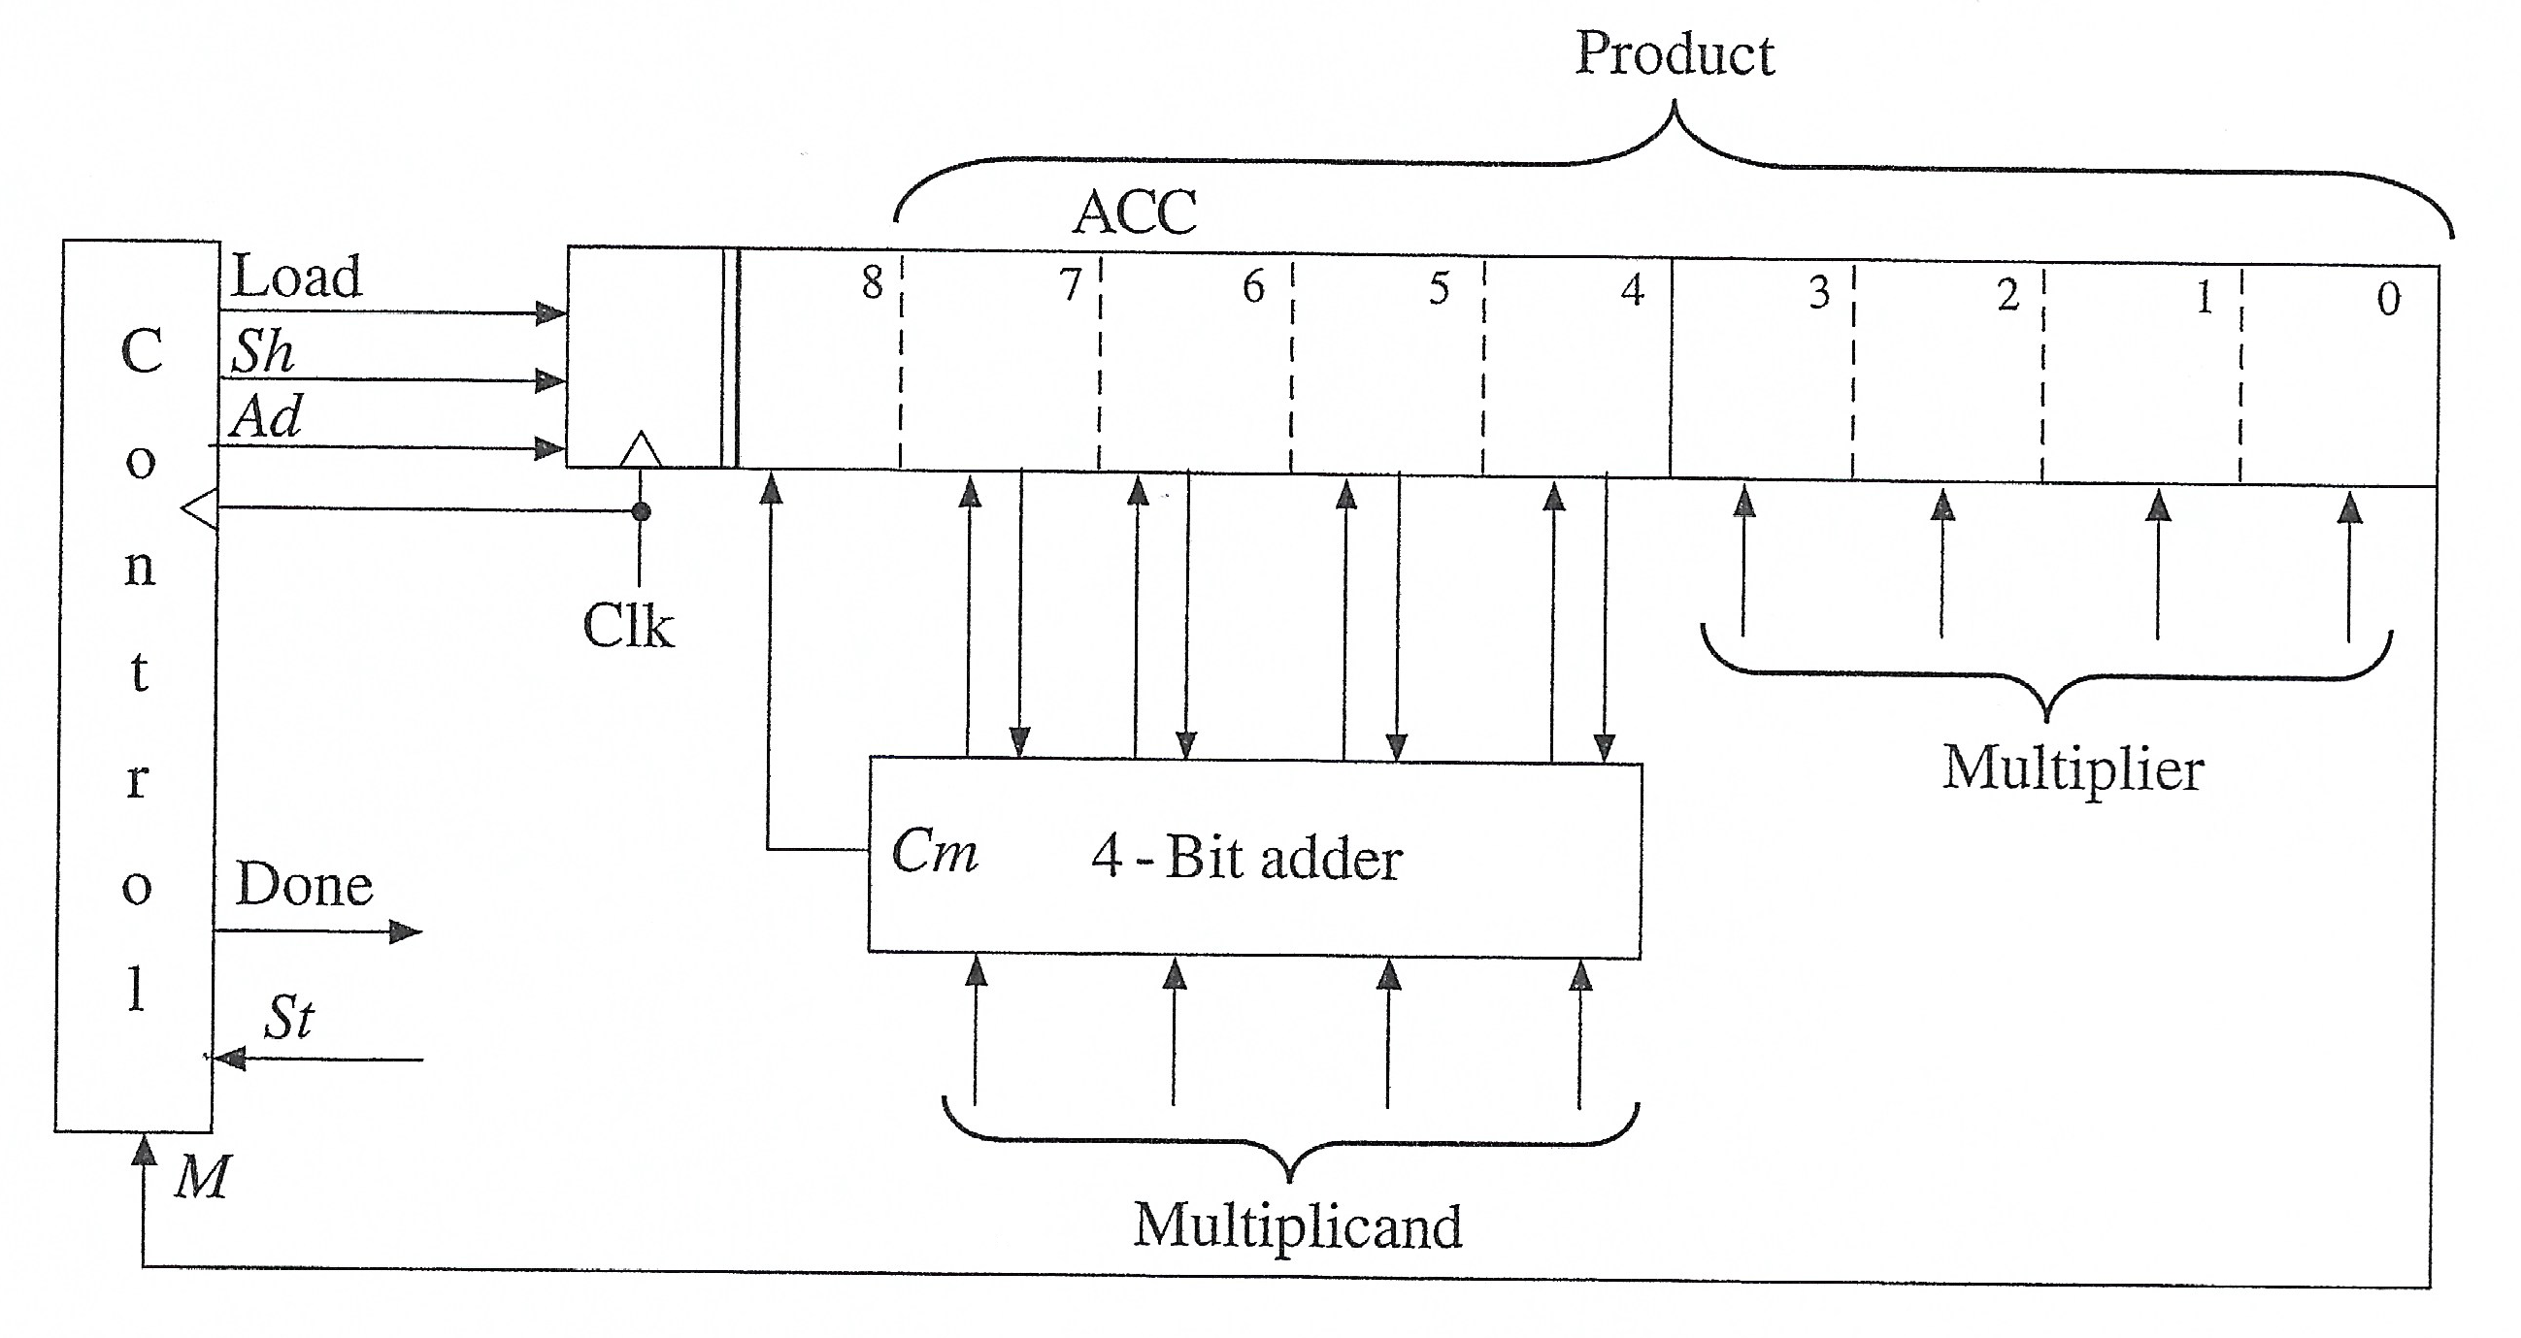
Example: Add/Shift Multiplier

Slide 7
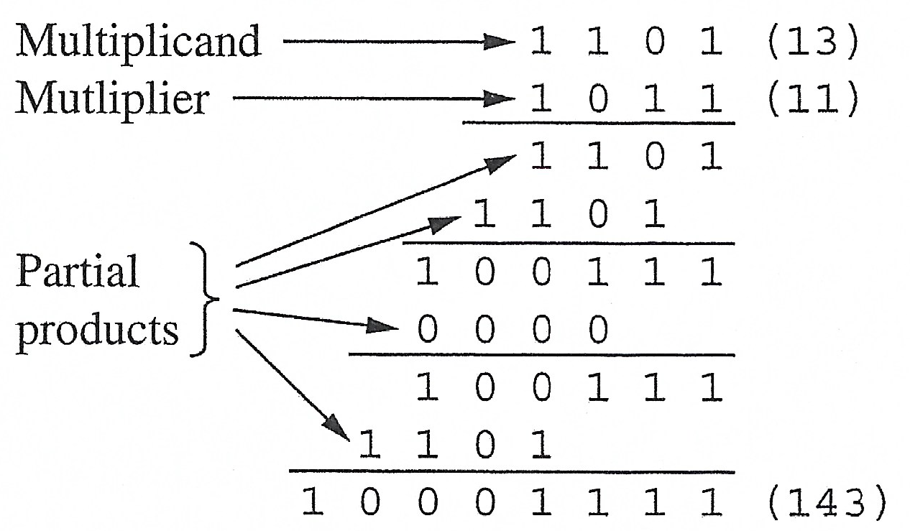
Example: 4 bit Add/Shift Multiplier

Slide 8
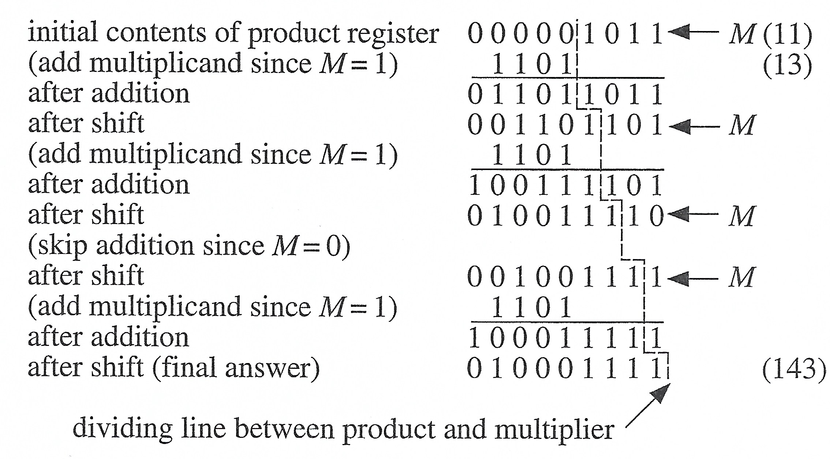
Example: 4-bit Add/Shift Multiplier

Slide 9
Extended State Graph for 4 bit Add/Shift Multiplier

Slide 10
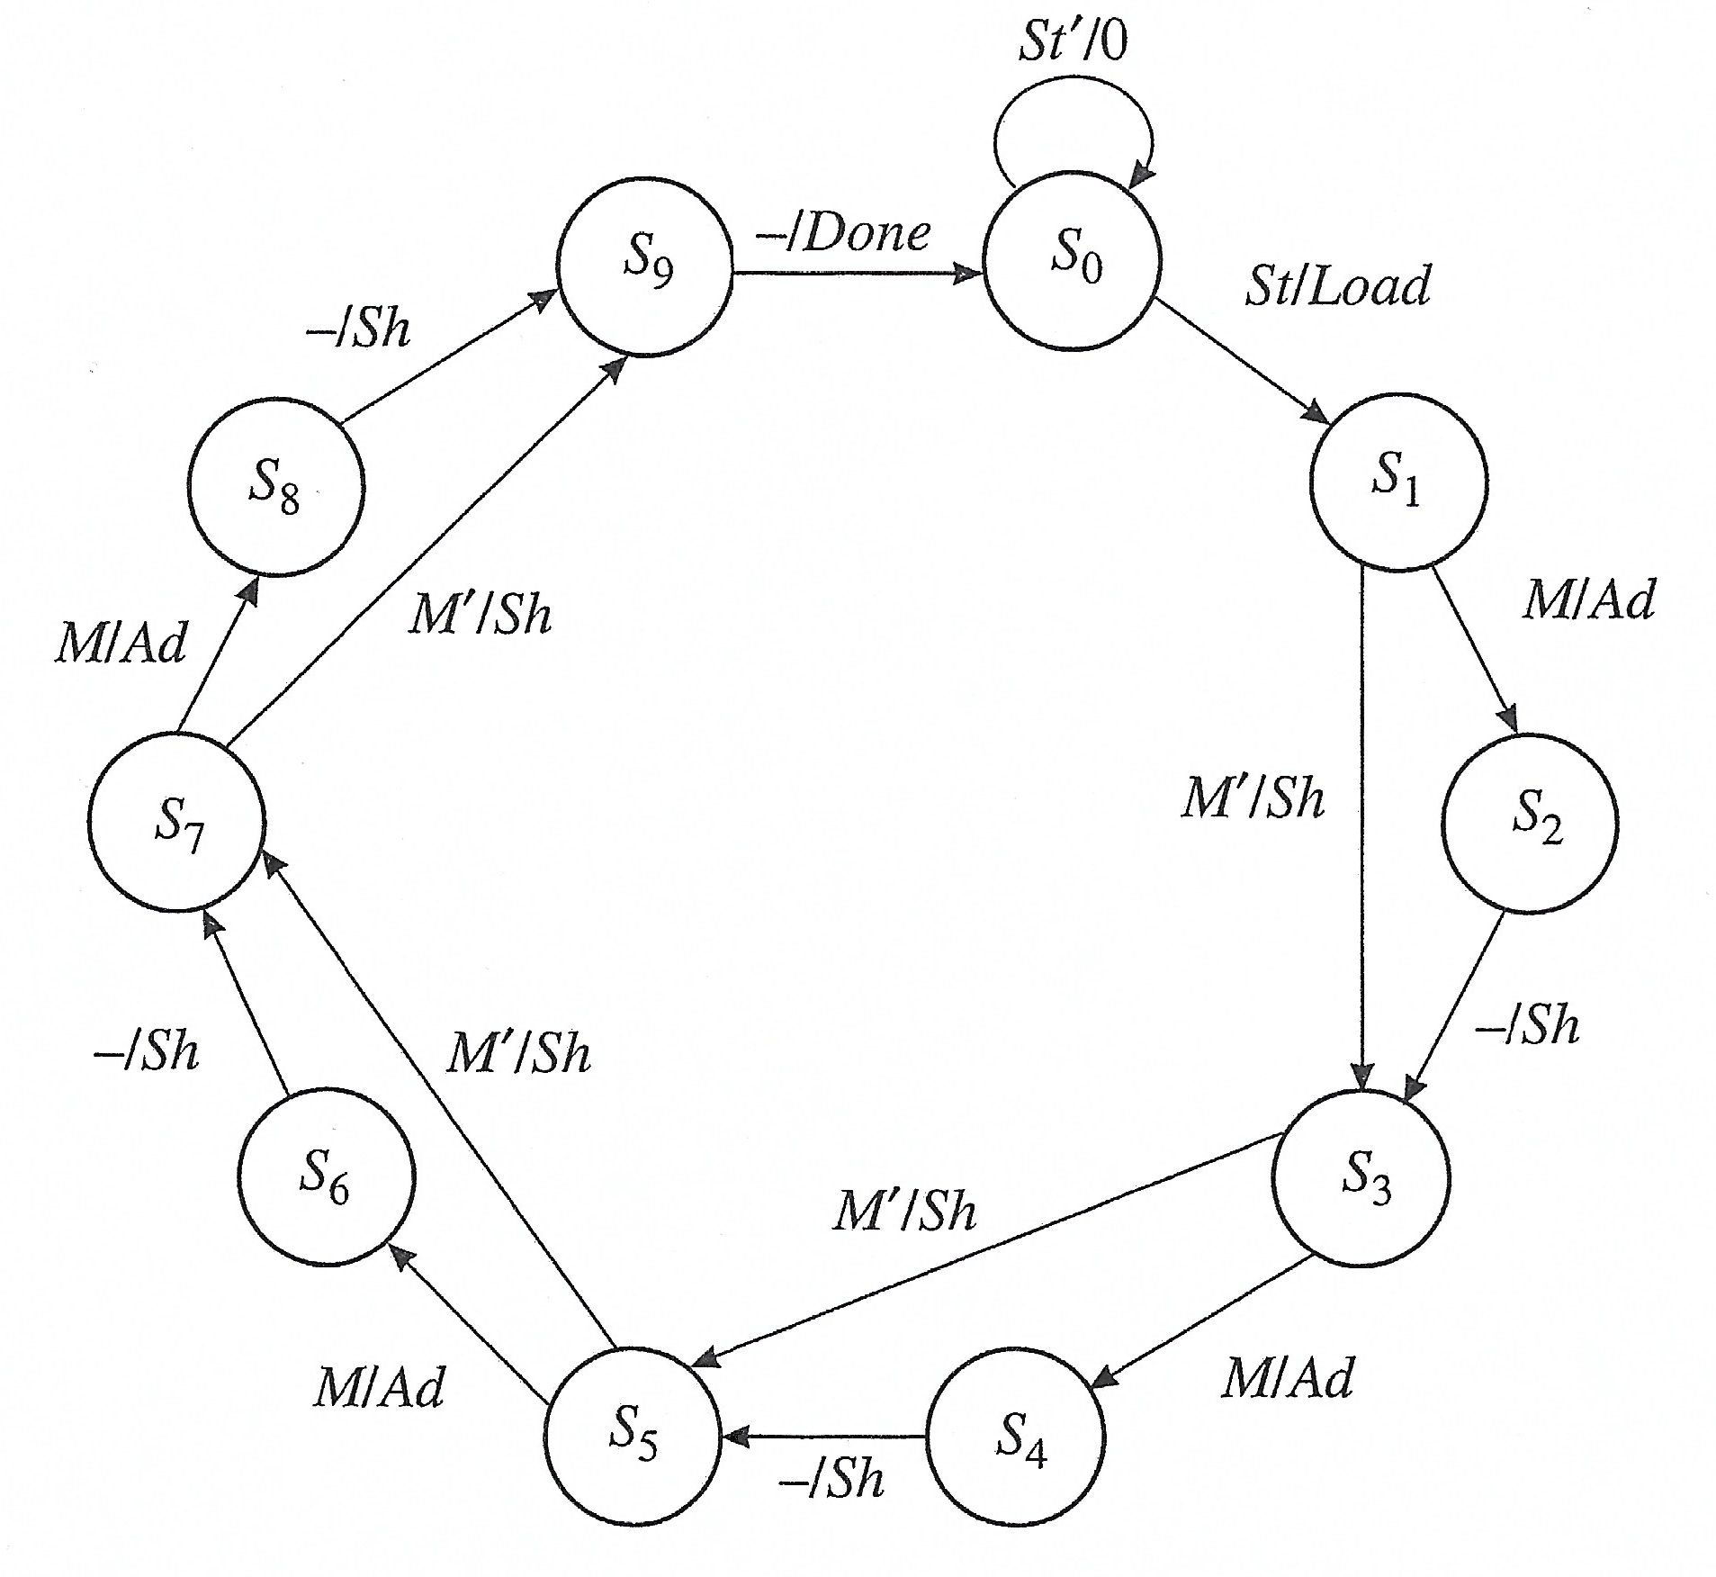
Extended State Graph for 4 bit Add/Shift Multiplier
Note: ‘-’ on the input means no inputs are monitored and transition occurs to the next state no matter what the inputs are

Slide 11
BCD to Excess 3 Moore FSM Example
(Standard State Graph Representation)
Start
S0
0
0
1
NC
S1
C
S2
1
0
0
1
0
1
NC
S3
C
S4
C
S5
1
0
1
0
1
0
1
0
1
NC
S6
NC
S7
C
S8
0
1
0
1
0
0
0
1
0
NC
S9
S10
1
1
0
0
NC
1

Slide 12
BCD to Excess 3 Moore FSM Example
(Extended State Graph Representation)
Start
S0
0
X
X’
NC
S1
C
S2
Z
0
X’
X
X’
X
NC
S3
C
S4
C
S5
Z
0
X’
Z
X’
X
X’
X
X
NC
S6
NC
S7
C
S8
0
X
X’
Z
X’
0
X’
0
X
NC
S9
S10
X
X
0
NC
Z
X’

Slide 13
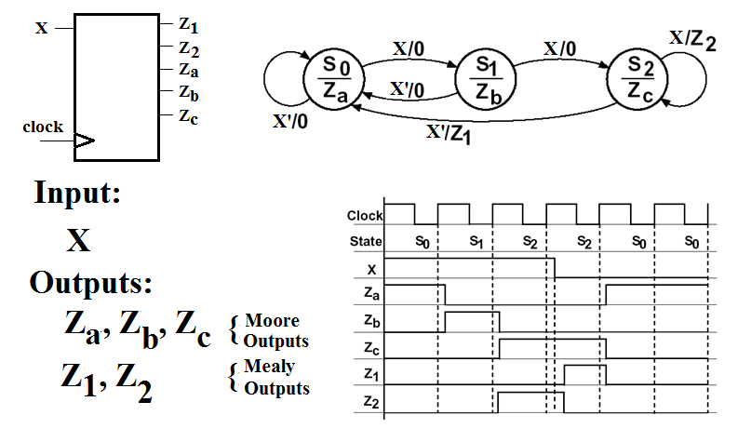
Hybrid Mealy/Moore FSM
(Extended State Graph Representation)

Slide 14
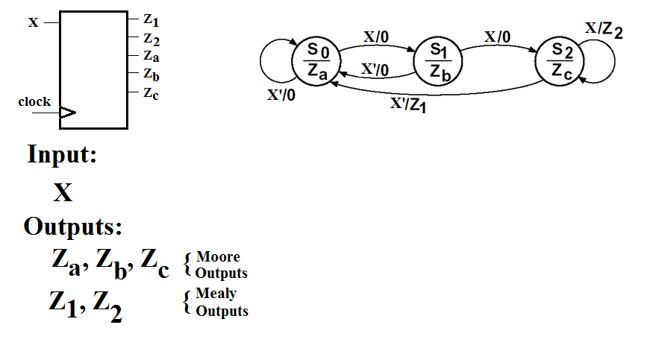
Equivalent Moore Output Representation on a Pure Mealy Extended State Graph

Slide 15
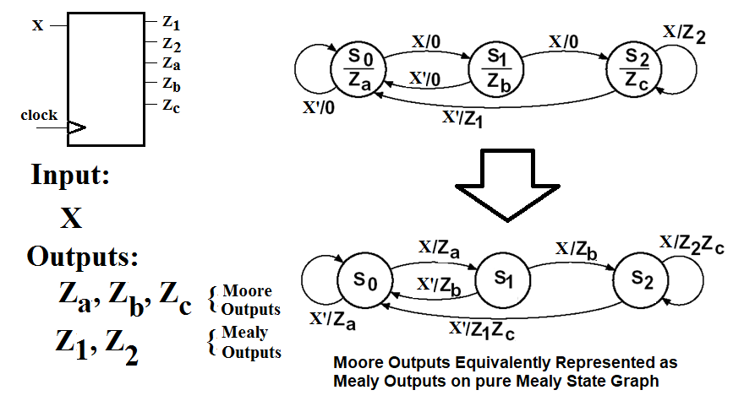
Equivalent Moore Output Representation on a Pure Mealy Extended State Graph
    Each Moore output appears as a Mealy output on ALL transitional arcs that leave the state that is associated with it

