Slide 1
Macros, Functions and Tasks in Verilog

Slide 2
`define Directive
Used to create a macro for text substitution in the source code before it is compiled (elaborated/synthesized).
Can be used both inside and outside a module definition
Format
`define <macro_name> <macro_definition>
Can be used to define both constants and expressions
`define wordsize 16
`define max(a,b) ((a)>(b) ? (a) : (b))
After a text macro is defined it can be used in the source description by using the (`) character followed by the macro name
Example: n=`max(p+q,r+s);

Slide 3
Functions
Functions are designed to produce a single value from one or more input expressions
Similar in concept to a mathematical function
The lines of code are enclosed in function....endfunction brackets
Functions can only be called in a procedural section in the main body of the model and in continuous assignment statements (e.g. assign statements)
Functions can be called many times reducing coding length and repetition
Functions can only be used for modeling combinational logic

Slide 4
Functions
Function Declaration Format:
function [optional vector size] function_name
input [declarations]
<other declarations> // reg, parameter, integer, etc.
begin
sequential statements
end
endfunction

Slide 5
Functions
A function returns a value by assigning it to the function name.
The value returned can be a single bit or a vector of bits.
Functions are often used to perform type conversions
A function can be used anywhere an expression can be used – it can be part of a larger expression
Unlike a task which requires a separate statement to call it
Functions are declared in the module in which they are used.
It is possible to define a function in a separate file and use the compile directive `include to include the function in the file in which it is to used

Slide 6
`include Directive
Used to insert the contents of one source file into another source file during compilation.
Location of `include directive in the source file determines where in the “included” contents are to appear in that file
`include directives can be nested but there should be no circular references within the nesting structure
`include directives are often used to bring within the module’s encapsulating boundaries, commonly used definitions, tasks, and functions without redefining them
Format:
`include <include_file.v>

Slide 7
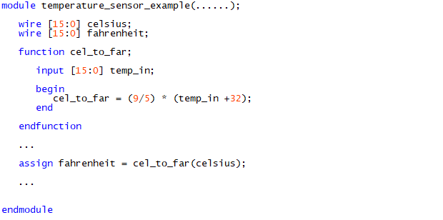
Example Function Call

Slide 8
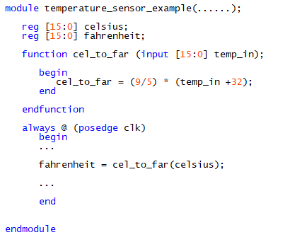
Example Function Call

Slide 9
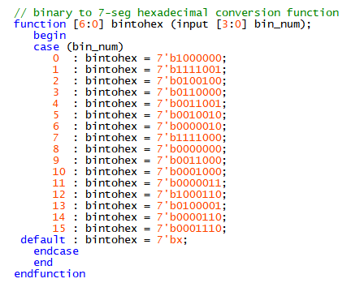
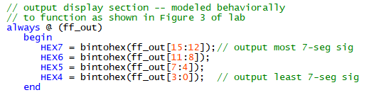
Example Function Call
if ff_out[15:0] is a reg

Slide 10

Example Function Call
if ff_out[15:0] is a wire

Slide 11
for loop
A for loop in Verilog is a procedural construct that is primarily used to replicate hardware logic.
Syntax
for (<initial_condition>; <condition>; <step_assignment>)
begin
// Statements
end
<initial_condition> -- specifies initial values of signals
<condition> -- a logical check to evaluate if the given condition is true for the current iteration
<step_assignment>) – expression to be used to update the control variable for the next iteration
Purpose -- to iterate a set of statements given within the loop as long as the given condition is true.

Slide 12
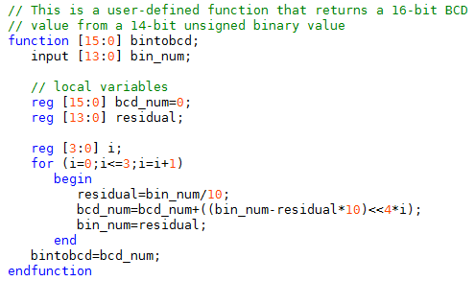

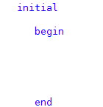
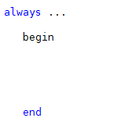

Slide 13
Tasks
Tasks are similar to procedures, subroutines, or methods used in other high-level programming languages
The lines of code are enclosed in task....end task brackets
Tasks can only be called in a procedural section in the main body of the model
Like functions and macros, tasks can be called many times thereby reducing coding length and repetition
tasks can be used for modeling both combinational and sequential logic

Slide 14
Tasks
tasks are defined in the module in which they are used.
It is possible to define a task in a separate file and use the compile directive `include to include the task in the file which instantiates the task.
tasks can call another task or function
A task must be specifically called with a statement
Unlike a function it cannot be used within an expression
tasks can include timing delays, like posedge, negedge, # delay and wait
tasks can have any number of inputs and outputs
The variables declared within a task are local to that task.
The order of declaration within the task defines how the variables passed to the task by the caller are used

Slide 15
Tasks
Tasks can be thought of normally acting in the following manner when only local variables are used:
Data is passed to task through one or more input or inout declarations.
Similar to pass-by-value occurs at beginning of the task region
Task performs its appointed function
Results are returned to the calling module through output or inout declarations
Similar to pass-by-reference at end of task region
Tasks can also take, drive and source global variables, when no local variables are used
The use of global variables in tasks should be limited due to their possible side-effects and lack of information hiding

Slide 16
Tasks
Task Declaration Format:
task task_name
input [declarations]
output [declarations]
inout [declarations]
<other declarations> // reg, parameter, integer, etc.
begin
sequential statements
end
endtask

Slide 17
`define Directive
Used to create a macro for text substitution in the source code before it is compiled (elaborated/synthesized).
Can be used both inside and outside a module definition
Format
`define <macro_name> <macro_definition>
Can be used to define both constants and expressions
`define wordsize 16
`define max(a,b) ((a)>(b) ? (a) : (b))
After a text macro is defined it can be used in the source description by using the (`) character followed by the macro name
Example: n=`max(p+q,r+s);

Slide 18
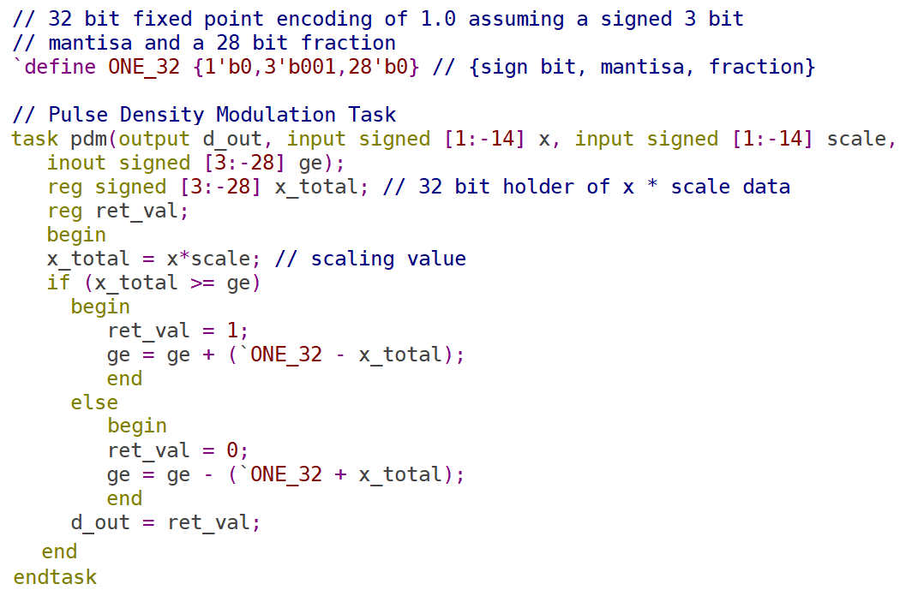

Slide 19
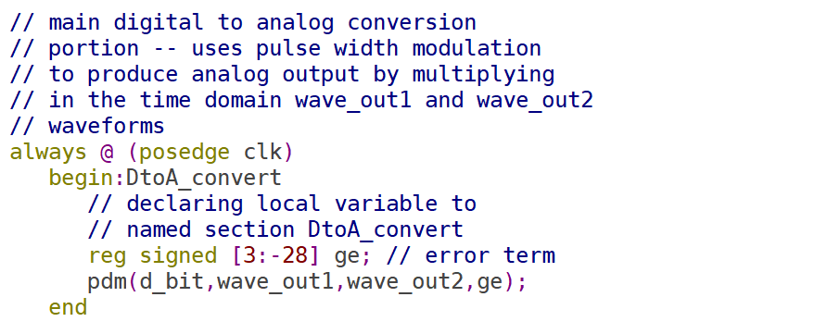

Slide 20
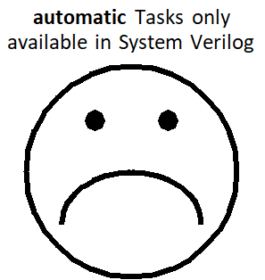
Static versus automatic Tasks
Unlike functions in high-level ISP Languages like C/C++, tasks in Verilog are static in nature by default
This means all internal items declared within the task are shared between calls of the same task
If the same task is used in the same module more than once (or if it calls itself in a recursive manner) it should be declared as an automatic task.
automatic tasks are re-entrant – the items declared within it are allocated upon every individual call of the task.
Format:
task automatic <task_name>
endtask

