Slide 1
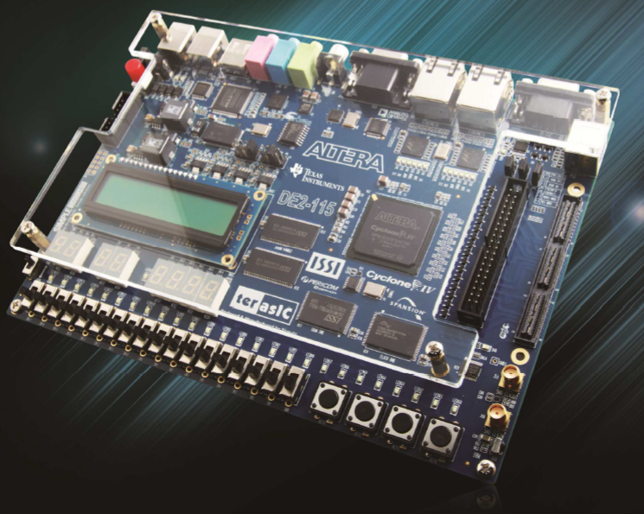
CPE 322 Digital Hardware Design Fundamentals
Non CLB FPGA Building Blocks:
Embedded Phase-Locked-Loops

Slide 2
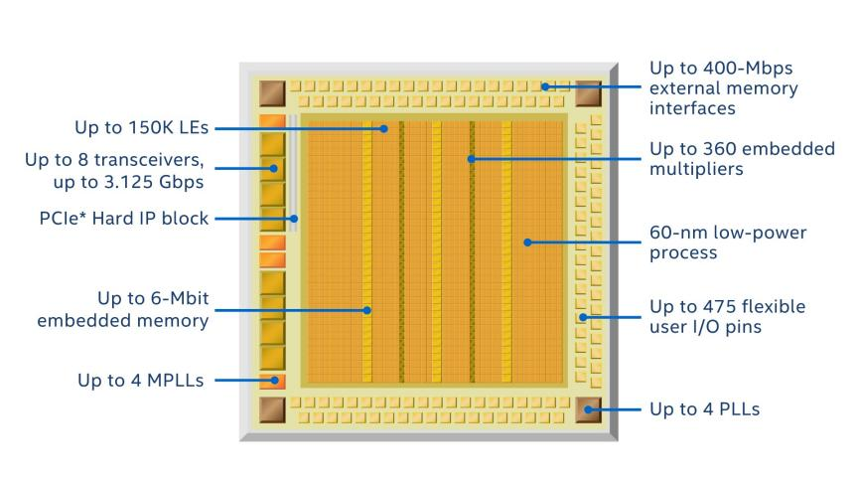
Cyclone IV E Family FPGA Layout

Slide 3
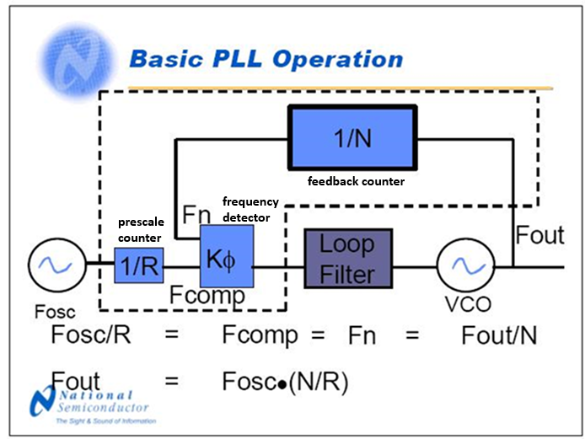
Basic PLL Operation

Slide 4
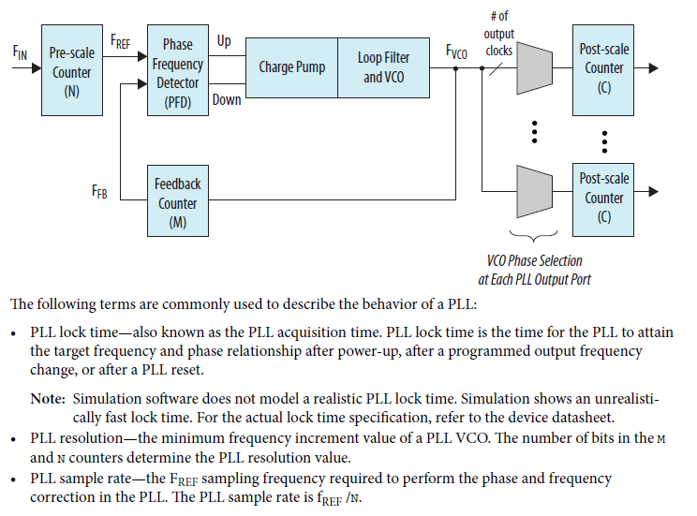
PLL in IntelFPGAs

