Slide 1
EcoCool: Energy-Saving Night Ventilation
kl223ph
Introduction to Applied IoT, Summer course 2024

Slide 2
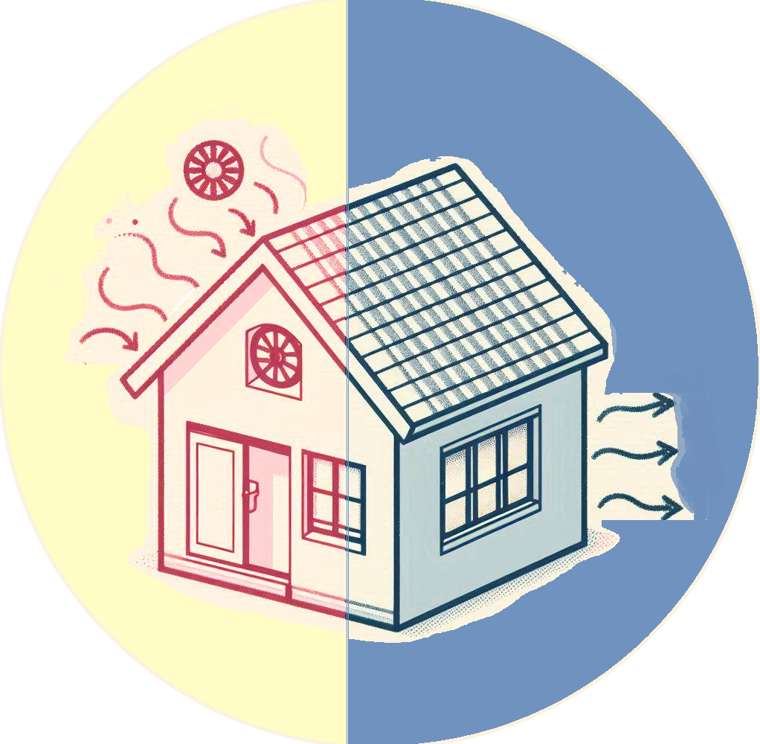








Night Flush
To ventilate during the night's lower temperature and “flush out” the heat accumulated during a hot summer day

Slide 3
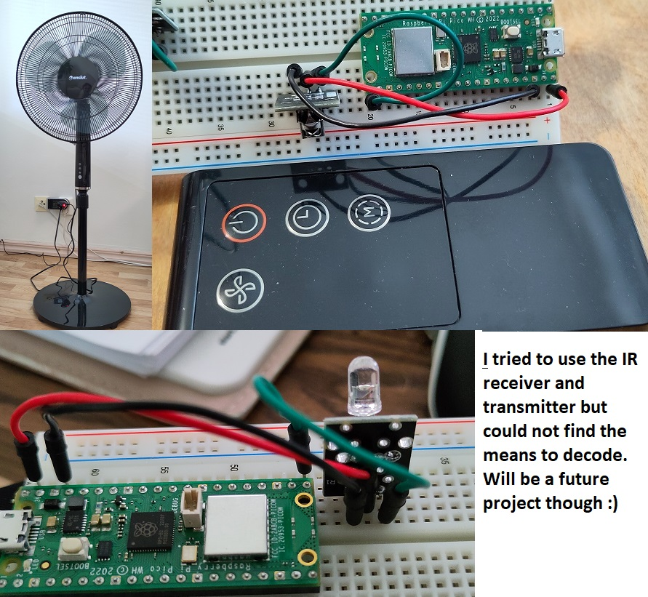
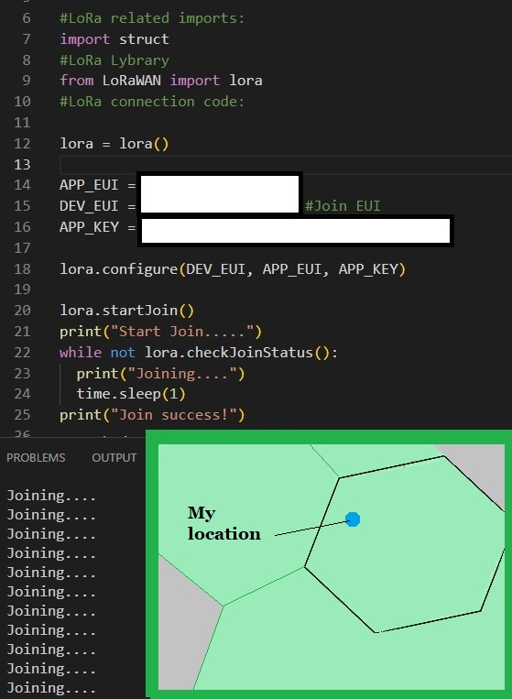

First ideas

Slide 4
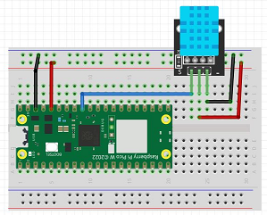
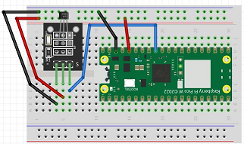
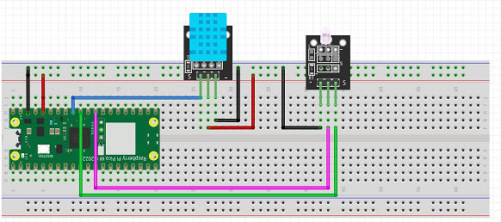
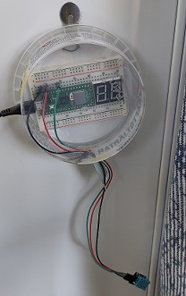
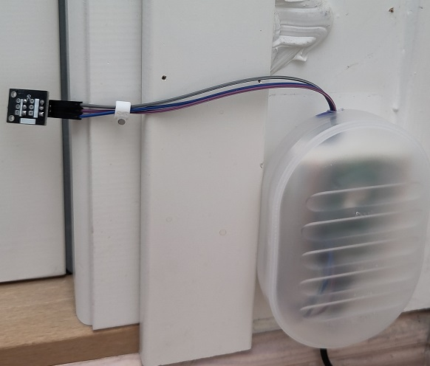
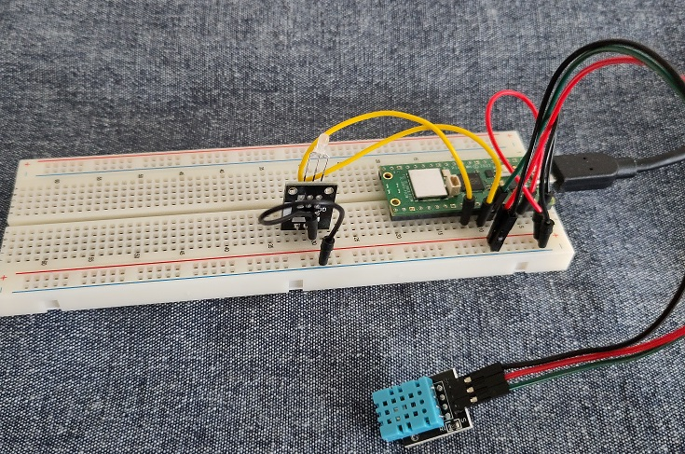
3 Raspberry Pi Pico

Slide 5
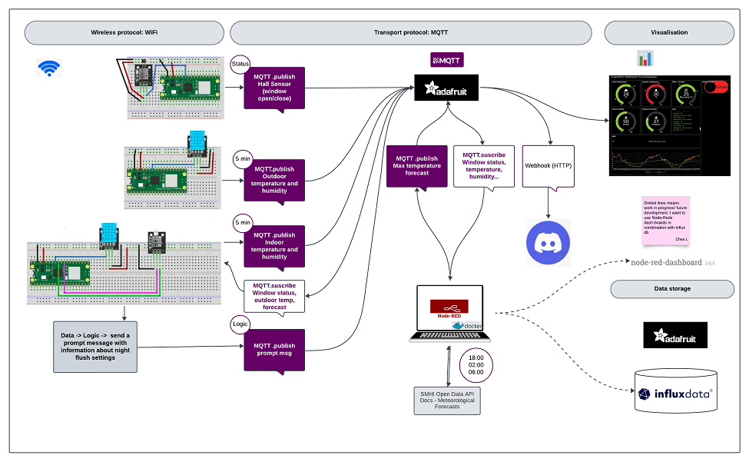

Slide 6
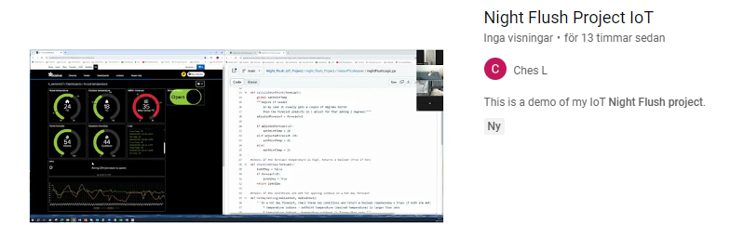
https://www.youtube.com/watch?v=jSCFRoGST6Y

