Slide 1
Data Mining Association Analysis: Basic Concepts and Algorithms
Adapted from
Introduction to Data Mining
by
Tan, Steinbach, Kumar

Slide 2
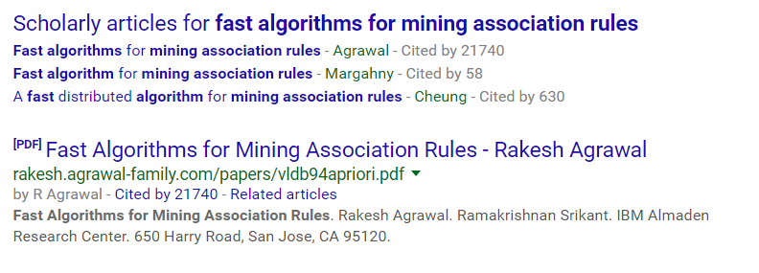
One of the most cited papers in all of Comp Sci

Slide 3
Association Rule Mining
Given a set of transactions, find rules that will predict the occurrence of an item based on the occurrences of other items in the transaction
Market-Basket transactions
Example of Association Rules
{Diaper} → {Beer}, {Milk, Bread} → {Eggs,Coke}, {Beer, Bread} → {Milk},

Slide 4
Transaction data can be broadly interpreted I: A set of documents…
A text document data set. Each document is treated as a “bag” of keywords. Note, text is ordered, but bags of word are not ordered
doc1: Student, Teach, School
doc2: Student, School
doc3: Teach, School, City, Game
doc4: Baseball, Basketball
doc5: Basketball, Player, Spectator
doc6: Baseball, Coach, Game, Team
doc7: Basketball, Team, City, Game
Example of Association Rules
{Student} → {School}, {data} → {mining}, {Baseball} → {ball},

Slide 5
Transaction data can be broadly interpreted II: A set of genes
Example of Association Rules
{GENE1} → {GENE12}, {GENE3, GENE12} → {GENE3},

Slide 6
Transaction data can be broadly interpreted III: A set of time series patterns
1
2
3
4
A
B
A
C
Example of Association Rules
D
{A} → {B}
C
A
A
→
0
120
0
180

Slide 7
Use of Association Rules
Association rules do not represent any sort of causality or correlation between the two itemsets.
X ⇒ Y does not mean X causes Y, so no Causality
X ⇒ Y can be different from Y ⇒ X, unlike correlation
Association rule types:
Actionable Rules – contain high-quality, actionable information
Trivial Rules – information already well-known by those familiar with the domain
Inexplicable Rules – no explanation and do not suggest action
Trivial and Inexplicable Rules occur most often ;-(
Notes:
A 100-year old furniture giant (W…) claimed bankruptcy, who started the brochure shopping in the US.

Slide 8
The Ideal Association Rule
Imagine that we have a large transaction dataset of patient symptoms and interventions (including drugs taken).
We run our algorithm and it gives a rule that reads:
{warfarin, levofloxacin } → {nose bleeds}
Then we have automatically discovered a dangerous drug interaction. Both warfarin and levofloxacin are useful drugs by themselves, but together they are dangerous… patterns of bruises. Signs of an active bleed include: coughing up blood in the form of coffee grinds (hemoptysis), gingival bleeding, nose bleeds,….
Notes:
A 100-year old furniture giant (W…) claimed bankruptcy, who started the brochure shopping in the US.

Slide 9
Intuitive Association Rules
In the music recommendation domain:
{purchased(beatles LP)} → {purchased(the kinks LP)}
These kinds of rules are very exploitable in ecommerce.
Notes:
A 100-year old furniture giant (W…) claimed bankruptcy, who started the brochure shopping in the US.

Slide 10
Definition: Frequent Itemset
Itemset
A collection of one or more items
Example: {Milk, Bread, Diaper}
k-itemset
An itemset that contains k items
Support count (σ)
Frequency of occurrence of an itemset
E.g. σ({Milk, Bread, Diaper}) = 2
Support (range from 0 to 1)
Fraction of transactions that contain an itemset
E.g. s({Milk, Bread, Diaper}) = 2/5
Frequent Itemset
An itemset whose support is greater than or equal to a minsup threshold
TID
Items
1
Bread, Milk
2
Bread, Diaper, Beer, Eggs
3
Milk, Diaper, Beer, Coke
4
Bread, Milk , Beer, Diaper
5
Bread, Milk, Diaper, Coke

Slide 11
Definition: Association Rule
Association Rule
An implication expression of the form X → Y, where X and Y are itemsets*
Example: {Milk, Diaper} → {Beer}
Important Note
Association rules do not consider order. So…
{Milk, Diaper} → {Beer}
and
{Diaper, Milk} → {Beer}
..are the same rule
*X and Y are disjoint

Slide 12
Definition: Association Rule
Association Rule
An implication expression of the form X → Y, where X and Y are itemsets*
Example: {Milk, Diaper} → {Beer}
Rule Evaluation Metrics
Support (s)
Fraction of transactions that contain both X and Y
Confidence (c)
Measures how often items in Y appear in transactions that contain X
*X and Y are disjoint

Slide 13
Definition: Association Rule
Association Rule
An implication expression of the form X → Y, where X and Y are itemsets*
Example: {Milk, Diaper} → {Beer}
Rule Evaluation Metrics
Support (s)
Fraction of transactions that contain both X and Y
Confidence (c)
Measures how often items in Y appear in transactions that contain X
TID
Items
1
Bread, Milk
2
Bread, Diaper, Beer, Eggs
3
Milk, Diaper, Beer, Coke
4
Bread, Milk, Diaper, Beer
5
Bread, Milk, Diaper, Coke
Example:
2
5
*X and Y are disjoint

Slide 14
Definition: Association Rule
Association Rule
An implication expression of the form X → Y, where X and Y are itemsets*
Example: {Milk, Diaper} → {Beer}
Rule Evaluation Metrics
Support (s)
Fraction of transactions that contain both X and Y
Confidence (c)
Measures how often items in Y appear in transactions that contain X
TID
Items
1
Bread, Milk
2
Bread, Diaper, Beer, Eggs
3
Milk, Diaper, Beer, Coke
4
Bread, Milk, Diaper, Beer
5
Bread, Milk, Diaper, Coke
Example:
2
5
2
3
*X and Y are disjoint

Slide 15
Association Rules
Why measure support?
Very low support rules can happen by chance
Even if true rules, low support rules are often not actionable
Why measure confidence?
Very low confidence rules are not reliable

Slide 16
Association Rule Mining Task
Given a set of transactions T, the goal of association rule mining is to find all rules having
support ≥ minsup threshold (provided by user)
confidence ≥ minconf threshold (provided by user)
Brute-force approach:
List all possible association rules
Compute the support and confidence for each rule
Prune rules that fail the minsup and minconf thresholds
⇒ Computationally prohibitive!

Slide 17
Mining Association Rules
Example of Rules:
{Milk,Diaper} → {Beer} (s=0.4, c=0.67) {Milk,Beer} → {Diaper} (s=0.4, c=1.0)
{Diaper,Beer} → {Milk} (s=0.4, c=0.67)
{Beer} → {Milk,Diaper} (s=0.4, c=0.67) {Diaper} → {Milk,Beer} (s=0.4, c=0.5)
{Milk} → {Diaper,Beer} (s=0.4, c=0.5)
Observations:
All the above rules are binary partitions of the same itemset: {Milk, Diaper, Beer}
Rules originating from the same itemset have identical support but can have different confidence
Thus, we can decouple the support and confidence requirements

Slide 18
Mining Association Rules
Two-step approach:
Frequent Itemset Generation
Generate all itemsets whose support ≥ minsup
Rule Generation
Generate high confidence rules from each frequent itemset, where each rule is a binary partitioning of a frequent itemset
Frequent itemset generation is still computationally expensive

Slide 19
Frequent Itemset Generation
Lattice
Given d items, there are M = 2^{d} possible candidate itemsets

Slide 20
Frequent Itemset Generation
Brute-force approach:
Each itemset in the lattice is a candidate frequent itemset
Count the support of each candidate by scanning the database
Match each transaction against every candidate
Complexity ~ O(NMw) => Expensive since M = 2^{d} !!!
Transactions
List of
TID
Items
Candidates
1
Bread, Milk
2
Bread, Diaper, Beer, Eggs
N
3
Milk, Diaper, Beer, Coke
4
Bread, Milk, Diaper, Beer
M
5
Bread, Milk, Diaper, Coke
w

Slide 21
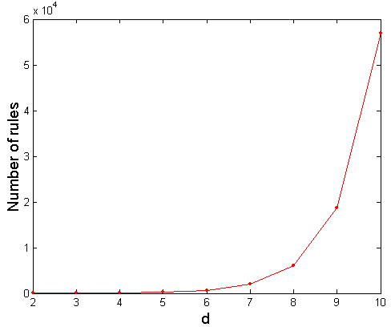
Computational Complexity
Given d unique items:
Total number of itemsets = 2^{d}
Total number of possible association rules:
If d=6, R = 602 rules
If d=20, R = 34,85,735,825 rules

Slide 22
Frequent Itemset Generation Strategies
Reduce the number of candidates (M)
Complete search: M=2^{d}
Use pruning techniques to reduce M
Reduce the number of transactions (N)
Reduce size of N as the size of itemset increases
Reduce the number of comparisons (NM)
Use efficient data structures to store the candidates or transactions
No need to match every candidate against every transaction

Slide 23
Reducing Number of Candidates
Apriori principle:
If an itemset is frequent, then all of its subsets must also be frequent
Apriori principle holds due to the following property of the support measure:
Support of an itemset never exceeds the support of its subsets
This is known as the anti-monotone property of support

Slide 24
Illustrating Apriori Principle
Found to be Infrequent
Pruned supersets

Slide 25
Illustrating Apriori Principle
Pruned subsets
Found to be frequent

Slide 26
Illustrating Apriori Principle
Items (1-itemsets)
Pairs (2-itemsets)
(No need to generate candidates involving Coke or Eggs)
Minimum Support = 3
Triplets (3-itemsets)
If every subset is considered,
⁶C₁ + ⁶C₂ + ⁶C₃ = 41
With support-based pruning,
6 + 6 + 1 = 13

Slide 27
Apriori Algorithm
Method:
Let k = 1
Generate frequent itemsets of length k
Repeat until no new frequent itemsets are identified
Generate length (k+1) candidate itemsets from length k frequent itemsets
Prune candidate itemsets containing subsets of length k that are infrequent
Count the support of each candidate by scanning the DB
Eliminate candidates that are infrequent, leaving only those that are frequent

Slide 28
Reducing Number of Comparisons
Candidate counting:
Scan the database of transactions to determine the support of each candidate itemset
To reduce the number of comparisons, store the candidates in a hash structure
Instead of matching each transaction against every candidate, match it against candidates contained in the hashed buckets

Slide 29
The problem with association rules
How do we set support and confidence?
We tend to either find no rules, or a few million
Given we find a few million, we can rank them using some ranking function….

Slide 30
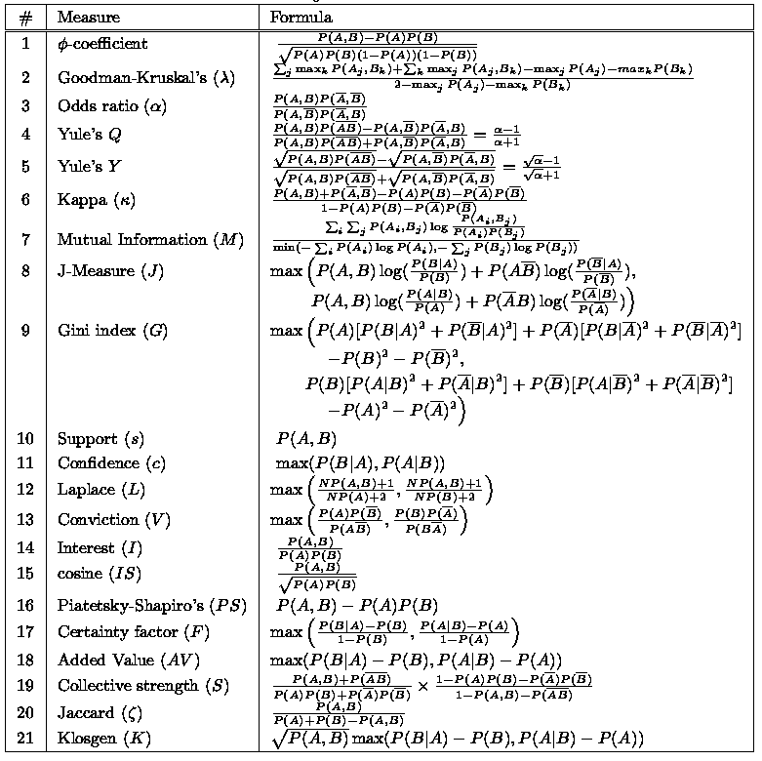
There are lots of measures proposed in the literature….

Slide 31
Finding rules in real valued data
(order matters)

Slide 32
1
2
3
4
A
B
A
C
Example of Association Rules
D
{A} → {B}
C
A
A
→
0
120
0
180

Slide 33
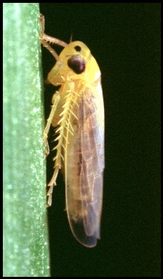
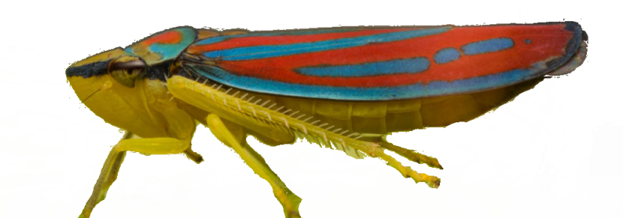
Leafhopper is a common name applied to any species from the family Cicadellidae.
They are plant feeders that suck plant sap from grass, shrubs, or trees.
The family is distributed all over the world, with at least 20,000 described species.
They do billions of dollars of damage to plants each year.

Slide 34
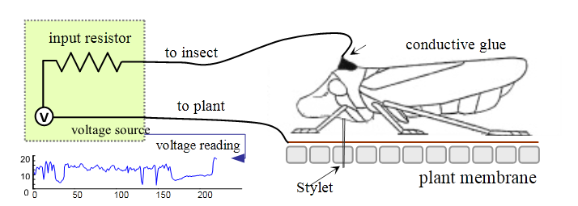
Good News: It is easy to make data
Approximately 14.4 minutes of insect telemetry
0
10,000
20,000
30,000

Slide 35
Good News: It is easy to make data
Bad News: It is easy to make data
-0.5
0
500
1000
1500
2000
2500
3000
How can we make sense of this data?

Slide 36
Time Series Motifs
Approximately 14.4 minutes of insect telemetry
0
10,000
20,000
30,000
The Time Series Motif of a time series database D is the unordered pair of time series {T_{i} , T_{j}} in D which is the most similar among all possible pairs.
More formally, ∀a,b,i,j the pair {T_{i} , T_{j}} is the motif iff dist(T_{i} , T_{j}) ≤ dist(T_{a}, T_{b}), i ≠ j and a ≠ b

Slide 37
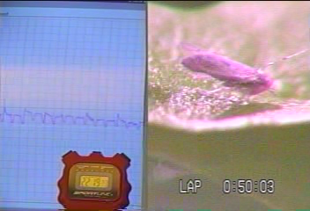
Time Series Motifs
0
10,000
20,000
30,000
0
100
200
300
400
500

Slide 38
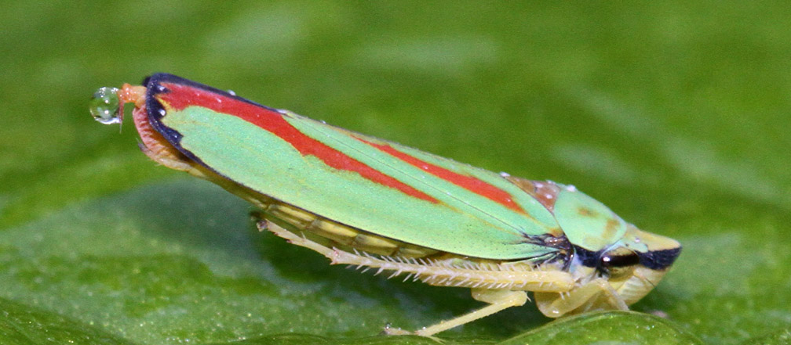
Time Series Motifs
Additional examples of the motif
0
100
200
300
400

Slide 39
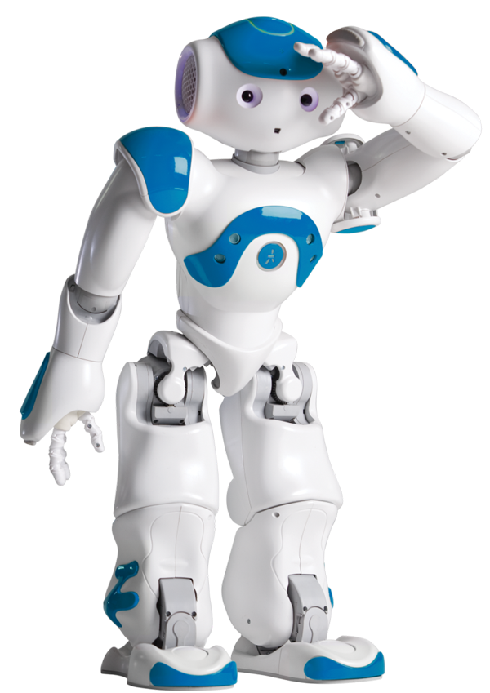
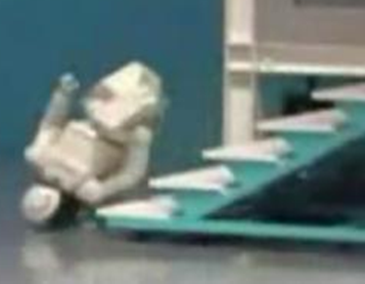
Motifs are useful, but can we predict the future?
What happens next?
-10
-15
-20
-25
-30
0
1000
2000
3000
4000
5000
6000
7000
8000
Prediction vs. Forecasting (my definitions)
Forecasting is “always on”, it constantly predicts a value say, two minutes out
Prediction only make a prediction occasionally, when it is sure what will happen next

Slide 40
Previous attempts have failed…
However, we can do time series rule finding
The technique will use:
Time Series Motifs
MDL (minimum description length)
Admissible speed-up techniques

Slide 41
Let us start by finding motifs
-10
-15
-20
-25
-30
0
1000
2000
3000
4000
5000
6000
7000
8000
9000
Second occurrence
First occurrence
0
20
40
60
80
100

Slide 42
We can convert the motifs to a rule
-10
-15
-20
-25
-30
0
1000
2000
3000
4000
5000
6000
7000
8000
9000
We can use the motif to make a rule…
IF we see thisshape, (antecedent)
THEN we see thatshape, (consequent)
within maxlag time
The match between this and the observed window must be within a threshold t₁ = 7.58
0
20
40
60
80
100
t₁ = 7.58
0
20
40
60
0
20
40
maxlag = 0

Slide 43
We can monitor streaming data with our rule...
t₁ = 7.58
0
20
40
60
0
20
40
maxlag = 0
8000
9000

Slide 44
The rule gets invoked…
t₁ = 7.58
0
20
40
60
0
20
40
maxlag = 0

Slide 45
It seems to work!
t₁ = 7.58
0
20
40
60
0
20
40
maxlag = 0

Slide 46
What is the ground truth?
The first verse of The Raven by Poe
Once upon a midnight dreary, while I pondered weak and weary.. ..rapping at my chamber door……
-10
-15
-20
-25
-30
0
1000
2000
3000
4000
5000
6000
7000
8000
9000

Slide 47
What is the ground truth?
The first verse of The Raven by Poe
Once upon a midnight dreary, while I pondered weak and weary.. ..rapping at my chamber door……
-10
-15
-20
-25
-30
0
1000
2000
3000
4000
5000
6000
7000
8000
9000
t₁ = 7.58
at
my
chamber
door
0
20
40
60
0
20
40
maxlag = 0
0
20
40
60
80
100
The phrase “at my chamber door” does appear 6 more times, and we do fire our rule correctly each time, and have no false positives.
What are we invariant to?
Who is speaking? Somewhat, we can handle other males, but generalizing to females are tricky.
Rate of speech? To a large extent, yes.
Foreign accents? Sore throat? etc

Slide 48
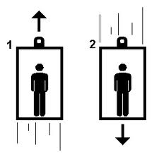

Why we need the Maxlag parameter
Here the maxlag depends on the number of floors we have in our building.
We can hand-edit this rule to generalize for short buildings to tall buildings
Can physicians edit medical rules to generalize from male to female…

Slide 49
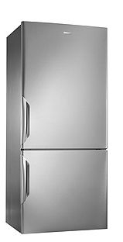
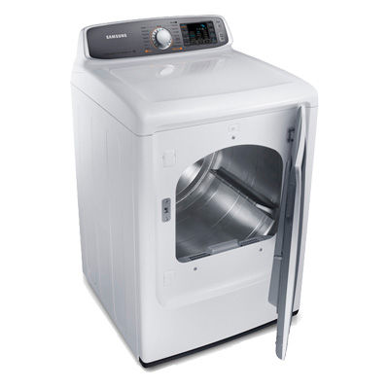
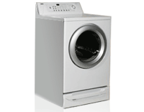
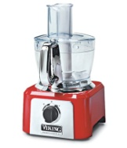
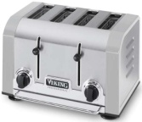
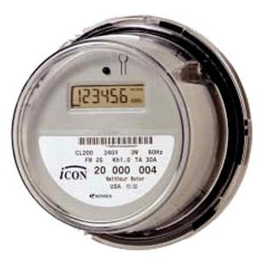
maxlag = 20 minutes
15500
16000
16500
17000
0
120
0
180
IF we see a Clothes Washer used
THEN we will see Clothes Dryer used within 20 minutes

Slide 50
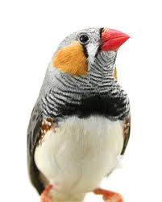
More examples of rule finding: Part I
Training data (day 40)

Slide 51
More examples of rule finding: Part II
Training data (day 40)
Test data (day 50)

Slide 52
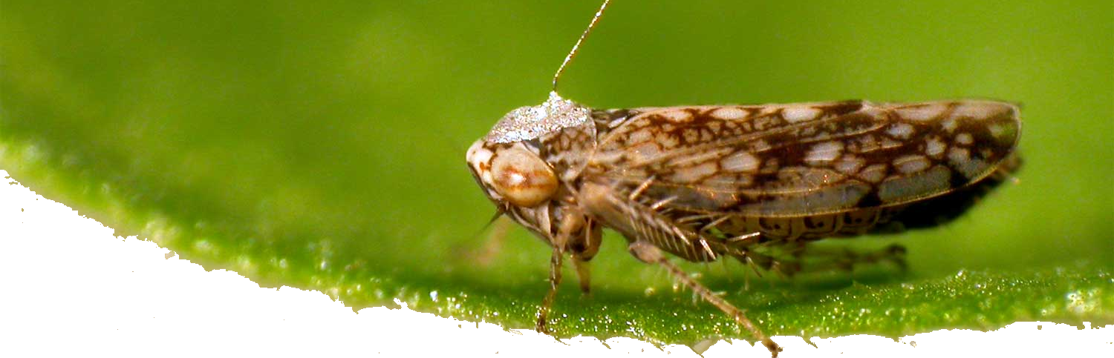

Slide 53
If you want to see more, read
Mohammad Shokoohi-Yekta, Yanping Chen, Bilson Campana, Bing Hu, Jesin Zakaria, Eamonn Keogh (2015). Discovery of Meaningful Rules in Time Series. SIGKDD 2015

