Slide 1

Some thoughts on evaluation
Eamonn Keogh
eamonn@cs.ucr.edu

Slide 2
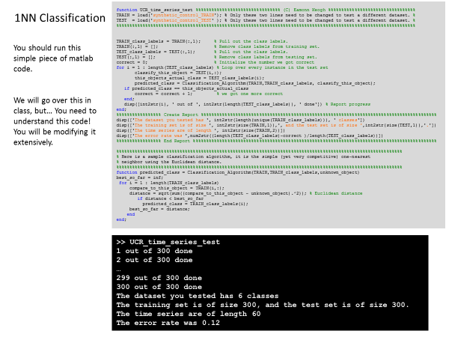
Quick Reminder
We saw the nearest neighbor algorithm.
As we saw that we could use any distance function…

Slide 3
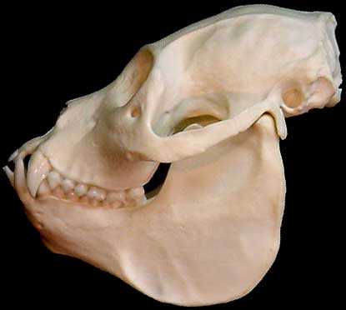
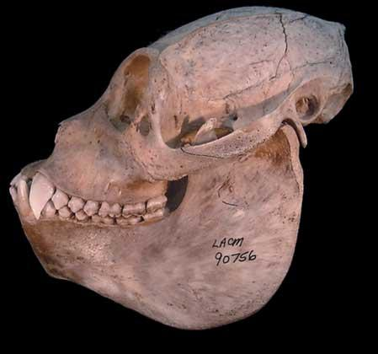
Quick Reminder
We saw we could use the Euclidean distance….
Mantled Howler Monkey
Alouatta palliata
Euclidean Distance
Red Howler Monkey
Alouatta seniculus

Slide 4
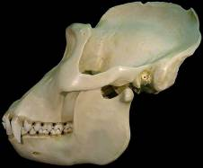
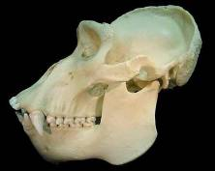
Quick Reminder
We saw we could use the DTW distance
Lowland Gorilla
Gorilla gorilla graueri
DTW
Alignment
Mountain Gorilla
Gorilla gorilla beringei
One-to-many mapping
Notes:
Is man an ape or an angel?
Now I am on the side of the angels.
Benjamin Disraeli, 25 November 1864

Slide 5
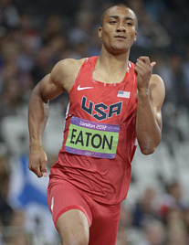
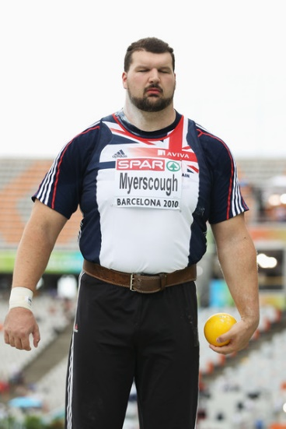
Now we can ask ourselves a few questions..
Considering only 1NN for simplicity…
Is the DTW distance better than Euclidean distance?
Is anything better than DTW distance?
If the XYZ measure better than DTW on some datasets, that is still useful, right?
I can publish a paper “The XYZ measure is good for classifying some datasets, maybe your dataset!”
After all if you think of track and field events as ‘datasets’ and people as “algorithms.
Then maybe Ashton is like DTW pretty good at almost everything.
But, you do have people like Carl who are very good a just one or two things.
There is a place in the world for Carl, may be there is a place for the XYZ algorithm.
In fact, in the last ten years, a few hundred such algorithms have been published..
Ashton Eaton
Carl Myerscough
Notes:
Is man an ape or an angel?
Now I am on the side of the angels.
Benjamin Disraeli, 25 November 1864

Slide 6

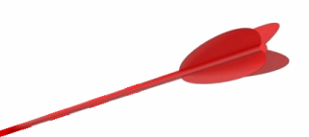
Can you beat 1NN-DTW?
The Texas Sharpshooter Fallacy
A paper in SIGMOD 2016 claims “Our STS3 approach is more accurate than DTW in our suitable scenarios”.
They then note “DTW outperforms STS3 in 79.5% cases.” !?! (our emphasis)
They then do a post-hoc explanation of why they think they won on 20.5% of the cases that “suit them”.
The problem is the post-hoc analysis, this is a form of the Texas Sharpshooter Fallacy. Below is a visual representation.
This is what they show you, and you are impressed…
Notes:
Open-Ended Warping: Here is a good refernce
Matching incomplete time series with dynamic time warping: an algorithm and an application to post-stroke rehabilitation
Paolo Tormene Toni Giorgino Silvana Quaglini, Mario Stefanelli

Slide 7



Can you beat 1NN-DTW?
The Texas Sharpshooter Fallacy
A paper in SIGMOD 2016 claims “Our STS3 approach is more accurate than DTW in our suitable scenarios”.
They then note “DTW outperforms STS3 in 79.5% cases.” !?! (our emphasis)
They then do a post-hoc explanation of why they think they won on 20.5% of the cases that “suit them”.
The problem is the post-hoc analysis, this is a form of the Texas Sharpshooter Fallacy. Below is a visual representation.
This is what they show you, and you are impressed…
…until you realize that they shot the arrow first, and then painted the target around it!
Notes:
Open-Ended Warping: Here is a good refernce
Matching incomplete time series with dynamic time warping: an algorithm and an application to post-stroke rehabilitation
Paolo Tormene Toni Giorgino Silvana Quaglini, Mario Stefanelli

Slide 8
Can you beat 1NN-DTW?
A good visual trick to compare algorithms on the 80 or so labeled time series in the public domain is the Texas Sharpshooter plot.
For each dataset
First you compute the baseline accuracy of the approach you hope to beat.
Then you compute the expected improvement we would get using your proposed approach (at this stage, learning any parameters and settings) using only the training data. Note that the expected improvement could be negative.
Then compute the actual improvement obtained (using these now hardcoded parameters and settings) by testing on the test dataset.
You can plot the point {expected improvement , actual improvement } in a 2D grid, as below.
In this example, we predicted the expected improvement would be 10%, and the actual improvement obtained was 7%, pretty close!
We need to do these for all 80 or so datasets. What are the possible outcomes?
7%
Actual Accuracy Gain
10%
Expected Accuracy Gain

Slide 9
Can you beat 1NN-DTW? 3 of 3
With a Texas Sharpshooter plot, each dataset falls into one of four possibilities.
We expected an improvement and we got it! This is clearly the best case.
We expected to do worse, and we did. This is still a good case, we know not to use our proposed algorithm for these datasets
We expected to do worse, but we did better. This is the wasted opportunity case.
We expected to do better, but actually did worse. This is the worst case.
Texas Sharpshooter Plot
Now that we know how to read the plots, we will use it to see if DTW is better than Euclidean Distance,
Expected Improvement: We will search over different warping window constraints, from 0% to 100%, in 1% increments, looking for the warping window size that gives the highest 1NN training accuracy (if there are ties, we choose the smaller warping window size).
Actual Improvement: Using the warping window size we learned in the last phase, we test the holdout test data on the training set with 1NN.
We expected to do worse, but we did better
We expected an improvement and we got it!
Actual Accuracy Gain
We expected to do worse, and we did
We expected to do better, but actually did worse
Expected Accuracy Gain

Slide 10
The results are strongly supportive of the claim “DTW better than Euclidean distance for most problems”
We sometimes had difficultly in predicting when DTW would be better/worse, but many of the training sets are tiny, making such tests very difficult.
For example, 51 is BeetleFy, with just 20 train and 20 test instances. Here we expected to do a little better, but we did a little worse.
In contrast, for 76 (LargeKitchenAppliances) we had 375 train and 375 test instances, and where able to more accurately predict a large improvement.
2.2
78
2
82
1.8
1.6
76
Actual Accuracy Gain
1.4
41
40
68
10
42
52
39
15
1.2
70
9
5
27
38
7
13
85
14
29
6
72
80
59
64
60
3
28
79
11
19
32
71
8
36
81
2
43
74
44
58
1
37
45
48
54
23
67
62
65
18
84
75
83
86
1
20
63
24
73
77
16
34
56
21
30
25
12
49
26
55
22
17
4
31
50
35
53
69
61
33
47
46
57
66
51
0.8
0.8
1
1.2
1.4
1.6
1.8
2
2.2
Expected Accuracy Gain

Slide 11
Can you beat 1NN-DTW?
Recall the paper in SIGMOD that claimed “Our STS3 approach is more accurate than DTW in our suitable scenarios”. And “DTW outperforms STS3 in 79.5% cases.”
They are claiming to be better for 1/5th of the datasets, but in essence they are only reporting one axis of the Sharpshooter plot.
They did (slightly) win 20.5% of the time.
They lost 79.5% of the time.
Breakeven point

Slide 12
Can you beat 1NN-DTW?
Recall the paper in SIGMOD that claimed “Our STS3 approach is more accurate than DTW in our suitable scenarios”. And “DTW outperforms STS3 in 79.5% cases.”
They are claiming to be better for 1/5th of the datasets, but in essence they are only reporting one axis of the Sharpshooter plot.
It may be* that if we computed the Sharpshooter plot it would look like the below (for two selected points only)
They did (slightly) win 20.5% of the time, but they did not predict ahead of time that they would win.
They lost 79.5% of the time.
Moreover, on a huge fraction of the datasets they lost on, they might have said “you should use our algorithm here, we think we will win”, and we would have been much worse off!
Actual Accuracy Gain
Expected Accuracy Gain

Slide 13
Lets return to our toy example
The reason why people miss the flaw in the previous slides, is because they forget that they need to know ahead of time which algorithm (which person) to use.
In other situations, it is obvious!
If I asked you to pick someone from the below to do a high jump, who would you pick? If I asked for someone to throw a hammer?
Ashton Eaton
Carl Myerscough
Notes:
Is man an ape or an angel?
Now I am on the side of the angels.
Benjamin Disraeli, 25 November 1864

Slide 14
Can you beat 1NN-DTW?
Summary:
I think that at least 90% of the claims to beat DTW are wrong.
Of the 10% of claims that remain
They are beating the simplest 1NN-DTW with w learned in a simple way. Using KNN-DTW , smoothing the data, relaxing the endpoint constraints, better methods for learning w etc, would often close some or all the gap.
The improvements are so small in most cases, it takes a sophisticated and sensitive test to be sure you have a real improvement.
The Texas Sharpshooter test is a great sanity check for this, but you should see the work of Anthony Bagnall and students https://arxiv.org/abs/1602.01711 for a more principled methods.

Slide 15
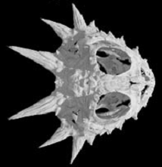
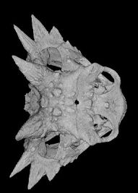
Flat-tailed Horned Lizard
Phrynosoma mcallii
Summary…
DTW is an extraordinarily powerful and useful tool.
Its uses are limited only by our imaginations.
We believe it will remain and important part of the data mining toolbox for decades to come.
Texas Horned Lizard
Phrynosoma cornutum

Slide 16
The Texas sharpshooter plot is a recent invention
It is sort of a more visual version of a contingency table, or confusion matrix

Slide 17
ROC curves
ROC = Receiver Operating Characteristic
Started in electronic signal detection theory (1940s - 1950s)
Has become very popular method used in machine learning/data mining applications to assess classifiers

Slide 18
ROC curves: simplest case
Consider diagnostic test for a disease
Test has two possible outcomes:
‘positive’ = suggesting presence of disease
‘negative’ = suggesting absence of disease
An individual can test either positive or negative for the disease
For “positive/negative” think “katydid/grasshopper”, or “male/female”, or “spam/not spam” etc

Slide 19
Contingencies
Warning, may be “flipped” in different books/papers
 |  | Our Classification Was
 |  | It’s NOT a Heart Attack | Heart Attack!!!
GOLD STANDARD TRUTH | Was NOT a Heart Attack | A | B
 | Was a Heart Attack | C | D

Slide 20
Some Terms
 |  | MODEL PREDICTED
 |  | NO EVENT | EVENT
GOLD STANDARD TRUTH | NO EVENT | TRUE NEGATIVE | B
 | EVENT | C | TRUE POSITIVE

Slide 21
Some More Terms
 |  | MODEL PREDICTED
 |  | NO EVENT | EVENT
GOLD STANDARD TRUTH | NO EVENT | A | FALSE POSITIVE (Type 1 Error)
 | EVENT | FALSE NEGATIVE (Type 2 Error) | D

Slide 22
Accuracy
What does this mean?
Contingency Table Interpretation
(True Positives) + (True Negatives)
(True Positives) + (True Negatives) + (False Positives) + (False Negatives)
Is this a good measure?
 |  | Our Classification Was
 |  | It’s NOT a Heart Attack | Heart Attack!!!
GOLD STANDARD TRUTH | Was NOT a Heart Attack | A | B
 | Was a Heart Attack | C | D

Slide 23
Is accuracy a good measure?
Suppose that one class is very rare…
(True Positives) + (True Negatives)
(True Positives) + (True Negatives) + (False Positives) + (False Negatives)
(0) + (99,996)
(0) + (99,996) + (1) + (3)
Accuracy = 99.996
 |  | Our Classification Was
 |  | Not bomb | bomb
GOLD STANDARD TRUTH | Not bomb | 99,996 | 1
 | bomb | 3 | 0
Our accuracy is very high, but we missed three bombs!

Slide 24
 |  | Our Classification Was
 |  | Not bomb | bomb
GOLD STANDARD TRUTH | Not bomb | 99,996 | 1
 | bomb | 3 | 0
Even if it means increasing this number
We would like to reduce this number

Slide 25
Specific Example
without the disease
with disease
Test Result

Slide 26
Call these patients “negative”
Call these patients “positive”
Test Result

Slide 27
Call these patients “negative”
Call these patients “positive”
True Positives
Test Result
without the disease
with the disease

Slide 28
Call these patients “negative”
Call these patients “positive”
Test Result
False Positives

Slide 29
Call these patients “negative”
Call these patients “positive”
True negatives
Test Result

Slide 30
Call these patients “negative”
Call these patients “positive”
False negatives
Test Result

Slide 31
Key Idea: Threshold
Although the Test Result was some value X. If I am more afraid of false positives, I can multiple X by 1.2 to “nudge” it to the right. Next slide

Slide 32
Key Idea: Threshold
Although the Test Result was some value X. If I am more afraid of false positives, I can multiple X by 1.2 to “nudge” it to the right.
Now I get no false positives (but more false negatives)

Slide 33
Key Idea: Threshold
Although the Test Result was some value X. If I am more afraid of false negatives, I can multiple X by 0.8 to nudge it to the left.
Now I get no false negatives (but more false positives)

Slide 34
ROC curve
0%
False Positive Rate
100%
100%
True Positive Rate
 |  | Our Classification Was
 |  | It’s NOT a Heart Attack | Heart Attack!!!
 | Was NOT a Heart Attack | A | B
 | Was a Heart Attack | C | D
0%

Slide 35
ROC curve
100%
True Positive Rate
0%
0%
100%
False Positive Rate

Slide 36
ROC curve comparison
A good classifier
A poor classifier
100%
100%
True Positive Rate
True Positive Rate
0%
0%
0%
100%
0%
False Positive Rate
100%
False Positive Rate

Slide 37
ROC curve extremes
Best Test:
Worst test:
100%
100%
True Positive Rate
True Positive Rate
0%
0%
0%
100%
0%
False Positive Rate
100%
False Positive Rate

Slide 38
This can happen…
100%
Red: Decision Tree
Blue: Naïve Bayes
True Positive Rate
0%
0%
False Positive Rate
100%

Slide 39
Area under ROC curve (AUC)
Overall measure of test performance
For continuous data, AUC equivalent to Mann-Whitney U-statistic (nonparametric test of difference in location between two populations)

Slide 40
AUC for ROC curves
100%
100%
AUC = 100%
True Positive Rate
True Positive Rate
AUC = 50%
0%
0%
0%
100%
0%
False Positive Rate
100%
False Positive Rate
100%
100%
AUC = 90%
True Positive Rate
True Positive Rate
AUC = 65%
0%
0%
0%
False Positive Rate
100%
0%
100%
False Positive Rate

Slide 41
But how do we adjust the threshold?

Slide 42
 |  | Our Classification Was
 |  | Not bomb | bomb
GOLD STANDARD TRUTH | Not bomb | 99,996 | 1
 | bomb | 3 | 0
10
9
8
7
6
If the red squares are bombs, and we want to reduce false negatives, then we can shift the line away from them…
5
4
3
2
1
1
2
3
4
5
6
7
8
9
10

Slide 43
 |  | Our Classification Was
 |  | Not bomb | bomb
GOLD STANDARD TRUTH | Not bomb | 99,996 | 1
 | bomb | 3 | 0
10
9
8
7
If the red squares are bombs, and we want to reduce false negatives, then we can multiply all the distances to a red square by 0.8, before finding the nearest neighbor
6
5
4
3
2
1
1
2
3
4
5
6
7
8
9
10

Slide 44
 |  | Our Classification Was
 |  | Not bomb | bomb
GOLD STANDARD TRUTH | Not bomb | 99,996 | 1
 | bomb | 3 | 0
If the red squares are bombs, and we want to reduce false negatives, then we can multiply all the probably calculations for bomb by 1.2
p(not bomb| data) = 1/3 * 3/8
3/8
p(bomb | data) = 2/5 * 5/8 * 1.2
3/8

Slide 45
Summary
For many problems, accuracy is a poor measure of how well a classifier is doing.
This is especially true if one class is rare and/or the misclassification costs vary.
The ROC curve allows us to mitigate this problem.

Slide 46
Recommend Reading
An introduction to ROC analysis. Tom Fawcett

Slide 47
Classifier Accuracy Measures
The sensitivity: the percentage of correctly predicted positive data over the total number of positive data
The specificity: the percentage of correctly identified negative data over the total number of negative data.
The accuracy: the percentage of correctly predicted positive and negative data over the sum of positive and negative data

