Slide 1
Dear Reader
This set of slides is partly redundant with “similarity_search.ppt”
I have expanded some examples in this file.
We will quickly review the first dozen of so slides, which you have already seen.

Slide 2



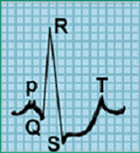
Motivating example
You go to the doctor because of chest pains. Your ECG looks strange…
You doctor wants to search a database to find similar ECGs, in the hope that they will offer clues about your condition...
ECG
  How do we define similar?
  How do we search quickly?
Two questions:

Slide 3
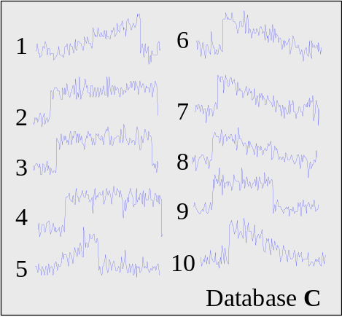
Indexing Time Series
We have seen techniques for assessing the similarity of two time series.
However we have not addressed the problem of finding the best match to a query in a large database (other than the lower bounding trick)
Query Q
The obvious solution, to retrieve and examine every item (sequential scanning), simply does not scale to large datasets.
We need some way to index the data...

Slide 4
We can project time series of length n into n-dimension space.
The first value in C is the X-axis, the second value in C is the Y-axis etc.
One advantage of doing this is that we have abstracted away the details of “time series”, now all query processing can be imagined as finding points in space...

Slide 5
Interesting Sidebar
The Minkowski Metrics have simple geometric interoperations...
…we can project the query time series Q into the same n-dimension space and simply look for the nearest points.
Q
Euclidean
Weighted Euclidean
Manhattan
Max
Mahalanobis
…the problem is that we have to look at every point to find the nearest neighbor..

Slide 6
…we can project the query time series Q into the same n-dimension space and simply look for all objects in a given range…
range
Q
…the problem is that we have to look at every point..

Slide 7
We can group clusters of datapoints with “boxes”, called Minimum Bounding Rectangles (MBR).
We can further recursively group MBRs into larger MBRs….
R1
R4
R2
R5
R3
R6
R9
R7
R8

Slide 8
…these nested MBRs are organized as a tree (called a spatial access tree or a multidimensional tree). Examples include R-tree, Hybrid-Tree etc.
R10
R11
R10 R11 R12
R1 R2 R3
R4 R5 R6
R7 R8 R9
Data nodes containing points
R12

Slide 9


The tree resides in main memory, the actual data (and any metadata) resides on disk.
A disk access costs 1,000 to 100,000 more than a main memory access.
R1
R10 R11 R12
R1 R2 R3
R4 R5 R6
R7 R8 R9
182
234
343
117
298

Slide 10
Note that to record an MBR, we need only remember the location of two opposite corners…. This is true no matter how many dimensions
{3.2, 4.5}
R1
{1.2, 1.4}
{2.2, 3.5, 6.7}
MBR R1 =[ {1.2, 1.4}, {3.2, 4.5} ]
R41
{1.1, 1.2, 0.9}
MBR R41 =[{1.1, 1.2, 0.9},{2.2, 3.5, 6.7}]

Slide 11
We can define a function, MINDIST(point, MBR), which tells us the minimum possible distance between any point and any MBR, at any level of the tree.
MINDIST(point, MBR) = 5
MINDIST(point, MBR) = 0

Slide 12
The algorithm for MINDIST(point, MBR) is very simple. In 2-D, there are nine regions where the point could be in relation to the MBR (including inside it)…
{13.2, 4.5}
{6.2, 2.7}
{11.2, 1.4}
MINDIST(point, MBR) = 5
MINDIST({6.2, 2.7}, [ {11.2, 1.4}, {13.2, 4.5} ]) = 5

Slide 13
We can use the MINDIST(point, MBR), to do fast search..
MINDIST( , R10) = 0
MINDIST( , R11) =10
MINDIST( , R12) =17
R10
R11
R10 R11 R12
R1 R2 R3
R4 R5 R6
R7 R8 R9
Data nodes containing points
R12

Slide 14
We can use the MINDIST(point, MBR), to do fast search..
MINDIST( , R1) = 0
MINDIST( , R2) = 2
MINDIST( , R3) =10
0 10 17
R10
R11
R10 R11 R12
R1 R2 R3
R4 R5 R6
R7 R8 R9
Data nodes containing points
R12

Slide 15
We now go to disk, and retrieve all the data objects whose pointers are in the green node. We measure the true distance between our query and those objects. Let us imagine two scenarios, the closest object, the “best-so-far” has a value of..
1.5 units (we are done searching!)
4.0 units (we have to look in R2, but then we are done)
0 10 17
R10
R11
R10 R11 R12
0 2 10
R1 R2 R3
R4 R5 R6
R7 R8 R9
Data nodes containing points
R12

Slide 16
If we project a query into n-dimensional space, how many additional (nonempty) MBRs must we examine before we are guaranteed to find the best match?
For the one dimensional case, the answer is clearly 2...

Slide 17
If we project a query into n-dimensional space, how many additional (nonempty) MBRs must we examine before we are guaranteed to find the best match?
For the two dimensional case, the answer is 8...

Slide 18
If we project a query into n-dimensional space, how many additional (nonempty) MBRs must we examine before we are guaranteed to find the best match?
For the three dimensional case, the answer is 26...
More generally, in n-dimension space we must examine 3^{n} -1 MBRs
This is known as the curse of dimensionality
n = 21 ⇒ 10,460,353,201 MBRs

Slide 19
Spatial Access Methods
We can use Spatial Access Methods like the R-Tree to index our data, but…
The performance of R-Trees degrade exponentially with the number of dimensions. Somewhere above 6-20 dimensions the R-Tree degrades to linear scanning (but ten times worse!)
Often we want to index time series with hundreds, perhaps even thousands of features….
Key observation: The intrinsic dimensionality is typically much less that the recorded dimensionality…

Slide 20
Key observation: The intrinsic dimensionality is typically much less that the recorded dimensionality…
This idea is so important, we will spend a few classes on it. But for now, recall this imagine, from a slide we saw on the first day.
What is the recorded dimensionality?
What is the intrinsic dimensionality
stroke
push off
stroke
push off
glide
glide
glide
0
1000
2000
3000
4000

Slide 21
GEMINI GEneric Multimedia INdexIng
{Christos Faloutsos}
Establish a distance metric from a domain expert.
Produce a dimensionality reduction technique that reduces the dimensionality of the data from n to N, where N can be efficiently handled by your favorite SAM.
Produce a distance measure defined on the N dimensional representation of the data, and prove that it obeys D_{indexspace}(A,B) ≤ D_{true}(A,B). i.e. The lower bounding lemma.
Plug into an off-the-shelve SAM.

Slide 22

We have 6 objects in 3-D space. We issue a query to find all objects within 1 unit of the point (-3, 0, -2)...
A
3
2.5
2
1.5
C
1
0.5
B
F
0
-0.5
-1
3
2
D
3
1
2
0
E
1
-1
-1
0
-2
-2
-3
-4
-3

Slide 23

The query successfully finds the object E.
A
3
2
C
1
B
F
0
-1
3
2
D
3
1
2
0
E
1
-1
0
-1
-2
-2
-3
-3
-4

Slide 24
Consider what would happen if we issued the same query after reducing the dimensionality to 2, assuming the dimensionality technique obeys the lower
bounding lemma...
The query successfully finds the object E.
A
3
2
C
1
B
F
0
-1
3
2
D
3
1
2
0
E
1
-1
0
-1
-2
-2
-3
-3
-4

Slide 25
Example of a dimensionality reduction technique in which the lower bounding lemma is satisfied
Informally, it’s OK if objects appear closer in the dimensionality reduced space, than in the true space.
3
Note that because of the dimensionality reduction, object F appears to less than one unit from the query (it is a false alarm).
This is OK so long as it does not happen too much, since we can always retrieve it, then test it in the true, 3-dimensional space. This would leave us with just E , the correct answer.
2.5
A
2
1.5
C
F
1
0.5
0
B
-0.5
E
D
-1
-4
-3
-2
-1
0
1
2
3

Slide 26
Example of a dimensionality reduction technique in which the lower bounding lemma is not satisfied
Informally, some objects appear further apart in the dimensionality reduced space than in the true space.
3
Note that because of the dimensionality reduction, object E appears to be more than one unit from the query (it is a false dismissal).
This is unacceptable.
We have failed to find the true answer set to our query.
2.5
A
2
E
1.5
1
C
0.5
0
F
B
-0.5
D
-1
-4
-3
-2
-1
0
1
2
3

Slide 27
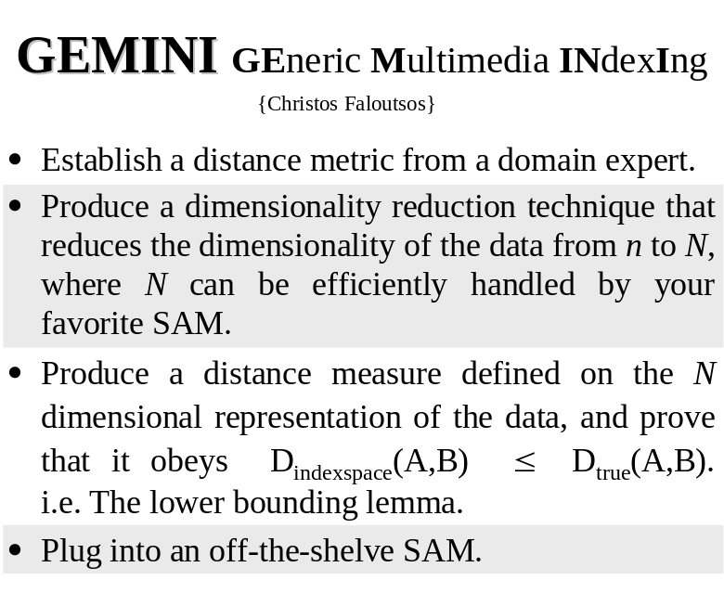
The examples on the previous slides illustrate why the lower bounding lemma is so important.
Now all we have to do is to find a dimensionality reduction technique that obeys the lower bounding lemma, and we can index our time series!

Slide 28
Notation for Dimensionality Reduction
For the future discussion of dimensionality reduction we will assume that
M is the number time series in our database.
n is the original dimensionality of the data.
N is the reduced dimensionality of the data.
C_{Ratio} = N/n is the compression ratio.
(i.e. the length of the time series)

Slide 29
Time Series
Representations
Data Adaptive
Non Data Adaptive
Sorted
Piecewise
Singular
Symbolic
Trees
Wavelets
Random
Spectral
Piecewise
Coefficients
Polynomial
Value
Mappings
Aggregate
Decomposition
Approximation
Piecewise
Adaptive
Natural
Strings
Orthonormal
Bi
-
Discrete
Discrete
Linear
Piecewise
Orthonormal
Approximation
Constant
Language
Fourier
Cosine
Approximat
ion
Transform
Transform
Interpolation
Regression
Haar
Daubechies
Coiflets
Symlets
dbn n > 1
UUCUCUCD
0
20
40
60
80
100
120
0
20
40
60
80
100
120
0
20
40
60
80
100
120
0
20
40
60
80
100
120
0
20
40
60
80
100
120
0
20
40
60
80
100
120
0
20
40
60
80
100
120
U
U
C
U
C
U
D
D
DFT
DWT
SVD
APCA
PAA
PLA
SYM

Slide 30
An Example of a Dimensionality Reduction Technique I
Raw
Data
0.4995
0.5264
0.5523
0.5761
0.5973
0.6153
0.6301
0.6420
0.6515
0.6596
0.6672
0.6751
0.6843
0.6954
0.7086
0.7240
0.7412
0.7595
0.7780
0.7956
0.8115
0.8247
0.8345
0.8407
0.8431
0.8423
0.8387
…
…
The graphic shows a time series with 128 points.
The raw data used to produce the graphic is also reproduced as a column of numbers (just the first 30 or so points are shown).
C
0
20
40
60
80
100
120
140
n = 128
Notes:
Agrawal, R., Faloutsos, C. & Swami, A. (1993). Efficient similarity search in sequence databases. In proceedings of the 4th Int'l Conference on Foundations of Data Organization and Algorithms. Chicago, IL, Oct 13-15. pp 69-84.
Agrawal, R., Lin, K. I., Sawhney, H. S. & Shim, K. (1995a). Fast similarity search in the presence of noise, scaling, and translation in time-series databases. In proceedings of the 21st Int'l Conference on Very Large Databases. Zurich, Switzerland, Sept. pp 490-50.

Slide 31
An Example of a Dimensionality Reduction Technique II
We can decompose the data into 64 pure sine waves using the Discrete Fourier Transform (just the first few sine waves are shown).
The Fourier Coefficients are reproduced as a column of numbers (just the first 30 or so coefficients are shown).
Note that at this stage we have not done dimensionality reduction, we have merely changed the representation...
Raw
Data
Fourier
Coefficients
C
0.4995
0.5264
0.5523
0.5761
0.5973
0.6153
0.6301
0.6420
0.6515
0.6596
0.6672
0.6751
0.6843
0.6954
0.7086
0.7240
0.7412
0.7595
0.7780
0.7956
0.8115
0.8247
0.8345
0.8407
0.8431
0.8423
0.8387
…
…
1.5698
1.0485
0.7160
0.8406
0.3709
0.4670
0.2667
0.1928
0.1635
0.1602
0.0992
0.1282
0.1438
0.1416
0.1400
0.1412
0.1530
0.0795
0.1013
0.1150
0.1801
0.1082
0.0812
0.0347
0.0052
0.0017
0.0002
…
…
0
20
40
60
80
100
120
140
. . . . . . . . . . . . . .

Slide 32

An Example of a Dimensionality Reduction Technique III
Truncated
Fourier
Coefficients
Raw
Data
Fourier
Coefficients
C
0.4995
0.5264
0.5523
0.5761
0.5973
0.6153
0.6301
0.6420
0.6515
0.6596
0.6672
0.6751
0.6843
0.6954
0.7086
0.7240
0.7412
0.7595
0.7780
0.7956
0.8115
0.8247
0.8345
0.8407
0.8431
0.8423
0.8387
…
…
1.5698
1.0485
0.7160
0.8406
0.3709
0.4670
0.2667
0.1928
0.1635
0.1602
0.0992
0.1282
0.1438
0.1416
0.1400
0.1412
0.1530
0.0795
0.1013
0.1150
0.1801
0.1082
0.0812
0.0347
0.0052
0.0017
0.0002
…
…
1.5698
1.0485
0.7160
0.8406
0.3709
0.4670
0.2667
0.1928
n = 128
N = 8
C_{ratio} = 1/16
C’
0
20
40
60
80
100
120
140
… however, note that the first few sine waves tend to be the largest (equivalently, the magnitude of the Fourier coefficients tend to decrease as you move down the column).
We can therefore truncate most of the small coefficients with little effect.
We have discarded
of the data.

Slide 33

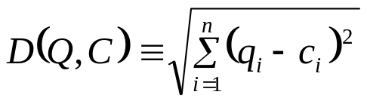
An Example of a Dimensionality Reduction Technique IIII
Truncated
Fourier
Coefficients 1
Truncated
Fourier
Coefficients 2
Raw
Data 1
Raw
Data 2
-
-
-
-
-
-
-
-
-
-
-
-
-
-
-
-
-
-
-
-
-
-
-
-
-
-
-
0.4995
0.5264
0.5523
0.5761
0.5973
0.6153
0.6301
0.6420
0.6515
0.6596
0.6672
0.6751
0.6843
0.6954
0.7086
0.7240
0.7412
0.7595
0.7780
0.7956
0.8115
0.8247
0.8345
0.8407
0.8431
0.8423
0.8387
…
…
0.7412
0.7595
0.7780
0.7956
0.8115
0.8247
0.8345
0.8407
0.8431
0.8423
0.8387
0.4995
0.5264
0.5523
0.5761
0.5973
0.6153
0.6301
0.6420
0.6515
0.6596
0.6672
0.6751
0.6843
0.6954
0.7086
0.7240
…
…
1.5698
1.0485
0.7160
0.8406
0.3709
0.4670
0.2667
0.1928
-
-
-
-
-
-
-
-
1.1198
1.4322
1.0100
0.4326
0.5609
0.8770
0.1557
0.4528
The Euclidean distance between the two truncated Fourier coefficient vectors is always less than or equal to the Euclidean distance between the two raw data vectors*.
So DFT allows lower bounding!
*Parseval's Theorem

Slide 34
Mini Review
We cannot fit all that raw data in main memory.
We can fit the dimensionally reduced data in main memory.
So we will solve the problem at hand on the dimensionally reduced data, making a few accesses to the raw data were necessary, and, if we are careful, the lower bounding property will insure that we get the right answer!
Raw
Data 1
Raw
Data 2
Raw
Data n
0.4995
0.5264
0.5523
0.5761
0.5973
0.6153
0.6301
0.6420
0.6515
0.6596
0.6672
0.6751
0.6843
0.6954
0.7086
0.7240
0.7412
0.7595
0.7780
0.7956
0.7412
0.7595
0.7780
0.7956
0.8115
0.8247
0.8345
0.8407
0.8431
0.8423
0.8387
0.4995
0.5264
0.5523
0.5761
0.5973
0.6153
0.6301
0.6420
0.6515
0.8115
0.8247
0.8345
0.8407
0.8431
0.8423
0.8387
0.4995
0.7412
0.7595
0.7780
0.7956
0.5264
0.5523
0.5761
0.5973
0.6153
0.6301
0.6420
0.6515
Truncated
Fourier
Coefficients 1
Truncated
Fourier
Coefficients 2
Truncated
Fourier
Coefficients n
Disk
1.5698
1.0485
0.7160
0.8406
0.3709
0.4670
0.2667
0.1928
1.1198
1.4322
1.0100
0.4326
0.5609
0.8770
0.1557
0.4528
1.3434
1.4343
1.4643
0.7635
0.5448
0.4464
0.7932
0.2126
Main
Memory

Slide 35
aabbbccb
0
20
40
60
80
100
120
0
20
40
60
80
100
120
0
20
40
60
80
100
120
0
20
40
60
80
100
120
0
20
40
60
80
100
120
0
20
40
60
80
100
120
0
20
40
60
80
100
120
a
a
b
b
b
c
c
b
DFT
DWT
SVD
APCA
PAA
PLA
SAX
Lin, J., Keogh, E.,
Lonardi, S. & Chiu, B. DMKD 2003
Chan & Fu. ICDE 1999
Korn, Jagadish & Faloutsos. SIGMOD 1997
Morinaka,
Yoshikawa, Amagasa, & Uemura, PAKDD 2001
Agrawal, Faloutsos, &. Swami. FODO 1993
Faloutsos, Ranganathan, & Manolopoulos. SIGMOD 1994
Keogh, Chakrabarti, Pazzani & Mehrotra KAIS 2000
Yi & Faloutsos VLDB 2000
Keogh, Chakrabarti, Pazzani & Mehrotra SIGMOD 2001

Slide 36
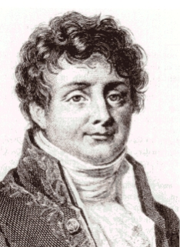
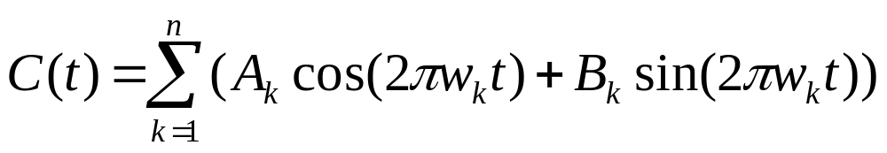
Discrete Fourier Transform I
Basic Idea: Represent the time series as a linear combination of sines and cosines, but keep only the first n/2 coefficients.
Why n/2 coefficients? Because each sine wave requires 2 numbers, for the phase (w) and amplitude (A,B).
X
X'
0
20
40
60
80
100
120
140
Jean Fourier
1768-1830
0
1
2
3
4
5
6
7
Excellent free Fourier Primer
Hagit Shatkay, The Fourier Transform - a Primer'', Technical Report CS-95-37, Department of Computer Science, Brown University, 1995.
http://www.ncbi.nlm.nih.gov/CBBresearch/Postdocs/Shatkay/
8
9
Notes:
Agrawal, R., Faloutsos, C. & Swami, A. (1993). Efficient similarity search in sequence databases. In proceedings of the 4th Int'l Conference on Foundations of Data Organization and Algorithms. Chicago, IL, Oct 13-15. pp 69-84.
Agrawal, R., Lin, K. I., Sawhney, H. S. & Shim, K. (1995a). Fast similarity search in the presence of noise, scaling, and translation in time-series databases. In proceedings of the 21st Int'l Conference on Very Large Databases. Zurich, Switzerland, Sept. pp 490-50.

Slide 37
Discrete Fourier Transform II
Pros and Cons of DFT as a time series representation.
Good ability to compress most natural signals.
Fast, off the shelf DFT algorithms exist. O(nlog(n)).
(Weakly) able to support time warped queries.
Difficult to deal with sequences of different lengths.
Cannot support weighted distance measures.
X
X'
0
20
40
60
80
100
120
140
0
1
2
3
4
5
6
7
Note: The related transform DCT, uses only cosine basis functions. It does not seem to offer any particular advantages over DFT.
8
9
Notes:
Keogh, E., Chakrabarti, K., Pazzani, M. & Mehrotra, S. (2001). Locally adaptive dimensionality reduction for indexing large time series databases. In proceedings of ACM SIGMOD Conference on Management of Data. Santa Barbara, CA, May 21-24. pp 151-162.

Slide 38

Discrete Wavelet Transform I
Basic Idea: Represent the time series as a linear combination of Wavelet basis functions, but keep only the first N coefficients.
Although there are many different types of wavelets, researchers in time series mining/indexing generally use Haar wavelets.
Haar wavelets seem to be as powerful as the other wavelets for most problems and are very easy to code.
X
X'
DWT
Alfred Haar
1885-1933
0
20
40
60
80
100
120
140
Haar 0
Haar 1
Haar 2
Haar 3
Haar 4
Haar 5
Excellent free Wavelets Primer
Stollnitz, E., DeRose, T., & Salesin, D. (1995). Wavelets for computer graphics A primer: IEEE Computer Graphics and Applications.
Haar 6
Haar 7
Notes:
Chan, K. & Fu, A. W. (1999). Efficient time series matching by wavelets. In proceedings of the 15th IEEE Int'l Conference on Data Engineering. Sydney, Australia, Mar 23-26. pp 126-133.

Slide 39

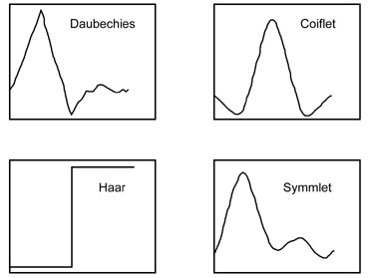
Discrete Wavelet Transform II
X
X'
DWT
Ingrid Daubechies
1954 -
0
20
40
60
80
100
120
140
Haar 0
We have only considered one type of wavelet, there are many others.
Are the other wavelets better for indexing?
YES: I. Popivanov, R. Miller. Similarity Search Over Time Series Data Using Wavelets. ICDE 2002.
NO: K. Chan and A. Fu. Efficient Time Series Matching by Wavelets. ICDE 1999
Haar 1
Later in this tutorial I will answer this question.
Notes:
Chan, K. & Fu, A. W. (1999). Efficient time series matching by wavelets. In proceedings of the 15th IEEE Int'l Conference on Data Engineering. Sydney, Australia, Mar 23-26. pp 126-133.
Popivanov, I. & Miller, R. J. (2002). Similarity search over time series data using wavelets. In proceedings of the 18th Int'l Conference on Data Engineering. San Jose, CA, Feb 26-Mar 1. pp 212-221
See this paper for the answer: Keogh, E. and Kasetty, S. (2002). On the Need for Time Series Data Mining Benchmarks: A Survey and Empirical Demonstration. In the 8th ACM SIGKDD International Conference on Knowledge Discovery and Data Mining. July 23 - 26, 2002. Edmonton, Alberta, Canada. pp 102-111.

Slide 40
Discrete Wavelet Transform III
Pros and Cons of Wavelets as a time series representation.
Good ability to compress stationary signals.
Fast linear time algorithms for DWT exist.
Able to support some interesting non-Euclidean similarity measures.
Signals must have a length n = 2^{some_integer}
Works best if N is = 2^{some_integer}. Otherwise wavelets approximate the left side of signal at the expense of the right side.
Cannot support weighted distance measures.
X
X'
DWT
0
20
40
60
80
100
120
140
Haar 0
Haar 1
Haar 2
Haar 3
Haar 4
Haar 5
Haar 6
Haar 7

Slide 41
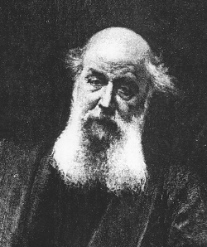

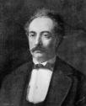
Singular Value Decomposition I
Basic Idea: Represent the time series as a linear combination of eigenwaves but keep only the first N coefficients.
SVD is similar to Fourier and Wavelet approaches is that we represent the data in terms of a linear combination of shapes (in this case eigenwaves).
SVD differs in that the eigenwaves are data dependent.
SVD has been successfully used in the text processing community (where it is known as Latent Symantec Indexing ) for many years.
Good free SVD Primer
Singular Value Decomposition - A Primer. Sonia Leach
X
X'
SVD
James Joseph Sylvester
1814-1897
0
20
40
60
80
100
120
140
eigenwave 0
eigenwave 1
eigenwave 2
eigenwave 3
Camille Jordan
(1838--1921)
eigenwave 4
eigenwave 5
eigenwave 6
eigenwave 7
Eugenio Beltrami
1835-1899
Notes:
Korn, F., Jagadish, H. & Faloutsos, C. (1997). Efficiently supporting ad hoc queries in large datasets of time sequences. In proceedings of the ACM SIGMOD Int'l Conference on Management of Data. Tucson, AZ, May 13-15. pp 289-300.
The word “eigenwave” and the above visualization first appear in: Keogh, E., Chakrabarti, K., Pazzani, M. & Mehrotra, S. (2001). Locally adaptive dimensionality reduction for indexing large time series databases. In proceedings of ACM SIGMOD Conference on Management of Data. Santa Barbara, CA, May 21-24. pp 151-162.

Slide 42
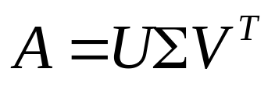
Singular Value Decomposition II
How do we create the eigenwaves?
We have previously seen that we can regard time series as points in high dimensional space.
We can rotate the axes such that axis 1 is aligned with the direction of maximum variance, axis 2 is aligned with the direction of maximum variance orthogonal to axis 1 etc.
Since the first few eigenwaves contain most of the variance of the signal, the rest can be truncated with little loss.
X
X'
SVD
0
20
40
60
80
100
120
140
eigenwave 0
eigenwave 1
eigenwave 2
eigenwave 3
eigenwave 4
eigenwave 5
eigenwave 6
This process can be achieved by factoring a M by n matrix of time series into 3 other matrices, and truncating the new matrices at size N.
eigenwave 7

Slide 43
Singular Value Decomposition III
Pros and Cons of SVD as a time series representation.
Optimal linear dimensionality reduction technique .
The eigenvalues tell us something about the underlying structure of the data.
Computationally very expensive.
  Time: O(Mn²)
  Space: O(Mn)
An insertion into the database requires recomputing the SVD.
Cannot support weighted distance measures or non Euclidean measures.
X
X'
SVD
0
20
40
60
80
100
120
140
eigenwave 0
eigenwave 1
eigenwave 2
eigenwave 3
eigenwave 4
eigenwave 5
eigenwave 6
Note: There has been some promising research into mitigating SVDs time and space complexity.
eigenwave 7

Slide 44
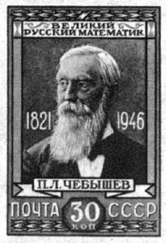
Chebyshev
Polynomials
Basic Idea: Represent the time series as a linear combination of Chebyshev Polynomials
X
Pros and Cons of Chebyshev Polynomials as a time series representation.
Time series can be of arbitrary length
Only O(n) time complexity
Is able to support multi-dimensional time series*.
X'
Cheb
0
20
40
60
80
T_{i}(x) =
100
120
140
1
x
2x²−1
4x³−3x
8x⁴−8x²+1
16x⁵−20x³+5x
32x⁶−48x⁴+18x²−1
64x⁷−112x⁵+56x³−7x
128x⁸−256x⁶+160x⁴−32x²+1
Pafnuty Chebyshev
1821-1946
Time series must be renormalized to have length between –1 and 1
Notes:
* Raymond T. Ng, Yuhan Cai: Indexing Spatio-Temporal Trajectories with Chebyshev Polynomials. SIGMOD 2004.

Slide 45
Chebyshev
Polynomials
X
X'
Cheb
0
20
40
60
80
T_{i}(x) =
100
120
140
Pafnuty Chebyshev
1821-1946
In 2006, Dr Ng published a “note of Caution” on his webpage, noting that the results in the paper are not reliable..
“…Thus, it is clear that the C++ version contained a bug. We apologize for any inconvenience caused…”
Both Dr Keogh and Dr Michail Vlachos independently found Chebyshev Polynomials are slightly worse than other methods on more than 80 different datasets.
Notes:
* Raymond T. Ng, Yuhan Cai: Indexing Spatio-Temporal Trajectories with Chebyshev Polynomials. SIGMOD 2004.

Slide 46
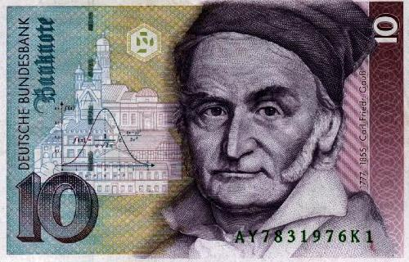
Piecewise Linear Approximation I
Basic Idea: Represent the time series as a sequence of straight lines.
Lines could be connected, in which case we are allowed
N/2 lines
If lines are disconnected, we are allowed only N/3 lines
Personal experience on dozens of datasets suggest disconnected is better. Also only disconnected allows a lower bounding Euclidean approximation
X
X'
Karl Friedrich Gauss
1777 - 1855
0
20
40
60
80
100
120
140
Each line segment has
length
left_height
(right_height can be inferred by looking at the next segment)
Each line segment has
length
left_height
right_height
Notes:
There are many hundreds of papers on this representation, dating back at least 30 years. Ref [1] compares the 3 major algorithms to calculate the representation, and [2] shows how to calculate the representation, online, and in linear time.
[1] Keogh, E., Chu, S., Hart, D. & Pazzani, M. (2001). An Online Algorithm for Segmenting Time Series. In Proceedings of IEEE International Conference on Data Mining. pp 289-296.
[2] T. Palpanas, M. Vlachos, E. Keogh, D. Gunopulos, W. Truppel (2004). Online Amnesic Approximation of Streaming Time Series. In ICDE . Boston, MA, USA, March 2004.
Douglas, D. H. & Peucker, T. K.(1973). Algorithms for the Reduction of the Number of Points Required to Represent a Digitized Line or Its Caricature. Canadian Cartographer, Vol. 10, No. 2, December. pp. 112-122.
Duda, R. O. and Hart, P. E. 1973. Pattern Classification and Scene Analysis. Wiley, New York.
Ge, X. & Smyth P. (2001). Segmental Semi-Markov Models for Endpoint Detection in Plasma Etching. To appear in IEEE Transactions on Semiconductor Engineering.
Heckbert, P. S. & Garland, M. (1997). Survey of polygonal surface simplification algorithms, Multiresolution Surface Modeling Course. Proceedings of the 24th International Conference on Computer Graphics and Interactive Techniques.
Hunter, J. & McIntosh, N. (1999). Knowledge-based event detection in complex time series data. Artificial Intelligence in Medicine. pp. 271-280. Springer.
Ishijima, M., et al. (1983). Scan-Along Polygonal Approximation for Data Compression of Electrocardiograms. IEEE Transactions on Biomedical Engineering. BME-30(11):723-729.
Koski, A., Juhola, M. & Meriste, M. (1995). Syntactic Recognition of ECG Signals By Attributed Finite Automata. Pattern Recognition, 28 (12), pp. 1927-1940.
Keogh, E. & Pazzani, M. (1999). Relevance feedback retrieval of time series data. Proceedings of the 22th Annual International ACM-SIGIR Conference on Research and Development in Information Retrieval.
Keogh, E., & Pazzani, M. (1998). An enhanced representation of time series which allows fast and accurate classification, clustering and relevance feedback. Proceedings of the 4th International Conference of Knowledge Discovery and Data Mining. pp 239-241, AAAI Press.
Keogh, E., & Smyth, P. (1997). A probabilistic approach to fast pattern matching in time series databases. Proceedings of the 3rd International Conference of Knowledge Discovery and Data Mining. pp 24-20.
Lavrenko, V., Schmill, M., Lawrie, D., Ogilvie, P., Jensen, D., & Allan, J. (2000). Mining of Concurent Text and Time Series. Proceedings of the 6th International Conference on Knowledge Discovery and Data Mining. pp. 37-44.
McKee, J.J., Evans, N.E., & Owens, F.J. (1994). Efficient implementation of the Fan/SAPA-2 algorithm using fixed point arithmetic. Automedica. Vol. 16, pp 109-117.
Pavlidis, T. (1976). Waveform segmentation through functional approximation. IEEE Transactions on Computers.
Qu, Y., Wang, C. & Wang, S. (1998). Supporting fast search in time series for movement patterns in multiples scales. Proceedings of the 7th International Conference on Information and Knowledge Management.
Ramer, U. (1972). An iterative procedure for the polygonal approximation of planar curves. Computer Graphics and Image Processing. 1: pp. 244-256.
Shatkay, H. (1995). Approximate Queries and Representations for Large Data Sequences. Technical Report cs-95-03, Department of Computer Science, Brown University.
Shatkay, H., & Zdonik, S. (1996). Approximate queries and representations for large data sequences. Proceedings of the 12th IEEE International Conference on Data Engineering. pp 546-553.
Vullings, H.J.L.M., Verhaegen, M.H.G. & Verbruggen H.B. (1997). ECG Segmentation Using Time-Warping. Proceedings of the 2nd International Symposium on Intelligent Data Analysis.
Wang, C. & Wang, S. (2000). Supporting content-based searches on time Series via approximation. Proceedings of the 12th International Conference on Scientific and Statistical Database Management.

Slide 47
Piecewise Linear Approximation II
How do we obtain the Piecewise Linear Approximation?
Optimal Solution is O(n²N), which is too slow for data mining.
A vast body on work on faster heuristic solutions to the problem can be classified into the following classes:
Top-Down
Bottom-Up
Sliding Window
Other (genetic algorithms, randomized algorithms, Bspline wavelets, MDL etc)
Extensive empirical evaluation* of all approaches suggest that Bottom-Up is the best approach overall.
X
X'
0
20
40
60
80
100
120
140
Notes:
* Keogh, E., Chu, S., Hart, D. & Pazzani, M. (2001). An Online Algorithm for Segmenting Time Series. In Proceedings of IEEE International Conference on Data Mining. pp 289-296.

Slide 48
Piecewise Linear Approximation III
Pros and Cons of PLA as a time series representation.
Good ability to compress natural signals.
Fast linear time algorithms for PLA exist.
Able to support some interesting non-Euclidean similarity measures. Including weighted measures, relevance feedback, fuzzy queries…
Already widely accepted in some communities (ie, biomedical)
Not (currently) indexable by any data structure (but does allows fast sequential scanning).
X
X'
0
20
40
60
80
100
120
140

Slide 49
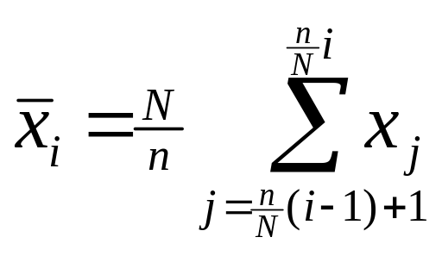
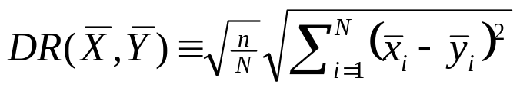
Piecewise Aggregate Approximation I
Basic Idea: Represent the time series as a sequence of box basis functions.
Note that each box is the same length.
X
X'
0
20
40
60
80
100
120
140
Given the reduced dimensionality representation we can calculate the approximate Euclidean distance as...
x1
x2
x3
x4
x5
This measure is provably lower bounding.
x6
x7
Independently introduced by two authors
Keogh, Chakrabarti, Pazzani & Mehrotra, KAIS (2000) / Keogh & Pazzani PAKDD April 2000
Byoung-Kee Yi, Christos Faloutsos, VLDB September 2000
x8
Notes:
Eamonn J. Keogh, Michael J. Pazzani: A Simple Dimensionality Reduction Technique for Fast Similarity Search in Large Time Series Databases. PAKDD 2000: 122-133
Eamonn J. Keogh, Kaushik Chakrabarti, Michael J. Pazzani, Sharad Mehrotra: Dimensionality Reduction for Fast Similarity Search in Large Time Series Databases. Knowl. Inf. Syst. 3(3): 263-286 (2001)
Byoung-Kee Yi, Christos Faloutsos: Fast Time Sequence Indexing for Arbitrary Lp Norms. VLDB 2000: 385-394

Slide 50
Piecewise Aggregate Approximation II
Pros and Cons of PAA as a time series representation.
Extremely fast to calculate
As efficient as other approaches (empirically)
Support queries of arbitrary lengths
Can support any Minkowski metric@
Supports non Euclidean measures
Supports weighted Euclidean distance
Can be used to allow indexing of DTW and uniform scaling*
Simple! Intuitive!
If visualized directly, looks ascetically unpleasing.
X
X'
0
20
40
60
80
100
120
140
X1
X2
X3
X4
X5
X6
X7
X8
Notes:
@ Byoung-Kee Yi, Christos Faloutsos: Fast Time Sequence Indexing for Arbitrary Lp Norms. VLDB 2000: 385-394
* Eamonn J. Keogh: Exact Indexing of Dynamic Time Warping. VLDB 2002: 406-417
* Keogh, E., Palpanas, T., Zordan, V., Gunopulos, D. and Cardle, M. (2004) Indexing Large Human-Motion Databases. In proceedings of the 30th International Conference on Very Large Data Bases, Toronto, Canada.

Slide 51


A Completely Pointless Slide
A piecewise constant approximate of a time series, and a piecewise constant approximation of me!
Piecewise Aggregate Approximation
X
X'
0
20
40
60
80
100
120
140
Notes:
@ Byoung-Kee Yi, Christos Faloutsos: Fast Time Sequence Indexing for Arbitrary Lp Norms. VLDB 2000: 385-394
* Eamonn J. Keogh: Exact Indexing of Dynamic Time Warping. VLDB 2002: 406-417

Slide 52
Basic Idea: Generalize PAA to allow the piecewise constant segments to have arbitrary lengths.
Note that we now need 2 coefficients to represent each segment, its value and its length.
Adaptive Piecewise Constant Approximation I
X
Raw Data (Electrocardiogram)
X
Adaptive Representation (APCA)
Reconstruction Error 2.61
0
20
40
60
80
100
120
140
<cv₁,cr₁>
Haar Wavelet or PAA
Reconstruction Error 3.27
<cv₂,cr₂>
DFT
Reconstruction Error 3.11
<cv₃,cr₃>
<cv₄,cr₄>
0
50
100
150
200
250
The intuition is this, many signals have little detail in some places, and high detail in other places. APCA can adaptively fit itself to the data achieving better approximation.
Notes:
Eamonn J. Keogh, Kaushik Chakrabarti, Michael J. Pazzani, Sharad Mehrotra: Dimensionality Reduction for Fast Similarity Search in Large Time Series Databases. Knowl. Inf. Syst. 3(3): 263-286 (2001)
Kaushik Chakrabarti, Eamonn J. Keogh, Sharad Mehrotra, Michael J. Pazzani: Locally adaptive dimensionality reduction for indexing large time series databases. ACM Trans. Database Syst. 27(2): 188-228 (2002)

Slide 53
Adaptive Piecewise Constant Approximation II
The high quality of the APCA had been noted by many researchers.
However it was believed that the representation could not be indexed because some coefficients represent values, and some represent lengths.
However an indexing method was discovered!
(SIGMOD 2001 best paper award)
Unfortunately, it is non-trivial to understand and implement and thus has only been reimplemented once or twice (In contrast, more than 300 people have reimplemented PAA).
X
X
0
20
40
60
80
100
120
140
<cv₁,cr₁>
<cv₂,cr₂>
<cv₃,cr₃>
<cv₄,cr₄>
Notes:
Eamonn J. Keogh, Kaushik Chakrabarti, Michael J. Pazzani, Sharad Mehrotra: Dimensionality Reduction for Fast Similarity Search in Large Time Series Databases. Knowl. Inf. Syst. 3(3): 263-286 (2001)
Kaushik Chakrabarti, Eamonn J. Keogh, Sharad Mehrotra, Michael J. Pazzani: Locally adaptive dimensionality reduction for indexing large time series databases. ACM Trans. Database Syst. 27(2): 188-228 (2002)

Slide 54
Adaptive Piecewise Constant Approximation III
Pros and Cons of APCA as a time series representation.
Fast to calculate O(n).
More efficient as other approaches (on some datasets).
Support queries of arbitrary lengths.
Supports non Euclidean measures.
Supports weighted Euclidean distance.
Support fast exact queries , and even faster approximate queries on the same data structure.
Somewhat complex implementation.
If visualized directly, looks ascetically unpleasing.
X
X
0
20
40
60
80
100
120
140
<cv₁,cr₁>
<cv₂,cr₂>
<cv₃,cr₃>
<cv₄,cr₄>

Slide 55

Clipped Data
Basic Idea: Find the mean of a time series, convert values above the line to “1’ and values below the line to “0”.
Runs of “1”s and “0”s can be further compressed with run length encoding if desired.
This representation does allow lower bounding!
Pros and Cons of Clipped as a time series representation.
Ultra compact representation which may be particularly useful for specialized hardware.
X
X'
Tony Bagnall
00000000000000000000000000000000000000000000111111111111111111111110000110000001111111111111111111111111111111111111111111111111
0
20
40
60
80
100
120
140
…110000110000001111….
44 Zeros
23 Ones
4 Zeros
2 Ones
6 Zeros
49 Ones
44 Zeros|23|4|2|6|49
Notes:
Bagnall, A.J. and Janacek, G.A., "Clustering time series from ARMA models with clipped data", In International Conference on Knowledge Discovery in Data and Data Mining (ACM SIGKDD 2004) Accepted, Seattle, USA, 2004
The first proof of lower bounding appears in: Chotirat Ann Ratanamahatana, Eamonn Keogh, Anthony Bagnall and Stefano Lonardi (2004). A Novel Bit Level Time Series Representation with Implications for Similarity Search and Clustering. UCR Tech Report. Published in PAKDD 2005

Slide 56
Pros and Cons of natural language as a time series representation.
The most intuitive representation!
Potentially a good representation for low bandwidth devices like text-messengers
Difficult to evaluate.
Natural Language
X
rise, plateau, followed by a rounded peak
0
20
40
60
80
100
120
140
rise,
plateau,
followed by a rounded peak
To the best of my knowledge only one group is working seriously on this representation. They are the University of Aberdeen SUMTIME group, headed by Prof. Jim Hunter.
Notes:
The only group that I know of that are working on natural language and time series are the SUMTIME group in Aberdeen. But see also the papers of Sarah Boyd.
S Sripada, E Reiter, I Davy, and K Nilssen (2004). Lessons from Deploying NLG Technology for Marine Weather Forecast Text Generation. To appear in Proceedings of PAIS session of ECAI-2004
Somayajulu G. Sripada, Ehud Reiter, Jim Hunter and Jin Yu (2003). Generating English Summaries of Time Series Data using the Gricean Maxims. In Proceedings of KDD 2003, pp 187-196
Sarah Boyd. Detecting and Describing Patterns in Time-Varying Data Using Wavelets. In IDA97, LNCS 1280, pages 585--596, 1997

Slide 57
Symbolic Approximation I
Basic Idea: Convert the time series into an alphabet of discrete symbols. Use string indexing techniques to manage the data.
Potentially an interesting idea, but all work thus far are very ad hoc.
X
X'
a a b b b c c b
Pros and Cons of Symbolic Approximation as a time series representation.
Potentially, we could take advantage of a wealth of techniques from the very mature field of string processing and bioinformatics.
It is not clear how we should discretize the times series (discretize the values, the slope, shapes? How big of an alphabet? etc).
There are more than 210 different variants of this, at least 35 in data mining conferences.
0
20
40
60
80
100
120
140
a
0
a
1
b
2
b
3
b
4
c
5
c
6
b
7
Notes:
André-Jönsson, H. & Badal. D. (1997). Using Signature Files for Querying Time-Series Data. In proceedings of Principles of Data Mining and Knowledge Discovery, 1st European Symposium. Trondheim, Norway, Jun 24-27. pp 211-220.
Geurts, P. (2001). Pattern Extraction for Time Series Classification. In proceedings of the 5th European Conference on Principles of Data Mining and Knowledge Discovery. Sep 3-7, Freiburg, Germany. pp. 115-127.
Huang, Y. & Yu, P. S. (1999). Adaptive Query Processing for Time-Series Data. In proceedings of the 5th Int'l Conference on Knowledge Discovery and Data Mining. San Diego, CA, Aug 15-18. pp 282-286.
Bernard Hugueney and Bernadette Bouchon-Meunier. Time-Series Segmentation and Symbolic Representation from Process-Monitoring to Data-Mining. In CI01, volume 2206 of LNCS, pages 118-123, 2001.
Outside of traditional data mining, see this very helpful paper.
A review of symbolic analysis of experimental data C. S. Daw, C. E. A. Finney, and E. R. Tracy. Review of Scientific Instruments Vol 74(2) pp. 915-930. February 2003

Slide 58

SAX: Symbolic Aggregate approXimation
SAX allows (for the first time) a symbolic representation that allows
Lower bounding of Euclidean distance
Dimensionality Reduction
Numerosity Reduction
X
X'
0
20
40
60
80
100
120
140
Jessica Lin
1976-
d
c
b
a
c
c
c
b
b
b
aaaaaabbbbbccccccbbccccdddddddd
a
-
a
-
0
0
40
60
80
100
20
120
baabccbc
Notes:
Lin, J., Keogh, E., Lonardi, S. & Chiu, B. (2003). A Symbolic Representation of Time Series, with Implications for Streaming Algorithms. In proceedings of the 8th ACM SIGMOD Workshop on Research Issues in Data Mining and Knowledge Discovery. San Diego, CA. June 13.
Chiu, B., Keogh, E. & Lonardi, S. (2003). Probabilistic Discovery of Time Series Motifs. In the 9th ACM SIGKDD International Conference on Knowledge Discovery and Data Mining. August 24 - 27. Washington, DC, USA. pp 493-498.
Lin, J., Keogh, E., Lonardi, S., Lankford, J. P. & Nystrom, D. M. (2004). Visually Mining and Monitoring Massive Time Series. In proceedings of the tenth ACM SIGKDD International Conference on Knowledge Discovery and Data Mining. Seattle, WA, Aug 22-25, 2004. (This work also appears as a VLDB 2004 demo paper, under the title "VizTree: a Tool for Visually Mining and Monitoring Massive Time Series.")
Keogh, E., Lonardi, S. and Ratanamahatana, C. (2004). Towards Parameter-Free Data Mining. In proceedings of the tenth ACM SIGKDD International Conference on Knowledge Discovery and Data Mining. Seattle, WA, Aug 22-25, 2004.
See also
Celly, B. & Zordan, V. B. (2004). Animated People Textures. In proceedings of the 17th International Conference on Computer Animation and Social Agents (CASA 2004). July 7-9. Geneva, Switzerland.

Slide 59
Comparison of all Dimensionality Reduction Techniques
We have already compared features (Does representation X allow weighted queries, queries of arbitrary lengths, is it simple to implement…
We can compare the indexing efficiency. How long does it take to find the best answer to out query.
It turns out that the fairest way to measure this is to measure the number of times we have to retrieve an item from disk.

Slide 60
Data Bias
Definition: Data bias is the conscious or unconscious use of a particular set of testing data to confirm a desired finding.
Example: Suppose you are comparing Wavelets to Fourier methods, the following datasets will produce drastically different results…
Good for
wavelets
bad for Fourier
Good for
Fourier bad for
wavelets
0
200
400
600
0
200
400
600
Notes:
Keogh, E. and Kasetty, S. (2002). On the Need for Time Series Data Mining Benchmarks: A Survey and Empirical Demonstration. In the 8th ACM SIGKDD International Conference on Knowledge Discovery and Data Mining. July 23 - 26, 2002. Edmonton, Alberta, Canada. pp 102-111.

Slide 61
Example of Data Bias: Whom to Believe?
For the task of indexing time series for similarity search, which representation is best, the Discrete Fourier Transform (DFT), or the Discrete Wavelet Transform (Haar)?
“Several wavelets outperform the DFT”.
“DFT-based and DWT-based techniques yield comparable results”.
“Haar wavelets perform slightly better that DFT”
“DFT filtering performance is superior to DWT”

Slide 62
Example of Data Bias: Whom to Believe II?
To find out who to believe (if anyone) we performed an extraordinarily careful and comprehensive set of experiments. For example…
We used a quantum mechanical device generate random numbers.
We averaged results over 100,000 experiments!
For fairness, we use the same (randomly chosen) subsequences for both approaches.

Slide 63

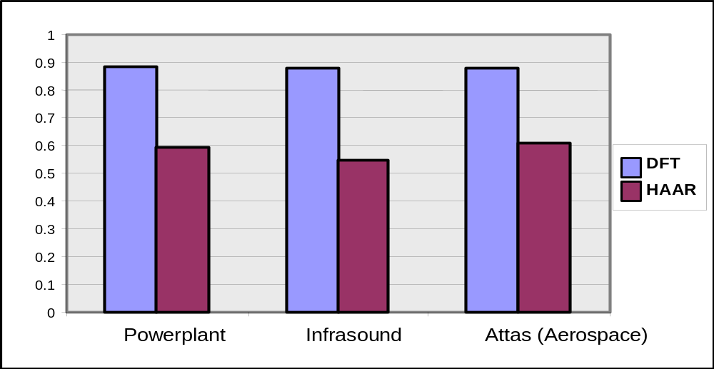
I tested on the Powerplant, Infrasound and Attas datasets, and I know DFT outperforms the Haar wavelet
Pruning Power

Slide 64
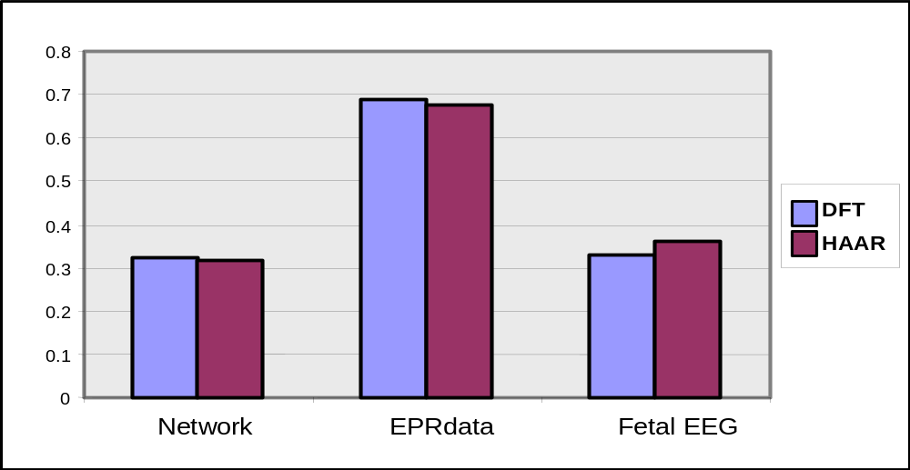
Stupid Flanders! I tested on the Network, ERPdata and Fetal EEG datasets and I know that there is no real difference between DFT and Haar
Pruning Power

Slide 65

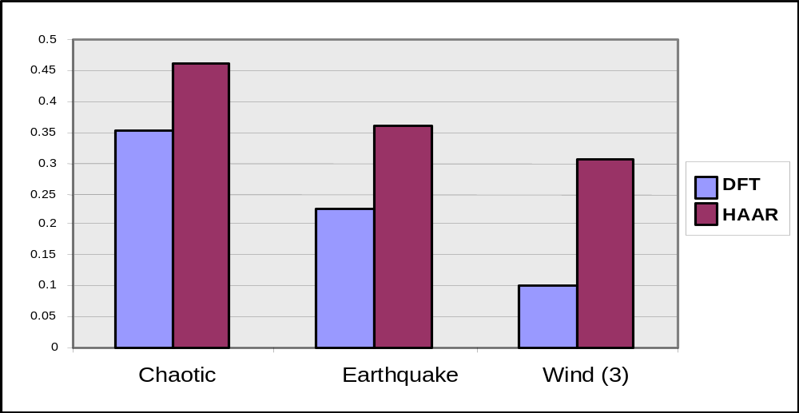
Those two clowns are both wrong!
I tested on the Chaotic, Earthquake and Wind datasets, and I am sure that the Haar wavelet outperforms the DFT
Pruning Power

Slide 66



The Bottom Line (1)
Any claims about the relative performance of a time series indexing scheme that is empirically demonstrated on only 2 or 3 datasets are worthless.

Slide 67
Implementation Bias
Definition: Implementation bias is the conscious or unconscious disparity in the quality of implementation of a proposed approach, vs. the quality of implementation of the completing approaches.
Example: Suppose you want to compare your new representation to DFT. You might use the simple O(n²) DFT algorithm rather than spend the time to code the more complex O(nLogn) radix 2 algorithm. This would make your algorithm run relatively faster.

Slide 68
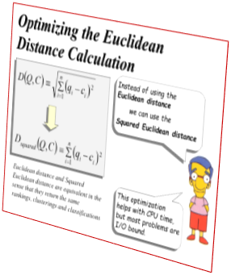
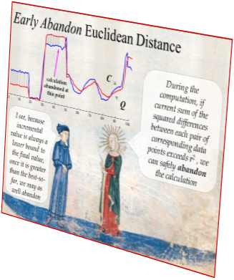
Example of Implementation Bias:
Similarity Searching
Algorithm accum = euclidean_dist(d,q);
accum = 0;
for i = 1 to length(d)
accum = accum + (d_{i} – q_{i})²
end;
accum = sqrt(accum); % delete this!
Optimization 1:
Neglect to take to square root
Optimization 2:
Pass the best_so_far into the euclidean_dist
function, and abandon the calculation if accum ever gets larger than best_so_far
Algorithm sequential_scan(data,query)
BSF = inf;
for every item in the database
if euclidean_dist(data_{i},query,BSF) < BSF
pointer_to_best_match = i;
BSF = euclidean_dist(data_{i},query);
end;
end;

Slide 69
Results of a Similarity Searching Experiment on Increasingly Large Datasets
This trivial optimizations can have differences which are larger than many of the speedups claimed for new techniques.
This experiment only considers the main memory case, disk based techniques offer many other possibilities for implementation bias.
5
4
Euclid
Opt1
Opt2
3
Seconds
2
1
0
10,000
50,000
100,000
Number of Objects

Slide 70
The Bottom Line (2)
There are many many possibilities for implementation bias when implementing a strawman.
Minor changes in these minor details can have effects as large as the claimed improvement.
Experiments should be done in a manner which is completely free of implementation bias (if possible)
If all the code is not available, that is a red flag.

Slide 71

Review: The Generic Data Mining Algorithm
Create an approximation of the data, which will fit in main memory, yet retains the essential features of interest
Approximately solve the problem at hand in main memory
Make (hopefully very few) accesses to the original data on disk to confirm the solution obtained in Step 2, or to modify the solution so it agrees with the solution we would have obtained on the original data
The GEMINI method can be generalized to some other data mining problems

Slide 72
Read for next week. You don’t need to understand every detail, spend no more than 30 minutes skimming…
After all that, we will see that sometimes you cannot index, and all you can do is fast brute force search..
Thanawin Rakthanmanon, Bilson Campana, Abdullah Mueen, Gustavo Batista, Brandon Westover, Qiang Zhu, Jesin Zakaria, Eamonn Keogh (2012). Searching and Mining Trillions of Time Series Subsequences under Dynamic Time Warping SIGKDD 2012. Best paper award
Also watch these two videos
http://www.youtube.com/watch?v=d_qLzMMuVQg
http://www.youtube.com/watch?v=c7xz9pVr05Q

