Slide 1
In this class we are going to learn read papers critically.
Papers can be wrong, boring, hard to read etc.
Papers can also have very poor figures ;-)
Lets spend a few minutes to see a some examples of poor figures, and how we might go about fixing them.
Why spend this time?
If you make good figures, your paper has a higher chance of getting accepted, and being cited.

Slide 2
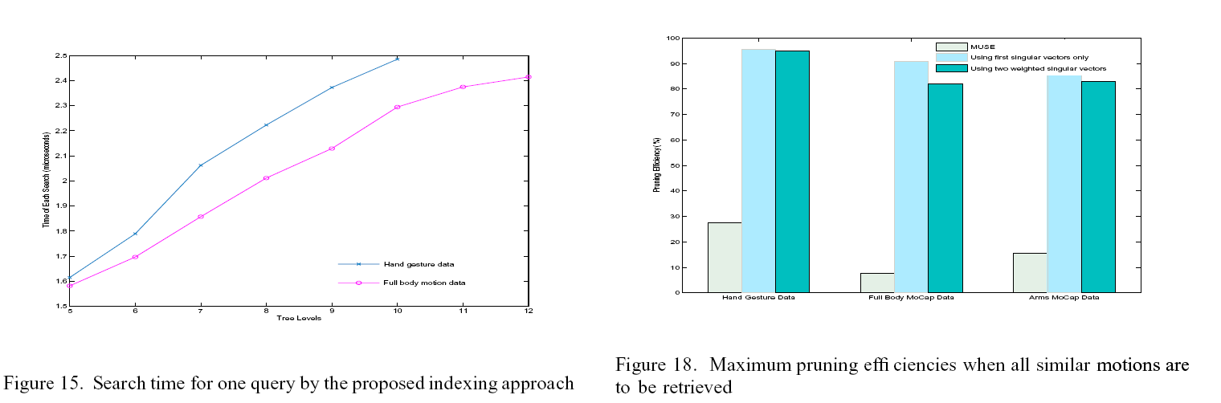
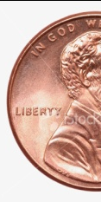
Lettering too small and font difficult to read
Here the font size on the legend and key is about 1mm. (coin for scale)

Slide 3
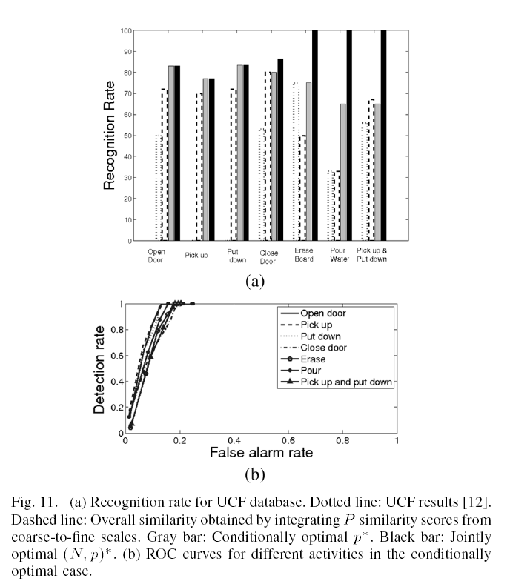
Key outside the graph (indirection)
Here the problem is not that the key is in text format (although it does not help). The problem is the distance between the key and the data.
Data
Key

Slide 4
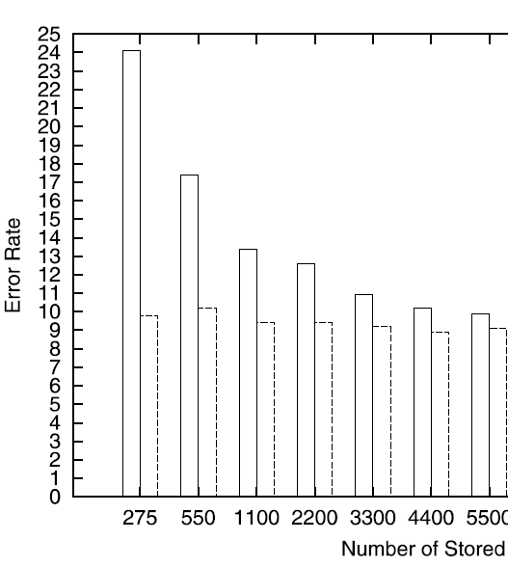

Unnecessary numbers in the axis
Do we really need every integer from zero to 25 in this chart? (if “yes”, then make a table, not a figure)
In this version, I can still find, say “23”, by locating 20 and counting three check marks.
This problem is more common in the X-axis

Slide 5
In the following slides is a figure one of my students made.
I keep prodding her, until I was happy with the figure.
Lets see how that worked…

Slide 6
2500
2000
1500
1000
500
0
4
6
8
10
12
14
16
18
20
Figure 17. The true positives (green/left) and true negatives (red/right) for the fish problem.

Slide 7
2500
2000
1500
1000
500
0
4
6
8
10
12
14
16
18
20
Figure 17. The true positives (green/left) and true negatives (red/right) for the fish problem.
What does the bounding box do for us?
Lets get rid of it.

Slide 8
2500
2000
1500
1000
500
0
4
6
8
10
12
14
16
18
20
Figure 17. The true positives (green/left) and true negatives (red/right) for the fish problem.

Slide 9
2500
2000
1500
1000
500
0
4
6
8
10
12
14
16
18
20
It is hard to read the heights (or existence) of very small bars because they are so close to the axis

Slide 10
2500
2000
1500
1000
500
0
2
4
6
8
10
12
14
16
18
20
Solution: “explode” away the X-axis.

Slide 11
2500
Do we need the black outline around the bars?
2000
1500
1000
500
0
2
4
6
8
10
12
14
16
18
20

Slide 12
2500
The figure looks better without them, especially if the histogram is resized small for a paper.
2000
1500
1000
500
0
2
4
6
8
10
12
14
16
18
20

Slide 13
2500
Hmm.. Did we choose the right bucket size for the data?
2000
1500
1000
There is no reason to think the default in Matlab or Excel is correct for your data….
500
0
2
4
6
8
10
12
14
16
18
20
4500
Too coarse
900
About right
300
Too fine
4000
800
250
3500
700
3000
600
200
2500
500
150
2000
400
1500
300
100
1000
200
50
500
100
0
2
4
6
8
10
12
14
0
2
4
6
8
10
12
14
0
2
4
6
8
10
12
14

Slide 14
One distribution obscures the other.
600
400
200
0
0
2
4
6
8
10
12
14
16
18
20

Slide 15
We can use transparent colors
600
400
200
0
0
2
4
6
8
10
12
14
16
18
20

Slide 16
Does the Y-axis need to be there? Sometimes it is irrelevant and if so, remove it.
600
400
200
0
0
2
4
6
8
10
12
14
16
18
20

Slide 17
Our figure caption tells us what we are looking at, that is good. It even uses color/location so that it will work in grayscale.
However, why not remove some indirection…
0
2
4
6
8
10
12
14
16
18
20
Figure 17. The true positives (green/left) and true negatives (red/right) for the fish problem.

Slide 18
This is better. ..
Do we even need the arrows?
true positives
false positives
0
2
4
6
8
10
12
14
16
18
20
Figure 17. The results for the fish problem.

Slide 19
true positives
false positives
0
2
4
6
8
10
12
14
16
18
20
Figure 17. The results for the fish problem.

Slide 20
2500
2000
1500
1000
true positives
false positives
500
0
4
6
8
10
12
14
16
18
20
0
2
4
6
8
10
12
14
16
18
20
Figure 17. The true positives (green/left) and true negatives (red/right) for the fish problem.
Figure 17. The results for the fish problem.

