Slide 1
Rubik’s Cube Detection
Nông Quốc Khánh

Slide 2


Phases
Phase 1: Rubik’s Cube detection
Phase 2: Alignment detection
Phase 3: Move classification

Slide 3
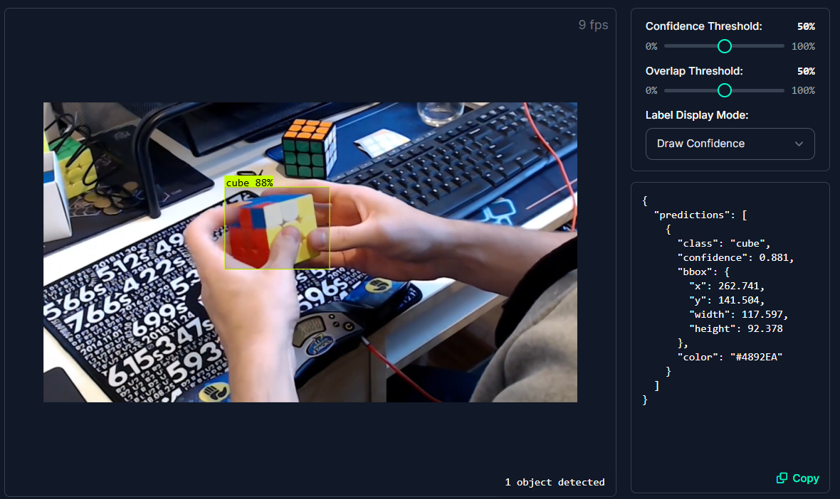
Phase 1: Rubik’s Cube detection
https://universe.roboflow.com/temba-mateke/cube-vision
Model: Roboflow 2.0 Object Detection (Fast)

Slide 4
Dataset

Slide 5
To do
Classify cube in the foreground and cube in the background.
Retrain with a more suitable dataset.

