Slide 1
Texture Mapping

Slide 2
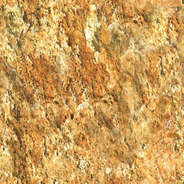
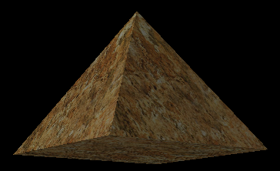
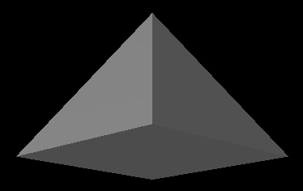

Slide 3
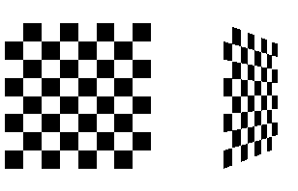
checker.c
Texture-Mapped Squares

Slide 4
void init(void){
glClearColor (0.0, 0.0, 0.0, 0.0);
glShadeModel(GL_FLAT);
glEnable(GL_DEPTH_TEST);
makeCheckImage();
glPixelStorei(GL_UNPACK_ALIGNMENT, 1);
glGenTextures(1, &texName);
glBindTexture(GL_TEXTURE_2D, texName);
glTexParameteri(GL_TEXTURE_2D, GL_TEXTURE_WRAP_S, GL_REPEAT);
glTexParameteri(GL_TEXTURE_2D, GL_TEXTURE_WRAP_T, GL_REPEAT);
glTexParameteri(GL_TEXTURE_2D, GL_TEXTURE_MAG_FILTER, GL_NEAREST);
glTexParameteri(GL_TEXTURE_2D, GL_TEXTURE_MIN_FILTER, GL_NEAREST);
glTexImage2D(GL_TEXTURE_2D, 0, GL_RGBA, checkImageWidth, checkImageHeight, 0, GL_RGBA, GL_UNSIGNED_BYTE, checkImage);
}

Slide 5
void display(void){
glClear(GL_COLOR_BUFFER_BIT | GL_DEPTH_BUFFER_BIT);
glEnable(GL_TEXTURE_2D);
glTexEnvf(GL_TEXTURE_ENV, GL_TEXTURE_ENV_MODE, GL_DECAL);
glBindTexture(GL_TEXTURE_2D, texName);
glBegin(GL_QUADS);
glTexCoord2f(0.0, 0.0); glVertex3f(-2.0, -1.0, 0.0);
glTexCoord2f(0.0, 1.0); glVertex3f(-2.0, 1.0, 0.0);
glTexCoord2f(1.0, 1.0); glVertex3f(0.0, 1.0, 0.0);
glTexCoord2f(1.0, 0.0); glVertex3f(0.0, -1.0, 0.0);
glTexCoord2f(0.0, 0.0); glVertex3f(1.0, -1.0, 0.0);
glTexCoord2f(0.0, 1.0); glVertex3f(1.0, 1.0, 0.0);
glTexCoord2f(1.0, 1.0); glVertex3f(2.41421, 1.0, -1.41421);
glTexCoord2f(1.0, 0.0); glVertex3f(2.41421, -1.0, -1.41421);
glEnd(); glFlush();
glDisable(GL_TEXTURE_2D);
}

Slide 6
glTexImage2D(GL_TEXTURE_2D, 0, GL_RGBA, checkImageWidth, checkImageHeight, 0, GL_RGBA, GL_UNSIGNED_BYTE, checkImage);
void glTexImage2D(GLenum target, GLint level, GLint internalformat,, GLsizei width, GLsizei height, GLint border, GLenum format, GLenum type, const GLvoid *pixels);
The target parameter is intended for future use by OpenGL; for this release, it must be set to the constant GL_TEXTURE_2D.
You use the level parameter if you're supplying multiple resolutions of the texture map; with only one resolution, level should be 0.
Components are selected for use in modulating or blending.
  This information tells OpenGL how many color components you want stored per texel and possibly the storage size of the components
  and/or whether you want the texture compressed
border indicates the width of the border, which is usually zero.
The format and type parameters describe the format and data type of the texture image data.

Slide 7
Most Common Texture Internal Formats
  GL_ALPHA: Store the texels as alpha values
  GL_LUMINANCE: Store the texels as luminance values
  GL_LUMINANCE_ALPHA: Store the texels with both luminance and alpha values
  GL_RGB: Store the texels as red, green, and blue components
  GL_RGBA: Store the texels as red, green, blue, and alpha components

Slide 8
Using the Color Buffer
One- and two-dimensional textures may also be loaded using data from the color buffer.
void glCopyTexImage1D(GLenum target, GLint level, GLenum internalformat, GLint x, GLint y, GLsizei width, GLint border);
void glCopyTexImage2D(GLenum target, GLint level, GLenum internalformat, GLint x, GLint y, GLsizei width, GLsizei height, GLint border);

Slide 9
Updating Textures
Repeatedly loading new textures can become a performance bottleneck in time-sensitive applications such as games or simulation applications.
void glTexSubImage1D(GLenum target, GLint level, GLint xOffset, GLsizei width, GLenum format, GLenum type, const GLvoid *data);
void glTexSubImage2D(GLenum target, GLint level, GLint xOffset, GLint yOffset, GLsizei width, GLsizei height, GLenum format, GLenum type, const GLvoid *data);

Slide 10
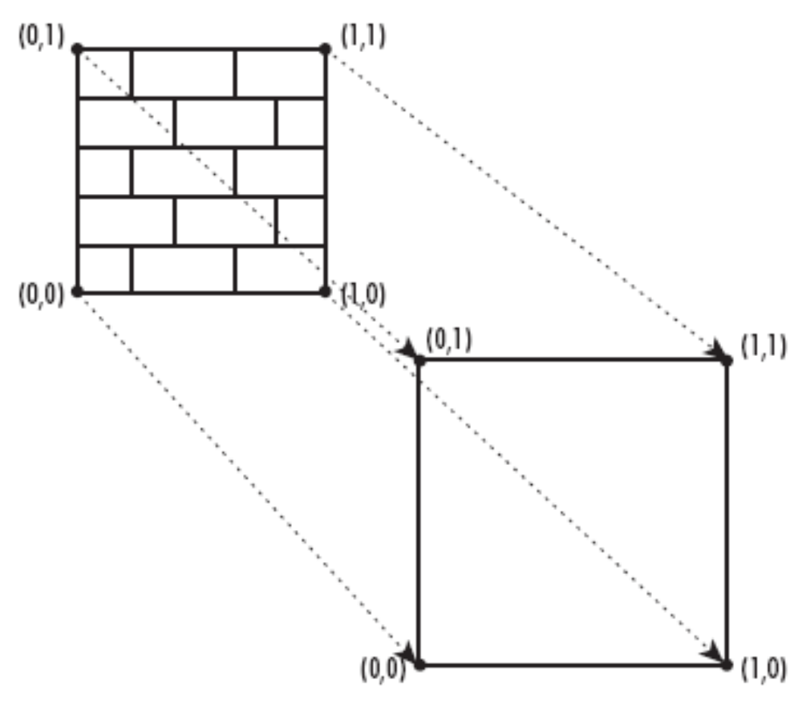
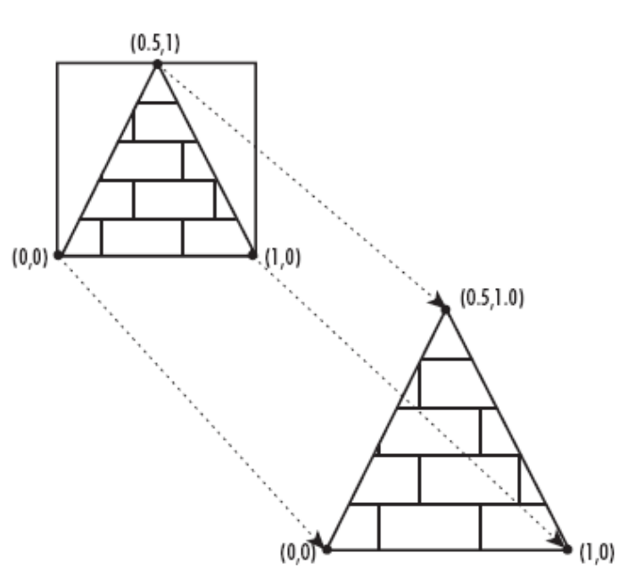
Applying a two-dimensional texture to a quad void glTexCoord2f(Glfloat s, GLfloat t);

Slide 11
Texture Magnification and Minification
glTexParameteri(GL_TEXTURE_2D, GL_TEXTURE_MAG_FILTER, GL_NEAREST);
glTexParameteri(GL_TEXTURE_2D, GL_TEXTURE_MIN_FILTER, GL_NEAREST);
Texture maps are square or rectangular, but after being mapped to a polygon or surface and transformed into screen coordinates, the individual texels of a texture rarely correspond to individual pixels of the final screen image.
Depending on the transformations used and the texture mapping applied, a single pixel on the screen can correspond to anything from a tiny portion of a texel (magnification) to a large collection of texels (minification).

Slide 12
GL_NEAREST: Nearest neighbor filtering is the simplest and fastest filtering method
GL_LINEAR: Linear filtering works by not taking the nearest texel to the texture coordinate, but by applying the weighted average of the texels surrounding the texture coordinate (a linear interpolation).

Slide 13
Modulating and Blending
void glTexEnv{if}{v}(GLenum target, GLenum pname, TYPEparam);
target must be GL_TEXTURE_ENV
If pname is GL_TEXTURE_ENV_MODE, param can be GL_DECAL, GL_MODULATE, or GL_BLEND
  In decal mode and with a three-component texture, the texture's colors replace the fragment's colors.
  With either of the other modes or with a four-component texture, the final color is a combination of the texture's and the fragment's values.
If pname is GL_TEXTURE_ENV_COLOR, param is an array of four floating-point values representing R, G, B, and A components. These values are used only if the GL_BLEND texture function has been specified as well.

Slide 14
Recall that when you specify your texture map with glTexImage*d(), the third argument is the number of R, G, B, A components to be selected for each texel.
A single selected component is interpreted as a luminance value (L); if there are two, the first is luminance, and the second is an alpha value (A). Three components form an RGB color triple (C), and four components provide an RGB triple and a value for alpha.

Slide 15
Decal, Modulate, and Blend Functions
Components Decal Mode Modulate Mode Blend Mode
1 Undefined C = LtCf, A = Af C = (1-Lt)Cf +
LtCc, A = Af
2 Undefined C = LtCf, A = AtAf C = (1-Lt)Cf +
LtCc, A = AtAf
3 C = Ct,A = Af C = CtCf, A = Af Undefined
4 C = (1- At)Cf
+ AtCt,A = Af C = CtCf, A = AtAf Undefined
A subscript of t indicates a texture value, f indicates a fragment value, c indicates the values assigned with GL_TEXTURE_ENV_COLOR, and no subscript indicates the final
You use decal mode in situations where you want to apply an opaque texture to an object- If you were drawing a soup can with an opaque label, for example.
You need to use modulation to create a texture that responds to lighting conditions;

Slide 16
Assigning Texture Coordinates
Void glTexCoord{1234}{sifd}{v}(TYPEcoords);
Sets the current texture coordinates (s, t, r, q). Subsequent calls to glVertex*() result in those vertices being assigned the current texture coordinates.
With glTexCoord1*(), the s coordinate is set to the specified value, t and r are set to 0, and q is set to 1.
Using glTexCoord2*() allows you to specify s and t; r and q are set to 0 and 1, respectively.
se the appropriate suffix (s, i, f, or d) and the corresponding value for TYPE (GLshort, GLint, GLfloat, or GLdouble)
Suppose the brick wall is square, and the texture is square, and you want to map the whole texture to the whole wall. The texture coordinates of the texture square are (0, 0), (1, 0), (1, 1), and (0, 1) in counterclockwise order.

Slide 17
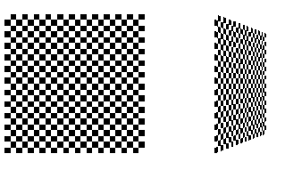
Repeating and Clamping Textures
glBegin(GL_POLYGON);
glTexCoord2f(0.0, 0.0); glVertex3f(-2.0, -1.0, 0.0);
glTexCoord2f(0.0, 3.0); glVertex3f(-2.0, 1.0, 0.0);
glTexCoord2f(3.0, 3.0); glVertex3f(0.0, 1.0, 0.0);
glTexCoord2f(3.0, 0.0); glVertex3f(0.0, -1.0, 0.0);
glEnd();
glBegin(GL_POLYGON);
glTexCoord2f(0.0, 0.0); glVertex3f(1.0, -1.0, 0.0);
glTexCoord2f(0.0, 3.0); glVertex3f(1.0, 1.0, 0.0);
glTexCoord2f(3.0, 3.0); glVertex3f(2.41, 1.0, -1.41);
glTexCoord2f(3.0, 0.0); glVertex3f(2.41, -1.0, -1.41);
glEnd();
In this case, the texture is repeated in both the s and t directions, since the following calls are made to glTexParameter*():
glTexParameterfv(GL_TEXTURE_2D, GL_TEXTURE_S_WRAP, GL_REPEAT);
glTexParameterfv(GL_TEXTURE_2D, GL_TEXTURE_T_WRAP, GL_REPEAT);

Slide 18
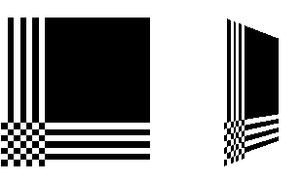
If GL_CLAMP is used instead of GL_REPEAT
Any values greater than 1.0 are set to 1.0, and any values less than 0.0 are set to 0.0.
Clamping is useful for applications where you want a single copy of the texture to appear on a large surface.
If the surface-texture coordinates range from 0.0 to 10.0 in both directions, one copy of the texture appears in the lower corner of the surface.

Slide 19
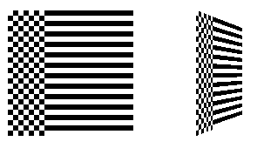
You can also clamp in one direction and repeat in the other.

Slide 20
Pyramid.cpp (ch8)
+
=

Slide 21
void SetupRC( ) {
GLubyte *pBytes;
GLint iWidth, iHeight, iComponents;
GLenum eFormat;
// Light values and coordinates
. . .
. . .
// Load texture
glPixelStorei(GL_UNPACK_ALIGNMENT, 1);
pBytes = gltLoadTGA(“Stone.tga”, &iWidth, &iHeight,
&iComponents, &eFormat);
glTexImage2D(GL_TEXTURE_2D, 0, iComponents, iWidth, iHeight,
0, eFormat, GL_UNSIGNED_BYTE, pBytes);
free(pBytes);
glTexParameteri(GL_TEXTURE_2D, GL_TEXTURE_MIN_FILTER, GL_LINEAR);
glTexParameteri(GL_TEXTURE_2D, GL_TEXTURE_MAG_FILTER, GL_LINEAR);
glTexParameteri(GL_TEXTURE_2D, GL_TEXTURE_WRAP_S, GL_CLAMP_TO_EDGE);
glTexParameteri(GL_TEXTURE_2D, GL_TEXTURE_WRAP_T, GL_CLAMP_TO_EDGE);
glTexEnvi(GL_TEXTURE_ENV, GL_TEXTURE_ENV_MODE, GL_MODULATE);
glEnable(GL_TEXTURE_2D);
}

Slide 22
void RenderScene(void) {
M3DVector3f vNormal;
M3DVector3f vCorners[5] = { { 0.0f, .80f, 0.0f }, // Top 0
{ -0.5f, 0.0f, -.50f }, // Back left 1
{ 0.5f, 0.0f, -0.50f }, // Back right 2
{ 0.5f, 0.0f, 0.5f }, // Front right 3
{ -0.5f, 0.0f, 0.5f }}; // Front left 4
….
….
// Front Face
gltGetNormalVector(vCorners[0], vCorners[4], vCorners[3], vNormal);
glNormal3fv(vNormal);
glTexCoord2f(0.5f, 1.0f);
glVertex3fv(vCorners[0]);
glTexCoord2f(0.0f, 0.0f);
glVertex3fv(vCorners[4]);
glTexCoord2f(1.0f, 0.0f);
glVertex3fv(vCorners[3]);

Slide 23
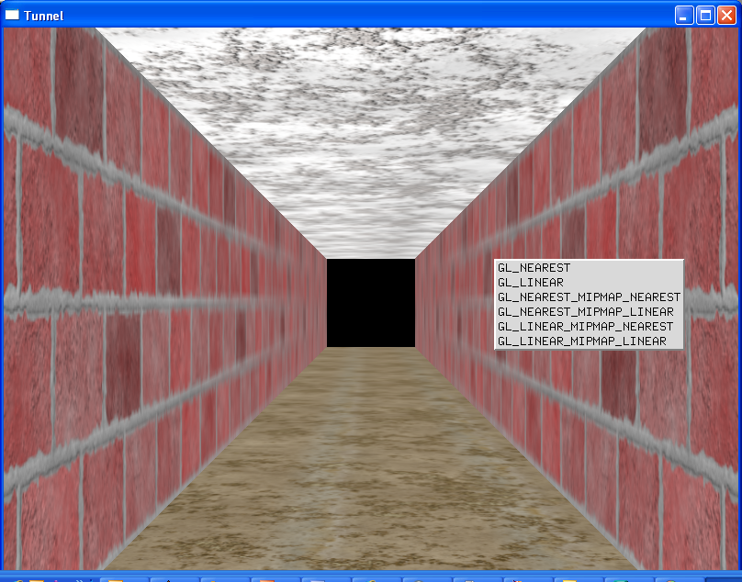
(Tunnel.cpp ch8) This program demonstrates using glBindTexture() by creating and managing three textures.

Slide 24
#include “../../shared/glools.h” // GLTools
// Rotation amounts
static GLfloat zPos = -60.0f;
// Texture objects
#define TEXTURE_BRICK 0
#define TEXTURE_FLOOR 1
#define TEXTURE_CEILING 2
#define TEXTURE_COUNT 3
GLuint textures[TEXTURE_COUNT];
const char *szTextureFiles[TEXTURE_COUNT] =
{ “brick.tga”, “floor.tga”, “ceiling.tga” };

Slide 25
void SetupRC() {
GLubyte *pBytes;
GLint iWidth, iHeight, iComponents;
GLenum eFormat; GLint iLoop;
glClearColor(0.0f, 0.0f, 0.0f,1.0f);
// Textures applied as decals, no lighting or coloring effects
glEnable(GL_TEXTURE_2D);
glTexEnvi(GL_TEXTURE_ENV, GL_TEXTURE_ENV_MODE, GL_DECAL);
// Load textures
glGenTextures(TEXTURE_COUNT, textures);
for(iLoop = 0; iLoop < TEXTURE_COUNT; iLoop++) {
// Bind to next texture object
glBindTexture(GL_TEXTURE_2D, textures[iLoop]);
// Load texture, set filter and wrap modes
pBytes = gltLoadTGA(szTextureFiles[iLoop],&iWidth, &iHeight, &iComponents, &eFormat);
gluBuild2DMipmaps(GL_TEXTURE_2D, iComponents, iWidth, iHeight, eFormat,
GL_UNSIGNED_BYTE, pBytes);
glTexParameteri(GL_TEXTURE_2D, GL_TEXTURE_MAG_FILTER, GL_LINEAR);
glTexParameteri(GL_TEXTURE_2D, GL_TEXTURE_MIN_FILTER,GL_LINEAR_MIPMAP_LINEAR);
glTexParameteri(GL_TEXTURE_2D, GL_TEXTURE_WRAP_S, GL_CLAMP_TO_EDGE);
glTexParameteri(GL_TEXTURE_2D, GL_TEXTURE_WRAP_T, GL_CLAMP_TO_EDGE);
// Don’t need original texture data any more
free(pBytes);}}

Slide 26
void ShutdownRC(void) {
glDeleteTextures(TEXTURE_COUNT, textures);
}

Slide 27
void RenderScene(void) {
GLfloat z;
glClear(GL_COLOR_BUFFER_BIT); // Clear the window with current clearing color
glPushMatrix();
glTranslatef(0.0f, 0.0f, zPos);
for(z = 60.0f; z >= 0.0f; z -= 10) {
glBindTexture(GL_TEXTURE_2D, textures[TEXTURE_FLOOR]);
glBegin(GL_QUADS);
glTexCoord2f(0.0f, 0.0f);
glVertex3f(-10.0f, -10.0f, z);
glTexCoord2f(1.0f, 0.0f);
glVertex3f(10.0f, -10.0f, z);
glTexCoord2f(1.0f, 1.0f);
glVertex3f(10.0f, -10.0f, z - 10.0f);
glTexCoord2f(0.0f, 1.0f);
glVertex3f(-10.0f, -10.0f, z - 10.0f);
glEnd();

Slide 28
glBindTexture(GL_TEXTURE_2D, textures[TEXTURE_CEILING]);
glBegin(GL_QUADS);
glTexCoord2f(0.0f, 1.0f);
glVertex3f(-10.0f, 10.0f, z - 10.0f);
glTexCoord2f(1.0f, 1.0f);
glVertex3f(10.0f, 10.0f, z - 10.0f);
glTexCoord2f(1.0f, 0.0f);
glVertex3f(10.0f, 10.0f, z);
glTexCoord2f(0.0f, 0.0f);
glVertex3f(-10.0f, 10.0f, z);
glEnd();
…..
…..
// Restore the matrix state
glPopMatrix();
// Buffer swap
glutSwapBuffers();
}

Slide 29
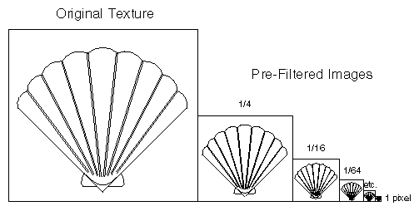
Multiple Levels of Detail
Mipmaps

Slide 30
Textured objects can be viewed, like any other objects in a scene, at different distances from the viewpoint.
OpenGL has to filter the texture map down to an appropriate size for mapping onto the object, without introducing visually disturbing artifacts.
To avoid such artifacts, you can specify a series of prefiltered texture maps of decreasing resolutions, called mipmaps.
Then, OpenGL automatically determines which texture map to use based on the size (in pixels) of the object being mapped.

Slide 31
To use mipmapping, you provide all sizes of your texture in powers of 2 between the largest size and a 1 × 1 map.
For example, if your highest-resolution map is 64 × 16, you must also provide maps of size 32 × 8, 16 × 4, 8 × 2, 4 × 1, 2 × 1, and 1 × 1.
To specify these textures, call glTexImage2D() once for each resolution of the texture map, with different values for the level, width, height, and image parameters.
  Starting with zero, level identifies which texture in the series is specified; with the previous example, the largest texture of size 64 × 16 would be declared with level = 0, the 32 × 8 texture with level = 1, and so on.

Slide 32
mipmap.c
GLubyte mipmapImage32[32][32][4];
GLubyte mipmapImage16[16][16][4];
GLubyte mipmapImage8[8][8][4];
GLubyte mipmapImage4[4][4][4];
GLubyte mipmapImage2[2][2][4];
GLubyte mipmapImage1[1][1][4];
void makeImages(void){
int i, j;
for (i = 0; i < 32; i++) {
for (j = 0; j < 32; j++) {
mipmapImage32[i][j][0] = 255;
mipmapImage32[i][j][1] = 255;
mipmapImage32[i][j][2] = 0;
mipmapImage32[i][j][3] = 255;
}
}

Slide 33
for (i = 0; i < 16; i++) {
for (j = 0; j < 16; j++) {
mipmapImage16[i][j][0] = 255;
mipmapImage16[i][j][1] = 0;
mipmapImage16[i][j][2] = 255;
mipmapImage16[i][j][3] = 255;
}
}
….
…

Slide 34
void init(void) {
glEnable(GL_DEPTH_TEST);
glShadeModel(GL_FLAT);
glTranslatef(0.0, 0.0, -3.6);
makeImages();
glPixelStorei(GL_UNPACK_ALIGNMENT, 1);
glGenTextures(1, &texName);
glBindTexture(GL_TEXTURE_2D, texName);
glTexParameteri(GL_TEXTURE_2D, GL_TEXTURE_WRAP_S, GL_REPEAT);
glTexParameteri(GL_TEXTURE_2D, GL_TEXTURE_WRAP_T, GL_REPEAT);
glTexParameteri(GL_TEXTURE_2D, GL_TEXTURE_MAG_FILTER, GL_NEAREST);
glTexParameteri(GL_TEXTURE_2D, GL_TEXTURE_MIN_FILTER,
GL_NEAREST_MIPMAP_NEAREST);

Slide 35
glTexImage2D(GL_TEXTURE_2D, 0, GL_RGBA, 32, 32, 0,
GL_RGBA, GL_UNSIGNED_BYTE, mipmapImage32);
glTexImage2D(GL_TEXTURE_2D, 1, GL_RGBA, 16, 16, 0,
GL_RGBA, GL_UNSIGNED_BYTE, mipmapImage16);
glTexImage2D(GL_TEXTURE_2D, 2, GL_RGBA, 8, 8, 0,
GL_RGBA, GL_UNSIGNED_BYTE, mipmapImage8);
glTexImage2D(GL_TEXTURE_2D, 3, GL_RGBA, 4, 4, 0,
GL_RGBA, GL_UNSIGNED_BYTE, mipmapImage4);
glTexImage2D(GL_TEXTURE_2D, 4, GL_RGBA, 2, 2, 0,
GL_RGBA, GL_UNSIGNED_BYTE, mipmapImage2);
glTexImage2D(GL_TEXTURE_2D, 5, GL_RGBA, 1, 1, 0,
GL_RGBA, GL_UNSIGNED_BYTE, mipmapImage1);
glTexEnvf(GL_TEXTURE_ENV, GL_TEXTURE_ENV_MODE, GL_DECAL);
glEnable(GL_TEXTURE_2D);
}

Slide 36
void display(void)
{
glClear(GL_COLOR_BUFFER_BIT | GL_DEPTH_BUFFER_BIT);
glBindTexture(GL_TEXTURE_2D, texName);
glBegin(GL_QUADS);
  glTexCoord2f(0.0, 0.0); glVertex3f(-2.0, -1.0, 0.0);
  glTexCoord2f(0.0, 8.0); glVertex3f(-2.0, 1.0, 0.0);
  glTexCoord2f(8.0, 8.0); glVertex3f(2000.0, 1.0, -6000.0);
  glTexCoord2f(8.0, 0.0); glVertex3f(2000.0, -1.0, -6000.0);
glEnd();
glFlush();
}

Slide 37
GL_NEAREST_MIPMAP_NEAREST
GL_NEAREST_MIPMAP_LINEAR
GL_LINEAR_MIPMAP_NEAREST
GL_LINEAR_MIPMAP_LINEAR
Just loading the mip levels with glTexImage does not by itself enable mipmapping. If the texture filter is set to GL_LINEAR or GL_NEAREST, only the base texture level is used, and any mip levels loaded are ignored.
You must specify one of the mipmapped filters for the loaded mip levels to be used.
The constants have the form GL_FILTER_MIPMAP_SELECTOR, where FILTER specifies the texture filter to be used on the mip level selected.
The SELECTOR specifies how the mip level is selected;
For example, GL_NEAREST selects the nearest matching mip level. Using GL_LINEAR for the selector creates a linear interpolation between the two nearest mip levels, which is again filtered by the chosen texture filter.
GL_NEAREST_MIPMAP_NEAREST gives very good performance
GL_LINEAR_MIPMAP_NEAREST is often used to speed up games because a higher quality linear filter is used, but a fast selection (nearest) is made between the different sized mip levels available.

Slide 38
The maps of lower resolution are usually filtered versions of an original, high-resolution map.
The construction of a series of such mipmaps is a software process, and thus isn't part of OpenGL.
Since mipmap construction is such an important operation, however, the OpenGL Utility Library contains three routines that aid in the manipulation of images to be used as texture maps.

Slide 39
The routines gluBuild1DMipmaps() and gluBuild2DMipmaps() construct and define the pyramid of mipmaps down to a resolution of 1 × 1 (or 1, for one-dimensional texture maps).
Both these routines require that the original image already be suitable for a texture map, namely that its dimensions must be powers of 2.
Most scanned images don't satisfy this property, so you have to scale the incoming image to some appropriate size. The GLU provides the routine gluScaleImage() to perform such scaling.

Slide 40
int gluBuild2DMipmaps(GLenum target, GLint components, GLint width, GLint height, GLenum format, GLenum type, void *data);
  Construct a series of mipmaps.
  A value of 0 is returned if all the mipmaps are constructed successfully; otherwise, a GLU error code is returned.
int gluScaleImage(GLenum format, GLint widthin, GLint heightin, GLenum typein, const void *datain, GLint widthout, GLint heightout, GLenum typeout, void *dataout);

Slide 41
Resident Textures
To optimize rendering performance, OpenGL automatically moves frequently accessed textures into this high-performance memory.
Textures in this high-performance memory are called resident textures.
To determine whether a bound texture is resident, you can call glGetTexParameter and find the value associated with GL_TEXTURE_RESIDENT.
Testing a group of textures to see whether they are resident may be more useful, and you can perform this test using the following function:
GLboolean glAreTexturesResident(GLsizei n, const GLuint *textures, GLboolean *residences);

Slide 42
Texture Priorities
By default, most OpenGL implementations use a Most Frequently Used (MFU) algorithm to decide which textures can stay resident.
You can provide hints to whatever mechanism an implementation uses to decide texture residency by setting each texture’s priority with this function:
void glPrioritizeTextures(GLsizei n, const GLuint *textures, const GLclampf *priorities);
This function takes an array of texture object names and a corresponding array of texture object priorities that are clamped between 0 and 1.0.
  A low priority tells the implementation that this texture object should be left out of resident memory whenever space becomes tight.
  A higher priority (such as 1.0) tells the implementation that you want that texture object to remain resident if possible, even if the texture seems to be used infrequently.
Bear in mind that texture priorities are only a hint to the implementation. Some OpenGL implementations are known to ignore them completely.

Slide 43
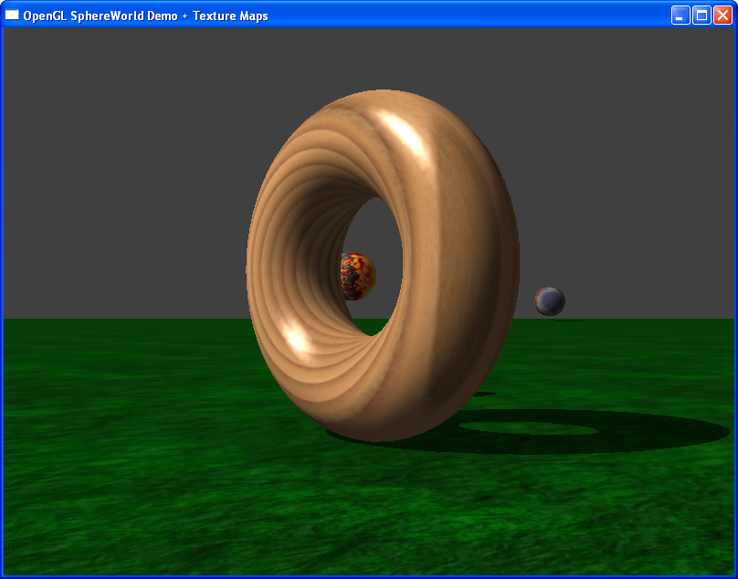
Secondary Color
SphereWorld.cpp (ch9)

Slide 44
GL_MODULATE: fragment colors are multiplied by the filtered texel colors being applied to the geometry.
However, this process has the side effect of suppressing the visibility of specular highlights on the geometry.
Basically, any texture color multiplied by ones (the white spot) is the same texture color. You cannot, by multiplication of any number less than or equal to one, make a color brighter than it already is!

Slide 45
The solution to this problem is to apply (by adding instead of multiplication) the specular highlights after texturing.
  This technique, called the secondary specular color.
You do this using the normal OpenGL lighting model and simply turn it on using glLightModeli, as shown here:
  glLightModeli(GL_LIGHT_MODEL_COLOR_CONTROL, GL_SEPARATE_SPECULAR_COLOR);
You can switch back to the normal lighting model by specifying GL_SINGLE_COLOR for the light model parameter:
  glLightModeli(GL_LIGHT_MODEL_COLOR_CONTROL, GL_COLOR_SINGLE);

Slide 46
Texture Compression
One drawback to using textures is that they require a lot of memory to store and process.
Texture compression support in OpenGL hardware can allow you to load a compressed texture; in most implementations, the texture data stays compressed even in the graphics hardware memory.
This allows you to load more texture into less memory and can significantly improve texturing performance due to fewer texture swaps.
Texture data does not have to be initially compressed to take advantage of OpenGL support for compressed textures. You can request that OpenGL compress a texture image

Slide 47
Texture Coordinate Generation
Texture coordinate generation is enabled on the S, T, R, and Q texture coordinates using glEnable:
  glEnable(GL_TEXTURE_GEN_S);
  glEnable(GL_TEXTURE_GEN_T);
  glEnable(GL_TEXTURE_GEN_R);
  glEnable(GL_TEXTURE_GEN_Q);
When texture coordinate generation is enabled, any calls to glTexCoord are ignored, and OpenGL calculates the texture coordinates for each vertex for you.

Slide 48
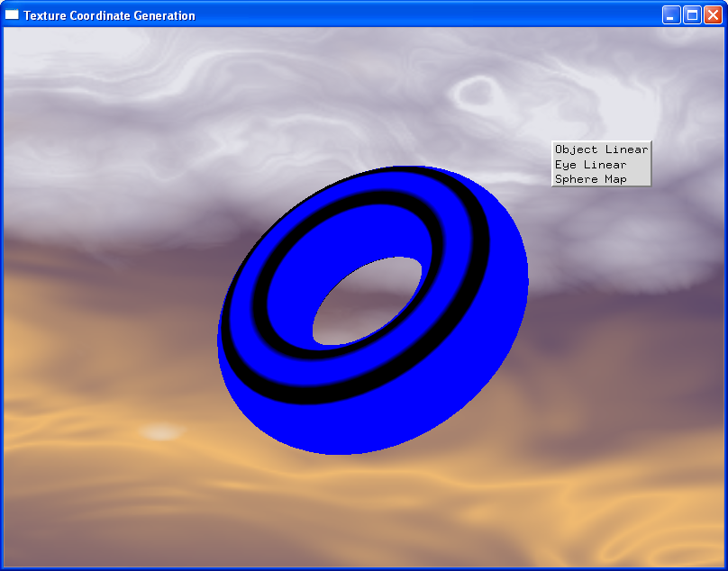
Object Linear

Slide 49
TexGen.cpp (ch9)
Object Linear
void ProcessMenu(int value){
// Projection plane
GLfloat zPlane[] = { 0.0f, 0.0f, 1.0f, 0.0f };
// Store render mode
iRenderMode = value;
switch(value){
case 1:
  // Object Linear
  glTexGeni(GL_S, GL_TEXTURE_GEN_MODE, GL_OBJECT_LINEAR);
  glTexGeni(GL_T, GL_TEXTURE_GEN_MODE, GL_OBJECT_LINEAR);
  glTexGenfv(GL_S, GL_OBJECT_PLANE, zPlane);
  glTexGenfv(GL_T, GL_OBJECT_PLANE, zPlane);
  break;
coord = P1*X + P2*Y + P3*Z + P4*W
Note that the texture coordinate generation function can be based on a different plane equation for each coordinate. Here, we simply use the same one for both the S and the T coordinates.
This technique maps the texture to the object in object coordinates, regardless of any modelview transformation in effect.

Slide 50

Eye Linear Mapping

Slide 51
case 2:
  // Eye Linear
  glTexGeni(GL_S, GL_TEXTURE_GEN_MODE, GL_EYE_LINEAR);
  glTexGeni(GL_T, GL_TEXTURE_GEN_MODE, GL_EYE_LINEAR);
  glTexGenfv(GL_S, GL_EYE_PLANE, zPlane);
  glTexGenfv(GL_T, GL_EYE_PLANE, zPlane);
  break;
When the texture generation mode is set to GL_EYE_LINEAR, texture coordinates are generated in a similar manner to GL_OBJECT_LINEAR.
The coordinate generation looks the same, except that now the X, Y, Z, and W coordinates indicate the location of the point of view (where the camera or eye is located).
The plane equation coefficients are also inverted before being applied to the equation to account for the fact that now everything is in eye coordinates.
The geometry is transformed by the modelview matrix, the texture will appear to slide across the surface.

Slide 52
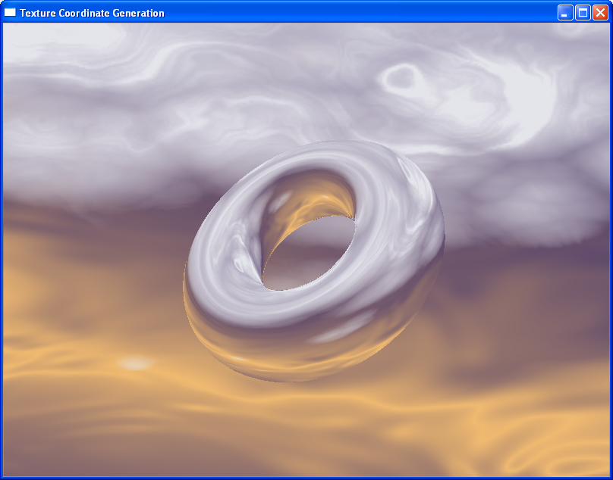
Sphere Mapping

Slide 53
case 3:
  default:
  // Sphere Map
  glTexGeni(GL_S, GL_TEXTURE_GEN_MODE, GL_SPHERE_MAP);
  glTexGeni(GL_T, GL_TEXTURE_GEN_MODE, GL_SPHERE_MAP);
  break;
When the texture generation mode is set to GL_SPHERE_MAP, OpenGL calculates texture coordinates in such a way that the object appears to be reflecting the current texture map.\
Sphere mapping has largely been replaced by cube mapping (discussed next).
In particular, sphere mapping requires only a single texture instead of six, and if true reflectivity is not required, you can obtain adequate results from sphere mapping.

Slide 54
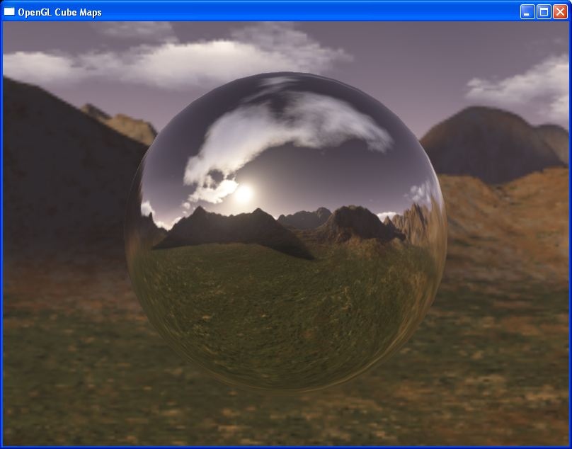
Cube Mapping

Slide 55
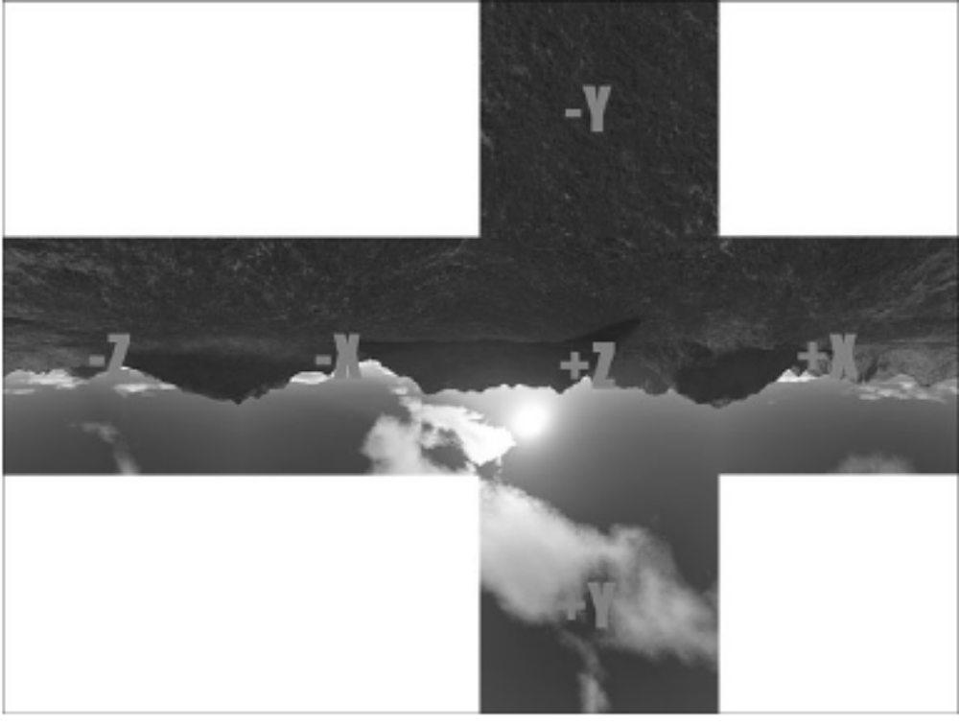
The layout of six cube faces in the CUBEMAP sample program.

Slide 56
Cube Mapping
GLFrame frameCamera; // The camera
// Six sides of a cube map
const char *szCubeFaces[6] = { "pos_x.tga", "neg_x.tga", "pos_y.tga", "neg_y.tga", "pos_z.tga", "neg_z.tga" };
GLenum cube[6] = { GL_TEXTURE_CUBE_MAP_POSITIVE_X,
GL_TEXTURE_CUBE_MAP_NEGATIVE_X,
GL_TEXTURE_CUBE_MAP_POSITIVE_Y,
GL_TEXTURE_CUBE_MAP_NEGATIVE_Y,
GL_TEXTURE_CUBE_MAP_POSITIVE_Z,
GL_TEXTURE_CUBE_MAP_NEGATIVE_Z };

Slide 57
void SetupRC() {
GLbyte *pBytes;
GLint iWidth, iHeight, iComponents;
GLenum eFormat;
int i;
// Cull backs of polygons
glCullFace(GL_BACK);
glFrontFace(GL_CCW);
glEnable(GL_CULL_FACE);
glEnable(GL_DEPTH_TEST);
// Set up texture maps
glTexParameteri(GL_TEXTURE_CUBE_MAP, GL_TEXTURE_MAG_FILTER, GL_LINEAR);
glTexParameteri(GL_TEXTURE_CUBE_MAP, GL_TEXTURE_MIN_FILTER, GL_LINEAR_MIPMAP_LINEAR);
glTexParameteri(GL_TEXTURE_CUBE_MAP, GL_TEXTURE_WRAP_S, GL_CLAMP_TO_EDGE);
glTexParameteri(GL_TEXTURE_CUBE_MAP, GL_TEXTURE_WRAP_T, GL_CLAMP_TO_EDGE);
glTexParameteri(GL_TEXTURE_CUBE_MAP, GL_TEXTURE_WRAP_R, GL_CLAMP_TO_EDGE);

Slide 58
// Load Cube Map images
for(i = 0; i < 6; i++) {
// Load this texture map
glTexParameteri(GL_TEXTURE_CUBE_MAP, GL_GENERATE_MIPMAP, GL_TRUE);
pBytes = gltLoadTGA(szCubeFaces[i], &iWidth, &iHeight, &iComponents, &eFormat);
glTexImage2D(cube[i], 0, iComponents, iWidth, iHeight, 0, eFormat, GL_UNSIGNED_BYTE, pBytes);
free(pBytes);
}
glTexGeni(GL_S, GL_TEXTURE_GEN_MODE, GL_REFLECTION_MAP);
glTexGeni(GL_T, GL_TEXTURE_GEN_MODE, GL_REFLECTION_MAP);
glTexGeni(GL_R, GL_TEXTURE_GEN_MODE, GL_REFLECTION_MAP);
// Enable cube mapping, and set texture environment to decal
glEnable(GL_TEXTURE_CUBE_MAP);
glTexEnvi(GL_TEXTURE_ENV, GL_TEXTURE_ENV_MODE, GL_DECAL);
}

Slide 59
///////////////////////////////////////////////////////////
// Draw the skybox. This is just six quads, with texture
// coordinates set to the corners of the cube map
void DrawSkyBox(void) {
GLfloat fExtent = 15.0f;
glBegin(GL_QUADS);
//////////////////////////////////////////////
// Negative X
glTexCoord3f(-1.0f, -1.0f, 1.0f);
glVertex3f(-fExtent, -fExtent, fExtent);
glTexCoord3f(-1.0f, -1.0f, -1.0f);
glVertex3f(-fExtent, -fExtent, -fExtent);
glTexCoord3f(-1.0f, 1.0f, -1.0f);
glVertex3f(-fExtent, fExtent, -fExtent);
glTexCoord3f(-1.0f, 1.0f, 1.0f);
glVertex3f(-fExtent, fExtent, fExtent);
///////////////////////////////////////////////
// Postive X
glTexCoord3f(1.0f, -1.0f, -1.0f);
glVertex3f(fExtent, -fExtent, -fExtent);
….
….

Slide 60
void RenderScene(void) {
// Clear the window
glClear(GL_COLOR_BUFFER_BIT | GL_DEPTH_BUFFER_BIT);
glPushMatrix();
frameCamera.ApplyCameraTransform(); // Move the camera about
//It is important to remember that in order for the manual selection of texture coordinates via glTexCoord3f to work, you must disable the texture coordinate generation.
// Sky Box is manually textured
glDisable(GL_TEXTURE_GEN_S);
glDisable(GL_TEXTURE_GEN_T);
glDisable(GL_TEXTURE_GEN_R);
DrawSkyBox();
// Use texgen to apply cube map
glEnable(GL_TEXTURE_GEN_S);
glEnable(GL_TEXTURE_GEN_T);
glEnable(GL_TEXTURE_GEN_R);

Slide 61
glPushMatrix();
glTranslatef(0.0f, 0.0f, -3.0f);
glMatrixMode(GL_TEXTURE);
glPushMatrix();
  // Invert camera matrix (rotation only) and apply to
  // texture coordinates
  M3DMatrix44f m, invert;
  frameCamera.GetCameraOrientation(m);
  m3dInvertMatrix44(invert, m);
  glMultMatrixf(invert);
  gltDrawSphere(0.75f, 41, 41);
glPopMatrix();
glMatrixMode(GL_MODELVIEW);
glPopMatrix();
glPopMatrix();
// Do the buffer Swap
glutSwapBuffers();
}

Slide 62
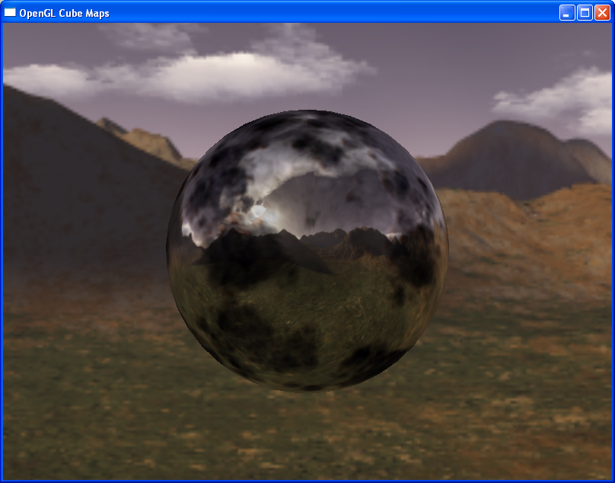
Multitexture

Slide 63
Modern OpenGL hardware implementations support the capability to apply two or more textures to geometry simultaneously.
If an implementation supports more than one texture unit, you can query with GL_MAX_TEXTURE_UNITS to see how many texture units are available:
  GLint iUnits;
  glGetIntegerv(GL_MAX_TEXTURE_UNITS, &iUnits);

Slide 64
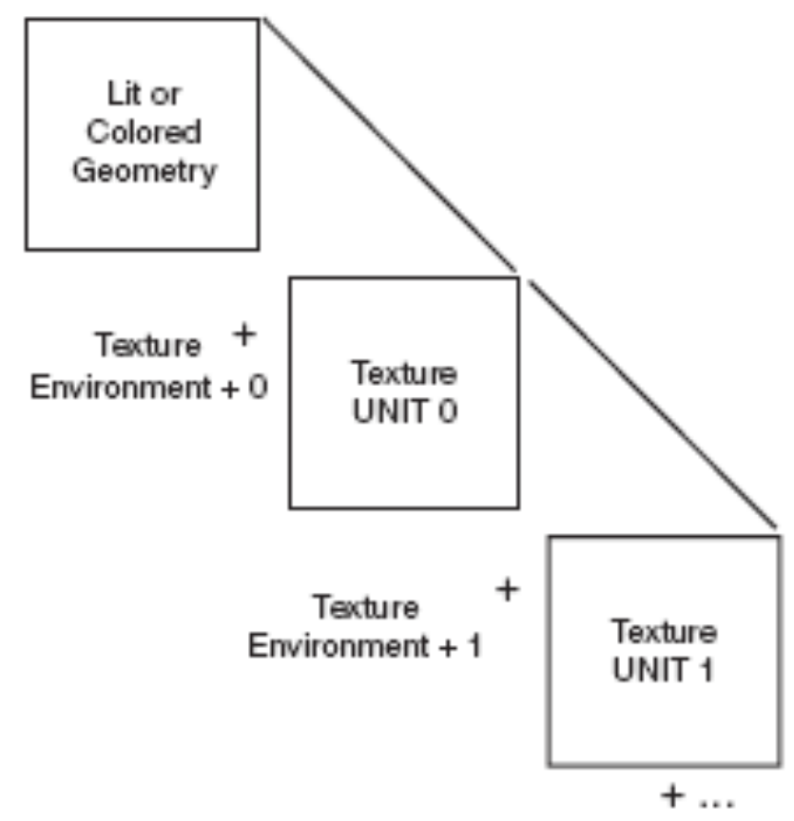
Multitexture order of operations

Slide 65
You can change the current texture unit by calling glActiveTexture with the texture unit identifier as the argument.
For example, to switch to the second texture unit and enable 2D texturing on that unit, you would call the following:
glActiveTexture(GL_TEXTURE1);
glEnable(GL_TEXTURE_2D);
To disable texturing on the second texture unit and switch back to the first (base) texture unit, you would make these calls:
glDisable(GL_TEXTURE_2D);
glActiveTexture(GL_TEXTURE0);
All calls to texture functions such as glTexParameter, glTexEnv, glTexGen, glTexImage, and glBindTexture are bound only to the current texture unit

Slide 66
glTexCoord; texture coordinates are used only for the first texture unit (GL_TEXTURE0).
To specify texture coordinates separately for each texture unit, you need one of the new texture coordinate functions.
  GlMultiTexCoord1f(GLenum texUnit, GLfloat s);
  glMultiTexCoord2f(GLenum texUnit, GLfloat s, GLfloat t);
  glMultiTexCoord3f(GLenum texUnit, GLfloat s, GLfloat t, Glfloat r);
The texUnit parameter is GL_TEXTURE0, GL_TEXTURE1, and so on up to the maximum number of supported texturing units.

Slide 67
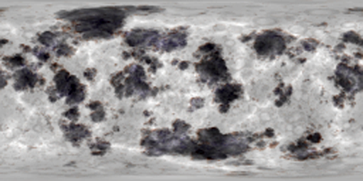
Multitexture.cpp (ch9)
In this example, we place the CUBEMAP texture on the second texture unit, and on the first texture unit we use a “tarnish” looking texture.

Slide 68
#include “../../shared/gltools.h” // OpenGL toolkit
#include “../../shared/glframe.h” // Camera class
#include <math.h>
. . .
. . .
// Storage for two texture objects
GLuint textureObjects[2];
#define CUBE_MAP 0
#define COLOR_MAP 1
. . .
. . .

Slide 69
// This function does any needed initialization on the rendering context.
void SetupRC() {
GLbyte *pBytes;
GLint iWidth, iHeight, iComponents;
GLenum eFormat;
int i;
// Cull backs of polygons
glCullFace(GL_BACK);
glFrontFace(GL_CCW);
glEnable(GL_CULL_FACE);
glEnable(GL_DEPTH_TEST);
glGenTextures(2, textureObjects);
// Set up texture maps
// Cube Map
glBindTexture(GL_TEXTURE_CUBE_MAP, textureObjects[CUBE_MAP]);
glTexParameteri(GL_TEXTURE_CUBE_MAP, GL_TEXTURE_MAG_FILTER, GL_LINEAR);
glTexParameteri(GL_TEXTURE_CUBE_MAP, GL_TEXTURE_MIN_FILTER,
GL_LINEAR_MIPMAP_LINEAR);
glTexParameteri(GL_TEXTURE_CUBE_MAP, GL_TEXTURE_WRAP_S, GL_CLAMP_TO_EDGE);

Slide 70
glTexParameteri(GL_TEXTURE_CUBE_MAP, GL_TEXTURE_WRAP_T, GL_CLAMP_TO_EDGE);
glTexParameteri(GL_TEXTURE_CUBE_MAP, GL_TEXTURE_WRAP_R, GL_CLAMP_TO_EDGE);
// Load Cube Map images
for(i = 0; i < 6; i++) {
  // Load this texture map
  glTexParameteri(GL_TEXTURE_CUBE_MAP, GL_GENERATE_MIPMAP, GL_TRUE);
  pBytes = gltLoadTGA(szCubeFaces[i], &iWidth, &iHeight,
  &iComponents, &eFormat);
  glTexImage2D(cube[i], 0, iComponents, iWidth, iHeight,
  0, eFormat, GL_UNSIGNED_BYTE, pBytes);
  free(pBytes);
}
// Color map
glBindTexture(GL_TEXTURE_2D, textureObjects[COLOR_MAP]);
glTexParameteri(GL_TEXTURE_2D, GL_TEXTURE_MAG_FILTER, GL_LINEAR);
glTexParameteri(GL_TEXTURE_2D, GL_TEXTURE_MIN_FILTER,
GL_LINEAR_MIPMAP_LINEAR);
glTexParameteri(GL_TEXTURE_2D, GL_TEXTURE_WRAP_S, GL_CLAMP_TO_EDGE);
glTexParameteri(GL_TEXTURE_2D, GL_TEXTURE_WRAP_T, GL_CLAMP_TO_EDGE);
glTexParameteri(GL_TEXTURE_2D, GL_GENERATE_MIPMAP, GL_TRUE);

Slide 71
pBytes = gltLoadTGA(“tarnish.tga”, &iWidth, &iHeight,
&iComponents, &eFormat);
glTexImage2D(GL_TEXTURE_2D, 0, iComponents, iWidth, iHeight,
0, eFormat, GL_UNSIGNED_BYTE, pBytes);
free(pBytes);
/////////////////////////////////////////////////////////////////////
// Set up the texture units
// First texture unit contains the color map
glActiveTexture(GL_TEXTURE0);
glEnable(GL_TEXTURE_2D);
glBindTexture(GL_TEXTURE_2D, textureObjects[COLOR_MAP]);
glTexEnvi(GL_TEXTURE_ENV, GL_TEXTURE_ENV_MODE, GL_DECAL); // Decal tarnish
// Second texture unit contains the cube map
glActiveTexture(GL_TEXTURE1);
glBindTexture(GL_TEXTURE_CUBE_MAP, textureObjects[CUBE_MAP]);
glTexGeni(GL_S, GL_TEXTURE_GEN_MODE, GL_REFLECTION_MAP);
glTexGeni(GL_T, GL_TEXTURE_GEN_MODE, GL_REFLECTION_MAP);
glTexGeni(GL_R, GL_TEXTURE_GEN_MODE, GL_REFLECTION_MAP);
glEnable(GL_TEXTURE_CUBE_MAP);
// Multiply this texture by the one underneath
glTexEnvi(GL_TEXTURE_ENV, GL_TEXTURE_ENV_MODE, GL_MODULATE);
}

Slide 72
void DrawSkyBox(void) {
GLfloat fExtent = 15.0f;
glBegin(GL_QUADS);
//////////////////////////////////////////////
// Negative X
// Note, we must now use the multitexture version of glTexCoord
glMultiTexCoord3f(GL_TEXTURE1, -1.0f, -1.0f, 1.0f);
glVertex3f(-fExtent, -fExtent, fExtent);
glMultiTexCoord3f(GL_TEXTURE1, -1.0f, -1.0f, -1.0f);
glVertex3f(-fExtent, -fExtent, -fExtent);
glMultiTexCoord3f(GL_TEXTURE1, -1.0f, 1.0f, -1.0f);
glVertex3f(-fExtent, fExtent, -fExtent);
glMultiTexCoord3f(GL_TEXTURE1, -1.0f, 1.0f, 1.0f);
glVertex3f(-fExtent, fExtent, fExtent);
. . .
. . .
glEnd();
}

Slide 73
// Called to draw scene
void RenderScene(void) {
// Clear the window
glClear(GL_COLOR_BUFFER_BIT | GL_DEPTH_BUFFER_BIT);
glPushMatrix();
frameCamera.ApplyCameraTransform(); // Move the camera about
// Sky Box is manually textured
glActiveTexture(GL_TEXTURE0);
glDisable(GL_TEXTURE_2D);
glActiveTexture(GL_TEXTURE1);
glEnable(GL_TEXTURE_CUBE_MAP);
glDisable(GL_TEXTURE_GEN_S);
glDisable(GL_TEXTURE_GEN_T);
glDisable(GL_TEXTURE_GEN_R);
glTexEnvi(GL_TEXTURE_ENV, GL_TEXTURE_ENV_MODE, GL_DECAL);
DrawSkyBox();

Slide 74
// Use texgen to apply cube map
glEnable(GL_TEXTURE_GEN_S);
glEnable(GL_TEXTURE_GEN_T);
glEnable(GL_TEXTURE_GEN_R);
glTexEnvi(GL_TEXTURE_ENV, GL_TEXTURE_ENV_MODE, GL_MODULATE);
glActiveTexture(GL_TEXTURE0);
glEnable(GL_TEXTURE_2D);
glPushMatrix();
glTranslatef(0.0f, 0.0f, -3.0f);
glActiveTexture(GL_TEXTURE1);
glMatrixMode(GL_TEXTURE);
glPushMatrix();
// Invert camera matrix (rotation only) and apply to
// texture coordinates
M3DMatrix44f m, invert;
frameCamera.GetCameraOrientation(m);
m3dInvertMatrix44(invert, m);
glMultMatrixf(invert);
glColor3f(1.0f, 1.0f, 1.0f);
gltDrawSphere(0.75f, 41, 41);
glPopMatrix();
glMatrixMode(GL_MODELVIEW);
glPopMatrix();
glPopMatrix();
// Do the buffer Swap
glutSwapBuffers();
}

