Slide 1
Qualification | BTEC Level 5 HND Diploma in Computing
Unit number and title | Unit
Submission date |  | Date Received 1st submission
Re-submission Date |  | Date Received 2nd submission
Student Name | Huynh Ngoc Hoang Trinh | Student ID | GCD201598
Class | GCD1102 | Assessor name | Nguyen Si Thin
Student declaration I certify that the assignment submission is entirely my own work and I fully understand the consequences of plagiarism. I understand that making a false declaration is a form of malpractice.
 |  | Student’s signature
P1 | P2 | M1 | M2 | D1

Slide 2
Business Intellgence
Assignment 1

Slide 3
Our team
Huynh Ngoc Hoang Trinh Phan Dinh Thang

Slide 4
Member task

Slide 5
CONTENTS OF THIS TEMPLATE
This is a slide structure based on a project proposal
P1 | The business processes and the mechanisms used to support business decision-making Business Process Supporting Processes
P2
Thе tools and tеchnologiеs associatеd with businеss intеlligеncе functionality
Businеss intеlligеncе tools
Lеvеls of Dеcision Making in Managеmеnt
Comparе thе typеs of support availablе for businеss dеcision-making at varying lеvеls within an organization

Slide 6

Scenario
Welcome to CT company - a leading corporation specializing in the research and treatment of cardiovascular problems. With more than a decade of experience in the medical field, we are committed to bringing the most advanced and effective solutions to protect and improve the health of heart patients
Email : ctcompany@gmail.com
Contact: +015841122

Slide 7
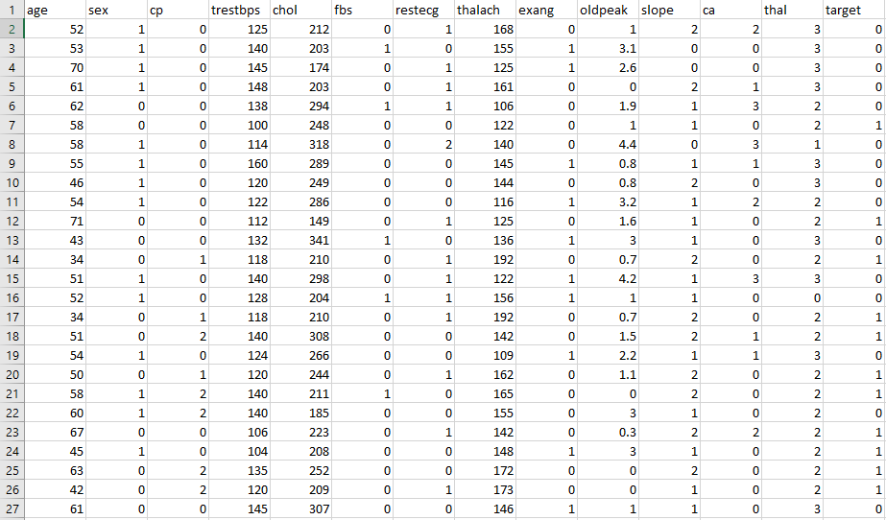
Dataset

Slide 8
Excecutive Support System
Executive support systems are handled directly by the senior most managers to support non-programmed judgments in strategic management. It contributes to the provision of assistance for internal and external data defined for corporate goals.

Slide 9
Advantages of ESS
It is easy for senior most executive to use Ability to analyze trends
Augmentation of managers' leadership capabilities Enhancement of personal thinking
and decision- making Contribution to strategic control flexibility
Broadened the organizational competitiveness in the market place Instruments of
change
Increased executive time horizons. Better reporting system
Improved mental model of business executive
Help improve consensus building and communication Increased communication
capacity and quality

Slide 10
Disadvantages of ESS
Functions are limited
Very tough to quantify benefits
Executive may encounter information overload System may become slow
Difficult to keep current data
May lead to less reliable and insecure data
Highly expensive for small company

Slide 11
Management Information System
Management information systems (MIS) have been used by modern
corporations to manage, order, organize, and manipulate the gigabytes and
masses of information generated for numerous purposes. MIS assists firms in
optimizing business operations, meeting the information demands of employees and other stakeholders, and making informed strategic decisions. However, funding allocation and monitoring concerns can have an impact on the effectiveness of MIS.

Slide 12
Advantages
It helps with planning
Reduces information overload
MIS Encourages Decentralization
It improves coordination

Slide 13
Disadvantages
High sensitivity necessitates constant monitoring.
MIS budgeting is exceedingly complex.
The quality of outputs is determined by the quality of inputs.
Lack of adaptability to change.
Because of frequent changes in top management, effectiveness suffers.

Slide 14
Business Process
Create a company page on the website where you can perform actions to manage service packages to sell to users. Furthermore, additional actions will be required to set up the public's profile so that users can search faster.
Building a brand: Run ads for the company's service packages to reach as many people as possible. Although this is extremely expensive, it also brings more special benefits to those in the company.
When service packages are advertised for sale online, the seller must receive orders and carry out procedures such as preparing equipment and human resources.
The merchant's profit will be determined by the number of orders completed by the consumer. Customers will go to the website to buy a certain service package.

Slide 15

INTRODUCE BUSINESS INTELLIGENCE
The integration of Python capabilities is one of the most significant recent enhancements to Power BI. Customers of Power BI can now run Python programs natively. Python is a fantastic programming language, particularly for data analytics. Python is the language of choice for developing machine learning frameworks and data science libraries, and it is actively supported and promoted by a large open source programming community.

Slide 16

Benefits of business intelligence
A successful BI program produces a variety of business benefits in an organization
Speed up and improve decision-making
Optimize internal business processes
Increase operational efficiency and productivity
Spot business problems that need to be addressed
Identify emerging business and market trends
Develop stronger business strategies
Drive higher sales and new revenues
Gain a competitive edge over rival companies.

Slide 17
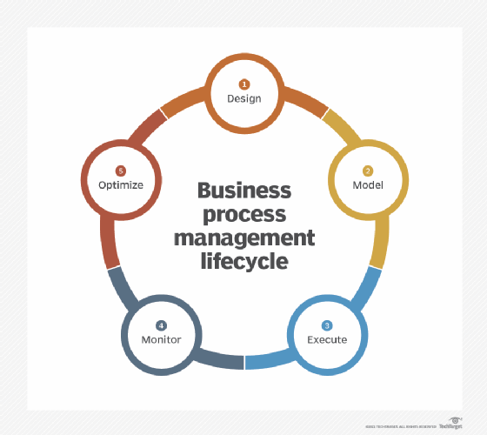
Business process
A combination of business tasks and activities that are carried out in an organized manner by people or systems is referred to as a "business process," and it results in a product that advances the company's objectives. A business process is made up of at least one of the following components, but not necessarily all of them: system, task/activity, worker(s), workflow, and information

Slide 18
Process type
A individual process | An individual carries out a business procedure as a personal process. Users provide the majority of it.
A vertical process | A vertical process is a business procedure carried out by a division or functional unit. Nothing from an external system is utilized by it.
A horizontal | A horizontal process is a business process that spans multiple departments, functional divisions, or businesses.

Slide 19
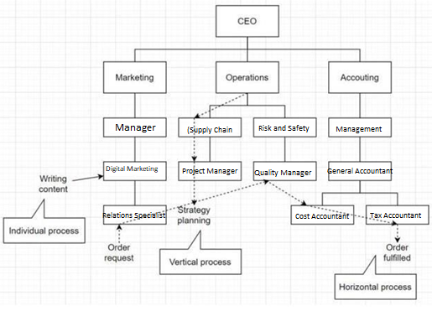
Business process types

Slide 20

Supporting process
Assisting with operations These are back-office procedures inside corporate operations, sometimes known as secondary procedures. Supporting processes differ from operational procedures in that they do not directly help customers

Slide 21
Data of business process
Unstructured data
Semi-structured data
Structured data

Slide 22

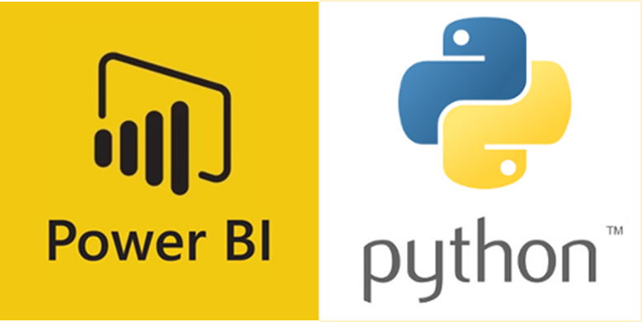
Tool For BI

Slide 23
Python and Power BI
One of the most significant recent enhancements to Power BI is the integration of Python capabilities. Power BI customers may now run Python programs natively. Python is an excellent programming language, especially for data analytics. Python is the language of choice for developing machine learning frameworks and data science libraries, and a strong open source programming community actively supports and promotes its use with these libraries.

Slide 24
Tableau
Tableau is an excellent business intelligence and data visualization solution for reporting and analyzing massive amounts of data. Salesforce acquired Tableau, an American company founded in 2003, in June 2019. It allows users to create a variety of charts, graphs, maps, dashboards, and stories for the goal of showing and analyzing data to aid in business decision-making.

Slide 25
Features of Tableau
Tableau users may quickly find answers to critical questions because to the platform's powerful data search and exploration capabilities.
Users with no relevant experience do not need any prior programming skills to start creating visualizations with Tableau.
It can connect to a variety of data sources that other BI packages do not support. Tableau users can integrate and generate reports from a variety of datasets.
Tableau Server provides a centralized location for managing all published data sources inside an organization.

