Slide 1
WordTower
Word Puzzle Game
Presenter: Waqas Wise
18p-0093
/

Slide 2
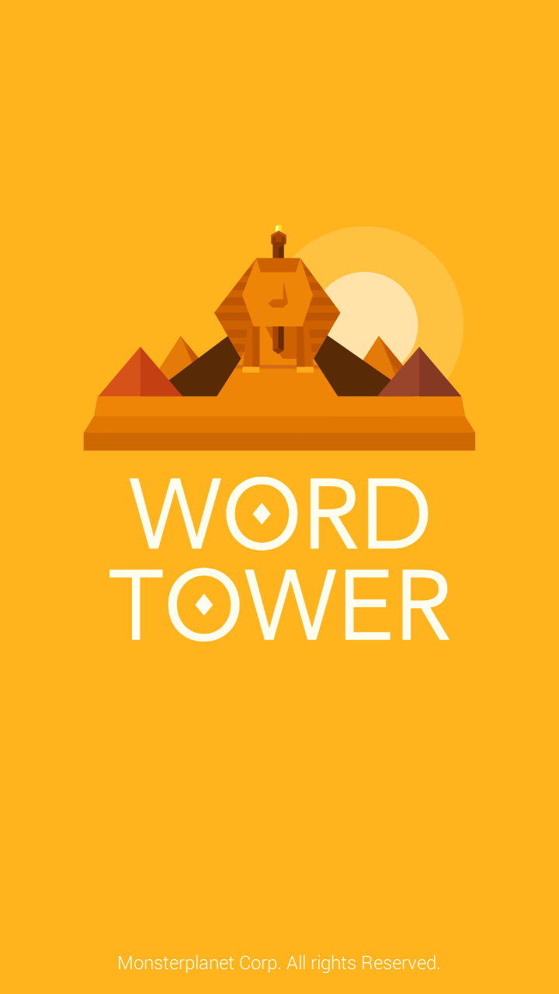
Introduction
Android/IOS game developed by
Merriam-Webster.
Theme: To join word boxes to form correct
English words.
The game is a level based game with the
difficulty level increasing gradually as
the levels increase.
/

Slide 3
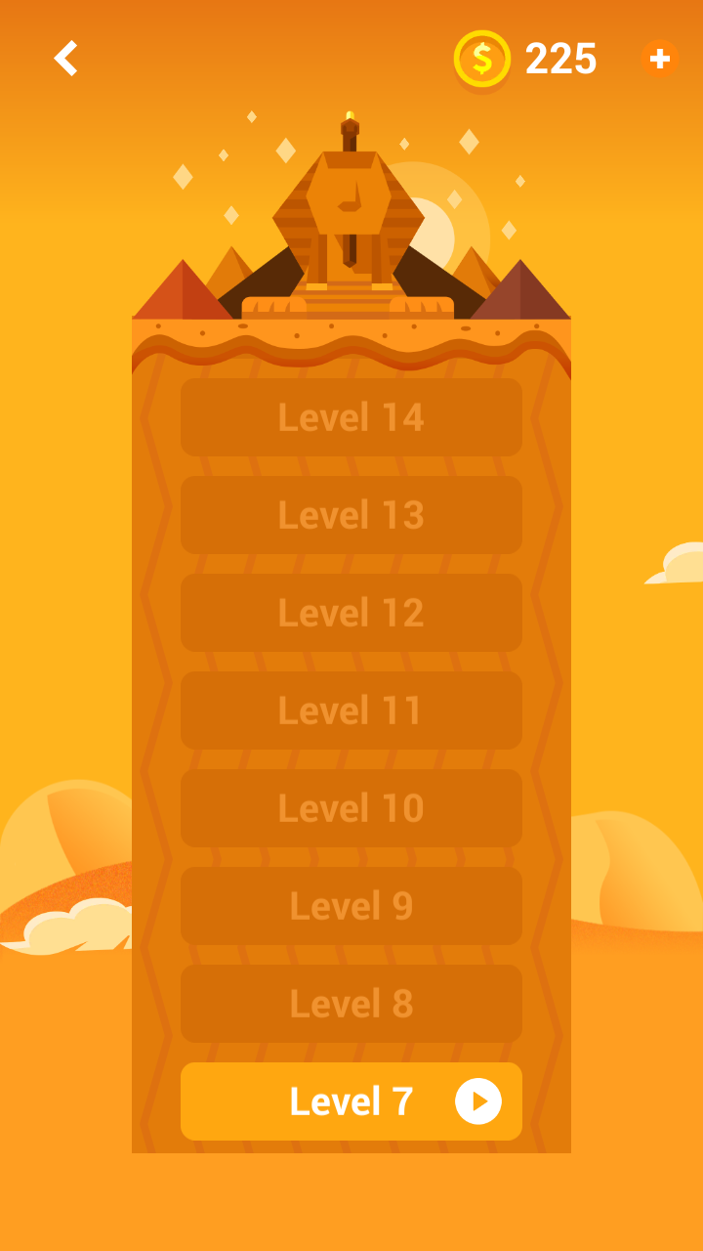
Game-play
The game is divided into different
stages & every stage consists of
40 levels.
You have to complete the previous
stage to move to the nest stage.
/

Slide 4
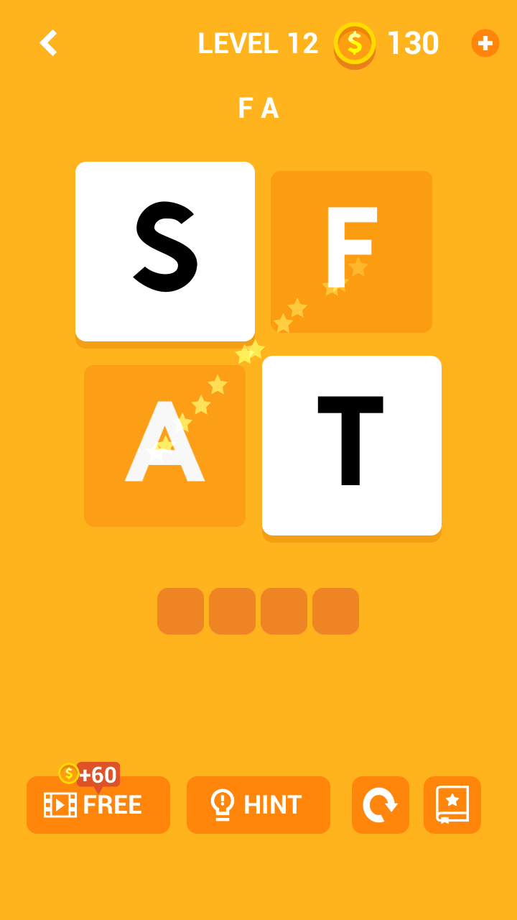
Join letter boxes to make a word.
You can also take hints which costs
60 coins.
/

Slide 5
Experience
Very challenging(especially in higher levels).
Helps with vocabulary and specifically word spellings.
I have personally only reached level 15.
/

Slide 6
Summary
The game is a productive way of killing time.
It forces the players to utilize their mind to the fullest.
/

Slide 7
Thank You
Please go ahead and ask any questions that you might have.
/

