Slide 1
Testing of MoA Enrichment using Python Script

Slide 2
Dataset TA-ORF-BBBC037-Rohban
41744
41754
41755
41756
41757

Slide 3
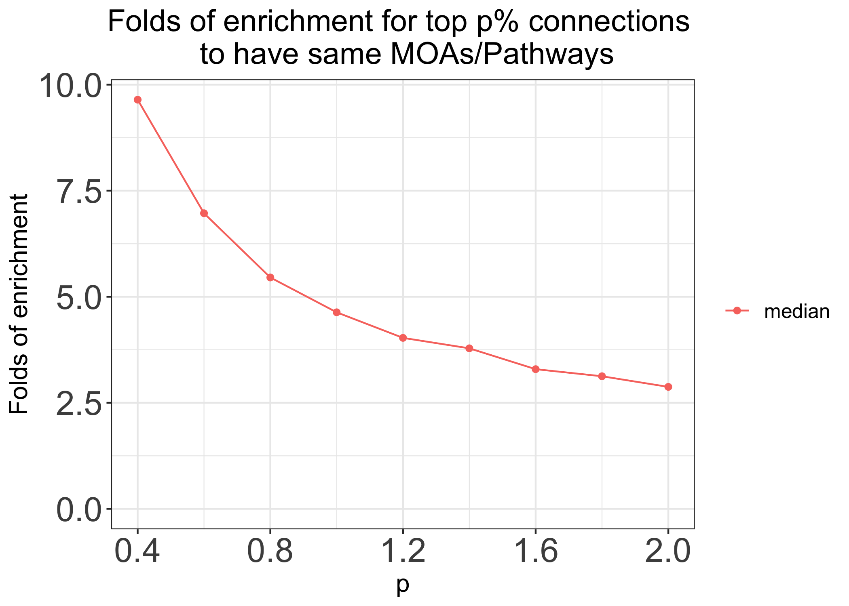
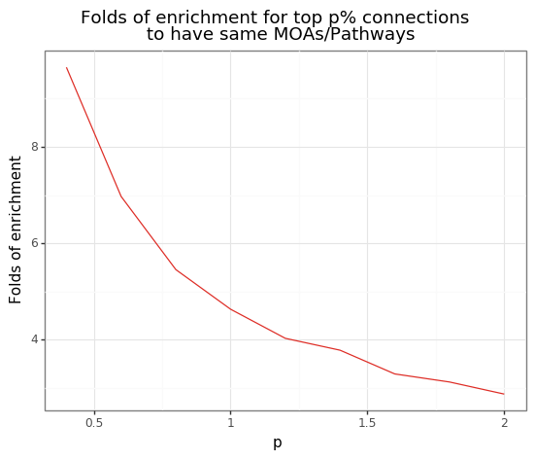
Median profiles
R
Python
Correlation profiles generated in R

Slide 4
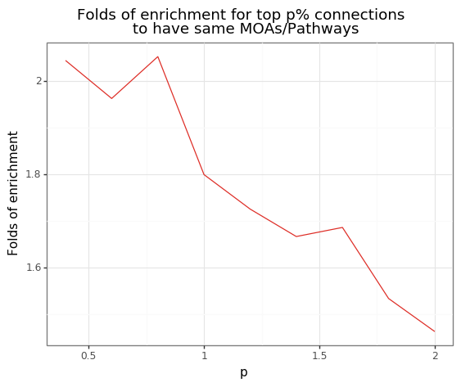
Median profiles
Python
Correlation profiles generated in python

