Slide 1
Numerical Linear Algebra & Parallel Computing Memory and Performance
Nouredine Ouhaddou
Mohammed VI Polytechnic University

Slide 2
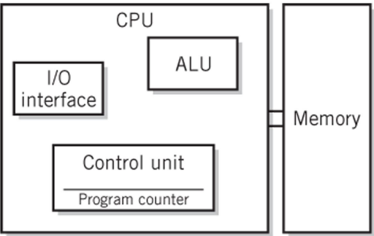
Memory and performance
Overview on CPU vs Memory:
ALU (arithmetic logic unit)
Performs calculations and comparisons
CU (control unit)
Performs fetch/execute cycle
Accesses program instructions
and issues commands to the
ALU
Moves data to and from CPU
registers and other Hardware
Components
Subcomponents:
Memory management unit: supervises fetching instructions and data from memory
I/O Interface: sometimes combined with
memory management unit as Bus Interface Unit

Slide 3
Memory and performance
Memory Unit
Memory:
The storage area in which programs are kept when they are running and that contains the data needed by the running programs
Types of memory
Volatile memory: storage that retains data only if it is receiving power, such as dynamic random access memory (DRAM)
Nonvolatile memory: a form of memory that retains data even in the absence of a power source and that is used to store programs between runs, such as flash memory
The memory consists of storage cells, each capable of storing one bit of information, processed in groups of fixed size called words.
Instruction and data can be written into the memory or read out under the control of the processor

Slide 4
Memory and performance
Performance
The speed with which a computer executes programs is affected by the design of its hardware and its machine language instructions
Because programs are usually written in a high-level language, performance is also affected by the compiler that translates programs into machine languages
For best performance, the following factors must be considered
Compiler
Instruction set (number and type of instructions)
Hardware design

Slide 5
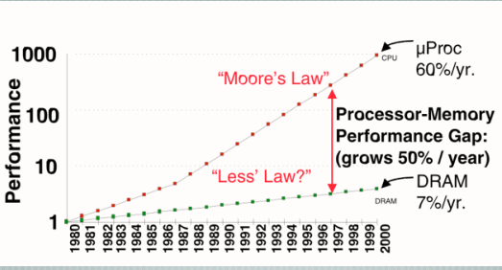
Memory and performance
Moore's law
In 1965, Intel co-founder Gordon Moore predicted (from just 3 data points!) that semiconductor density would double every 18 months.

Slide 6
Memory and performance
Memory issue:
Conflicting requirements in a memory system: we want both large and fast.
We can increase bandwidth by introducing concurrency in memory access (e.g. through pipelining accesses)
but this requires regular access patterns
random accesses to main memory can cause severe performance degradation
Memory performance is a compromise between power and performance.
Increasing the bandwidth also increase the latency of individual memory accesses.
A memory hierarchy attempts to make a large slow memory appear fast by buffering data in smaller faster memories close to the processor
Memory access optimization in hardware requires careful consideration of the tradeoffs between memory access latency and bandwidth, as well as the management of memory resources to meet the demands of modern applications.

Slide 7
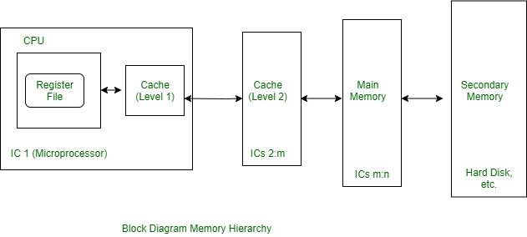
Memory and performance
Memory architecture (hierarchy) :
The memory hierarchy consists of several levels of memory, each with increasing size and decreasing speed:
Registers: Registers are the fastest type of memory and are located inside the CPU.
Cache: Cache is a small, fast memory that is used to store frequently accessed data, type of caches (L1, L2, L3, etc.).
Main Memory (RAM): Main memory is the primary memory used by the CPU to store data and program instructions.
Secondary Storage (e.g. hard disk, solid-state drive): Secondary storage is used to store data when it is not currently being used by the CPU.

