Slide 2
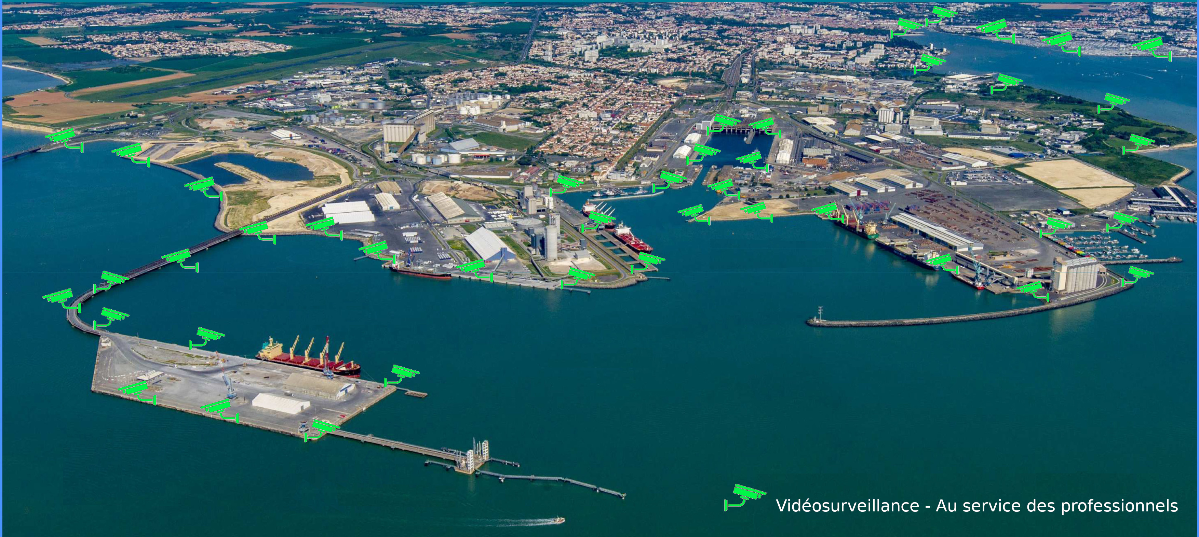

Slide 4
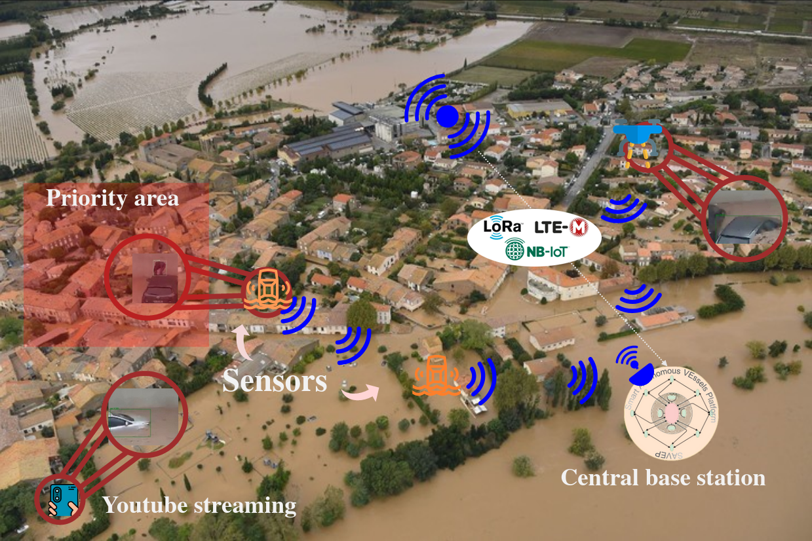
« Dynamic health assessment in water environments using LPWAN technologies », Wireless Technologies for Biomedical Applications, CRC Press

