Slide 1
数据库文本文字
2022. 06. 29

Slide 2
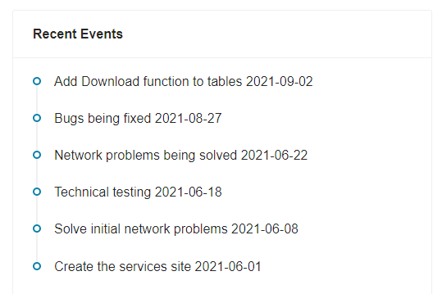
Home
Recent Events
Add data download function 2022-06-27
Add four analyze modules 2022-06-18
Solve network problems 2022-06-05
Complete data upload 2022-06-01
Create the service site 2022-05-20
P1

Slide 3
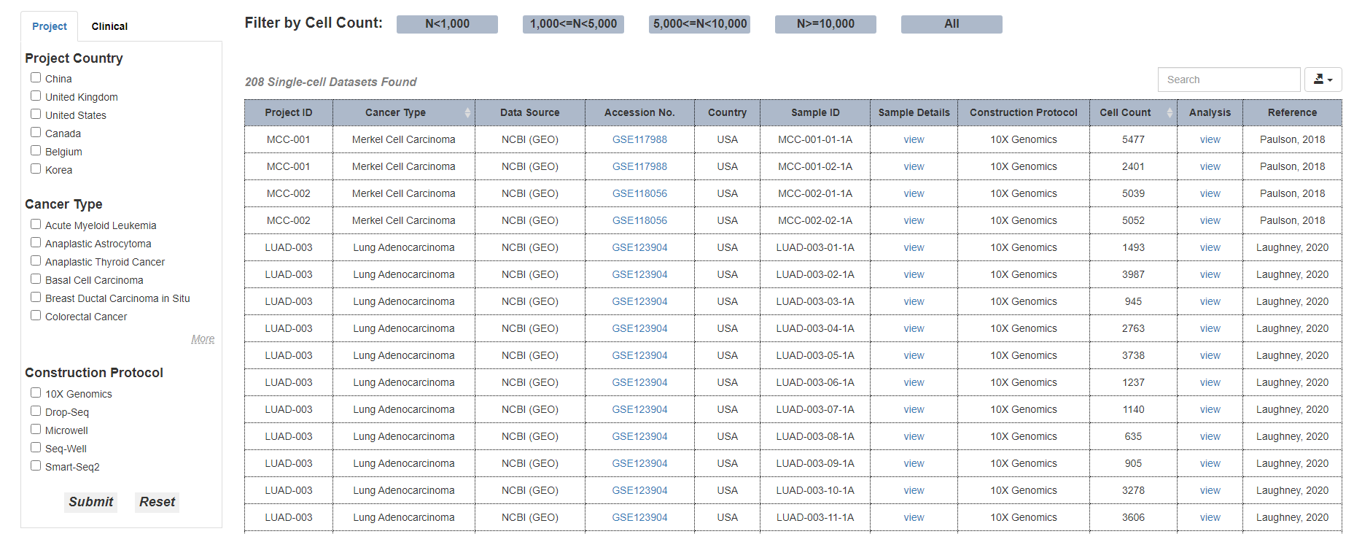
Browse
Bulk datasets
Single-cell datasets
Curated knowledge
Organs
S2
S3
S1
P2

Slide 4
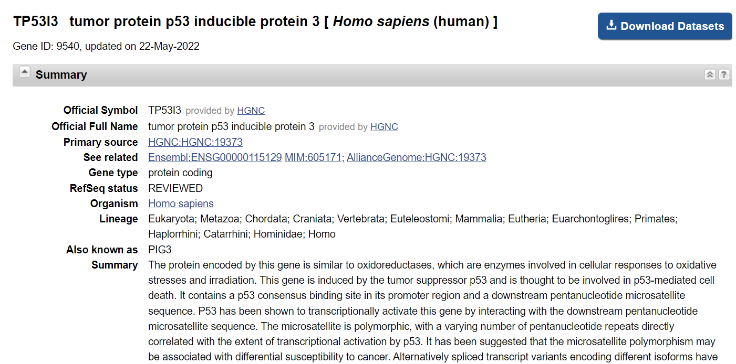
Browse -> Curated knowledges
Curated knowledges related to specific organ or premalignant disease
S4
P3

Slide 5
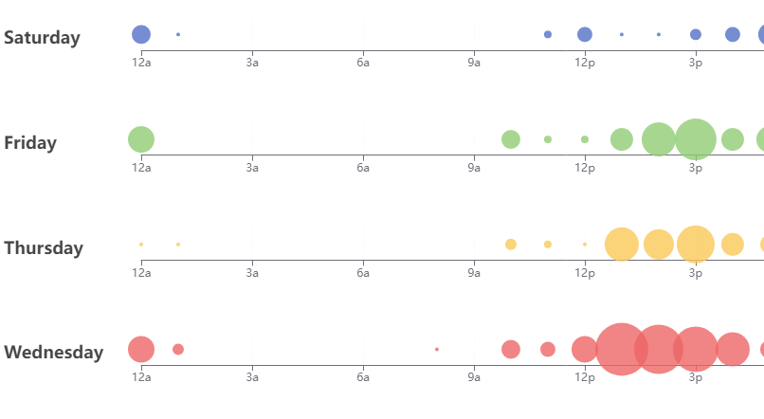
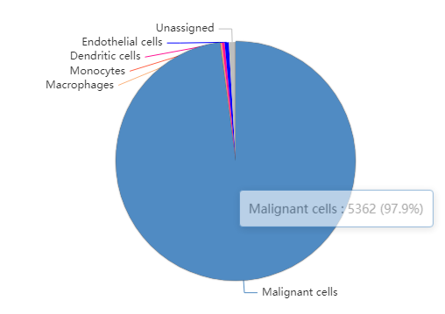
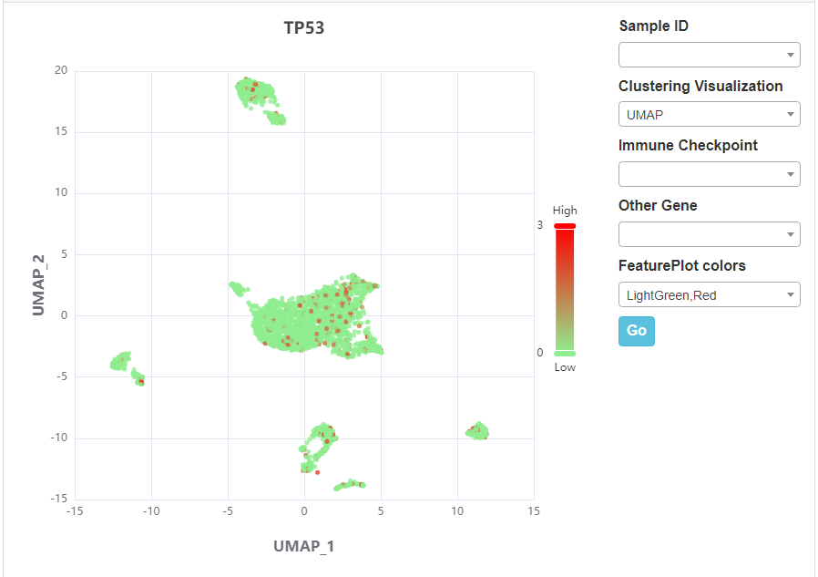
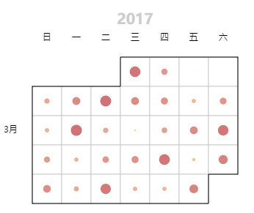
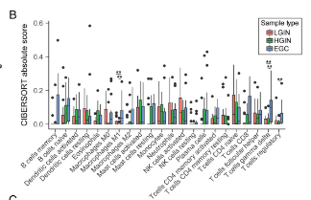
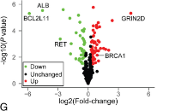
Browse -> Bulk data
Dynamic genes across premalignant lesions
Sample counts across premalignant lesions
Violin plot for top 5 dynamic genes
S7
模板：单轴散点图
Notes: Dynamic genes referred to genes whose expression show gradually increase (UP) or decrease (DOWN) trend along the evolution of premalignant diseases (FDR < 0.05, anova test)
S5
The dynamic gene table
S8
输出表 (页面展示输出前10行)：
TME cell types deconvolution analysis
DEGs for each premalignant lesion
2.1
4.1
4.2
Boxplot for deconvoluted TME cells
Volcano plot for DEGs
Violin plot for deconvoluted TME cells
模板：多系列盒须图
Premalignant lesion
模板：日历图
S6
S10
S9
Notes: DEG: Differently Expressed Genes (Premalignant lesion vs Normal control;
FDR < 0.05 & fold change > 1.5, student t-test)
4.3
2.2
输出表 (页面展示输出前10行)：
The DEG table
S6
Table of deconvoluted TME cells
输出表 (页面展示输出前10行)：
S9
Notes: The deconvolution analysis was performed by the CIBERSORTx platform (https://cibersortx.stanford.edu/). TME, tumor microenvironment.
P4
输出差异基因分析表（可展示top 10）：SuppTable5_Premalignant_bulk_DNG_GSExx_Demo_1

Slide 6
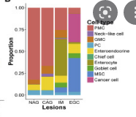
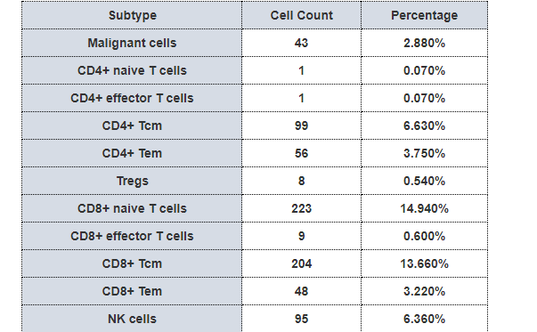
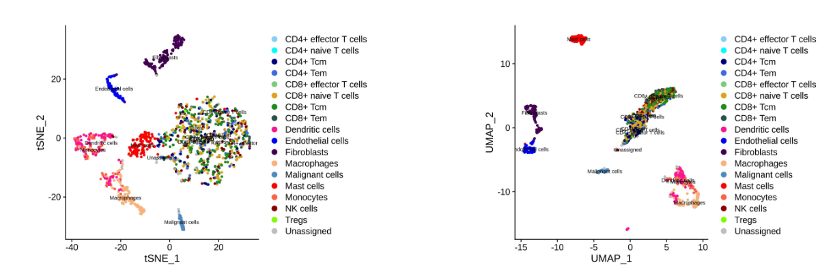
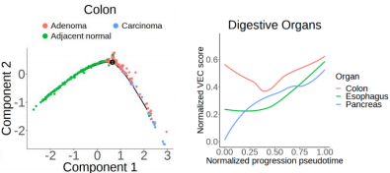
Browse -> Single-cell data
Cellular proportion analysis
General information
3.1
3.2
1.1
The boxplot of cellular proportions across lesions
The table of representative cellular proportions across lesions
Cell clusters
Disease lesions
1.2
输出表
S14
S14
3.3
The table of complete cellular proportions across lesions
S14
输出表 (页面展示输出前10行)：
S11
Pseudo-tumorigenesis trajectory analysis
Putative cell marker analysis
2.1
4.1
The putative pseudo-tumorigenesis trajectory
Violin plot for top 2 putative markers across cell clusters
鼠标悬浮可查看详细信息
模板：数据聚合
S12
S15
4.2
Table of putative cellular dynamic genes
Putative cell marker table
输出表 (页面展示输出前10行)： ：
2.2
输出表 (页面展示输出前10行)：
Notes: The pseudo-tumorigenesis trajectory analysis was performed by the Monocle platform (http://cole-trapnell-lab.github.io/monocle-release/) and the putative cellular dynamic genes referred to those genes whose expression showed significant gradual pattern along the putative pseudo-tumorigenesis trajectory (pseudotime)
S16
P5

Slide 7
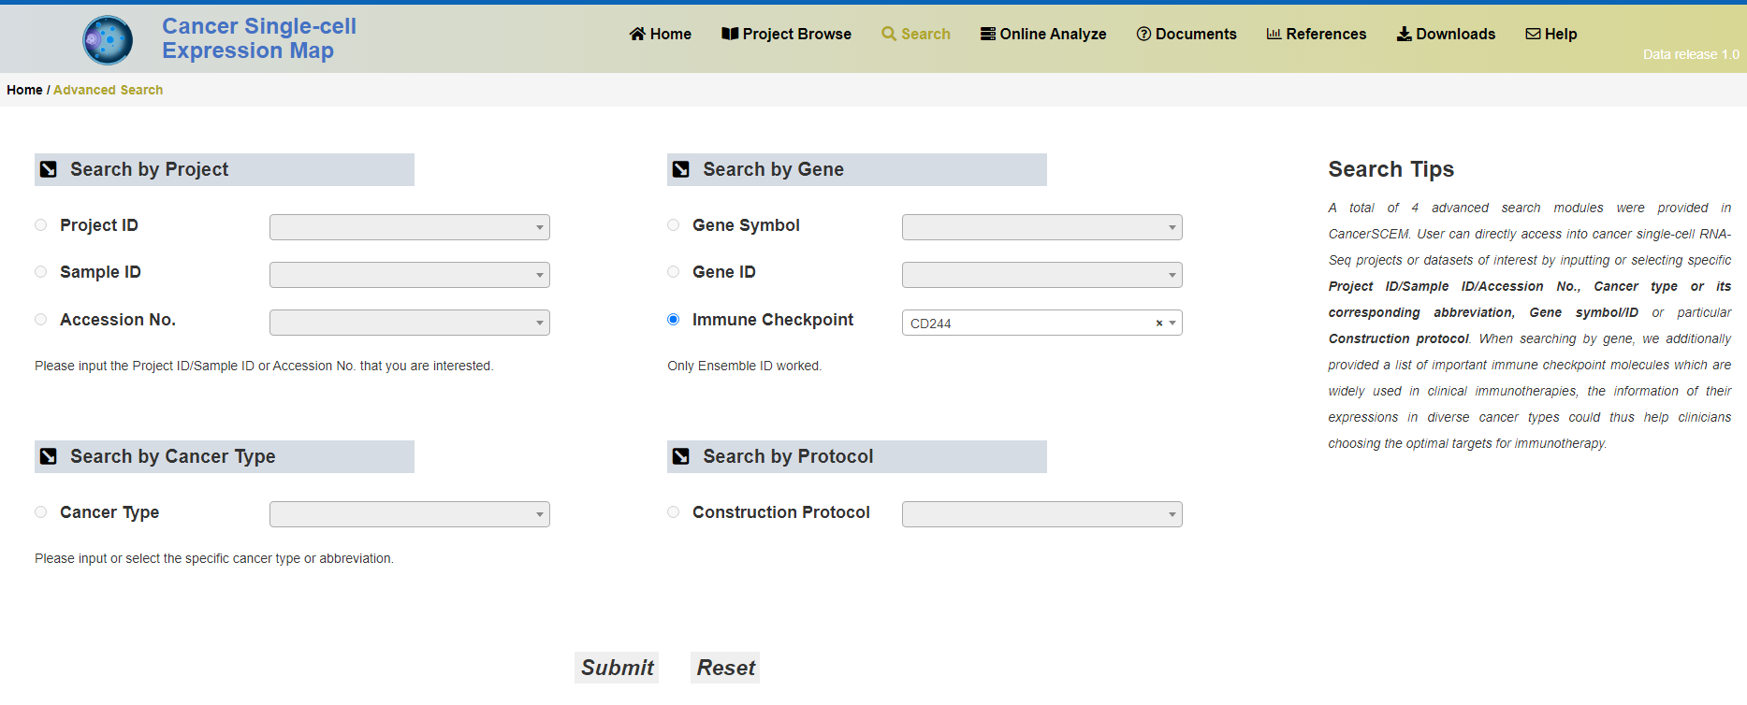
Search
Search by gene
Search by organ
Search by project
P7
Organ
下拉选择
Project ID
下拉选择
Gene Symbol
e.g. TP53
下拉选择:Single-cell/Bulk
Data type
下拉选择:Single-cell (跳转S3)/Bulk (跳转S2)
Data type
Entrez ID
e.g. 2831
P7
P8
P9
Search notes
The PreAtlas provides three main search modules, including Search by gene, Search by organ, Search by project. Here, the Search by gene module enable to provide basic information, associated organs or premalignant diseases, associated cell types, associated drugs and network associations for any input gene symbol or Entrez ID. The Seach by organ module enable to provide curated related transcriptomic datasets, associated cellular components and their proportions, associated dynamic genes and associated therapeutic drugs for diverse premalignant disease of any input organ.
P6

Slide 8
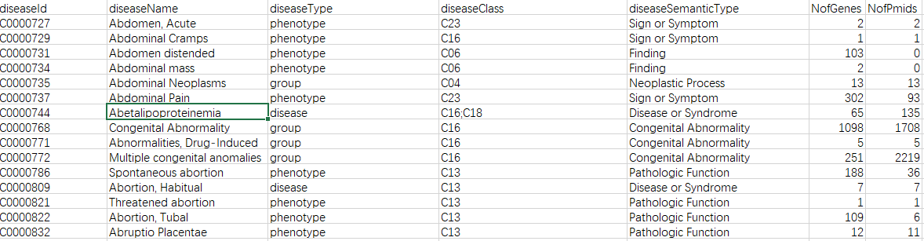
Search → Gene
P6页输入的结果
Search results for the input gene:
TP53
TP53
Associated cell types
Basic information for the input gene
Download
S17
S13
提供表格
展示格式参考贴图，提供4-5行信息
Associated drugs
Associated organs or premalignant diseases
Download
Curated knowledge-based
Download
S19
输出表 (页面展示输出前10行)：
S18
Network associations
Download
Transcriptomic data-based
S20
Download
S6
注：数据表格可提供下载
P7

Slide 9
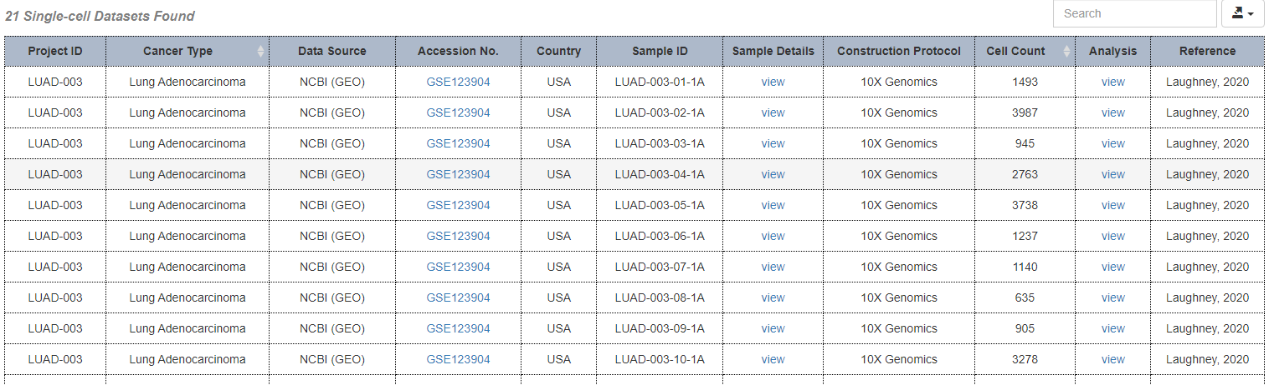
Search → Organ
Associated dynamic genes
Search results for the input organ:
P6页输入的结果
Bulk
Download
1.1) Bulk
Curated related transcriptomic datasets
S2
S8
Bulk
Download
1.2) Single-cell
格式同P2
Single-cell
Download
S3
Single-cell
Download
Associated cellular components and their proportions
S16
Bulk (by CIBERSORTx)
Download
S9
Associated threapeutic drugs
Database-derived
Download
Single-cell
Download
SuppTable12_Premalignant_network_DiseaseDrug
S21
输出表 (页面展示输出前10行)：
S14
Literature-derived
Download
SuppTable16_CancerPreventionDrug_Literature
输出表 (页面展示输出前10行)：
S22
P8
注：数据表格可提供下载

Slide 10
Search → Project
Search results for the input project:
P6页输入的结果
S2
S3
P2
P9

Slide 11

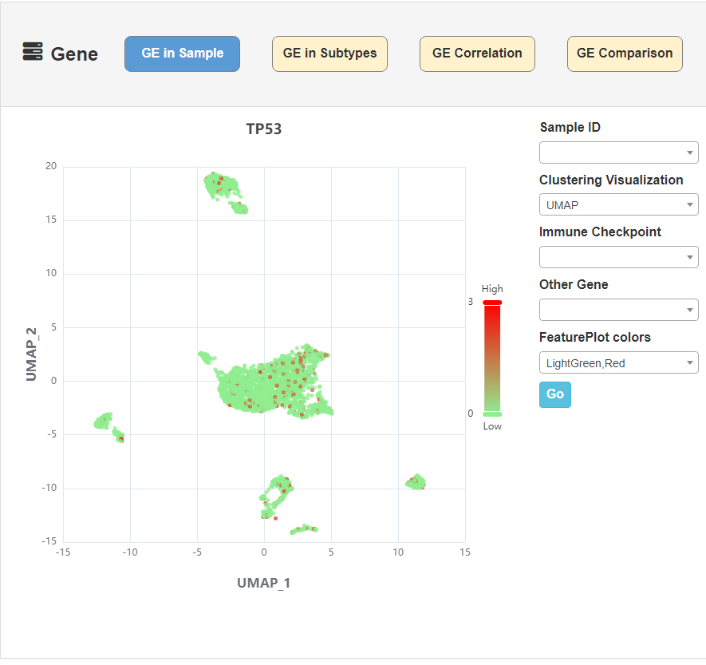
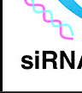
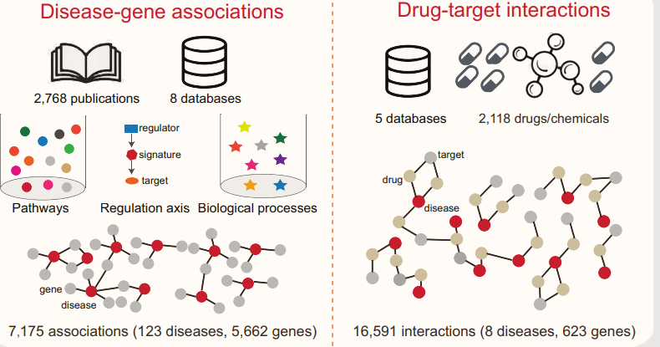
Analysis
Home/Browse/Search/Analysis/Download/Documentation/Contact
Brief introduction to the analysis modules in PreAtlas
Here, four interactive analytical and visualization modules haven been packaged in PreAtlas to in-depth investigate these datasets, including Gene Expression Analyze (GEA), Cellular Component Analyze (CCA), Dynamic Gene Analyze (DGA) and Multiple Network analyze (MNA). Here, the GEA module enable to dissect the gene-level distribution across diverse cell types and/or pathological lesions while the CCA Module enable to dissect the cellular-level distribution based on either cell type annotations within scRNA-seq data or deconvoluted TME cells within the bulk transcriptomic data. Of note, the DBA module could identify premalignant-related dynamic genes as potential cancer risk-screening and early-diagnosis biomarkers, which were defined as those showing gradually dysregulated (increase or decrease) expression patterns along the pathologically dynamic evolution or putative pseudo-tumorigenesis trajectories. Finally, the MNA module enable to perform the network analysis for systematically associating premalignant-related multiple information, including diseases, genes, cell types and drugs, allowing for uncovering the evolution and intervention mechanism underlying premalignant diseases from the holistic view.
Gena Expression Analyze (GEA)
Cellular Component Analyze
(CCA)
链接到P11
链接到P12
疾病（可用人体代替）
Dynamic Gene Analyze
(DGA)
基因
药物
Multiple Network Analyze
(MNA)
细胞（可参考提供的参考图）
链接到P13
链接到P14
P10
概览图（静态）

Slide 12
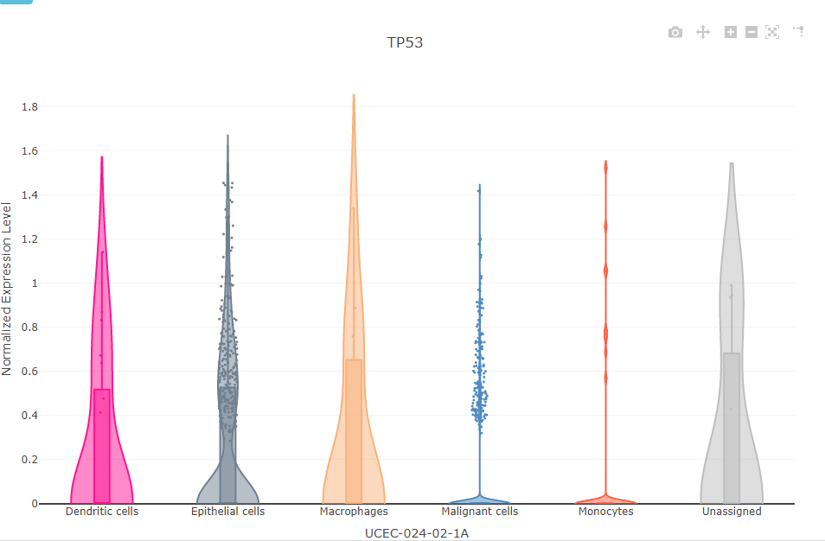
Analysis—1)
Gena Expression Analyze (GEA) Module
Gene expression distribution across cellular clusters
1.2)
1) UMAP plot
2) Violin plot
Organ
Organ
Project ID
Project ID
模板：数据聚合
模板：基础盒须图
Gene
Gene
Lesions
GO
Clusters
S23
GO
S23
P11

Slide 13
Analysis—2)
Cellular Component Analyze (CCA)
2.1)
Cellular distribution across lesions
2.2)
1) Boxplot plot
(CIBERSORTx based on bulk data)
2) Barplot plot
(based on single-cell data)
Organ
模板：堆叠条形图（x和y轴换一下）
Organ
模板：多系列盒须图
Project ID
Project ID
S10
GO
S14
P4中 4.1)、4.2）
P5 中3.1)、3.2）
GO
P12

Slide 14
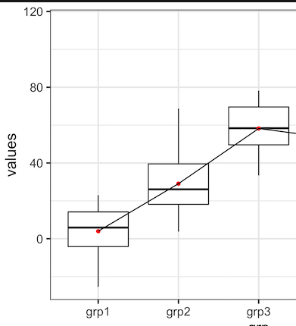
Analysis—3)
Dynamic Gene Analyze (DGA)
Dynamic genes across lesions
1) Boxplot plot
(bulk data)
2) Pseudo-timurigenesis plot
(single-cell data)
3.1)
3.2)
Organ
2.1) Lesions
2.2) Expression
Organ
Project ID
Organ
Project ID
Gene
Project ID
Expression
模板：折线图堆叠
Gene
模板：数据聚合
模板：基础盒须图
Pseudotime
S24
S25
鼠标悬浮可查看详细信息
P13

Slide 15
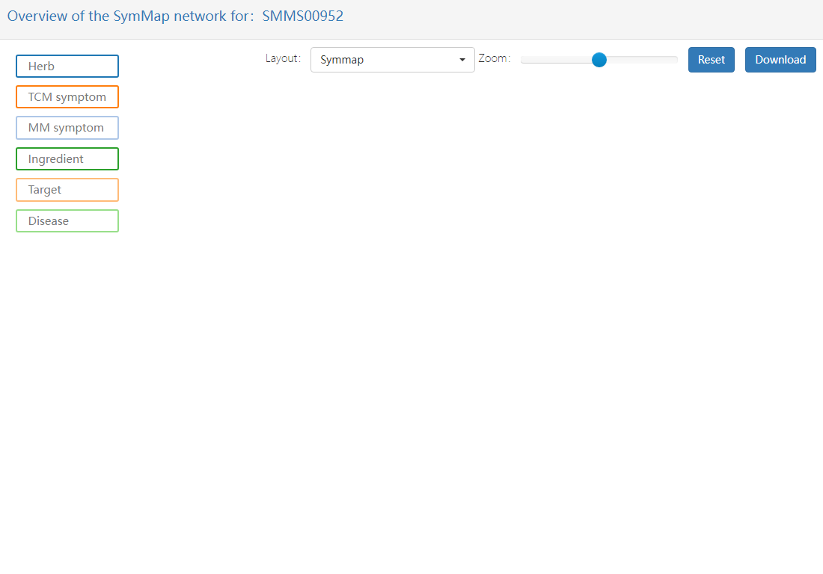
Analysis—4)
Multiple Network analyze (MNA).
Associating diseases, genes, cell types and drugs
Organ
Diseases
Genes
cell types
drugs
输入节点
Gene
S26
P14

Slide 16
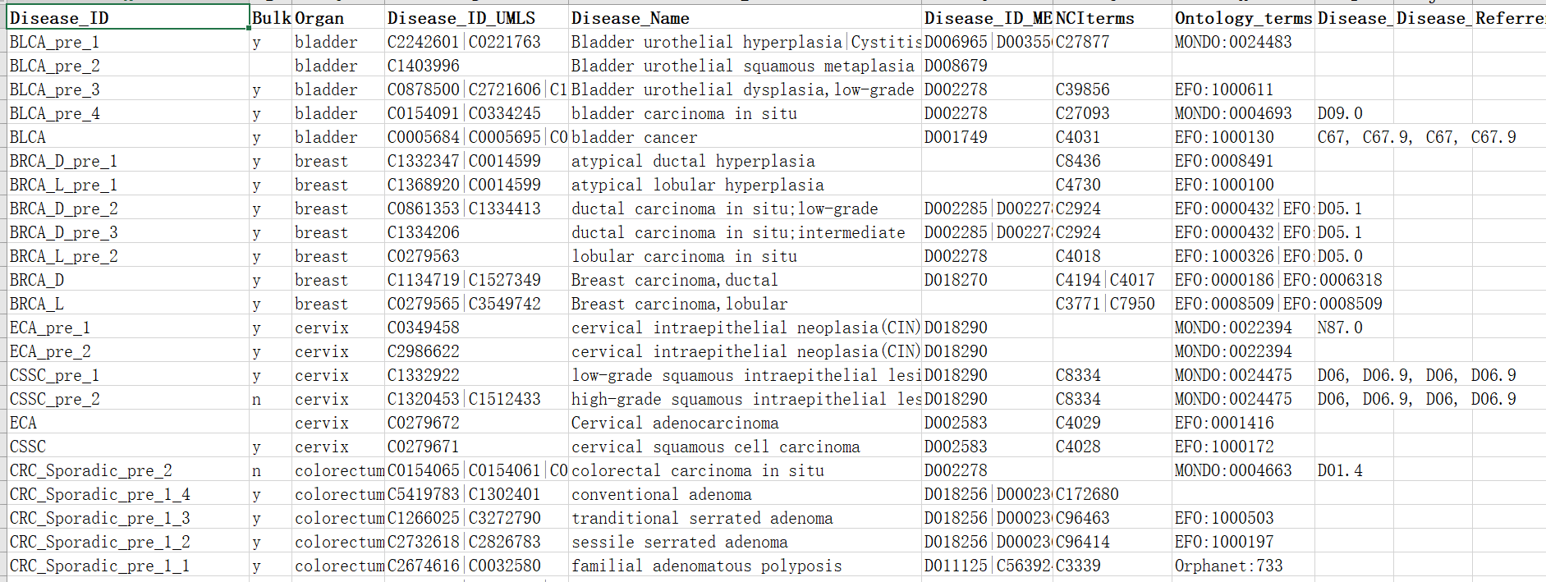
Download
Curated knowledges for premalignant diseases
提供下载链接
S27
Download:
S27: Curated knowledges for premalignant diseases (S1)
S28: Putative DEGs for premalignant diseases
S29: Putative Dynamics genes for premalignant diseases
S30: Putative dynamics cell types and corresponding markers for premalignant diseases
Cell markers for premalignant diseases
提供下载链接
S28
P15

Slide 17
Documentation
我方提供Word文档
P16

Slide 18
Contact
Contact Information
If you have any question or any suggestion/comment, please feel free to contact us via email.
Prof. Shao Li (corresponding author): shaoli@mail.tsinghua.edu.cn
Dr. Peng Zhang: zpzx@mail.tsinghua.edu.cn
Address:
Institute for TCM-X, MOE Key Laboratory of Bioinformatics, Bioinformatics Division, BNRIST, Department of Automation, Tsinghua University, 100084 Beijing, China
P17

