Slide 1
LAB III

Slide 2
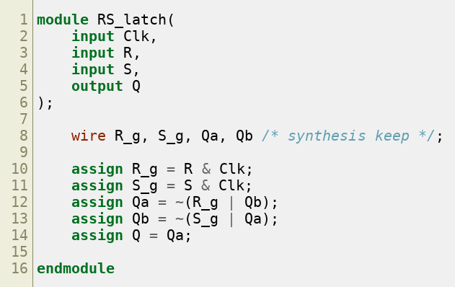
Part I - Gated RS Latch
Implemented a gated RS latch

Slide 3
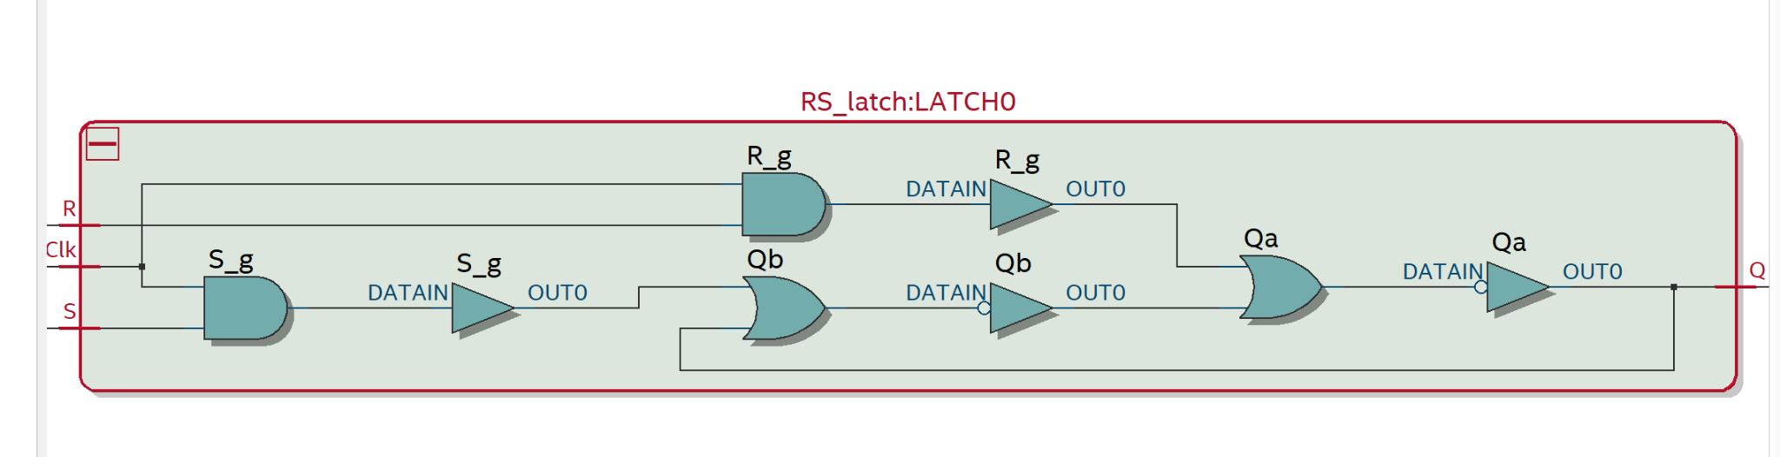
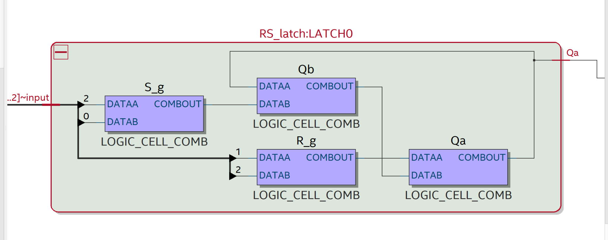
Part I - RTL and Technology Map
RTL verifies the cross-coupled latch logic; the Technology Map shows the four preserved combinational logic cells.

Slide 4
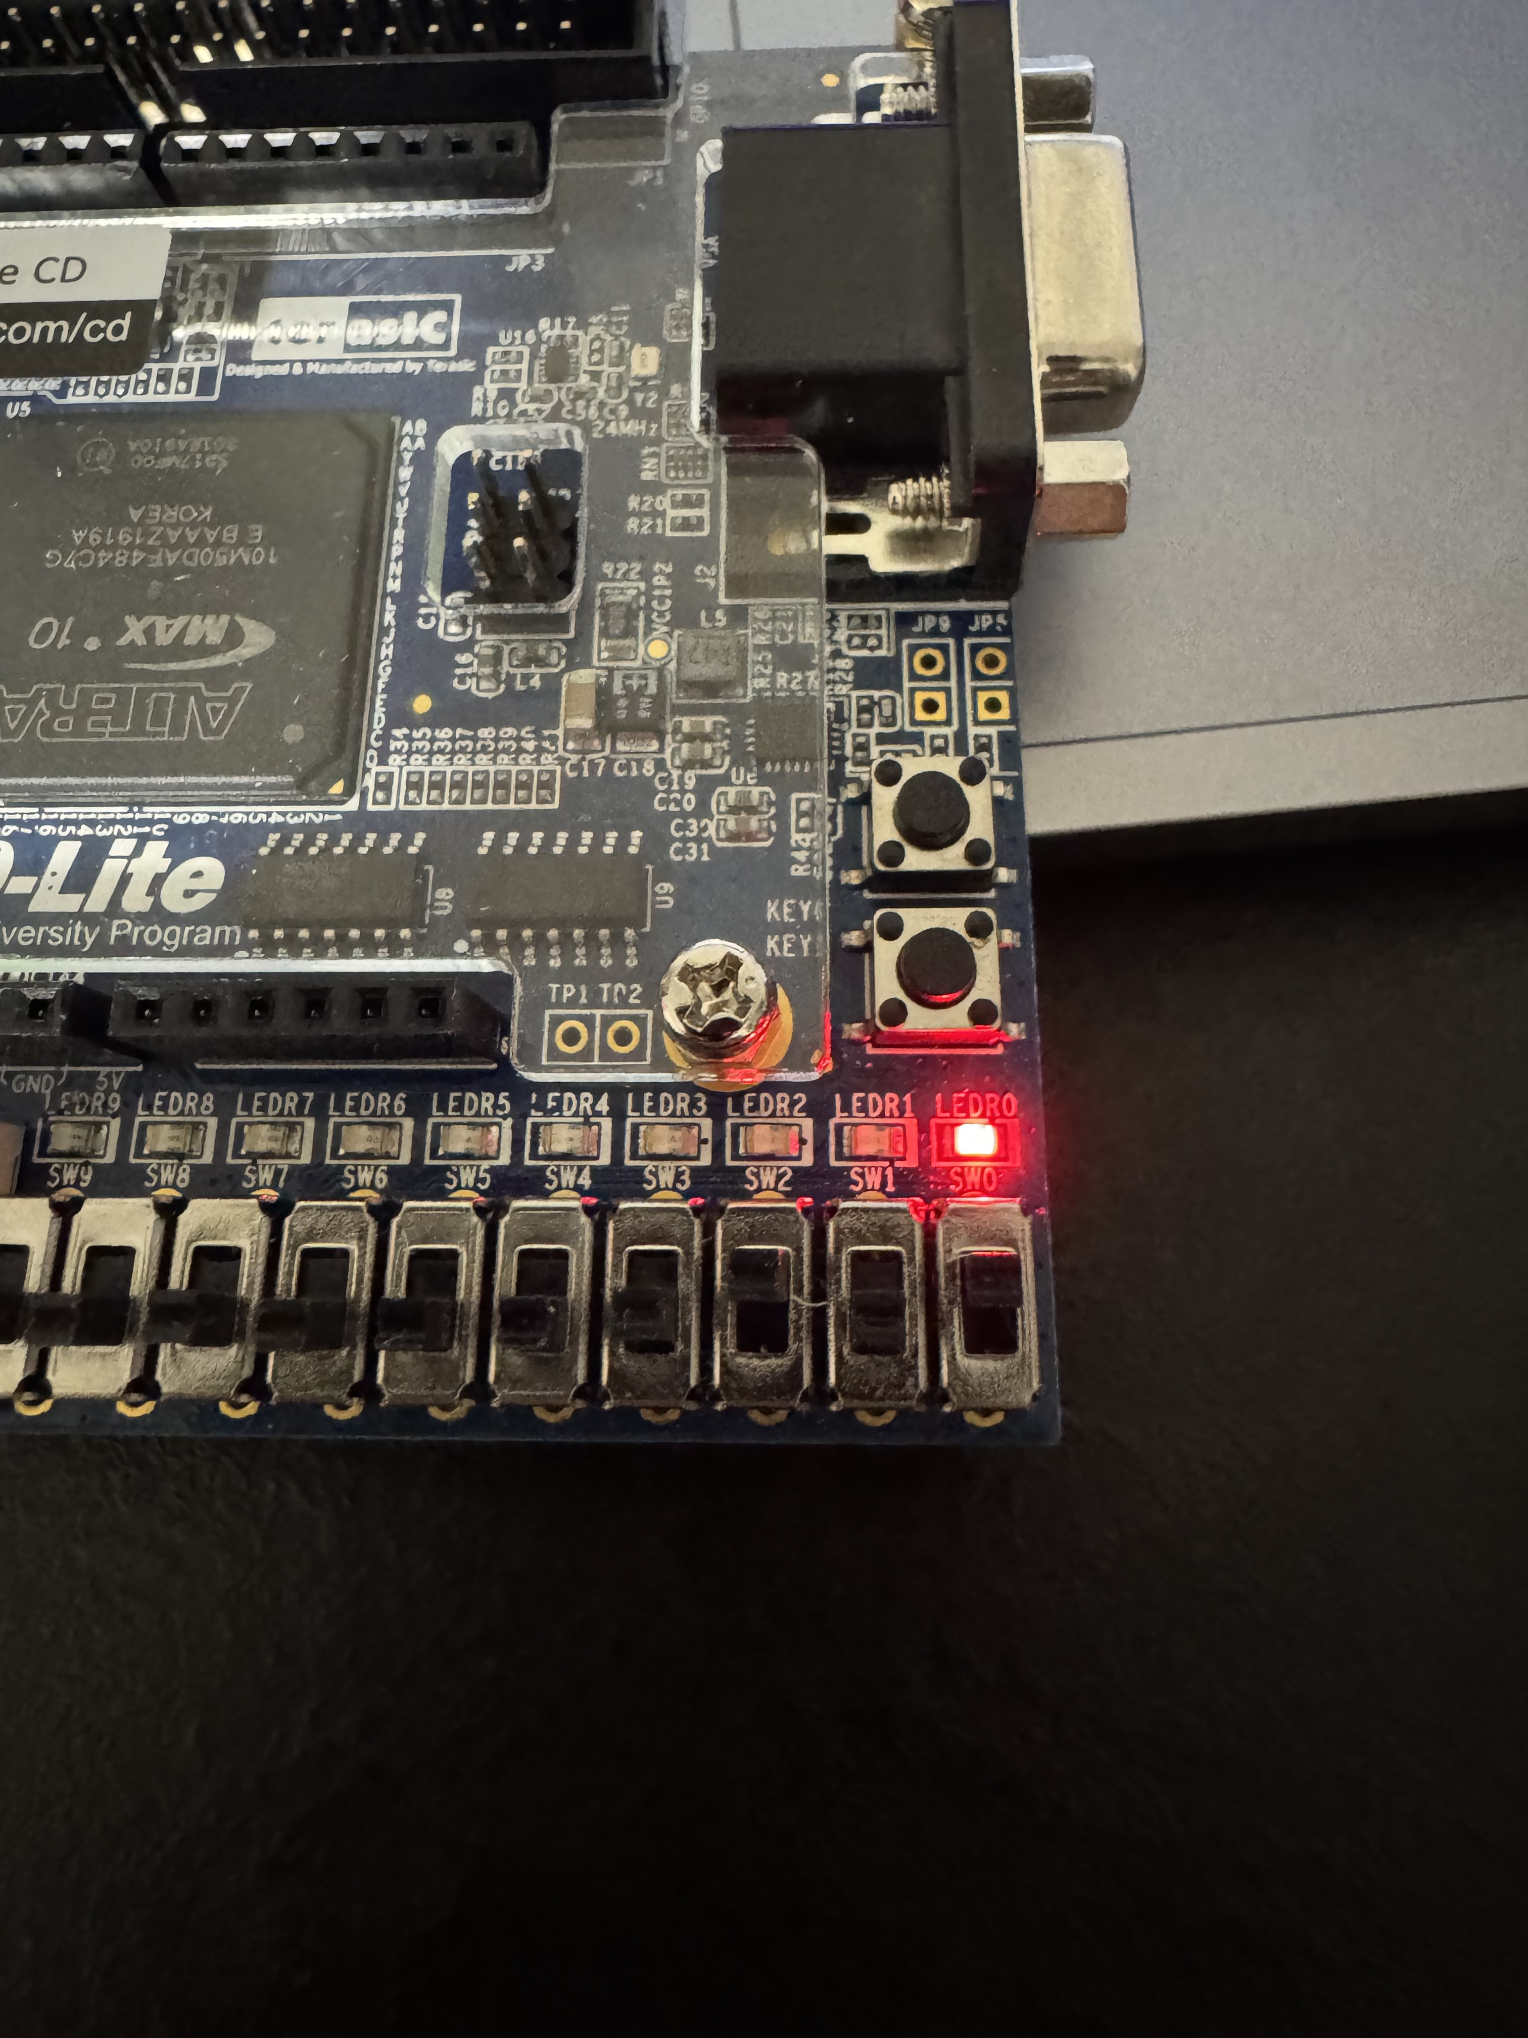

Slide 5
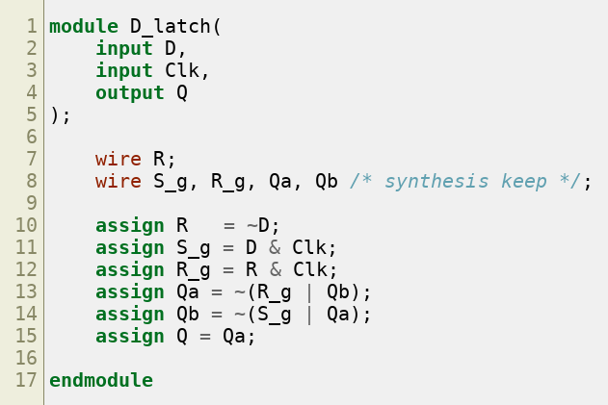
Part II - Gated D Latch
Converted the RS latch into a D latch by using D and its complement to generate the gated S and R inputs.

Slide 6
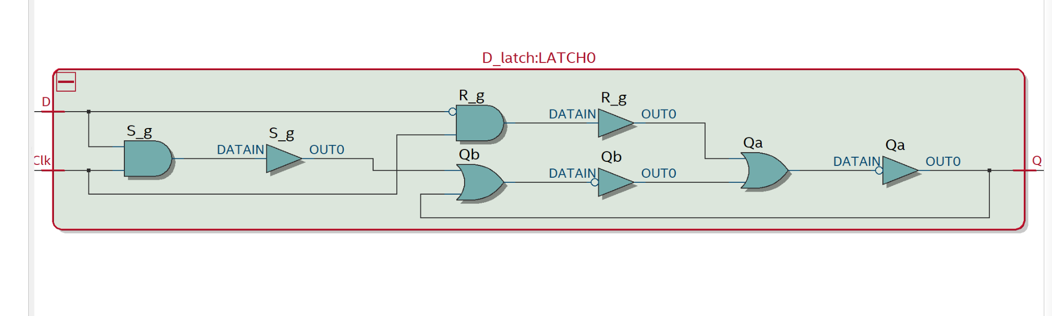
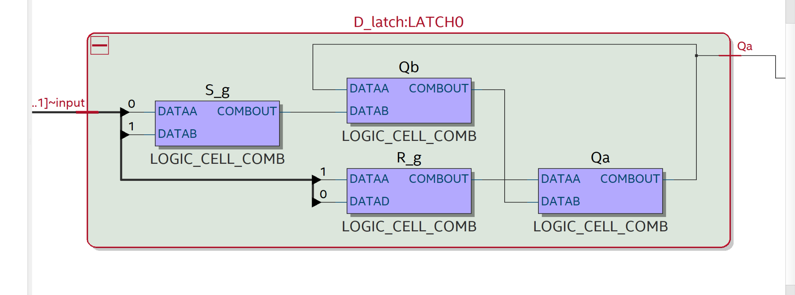
Part II - RTL and Technology Map
The D latch is transparent when Clk = 1 and holds its previous value when Clk = 0.

Slide 7
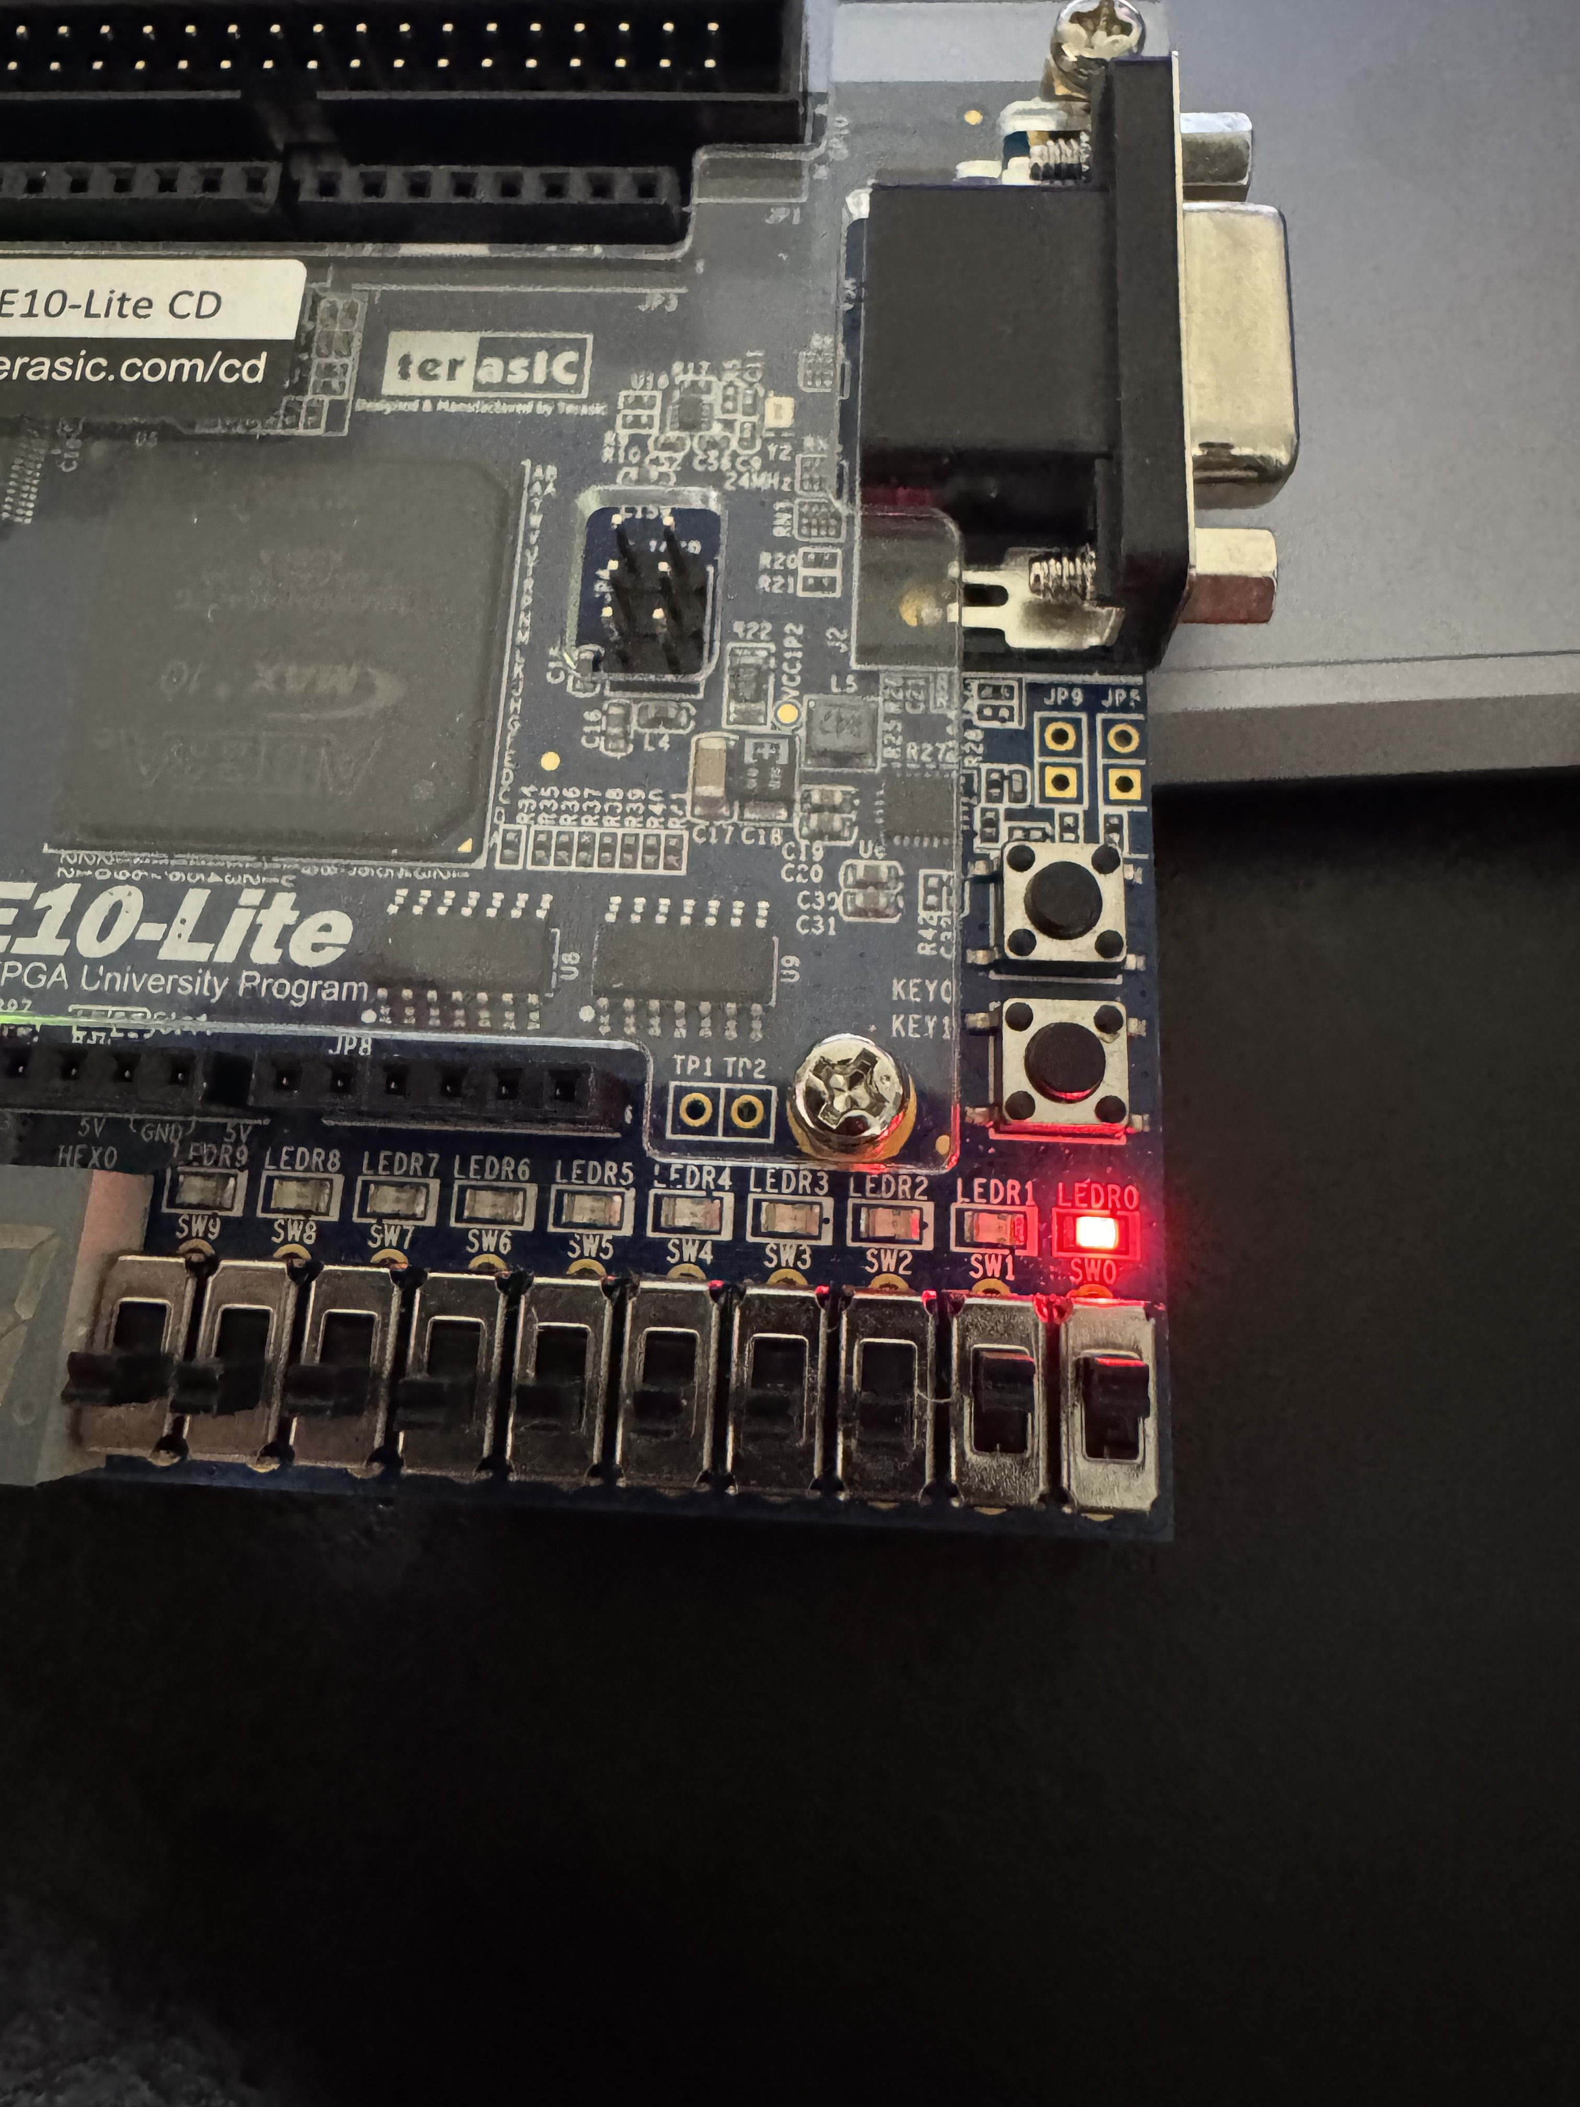

Slide 8
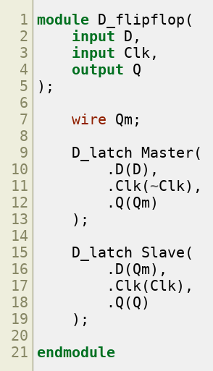
Part III - Master-Slave D Flip-Flop
Built the flip-flop from two D latches: the master uses the inverted clock and the slave uses the normal clock.

Slide 9
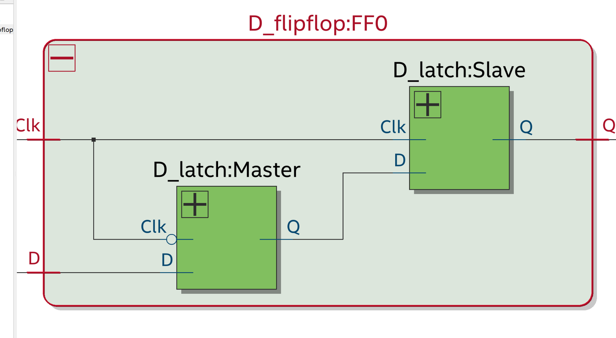
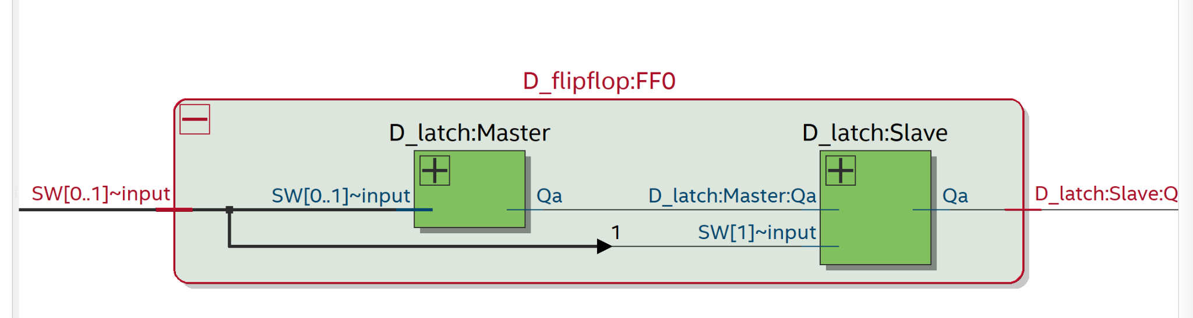
Part III - Master and Slave Latches
RTL and Technology Map both show the two latch stages connected in series to form an edge-triggered storage element.

Slide 10
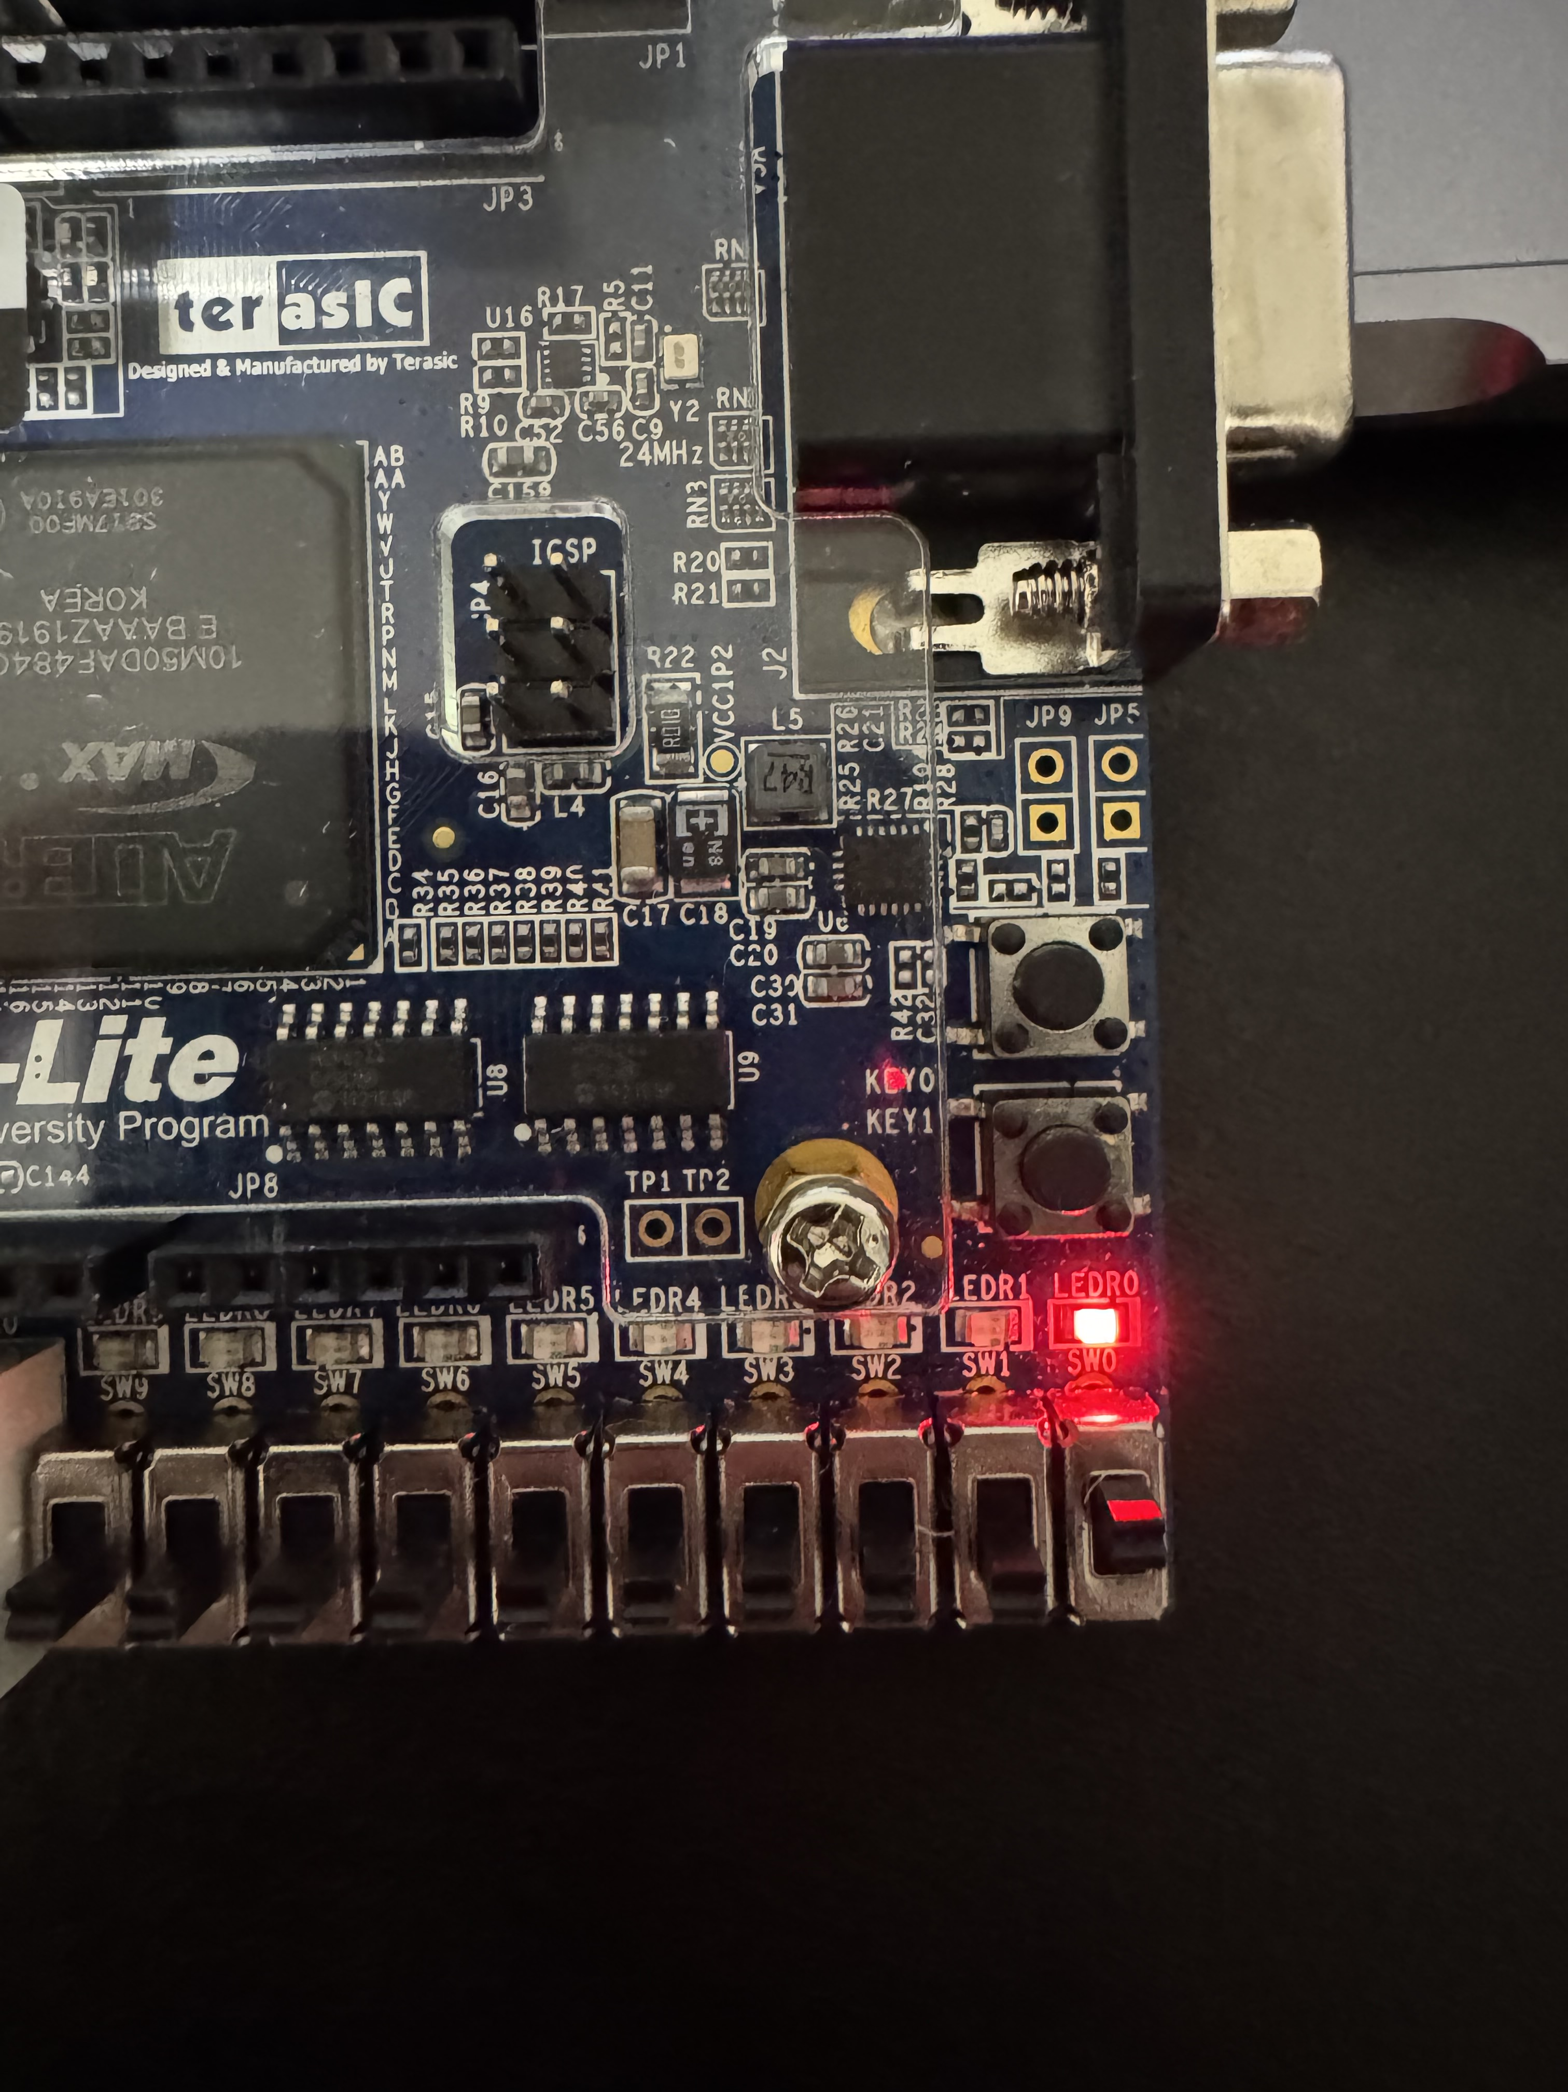

Slide 11
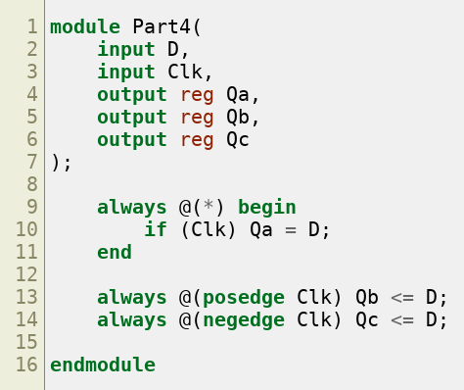
Part IV - Latch and Edge-Triggered Flip-Flops
Behavioral Verilog was used to compare a gated latch, positive-edge flip-flop, and negative-edge flip-flop.

Slide 12
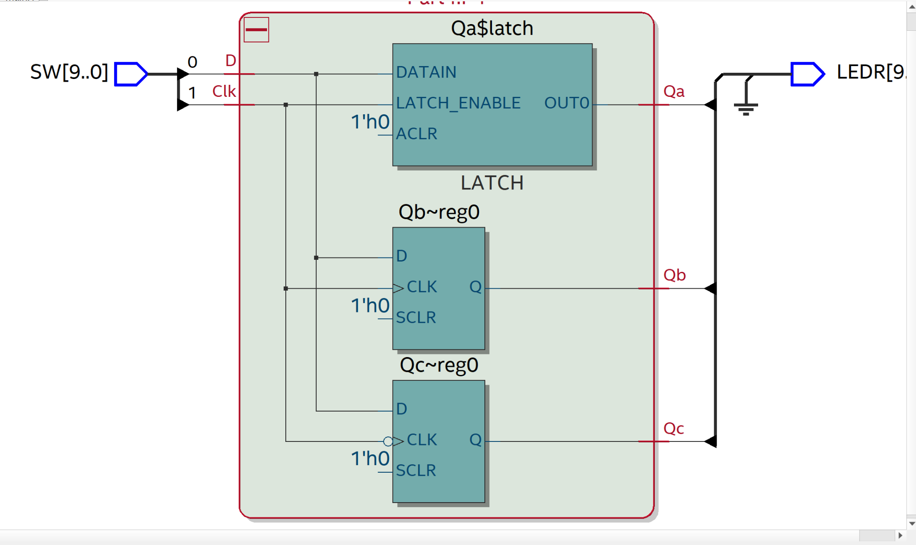
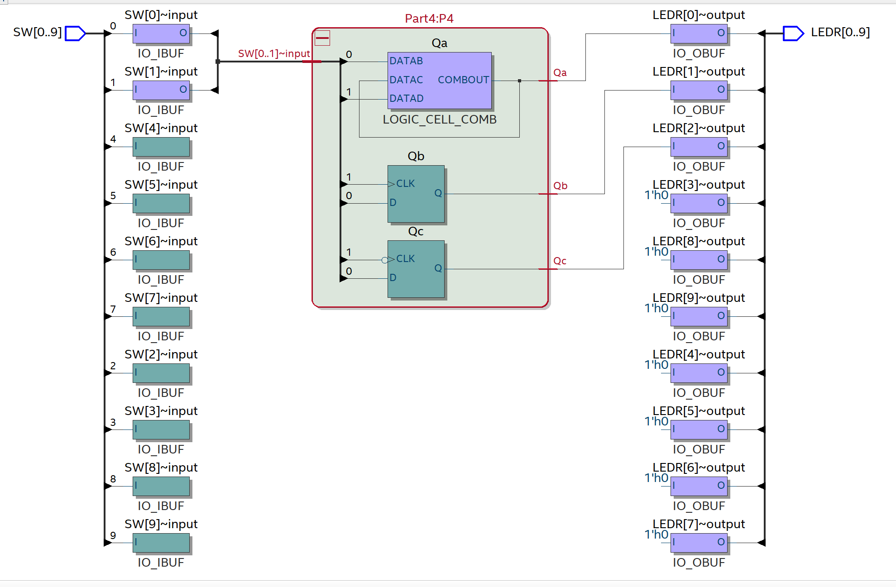
Part IV - RTL and Technology Map
Qa is implemented as a latch, Qb as a positive-edge register, and Qc as a negative-edge register.

Slide 13
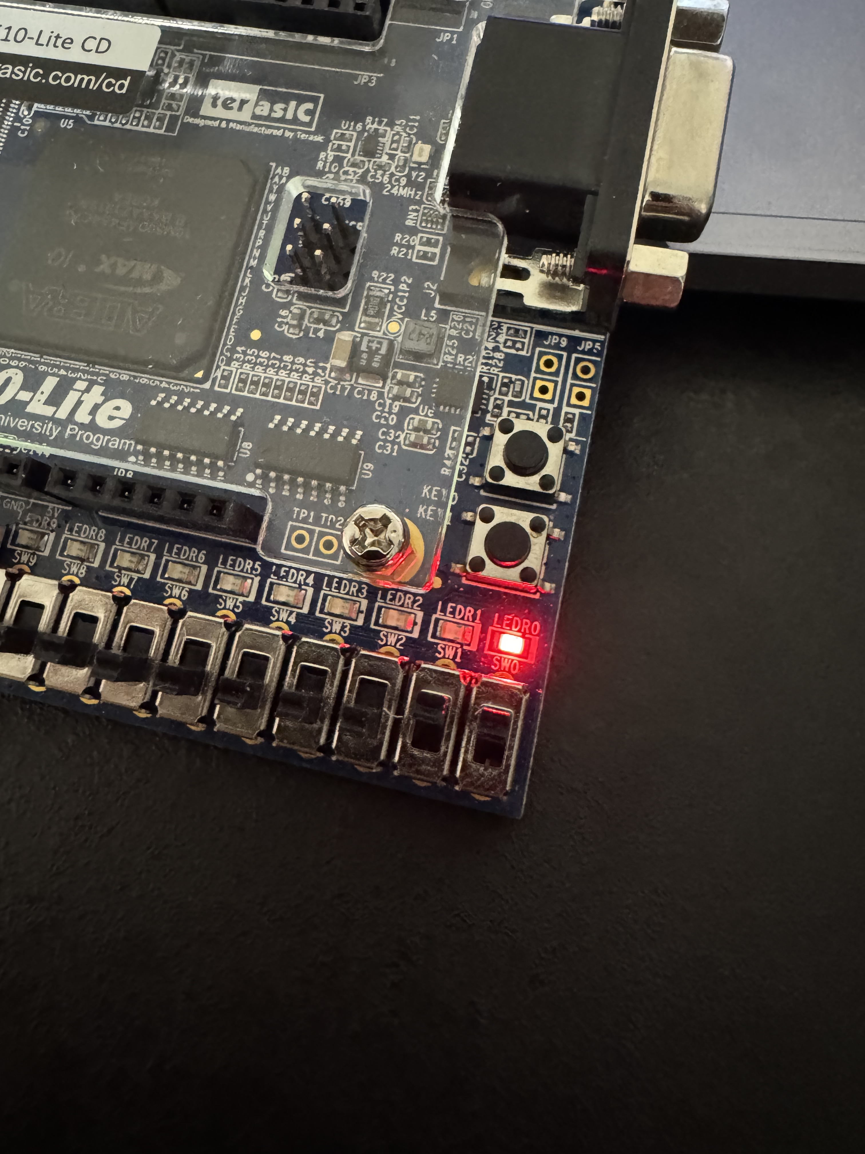

Slide 14
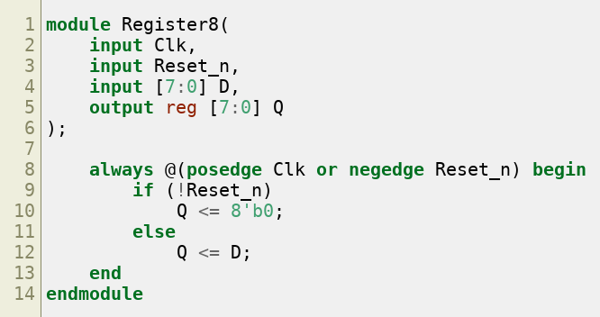
Part V - 8-Bit Register
The register captures SW[7:0] on KEY1 and clears asynchronously when active-low KEY0 is pressed.

Slide 15
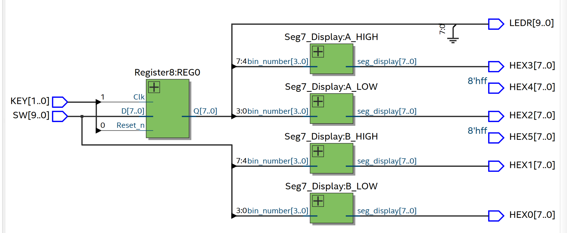
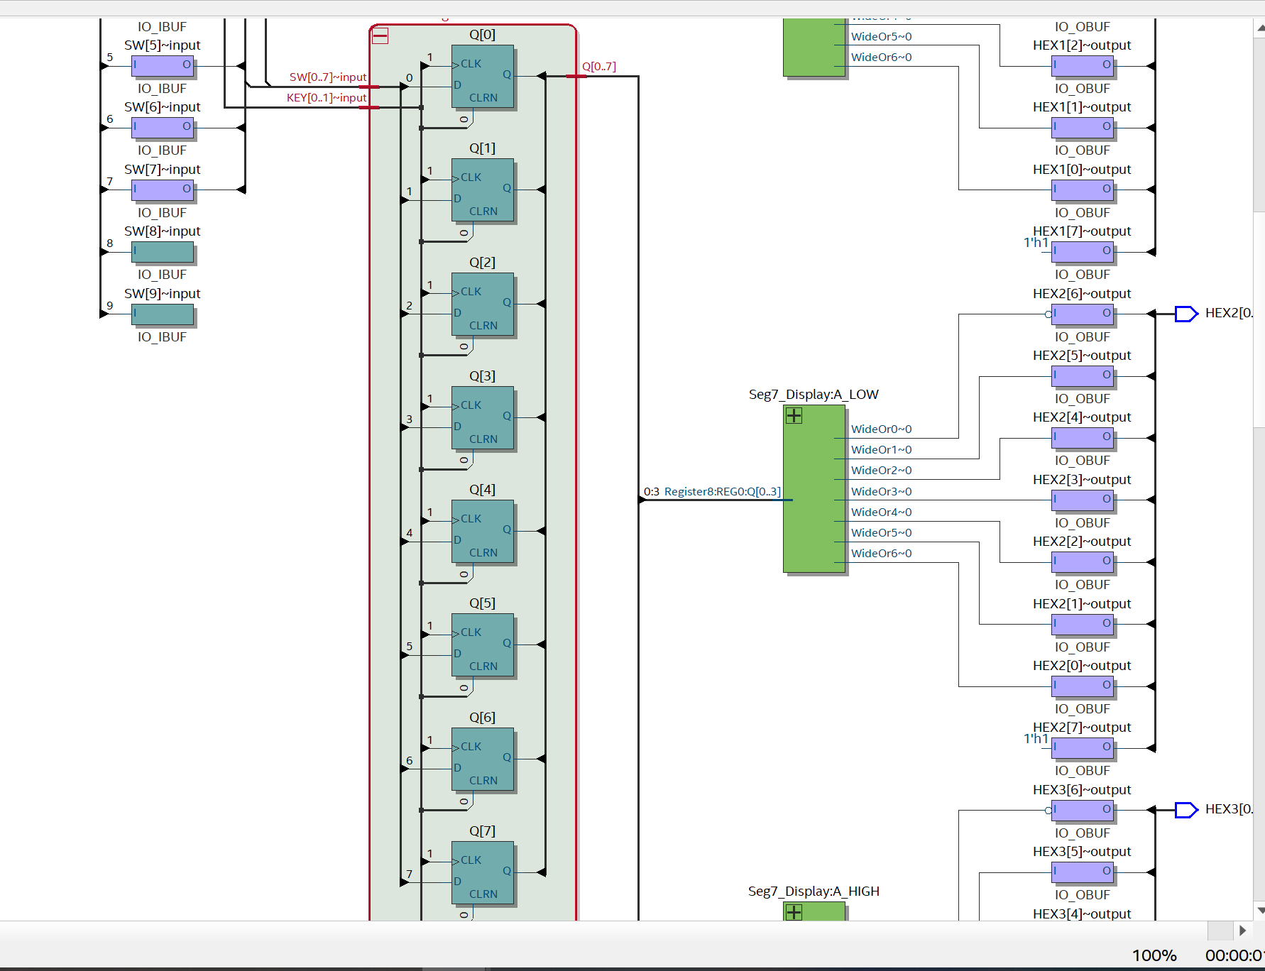
Part V - Register and 7-Segment Displays
HEX1–HEX0 show the current switch value; HEX3–HEX2 show the stored register value. The Technology Map shows eight flip-flop bits.

Slide 16
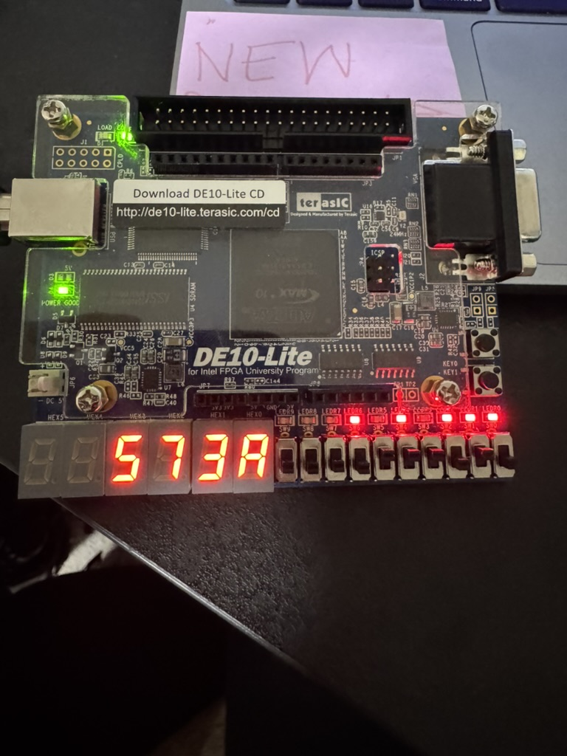

Slide 17
Conclusion
This lab demonstrated the progression from basic latches to edge-triggered flip-flops and registers. RTL Viewer was used to confirm the logic. Technology Map Viewer was used to inspect FPGA implementation, and each design was tested on the DE10-Lite board.

