Slide 1
LAB IV

Slide 2
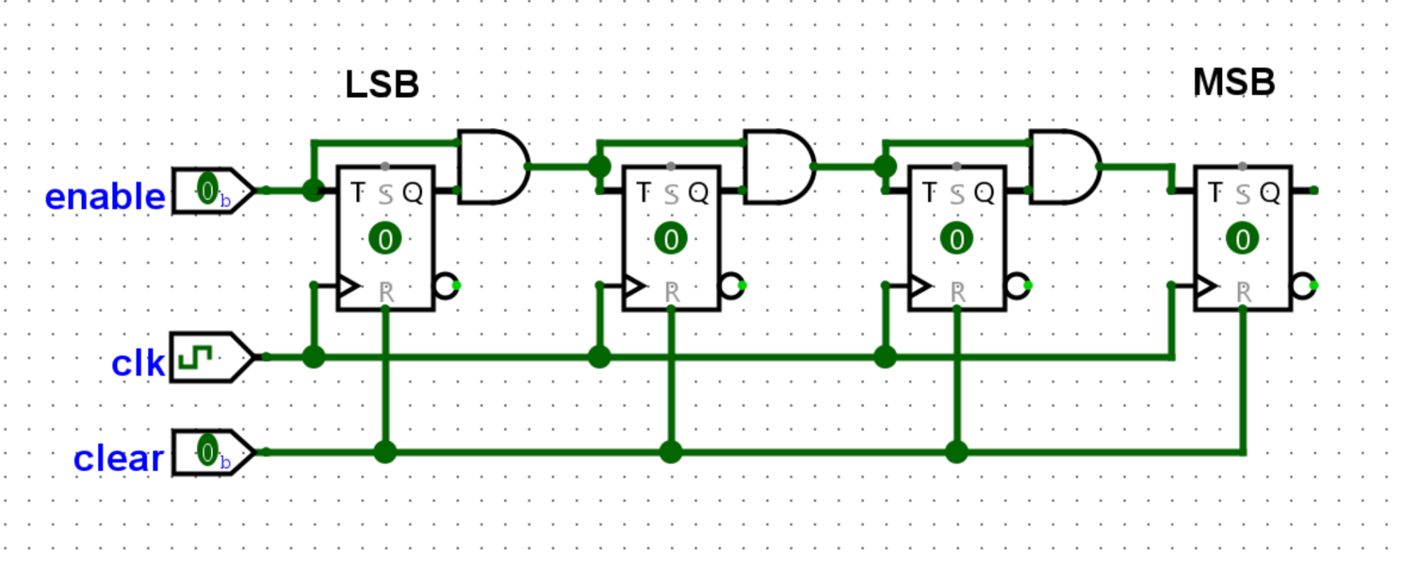
Part I - 8-Bit T Flip-Flop Counter
Built an 8-bit synchronous counter from eight T flip-flops.
Each higher bit toggles only when Enable and all lower order count bits are high.

Slide 3
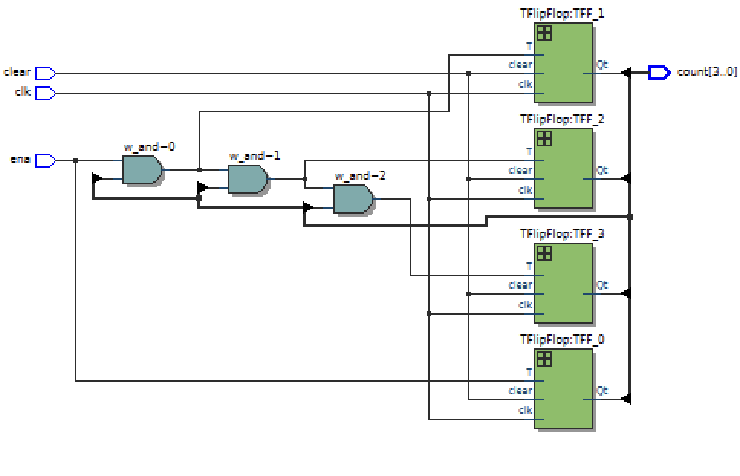
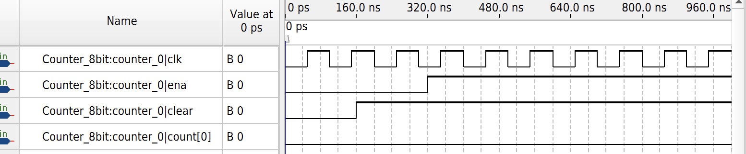
Part I - RTL and Simulation
RTL confirms the the T flip-flop counter. Simulation was used to verify clear, enable, and counting behavior.

Slide 4
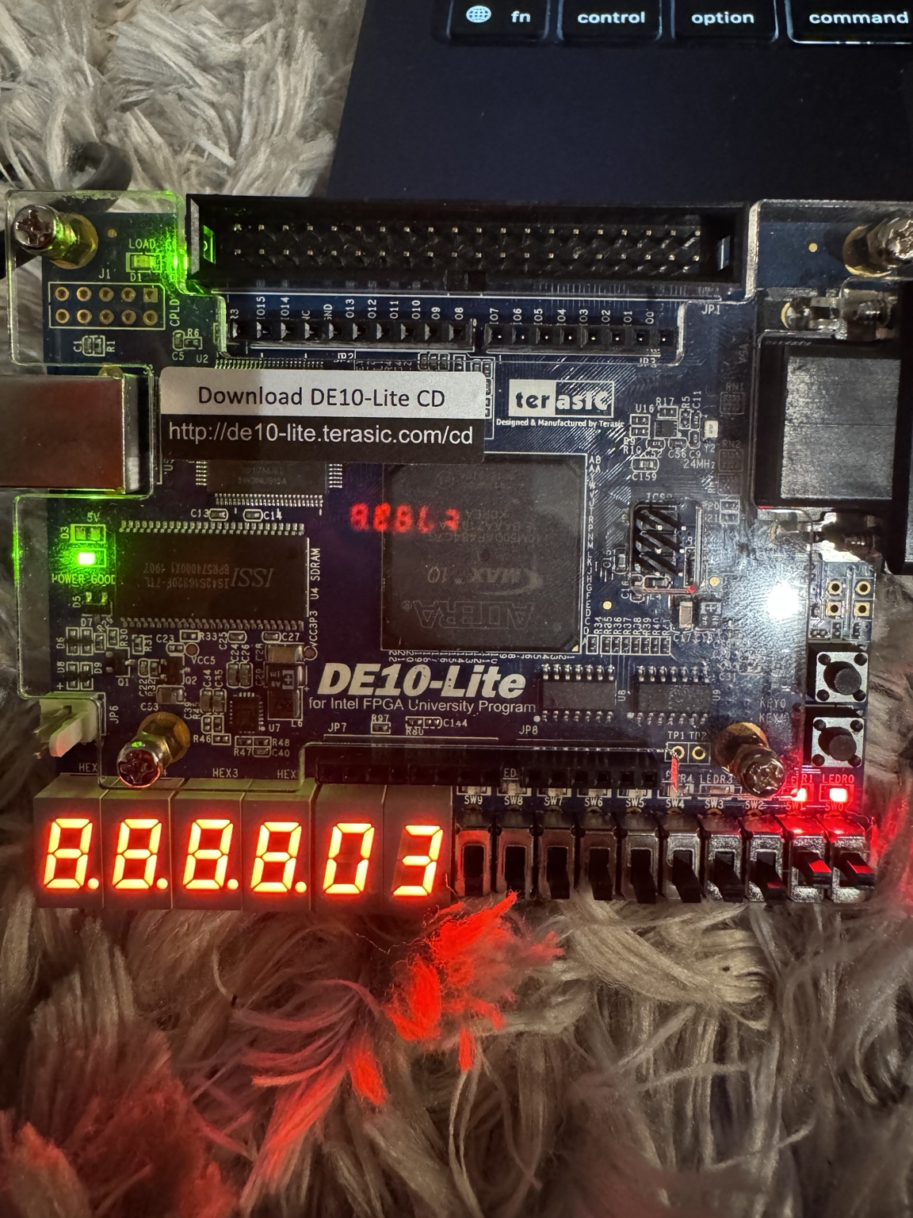

Slide 5
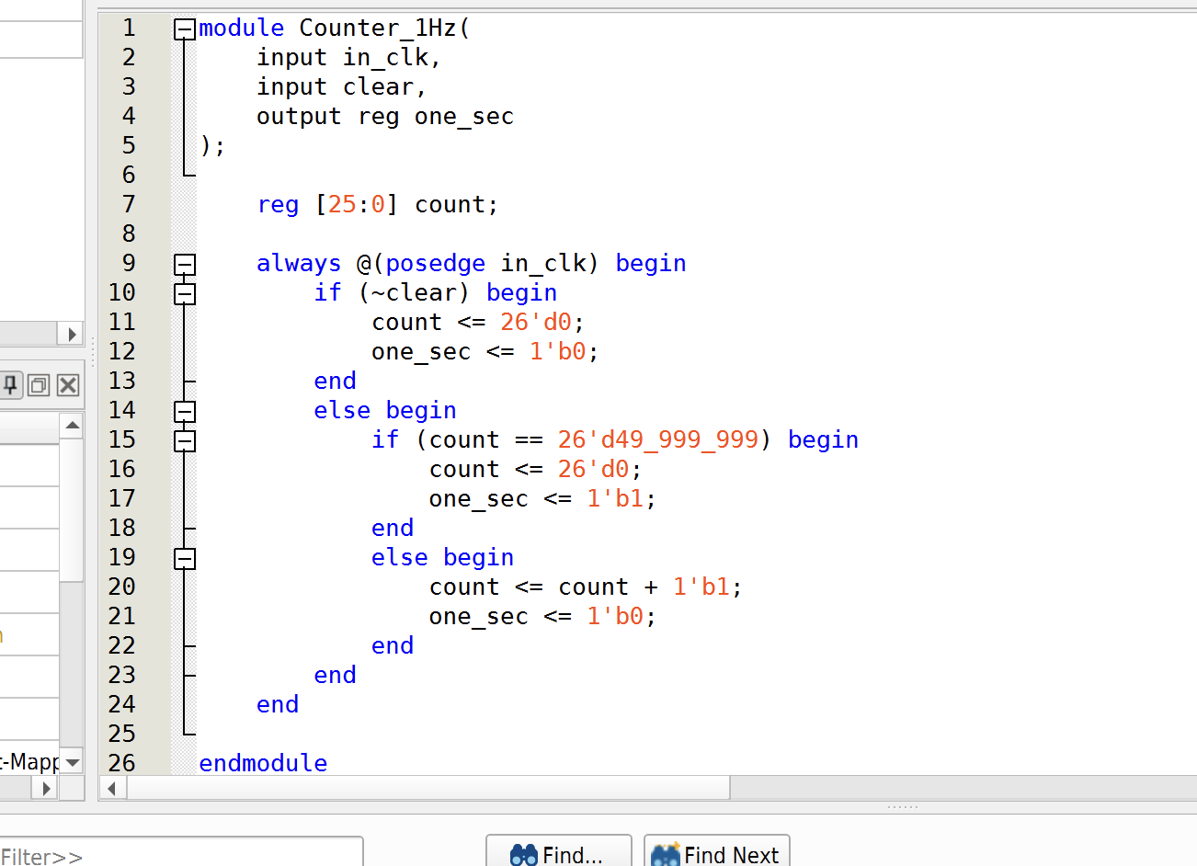
Part II - 16-Bit Behavioral Counter
Implemented a 16-bit synchronous counter behaviorally using Q <= Q + 1 with enable and active-low clear.

Slide 6
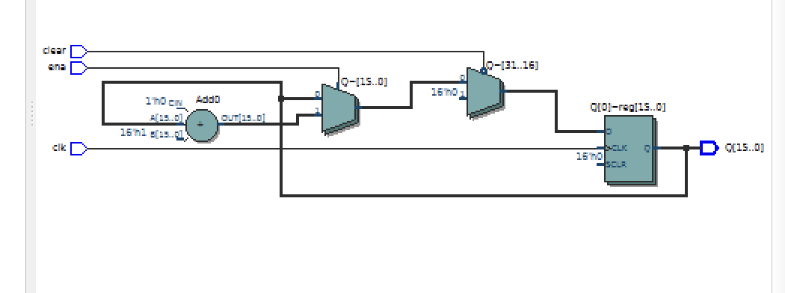
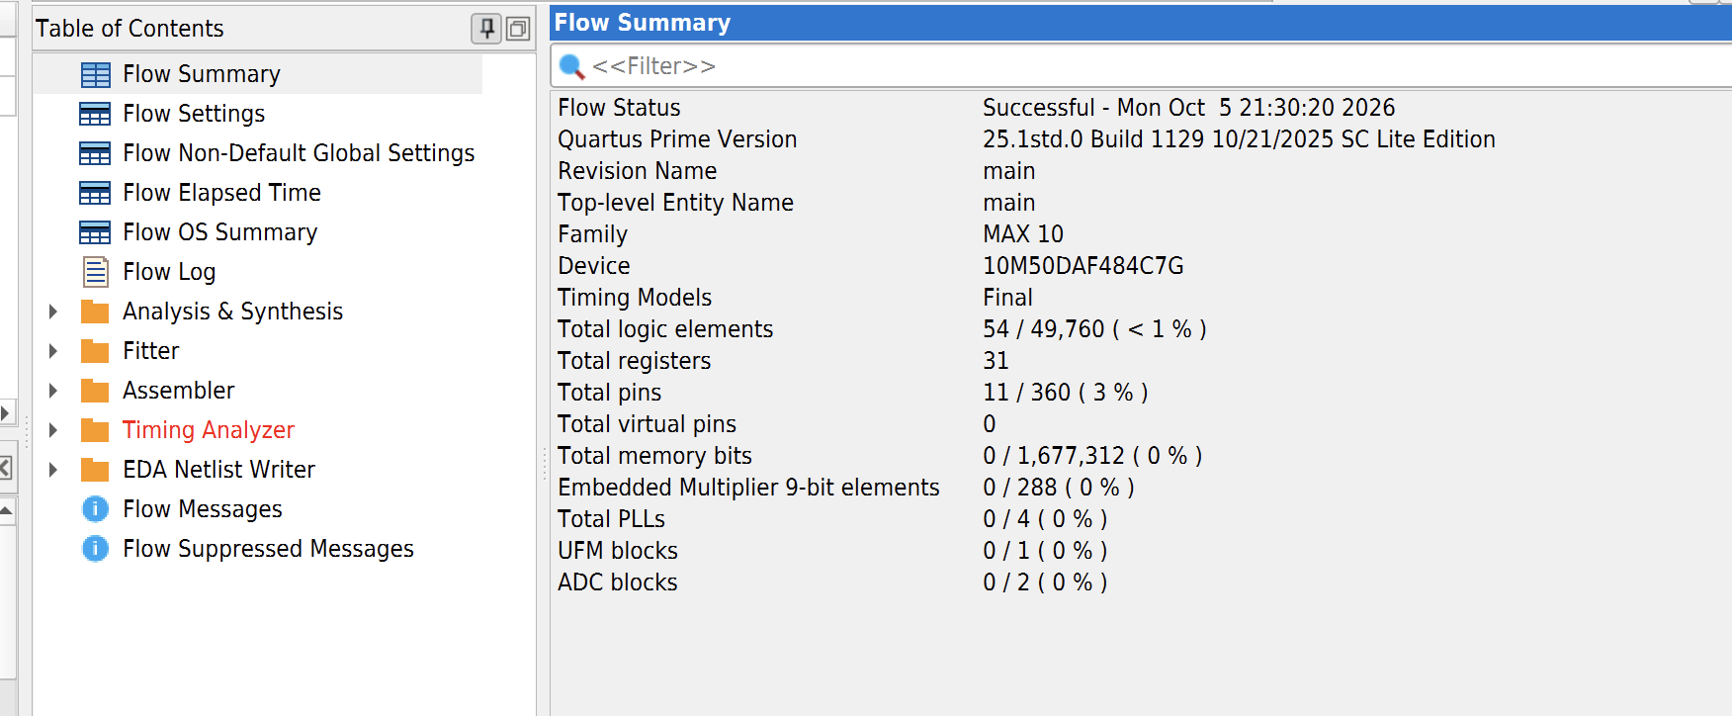
Part II - RTL and Performance
The counter synthesized to 18 logic elements and 16 registers. The measured Fmax was 396.35 MHz.

Slide 8
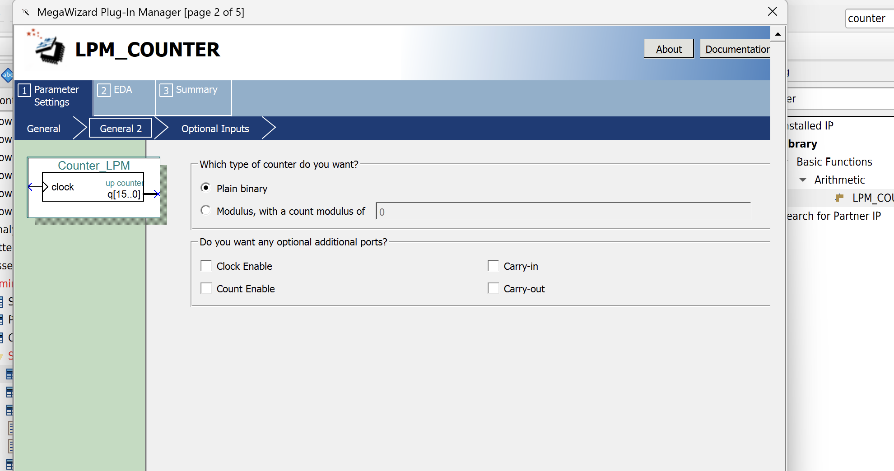
Part III - LPM 16-Bit Counter
Generated a 16-bit LPM_COUNTER with count enable and synchronous clear using the Quartus IP.

Slide 9
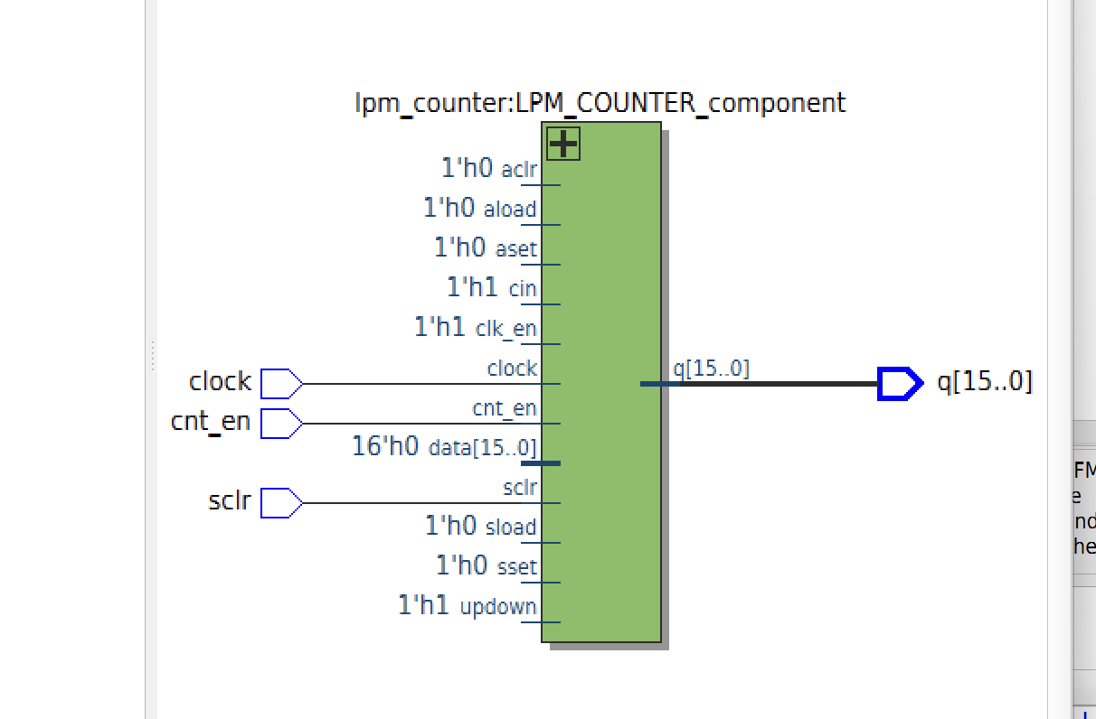
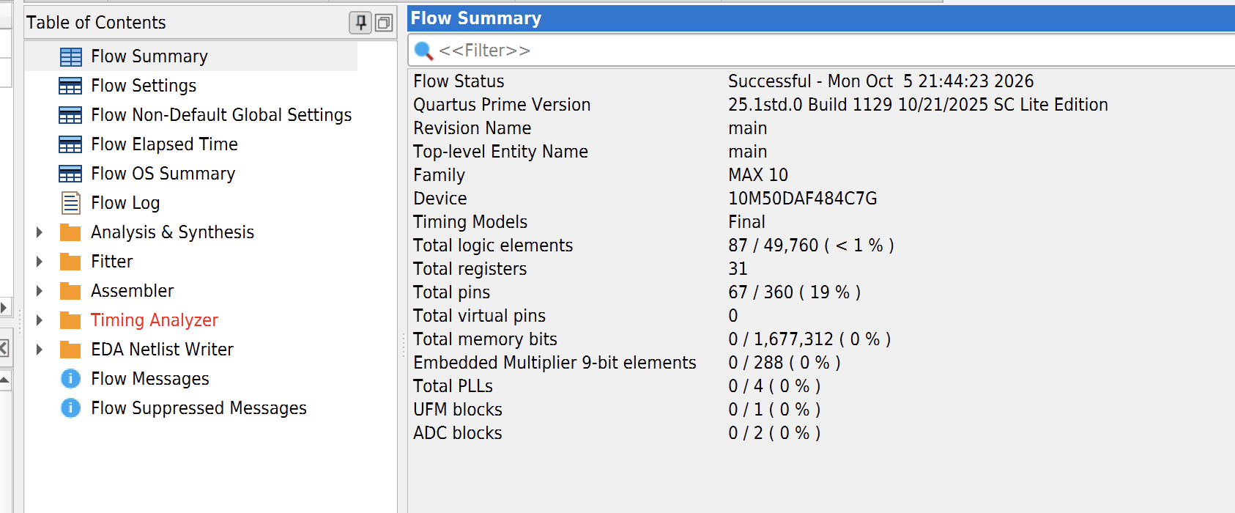
Part III - LPM Configuration and RTL
The LPM counter synthesized to 18 logic elements and 16 registers with an Fmax of 438.79 MHz,
higher than the behavioral implementation.

Slide 11
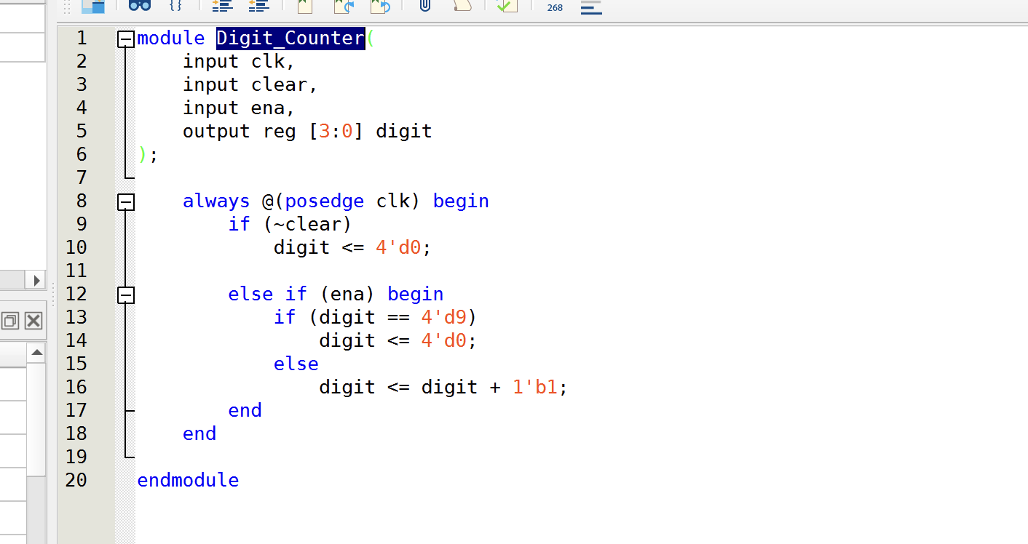
Part IV - 0-9 One-Second Counter
Used the 50 MHz board clock with a one-second enable pulse to the digit goes from 0 through 9 once per second.

Slide 12
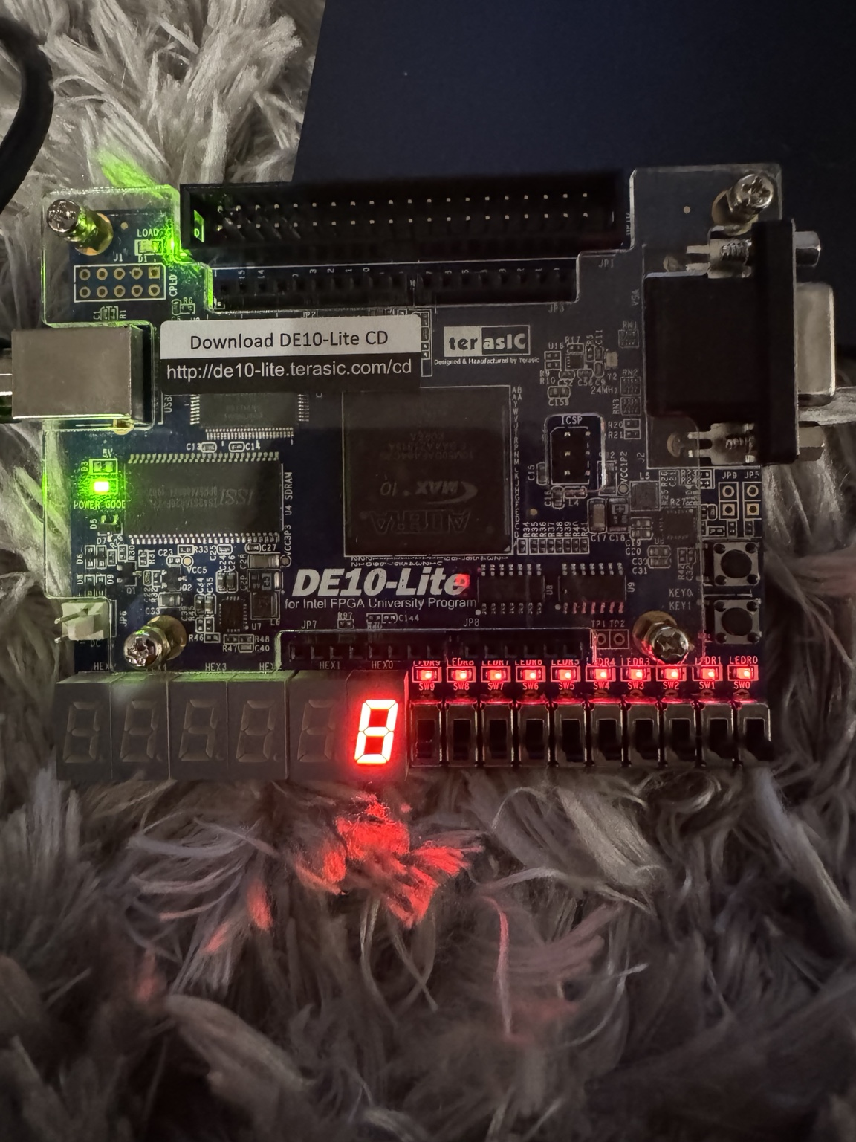
Part IV - Counter Implementation
Counter_1Hz generates the one-second enable while Digit_Counter goes from 9 back to 0.
The FPGA clock remains as 50 MHz clock.

Slide 14
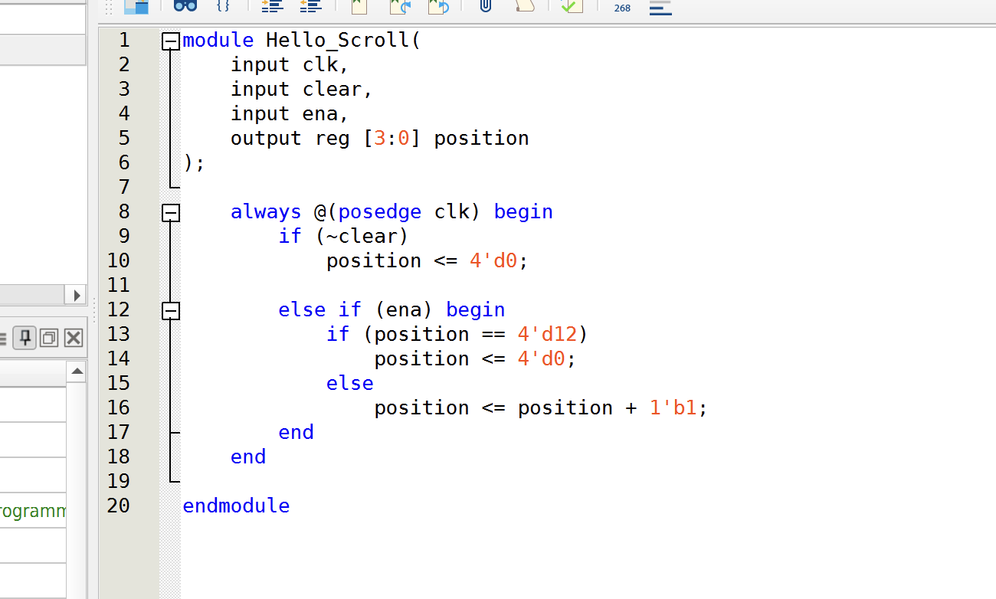
Part V - Scrolling HELLO
Extended the one-second counter concept to scroll HELLO across the seven-segment displays.

Slide 15
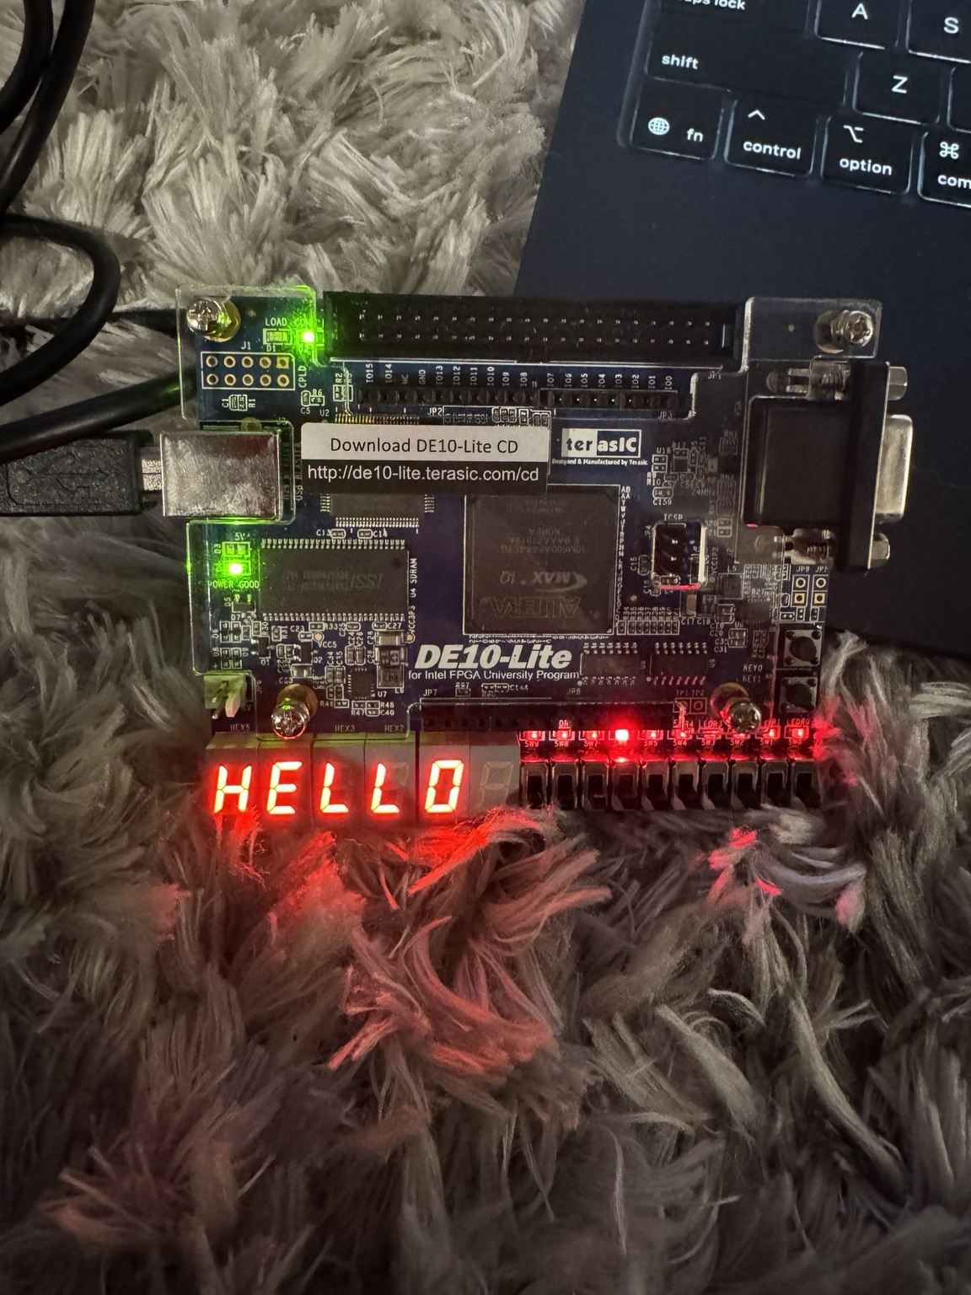
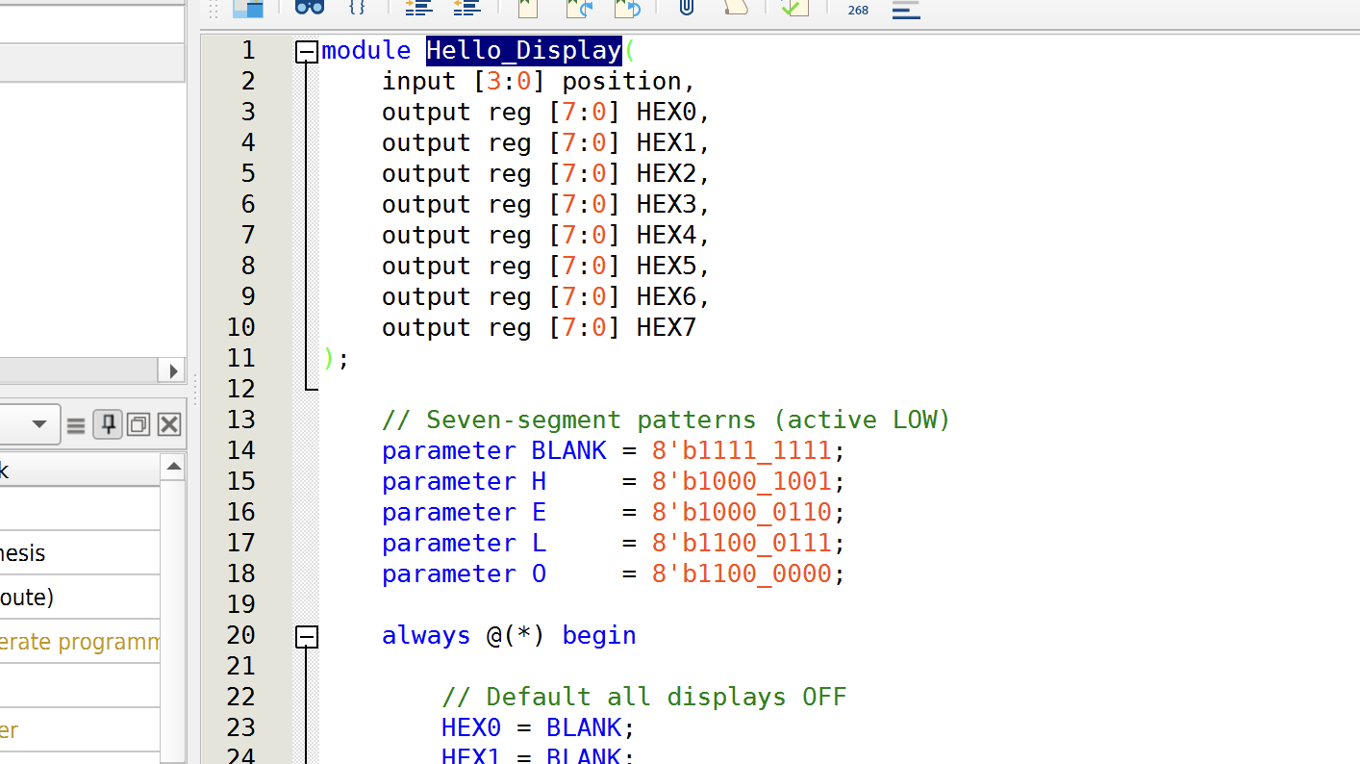
Part V - HELLO Display Implementation
Hello_Scroll controls the display position while Hello_Display maps H, E, L, L, O to active-low across HEX7–HEX0.

Slide 17
Conclusion
This lab compared the behavioral and LPM counter implementations. RTL Viewer and timing reports were used to be able to analyze each design, while the DE10-Lite board verified the 0-9 one-second counter and scrolling HELLO display. The LPM implementation got the highest measured Fmax of the 16-bit counters.

