Slide 1
LAB
VI

Slide 2
Lab VI - UART Overview
async_receiver
byte + ready
FSM +
5 s counter
char2seg
RXD
PC / PuTTY
LC234X
USB-UART
USB
echo byte
LEDR[7:0]
HEX0
TXD
async_transmitter
The DE10-Lite receives the 8 bit ASCII characters from PuTTY at a 115200 baud. The received byte is then echoed backwards to show on the LEDR[7:0], HEX0, and held by the FSM until the five-second timer ends

Slide 3
Async_receiver Explanation
Idle
Start
D0
D1
D2
D3
D4
D5
D6
D7
Stop
Synchronize
RX input
Sample bits
at 8x baud
Shift 8 bits
into RxD_data
Check stop bit
& pulse ready
The receiver watches for the low start bit, samples the eight UART data bits first, and checks the high stop bit. When a byte is complete then RxD_data keeps the character and RxD_data_ready pulses for one clock cycle

Slide 4
Async_transmitter Explanation
TxD_start
+ TxD_data
Load 8 bit
shift register
Baud tick
115200
Start + 8 data
+ 2 stop bits
TxD
GPIO[33]
UART frame: start -> bit 0 -> bit 1 -> ... -> bit 7 -> stop 1 -> stop 2
When TxD_start is started, the transmitter loads the TxD_data and sends a UART frame. The receiver ready pulse starts the transmitter, so each character is sent back to the PC as an echo

Slide 5
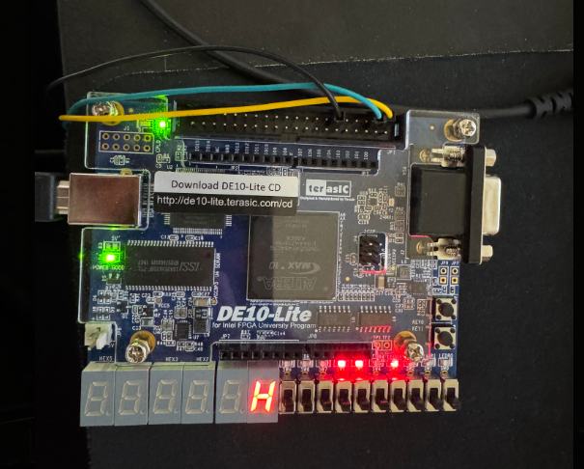
char2seg Explanation
8-bit ASCII
character
converted
to lowercase
case table selects
segment pattern
active-low
HEX0[7:0]
Character
ASCII
HEX0 pattern
H
0x48
10001001
char2seg is a combinational logic that maps ASCII codes to the DE10-Lite active-low seven segment display. Letters are approximated because a seven-segment display cannot make every letter exactly

Slide 6
FSM Explanation
rx_ready = 1
capture rx_data
IDLE
Display blank
HOLD
Display character
timeout = 1
clear display
No rx_ready in IDLE:
remain blank
New rx_ready while in HOLD:
update character + restart timer
The FSM has two states. IDLE waits for a character while HOLD keeps that character on the LEDs and HEX0. A new character replaces the old one and restarts the timer; when timeout is triggered, the display is cleared and the FSM returns back to IDLE

Slide 7
5-Second Counter Explanation
50,000,000 clocks / second × 5 seconds = 250,000,000 clock cycles
50 MHz
MAX10_CLK1_50
28-bit counter
0 -> 249,999,999
done = 1
at terminal count
FSM clears
display
2²⁷ = 134,217,728 < 250,000,000 < 2²⁸ = 268,435,456
So, a 28 bit register is needed.
The timer uses the original 50 MHz board clock rather than creating a new clock so clear resets the count when the FSM is idle or when a new UART character is pressed, so every new character receives a fresh five-second display interval

Slide 8
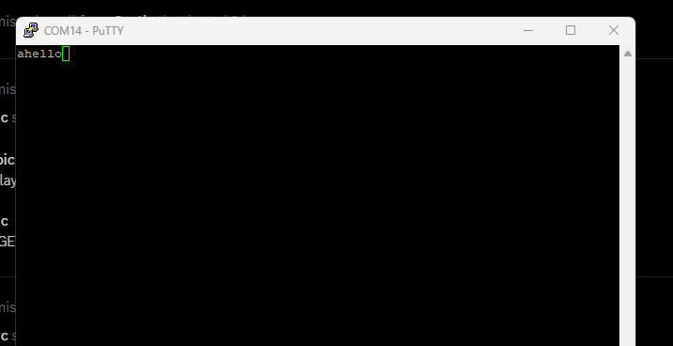
UART Hardware Setup and PuTTY
PuTTY: Serial, COM14, 115200 baud
LC234X UART connected to DE10-Lite GPIO
The PC communicates through the LC234X USB-UART adapter. FPGA RX is GPIO[35] and FPGA TX is GPIO[33]. PuTTY is configured for the adapter COM port14 at 115200 baud.

Slide 9
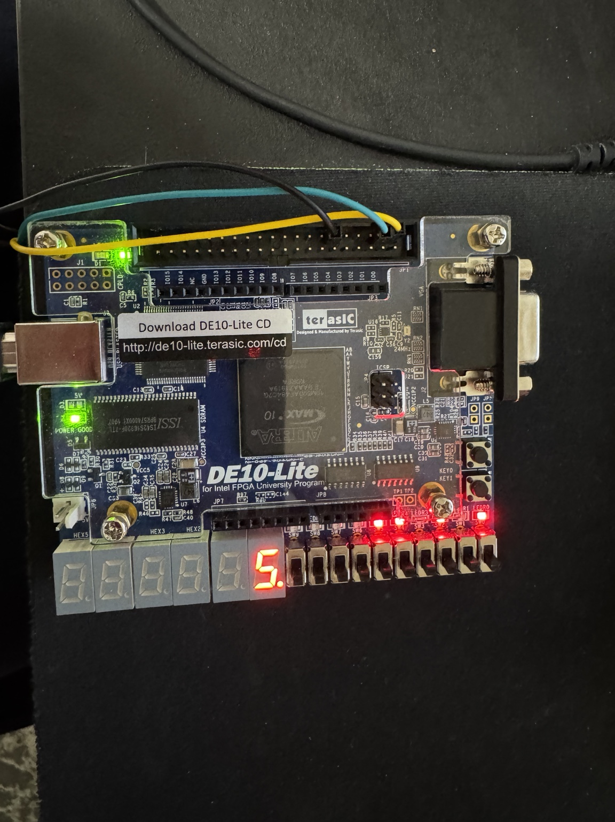
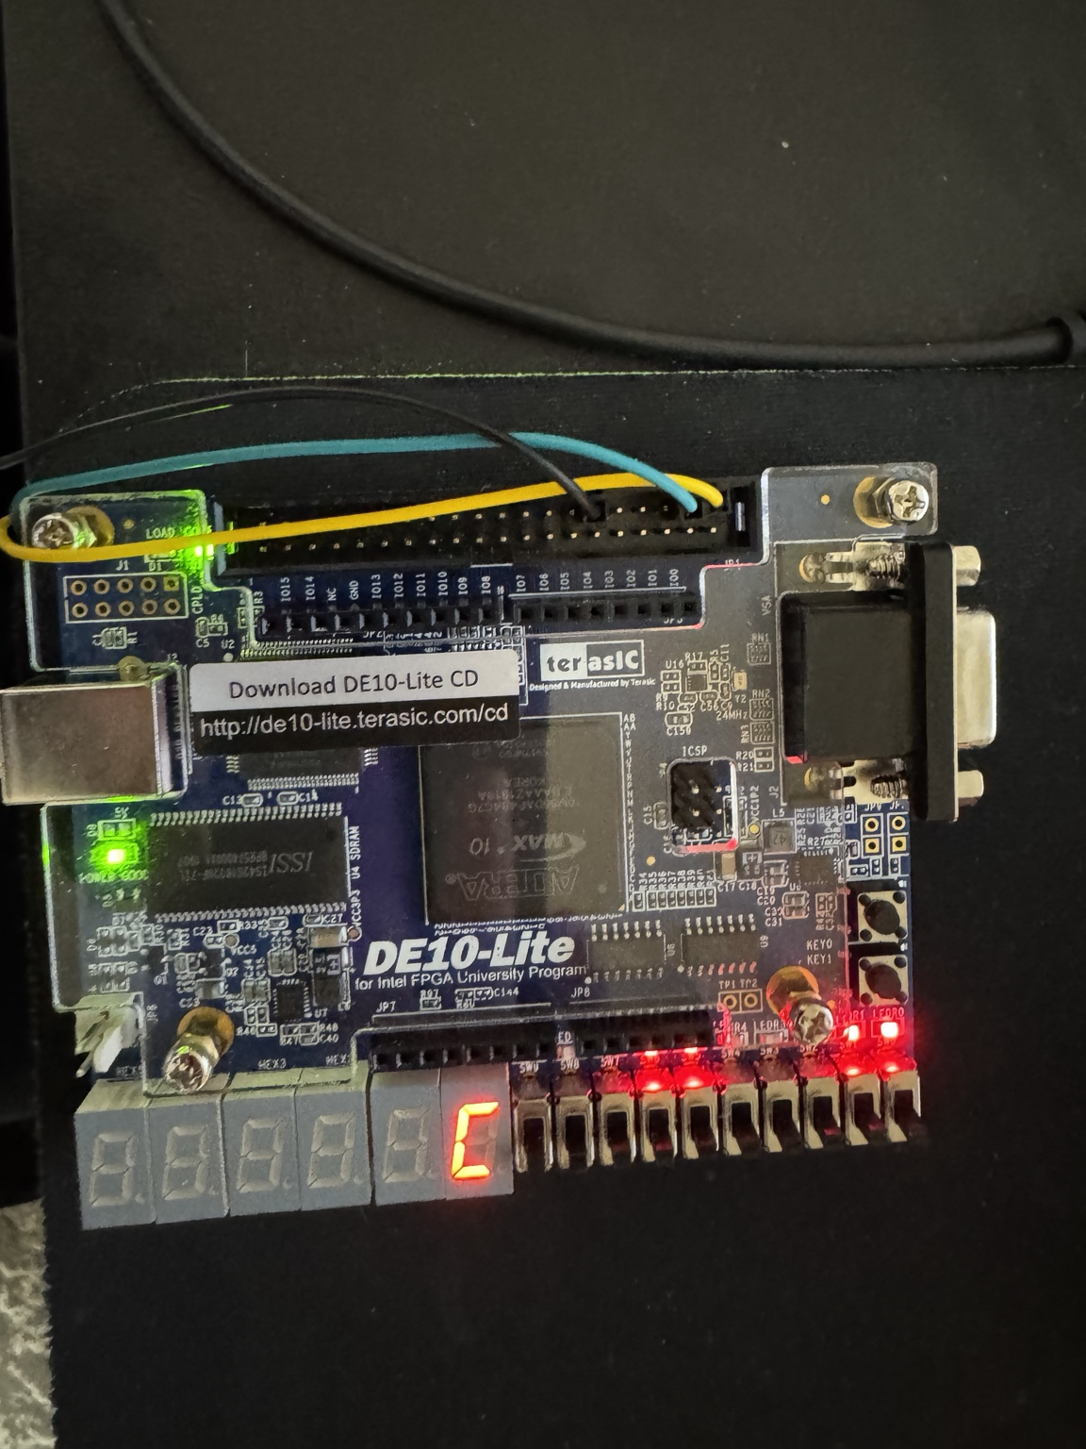
Character Receive and Display Verification
H
5
C
Multiple characters were sent from PuTTY and correctly showed on the HEX0. LEDR[7:0] also showed the ASCII byte in binary.

Slide 10
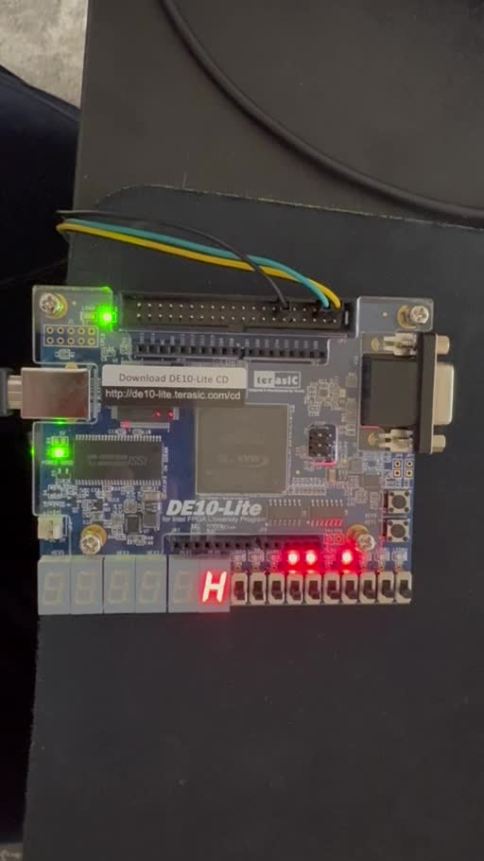
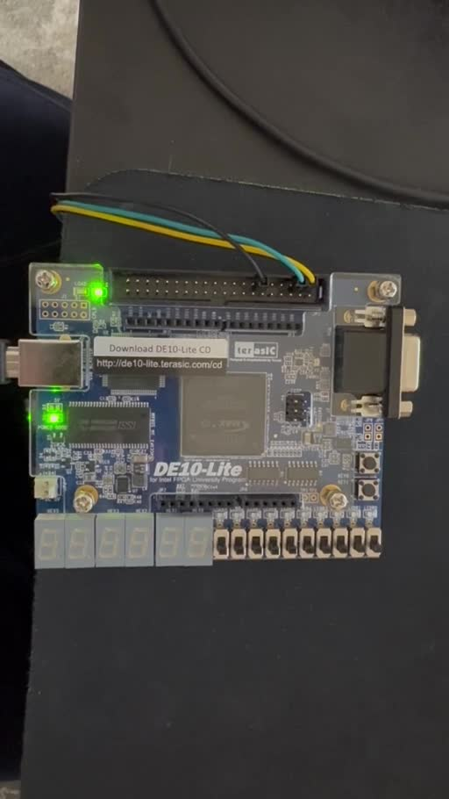
FSM and 5-Second Timeout Verification
timeout
Character displayed
Display cleared automatically
The working system two clips show a received character being held on HEX0 and then automatically clearing after the timer interval. This verifies the HOLD-to-IDLE FSM transition and the five-second counter behavior on the DE10-Lite

Slide 11
Conclusion
This lab used UART on the DE10-Lite using Verilog. The async_receiver converted the data from PuTTY into an 8-bit ASCII byte, while the async_transmitter returned the data. Char2seg converted the received character for HEX0 and LEDR[7:0] showed the byte in binary. A two-state FSM and a 28-bit counter were made so each received character stayed on for about five seconds before the display cleared. Hardware testing showed multiple characters on HEX0 and confirmed that the timed display turned off automatically.

