Slide 1
LAB
VII

Slide 2
Lab VII - Microcontroller Overview
DE10-Lite FPGA
Program
Counter
ROM
8 × 8
Instruction
Register
FSM
Controller
ALU +
Registers
→
→
→
→
SW[3:0]
Input
KEY1
Clock
HEX / LEDR
Output
A four-bit microcontroller fetches eight-bit instructions from ROM, decodes them through an FSM, and executes them using the ALU and registers. KEY1 advances each FSM phase.

Slide 3
Accumulator A and Accumulator B
Accumulator A
Accumulator B
Internal Bus
4-bit A
Accumulator A
LatchA
Internal Bus
4-bit B
Accumulator B
LatchB
→
→
if (LatchA)
AluA <= A;
IB_BUS = EnableA ? AluA : 4'bzzzz;
if (LatchB)
AluB <= B;
// B is supplied to the ALU
Accumulator A stores the result and can drive the internal bus. Accumulator B stores the operand used by the ALU. Both latch data on the clock when enabled.

Slide 4
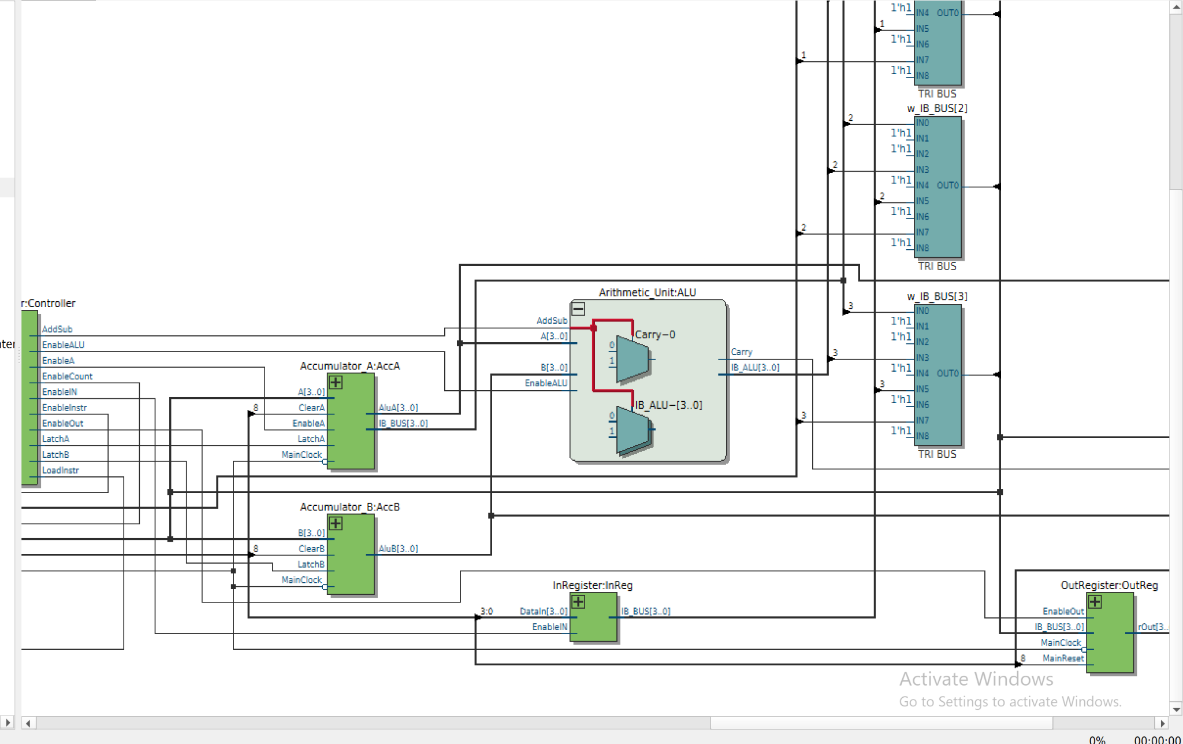
Arithmetic Logic Unit (ALU)
AddSub = 0 : A + B
AddSub = 1 : A − B
if (AddSub)
{Carry, IB_ALU} = A - B;
else
{Carry, IB_ALU} = B + A;
The four-bit ALU performs addition or subtraction using Accumulator A and Accumulator B. The subtraction order was corrected to A − B before the successful board demonstration.

Slide 5
Input Register and Output Register
Input Register
Output Register
SW[3:0]
EnableIN
→ IB_BUS
IB_BUS
EnableOut
→ HEX5 / LEDs
→
→
assign IB_BUS = EnableIN
? DataIn : {N{1'bz}};
if (MainReset) rOut <= 0;
else if (EnableOut)
rOut <= IB_BUS;
The input register places SW[3:0] on the internal bus during IN. The output register captures the bus during OUT and holds the last value on HEX5 and LEDR[3:0].

Slide 6
Instruction Register and Program Counter
Instruction Register
Program Counter
ROM
8-bit word
Opcode [7:4]
Operand [3:0]
EnableCount
from FSM
Counter[2:0]
→ ROM
→
→
if (LatchInstr) begin
ToInstr <= Instr;
r_data <= Data;
end
if (ClearCounter) Counter <= 0;
else if (EnableCount)
Counter <= Counter + 1;
The instruction register latches the ROM and four-bit operand. The program counter increments when EnableCount is asserted, then selects the next ROM address.

Slide 7
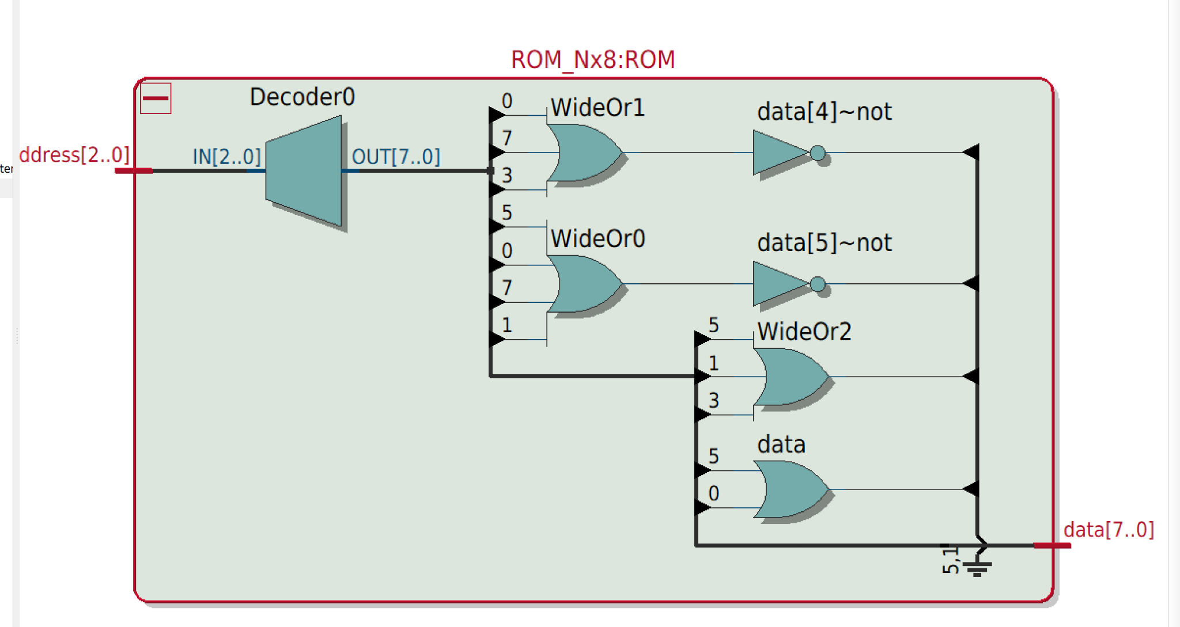
Program Memory (ROM) and Custom Assembly
Address Assembly Hex
0 IN 40
1 ADD 3 13
2 OUT 30
3 SUB 1 21
4 OUT 30
5 LDA 9 59
6 OUT 30
7 NOP 00
The ROM stores eight 8-bit instructions with a 4-bit opcode followed by a 4-bit operand. With SW[3:0] = 4, the three OUTs display 7, 6, and 9.

Slide 8
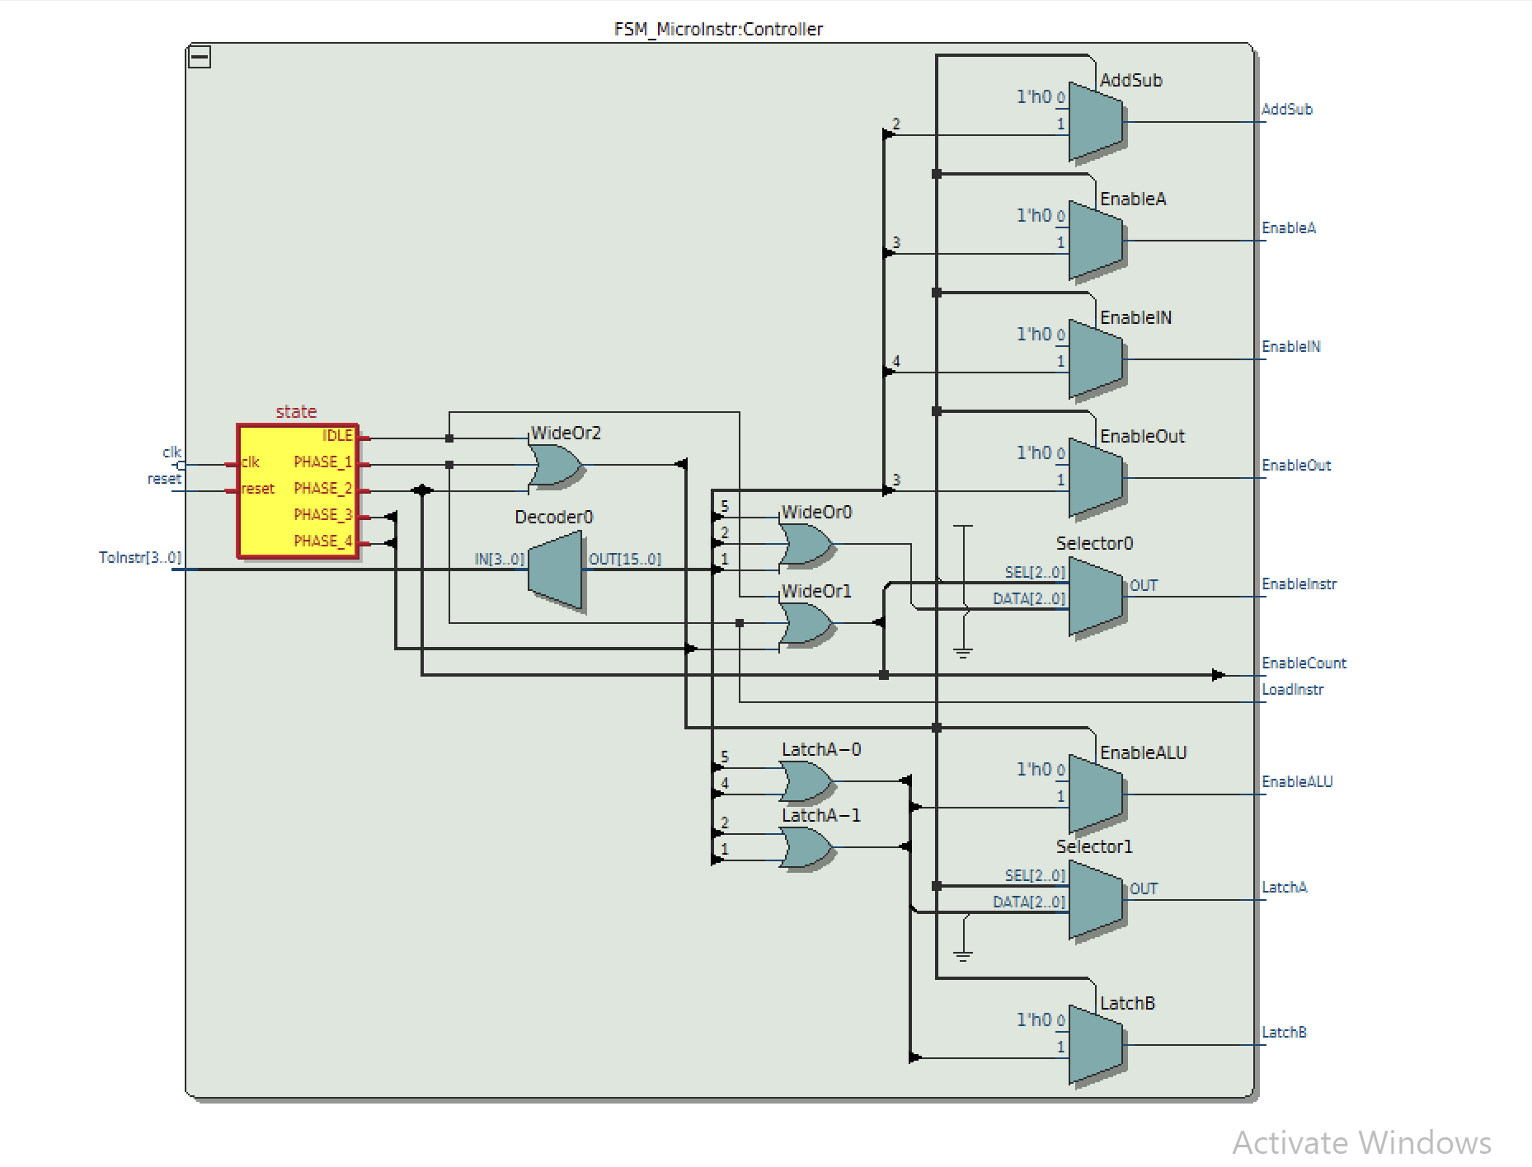
FSM Microinstruction Controller
IDLE
PHASE 1
Fetch
PHASE 2
Decode
PHASE 3
Execute A
PHASE 4
Execute B
The FSM uses four active phases for each instruction: fetch, decode, execute A, and execute B. It enables register latches, the ALU, output storage, and the counter.

Slide 9
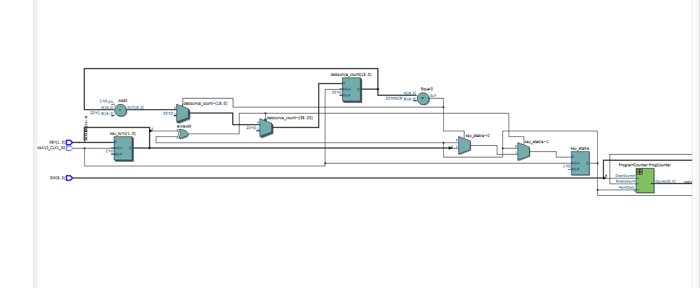
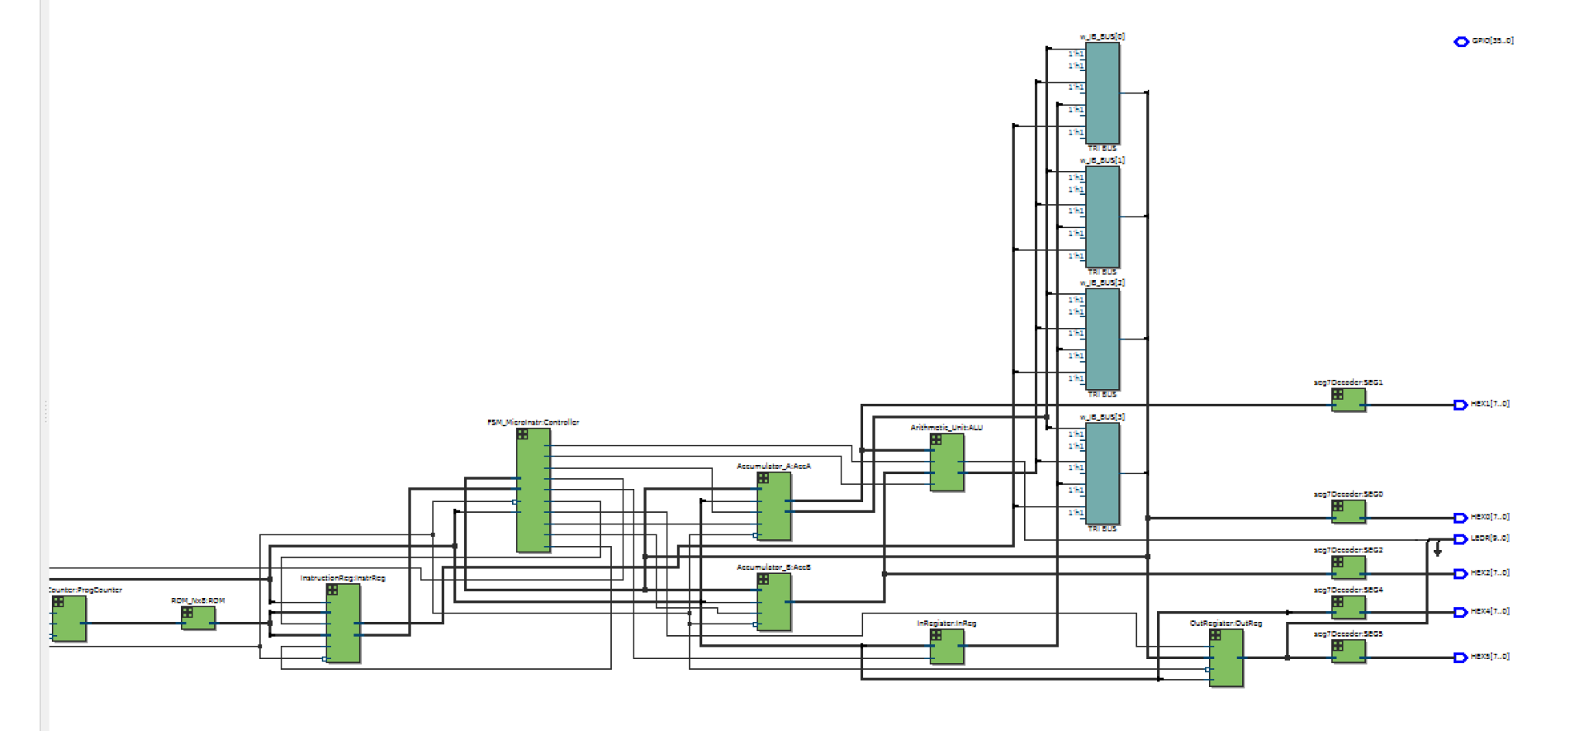
RTL Viewer - Clock and Datapath
KEY1 Debounce Logic
Microcontroller Path
RTL view confirms the connected hardware modules. KEY1 is synchronized and debounced using the 50 MHz board clock before advancing the microcontroller through its FSM stages.

Slide 10
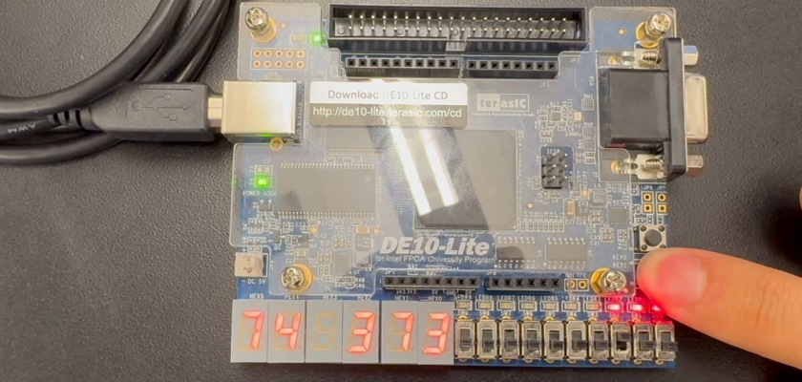
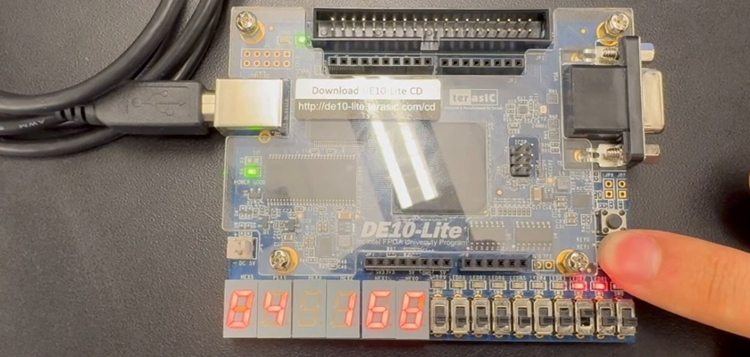
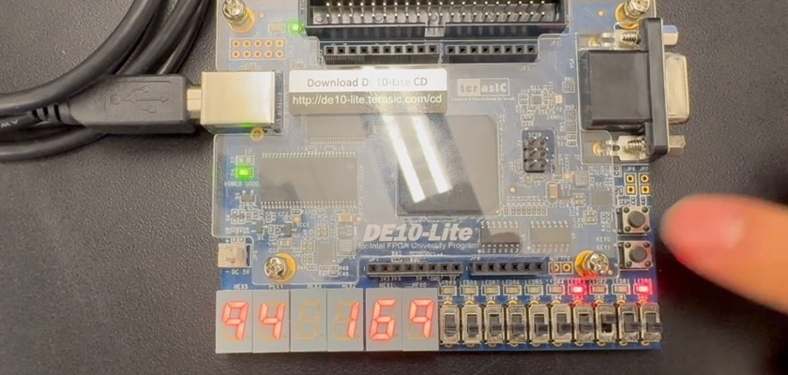
Verification and Validation
Source-level ROM check: 8 / 8 entries matched
A = 7 (ADD)
A = 6 (SUB)
LDA 9 on bus
Expected OUT sequence after the EnableOut fix: 7 -> 6 -> 9
All eight ROM instruction bytes match the assembly table. This shows accumulator A reaching 7 after ADD and 6 after SUB, the corrected output-register enable still needs a board re-test.

Slide 11
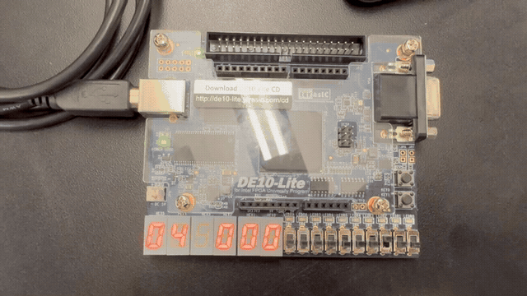
Working Microcontroller Demonstration
Controls
KEY1 Clock step
SW8 Reset
SW[3:0] Input = 4
HEX5 Output
LEDR[3:0] Binary output
Target OUT results: 7 -> 6 -> 9
The board video shows KEY1 stepping and internal instructions.

