Slide 1
LAB V

Slide 2
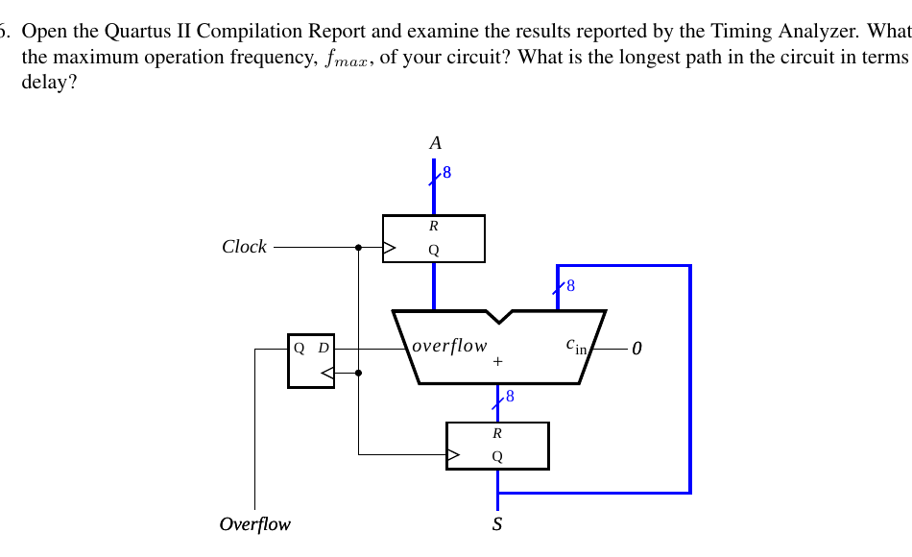
Part I - 8-Bit Accumulator
Implemented an 8-bit accumulator where SW[7:0] gives input A. KEY0 resets the stored sum,
and the updated result is displayed on LEDR[7:0].

Slide 3
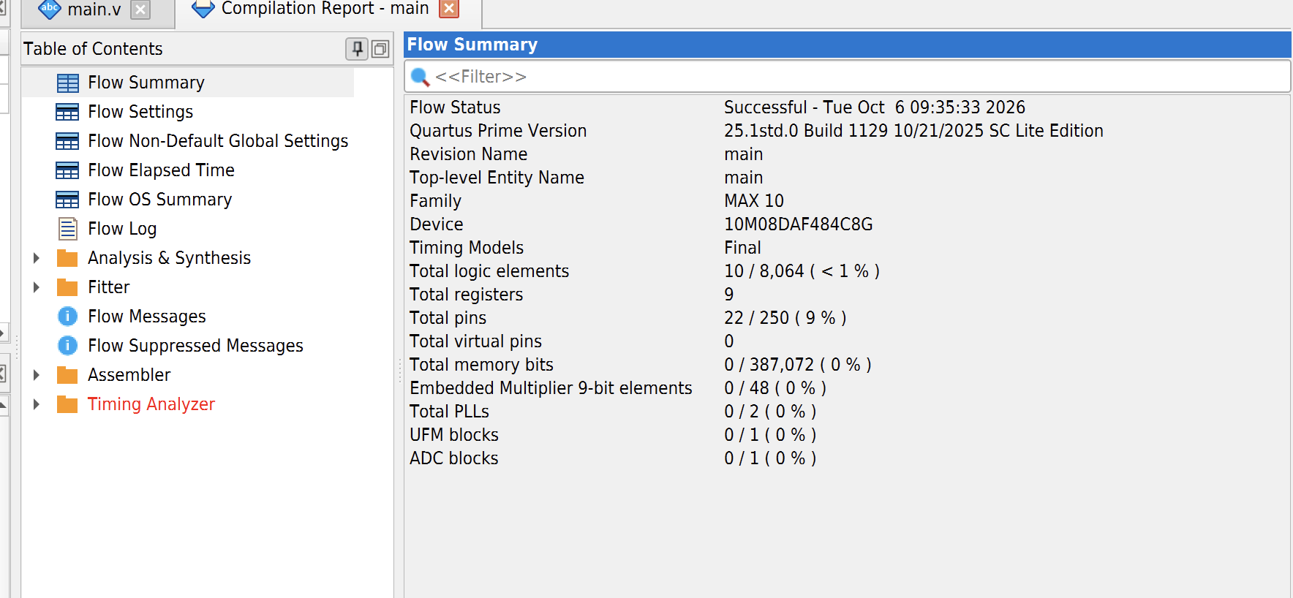
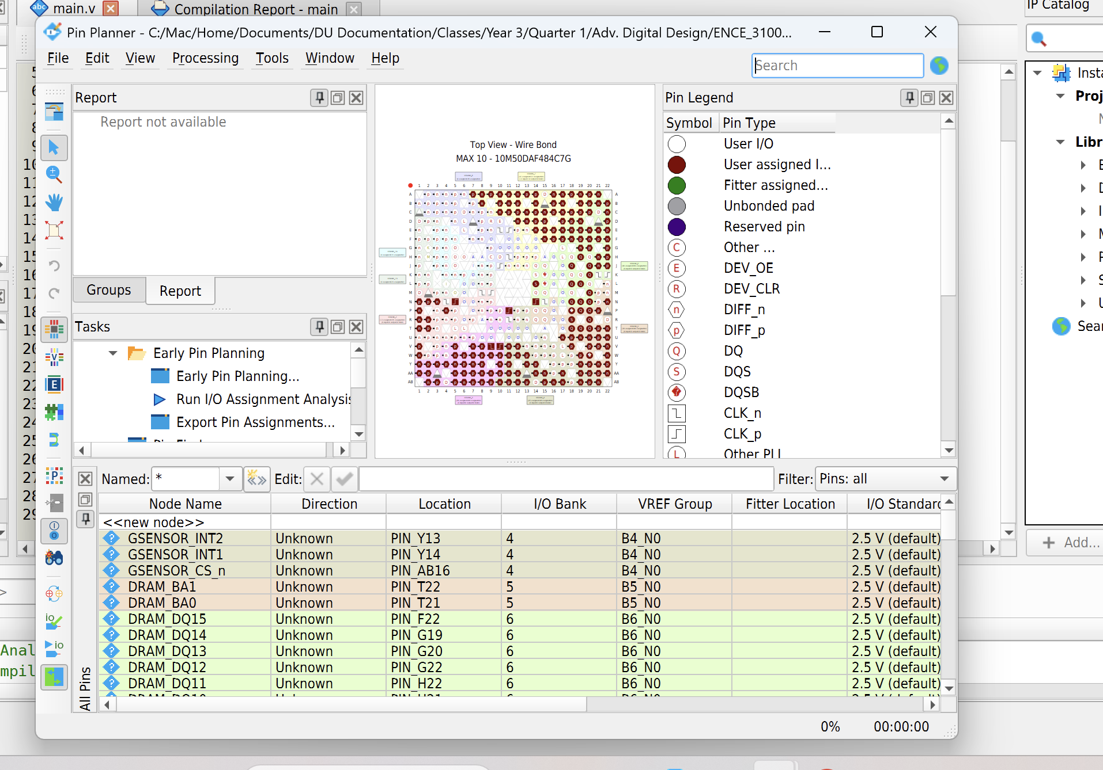
Part I - Compile and Pin Setup
After restarting the project with the correct MAX 10 device, the design compiled successfully.
The DE10-Lite pin assignments were imported so SW, KEY, LEDR, and HEX signals mapped to the board correctly.

Slide 4
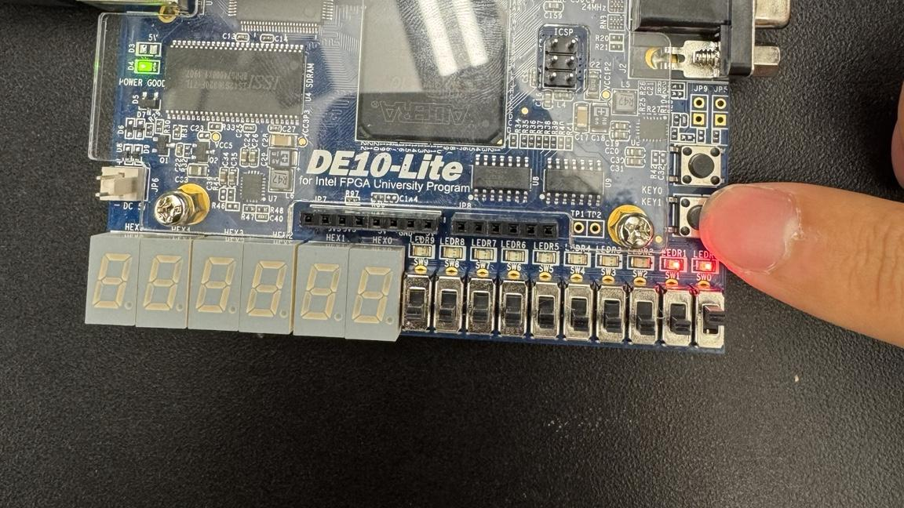

Slide 5
Part II - Add/Subtract Accumulator
Added the accumulator with SW8 as the add_sub control. When SW8 = 0, the circuit adds A to S.
When SW8 = 1, it subtracts A from S.

Slide 6
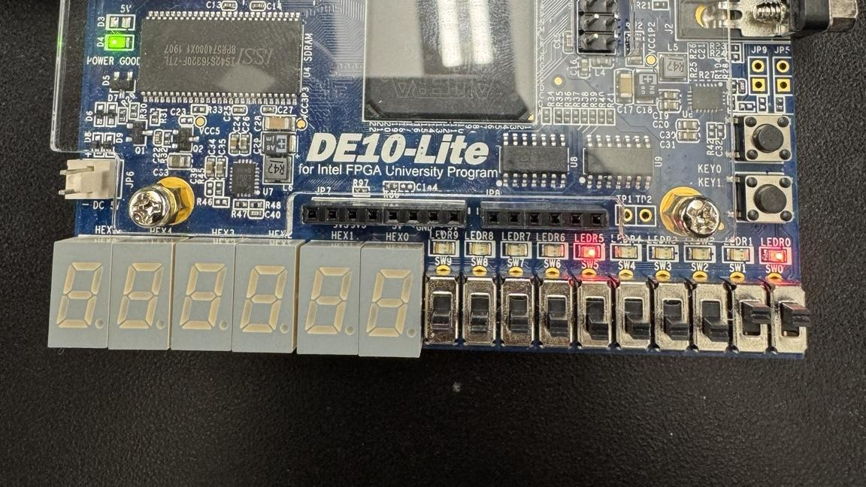
Part II - Button Clock Issue
Using KEY1 as a manual clock made the switch bounce multiple updates per press.
The final version used MAX10_CLK1_50 as the real clock and detected KEY presses as inputs.

Slide 8
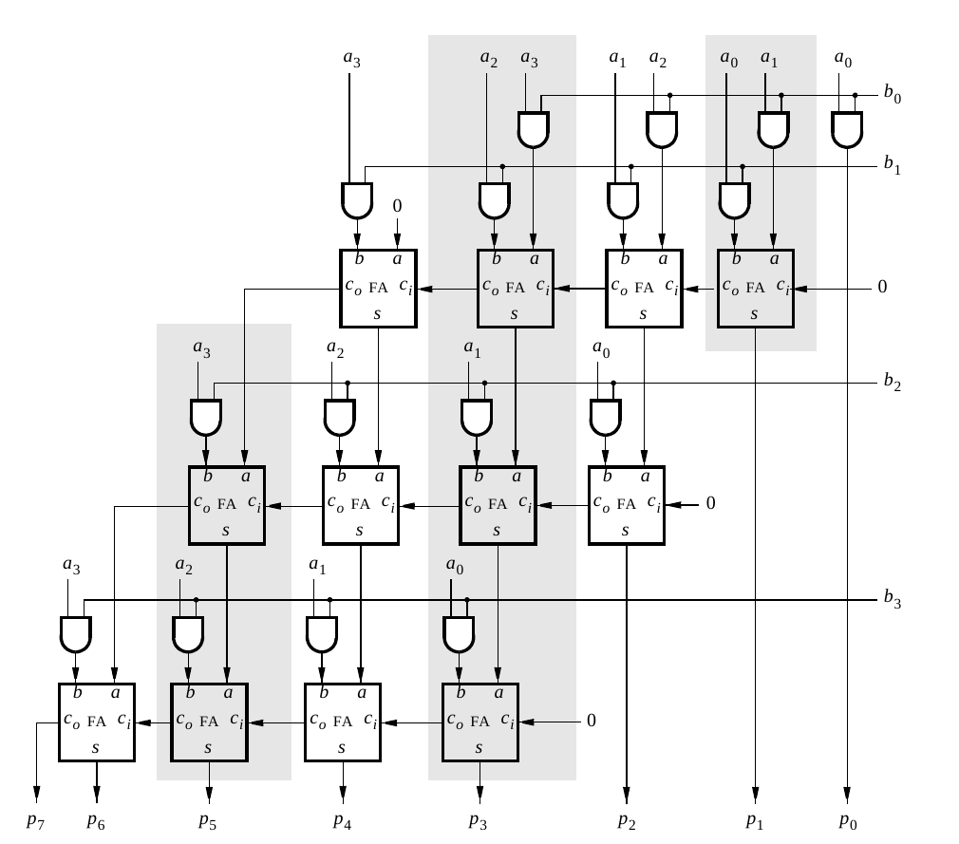
Part III - 4-Bit Multiplier
Built a 4-bit multiplier for A × B. Since the DE10-Lite has SW9-SW0, A was mapped to SW9-SW6 and B was mapped to SW3-SW0.

Slide 9
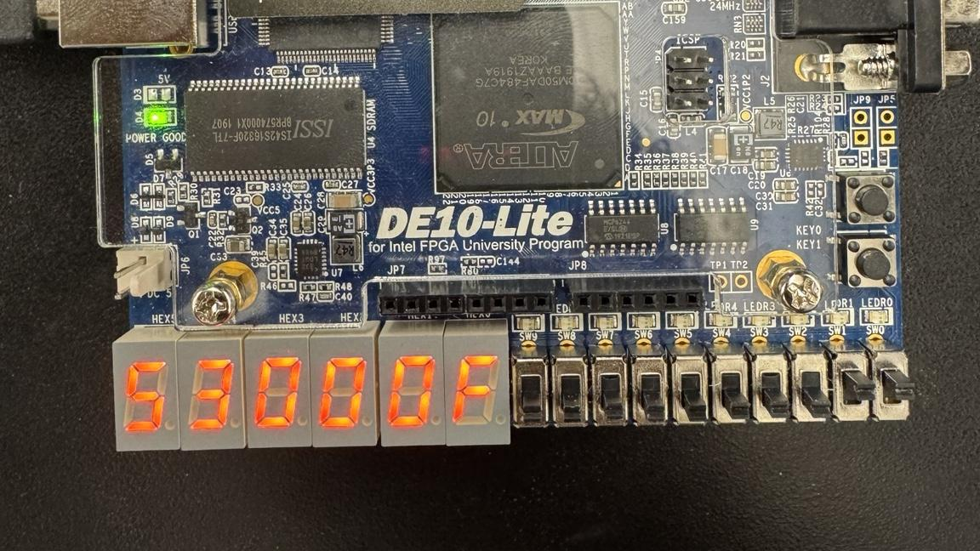
Part III - HEX Display Mapping
The product P is shown as two hexadecimal digits on HEX1 and HEX0.
A is displayed on HEX5 and B is displayed on HEX4 because the DE10-Lite does not have a HEX6.

Slide 10
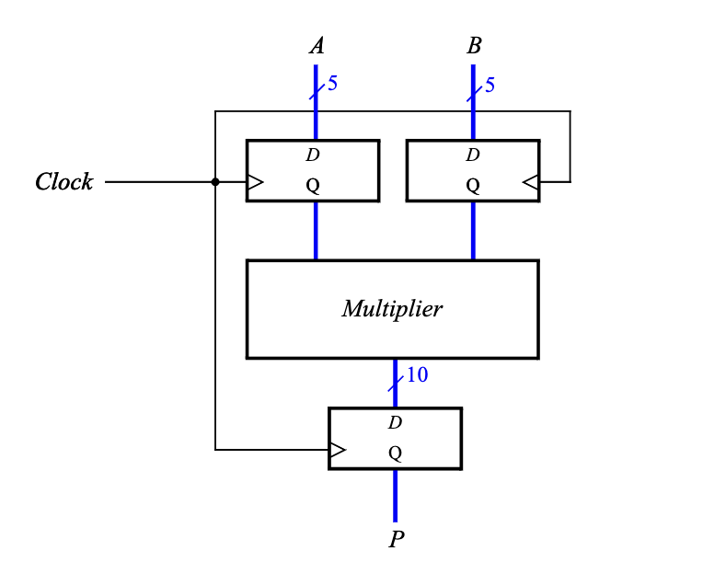
Part IV - 8x8 Registered Multiplier
Implemented an 8x8 multiplier using shifted partial products. A and B are loaded from SW[7:0],
then the 16-bit product is displayed on the HEX3-HEX0.

Slide 11
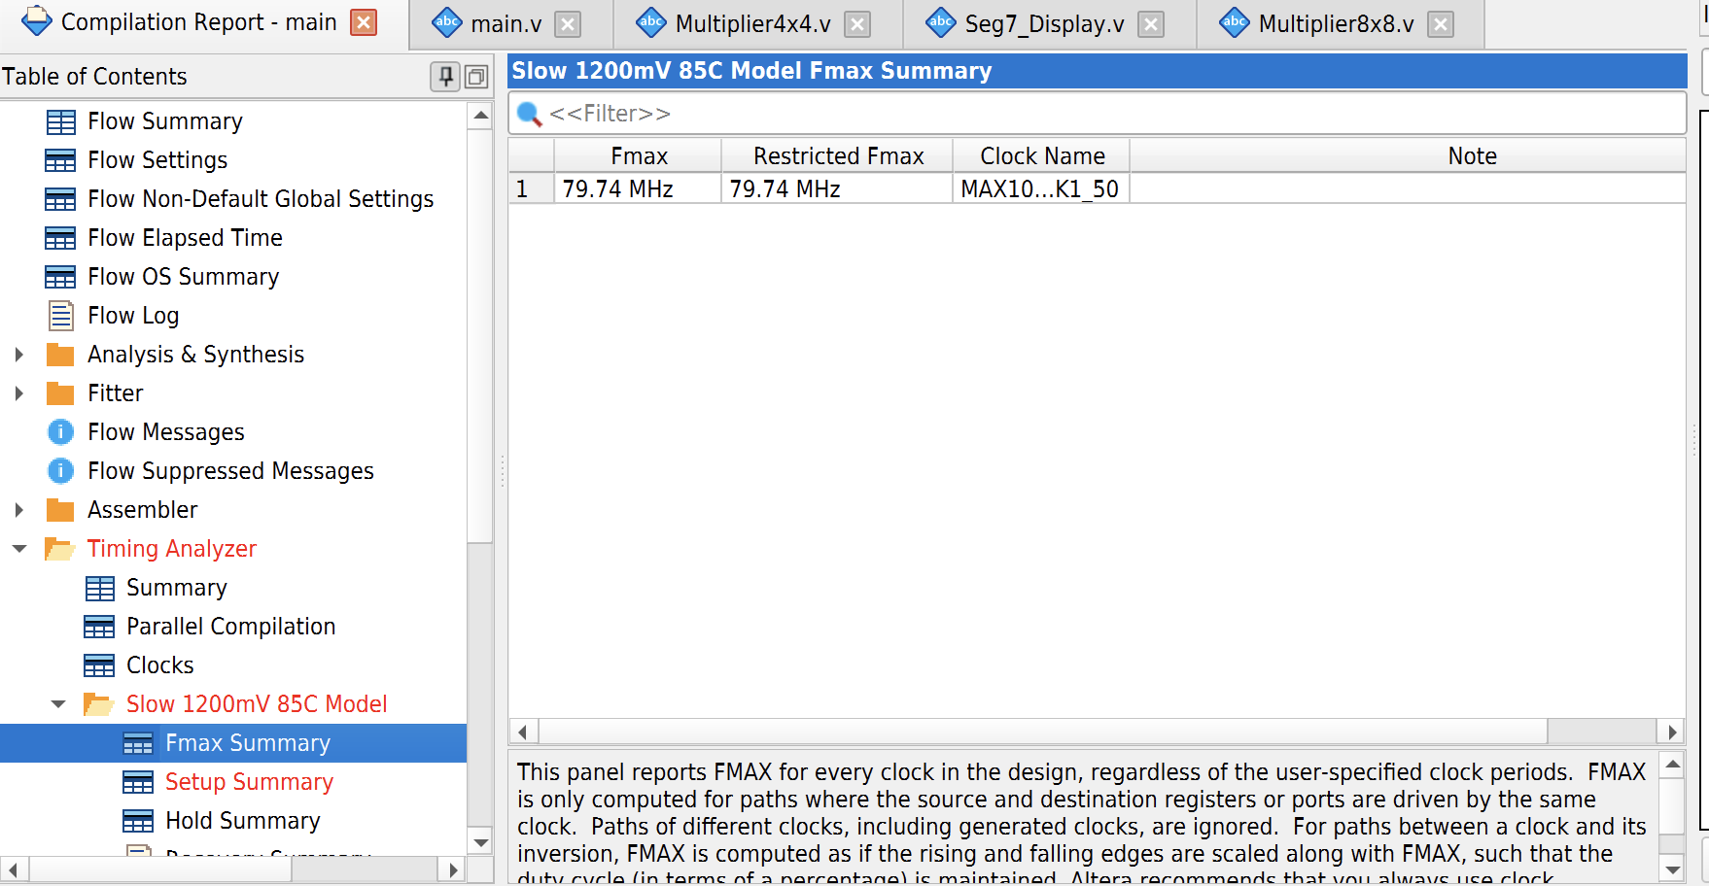
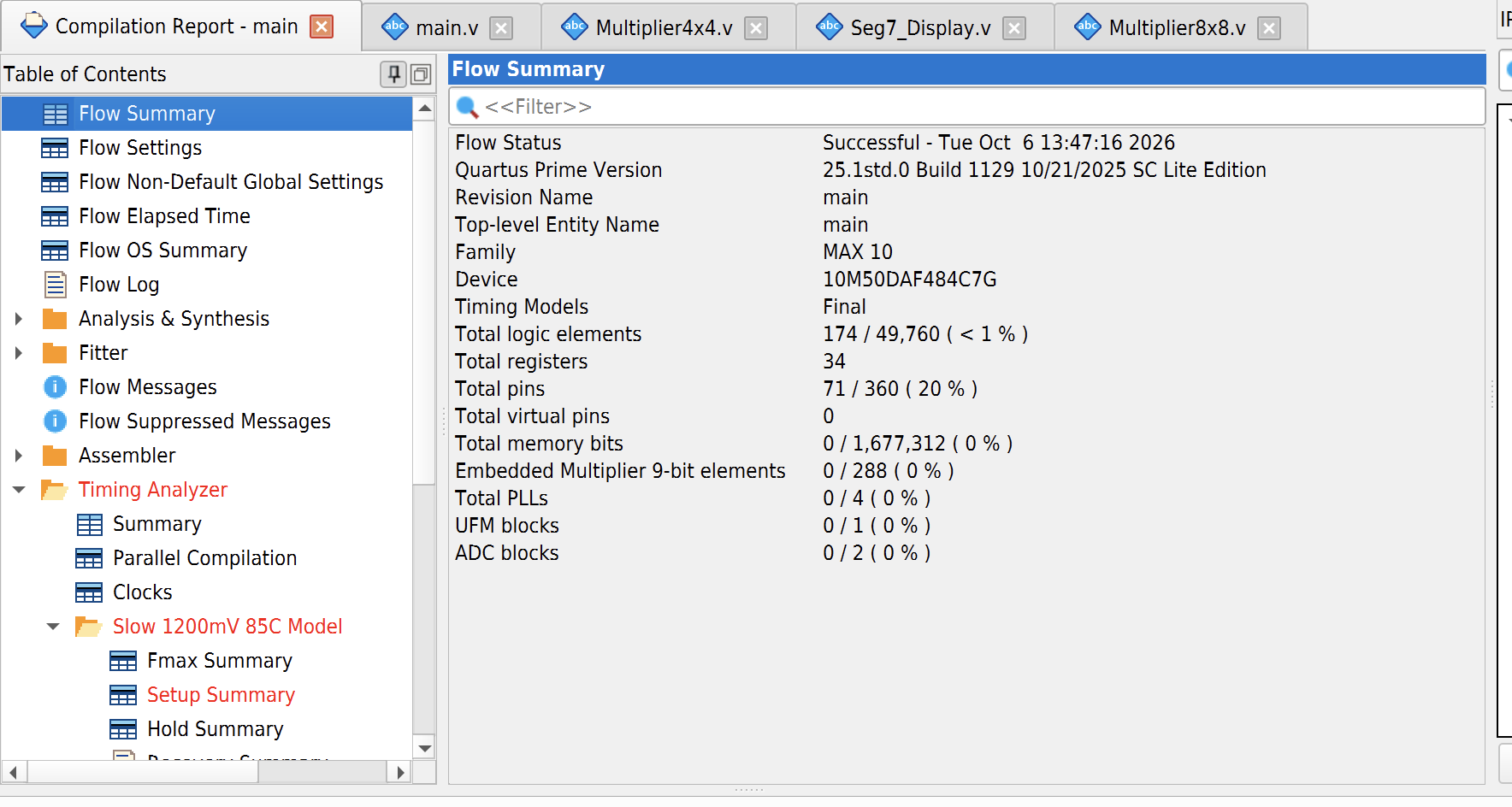
Part IV - Shift-and-Add Performance
The shift-and-add multiplier synthesized 174 logic elements and 34 registers. The measured Fmax was 79.74 MHz.

Slide 13
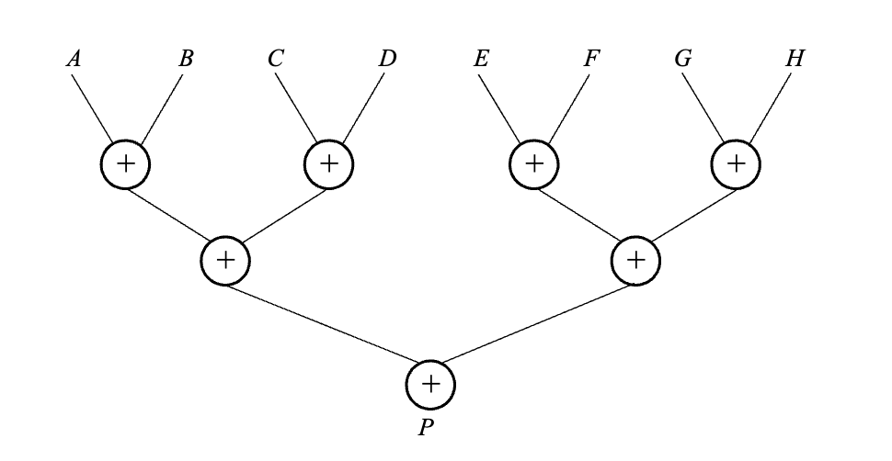
Part V - Adder Tree Multiplier
Replaced the long addition chain with an adder tree. Partial products are added in parallel pairs,
then combined until the final product is produced.

Slide 14
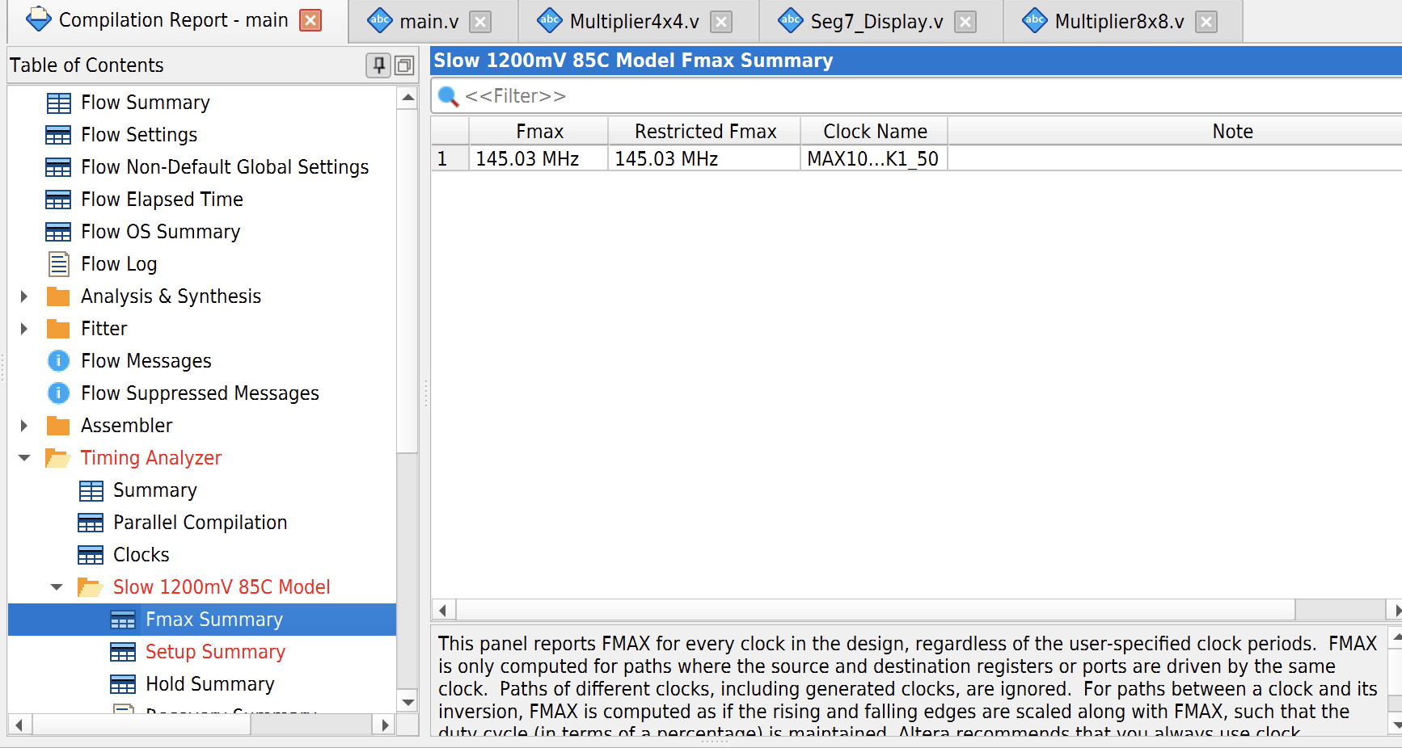
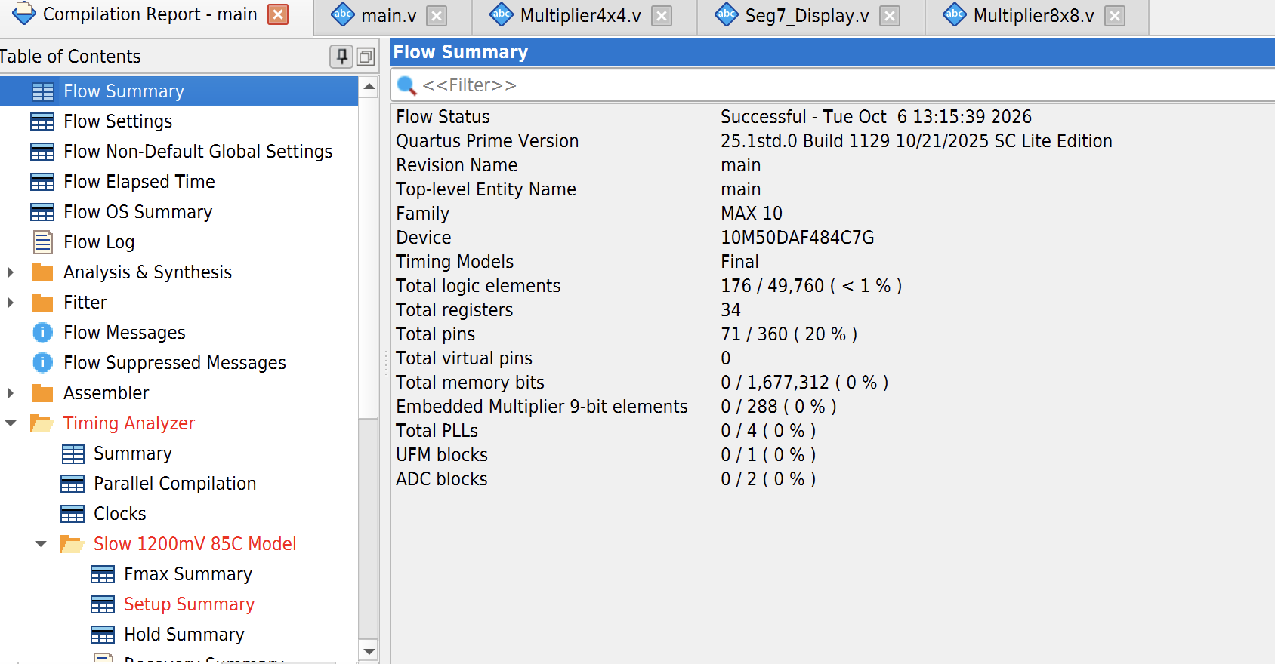
Part V - Adder Tree Performance
The adder-tree multiplier synthesized 176 logic elements and 34 registers. The measured Fmax increased to 145.03 MHz.

Slide 15
Part IV: 174 LEs, Fmax = 79.74 MHz
Part V: 176 LEs, Fmax = 145.03 MHz
The adder tree used almost the same amount of hardware but reduced the combinational addition,
producing a much higher maximum frequency.

Slide 16
Conclusion
This lab used arithmetic circuits in Verilog, starting off with an accumulator and add/subtract accumulator, then adding to 4x4 and 8x8 multipliers. The DE10-Lite board needed adapting the switch and HEX display mapping from the provided lab. The Part IV shift-and-add multiplier used 174 logic elements with an Fmax of 79.74 MHz, while the Part V adder-tree multiplier used 176 logic elements with an Fmax of 145.03 MHz. The adder-tree design was faster and better because it reduced the addition path.

