Slide 1
Chapter 3
Mathematical Functions, Strings, and Objects

Slide 2
Objectives
To solve mathematics problems by using the functions in the math module (§3.2).
To represent and process strings and characters (§§3.3-3.4).
To encode characters using ASCII and Unicode (§§3.3.1-3.3.2).
To use the ord to obtain a numerical code for a character and chr to convert a numerical code to a character (§3.3.3).
To represent special characters using the escape sequence (§3.3.4).
To invoke the print function with the end argument (§3.3.5).
To convert numbers to a string using the str function (§3.3.6).
To use the + operator to concatenate strings (§3.3.7).
To read strings from the keyboard (§3.3.8).
To introduce objects and methods (§3.5).
To format numbers and strings using the format function (§3.6).

Slide 3
Common Python Functions
A function is a group of statements that perfroms a specific task
Python provides a library of functions
In previous lecture we used builtin functions
  eval, input, print, int
We will look at abs, max, min, pow, round

Slide 4
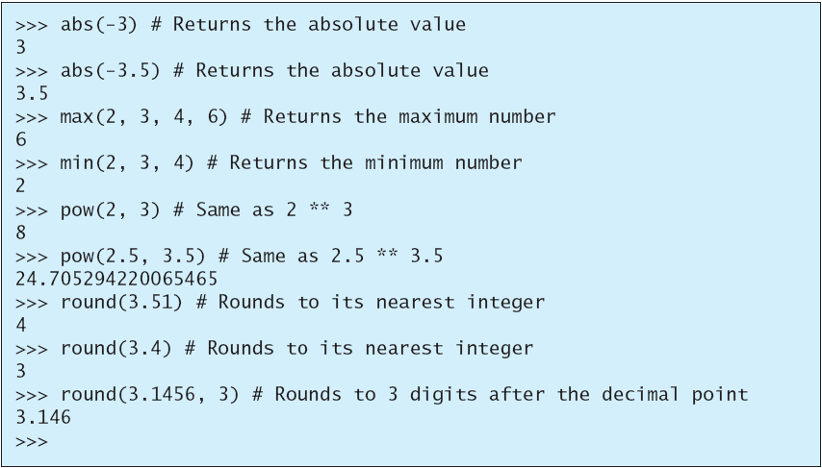
Built-in Functions and math Module

Slide 5
Common Python Functions
Notes
  round(number, ndigits)
    Rounds to closest multipe of 10**(-ndigits)
    In case of tie, round towards the even choice
    round(0.5) = 0
    round(1.5) = 2
    round(-1.5) = -2
    result can be surprising e.g: round(2.675, 2) = 2.67 (most decimals can’t be represented exactly as a float)
  pow(a,b) is equivalent to a**b

Slide 6
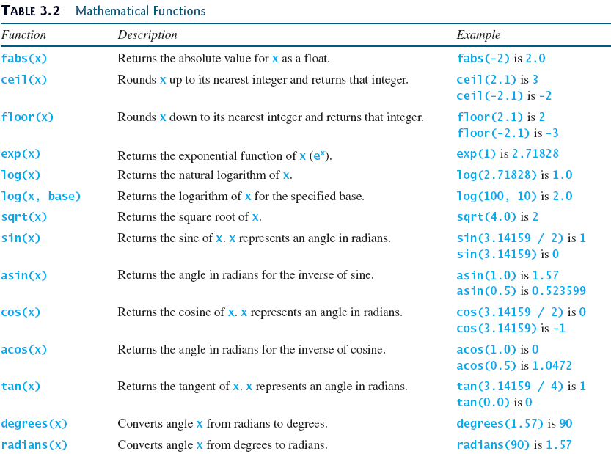
The Math Functions

Slide 7
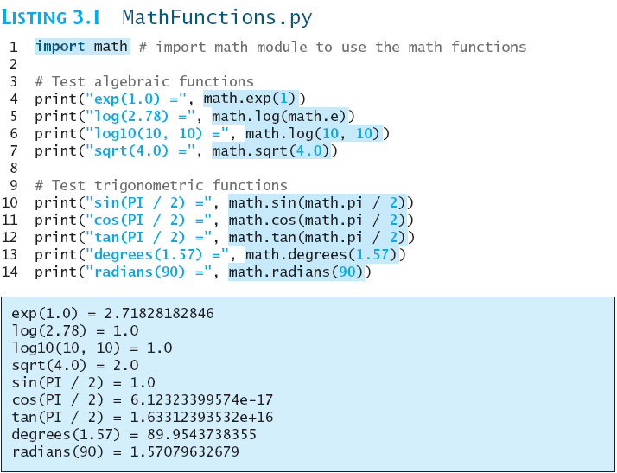
The Math Functions
MathFunctions
Run

Slide 8
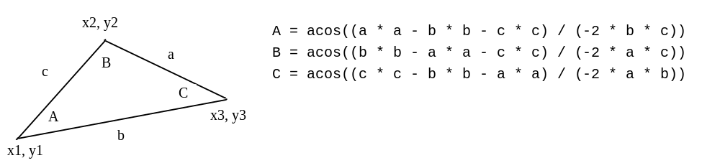
Problem: Compute Angles
Given three points of a triangle, you can compute the angles using the following formula:

Slide 9
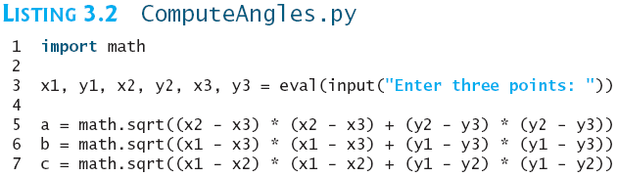
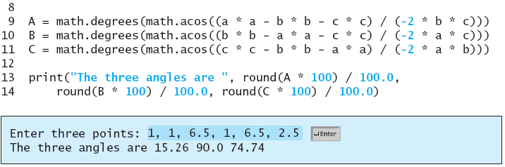
Problem: Compute Angles
Run

Slide 10

Strings and Characters
A string is a sequence of characters
Strings can be enclosed in single quotes or double quotes
Python does not have data type for characters
  A single character string represents a character
Use double quotes for strings with more than one character
Use single quotes for a string with a single character or for an empty string

Slide 11
Unicode and ASCII Code
Character encoding: how a character is mapped to its binary representation
ASCII is a 7-bit encoding scheme for representing all uppercase and lowercase letters, digits, punctuation marks and control characters
Review ASCII codes on next slide

Slide 12
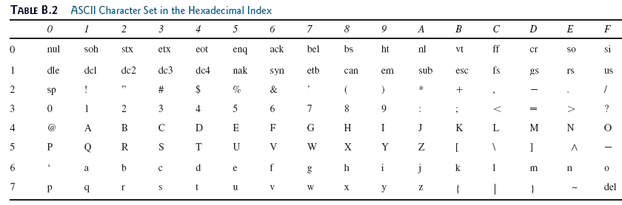
Unicode and ASCII Code

Slide 13
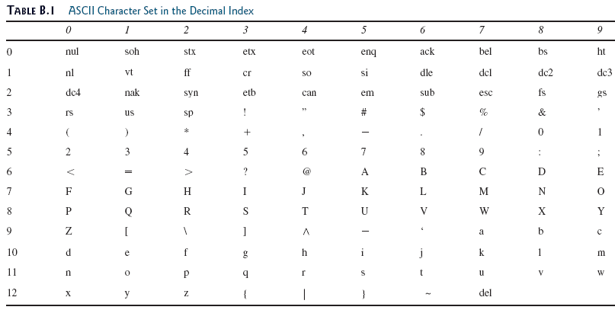
Unicode and ASCII Code

Slide 14
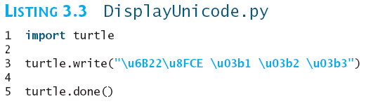

Unicode and ASCII Code
Unicode is an encoding scheme for representing international characters
ASCII is a small subset of Unicode
A Unicode starts with \u followed by four hexadecimal digits that run from \u0000 to \uFFFF
  alpha : \u03b1
  beta: \u03b2
Run

Slide 15
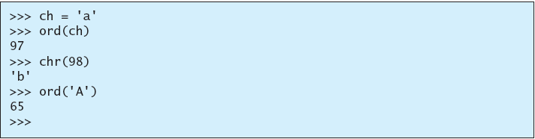
Functions ord and chr
ord(ch): given a string of one Unicode character, return integer representation (in base 10)
chr(code): returns character represented by the code
ASCII code for lowercase letters are consecutive integers
ASCII code for uppercase letters are consecutive integers
Difference between ASCII code of lowercase letter and corresponding uppercase letter is always 32
Useful for processing strings

Slide 16
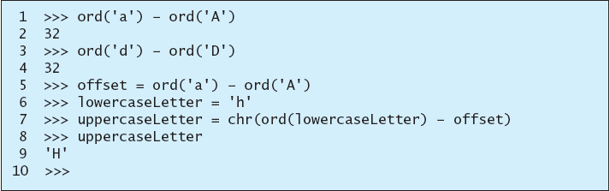
Functions ord and chr

Slide 17
Escape Sequences
Suppose you want to print a message with quotation marks in the output
  Statement has an error
  Python thinks the second quotation mark is the end of the string
Python uses a special notation to represent special characters
  Escape sequence: backslash(\) followed by a letter or a combination of digits
    \n: newline, line break or end-of-line
    \r: moves the cursor to the first position on the same line

Slide 18
Escape Sequences for Special Characters
Description Escape Sequence Unicode
Backspace \b \u0008
Tab \t \u0009
Linefeed \n \u000A
Carriage return \r \u000D
Backslash \\ \u005C
Single Quote \' \u0027
Double Quote \" \u0022

Slide 19


Printing without the Newline
print function automatically prints a linefeed (\n)
You can change behavior by passing a special argument:
Example
  Output
print can be used to print multiple items:
  Output

Slide 20
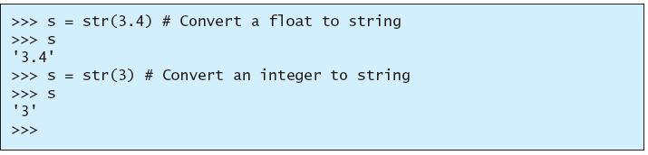
The str Function
The str function can be used to convert a number into a string
Example

Slide 21
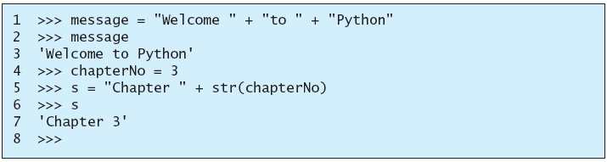
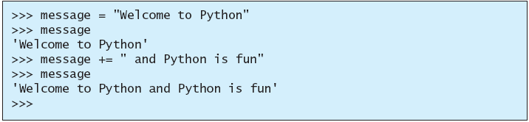
The String Concatenation Operator
You can use the + operator to add two numbers.
The + operator can also be used to concatenate (combine) two strings.
Example:
+= operator can also be used for string concatentation

Slide 22
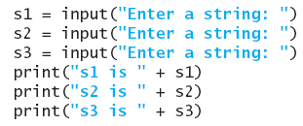
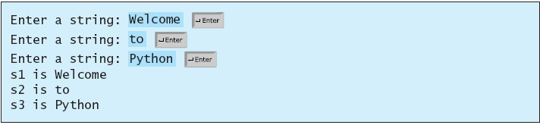
Reading Strings from the Console
To read a string from the console, use the input function. For example, the following code reads three strings from the keyboard:

Slide 23
Case Study: Minimum Number of Coins
Develop a program to classify a given amount of money into smaller monetary units
User enters an amount as a floating-point value representing a total in dollars and cents
Program outputs monetary equivalent in dollars, quarters, dimes, nickels and pennies
Goal is to reduce the number of coins

Slide 24
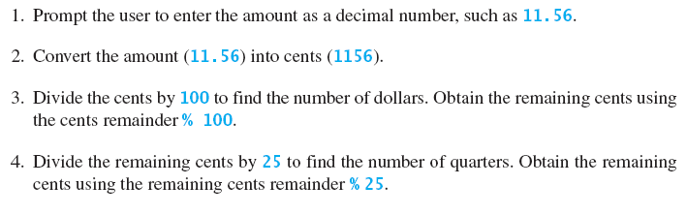
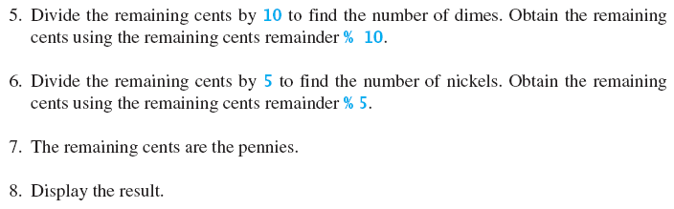
Case Study: Minimum Number of Coins

Slide 25
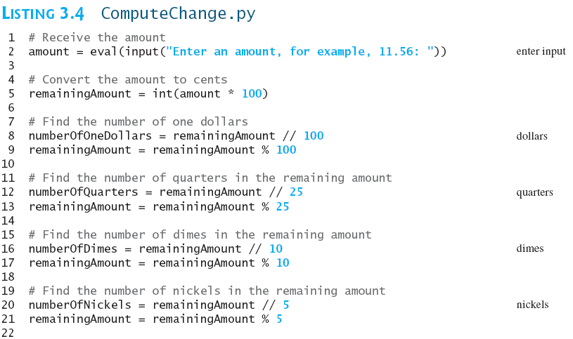
Case Study: Minimum Number of Coins
Run

Slide 26
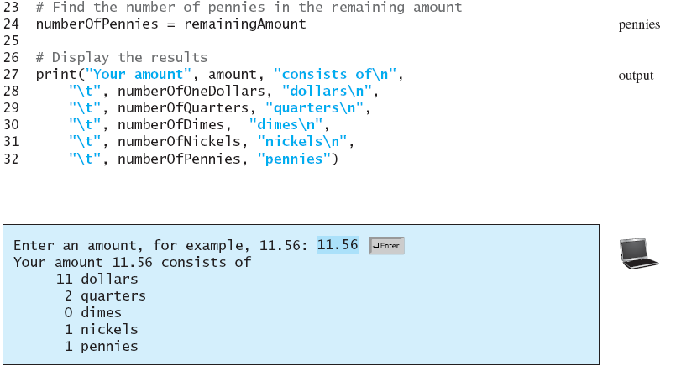
Case Study: Minimum Number of Coins

Slide 27
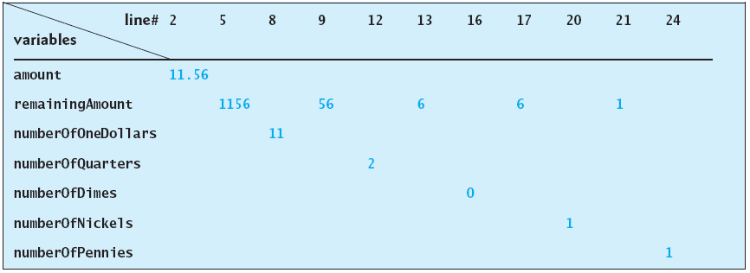
Case Study: Minimum Number of Coins

Slide 28
Introduction to Objects and Methods
In Python, all data—including numbers and strings—are actually objects
An object is an entity
  Each object has an id and a type
    id: unique integer assigned by Python
      will not change during execution of program
      id might be different between different executions
    type: determined based on value of object
      defined by a class (str for strings, int for integers)
  Objects of the same kind have the same type
You can use the id function and type function to get this information for an object

Slide 29
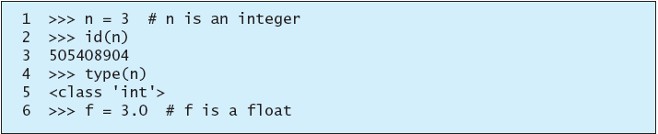
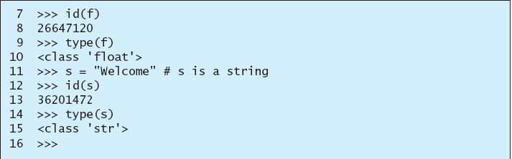
Introduction to Objects and Methods
What will be type for n if we assign it to 2.43?

Slide 30
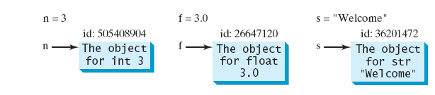
Introduction to Objects and Methods
A variable in Python is a reference to an object
For n = 3, we say n is an integer variable that holds value 3
Strictly speaking, n is a variable that references an int object with value 3
For simplicity, it is fine to say n is an int variable with value 3.

Slide 31
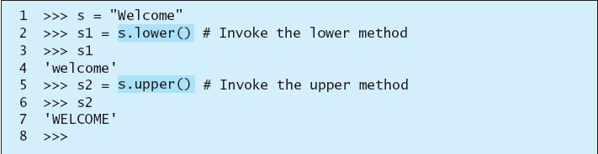
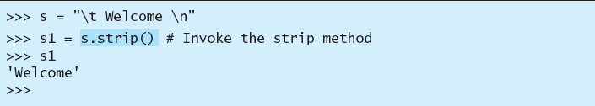
Introduction to Objects and Methods
Operations on objects are defined using functions
  Called methods in Python
  Example: string type has the following methods
    lower() and upper() to return a new string in lowercase and uppercase
    strip() removes (strips) the whitespace characters from both ends of a string
    White space: ‘ ‘, \t, \f, \r, \n

Slide 32
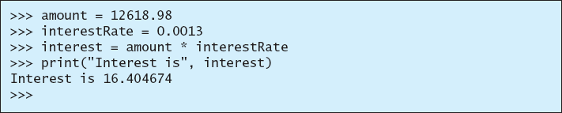
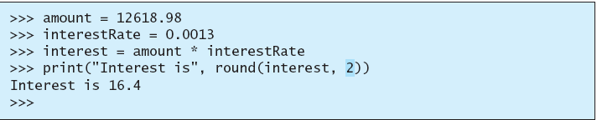
Formatting Numbers and Strings
Often it is desirable to display numbers in certain format
For example, the following code computes the interest, given the amount and the annual interest rate
Because amount is currency, we want to display 2 digits after decimal
  One way to do this is to use round()

Slide 33
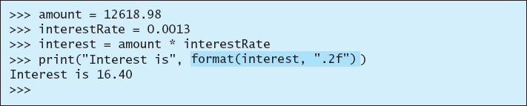
Formatting Numbers and Strings
Format is still incorrect: 2 digits are needed after decimal point
format function can fix this
  Syntax: format(item, format-specifier)
    item: number or string
    format-specifier: string to specify how item is formatted
    format() returns a string

Slide 34
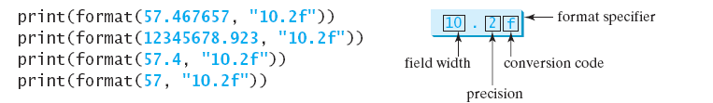
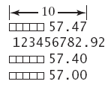


Formatting Floating-Point Numbers
width: width of the resulting string
precision: number of digits after decimal point
f: conversion code which sets the formatting for floating point numbers
We can omit the width specifier

Slide 35

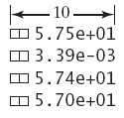

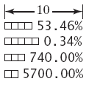
Formatting in Scientific Notation and Percentage
Use e instead of f to format number in scientific notation
Use % to format number as a percentage (% is counted as one space)

Slide 36


Justifying Format
By default numbers are right justified
Use < in format to specify item to be left justified within the specified width

Slide 37
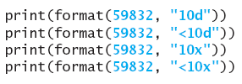
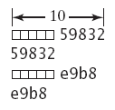
Formatting Integers
d, x, o, b can be used to format an integer in decimal, hexadecimal, octal and binary
  number has to be an integer, can’t be a float

Slide 38

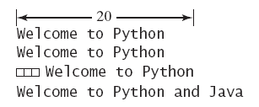
Formatting Strings
s can be used to format a string with a specified width
By default, strings are left justified

Slide 39
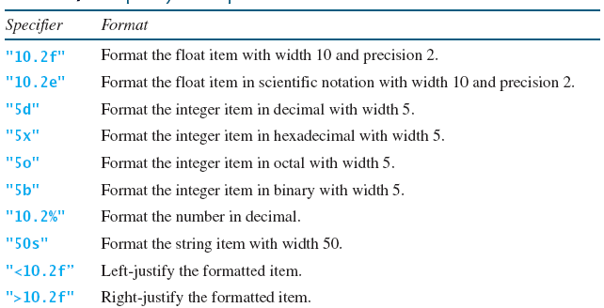
Frequently Used Specifiers

