Slide 1
Chapter 4 Selections
© Copyright 2012 by Pearson Education, Inc. All Rights Reserved.

Slide 2
Objectives
To write Boolean expressions by using comparison operators (§4.2).
To generate random numbers by using the random.randint(a, b) or random.random() functions (§4.3).
To program with Boolean expressions (AdditionQuiz) (§4.3).
To implement selection control by using one-way if statements (§4.4)
To program with one-way if statements (GuessBirthday) (§4.5).
To implement selection control by using two-way if .. else statements (§4.6).
To implement selection control with nested if ... elif ... else statements (§4.7).
To avoid common errors in if statements (§4.8).
To program with selection statements (§4.9–4.10).
To combine conditions by using logical operators (and, or, and not) (§4.11).
To use selection statements with combined conditions (LeapYear, Lottery) (§§4.12–4.13).
To write expressions that use the conditional expressions (§4.14).
To understand the rules governing operator precedence and associativity (§4.15).
© Copyright 2012 by Pearson Education, Inc. All Rights Reserved.

Slide 3
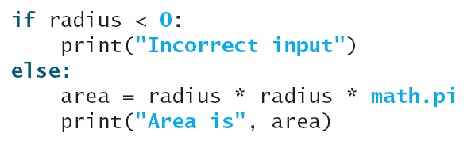
Introduction
What happens if we enter a negative value for radius ?
  A negative value for radius is not acceptable
Python provides selection statements that let you choose actions with two or more alternative courses
Example:
Selection statements use conditions which are Boolean expressions

Slide 4
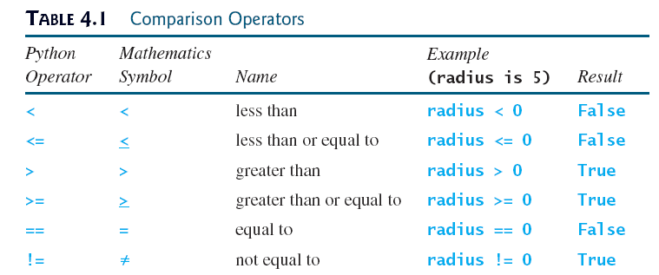
Boolean Data Types
Often in a program you need to compare two values, such as whether i is greater than j
There are six comparison operators (also known as relational operators) that can be used to compare two values
Example: radius = 5

Slide 5

Boolean Data Types
Example:
  Output: True
A variable that holds a Boolean value is known as a Boolean variable
A Boolean variable can hold one of the two values: True , False
  True and False are literals just like a number such as 10
  True and False can not be used as identifiers
  Internally Python uses 1 to represent True and 0 for False
  Example: lightsOn = True
  You can use int function to convert a Boolean to an integer
    print(int(True))
    print(int(False))

Slide 6
Boolean Data Types
You can use the bool function to convert a numeric value to a Boolean value
  Returns False if the value is 0
  Returns True otherwise
  E.g: print(bool(0)) : False
    print(bool(4)): True
  bool() or bool(‘’) returns False
  Evaluate bool(“1”), bool(“0”)

Slide 7
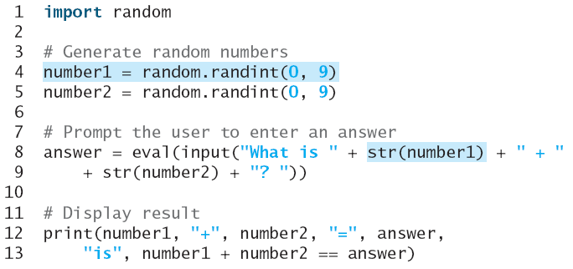
Generating Random Numbers
randint(a,b) in the random module can be used to generate a random integer between a and b inclusive
Create a program to let a first grader practice additions
  The program randomly generates two single-digit integers number1 and number2 and displays a question such as “What is 7 + 9?” to the student
  After the student types the answer, the program displays a message to indicate whether the answer is true or false
Run

Slide 8
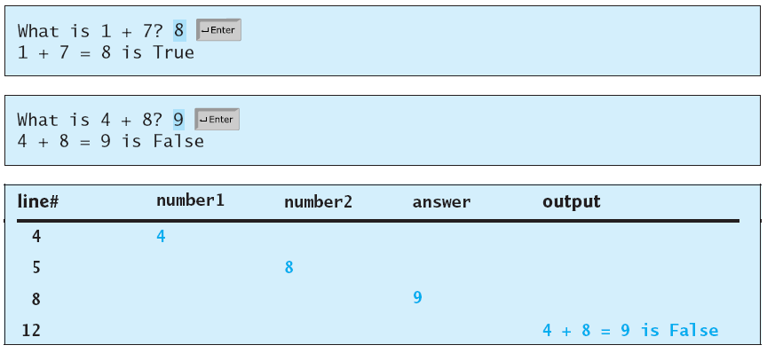
Generating Random Numbers

Slide 9
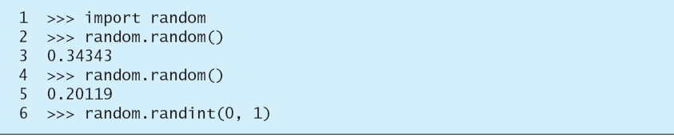
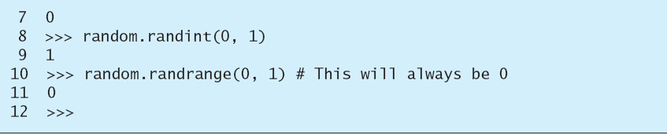
Generating Random Numbers
For integer random numbers:
  randint(a,b) generate a random integer r such that a<=r<=b
  randrange(a,b): generates random number r such that a<=r<b
For floating
  random(): generates a random floating number r such that 0.0<=r<1.0
  uniform(a,b): random number r such that a<=r<b

Slide 10
if Statements
Python has several types of selection statements
  one-way if statement
  two-way if-else statement
  nested if statements
  multi-way if-elif-else statements
One-way if statement syntax
  Executes an action if and only if the condition is true
  Statements must be indented at least one space to the right of the if keyword
  Each statement must be indented using the same number of spaces (we use four spaces)

Slide 11
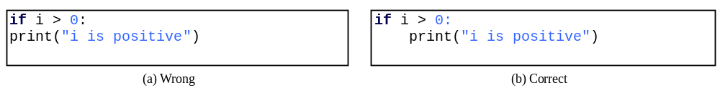
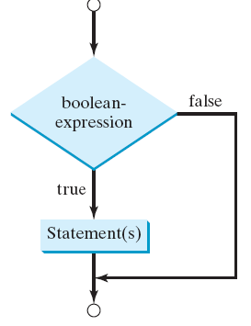
if Statements
Flowchart is a diagram that describes an algorithm or process
  Process operations are represented by boxes
    A rectangular box represents statements
    A diamond box denotes a Boolean condition
  Arrows connecting them show flow of control

Slide 12

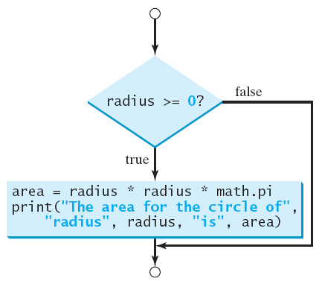
if Statements
Example
Flowchart

Slide 13
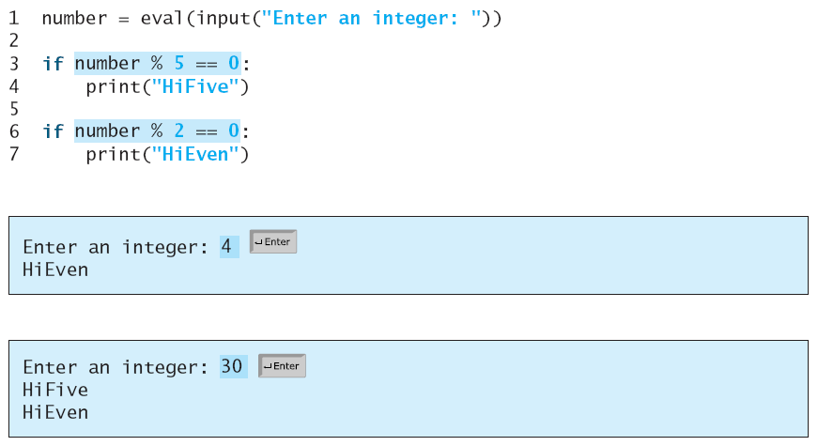
if Statements
Example 2
  Prompt user to enter integer
    If multiple of 5, diplay HiFive
    If multiple of 2, display HiEven
Run

Slide 14
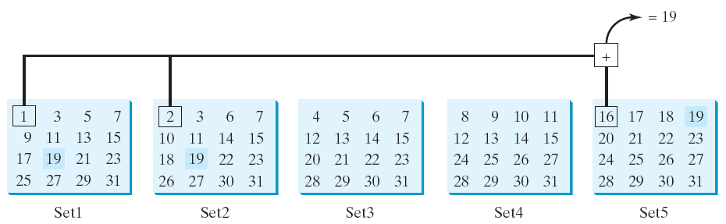

Problem: Guessing Birthday
You can guess the date of the month when your friend was born by asking five questions
  Each question asks whether the day is in one of the five sets of numbers
GuessBirthday

Slide 15
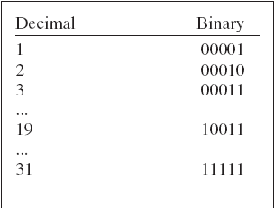
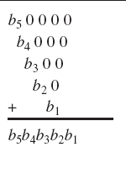
Problem: Guessing Birthday
Starting numbers in the five sets are: 1, 2, 4, 8, 16 which correspond to 1, 10, 100, 1000, and 10000
A binary number for integers between 1 and 31 has at most five digits
If number is b5b4b3b2b1 then

Slide 16
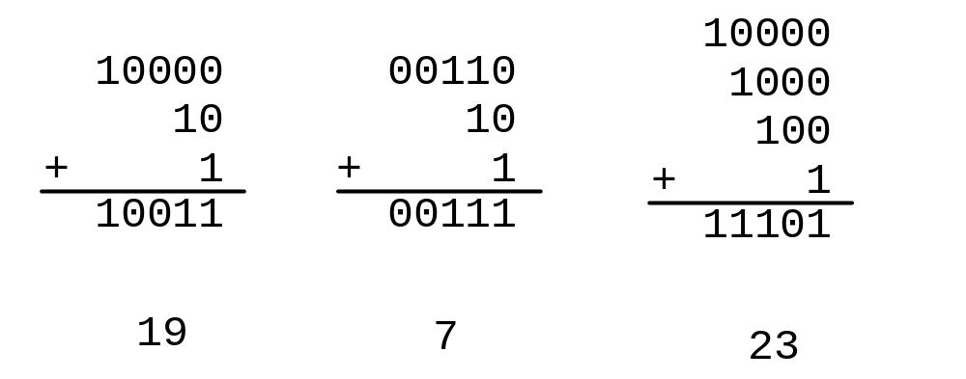
Problem: Guessing Birthday
19 is 10011 in binary. 7 is 111 in binary. 23 is 11101 in binary
All numbers in Set1 has b0 set to 1, all numbers in Set2 has b1 set to 1, …..

Slide 17
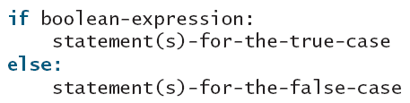
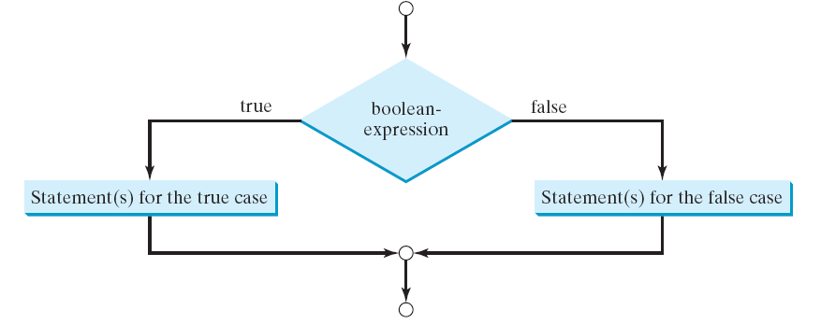
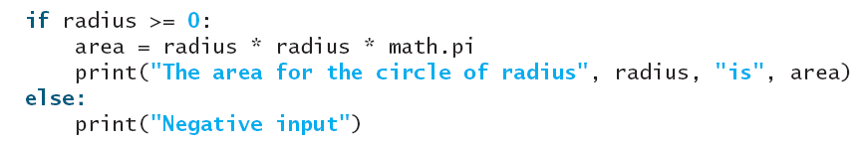
The Two-way if Statement
Two-way if-else can be used when we want to take an action when the condition is False.
Syntax
Flowchart
Example 1

Slide 18
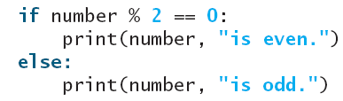
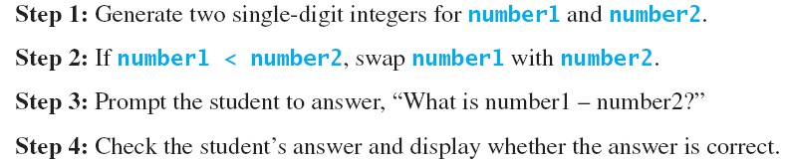
The Two-way if Statement
Example 2
Develop a program to practice subtraction
  Randomly generate two single-digit integers
  Student enters answer, program displays a message whether answer is correct

Slide 19
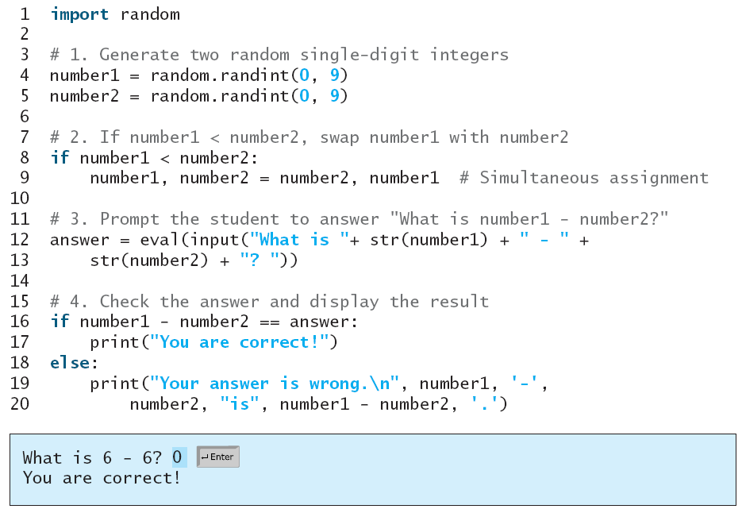
The Two-way if Statement

Slide 20
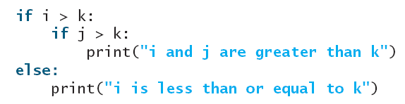
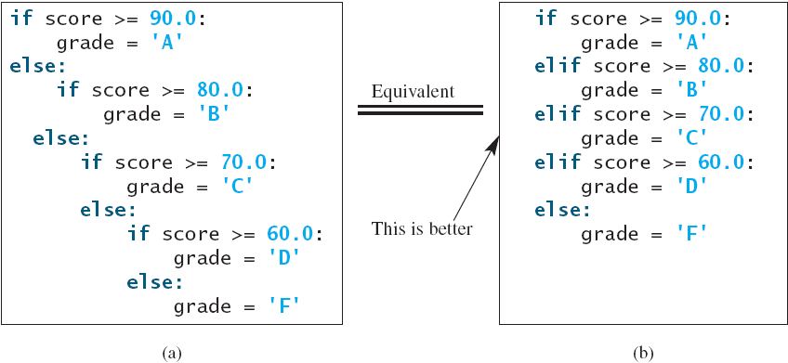
Nested if and Multi-way if-elif-else
Statement in an if/if-else statement can be another if/if-else
  inner if is said to be nested inside the outer if
  there is no limit to the depth of nesting

Slide 21
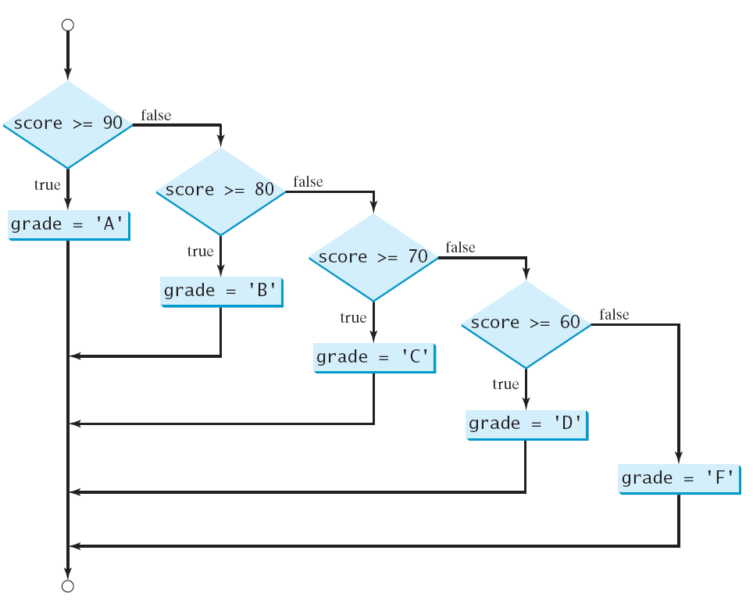
Nested if and Multi-way if-elif-else
Multi-way if avoids deep indentation nad makes a program easier to read

Slide 22
Trace if-else statement
animation
Suppose score is 70.0
The condition is false
if score >= 90.0:
grade = 'A'
elif score >= 80.0:
grade = 'B'
elif score >= 70.0:
grade = 'C'
elif score >= 60.0:
grade = 'D'
else:
grade = 'F'

Slide 23
Trace if-else statement
animation
Suppose score is 70.0
The condition is false
if score >= 90.0:
grade = 'A'
elif score >= 80.0:
grade = 'B'
elif score >= 70.0:
grade = 'C'
elif score >= 60.0:
grade = 'D'
else:
grade = 'F'

Slide 24
Trace if-else statement
animation
Suppose score is 70.0
The condition is true
if score >= 90.0:
grade = 'A'
elif score >= 80.0:
grade = 'B'
elif score >= 70.0:
grade = 'C'
elif score >= 60.0:
grade = 'D'
else:
grade = 'F'

Slide 25
Trace if-else statement
animation
Suppose score is 70.0
grade is C
if score >= 90.0:
grade = 'A'
elif score >= 80.0:
grade = 'B'
elif score >= 70.0:
grade = 'C'
elif score >= 60.0:
grade = 'D'
else:
grade = 'F'

Slide 26
Trace if-else statement
animation
Suppose score is 70.0
Exit the if statement
if score >= 90.0:
grade = 'A'
elif score >= 80.0:
grade = 'B'
elif score >= 70.0:
grade = 'C'
elif score >= 60.0:
grade = 'D'
else:
grade = 'F'

Slide 27
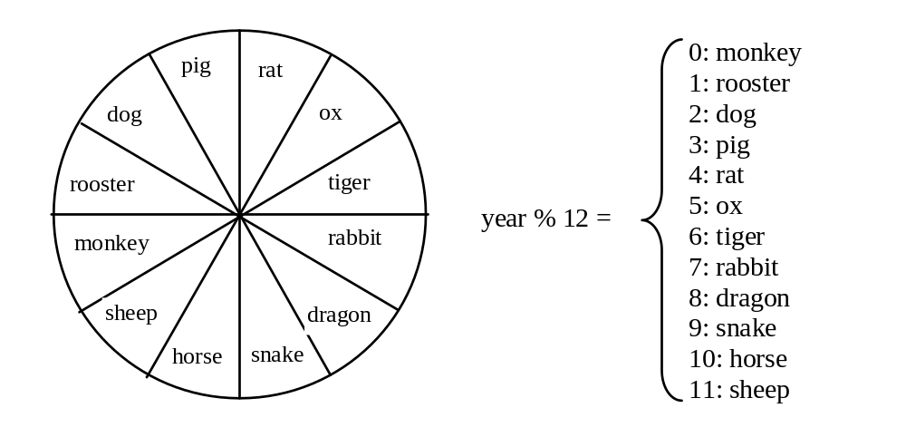
Example
Now let us write a program to find out the Chinese Zodiac sign for a given year. The Chinese Zodiac sign is based on a 12-year cycle, each year being represented by an animal: rat, ox, tiger, rabbit, dragon, snake, horse, sheep, monkey, rooster, dog, and pig, in this cycle.

Slide 28
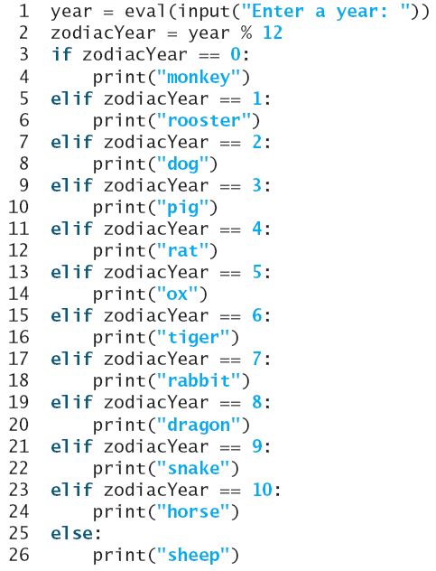
Example
ChineseZodiac

Slide 29
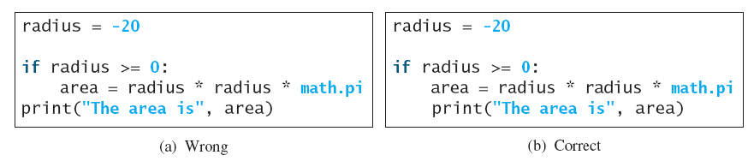
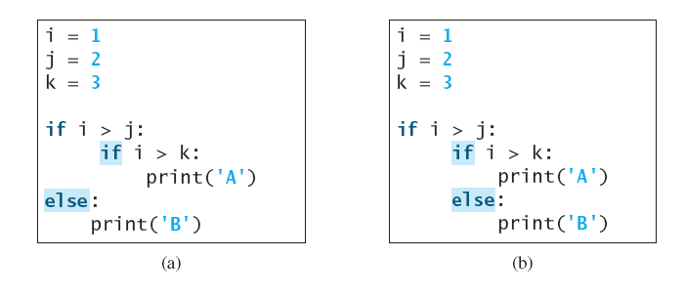
Common Errors
Most common errors in selection statements are caused by incorrect indentation. Consider the following code in (a) and (b).

Slide 30
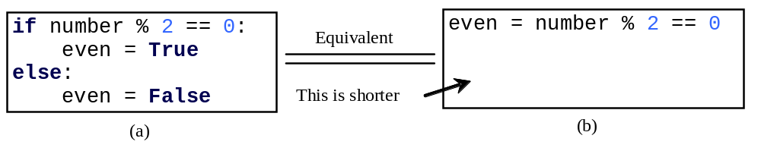
TIP
Simplify code in (a) below to (b)

Slide 31
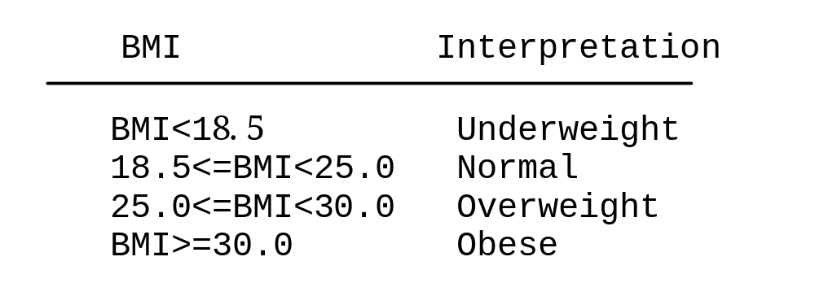
Case Study: Body Mass Index
Body Mass Index (BMI) is a measure of health on weight
It can be calculated by taking your weight in kilograms and dividing by the square of your height in meters
The interpretation of BMI for people 16 years or older is as follows:

Slide 32
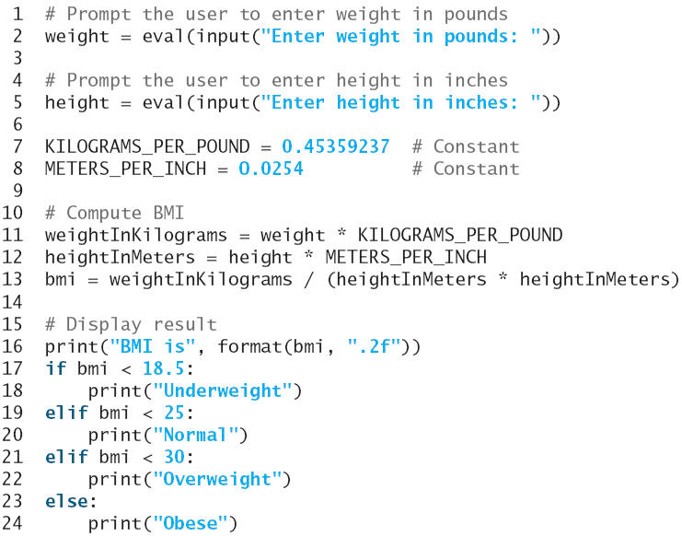
Case Study: Body Mass Index

Slide 33
Case Study: Computing Taxes
The US federal personal income tax is calculated based on the filing status and taxable income
There are four filing statuses: single filers, married filing jointly, married filing separately, and head of household
The tax rates for 2009 are shown below
Marginal Tax Rate | Single | Married Filing Jointly or Qualified Widow(er) | Married Filing Separately | Head of Household
10% | $0 – $8,350 | $0 – $16,700 | $0 – $8,350 | $0 – $11,950
15% | $8,351– $33,950 | $16,701 – $67,900 | $8,351 – $33,950 | $11,951 – $45,500
25% | $33,951 – $82,250 | $67,901 – $137,050 | $33,951 – $68,525 | $45,501 – $117,450
28% | $82,251 – $171,550 | $137,051 – $208,850 | $68,525 – $104,425 | $117,451 – $190,200
33% | $171,551 – $372,950 | $208,851 – $372,950 | $104,426 – $186,475 | $190,201 - $372,950
35% | $372,951+ | $372,951+ | $186,476+ | $372,951+

Slide 34
Case Study: Computing Taxes, cont.
Write a program to compute personal income tax
Prompt user for filing status : 0 for single filers, 1 for married filing jointly, 2 for married filing separately, and 3 for head of household
Program computes taxes as follows
if status == 0:
# Compute tax for single filers
elif status == 1:
# Compute tax for married filing jointly
elif status == 2:
# Compute tax for married filing separately
elif status == 3:
# Compute tax for head of household
else:
# Display wrong status

Slide 35
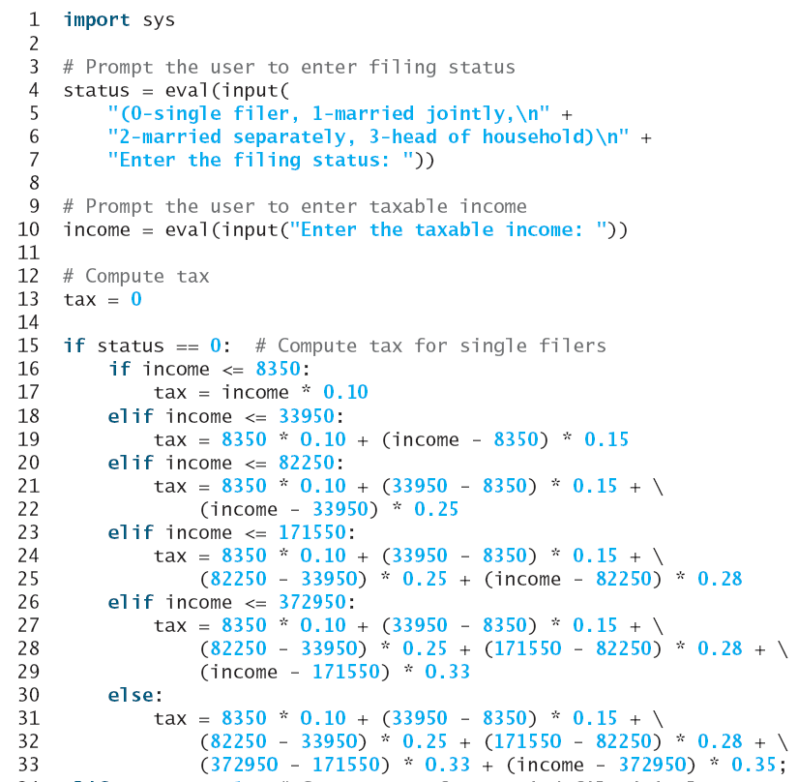

Slide 36
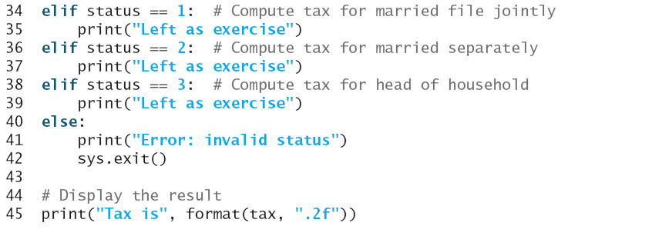
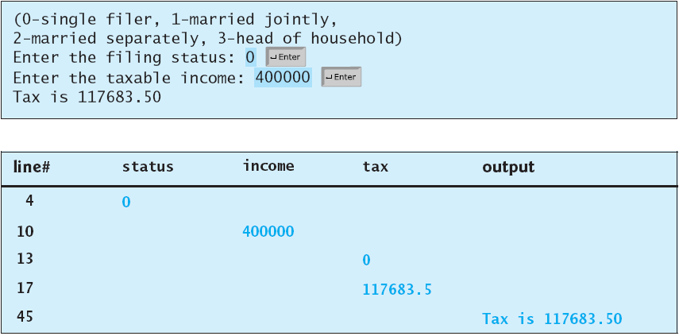

Slide 37
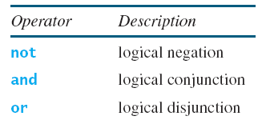
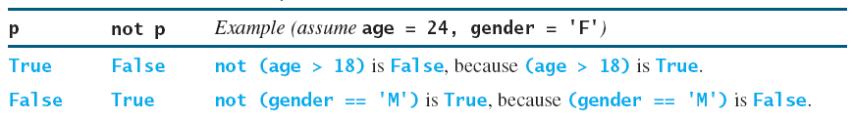
Logical Operators
Sometimes a combination of several conditions determines whether a statement is executed
Logical operators are used to combine conditions
Logical or Boolean operators operate on Boolean values to create a new Boolean value

Slide 38
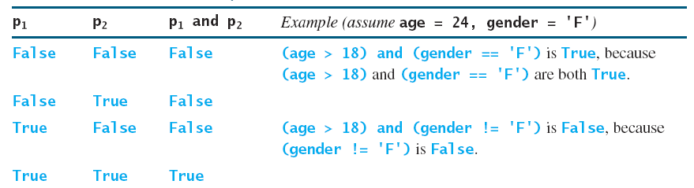
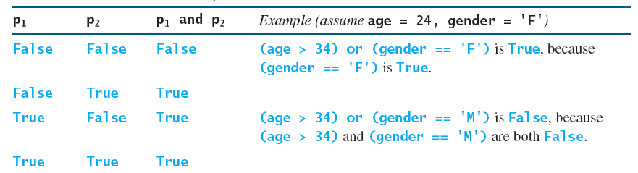
Truth Table for Operator and/or
or

Slide 39
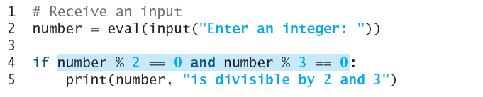
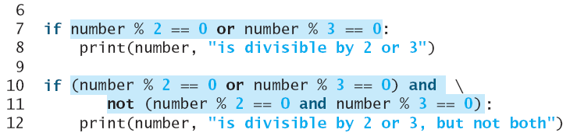
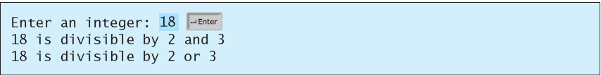
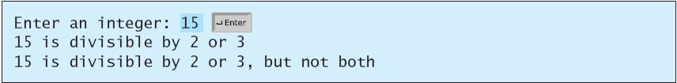
Examples
Here is a program that checks whether a number is divisible by 2 and 3, whether a number is divisible by 2 or 3, and whether a number is divisible by 2 or 3 but not both:
Run

Slide 40
De Morgan’s Law
Can be used to simplify Boolean expressions
not(c1 and c2) is the same as not c1 or not c2
not(c1 or c2) is the same as not c1 and not c2
not (number %2 == 0 and number %3 == 0) can be simplified to number %2 != 0 or number % 3 != 0

Slide 41
Short-circuiting
If one of the operands of an and operator is False, the expression is False
If one of the operands of an or operator is True, the expression is True
Python uses these properties to improve the performance of these operators
When evaluating p1 and p2
  evaluate p1 first and if p1 is True evaluate p2
  If p1 is False, no evaluation of p2 takes place
When evaluating p1 or p2
  evaluate p1 first and if p1 is False evaluate p2
  If p1 is True, no evaluation of p2 takes place
Demo short circuiting
  (or with non-existing variable: 1 or undefinedVar, and factorial/pow)

Slide 42
And/Or with non-Boolean Types
Value returned is not restricted to True or False, but rather to last evaluated argument
E.g.:y
  x = 0
  y = x or 33 // y will have value 33
not doesn’t work that way: it always returns a Boolean value
  E.g.:
    not ‘’ returns True
    not “abc” returns False

Slide 43
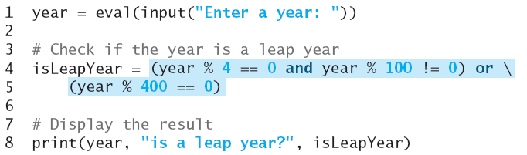
Problem: Determining Leap Year?
This program first prompts the user to enter a year as an int value and checks if it is a leap year
  Solar year: 365.242199
  Make average year length matches solar year: 365 + ¼ - 1/100 + 1/400 = 365.2425
A year is a leap year if it is divisible by 4 but not by 100, or it is divisible by 400
(year % 4 == 0 and year % 100 != 0) or (year % 400 == 0)
Run

Slide 44
Problem: Lottery
Write a program that randomly generates a lottery of a two-digit number, prompts the user to enter a two-digit number, and determines whether the user wins according to the following rule:
If the user input matches the lottery in exact order, the award is $10,000.
If the digits match all digits in the lottery, the award is $3,000.
If one digit in the user input matches a digit in the lottery, the award is $1,000.

Slide 45
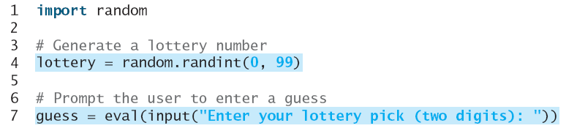
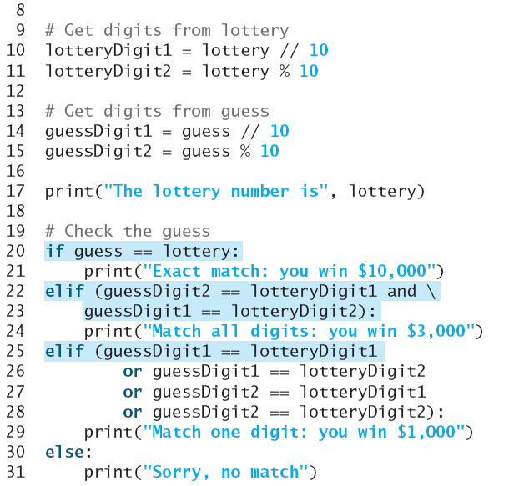

Slide 46
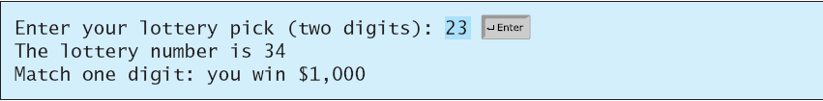
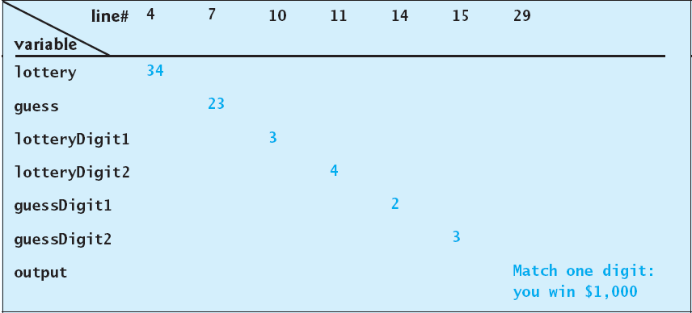

Slide 47
Conditional Operator
if x > 0:
y = 1
else:
y = -1
is equivalent to
y = 1 if x > 0 else -1
expression1 if boolean-expression else expression2

Slide 48
Conditional Operator
Assign the larger of number1 and number2 to max
Display message indicating whether number is even or odd

Slide 49

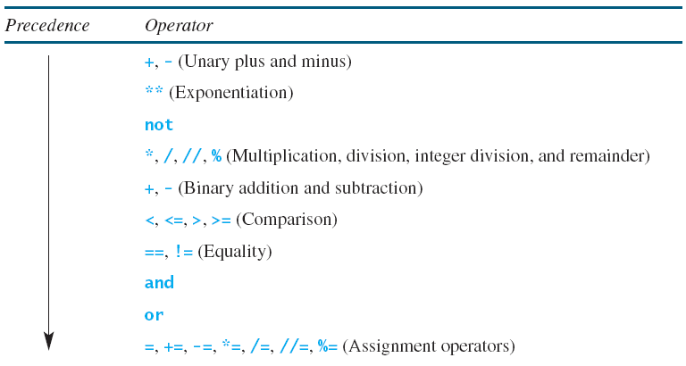
Operator Precedence
What is the value of the expression:
Expressions in parentheses are evaluated first
  For nested expressions, inner executes first
For expressions without parentheses, apply precedence and associativity rules
Precedence rules for operators that we learned

Slide 50
Operator Precedence
3 issues in table
What is the value of the expression:
-1**2?
** binds less tightly (as figure) when unary operator is on its right only (e.g 2**-1 = 0.5)
-1**2?
What is the value of the expression:
not 1 – 1 ?
Comparison and equality have same precedence order

Slide 51
Operator Precedence
If operators of same precedence are close to each other, associativity determines the order of evaluation
All binary operators except assignment and exponentiation are left associative
  a – b + c – d is equivalent to ((a – b) + c) – d
Assignment operators are right associative
  a = b = c = 5 is equivalent to a = (b = (c = 5))
  For nested expressions, inner executes first
For expressions without parentheses, apply precedence and associativity rules

Slide 52
Operator Associativity
When two operators with the same precedence are evaluated, the associativity of the operators determines the order of evaluation. All binary operators except assignment operators and exponentiation are left-associative.
a – b + c – d is equivalent to ((a – b) + c) – d
Assignment operators are right-associative. Therefore, the expression
a = b = c = 5 is equivalent to a = (b = (c = 5))
** is right associative : 2**3**2 = 2**(3**2)=512
Why is exponentiation right associative?

