Slide 1
Chapter 2 Elementary Programming

Slide 2
Motivations
Suppose, for example, that you need to take out a student loan. Given the loan amount, loan term, and annual interest rate, can you write a program to compute the monthly payment and total payment? This chapter shows you how to write programs like this. Along the way, you learn the basic steps that go into analyzing a problem, designing a solution, and implementing the solution by creating a program.

Slide 3
Objectives
To write programs that perform simple computations (§2.2).
To obtain input from a program’s user by using the input function (§2.3).
To use identifiers to name variables and functions (§2.4).
To assign data to variables (§2.5).
To perform simultaneous assignments (§2.6).
To define named constants (§2.7)
To use the operators +, -, *, /, //, %, and ** (§2.8).
To write and evaluate numeric expressions (§2.9).
To use augmented assignment operators to simplify coding (§2.9).
To perform numeric type conversion and rounding with the int and round functions (§2.11).
To obtain the current system time by using time.time() (§2.12).
To describe the software development process and apply it to develop the loan payment program (§2.13).
To compute and display the distance between two points (§2.14).

Slide 4
Writing a Simple Program
An algorithm describes how a problem is solved by listing the actions that need to be taken
Algorithms can help a programmer plan a program before writing it
Algorithms are usually described in a natural language or in pseudocode
To compute the area of a circle
  Get the circle’s radius
  Compute the area by applying the formula
    Area= radius x radius x pi
  Display the result
Storing the radius in the program
  Value is stored in the computer’s memory
  A program uses a variable to access it
  In our example, use radius and for the names of variables

Slide 5
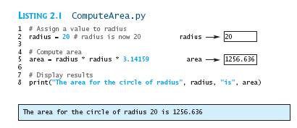
Writing a Simple Program
Variables in Python do not have a data type like in other programming languages
Python automatically figures out the data type according to the value assigned to the variable
print uses the syntax
  print(item1,iterm2, …, itemk)
ComputeArea
Run

Slide 6
Trace a Program Execution
animation
Assign 20 to radius
# Assign a radius
radius = 20 # radius is now 20
# Compute area
area = radius * radius * 3.14159
# Display results
print("The area for the circle of radius " +
str(radius) + " is " + str(area))
radius
20

Slide 7
Trace a Program Execution
animation
Assign result to area
# Assign a radius
radius = 20 # radius is now 20
# Compute area
area = radius * radius * 3.14159
# Display results
print("The area for the circle of radius“,
radius, " is "area)
radius
20
area
1256.636

Slide 8
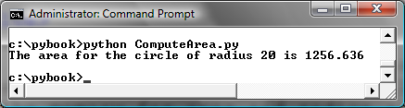
Trace a Program Execution
animation
print a message to the console
# Assign a radius
radius = 20 # radius is now 20
# Compute area
area = radius * radius * 3.14159
# Display results
print("The area for the circle of radius",
radius, "is", area)
radius
20
area
1256.636

Slide 9
Reading Input from the Console
1. Use the input function
  variable = input("Enter a string: ")
2. Use the eval function
  var = eval(stringVariable)
  eval("51 + (54 * (3 + 2))") returns 321.
ComputeAreaWithConsoleInput
ComputeAverage
Run
Run

Slide 10

Reading Input from the Console
Normally a statement ends at the end of a line
Statements can be split on multiple lines
  E.g.: print statement in previous example
  Python scans the print statement and knows it is not finished until it finds the closing parenthesis
In some cases, Python interpreter cannot determine the end of the statement written on multiple lines
You can use line continuation symbol (\) at the end of line

Slide 11
Identifiers
An identifier is a sequence of characters that consists of letters, digits, underscores (_)
An identifier must start with a letter or an underscore. It cannot start with a digit.
An identifier cannot be a reserved word. (See Appendix A, "Python Keywords," for a list of reserved words.) Reserved words have special meanings in Python, which we will later.
An identifier can be of any length.
Area, radius, number1 are valid identifiers

Slide 12
Variables and Expressions
Assignment statement: statement for assigning a value to a variable
  = is called an assignment operator
  Syntax: variable = expression
Variable radius is initially assigned 1.0 and then changed to 2.0
Same for the variable area
# Compute the first area
radius = 1.0
area = radius * radius * 3.14159
print("The area is ", area,
" for radius ", radius)
# Compute the second area
radius = 2.0
area = radius * radius * 3.14159
print("The area is ", area,
" for radius ", radius)

Slide 13
Variables and Expressions
Memory model: statement for assigning a value to a variable
  Every memory byte has an address
  Mark addresses with an id (id1,id2,…)
Program
Objects
Variables/Frames
Other

Slide 14
Variables and Expressions
Memory model: statement for assigning a value to a variable
  Every memory byte has an address
  Mark addresses with an id (id1,id2,…)
Program
Objects
Variables/Frames
Other

Slide 15
Variables and Expressions
Memory model: statement for assigning a value to a variable
  Every memory byte has an address
  Mark addresses with an id (id1,id2,…)
Variables
/Frames
Objects

Slide 16
Variables and Expressions
Memory model: statement for assigning a value to a variable
  Every memory byte has an address
  Mark addresses with an id (id1,id2,…)
id0
Variables
/Frames
id1
Objects
id2
id3

Slide 17
Variables and Expressions
Memory model: statement for assigning a value to a variable
  Every memory byte has an address
  Mark addresses with an id (id1,id2,…)
# Compute the first area
radius = 1.0
area = radius * radius * 3.14159
print("The area is ", area,
" for radius ", radius)
# Compute the second area
radius = 2.0
area = radius * radius * 3.14159
print("The area is ", area,
" for radius ", radius)
id1
radius
id1
1.0

Slide 18
Variables and Expressions
Memory model: statement for assigning a value to a variable
  Every memory byte has an address
  Mark addresses with an id (id1,id2,…)
# Compute the first area
radius = 1.0
area = radius * radius * 3.14159
print("The area is ", area,
" for radius ", radius)
# Compute the second area
radius = 2.0
area = radius * radius * 3.14159
print("The area is ", area,
" for radius ", radius)
id1
radius
id1
1.0
id2
area
id2
3.14159

Slide 19
Variables and Expressions
Memory model: statement for assigning a value to a variable
  Every memory byte has an address
  Mark addresses with an id (id1,id2,…)
# Compute the first area
radius = 1.0
area = radius * radius * 3.14159
print("The area is ", area,
" for radius ", radius)
# Compute the second area
radius = 2.0
area = radius * radius * 3.14159
print("The area is ", area,
" for radius ", radius)
id1
radius
id3
1.0
id2
area
id4
3.14159
id3
2.0

Slide 20
Variables and Expressions
Memory model: statement for assigning a value to a variable
  Every memory byte has an address
  Mark addresses with an id (id1,id2,…)
# Compute the first area
radius = 1.0
area = radius * radius * 3.14159
print("The area is ", area,
" for radius ", radius)
# Compute the second area
radius = 2.0
area = radius * radius * 3.14159
print("The area is ", area,
" for radius ", radius)
id1
radius
id3
1.0
id2
area
id4
3.14159
id3
2.0
id4
12.56636

Slide 21



Variables and Expressions
An expression represents a computation involving values, variables, and operators
A variable can be used on both sides of the = operator
To assign a value to a variable, place variable name to the left of assignment

Slide 22
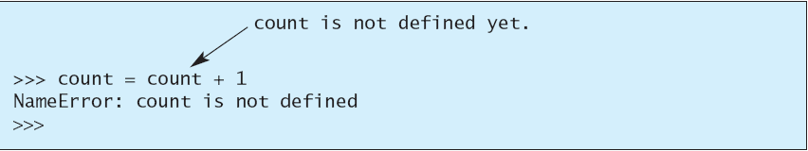

Variables and Expressions
Every variables has a scope
  Part of the program where the variable can be referenced
  Rules for scope will be introduced as gradually
  For now: a variable must be created BEFORE it is used
What is wrong with the following code?

Slide 23
Simultaneous Assignment
var1, var2, ..., varn = exp1, exp2, ..., expn
Evaluate all expressions on the right and assign them to corresponding variable on the left SIMULTANEOUSLY
Example usage: swapping 2 variables
Example 2: Obtain multiple input in one statement
  Prompt user to enter 3 numbers and compute average
x, y = y, x # Swap x with y
ComputeAverageWithSimultaneousAssignment
Run

Slide 24
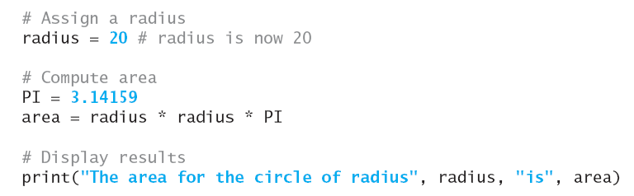
Named Constants
The value of a variable may change during the execution of a program
A named constant or simply constant represents permanent data that never changes.
Python does not have a special syntax for naming constants.
You can simply create a variable to denote a constant. To distinguish a constant from a variable, use all uppercase letters to name a constant

Slide 25
Named Constants
Benefits to using constants
  Don’t type the value if used multiple times
  To change value, change it in one location (e.g, change value of pi)
  Names make programs easier to read

Slide 26
Numerical Data Types and Operators
Python has 2 numeric types: integers and floating-point numbers
  Integer types (int) are for representing whole numbers (unlimited precision)
  Floating-point represent numbers with a fractional part
  2 types are stored differently
A number that has a decimal point is a float even if its fractional part is 0 (1.0 is a float but 1 is an integer)
A literal is a constant that appears directly in a program

Slide 27
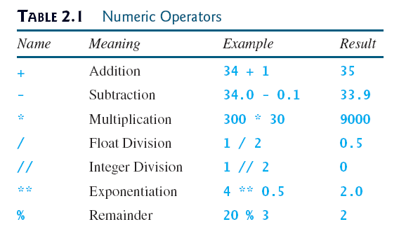
Numeric Operators

Slide 28
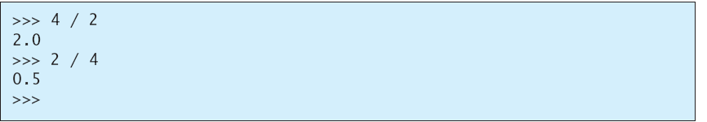
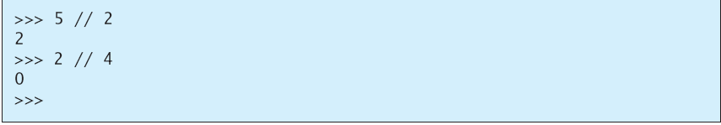
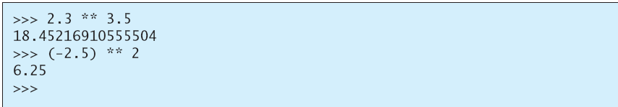
Numeric Operators

Slide 29
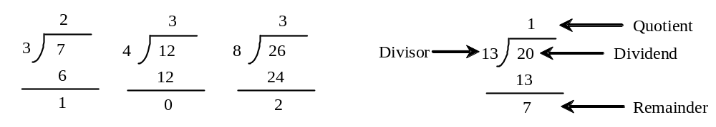
The % Operator

Slide 30

Remainder Operator
Remainder is very useful in programming. For example, an even number % 2 is always 0 and an odd number % 2 is always 1.
So you can use this property to determine whether a number is even or odd.
Suppose today is Saturday and you and your friends are going to meet in 10 days. What day is in 10 days? You can find that day is Tuesday using the following expression:

Slide 31
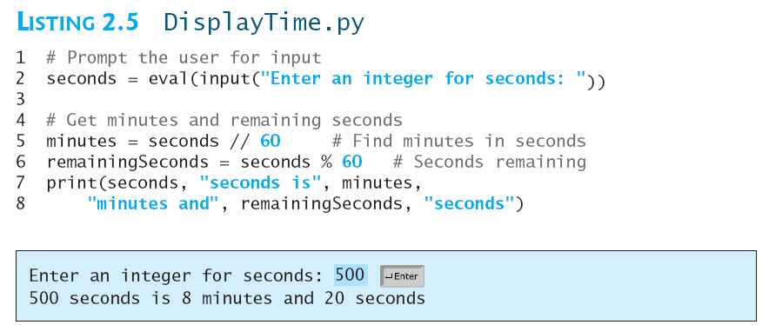
Problem: Displaying Time
Write a program that obtains minutes and seconds from seconds.
DisplayTime
Run

Slide 32
Overflow
When a variable is assigned a value that is too large (in size) to be stored, it causes overflow. For example, executing the following statement causes overflow.
>>>245.0 ** 1000
OverflowError: 'Result too large'

Slide 33
Underflow
When a floating-point number is too small (i.e., too close to zero) to be stored, it causes underflow. Python approximates it to zero. So normally you should not be concerned with underflow.

Slide 34
Scientific Notation
Floating-point literals can also be specified in scientific notation
  1.23456e+2, same as 1.23456e2, is equivalent to 123.456
  1.23456e-2 is equivalent to 0.0123456.
  E (or e) represents an exponent and it can be either in lowercase or uppercase.

Slide 35

Evaluating Expressions
is translated to
(3+4*x)/5 – 10*(y-5)*(a+b+c)/x + 9*(4/x + (9+x)/y)
Arithmetic rules for evaluating expressions
  ** applied first
  *, /, //, % are applied next (from left to right)
  +,- applied last (from left to right)
Parentheses are evaluated inside out and from left to right

Slide 36
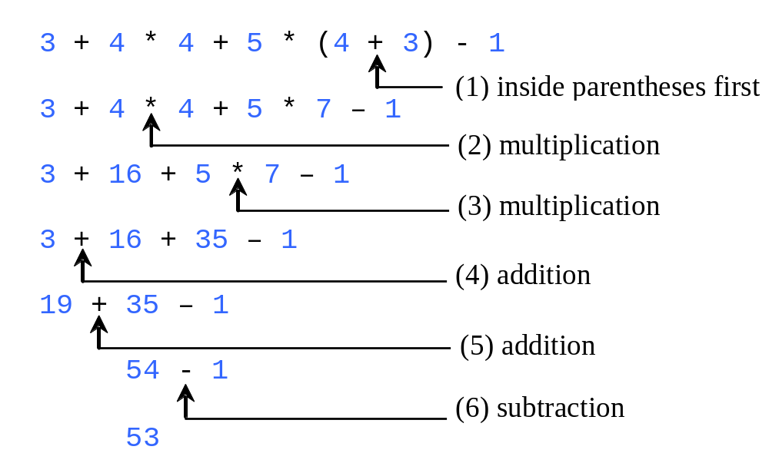
Evaluating Expressions

Slide 37


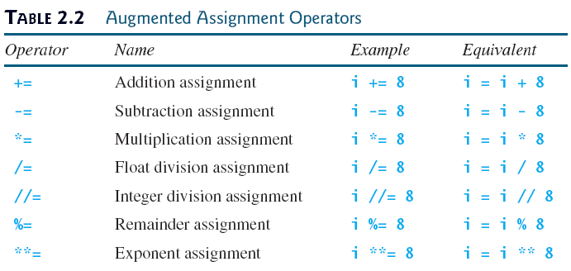
Augmented Assignment Operators
Common operation: value of a variable is used, modified, and then reassigned back to the same variable
Combine assignment and addition operators (e.g: += is addition assignment operator)

Slide 38
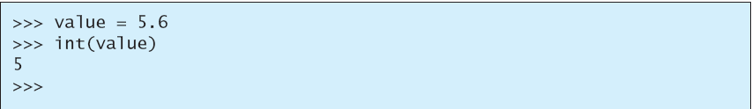
Type Conversion and Rounding
How to perform operation with 2 operands of different types?
  E.g: integer + float: Python automatically converts integer to a float value (type conversion)
  3*4.5 is the same as 3.0*4.5
You can use the type name to do the conversion explicitly
  int(4.5) = 4
  float(4) = 4.0

Slide 39
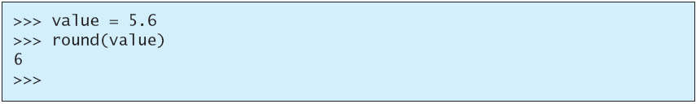
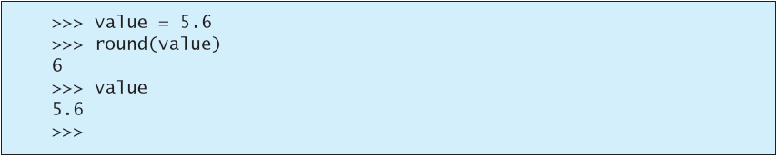
Type Conversion and Rounding
Converting a float to int truncates rather than rounds up the number
Use round function for rounding (to be discussed in detail in chapter 3)
int and round do not change the variable being converted

Slide 40
Type Conversion and Rounding
How to perform operation with 2 operands of different types?
  E.g: integer + float: Python automatically converts integer to a float value (type conversion)
  3*4.5 is the same as 3.0*4.5
You can use the type name to do the conversion explicitly
  int(4.5) = 4
  float(4) = 4.0

Slide 41
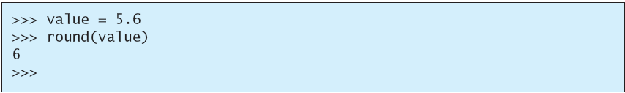
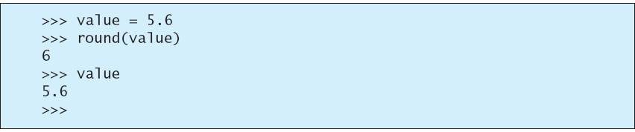
Type Conversion and Rounding
You can also use the round function to round a number to the nearest whole value (instead of truncating)
int and round do not change the variable being converted

Slide 42
Type Conversion and Rounding
int vs eval
  int can also be used to convert a string to an integer
    int does not work on non-integer strings
      int(“3.4”) will cause an error
      int(“3+4”) will cause an error
      int(“ 34”) results in 34
      int(“ -34 “) results in -34
  eval evaluates a complex expression
    eval(“3+4”) results in 7
    eval(“ 34”) results in 34
    eval(“ -34 “) results in -34

Slide 43
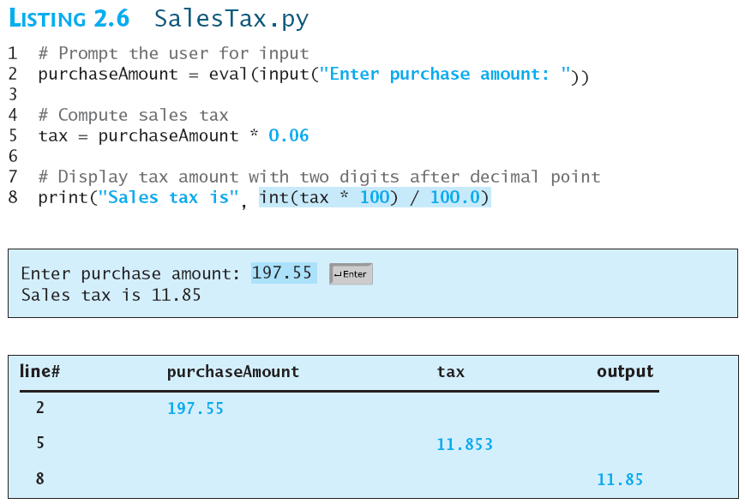
Keeping Two Digits After Decimal Points
Write a program that displays the sales tax with two digits after the decimal point.
SalesTax
Run

Slide 44
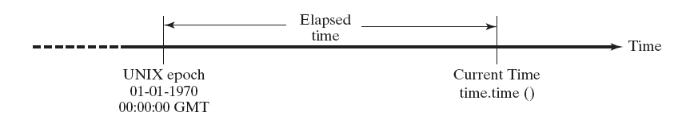
Displaying Current Time
- Write a program that displays current time in GMT in the format hour:minute:second such as 1:45:19.
- The time.time() function returns the current time in seconds with millisecond precision since the midnight, January 1, 1970 GMT. (1970 was the year when the Unix operating system was formally introduced.)
- You can use this function to obtain the current time, and then compute the current second, minute, and hour as follows.

Slide 45
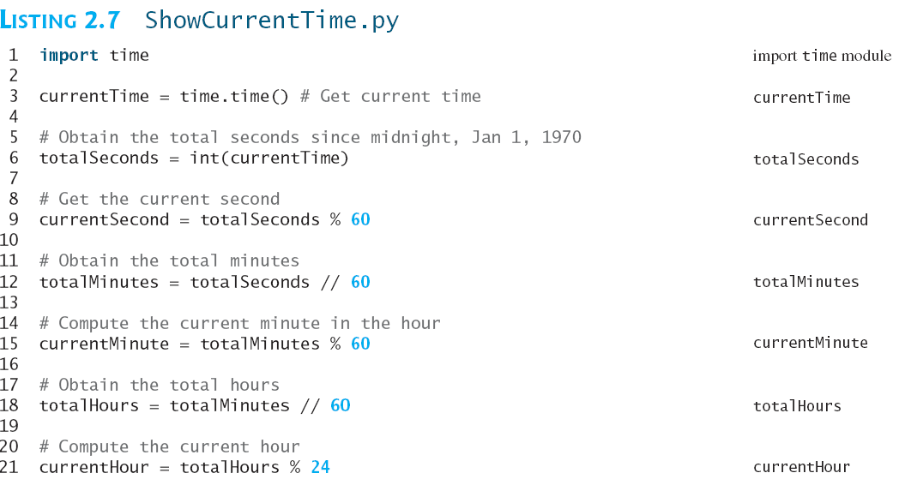
Displaying Current Time

Slide 46
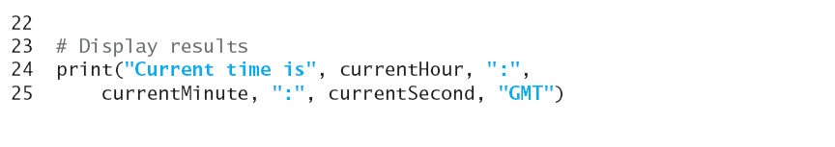
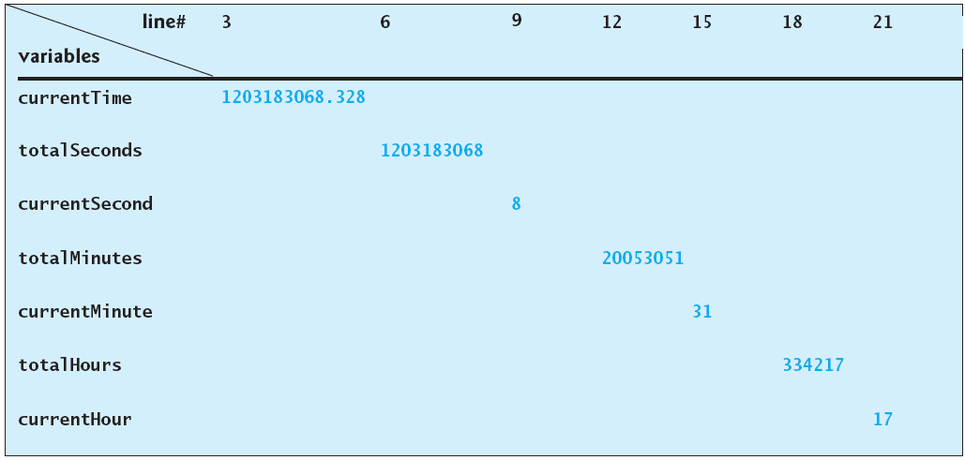
Displaying Current Time
ShowCurrentTime
Run

Slide 47
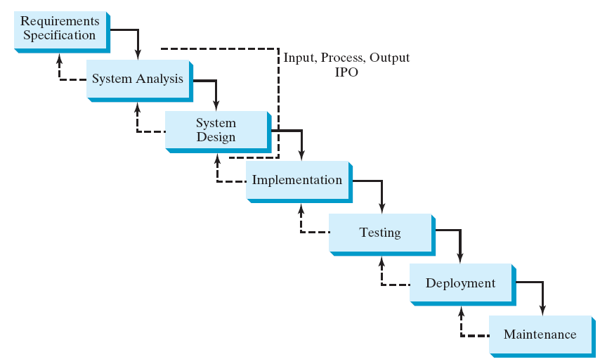
Software Development Process

Slide 48
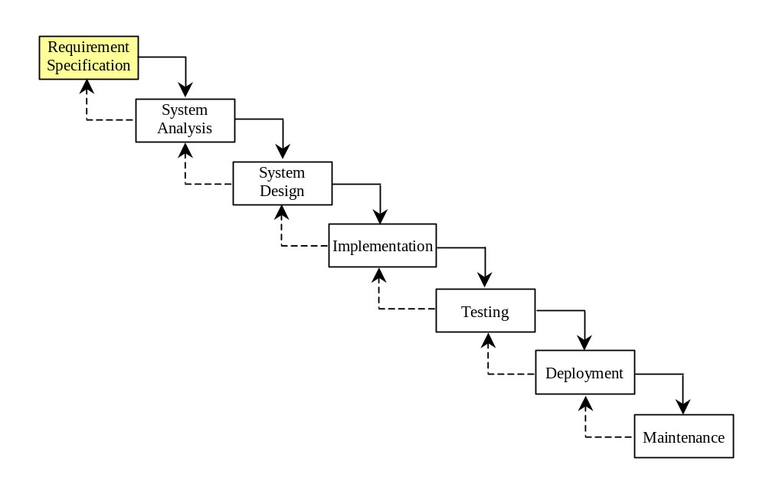
Requirement Specification
A formal process that seeks to understand the problem and document in detail what the software system needs to do. This phase involves close interaction between users and designers.
Most of the examples in this book are simple, and their requirements are clearly stated. In the real world, however, problems are not well defined. You need to study a problem carefully to identify its requirements.

Slide 49
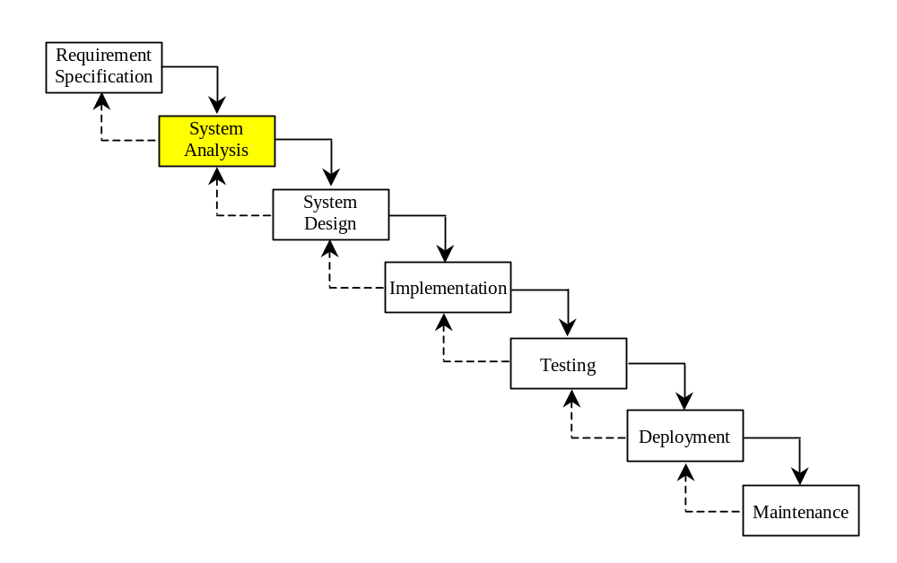
System Analysis
Seeks to analyze the business process in terms of data flow, and to identify the system’s input and output.
Part of the analysis entails modeling the system’s behavior. The model is intended to capture the essential elements of the system and to define services to the system.

Slide 50
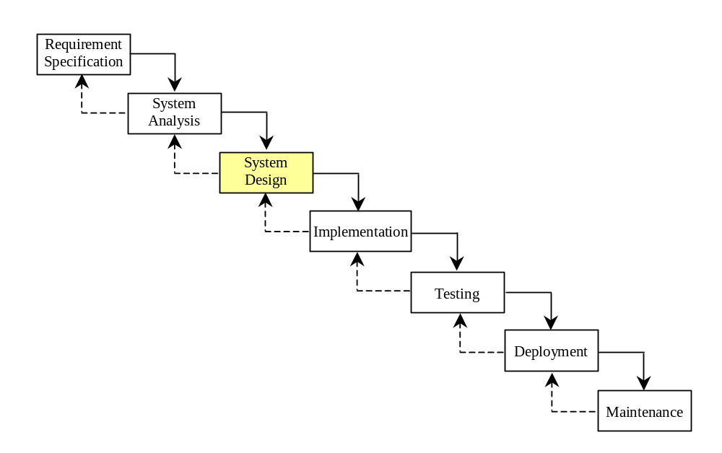
System Design
The process of decomposing system into components and designing the components.
This phase involves the use of many levels of abstraction to decompose the problem into manageable components, identify classes and interfaces, and establish relationships among the classes and interfaces.

Slide 51
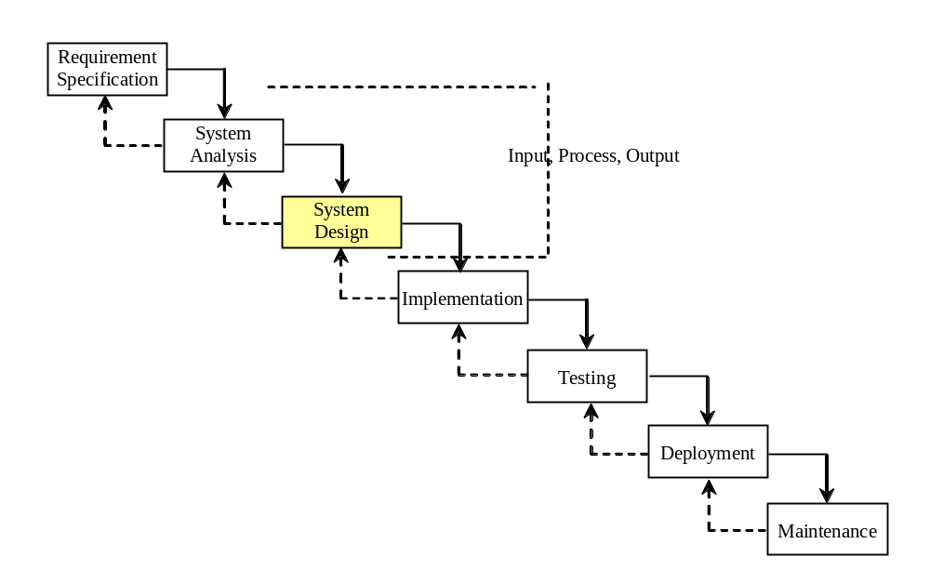
IPO
The essence of system analysis and design is input, process, and output. This is called IPO.

Slide 52
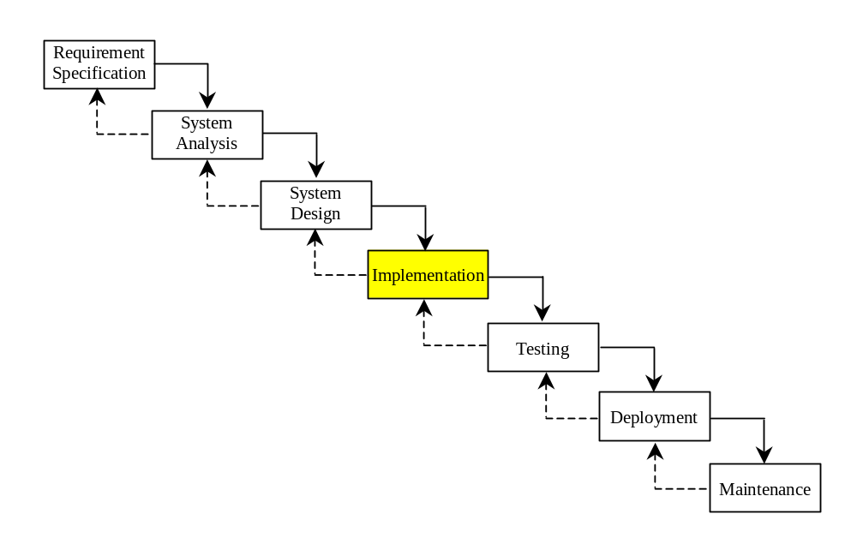
Implementation
The process of translating the system design into programs. Separate programs are written for each component and put to work together.
This phase requires the use of a programming language like Python. The implementation involves coding, testing, and debugging.

Slide 53
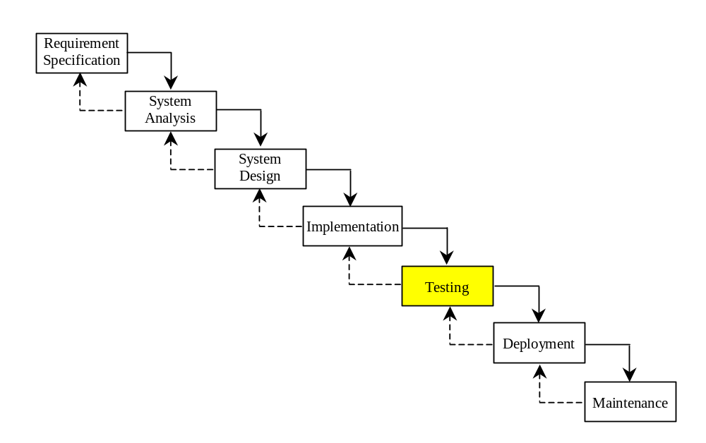
Testing
Ensures that the code meets the requirements specification and weeds out bugs.
An independent team of software engineers not involved in the design and implementation of the project usually conducts such testing.

Slide 54
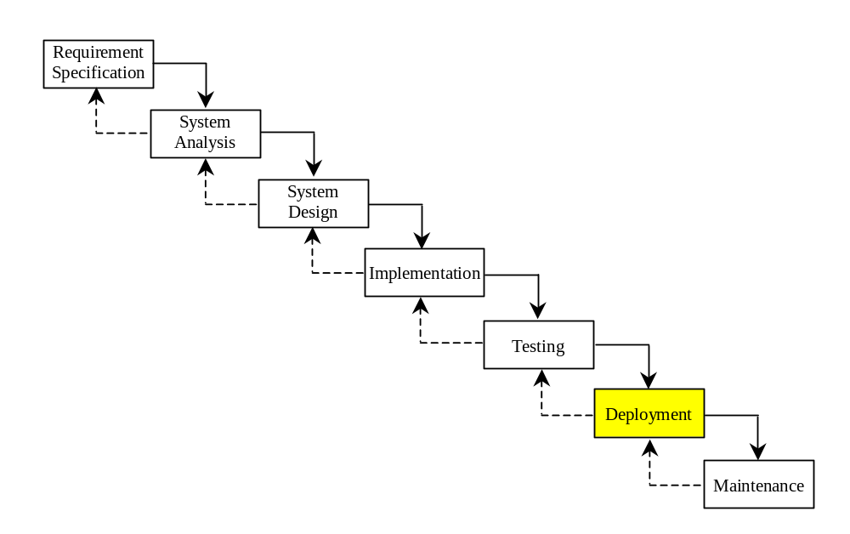
Deployment
Deployment makes the project available for use.

Slide 55
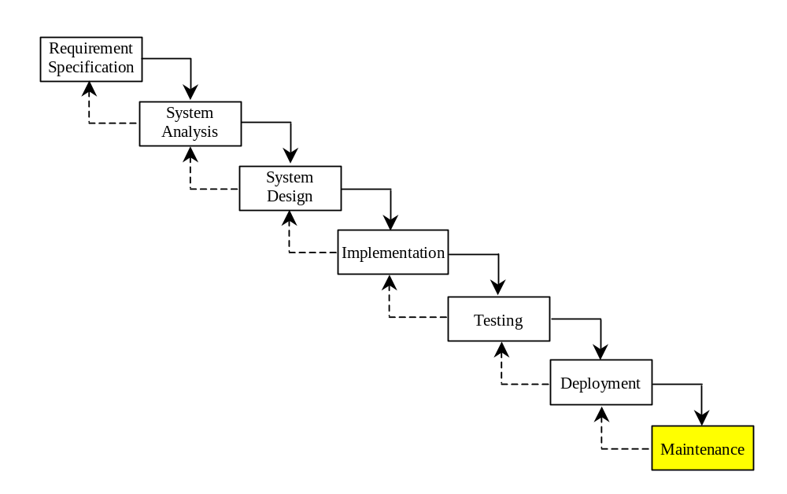
Maintenance
Maintenance is concerned with changing and improving the product.
A software product must continue to perform and improve in a changing environment. This requires periodic upgrades of the product to fix newly discovered bugs and incorporate changes.

Slide 56

Problem: Computing Loan Payments
This program lets the user enter the interest rate, number of years, and loan amount, and computes monthly payment and total payment.
ComputeLoan
Run

Slide 57
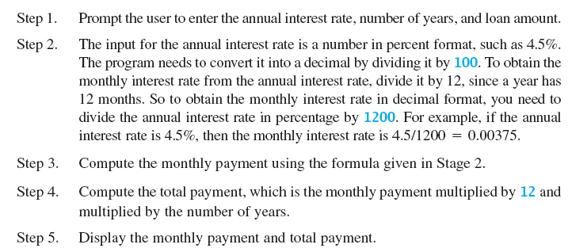
Case Study: Computing Loan Payments
This program prompts the user to enter two points, computes their distance, and displays the points.

Slide 58
Case Study: Computing Loan Payments

Slide 59

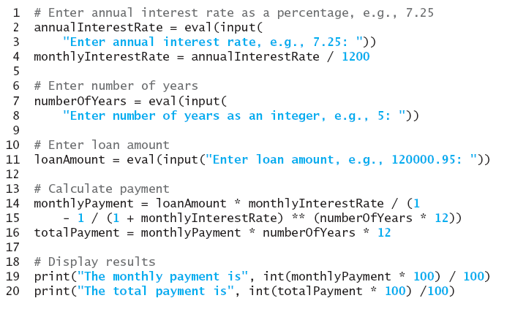
Case Study: Computing Loan Payments

Slide 60
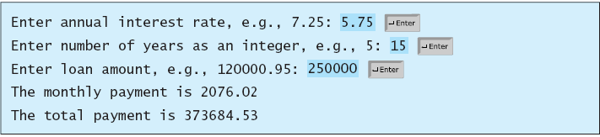
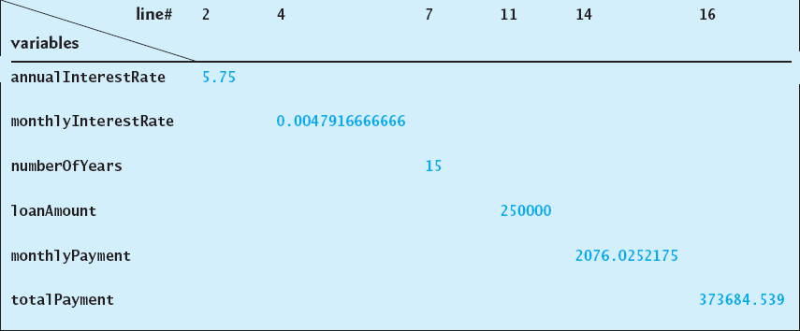
Case Study: Computing Loan Payments

Slide 61

Case Study: Computing Distances
This program prompts the user to enter two points, computes their distance, and displays the points and their distances in graphics.

Slide 62
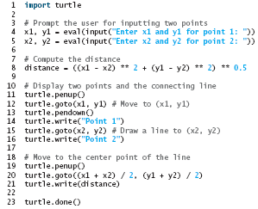
Case Study: Computing Distances

Slide 63
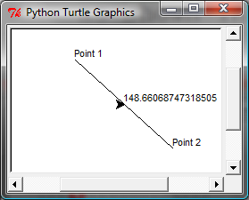
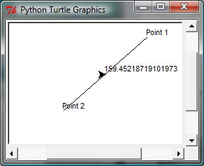
Case Study: Computing Distances

