Slide 1
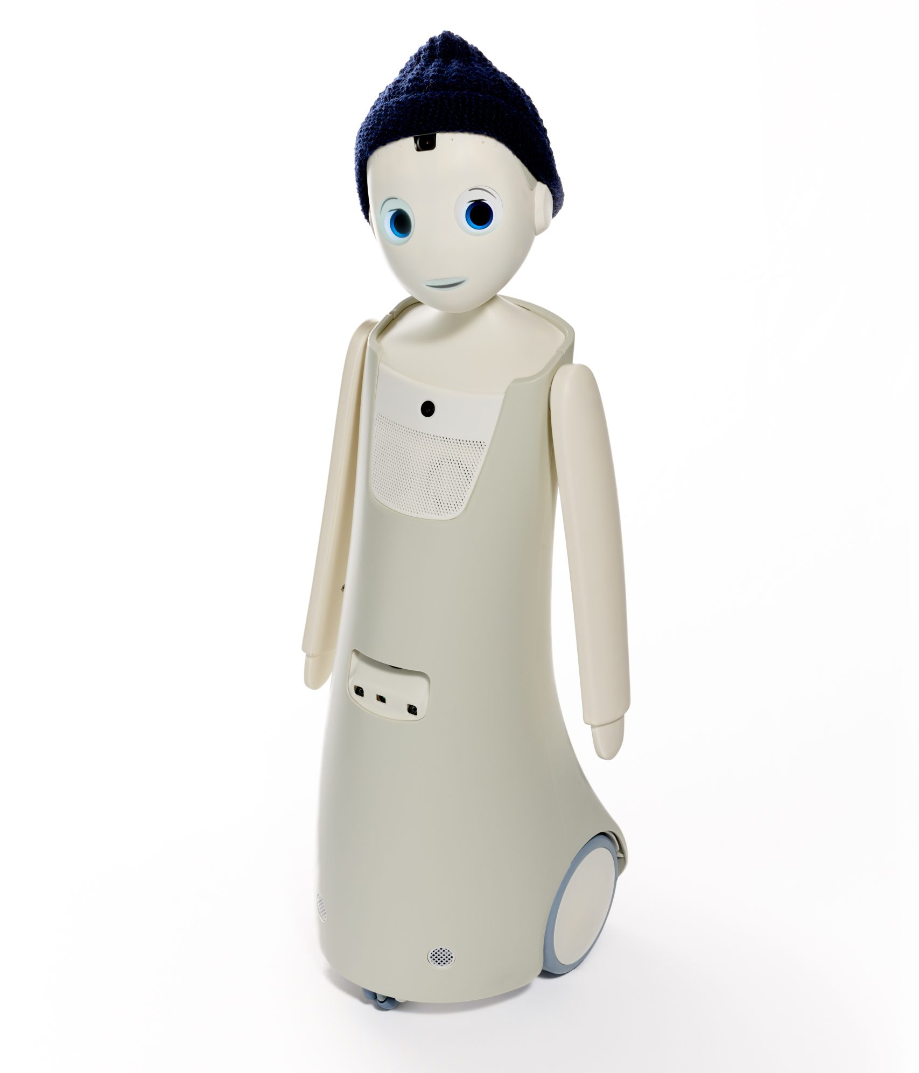

Project 59
Interactive Social Guide Robot
Decision making using a rule-based and an LLM-integrated navigation pipeline
Background
Objective
A guide robot must recognise interest in interaction while roaming the laboratory. Changing gaze and distance, and missed detections, make this decision difficult. [1]
Develop a temporal social-state pipeline for Navel to support a comparison and evaluation of rule-based and LLM decisions in navigation scenarios
RQ1
How can gaze and distance observations over time be structured into a shared social-state representation for rule-based and LLM decision-making?
RQ2
How well can an LLM’s decisions align with human preferences and appropriateness ratings, compared with those of a rule-based policy using the same representation?
Our Pipeline
Navel Sensors
Track History
Shared Social State
Decision Policies
Person detections, social cues and robot movement data
Person histories, changes in attention and distance, and observation quality
A structured summary of the social context and available evidence
Rule-based and LLM policies select an action from the same social state
Four possible actions
APPROACH
ENGAGE
YIELD
CONTINUE
Interested person
farther away
Interested person
already nearby
Person needs
room to pass
No sustained
interest in interaction
Hello!
Move closer
Stop and greet
Give room to pass
Stay on the route
Results
Conclusion and future work
Eddie Kim and Jeruh Kim
Electrical, Computer and
Software Engineering
Contact: hkim807@aucklanduni.ac.nz jkim828@aucklanduni.ac.nz
Supervisor: Ho Seok Ahn
[Official department logo to add]
[1] Project 59 development replay. [2] Initial survey (37 responses). Photo: navel robotics. Thanks to our survey participants.
Notes:
Draft poster for Project 59. Students: Eddie Kim and Jeruh Kim. Supervisor: Ho Seok Ahn. Contact: hkim807@aucklanduni.ac.nz.
Sources: /Users/eddiekim/Downloads/Poster Design Guide.pdf (A1 portrait, required fields, PDF <50 MB). Its 2024 deadline is historical. /Users/eddiekim/Downloads/Speech_Nilushika2023.pdf. Layout reference: /Users/eddiekim/Downloads/Poster_77 (1).pdf.
Survey source: /Users/eddiekim/Downloads/Human Evaluation of Robot Behaviour (Responses).xlsx, Form responses 1. Preference counts and all 36 rating means independently verified against config/human-reference.json. Every preference bar sums to 37. Unable to judge is a survey response, not an action.
Pipeline source: docs/results/first-action-live-output/results.csv, report.md, verification.json. Nine SDK captures, first valid policy output, identical initial eligible states. qwen2.5:7b, temperature 0, seed 42, warmed model. Times are from replay start, not inference latency. All actions NOT_EXECUTED_OFFLINE.
Both policies produce outputs in S2,S3,S9. Six no-action cases remain in coverage denominator. LLM outputs fail live-client acceptance (S2 stale observation, S3 gaze not ready, S9 person no longer visible). Acceptance/timings reflect one development replay and may vary.
The survey clips are trimmed and trim offsets are unavailable. This prevents survey-end human-alignment scoring. Initial survey is completed. Human evaluation of actual completed-system behaviour is future work. Do not claim VLM/hybrid results or policy superiority.
Navel product image: https://navelrobotics.com/wp-content/uploads/2025/02/Navel0157-scaled.jpg via https://navelrobotics.com/en/navel-the-new-empathy-robot-for-good-care/. University logo extracted unchanged from supplied exemplar. Official department logo is a labelled draft field. No sponsor confirmed.
Fonts Rubik and Noto Sans are design selections evoking the robot, not verified official brand fonts.

