Slide 1
Figure 1
a)
3 ✕ 10⁸
High food scenario – cool season (both temperate and tropical)
1.5 ✕ 10⁸
High food scenario – warm season and constant environments (both temperate and tropical)
Low food scenario – cool season
Low food scenario – warm season and constant environments
b)
6 ✕ 10⁶
Tropical warm season (299 K)
Tropical constant environment and cool season (295 K)
3 ✕ 10⁶
Temperate warm season (294 K)
Temperate constant environment and cold season (290 K)
Figure 1. a) Food relationships with body length (foodscapes) did not vary between tropical and temperate scenarios, but changed seasonally. Food increased during the cool season (dashed lines) above a baseline (solid red) in both rich and poor environments. Thickness of lines indicate the abundance of food (productivity) of the environment overall. Solid lines indicate constant tropical or temperate environments, or the average temperature in the cool season of tropical and temperate environments e. b) In seasonal environments, costs increased during the warm season (dashed lines).

Slide 2
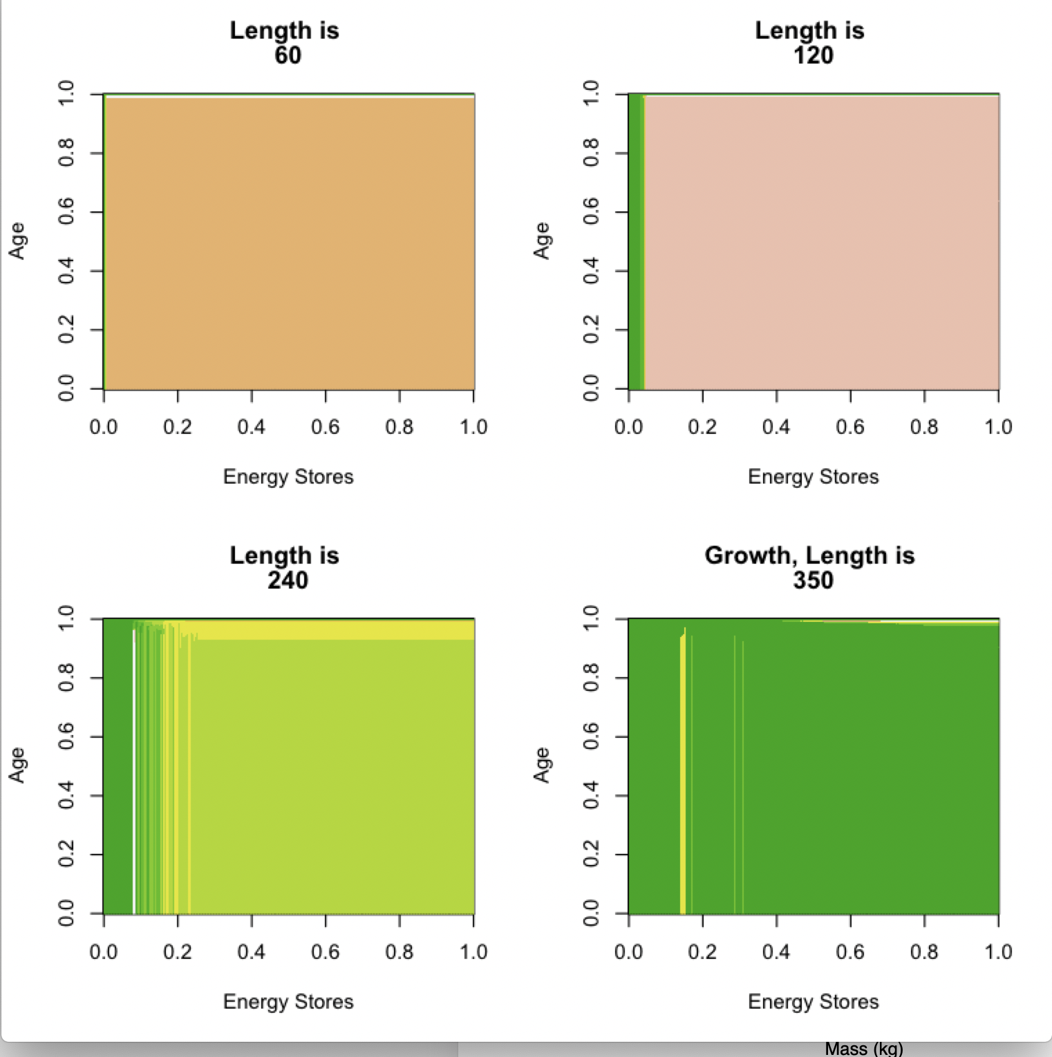
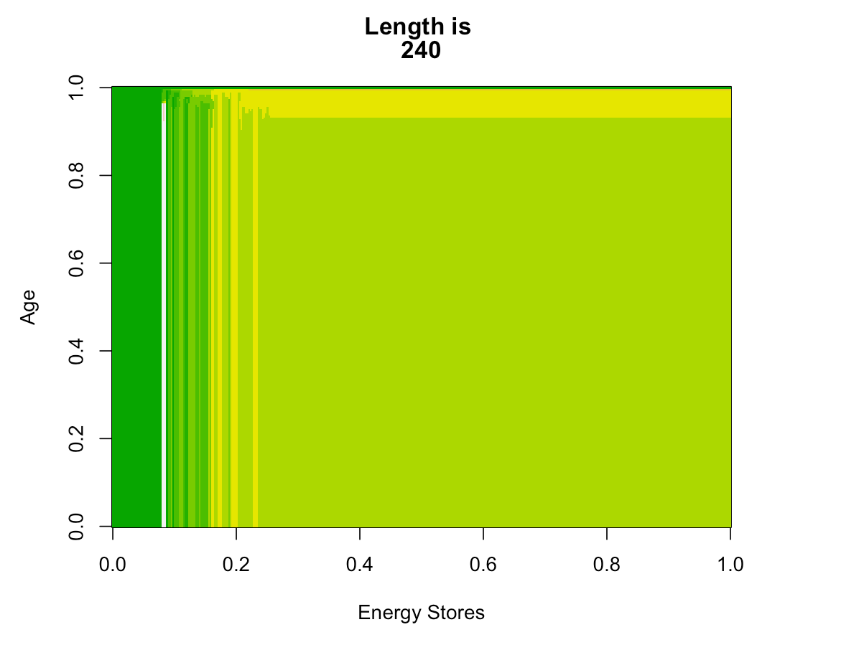
Figure 2.
a)
Allometric relationships emerging from the size spectrum
Food availability (J/month)
Metabolic costs (J)
Mortality rate
b)
Fraction of stores allocated to growth
Age (years)
l(t) = 60 cm
w₁(t) = 2.16 kg
l(t) = 120 cm
w₁(t) = 17.28 kg
l(t) = 240 cm
w₁(t) = 138.24 kg
c)
Energy stores (J)
Allocation of all energy on reproduction (none to growth) when stores are too limited to meet metabolic overhead
18
Near end of life allocation to growth increases and overhead decreases
9
Optimal allocation of 40% of stores on growth; the rest goes to reproduction and a metabolic overhead
Age (years)
Vertical stripes indicate where strategies are mixed and can be influenced by integer values of state
0
0
8.4 ✕ 10⁸
1.68 ✕ 10⁹
Energy stores (J)
Figure 2. a) The relationships between food (black line), mortality (red line), and metabolic costs (blue line) and structural body mass for a constant, cool high-food low-risk environment, generating the strategy in b and c. b) Example rule (the solution of Eq. 8) for allocation to growth at three body lengths (60, 120, and 240 cm). Note that there is minimal variation in age-dependent variation in allocation to growth, but that allocation does change with body size. For smaller fish, energetic state only changes the optimal strategy when it is very low (green vertical stripes). c) Detail of the optimal allocation to growth at 240 cm, for every combination of energetic stores and age.

Slide 3
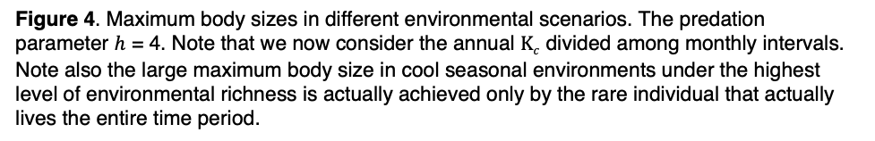
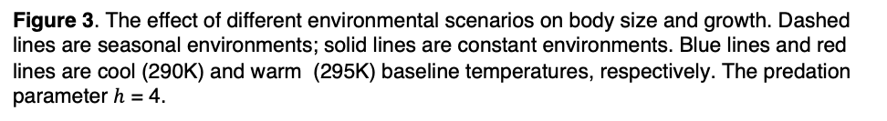




Figure 3
$$Κc=1$$
$$Κc=2.5$$
$$Κc=5$$
Figure 3. The effect of different environmental scenarios on body size and growth. Dashed lines are seasonal environments; solid lines are constant environments. Blue lines and red lines are cool (290K) and warm (295K) baseline temperatures, respectively. The predation parameter $h$ = 4.
Figure 4
Base Temperature
$Κc$ (per month)
Figure 4. Maximum body sizes in different environmental scenarios. The predation parameter $h$ = 4. Note that we now consider the annual $Κc$ divided among monthly intervals. Note also the large maximum body size in cool seasonal environments under the highest level of environmental richness is actually achieved only by the rare individual that actually lives the entire time period.

Slide 4

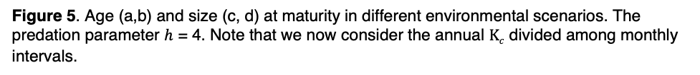

Figure 5
Base Temperature
$Κc$ (per month)
Base Temperature
$Κc$ (per month)
Figure 5. Age (a,b) and size (c, d) at maturity in different environmental scenarios. The predation parameter $h$ = 4. Note that we now consider the annual $Κc$ divided among monthly intervals.

Slide 5
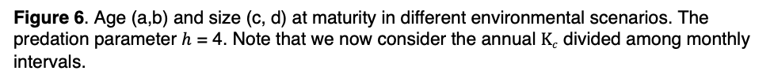
Figure 6
Base Temperature
$Κc$ (per month)
Figure 6. Age (a,b) and size (c, d) at maturity in different environmental scenarios. The predation parameter $h$ = 4. Note that we now consider the annual $Κc$ divided among monthly intervals.

Slide 6
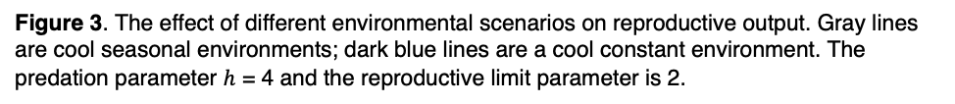



Supplemental Figure 1
Reproductive output in cool seasonal and constant environments
$$Κc=1$$
$$Κc=2.5$$
$$Κc=5$$
Figure 3. The effect of different environmental scenarios on reproductive output. Gray lines are cool seasonal environments; dark blue lines are a cool constant environment. The predation parameter $h$ = 4 and the reproductive limit parameter is 2.

